Slide 1
Business-Driven Solutions to Kentucky’s Workforce Challenges
Kate Shanks,
Senior Vice President,
Kentucky Chamber
of Commerce
LaKisha Miller,
Executive Director,
Kentucky Chamber Foundation
Workforce Center

Slide 2
Kentucky Ranks Among the Bottom 10 States for Workforce Participation

Slide 3
Open Jobs Continue to Outnumber Kentuckians Looking for Work

Slide 4
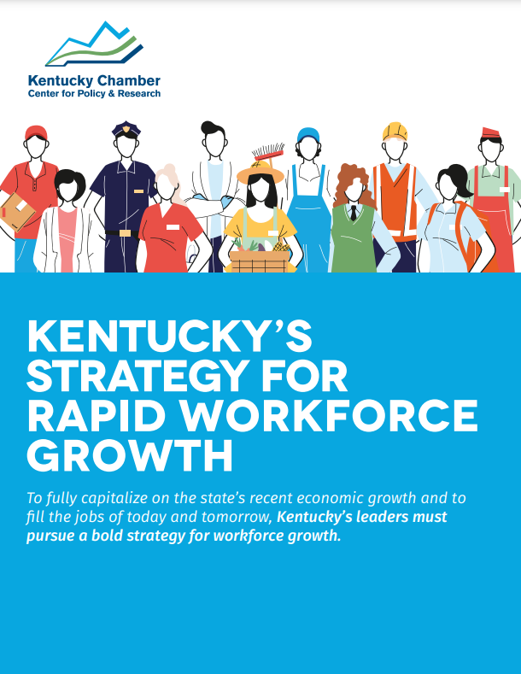
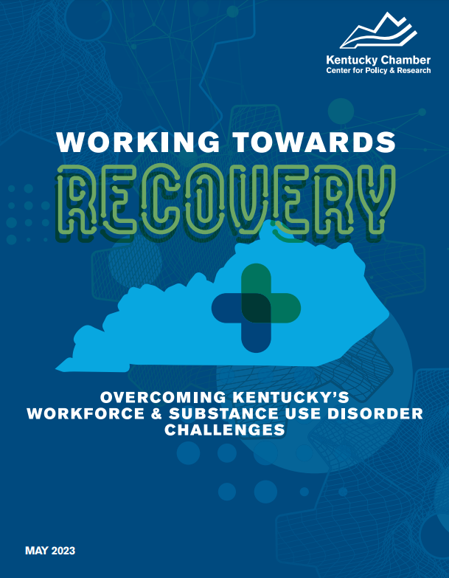
Resources for Understanding Kentucky’s Workforce Challenges and Solutions

Slide 5
Kentucky Needs a Strategy for Rapid Workforce Growth

Slide 6
Kentucky Chamber Foundation’s Workforce Center
Talent Pipeline Management (TPM®)
TPM® is an employer-led and demand-driven approach that aims to address the skills gap by organizing employers around their most critical workforce needs.
The goal is to create alignment with education, government, and partners for hiring and upskilling into in-demand careers.
OUR RESULTS
With employers leading the way, our TPM®️ team and state partners connected 5,000 Kentuckians to jobs, training, and work-based learning opportunities.
Almost 400 employers are at the table working together to help strengthen our workforce across Kentucky’s key and signature industries.

Slide 8
Kentucky Chamber Foundation’s Workforce Center
Workforce Recovery Program
Substance use disorder and justice involvement are two leading factors in Kentucky's low rates of workforce participation.
The opioid epidemic alone might be responsible for removing as many as 55,000 working-age Kentuckians from the labor market.
OUR RESULTS
Fair Chance Academy
Certified 80 Kentucky businesses in fair chance business practices, impacting over 50,000 employees across the state.
Kentucky Transformational Employment Program (KTEP)
Recruited 145 businesses to participate in the KTEP program, which impacts over 50,000 employees.

Slide 9
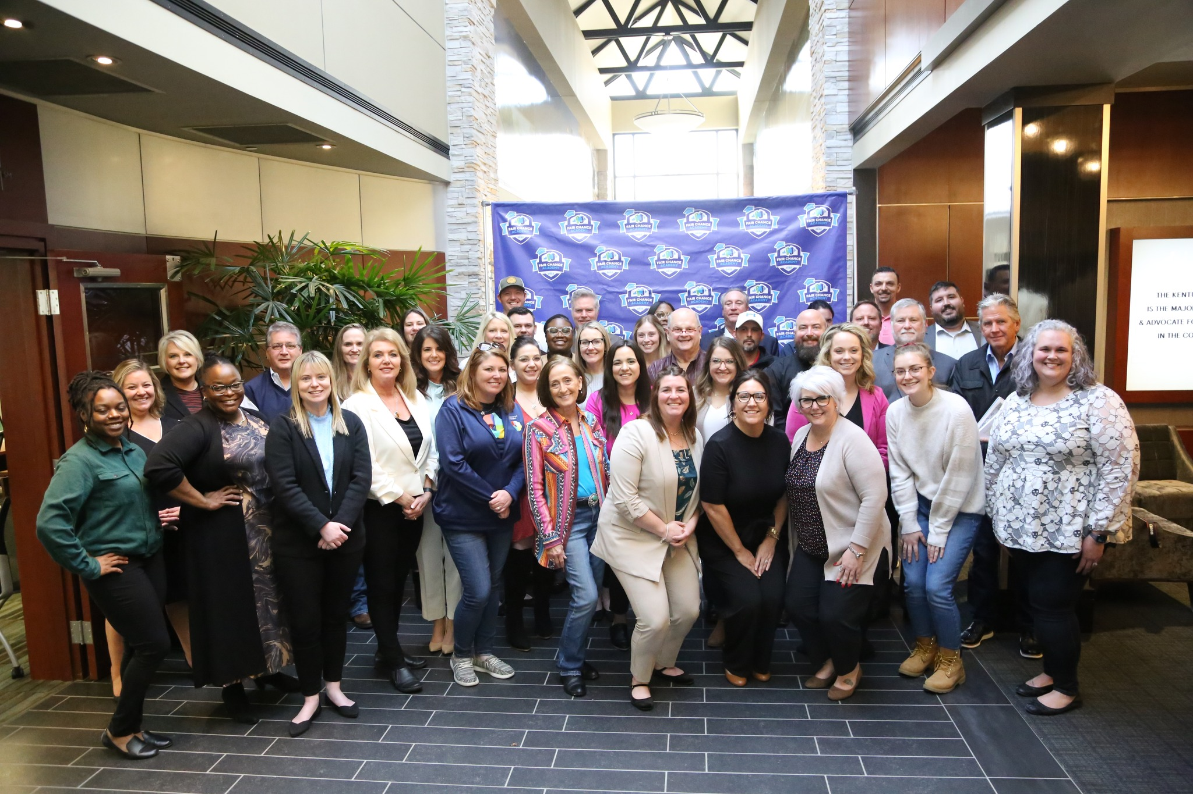
“I feel so fortunate to have attended the Academy these last three weeks. Prior to this, I felt like I was alone, and this task ahead of me was all on me to do by myself. Now, I feel like I have tremendous resources that I have never had before. It gives me even more confidence that we’re going to be successful in doing something that no one
else has ever done. In my industry, no one has ever tried to do this, and now I have a path forward.”
- The Jordan Center CEO David McKenzie

Slide 10
Fair Chance Academy Graduates | Cohort I

Slide 11
Fair Chance Academy Graduates | Cohort II

Slide 12
Fair Chance Academy | Cohort III

Slide 13
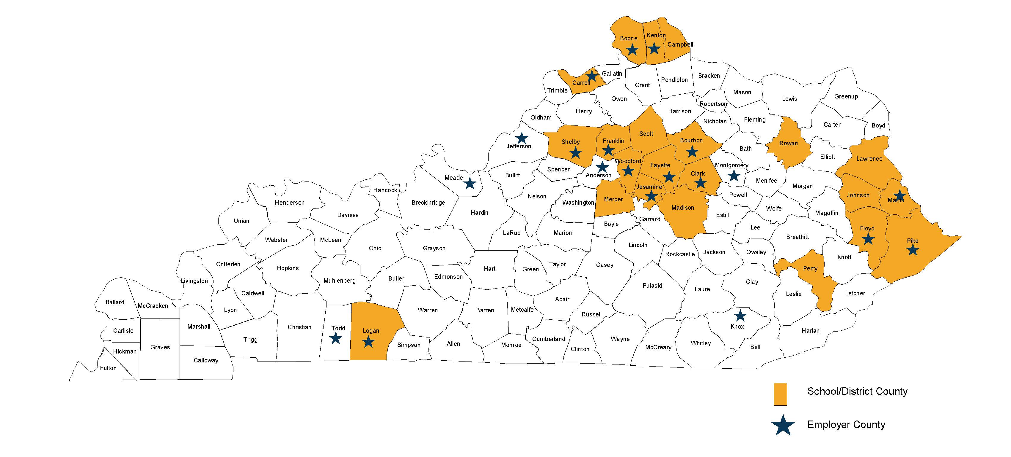
Bus to Business®️ Program Highlights
This program aims to bridge the gap between the classroom and careers so students are better equipped to make career choices.
Since 2019, 90K students engaged through webinars, events and, work-based learning activities.
This resulted in 150 job and work-based learning placement opportunities for 2022-2023.

Slide 14
