Slide 1
An Update on Kentucky’s Workforce and Labor Market
Dr. Charles Aull, Executive Director,
Kentucky Chamber Center for Policy and Research

Slide 2
Presentation Overview
Broad summary of Kentucky’s current labor market with analysis of recent and long-term trends and comparisons to other states
A discussion of structural factors shaping our labor market
A discussion of public policy considerations

Slide 3
Key Takeaways
Workforce participation and levels in Kentucky remain below where they were before the pandemic
Employer demand for workers remains elevated and continues to outpace worker availability
Kentucky has become a focal point for business investment and expansion
Competition for workers among states will likely intensify due to demographic challenges
State public policy will play a key role in success vs. failure

Slide 4
Workforce Participation
“Workforce participation” the percent of the population employed and unemployed (i.e., looking for work)
Workforce participation in the U.S. and Kentucky are below pre-pandemic rates
The gap between U.S. and Kentucky workforce participation rates persists

Slide 5
Workforce Participation
Following a steady decline since 2000, workforce participation rates stabilized and rebounded beginning in 2015
The pandemic interrupted that trend, and it has struggled to restart in Kentucky

Slide 6
Workforce Participation in Kentucky Remains Below Most Other States

Slide 7
Workforce Participation
“Prime-age” workforce participation = 25-54 year-old individuals
As of 2022, prime-age workforce participation was close to recovered*
A gap between U.S. and Kentucky prime-age workforce participation rates persists

Slide 8
Prime-age Workforce Participation in Kentucky Remains Below Most Other States

Slide 9
Workforce Levels
“Workforce levels”= the actual number of individuals in the workforce (employed + unemployed)
Kentucky saw a strong workforce recovery between June 2020 and June 2022, regaining approx. 122,000 workers
Kentucky had approx. 20,000 fewer individuals in the workforce in May 2023 than it did in January 2020

Slide 10
Workforce Levels
Workforce levels in Kentucky grew 3.5% between 2002 and 2022
4.8% between 2002 and 2019
Workforce levels in the US grew 13.4% between 2002 and 2022
Workforce levels in Tennessee grew 14.4% between 2002 and 2022

Slide 11
Payroll Growth and Labor Demand
Payroll growth has been exceptionally strong in Kentucky, adding 65k since January 2019 and 343k since April 2020
Kentucky surpassed two million nonfarm payroll positions in March 2022

Slide 12
Job Openings and Labor Demand
Job openings in Kentucky remain elevated at 142,000 openings reported in April 2023
Openings continue to outpace Kentuckians looking for work by 1.9:1 ratio (U.S. ratio is 1.6:1)
Unemployment remains historically low in Kentucky, below 4% since November 2022

Slide 13
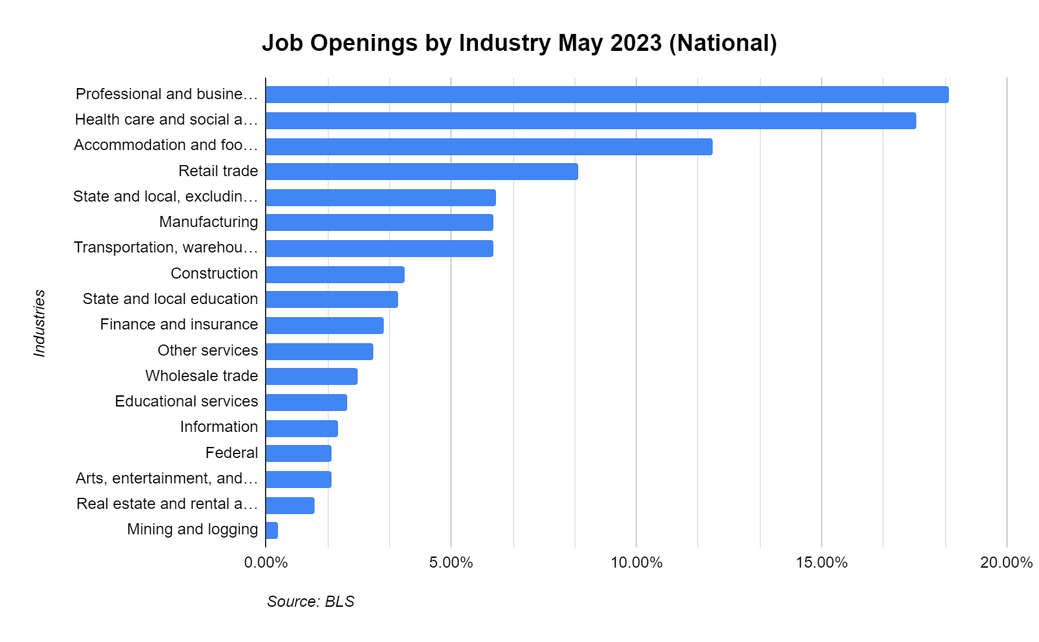
Industries with the Highest Demand Based on Job Openings (National)
Professional & business services: 18.44%
Health care & social assistance: 17.56%
Accommodation & food services: 12.04%
Retail trade: 8.44%
State & local government (non-education): 6.20%
Manufacturing: 6.15%
Transportation, warehousing, & utilities: 6.13%

Slide 14
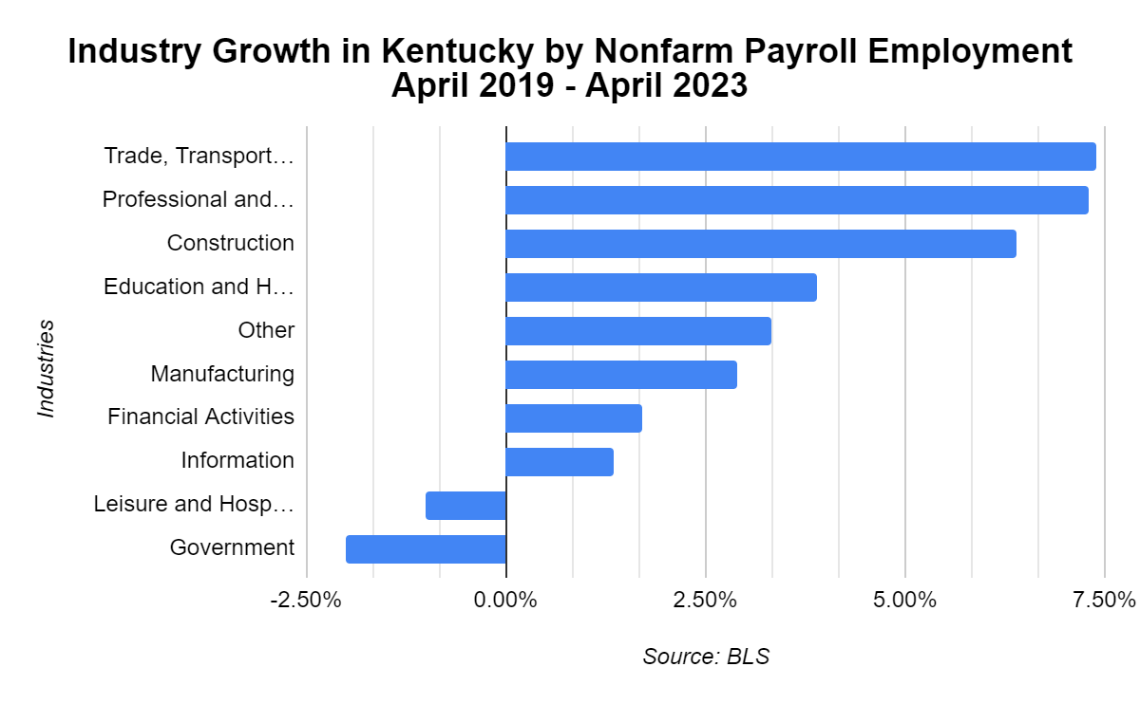
Industries with the Strongest Growth Based on Payroll (Kentucky April 2019 – April 2023)
Transportation, warehousing, & utilities: 7.4%
Professional and business services: 7.3%
Construction: 6.4%
Education and health services: 3.9%
Manufacturing: 2.9%

Slide 15
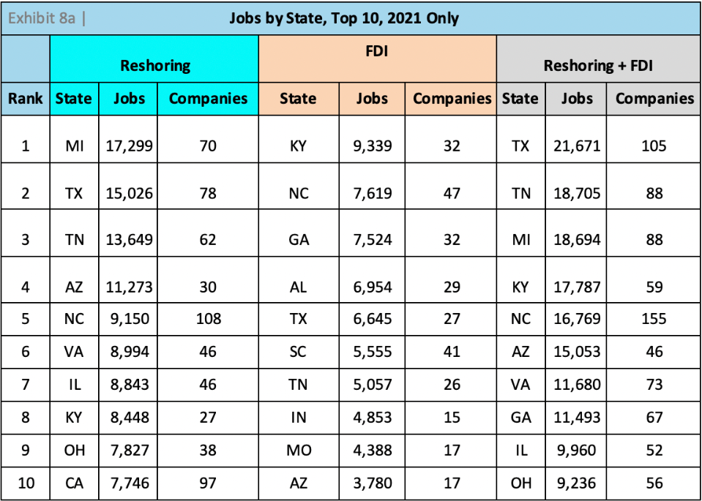
Future Workforce Demand in Kentucky
Health care
Construction, advanced manufacturing, energy, technology, and ancillary services
Federal policy
International affairs
Reshoring and Foreign Direct Investment in Kentucky (source: reshorenow.org)

Slide 16
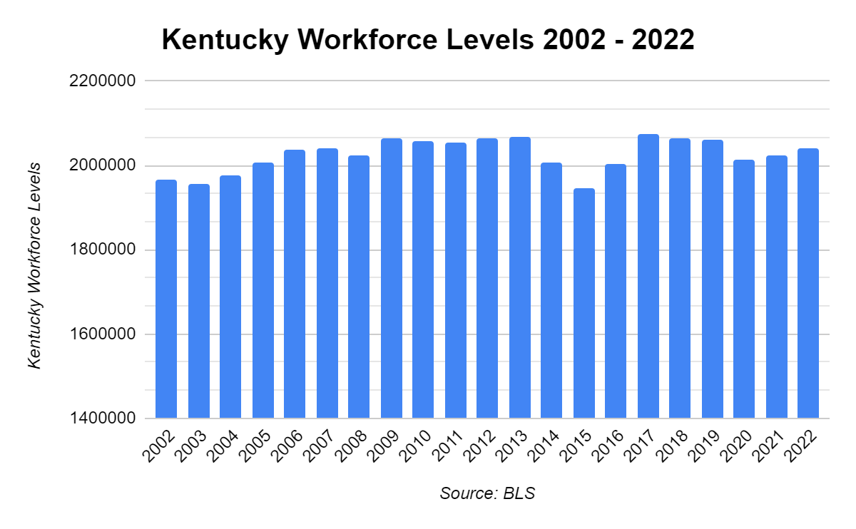
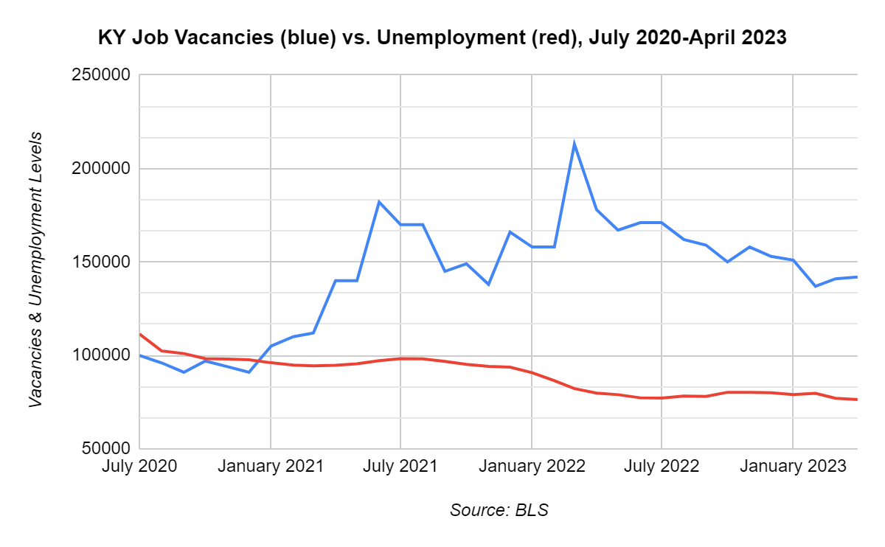
Key Takeaways So Far
Workforce challenges persist in Kentucky as workforce participation remains low and workforce growth remains stagnant.
Demand for workers remains elevated as new jobs are created at a rate that outpaces Kentuckians looking for work.

Slide 17
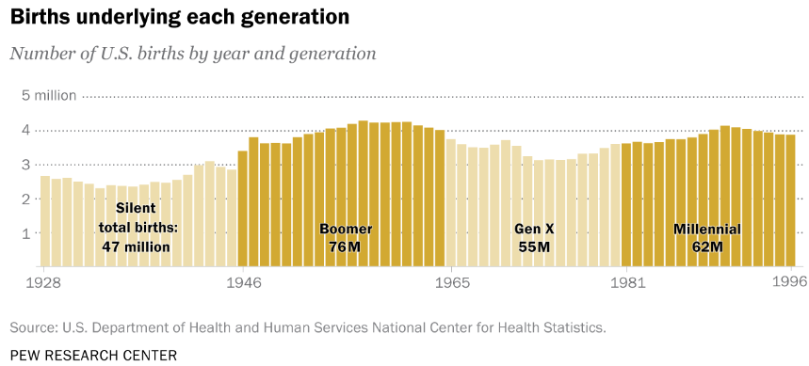
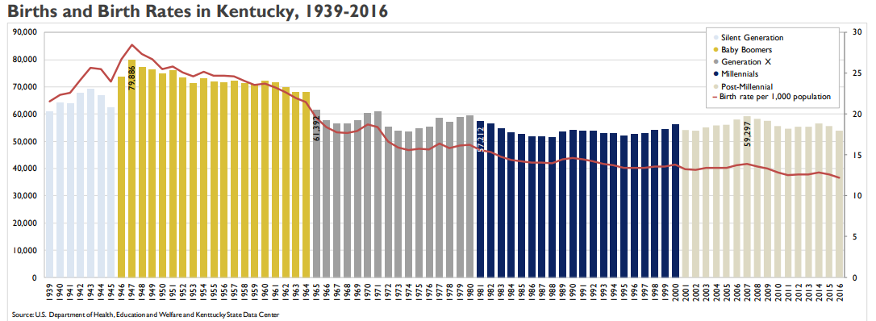
The Structural Challenge of an Aging Population

Slide 18
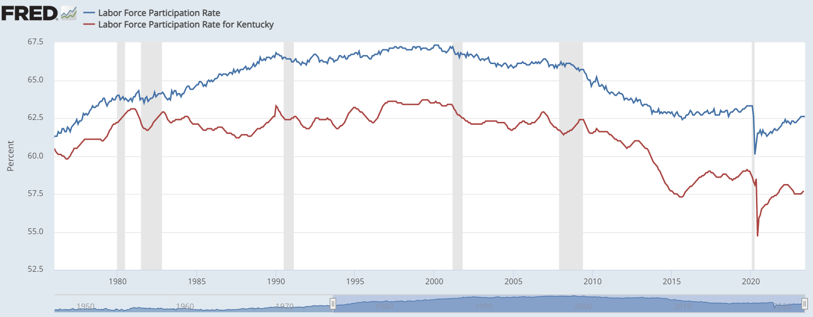
Boomers Drove a Surge in Workforce Participation

Slide 19
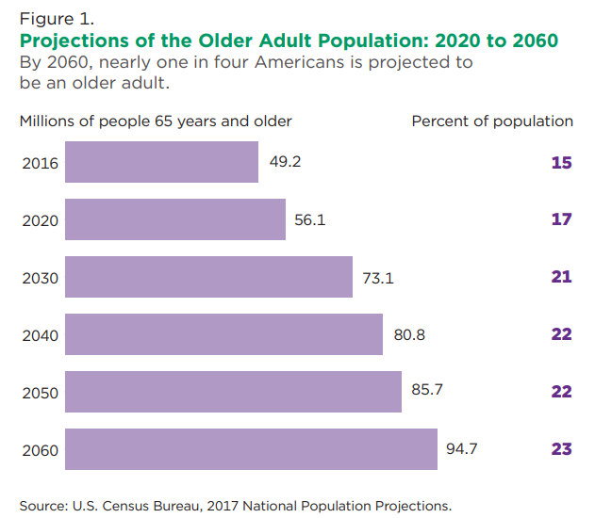
Key Moments for Our Aging Population
U.S. Census 2017
2011: Oldest Baby Boomers reached 65
2019: All Baby Boomers reached 55+
2029: All Baby Boomers will be 65+
2030: International migration overtakes natural increases (births minus deaths)*
2034: Older adults (65+) will outnumber children for the first time in U.S. history
2060: Nearly 1 in 4 U.S. adults will be 65+; births narrowly outpace deaths

Slide 20
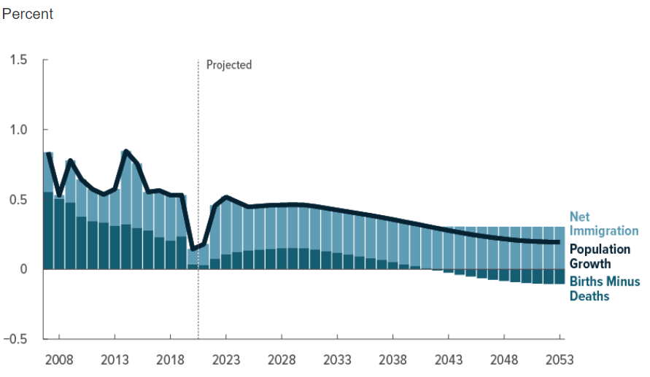
Key Moments for Our Aging Population
Congressional Budget Office 2023
2042: Deaths will outnumber births; growth will become fully dependent on net immigration
2023-2053: 0.3% annual population growth instead of 0.8% (1983-2022)
2023-2053: 0.2% annual prime-age population growth instead of 0.9% (1983-2022)
2023-2053: Projected birth rate: 1.75 instead of 2.02 (1987-2007)

Slide 21
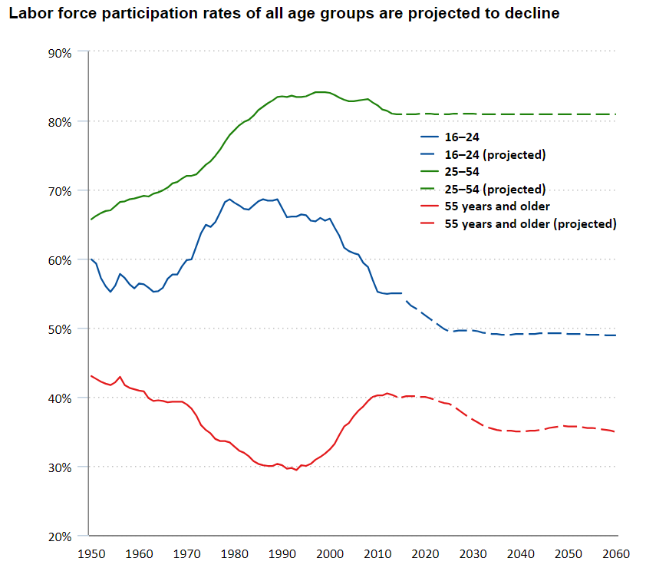
Projected Decline in Workforce Participation (BLS)

Slide 22
Retirement is “Imminent” for
Almost 1 in 4 Kentucky Workers

Slide 23
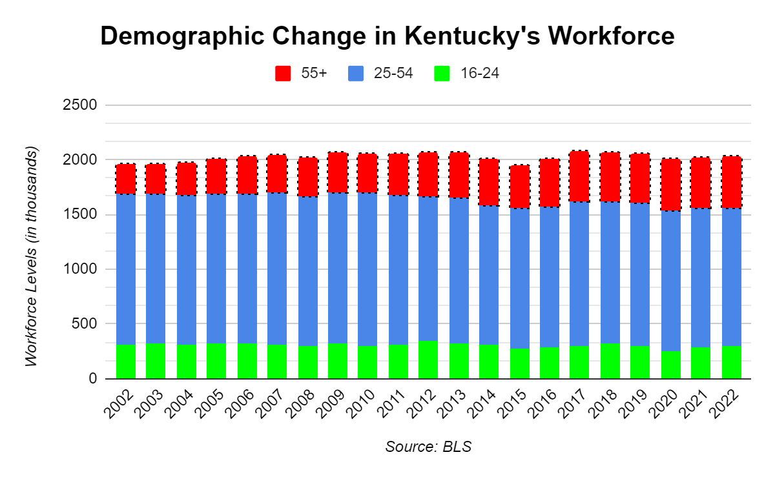
Kentucky’s Fastest Growing Workforce Group is 55+
Demographic change from 2002 to 2022
16-24: -4.1%
25-45: -8.7%
55+: 73.2%
Kentucky’s fastest-growing workforce group is 55+
The pool of new workers and prime-age workers is stagnant or shrinking

Slide 24
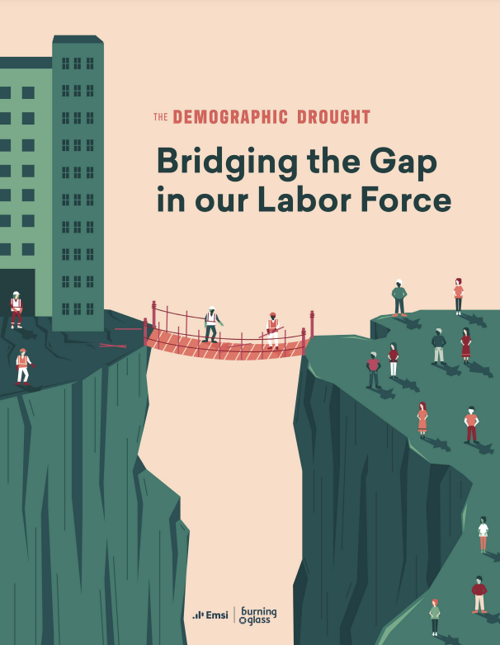
Emsi-Burning Glass: The Demographic Drought
“Fifty years of birth rates below replacement levels, combined with a recent precipitous drop in immigration, has left us with fewer and fewer young, working-age people. This decline is happening as a record number of Americans are reaching retirement age… This trend is not projected to turn around any time this century.”

Slide 25
Additional Factors
Substance use disorder and incarceration
Skills gaps and discouraged workers
Jobs and geographic misalignment
Public assistance programs (SSDI)
Social/cultural attitudes toward work
Health outcomes

Slide 26
How Should State Policy Respond to These Dynamics?

Slide 27
Attract More Workers
Kentucky has struggled to attract new workers and population, netting just 22k new residents between April 2020 and July 2022 (6.3k international, 14.1k domestic)
Tennessee: 157k (11.4k international, 146k domestic)
Indiana: 44.5k (21k international, 22k domestic)
Georgia: 166k (38k international, 128k domestic)
North Carolina: 248k (37k international, 211k domestic)

Slide 28
Optimize Our Homegrown Workforce
Kentucky has also struggled to optimize its homegrown workforce.
Examples:
Throughout 2022, 70k Kentucky adults may have been sidelined from the workforce due to child care challenges (Census)
Opioid abuse may have reduced Kentucky’s labor force by up to 55k (UK CBER)

Slide 29
Examples of Pro-Active State Policy Solutions
A competitive tax environment for workers
Abundant access to affordable quality child care
Work-focused re-entry support for Kentuckians leaving incarceration (expungement, second-chance liability, job training in jails)
Incentives and public-private partnerships to help Kentucky employers offer unique and robust incentive packages (education benefits and paid family leave)
Reduce the prevalence of substance use disorder and facilitate employment for individuals in recovery
Connecting Kentuckians in high unemployment areas to jobs through reliable infrastructure, transportation, and broadband, while strategically partnering with local communities on quality-of-life and talent attraction and retention projects (See Indiana for an example)
Target state financial aid programs to respond to workforce needs and demand with more precision
Developing a statewide strategy to optimize underutilized or “untapped” talent such as refugees, immigrants, and individuals with disabilities

Slide 30
Resources: Kychamber.com

