Slide 1
We are the Champions for the Lincoln Trail Region!
Lincoln Trail
Area Development District
Regional Economic Overview
Prepared by: Dan London
For: Economic Development & Workforce Investment Joint Committee
Locally Based…Regionally Focused

Slide 2
What are my goals today?
Update
Highlight
Projects
Provide the Committee with an update on BlueOvalSK.
Highlight the region’s economic growth.
Paint a picture of the forthcoming infrastructure requirements.

Slide 3
What is BlueOvalSK?
Investment in KY
JOBS
Historic
A $5.8 BILLION project!
The project will employ more than 5,000 employees.
The largest investment ever in Kentucky.
Joint Venture
Production
Ford partnered with South Korea’s SK On.
86 GWh per year.
Source: Cabinet for Economic Development

Slide 4
Comprehending the size…
SIZE
Located on the 1,500 acre mega site in Glendale, KY. Two (2) plants totaling 8,400,000 square feet/2.3 square miles.
WORLD RANKING
Ranks 10th in the world.
NATIONAL RANKING
Ranks 2nd in the United States behind Kia’s West Point, GA plant (28M sf).
Source: L.B. Schmidt & Associates, LLC: E-Town-Fort Knox MSA Transformation Project

Slide 5
Progress as of August
EARTH WORK
CONCRETE
Crews have moved almost 7,000,000 cubic yard of earth.
Placed 257,000 cubic yards of concrete.
ROOFING & SIDING
STEEL
Installed 2.8M square feet of roofing & 535,000 square feet of exterior siding.
Erected 44,000 tons of steel.
Source: BlueOvalSK

Slide 6
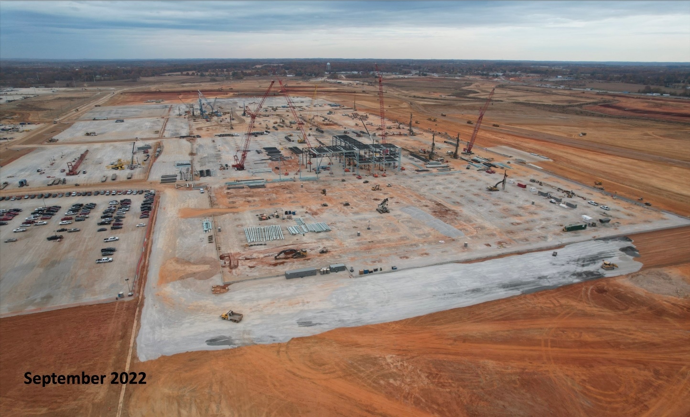
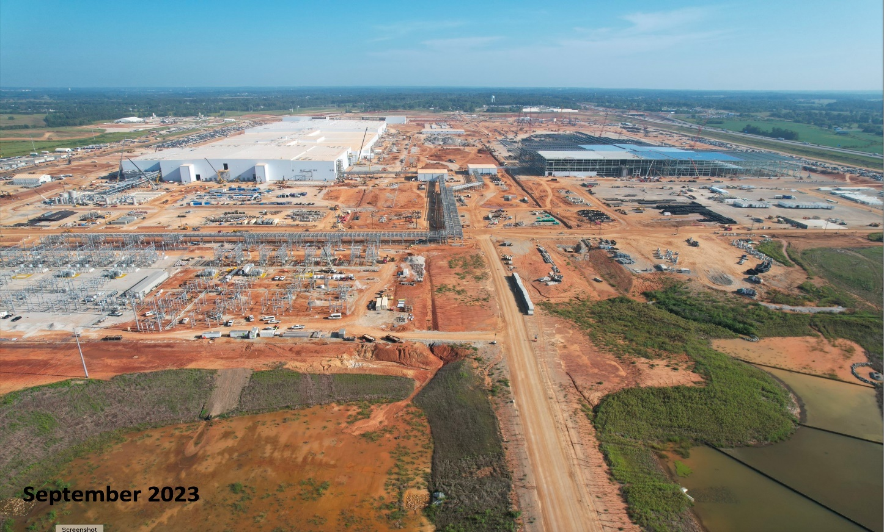
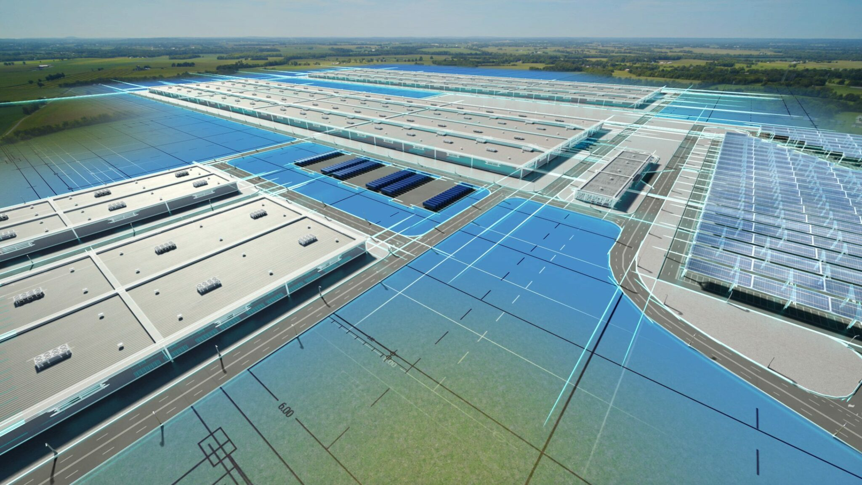
Pictures are worth a thousand words…
Andy’s pics
1 GWh = 1B watt hrs
30 KWh = household per day
86 GWh per year
50 – 100 KWh = EV battery pack
1 GWh factory = 10k to 20k EVs per year
Source: Elizabethtown-Hardin County Industrial Foundation & BlueOvalSK
Source: Michael D. Plante & Jessica Rindels, Dallas Fed Economics

Slide 7
What’s BlueOvalSk’s economic impact?
Now
Up to 720 local workers
Up to 2,880 traveling workers
Up to 3,500 peak workers
2,800 housing units for traveling workers
$1.6B construction payroll
$75M local materials/services
Payroll
Average construction pay of $50,000
Average annual BOSK pay of $53,000; $73,000 with fringe benefits
8,016 total jobs in the region – direct plant payroll of $363M with fringe
Equip Install
People
Q3 2023 – Q4 2025 (EOY)
500 – 1,000 South Korean Techs on site
Unknown payroll
Elizabethtown/Hardin County: +22,380
Elizabethtown: Could become the 5th largest city
Workforce
EOY 23: 1,000 FTE
EOY 24: 2,500 FTE
EOY 25: 5,000 FTE
BOSK plans to run 2, 12-hour shifts
Needs
8,811 new housing units
3,901 K-12 students
75 new hospital beds (389 new hospital jobs & 380 new ambulatory jobs)
Source: L.B. Schmidt & Associates, LLC: E-Town-Fort Knox MSA Transformation Project

Slide 8
Wait…there’s more!
Nucor Steel
$1.7 BILLION investment & 400 jobs.
Bourbon Industry
$2.1 BILLION in new investments & 700 new jobs.
AESC Battery Plant in Bowling Green
$2 BILLION in investments & 2,000 jobs..
UPS & Rivian in Bullitt County
$178 million investment & 120 jobs from UPS & a $10 million investment & 218 jobs from Rivian.
Source: Cabinet for Economic Development
Notes:
AESC will be 1.6M sf

Slide 9
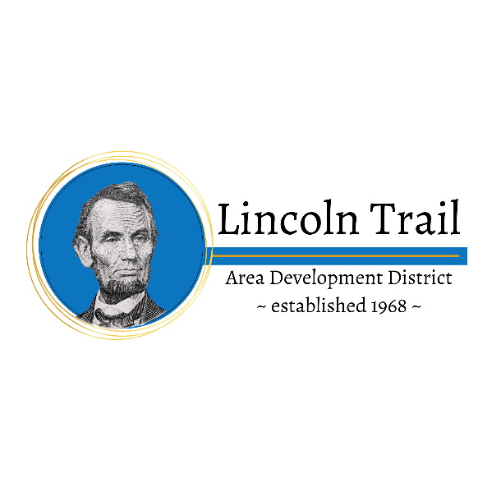
Lincoln Trail Area Development District
6 Year Economic Lines of Effort (LOE), Objectives & Actions
Mission
Vision
To bring those local, civic and governmental leaders together to accomplish those objectives that cannot be achieved by the governments acting separately.
To be the state’s premier locally based, regionally focused integrator and collaborator enabling our stakeholders to create a better everyday life for themselves and their constituents.
End State: Safe and efficient means of multi-modal movement of people, goods & services in & out of the region.:
Establish a mass transit system in the urbanized area(s) of the region.
Improve and/or build new highways to facilitate movement of people, goods & products.
Improve and/or build new rail lines to facilitate movement of goods & products.
Expand riverport infrastructure & capability to facilitate movement of goods & products.
Transport.
LOE 1
Initiate a mass transit study (LTADD & TACK - $160k).
Construct new routes: Bardstown Bypass (245 to 31 & BPkwy), Glendale Bypass (KYTC) ($3.995M), Glendale Industrial Connector ($17.3M), Hodgenville bypass connector, I65 Gilead Church interchange ($27.23M), Lebanon Bypass ($25M), Leitchfield Bypass ($11M) & Munfordville Bypass.
Initiate Major Widening: US 150 from BPkwy ($43.5M), KY 245 ($67M) & KY 313
Relocate/reconstruct the following highways: College Street Road ($1.5), US31E Bardstown to Louisville ($49M), Highway 84 from Hodgenville to Sonora ($4M), KY 79 from KY 144 to KY 1051 ($18M), KY 86 in Breck County ($6M), US 68 to KY 55 ($15M) & Pear Orchard Northwest ($7M)
Extend the following highways: Ring Road to 31W ($32.5M), Ring Road from 31W to Lincoln Pkwy ($14M) & New Glendale Road ($35M)
T
Actions
Objectives
End State: Sufficient, affordable & quality housing for all people seeking to remain in or transition into our region.
Increase affordable housing within the region to erase waiting periods.
Develop housing capacity in the region to facilitate current & future population growth.
Housing
LOE 2
Initiate a housing study to determine inventory & requirements for each “level” of housing (LTADD/CUP).
H
Actions
Objectives
End State: Multi-jurisdictional consortiums & partnerships to share resources & responsibilities utilizing efficiencies & economies of scale.
Create multi-utility partnerships to treat water & wastewater.
Expand regional airport’s passenger & cargo infrastructure.
Regional Resources
LOE 3
Expand Hardin County waste water treatment & service area ($350M).
Expand water interconnections: (Meade to HCWD/Louisville, $3M) & LaRue to Green River ($3M).
Upgrade the E-Town Airport (Nest w/Knox) terminal & taxiways ($2.5M)
R
Actions
Objectives
End State: Capacity to ensure all citizens, stakeholders & businesses have access to clean & safe drinking water & sewer, gas & electricity to facilitate job creation & small business opportunities.
Expand current water treatment plant capacities & construct additional water treatment plants to add additional local & regional capacities.
Expand water line networks.
Expand natural gas transmission to facilitate economic growth.
Utilities
LOE 4
Expand the following water & waste water treatment plants & systems: Bardstown ($30.3M), Bardstown Northern ($51,600,000), Brandenburg ($10M), Hardinsburg ($16.8M) & Leitchfield ($34.05M).
Construct new water treatment plants: LaRue County ($31.06M).
Expand gas line from to Hart & LaRue Counties ($50M).
Extend/upgrade the following water lines: BOSK/KCTCS ($4M) & ($5M), Glendale ($2.5M), Green River Valley ($4M), HCWD#1 Louisville Transmission & Vine Grove ($1.575)
U
Actions
Objectives
End State: Recruit, shape & create a barrier free environment for the current & future workforce to meet economic demands of job creators & citizens.
Mitigate workforce participation barriers.
Upgrade training capacity for advanced manufacturing & create customizable training space for workforce development.
Create additional pathways for engineering training.
Increase the manufacturing, green/sustainability, healthcare & other high priority sector workforce & increase employer job quality certifications.
Develop strategies to address the employment needs of underserved populations.
Social & Human Capital
LOE 5
Initiate a child care study to determine the level & types of barriers ($38k).
Renovation of outdated industrial/manufacturing training facilities at ECTC ($44M).
Construct engineering building though ECTC & UL partnership ($40M).
Expand Springfield ECTC Campus to include welding, industrial maintenance & nursing.
S
Actions
Objectives
End State: Capacity to ensure all citizens, stakeholders and businesses have access to quality health care and quality of life to create and promote healthy and safe environments for families to reside.
Establish regional specialized first responder capabilities.
Expand existing First Responder capabilities to meet current & future growth.
Treatment & Public Protect.
LOE 6
Construct & man a specialized regional first responder facility in Glendale ($20M).
Construct new fire stations: City of Elizabethtown ($15M) & City of Hodgenville
T
Actions
Objectives
Notes:
Hardin County Waste Water: Includes money for E-Town expansion $325M, Glendale line expansion ($24M) & $150K Glendale plant study).
Glendale Industrial Connector: Constructs a new roadway from an intersection with KY 222 between Mudsplash Road & Robey Drive extending north to a new intersection with KY 1136 near case loop for a distance of 1.7 miles.

Slide 10
Questions?

Slide 11
Back-up Slides

Slide 12
2024 LOE 1 Budget Priorities
(Page 1 of 3)
$3,955,000
Appropriation
$27,230,000
Appropriation
Fees
Fees
Grant/Loans
Grant/Loans
P3
P3
Taxes
Taxes
#1 Priority
LOE 1d: Glendale Bypass ($3,955,000)
Why? The highway system serving Glendale is inadequate to facilitate increasing volumes from economic growth & population increases.
#2 Priority
LOE 1c: I65 Gilead Church Interchange ($27,230,000)
Why? The highway system serving Glendale is inadequate to facilitate increasing volumes from economic growth & population increases.
$32,500,000
Appropriation
$43,500,000
Appropriation
Fees
Fees
Grant/Loans
Grant/Loans
P3
P3
Taxes
Taxes
LOE 1e: Ring Road Extension ($32,500,000)
Why? This extension is critical to move products from what will likely be the primary industrial support base in E-Town to Glendale. In addition, a significant population explosion is expected in E-Town requiring additional highway capacity.
#3 Priority
#4 Priority
LOE 1d: Major Widening of US150 from Bluegrass Parkway ($43,500,000)
Why? Improvement of traffic flow through Nelson, Washington & Marion Counties & a significant opportunity for regional economic development.

Slide 13
2024 LOE 1 Budget Priorities
(Page 2 of 3)
$4,000,000
Appropriation
$67,000,000
Appropriation
Fees
Fees
Grant/Loans
Grant/Loans
P3
P3
Taxes
Taxes
#5 Priority
LOE 1b: Reconstruction of Highway 84 from Hodgenville to Sonora ($4,000,000)
Why? Reconstruction of Highway 84 will improve commute time from Hodgenville to Sonora & facilitate increased traffic volumes from product & people movement.
#6 Priority
LOE 1b: Widening of KY 245 ($67,000,000)
Why? Widening of KY 245 will relieve significant congestion for people travelling in all directions through Nelson County & open the area to significant economic development.
$15,000,000
Appropriation
$6,000,000
Appropriation
Fees
Fees
Grant/Loans
Grant/Loans
P3
P3
Taxes
Taxes
LOE 1e: Improve Connectivity Between US 68 & KY 55 ($15,000,000)
Why? Reduction of congestion & safety improvements for travelers through Lebanon. It will improve commute times for workers travelling to BlueOvalSK & open the area to significant economic development.
LOE 1c: Realign KY 86 in Breckinridge County ($6,000,000)
Why? Breck County lacks the necessary highway access to facilitate economic & population growths.
#7 Priority
#8 Priority
Notes:
LOE 1 total cost: $199,185,000

Slide 14
2024 LOE 1 Budget Priorities
(Page 3 of 3)
$4,000,000
Appropriation
Fees
Grant/Loans
P3
Taxes
#9 Priority
LOE 1b: Glendale Industrial Connector ($17,300,000)
Why? Hardin County is experiencing aggressive growth due to BOSK. This project provides improved connectivity to & from the industrial site. This new corridor will provide additional economic growth within the region & facilitate increasing traffic volumes due to expected population increases.
Notes:
LOE 1 total cost: $199,185,000

Slide 15
2024 LOE 3 & 4 Budget Priorities
(Page 1 of 2)
$16,804,580
Appropriation
$350,000,000
Appropriation
Fees
Fees
Grant/Loans
Grant/Loans
P3
P3
Taxes
Taxes
#1 Priority
LOE 4b: Hardinsburg Water Treatment Plant Expansion ($16,804,580)
Why? Water plant is at capacity. No additional water lines can be added; negatively impacting quality of life & capping economic development.
#2 Priority
LOE 3a: Hardin County Wastewater Expansion ($350,000,000)
Why? The sewer collection facilities serving Hardin County are inadequate to facilitate increasing volumes from economic growth & population increases.
$29,233,110
Appropriation
$17,500,000
Appropriation
Fees
Fees
Grant/Loans
Grant/Loans
P3
P3
Taxes
Taxes
LOE 4a: Bardstown Wastewater Upgrades ($30,267,132)
Why? The sewer collection facilities serving Nelson County are inadequate to facilitate increasing volumes from economic growth & population increases. In addition, aging & obsolete systems requirement replacement to create more efficiency.
#3 Priority
#4 Priority
LOE 4d: HCWD#1 – Meade County Transmission Line ($17,500,000)
Why? Regional connectivity is necessary to facilitate economic & population growth in the region & to further drought proof the current system.

Slide 16
2024 LOE 3 & 4 Budget Priorities
(Page 2 of 2)
$4,575,280
Appropriation
$34,050,000
Appropriation
Fees
Fees
Grant/Loans
Grant/Loans
P3
P3
Taxes
Taxes
#5 Priority
LOE 3b & 4d: LaRue County & Vine Grove Water Line Extensions ($4,575,280)
Why? Expansion & replacement will ensure reliable availability, build capacity & stabilize systems plagued with leaks & breaks.
#6 Priority
LOE 4a: Leitchfield Wastewater Plant ($34,050,000)
Why? The sewer collection facilities are nearing the end of useful life & major components are increasingly difficult to maintain & operate efficiently.
$31,057,000
Appropriation
$50,000,000
Appropriation
Fees
Fees
Grant/Loans
Grant/Loans
P3
P3
Taxes
Taxes
LOE 4b: LaRue County Water District Treatment Plant ($31,057,000)
Why? LCWD is reliant on eight (8) different finished water source suppliers to meet demand within its distribution system. A new plant is needed to increase availability, quality & balance.
LOE 4c: LG&E Gas Line Expansion to Hart & LaRue Counties ($50,000,000)
Why? Hart & LaRue Counties lack the necessary gas access to facilitate economic & population growths.
#7 Priority
#8 Priority
Notes:
LOE 3&4 total: $378,909,970

Slide 17
2024 LOE 6 Budget Priorities
$20,000,000
Appropriation
$XXXX
Appropriation
Fees
Fees
Grant/Loans
Grant/Loans
P3
P3
Taxes
Taxes
#1 Priority
LOE 6a: Construct & man a specialized regional 1st responder facility in Glendale ($20,000,000)
Why? The current 1st responder capabilities do not meet the requirements for responding to incidents at BlueOvalSK.
#2 Priority
LOE 6b: City of Hodgenville Fire Station ($5,000,000)
Why? The City of Hodgenville lacks the ability to house fire & rescue apparatus required to provide mutual aid to BlueOvalSK in the event of an emergency.
$15,000,000
Appropriation
Fees
Grant/Loans
P3
Taxes
LOE 6b: City of Elizabethtown ($15,000,000)
Why? The City of Elizabethtown must expand its fire & rescue capabilities due to economic expansion. Furthermore, the city lacks the ability to house fire & rescue apparatus required to provide mutual aid to BlueOvalSK in the event of an emergency.
#3 Priority
Notes:
LOE 3&4 total: $378,909,970

