Slide 1
Workforce Overview
EDWI Interim Joint Committee
September 28, 2023

Slide 2
Kentucky has 10 Workforce Boards
Common acronyms for workforce boards:
WIB – Workforce Investment Board
WDB – Workforce Development Board
LWA – Local Workforce Area
7 of the 10 WIBs are managed by Area Development Districts (ADDs)

Slide 3
WIOA Formula Funding
US Department of Labor
Kentucky
WIBs are overseen by:
Board of Directors made up of employers and community organizations
Local Elected Officials (LEOs)
By formula to each state based on measures of unemployment
10 local WIBs
By formula to each local area based on measures of unemployment

Slide 4
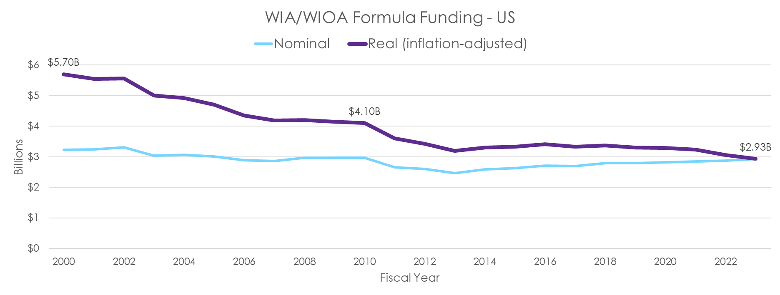
Federal investment has been shrinking
49% real decline over the last 2 decades
Source: US Department of Labor
Note: ARRA not included

Slide 5
Kentucky’s allocation of federal investment has been shrinking
17% nominal decline over the last half decade
Source: US Department of Labor

Slide 6
Workforce pipeline impacted by youth disconnection
Across the Commonwealth,1-in-7 young people ages 16 to 24 were not working or enrolled in school in 2021 – more than 77,000 young adults!
Kentucky’s youth disconnection rate is among the top 10 highest across states
Adverse outcomes from the pandemic and natural disasters may increase disconnection rate
Chronic absenteeism, lower college enrollment, poor mental health
Source: ACS PUMS 2021

Slide 7
Youth Disconnection Rate in KY
In some rural parts of the state, 1-in-4 youth and young adults are disconnected from work and school.

Slide 8
The economic costs of youth disconnection
INDIVIDUAL
Lost income
Poorer health outcomes
More involvement with the criminal justice system
TAXPAYER
Lower tax revenue
Higher government expenditures
Police, corrections
Public assistance programs
NATION
Lower economic output
Higher poverty
Higher crime
Source: Belfield & Levin, The Economics of Investing in Opportunity Youth, (2012)

Slide 9
The economic costs of youth disconnection
$14K
TAXPAYER BURDEN
per youth for every year they experience disconnection in their young adult years
$235K
TAXPAYER BURDEN
per youth over the course of their lifetime after experiencing persistent youth disconnection
Source: Belfield & Levin, The Economics of Investing in Opportunity Youth, (2012)

Slide 10
The Spot: Young Adult Opportunity Campus
Provides free career resources for young adults ages 16-24 across the Louisville region
Partnership between KentuckianaWorks and Goodwill Industries of Kentucky
July 1, 2022 – June 30, 2023
Served 452 young adults across 7 counties
205 job placements
42 completed internships
187 occupational skills credentials

Slide 11
Meet Alvey
Alyssa (Alvey) Madero
Enrolled at The Spot: Young Adult Opportunity Campus in Bullitt County
Completed multiple training courses
Soft skills training
Applied digital skills training
Earned a Customer Service and Sales credential
Completed her GED!
Scored in the 93rd percentile on her Language Arts section, which gave her a College Ready score in that subject!
Proud mom of 3 kids and recently got married
Currently works full time for UPS in the Brokerage Department and plans to begin pursuing her college degree soon

Slide 12
Cumberlands Workforce Development Board - WIOA Youth
Spring 2020 - Summer 2022
$2.1 million on paid work experience hours
579 youth
195 different worksite employers
Combined total of 206,871 working hours

Slide 13
Thank You!
Michael Gritton
Executive Director, KentuckianaWorks
502.574.3069
michael.gritton@
kentuckianaworks.org
Myra Wilson
Director, Cumberlands Workforce Development Board
270.866.7425
myra@lcadd.org
Dean McKay, SHRM-SCP
Director – Organizational Development & Information Technology, Skilcraft, an Oni Company
Board Chair, WIB of Northern Kentucky

