Slide 1
Presentation to the Economic Development and Workforce Investment Interim Joint Committee Bourbon Brings Jobs: Workforce Training and Spirits Innovation October 26, 2023 ---
Nancy Cox, PhD, Vice President for Land-grant Engagement and Dean,
UK Martin-Gatton College of Agriculture, Food and Environment
Seth DeBolt, PhD, Professor and Director of the James B. Beam Institute for Kentucky Spirits,
UK Martin-Gatton College of Agriculture, Food and Environment

Slide 2
The Land-grant Mission Serving Kentucky’s Signature Industries
Extension
Engagement – collaborating with diverse institutions, communities, and people to improve lives
Research
Discovery – expanding knowledge and addressing challenges
Instruction
Learning – enhancing access to educational opportunities for all

Slide 3
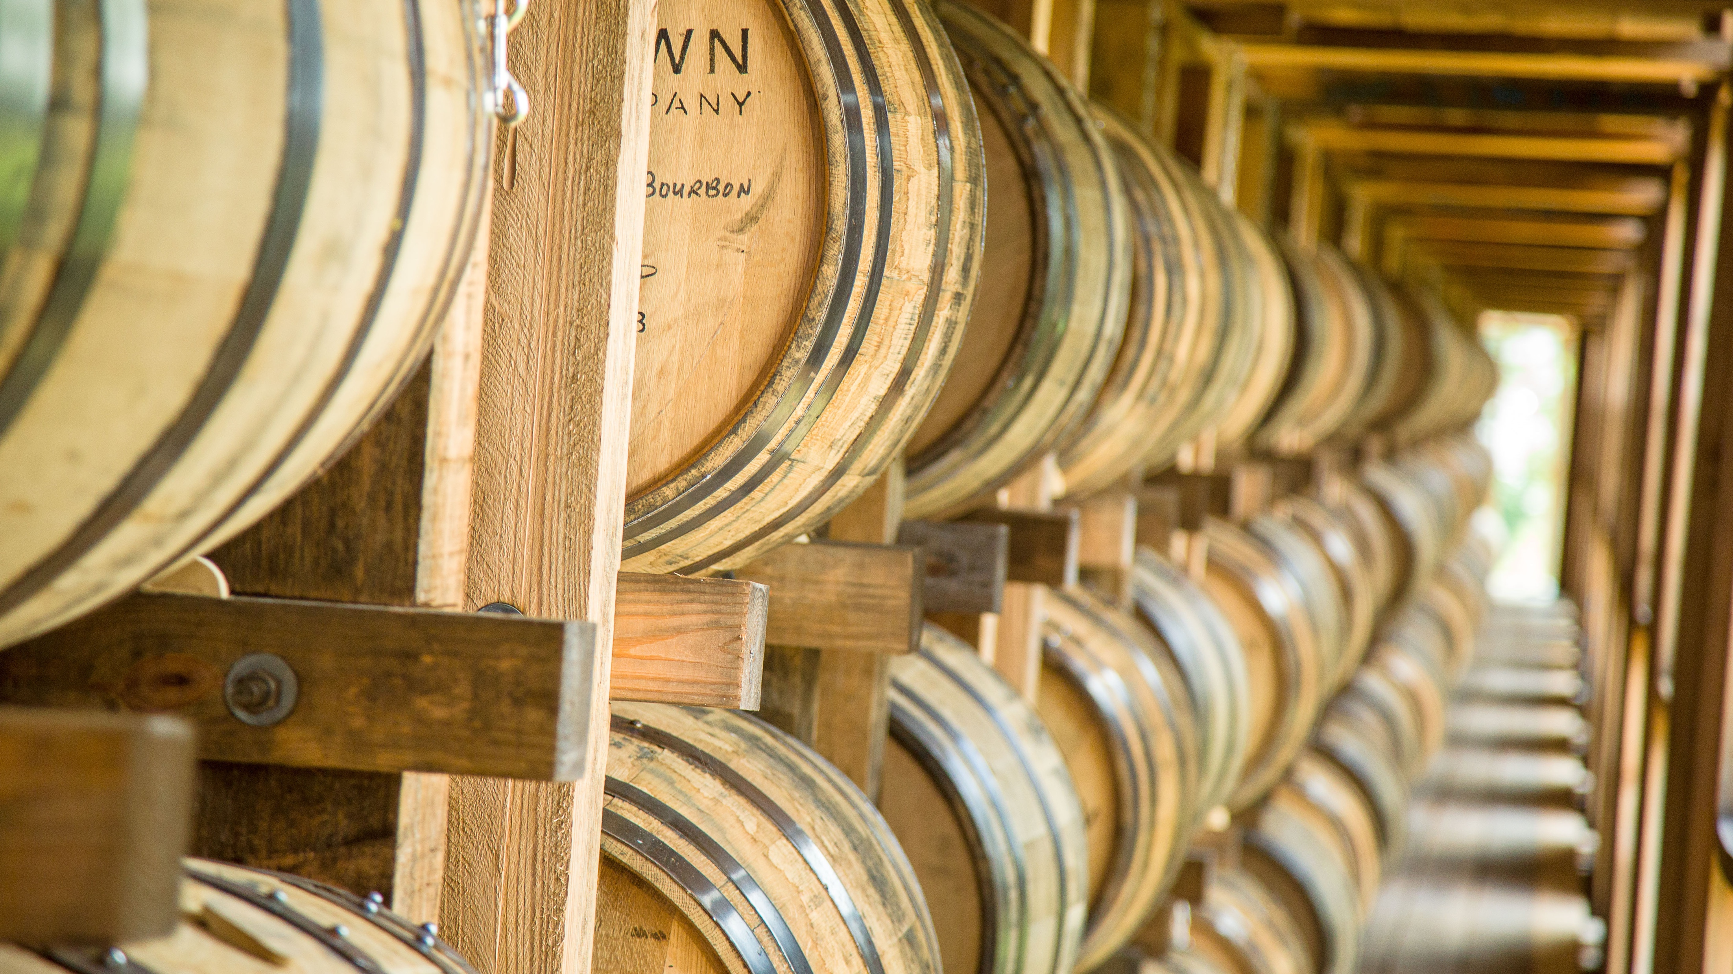
“When Beam Suntory first partnered with the University of Kentucky to create the James B. Beam Institute for Kentucky Spirits, we did so as an investment in the future of bourbon and the future of Kentucky’s workforce. The Institute has firmly established itself as a forum for continuing education and research, as well as collaboration across the industry to tackle some of our toughest challenges together.”
Alex Alvarez
Chief Supply Chain Officer
Beam Suntory

Slide 4
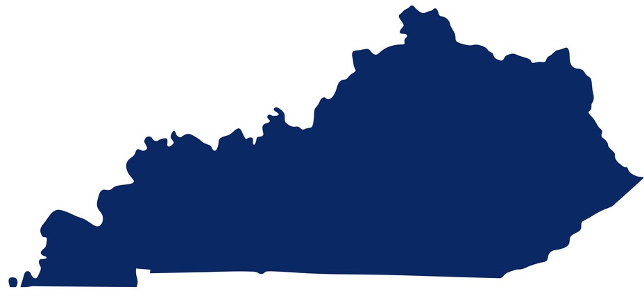
Kentucky is the Essential Ingredient
No Grains?
No Water?
No Oak?
No Bourbon.
No Scotch.
No Tequila (aged).
No Rum.

Slide 5
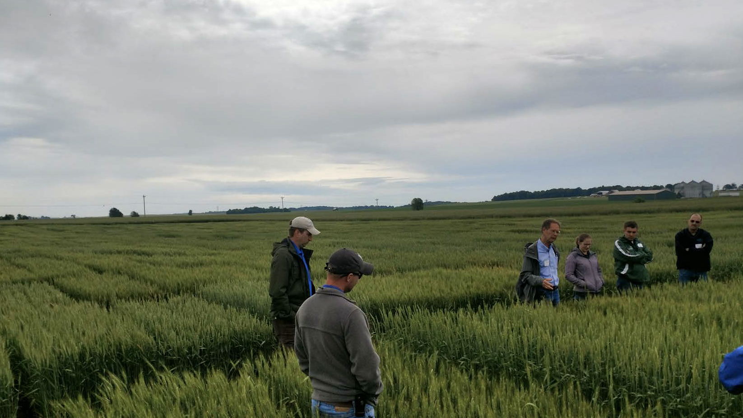
Why our farms?
Why here?

Slide 6
Kentucky’s most important crops for bourbon: Corn and wheat
World’s 1st and 2nd most important cereals
Globally, 70 percent used as animal feed, 30% used as food and drink (value sector)
Established research excellence

Slide 7
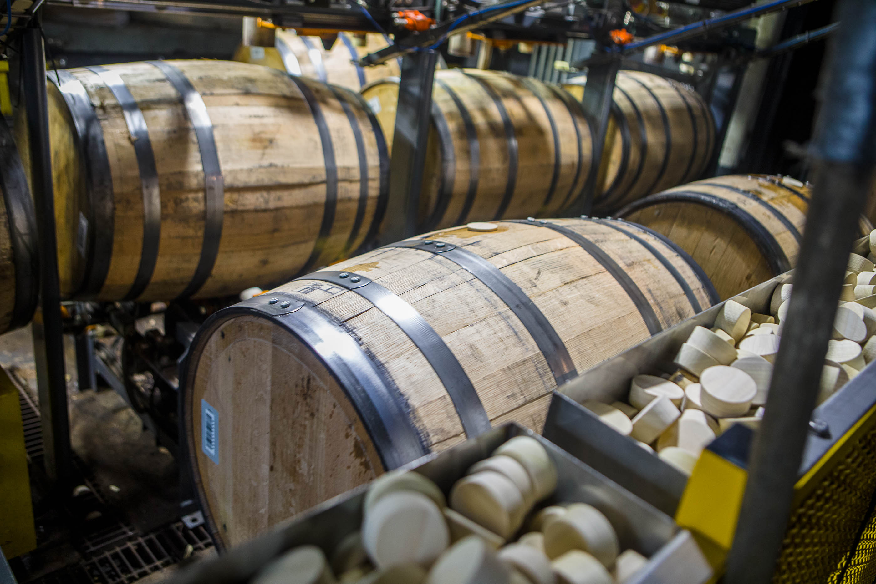
Serving Kentucky’s Signature Industry Mission and Vision of the Beam Institute
An internationally-recognized institute dedicated to the advancement of the bourbon industry through workforce programming, scientific discovery and industry partnerships.

Slide 8
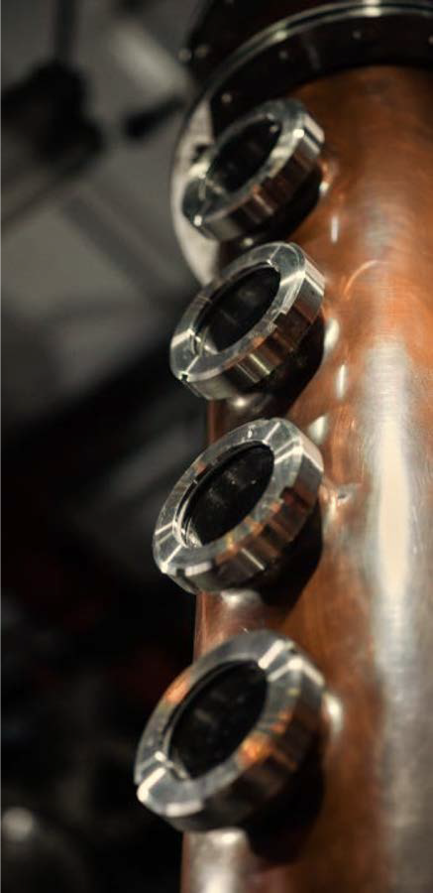
Who Are We?
Institute Operations
Seth DeBolt, Director
Ilka Balk, Associate Director
Brad Berron, Research Director
Glenna Joyce, Educational Coordinator
Faculty Fellows: 60 faculty fellows are part of the Beam Institute. Fellows come from multiple disciplines of study and are available for research projects, outreach and education

Slide 9
Development Timeline
2019: Beam Suntory Shared Values Begins
2023: Beam Institute Opens
2015: Univ. Senate Approves Certificate
Koetter Donates $200K
2012: First Courses Launch
2019: Online Certificate Launch
2020: MOU Signed with SWRI
2022: SWRI-JBBI Visit & Strategic Planning
2012
2015
2019
2020
2021
2022
2023
2023: 4th Annual Industry Conference
2012-15: Added Six Classes
Beam Suntory Donates $5M
Boswell Family Donates $1M
2022: Apprenticeship Program First Graduates
Academic Milestones
Philanthropy Milestones
Institution Milestones
Partnership Milestones
2019: 1st Annual Industry Conference
2021: JBBI Construction Begins
2021: Program Reaches More Than 140 Students

Slide 10
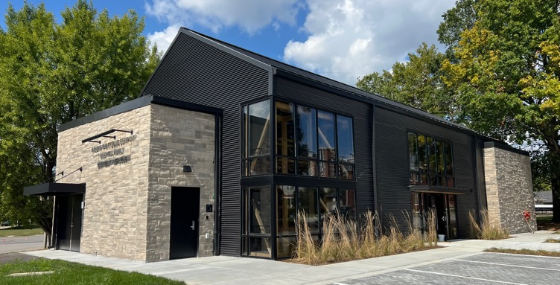
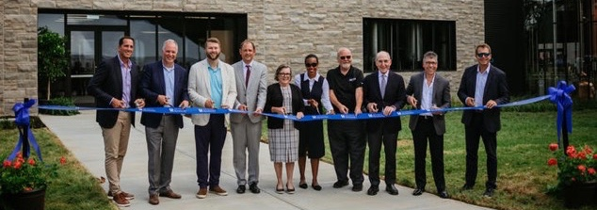
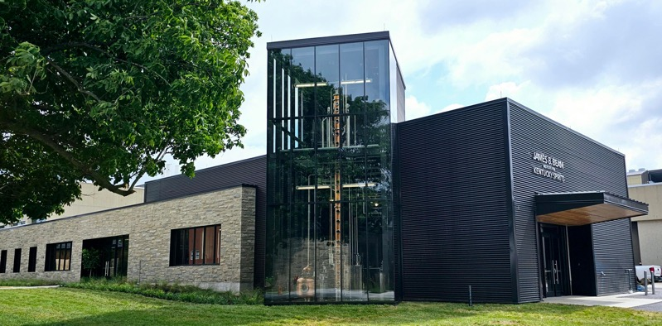
State of the Art Institute Growth in Multidisciplinary Programming
7,500 sqft teaching distillery on campus
Largest operational teaching distillery
Analytical space
Teaching space
Sensory lab
660 Barrel Maturation Facility
First of a kind maturation warehouse for American whiskey research and education
Private Investment
$5M gift from Beam Suntory
$1M gift from the Boswell Family and Independent Stave Company
$165,000 gift from Koetter Construction
Several gifts under $50k

Slide 11
“Distillers in Scotland and Kentucky have strong, shared values in heritage, quality and sustainability, this gives a firm platform for the Scotch Whiskey Research Institute and University of Kentucky collaboration where joint research on areas like maturation will benefit our member companies on both sides of the Atlantic.”
James Brosnan
Director of Research
Scotch Whiskey Research Institute

Slide 12
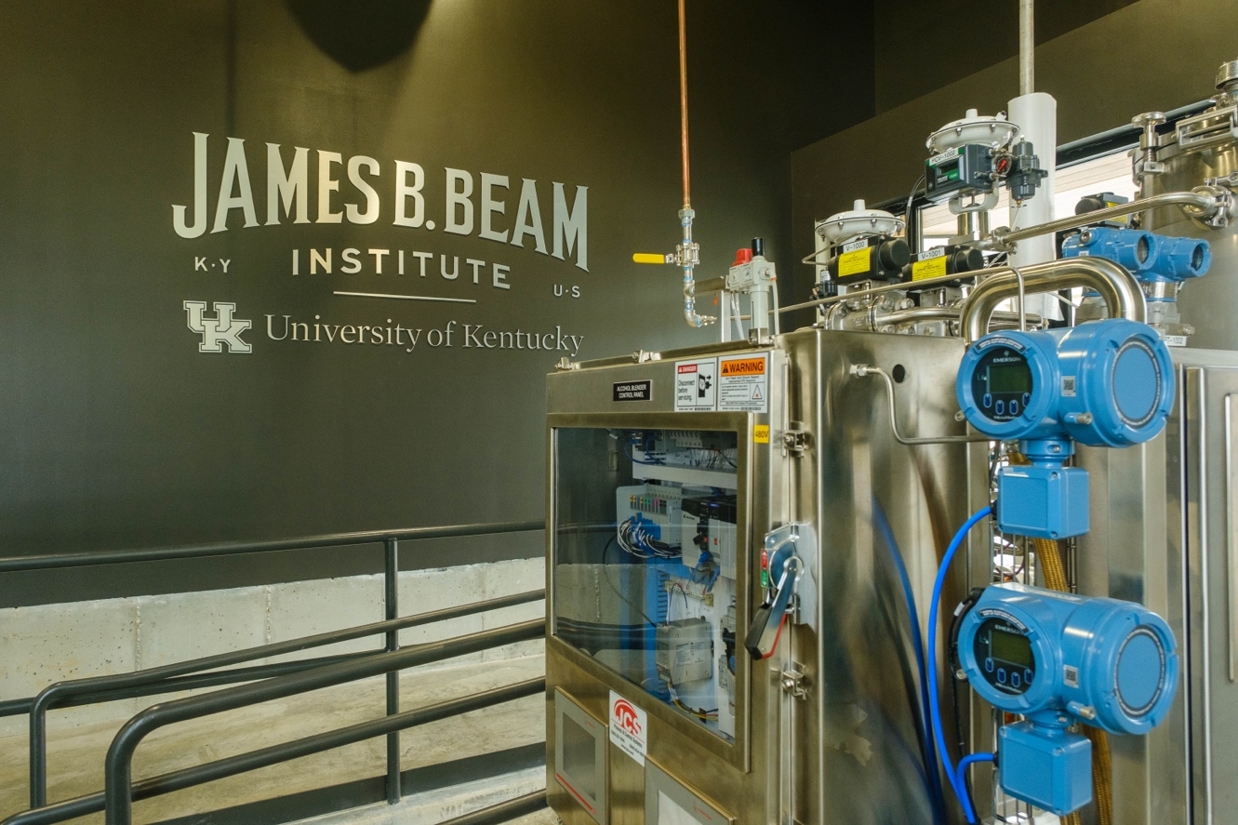
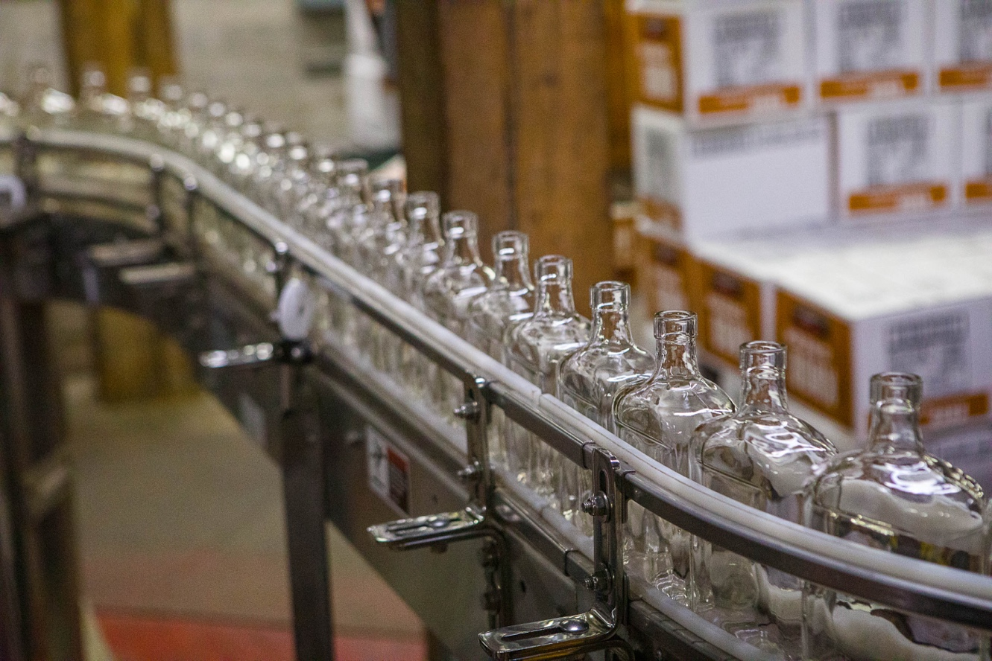
Educational Programming
Business
DISCUS leadership academy. Previously run through Cornell moved to UK Gatton School in 2022 aligning with JBBI
Engineering
Bourbon Production Engineering, Lean Systems Engineering, Watershed Engineering
Agriculture, Food and Environment
Dist/Wine/Brew, Fermentation, Sensory, Viticulture, Enology, Wine appreciation
Basic Science
Brewing Sci/Tech, Spirit Chemistry
Social and Corporate Responsibility
Humanities
Spirits tourism, Craft writing, Law

Slide 13
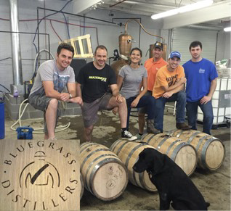
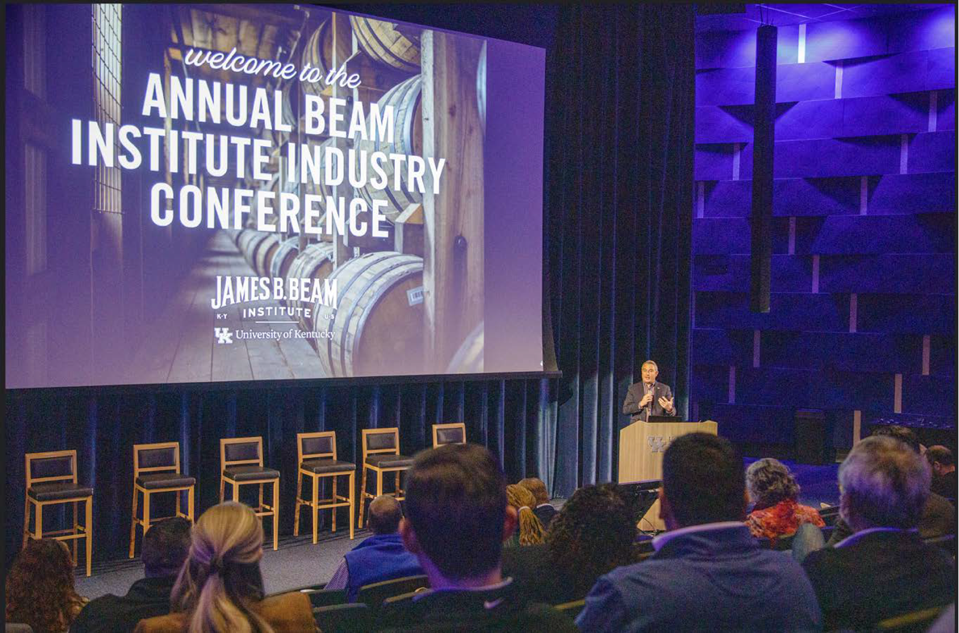
Workforce Training & Industry Engagement
Undergraduate/Graduate Coursework
12 new classes with two new classes added in 2022
35%-65% growth in certificate completion each year
Internship and Co-op
Certificate students get real world experience
Employers get first look at top students
Annual Industry Conference
Emphasis on technical content, not sales
2023 Industry Conf welcomed more than 850 attendees
Largely considered ‘the conference’ for distilled spirits in North America
Kentucky focused with Kentucky Distillers Association as partner
Short-Course Program for Distillery Workers
Leverage UK faculty expertise
State accredited apprenticeship program launched. The future model of flexible industry training through higher education

Slide 14
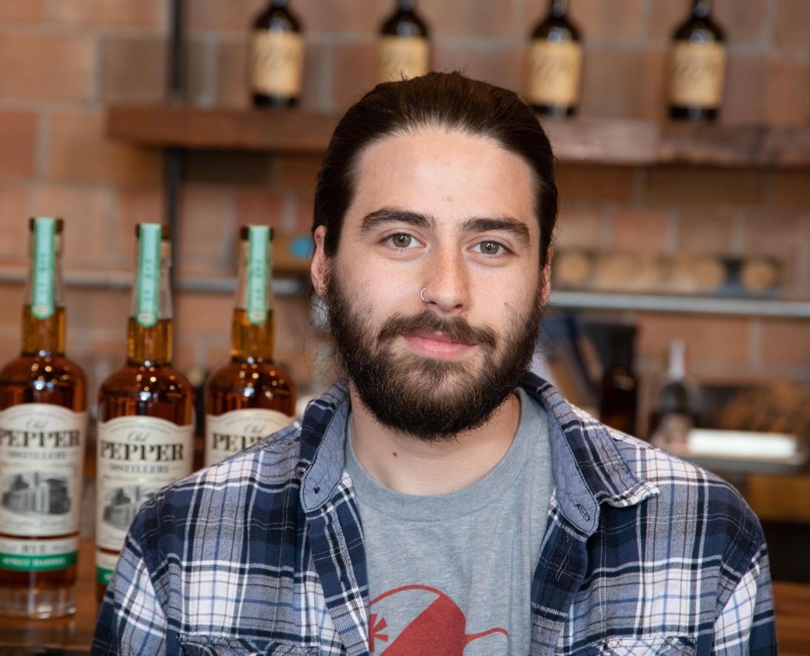
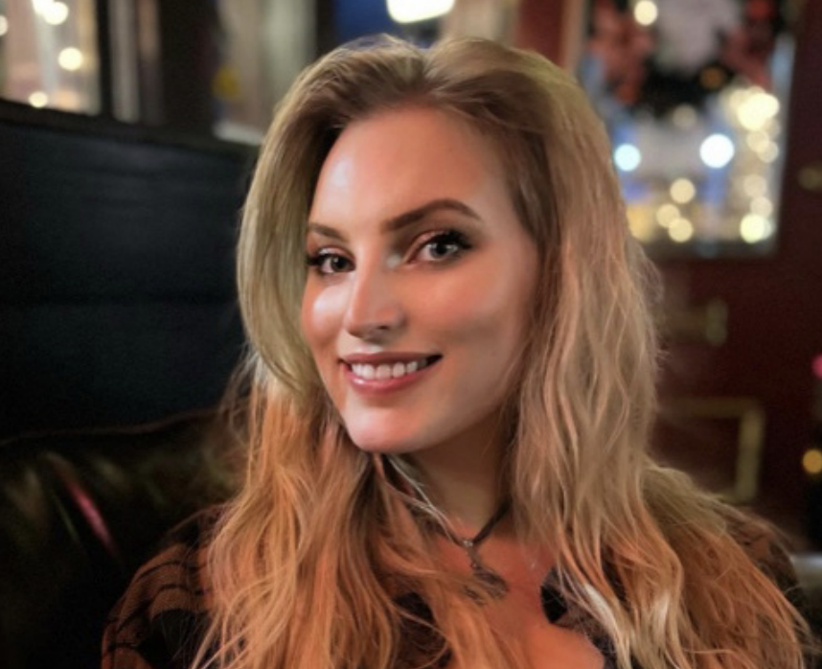
Workforce Training & Industry Engagement
Cody Giles, named head distiller at James E. Pepper Distillery.
Grace Outlaw, joined the Sazerac Operations Leadership Program.

Slide 15
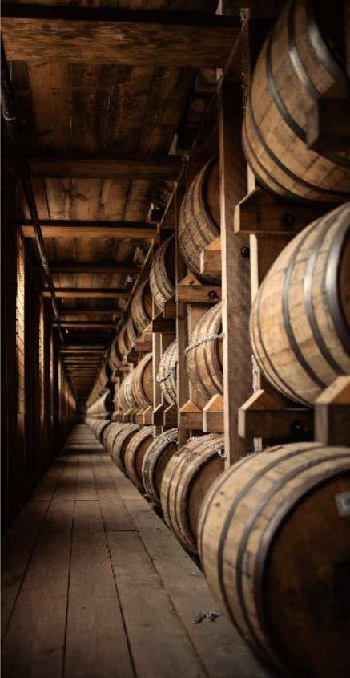
Research Partnership Models
Research Models
Non-confidential, industry-wide research
Partially confidential research
Confidential research
Streamlined Access to UK – Access to leading-edge resources
Metabolite analysis
Metabolomics core
Light microscopy core
Electron microscopy core
Proteomics core
Sensory Panels
Custom analytical assays developed by world class experts

Slide 16
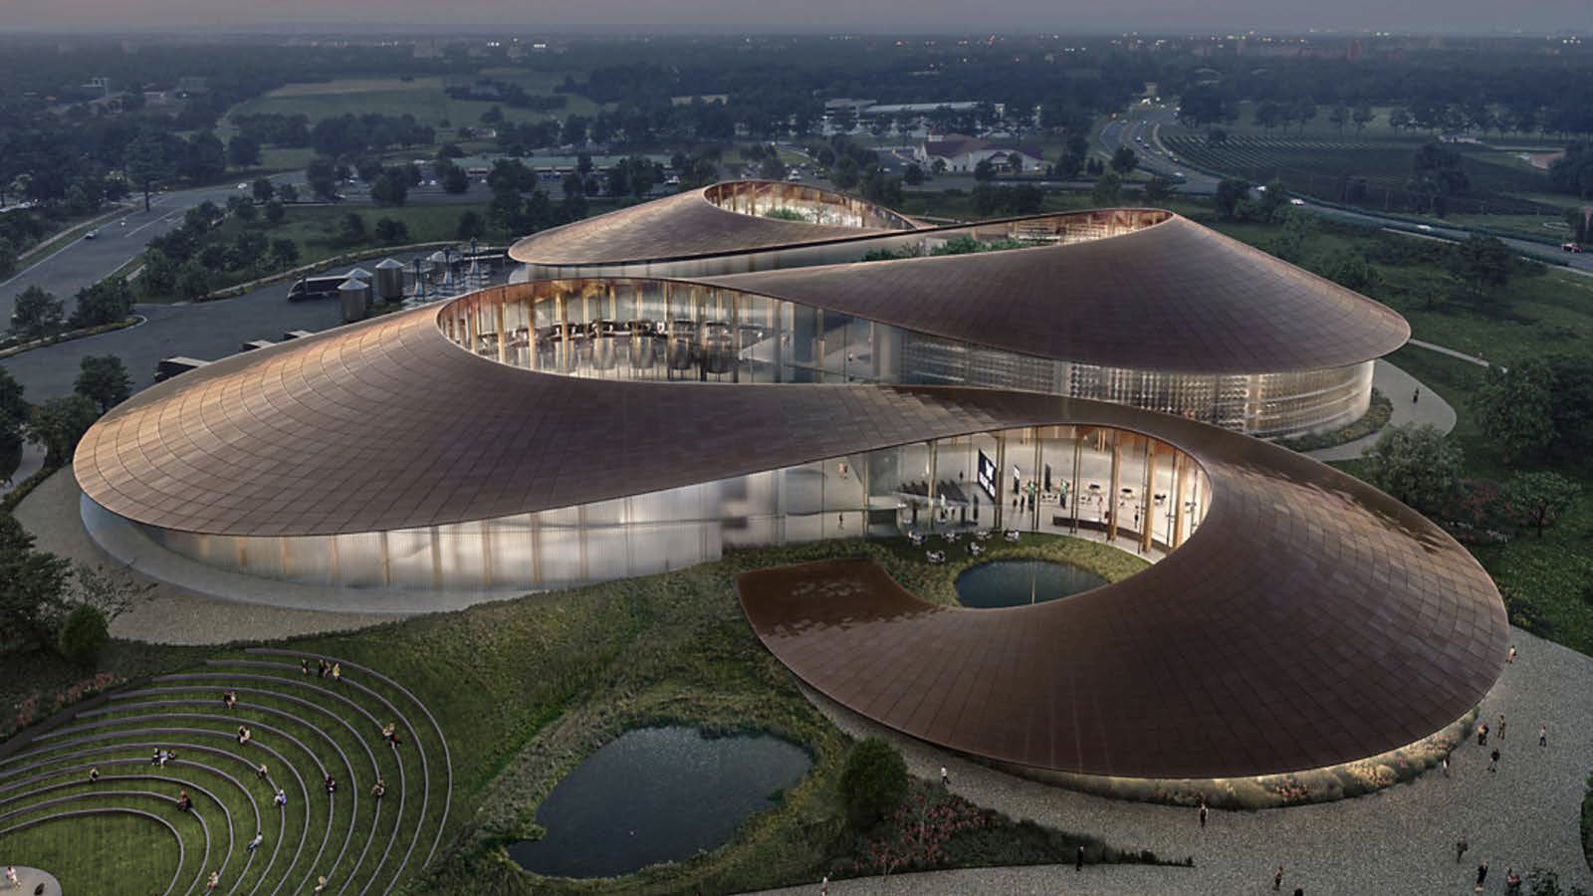
Future Proofing the bourbon industry

Slide 17
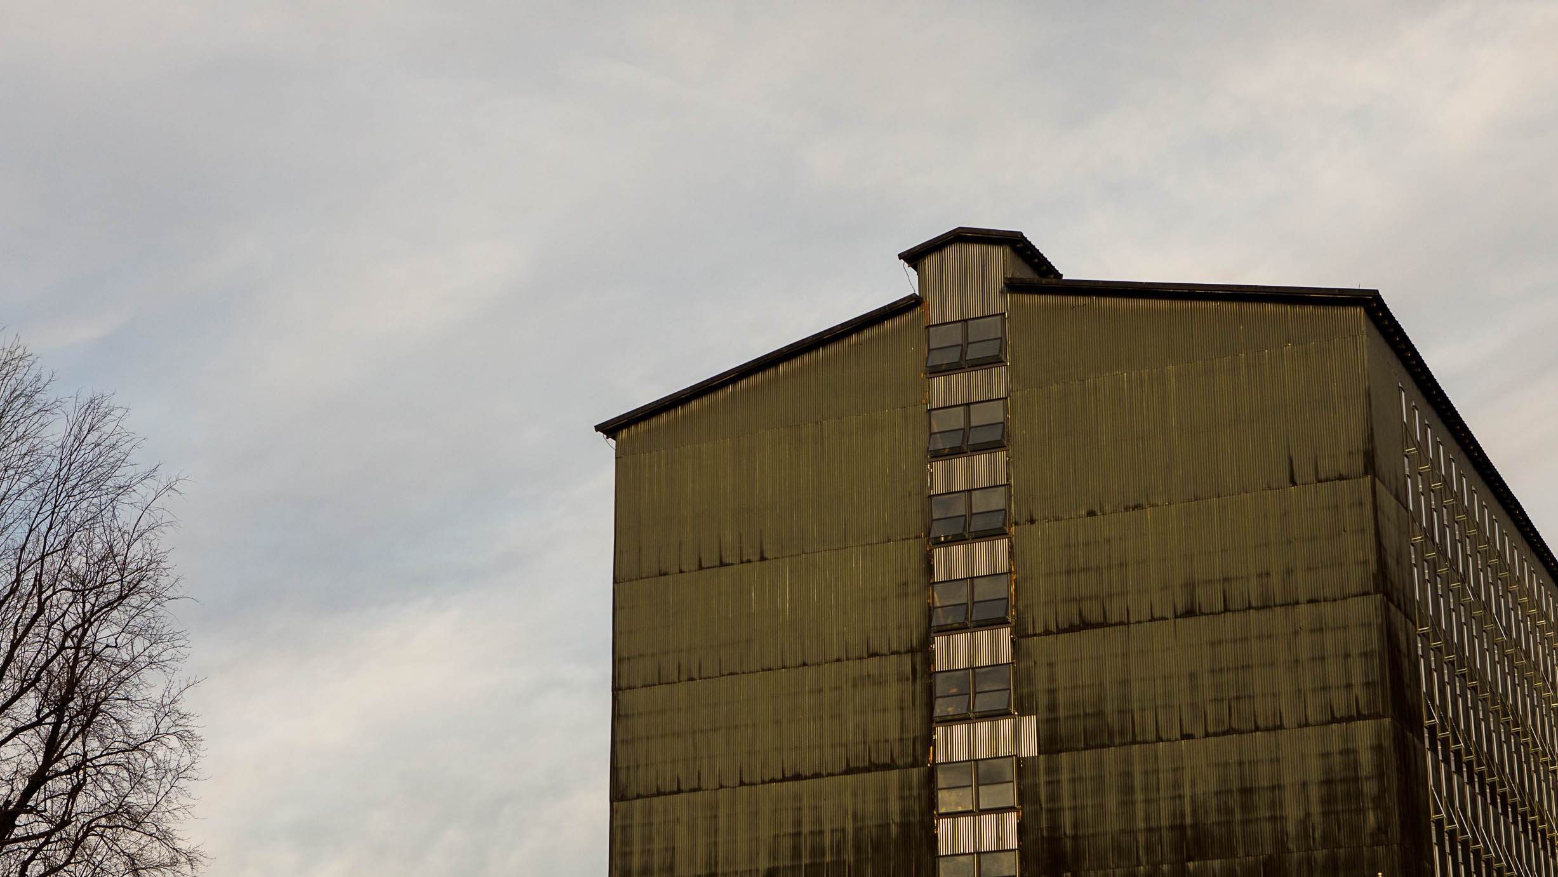
“We are excited to better understand its genetics to help ensure the next generation of Independent Stave Company stakeholders has a high-quality, plentiful supply of this noble species.”
Brad Boswell
CEO, Independent Stave Company

Slide 18
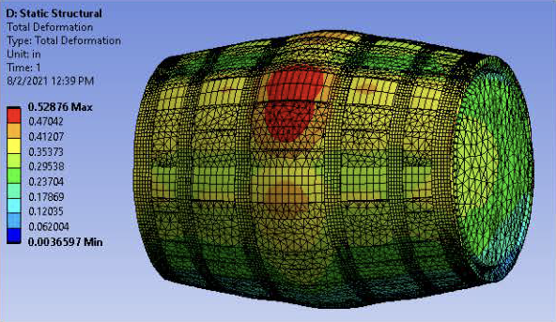
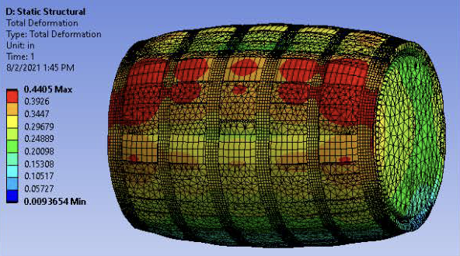
Innovation to Reduce Liquid Loss
Engineering innovation to reduce liquid loss could have an estimated $400 million impact, annually
Research Focus in Barrel Quality
Stave Quality
Recovery
Corrosion
Sensing
Controls
Maturation
Safety
Lean Manufacturing
Regular Hoop Placement
Even Hoop Placement

Slide 19
Presentation to the Economic Development and Workforce Investment Interim Joint Committee Bourbon Brings Jobs: Workforce Training and Spirits Innovation October 26, 2023 ---
Nancy Cox, PhD, Vice President for Land-grant Engagement and Dean,
UK Martin-Gatton College of Agriculture, Food and Environment
Seth DeBolt, PhD, Professor and Director of the James B. Beam Institute for Kentucky Spirits,
UK Martin-Gatton College of Agriculture, Food and Environment

