Slide 1
BACKROADS OF APPALACHIA:
MOVING EASTERN KENTUCKY FORWARD

Slide 2
WHAT WE DO
WE BRING JOBS & OPPORTUNITY TO KENTUCKY
THROUGH MOTORSPORTS & TOURISM
ECONOMIC DEVELOPMENT
WORKFORCE DEVELOPMENT
SUPPORT LOCAL BUSINESSES
We leverage tourism to create jobs and revitalize former coal towns by hosting events and mapping, trademarking, and marketing motorsports trails in Eastern Kentucky to tourists across the nation and the world.
We hire women and men in addiction recovery programs and provide them with job training in careers related to tourism, special events, and entrepreneurship.
We support small businesses, especially disadvantaged entrepreneurs & second chance employers in rural communities hit hardest by the coal industry downturn and COVID19.

Slide 3
MOTORSPORTS ENTHUSIASTS WANT
To escape to the country
Curvy roads with low traffic
Within a 1-day drive
Authentic, friendly cultural experience

Slide 4
OUR TRAILS
2023 KY Counties Served: Adair, Bath, Bell, Boyd, Breathitt, Carter, Casey, Clark, Clay, Clinton, Cumberland, Edmonson, Elliot, Estill, Fleming, Floyd, Garrard, Green, Greenup, Harlan, Hart, Jackson, Johnson, Knott, Knox, Laurel, Lawrence, Lee, Leslie, Letcher, Lewis, Lincoln, Madison, Magoffin, Martin, Mason, McCreary, Menifee, Metcalfe, Monroe, Montgomery, Morgan, Owsley, Perry, Pike, Pulaski, Rockcastle, Rowan, Wayne, Whitley, and Wolfe.
53
44
4
Trails
KY Counties
States:
Connects to
OH, TN, WV, VA

Slide 5
OUR MARKET
Global motorsports industry generated nearly $190 billion in 2019 *
Racing
Motorcycles & Dual Sport
Exotics & Sports Cars
Hill Climbs, Timed Trials & Rally Racing
Economic Impact in 2021
*based on an internal regional tourism multiplier study by AmeriCorps VISTA and economist Conner Walter
Off-Road Vehicles
Car Clubs
Electric Vehicles
*from a 2021 report from EY-Parthenon commissioned by The Fédération Internationale de l'Automobile (FIA)

Slide 6
ECONOMIC DEVELOPMENT:
3 Ways We Support It
1
HOST SPECIAL EVENTS & RACES
2
DRIVE CUSTOMERS TO LOCAL BUSINESSES
3
ATTRACT INDUSTRY & TELEWORKERS

Slide 7
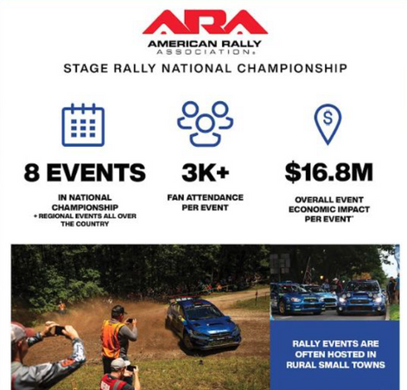
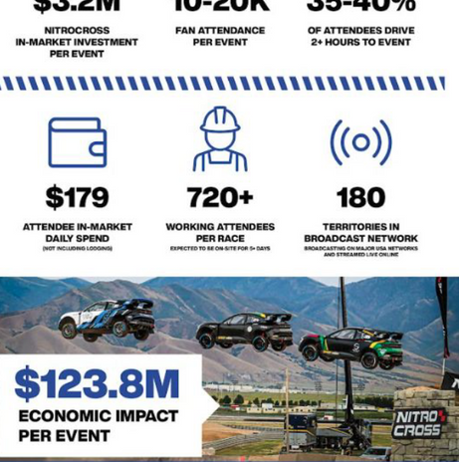
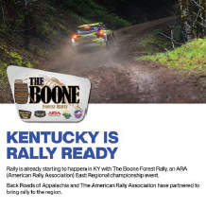
Recent Events
1
HOST SPECIAL EVENTS & RACES
2023 Examples & Attendees
Large Events:
Pine Mountain Hill Climb: 1,642 (Bell County)
McCreary Gravel Rally: 1,337 (McCreary County)
Drift Indy, Corbin Arena: 1,897 (Whitley / Knox County)
Boone Forest Rally: 1,537 (Jackson County)
Small Events, High-Wealth Visitors (multiple counties):
Porsche Club of America, Wilderness Trail Run: 21
Red Mirror Mustangs, Shelby Mountain Run: 315
Slingshots Storm the Mountains: 109
Potential Future Events
Future Potential Examples
American Rally Association (ARA) Stage Rally National Championship
Nitrocross Stadium Rallycross

Slide 8
2
DRIVE CUSTOMERS TO LOCAL BUSINESSES
46+ New Businesses
RESULTS:
MOBILE APP, 2022 KENTUCKY SMALL BUSINESS
SURVEY
*Current estimate as of 11/6/2023. Based on 30 created along Dragon Slayer trail since 2020 and 16 created along other trails since 2022 as indicated in ARC POWER Grant Report.
MOBILE APP
From 9/01/2022-01/25/2023, 102 KY small businesses responded to a Google Survey about the Backroads of Appalachia mobile app, self-reporting:
83% Increased Customers
84% Increased Revenue
Jobs Saved: 280
Jobs Created: 206
9,000+
Downloads
1,300+
Points of Interest
Explore Trails
Build & Share Your Itinerary
Calendar of Events
Turn By Turn Navigation
Example Survey Question:
BIG THANK YOU to the USDA Rural Business Development Grant for $99,949 to create the mobile app!
Sasquatchi Hibachi
Cumberland, KY
General Store at Pine Mountain Crossing
Eolia, KY
Pat’s Snack Bar
Manchester, KY

Slide 9
APPALACHIAN OVERLAND TRIANGLE
DIRTFISH RALLY SCHOOL
3
ATTRACT INDUSTRY & TELEWORKERS
GREEN APU
Planned manufacturing facility in Boyd county hiring 100+ employees manufacturing Electric APU unit and Hybrid Electric / Diesel Heavy-duty Reefer unit to reduce fuel consumption as a heavy-duty truck-idle solution.
VERMONT SPORTS CARS - ELECTRIC
*Backroads is leveraging Kentucky’s natural beauty, friendly people, and growing Broadband infrastructure to entice big employers and teleworkers to the region!

Slide 10
LOCAL GOVERNMENT SUPPORT
PAINTSVILLE, KY
“This year Backroads sponsored two events in our community: Sling Shots Storm the Mountains and Thundering Indian Motorcycle Group. These groups...visited many attractions / restaurants. In Paintsville alone they produced over 300 room nights and an estimated $50,000 in direct spending. In addition, they solicited suppliers from Atlanta, GA to visit our location for a week...with these two events we have already welcomed people back into our community that came to visit on their own.”
-Jeremiah Parsons, Executive Director,
Paintsville Tourism Commision
CORBIN, KY
“The City of Corbin and Backroads of Appalachia hosted an event in conjunction with Drift Indy in August. Based out of Indianapolis, Drift Indy brought in 60 drift cars, drivers and hundreds of spectators. The event was held at the Corbin arena, which resulted not only in economic impact for the facility, but also in exposure of the facility, which is the largest in the Southeast KY Region. Cars and drivers came from all over the country to participate in the two-day event.”
-Maggy Monhollen, Executive Director,
Corbin Tourism and Convention Commision
BOYD COUNTY, KY
“The most recent set of rally groups generated over 600 room nights, and $411,840 of revenue during the weekend of May 5-7, 2023...the groups spent their days exploring our entire Eastern Kentucky region and generated revenue in multiple counties during their visits.”
-Andrew Steele, Executive Director,
Boyd County Tourism & Convention Bureau

Slide 11
PUTTING KY ON THE MAP
Extreme sports legend, Travis Pastrana, will drive Subaru’s brand-new rally car racing Brandon Semenuk’s BRZs in Boyd County, KY in March 2024!

Slide 12
WHERE WE’RE GOING
Backcountry Discovery Routes:
economic impact of a similar organization in other states
Ride BDR Economic Impact Study reported:
$60 million economic impact in 2022
$335 average daily visitor expenditure
90% plan to ride again in next 2 years
*Economic Impact Study: https://ridebdr.com/news/economicstudy2023/

Slide 13
PREVIOUS REQUEST 2022-2023
RESULTING IMPACT
63 Events
in 2022
37,000 Visitors
86 Events
in 2023
in 2023
2022 Total Event Days: 107
2023 Total Event Days: 196
*Based on ARC POWER Grant Report indicating 37,786 New Visitor Days and 1,997 New Visitor Nights in 2023.
46 New Businesses
Triple Tax Revenue
*Cumberland, KY since opening Dragon Slayer Hwy 160 Trail in 2020 DURING COVID
*Current estimate as of 11/6/2023. Based on 30 created along Dragon Slayer trail since 2020 and 16 created along other trails since 2022 as indicated in ARC POWER Grant Report.
Economic Impact in 2021
*based on an internal regional tourism multiplier study by AmeriCorps VISTA and economist Conner Walter
9k Downloads
$9M-$13M
Mobile App
*total across both Android and Apple platforms
Economic Impact in 2022
*Based on 2022 Economic Impact Report, an independent study performed by Economics Professor Gregory Green, Ph.D. Updated 2023 Report expected Dec 2023.

Slide 14
NEW REQUEST 2024-2025
FUTURE IMPACT
90 Events
40,000 Visitors
in 2024
in 2024
100 Events
50,000 Visitors
in 2025
in 2025
60+ New Businesses
Triple Tax Revenue
*To be based on the total number of new businesses since 2020 who self-report they opened partially because of the increase in potential customers along Backroads trails or because of Backroads special events.
*in at least one Kentucky town
Economic Impact in 2021
*based on an internal regional tourism multiplier study by AmeriCorps VISTA and economist Conner Walter
12k Downloads
$30 million
Mobile App
*total across both Android and Apple platforms
Economic Impact in 2024-2025
*To be based on combined 2024 & 2025 Economic Impact Reports.
*note: Salary & Fringe are requested because it is necessary to continue producing these economic impacts, and the ARC grant funding for this ends July 2024. Also, this additional funding request will be used as matching funds to leverage future grant funding, such as an ARC ARISE grant application to develop the Appalachian Overland Triangle with a headquarters in Owsley County, KY.

Slide 15
CONTACT US
Erik Hubbard
Executive Director
BackroadsOfAppalachiaDirector@gmail.com
www.backroadsofappalachia.org

