Slide 1
housing’s IMPACT on employers and employees
November 2023
Presented by: Patrick Bowen
patrickb@bowennational.com
614-833-9300

Slide 2
Bowen National Research
National real estate research
500+ studies a year
Over 150 studies in KY
Completed 4 County Housing Needs Assessments in KY
KHC approved
Vice Chair of the National Council of Housing Market Analysts

Slide 3
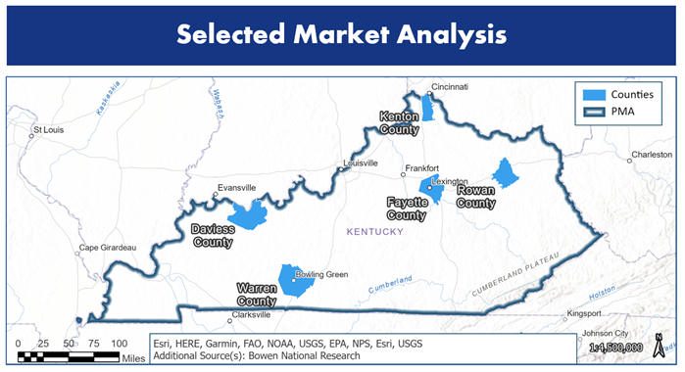
Market Examples
5 Counties Evaluated:
Daviess (Owensboro)
Fayette (Lexington)
Kenton (Covington)
Rowan (Morehead)
Warren (Bowling Green)
3 Metrics Considered:
Workers Commuting Patterns and Distances
Workers Wages and Housing Affordability
Housing Availability (Rental and For-Sale)

Slide 4
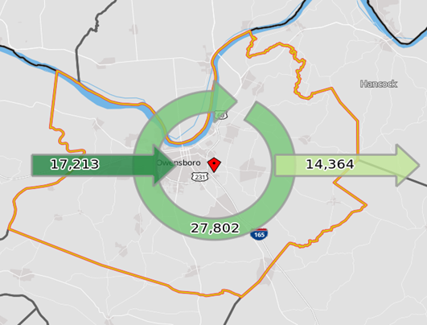
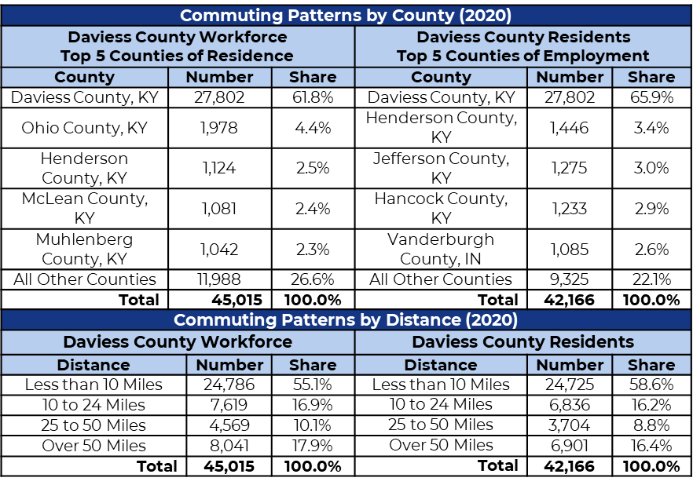
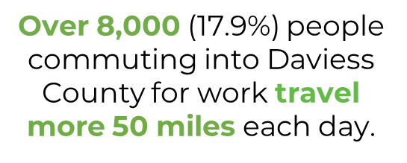
Inflow/Outflow Job Counts in 2020 Daviess County, KY

Slide 5
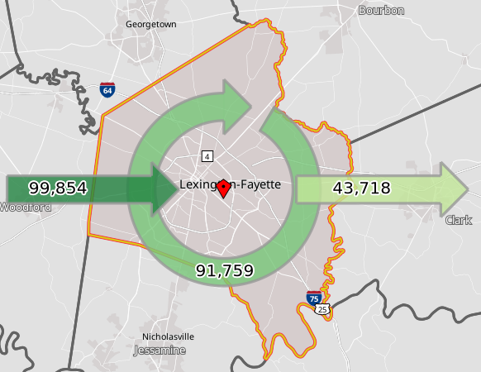
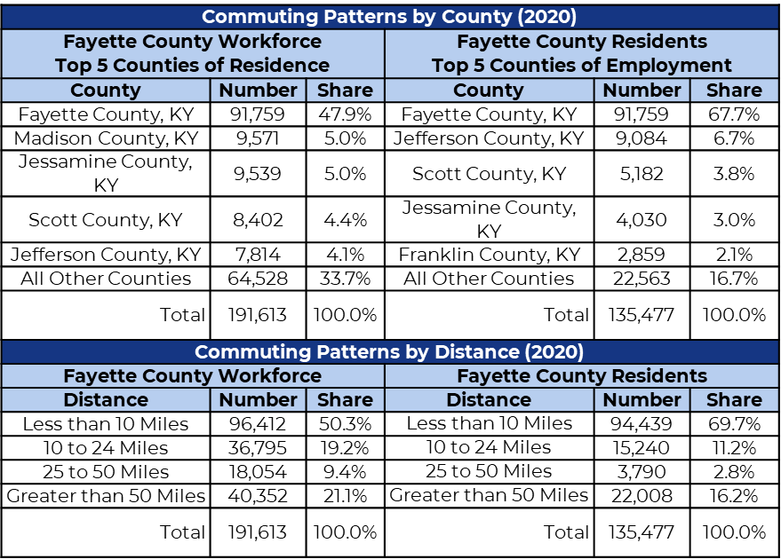
Inflow/Outflow Job Counts in 2020 Fayette County, KY
Nearly 100,000 people commute into Fayette County for work each day, while over 40,000 (21.1%) of people commuting into the county for work travel more 50 miles each day.

Slide 6
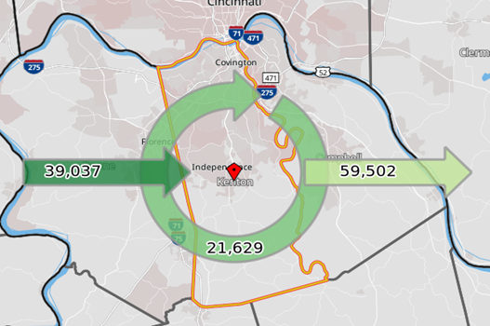
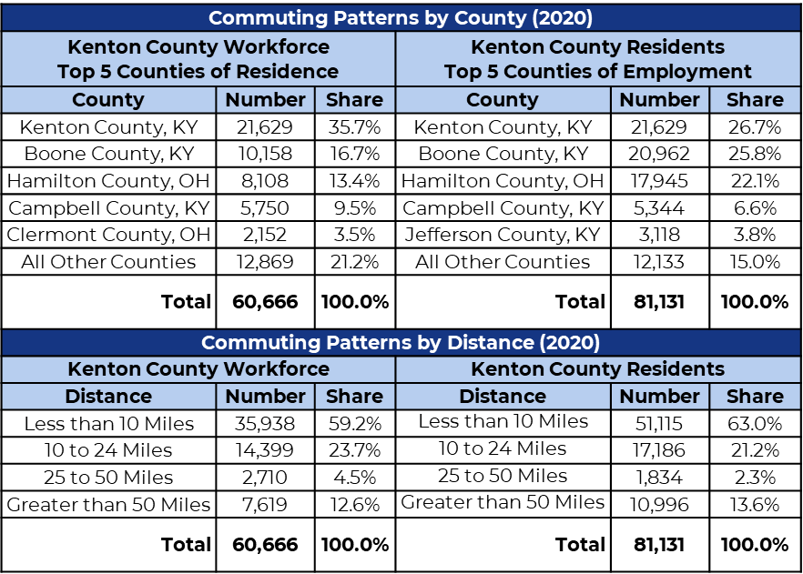
Inflow/Outflow Job Counts in 2020 Kenton County, KY
Over 7,600 (12.6%) people commuting into Kenton County for work travel more 50 miles each day.

Slide 7
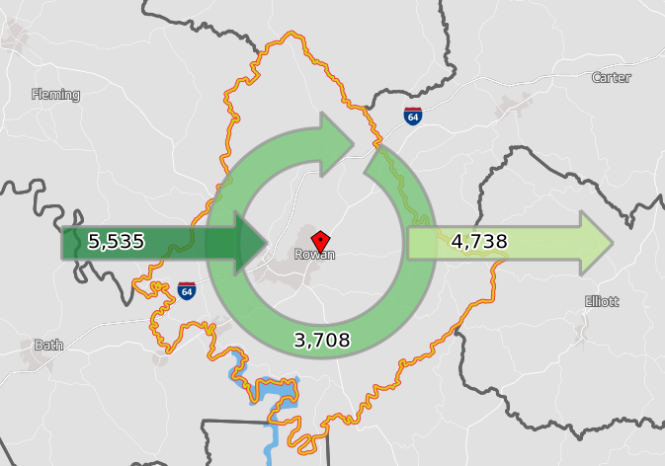
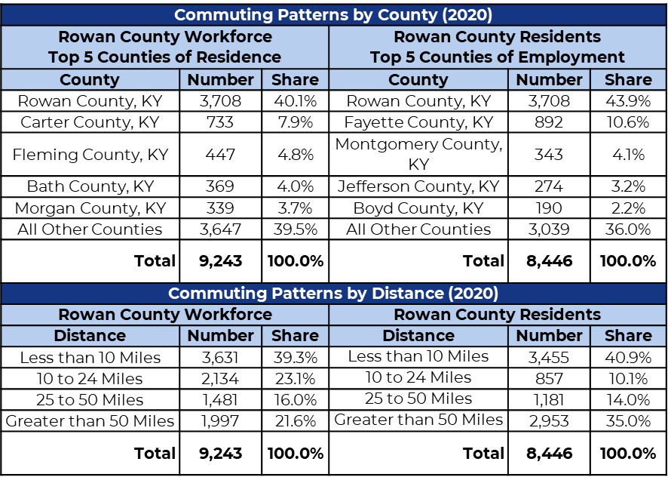
Inflow/Outflow Job Counts in 2020 Rowan County, KY
Nearly 2,000 (21.6%) people commuting into Rowan County for work travel more 50 miles each day; More people commute into the county than out of the county.

Slide 8
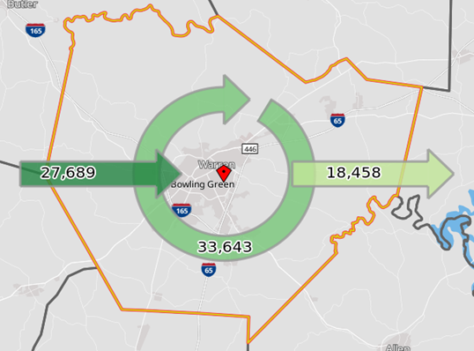
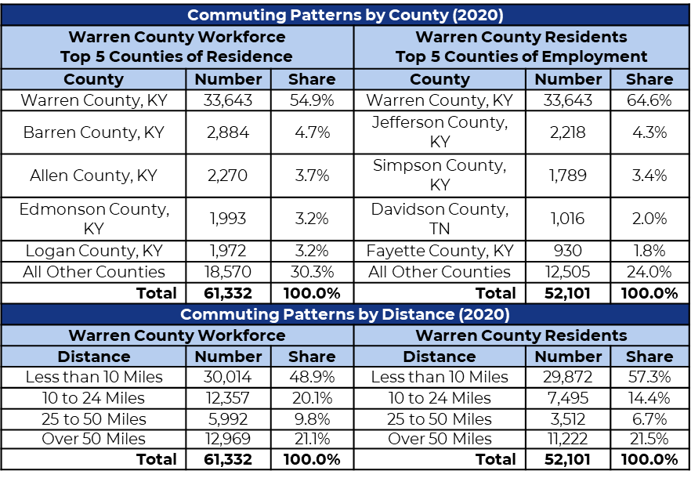
Inflow/Outflow Job Counts in 2020 Warren County, KY
Nearly 13,000 (21.1%) people commuting into Warren County for work travel more 50 miles each day.

Slide 9
Typical Housing Costs - Daviess County
Cost Type (Rent/Buy) | Housing Costs
Fair Market Rent (Two-Bedroom) | $926
Median List Price (May 2023) | $263,500
Housing affordability for each occupation below the 2-Br. Fair Market Rent (FMR) and median list price of available homes for the county is highlighted in red text.
Daviess County, KY
Wages and Housing Affordability for Top 30 Occupations by Share of Labor Force (Owensboro, KY Metropolitan Statistical Area)
Occupation Sector, Title & Wages |  |  |  |  | Housing Affordability
Sector Group (Code) | Labor Force Share | Occupation Title | Annual Wages |  | Max. Monthly Rent |  | Max. Purchase Price
 |  |  | Lower Quartile | Median | Lower Quartile | Median | Lower Quartile | Median
Sales and Related Occupations (41) | 2.7% | Retail Salespersons | $22,300 | $28,200 | $558 | $705 | $74,333 | $94,000
 | 2.6% | Cashiers | $21,290 | $23,750 | $532 | $594 | $70,967 | $79,167
 | 0.9% | First-Line Supervisors, Retail | $30,920 | $38,620 | $773 | $966 | $103,067 | $128,733
Food Preparation/ Serving (35) | 2.1% | Cooks, Fast Food | $21,360 | $22,240 | $534 | $556 | $71,200 | $74,133
 | 1.5% | Waiters/Waitresses | $17,990 | $21,150 | $450 | $529 | $59,967 | $70,500
 | 1.0% | Cooks, Restaurant | $23,280 | $28,720 | $582 | $718 | $77,600 | $95,733
 | 0.8% | First-Line Supervisors, Food Prep | $28,870 | $32,930 | $722 | $823 | $96,233 | $109,767
Office and Administrative Support (43) | 1.5% | Office Clerks, General | $29,110 | $35,010 | $728 | $875 | $97,033 | $116,700
 | 1.3% | Bookkeeping/Auditing Clerks | $33,820 | $39,940 | $846 | $999 | $112,733 | $133,133
 | 1.2% | Customer Service Representatives | $31,440 | $37,940 | $786 | $949 | $104,800 | $126,467
 | 1.0% | Secretaries/Admin. Assistants | $31,320 | $35,820 | $783 | $896 | $104,400 | $119,400
 | 0.8% | Shipping/Inventory Clerks | $32,370 | $41,250 | $809 | $1,031 | $107,900 | $137,500
 | 0.8% | First-Line Supervisors, Office | $44,680 | $55,270 | $1,117 | $1,382 | $148,933 | $184,233
Transportation Material Moving (53) | 2.4% | Stockers/Order Fillers | $26,600 | $28,320 | $665 | $708 | $88,667 | $94,400
 | 2.0% | Laborers/Material Movers | $31,750 | $36,870 | $794 | $922 | $105,833 | $122,900
 | 1.4% | Heavy/Tractor Trailer Drivers | $39,600 | $47,310 | $990 | $1,183 | $132,000 | $157,700
 | 0.8% | Light Truck Drivers | $32,290 | $37,410 | $807 | $935 | $107,633 | $124,700

Slide 10
Daviess County, KY
Wages and Housing Affordability for Top 30 Occupations by Share of Labor Force (Owensboro, KY Metropolitan Statistical Area)
Occupation Sector, Title & Wages |  |  |  |  | Housing Affordability
Sector Group (Code) | Labor Force Share | Occupation Title | Annual Wages |  | Max. Monthly Rent |  | Max. Purchase Price
 |  |  | Lower Quartile | Median | Lower Quartile | Median | Lower Quartile | Median
Education, Training, and Library (25) | 1.0% | Teaching Assistants | $28,220 | $28,220 | $706 | $706 | $94,067 | $94,067
 | 1.0% | Elementary School Teachers | $46,580 | $51,830 | $1,165 | $1,296 | $155,267 | $172,767
Production Occupations (51) | 2.0% | Misc. Assemblers/Fabricators | $38,250 | $50,420 | $956 | $1,261 | $127,500 | $168,067
 | 1.2% | Packaging Machine Operators | $37,890 | $48,560 | $947 | $1,214 | $126,300 | $161,867
 | 1.1% | First-Line Supervisors, Production | $58,960 | $76,850 | $1,474 | $1,921 | $196,533 | $256,167
Healthcare (29, 31) | 2.9% | Registered Nurses | $60,760 | $78,040 | $1,519 | $1,951 | $202,533 | $260,133
 | 1.7% | Home Health/Personal Aides | $26,440 | $29,100 | $661 | $728 | $88,133 | $97,000
 | 1.1% | Nursing Assistants | $30,460 | $33,490 | $762 | $837 | $101,533 | $111,633
Management (11) | 2.3% | General/Operations Managers | $48,350 | $72,750 | $1,209 | $1,819 | $161,167 | $242,500
Installation/ Maintenance/ Repair (49) | 1.1% | Maintenance/Repair Workers | $32,880 | $46,050 | $822 | $1,151 | $109,600 | $153,500
 | 1.1% | Industrial Machinery Mechanics | $56,930 | $65,080 | $1,423 | $1,627 | $189,767 | $216,933
Protective Services (33) | 1.1% | Security Guards | $23,320 | $27,560 | $583 | $689 | $77,733 | $91,867
Bldg./Grounds Maintenance (37) | 1.8% | Janitors and Cleaners | $23,410 | $26,980 | $585 | $675 | $78,033 | $89,933

Slide 11
Typical Housing Costs – Fayette County, KY
Cost Type (Rent/Buy) | Housing Costs
Fair Market Rent (Two-Bedroom) | $1,025
Median List Price (May 2023) | $399,000
Housing affordability for each occupation below the 2-Br. Fair Market Rent (FMR) and median list price of available homes for the county is highlighted in red text.
Fayette County, KY
Wages and Housing Affordability for Top 30 Occupations by Share of Labor Force (Lexington-Fayette, KY Metropolitan Statistical Area)
Occupation Sector, Title & Wages |  |  |  |  | Housing Affordability
Sector Group (Code) | Labor Force Share | Occupation Title | Annual Wages |  | Max. Monthly Rent |  | Max. Purchase Price
 |  |  | Lower Quartile | Median | Lower Quartile | Median | Lower Quartile | Median
Sales and Related Occupations (41) | 2.4% | Retail Salespersons | $22,760 | $27,810 | $569 | $695 | $75,867 | $92,700
 | 2.0% | Cashiers | $22,260 | $26,350 | $557 | $659 | $74,200 | $87,833
 | 0.7% | First-Line Supervisors, Retail | $31,950 | $39,080 | $799 | $977 | $106,500 | $130,267
 | 0.7% | Sales Reps, Wholesale/Mfg. | $45,620 | $59,000 | $1,141 | $1,475 | $152,067 | $196,667
Food Preparation/ Serving (35) | 2.3% | Cooks, Fast Food | $20,850 | $22,540 | $521 | $564 | $69,500 | $75,133
 | 1.5% | Waiters/Waitresses | $18,650 | $21,200 | $466 | $530 | $62,167 | $70,667
 | 1.2% | Fast Food and Counter Workers | $21,960 | $23,670 | $549 | $592 | $73,200 | $78,900
 | 1.0% | Cooks, Restaurant | $26,640 | $29,690 | $666 | $742 | $88,800 | $98,967
 | 1.0% | First-Line Supervisors, Food Prep | $29,880 | $34,770 | $747 | $869 | $99,600 | $115,900
Office and Administrative Support (43) | 2.0% | Customer Service Representatives | $29,350 | $35,520 | $734 | $888 | $97,833 | $118,400
 | 1.6% | Office Clerks, General | $29,620 | $35,400 | $741 | $885 | $98,733 | $118,000
 | 1.3% | Bookkeeping/Auditing Clerks | $36,450 | $43,690 | $911 | $1,092 | $121,500 | $145,633
 | 1.2% | Secretaries/Admin. Assistants | $34,720 | $40,240 | $868 | $1,006 | $115,733 | $134,133
 | 0.9% | Medical Secretaries/Admin Assts. | $31,960 | $36,860 | $799 | $922 | $106,533 | $122,867
 | 0.9% | First-Line Supervisors, Office | $46,580 | $59,260 | $1,165 | $1,482 | $155,267 | $197,533
Transportation Material Moving (53) | 2.4% | Laborers/Material Movers | $29,580 | $32,870 | $740 | $822 | $98,600 | $109,567
 | 2.1% | Stockers/Order Fillers | $28,080 | $33,280 | $702 | $832 | $93,600 | $110,933
 | 1.3% | Heavy/Tractor Trailer Drivers | $43,030 | $49,290 | $1,076 | $1,232 | $143,433 | $164,300
 | 0.8% | Light Truck Drivers | $33,270 | $40,140 | $832 | $1,004 | $110,900 | $133,800

Slide 12
Fayette County, KY
Wages and Housing Affordability for Top 30 Occupations by Share of Labor Force (Lexington-Fayette, KY Metropolitan Statistical Area)
Occupation Sector, Title & Wages |  |  |  |  | Housing Affordability
Sector Group (Code) | Labor Force Share | Occupation Title | Annual Wages |  | Max. Monthly Rent |  | Max. Purchase Price
 |  |  | Lower Quartile | Median | Lower Quartile | Median | Lower Quartile | Median
Education, Training, and Library (25) | 0.8% | Elementary School Teachers | $52,140 | $59,070 | $1,304 | $1,477 | $173,800 | $196,900
Production Occupations (51) | 2.3% | Misc. Assemblers/Fabricators | $36,140 | $44,420 | $904 | $1,111 | $120,467 | $148,067
Healthcare/ Personal Care (29, 31, 39) | 3.0% | Registered Nurses | $63,490 | $77,010 | $1,587 | $1,925 | $211,633 | $256,700
 | 1.1% | Nursing Assistants | $31,270 | $35,580 | $782 | $890 | $104,233 | $118,600
 | 0.9% | Home Health/Personal Aides | $25,330 | $28,200 | $633 | $705 | $84,433 | $94,000
 | 0.8% | Animal Caretakers | $23,700 | $28,940 | $593 | $724 | $79,000 | $96,467
 | 0.7% | Medical Assistants | $32,780 | $36,120 | $820 | $903 | $109,267 | $120,400
Management (11) | 2.5% | General/Operations Managers | $50,460 | $76,800 | $1,262 | $1,920 | $168,200 | $256,000
Installation/ Maintenance/ Repair (49) | 0.8% | Maintenance/Repair Workers | $35,510 | $43,780 | $888 | $1,095 | $118,367 | $145,933
Protective Services (33) | 0.8% | Security Guards | $22,420 | $28,430 | $561 | $711 | $74,733 | $94,767
Bldg./Grounds Maintenance (37) | 1.3% | Janitors and Cleaners | $25,680 | $29,910 | $642 | $748 | $85,600 | $99,700

Slide 13
Kenton County, KY
Typical Housing Costs – Kenton County
Cost Type (Rent/Buy) | Housing Cost
Fair Market Rent (Two-Bedroom) | $1,093
Median List Price (May 2023) | $292,070
Housing affordability for each occupation below the 2-Br. Fair Market Rent (FMR) and median list price of available homes for the county is highlighted in red text.
Wages and Housing Affordability for Top 30 Occupations by Share of Labor Force (Cincinnati, OH-KY-IN Metropolitan Statistical Area)
Occupation Sector, Title & Wages |  |  |  |  | Housing Affordability
Sector Group (Code) | Labor Force Share | Occupation Title | Annual Wages |  | Max. Monthly Rent |  | Max. Purchase Price
 |  |  | Lower Quartile | Median | Lower Quartile | Median | Lower Quartile | Median
Sales and Related Occupations (41) | 2.1% | Retail Salespersons | $23,740 | $29,150 | $594 | $729 | $79,133 | $97,167
 | 2.0% | Cashiers | $22,990 | $26,210 | $575 | $655 | $76,633 | $87,367
 | 1.2% | Sales Reps, Wholesale/Mfg. | $49,430 | $66,160 | $1,236 | $1,654 | $164,767 | $220,533
 | 0.8% | Sales Reps, Services | $44,130 | $60,760 | $1,103 | $1,519 | $147,100 | $202,533
Food Preparation/ Serving (35) | 2.3% | Fast Food and Counter Workers | $22,330 | $25,440 | $558 | $636 | $74,433 | $84,800
 | 1.5% | Waiters/Waitresses | $21,560 | $23,160 | $539 | $579 | $71,867 | $77,200
 | 1.0% | Cooks, Restaurant | $27,710 | $29,910 | $693 | $748 | $92,367 | $99,700
 | 0.9% | First-Line Supervisors, Food Prep | $29,690 | $35,570 | $742 | $889 | $98,967 | $118,567
Office and Administrative Support (43) | 2.0% | Customer Service Representatives | $31,630 | $37,680 | $791 | $942 | $105,433 | $125,600
 | 1.5% | Office Clerks, General | $31,450 | $38,350 | $786 | $959 | $104,833 | $127,833
 | 1.1% | Bookkeeping/Auditing Clerks | $38,000 | $45,510 | $950 | $1,138 | $126,667 | $151,700
 | 1.1% | Secretaries/Admin. Assistants | $34,930 | $39,890 | $873 | $997 | $116,433 | $132,967
 | 1.0% | First-Line Supervisors, Office | $48,840 | $62,340 | $1,221 | $1,559 | $162,800 | $207,800
 | 0.8% | Shipping/Inventory Clerks | $33,710 | $37,600 | $843 | $940 | $112,367 | $125,333
Transportation Material Moving (53) | 2.6% | Laborers/Material Movers | $31,150 | $36,760 | $779 | $919 | $103,833 | $122,533
 | 2.5% | Stockers/Order Fillers | $29,810 | $36,020 | $745 | $901 | $99,367 | $120,067
 | 1.4% | Heavy/Tractor Trailer Drivers | $46,430 | $50,570 | $1,161 | $1,264 | $154,767 | $168,567
 | 0.8% | Industrial Truck Operators | $37,200 | $43,400 | $930 | $1,085 | $124,000 | $144,667

Slide 14
Kenton County, KY (Continued)
Wages and Housing Affordability for Top 30 Occupations by Share of Labor Force (Cincinnati, OH-KY-IN Metropolitan Statistical Area)
Occupation Sector, Title & Wages |  |  |  |  | Housing Affordability
Sector Group (Code) | Labor Force Share | Occupation Title | Annual Wages |  | Max. Monthly Rent |  | Max. Purchase Price
 |  |  | Lower Quartile | Median | Lower Quartile | Median | Lower Quartile | Median
Education, Training, and Library (25) | 0.9% | Secondary School Teachers | $50,240 | $64,190 | $1,256 | $1,605 | $167,467 | $213,967
 | 0.9% | Elementary School Teachers | $48,620 | $61,930 | $1,216 | $1,548 | $162,067 | $206,433
 | 0.8% | Teaching Assistants | $28,440 | $35,620 | $711 | $891 | $94,800 | $118,733
Production Occupations (51) | 1.4% | Misc. Assemblers/Fabricators | $32,030 | $36,410 | $801 | $910 | $106,767 | $121,367
Healthcare (29, 31) | 2.3% | Registered Nurses | $65,800 | $78,520 | $1,645 | $1,963 | $219,333 | $261,733
 | 1.2% | Home Health/Personal Aides | $25,370 | $28,010 | $634 | $700 | $84,567 | $93,367
 | 1.0% | Nursing Assistants | $30,700 | $35,590 | $768 | $890 | $102,333 | $118,633
Management, Business/ Finance (11, 13) | 2.5% | General/Operations Managers | $60,200 | $89,840 | $1,505 | $2,246 | $200,667 | $299,467
 | 0.9% | Accountants and Auditors | $57,740 | $73,400 | $1,444 | $1,835 | $192,467 | $244,667
Computers/ Mathematics (15) | 0.9% | Software Developers | $82,680 | $104,540 | $2,067 | $2,614 | $275,600 | $348,467
Installation/ Maintenance/ Repair (49) | 1.0% | Maintenance/Repair Workers | $37,220 | $47,050 | $931 | $1,176 | $124,067 | $156,833
Bldg./Grounds Maintenance (37) | 1.3% | Janitors and Cleaners | $27,500 | $30,700 | $688 | $768 | $91,667 | $102,333

Slide 15
Typical Housing Costs - Rowan County
Cost Type (Rent/Buy) | Housing Costs
Fair Market Rent (Two-Bedroom) | $770
Median List Price (May 2023) | $265,000
Housing affordability for each occupation below the 2-Br. Fair Market Rent (FMR) and median list price of available homes for the county is highlighted in red text.
Rowan County, KY
Wages and Housing Affordability for Top 30 Occupations by Share of Labor Force (Central Kentucky Nonmetropolitan Area)
Occupation Sector, Title & Wages |  |  |  |  | Housing Affordability
Sector Group (Code) | Labor Force Share | Occupation Title | Annual Wages |  | Max. Monthly Rent |  | Max. Purchase Price
 |  |  | Lower Quartile | Median | Lower Quartile | Median | Lower Quartile | Median
Sales and Related Occupations (41) | 3.0% | Cashiers | $18,050 | $22,970 | $451 | $574 | $60,167 | $76,567
 | 2.1% | Retail Salespersons | $21,720 | $26,260 | $543 | $657 | $72,400 | $87,533
 | 0.9% | First-Line Supervisors, Retail | $28,300 | $36,910 | $708 | $923 | $94,333 | $123,033
Food Preparation/ Serving (35) | 2.7% | Cooks, Fast Food | $18,400 | $21,410 | $460 | $535 | $61,333 | $71,367
 | 1.2% | Waiters/Waitresses | $17,050 | $19,730 | $426 | $493 | $56,833 | $65,767
 | 1.1% | First-Line Supervisors, Food Prep | $27,270 | $28,910 | $682 | $723 | $90,900 | $96,367
 | 1.0% | Fast Food and Counter Workers | $17,450 | $21,690 | $436 | $542 | $58,167 | $72,300
 | 0.8% | Cooks, Restaurant | $21,840 | $27,100 | $546 | $678 | $72,800 | $90,333
Office and Administrative Support (43) | 1.6% | Secretaries/Admin. Assistants | $31,040 | $35,350 | $776 | $884 | $103,467 | $117,833
 | 1.5% | Office Clerks, General | $24,520 | $30,510 | $613 | $763 | $81,733 | $101,700
 | 1.3% | Bookkeeping/Auditing Clerks | $31,030 | $38,740 | $776 | $969 | $103,433 | $129,133
 | 1.1% | Customer Service Representatives | $28,000 | $32,320 | $700 | $808 | $93,333 | $107,733
 | 0.8% | First-Line Supervisors, Office | $37,180 | $47,010 | $930 | $1,175 | $123,933 | $156,700
 | 0.7% | Medical Secretaries/Admin Assts. | $28,090 | $30,850 | $702 | $771 | $93,633 | $102,833
Transportation Material Moving (53) | 2.1% | Stockers/Order Fillers | $25,010 | $30,440 | $625 | $761 | $83,367 | $101,467
 | 2.1% | Laborers/Material Movers | $28,320 | $32,800 | $708 | $820 | $94,400 | $109,333
 | 1.2% | Heavy/Tractor Trailer Drivers | $37,060 | $46,100 | $927 | $1,153 | $123,533 | $153,667

Slide 16
Rowan County, KY
Wages and Housing Affordability for Top 30 Occupations by Share of Labor Force (Central Kentucky Nonmetropolitan Area)
Occupation Sector, Title & Wages |  |  |  |  | Housing Affordability
Sector Group (Code) | Labor Force Share | Occupation Title | Annual Wages |  | Max. Monthly Rent |  | Max. Purchase Price
 |  |  | Lower Quartile | Median | Lower Quartile | Median | Lower Quartile | Median
Education, Training, and Library (25) | 1.1% | Elementary School Teachers | $47,710 | $51,970 | $1,193 | $1,299 | $159,033 | $173,233
 | 1.0% | Teaching Assistants | $24,160 | $27,980 | $604 | $700 | $80,533 | $93,267
 | 0.8% | Secondary School Teachers | $48,170 | $55,790 | $1,204 | $1,395 | $160,567 | $185,967
Production Occupations (51) | 2.7% | Misc. Assemblers/Fabricators | $30,630 | $35,300 | $766 | $883 | $102,100 | $117,667
 | 1.0% | First-Line Supervisors, Production | $46,800 | $58,650 | $1,170 | $1,466 | $156,000 | $195,500
 | 0.9% | Packaging Machine Operators | $40,710 | $42,370 | $1,018 | $1,059 | $135,700 | $141,233
Healthcare (29, 31) | 1.9% | Registered Nurses | $61,180 | $64,110 | $1,530 | $1,603 | $203,933 | $213,700
 | 1.1% | Home Health/Personal Aides | $21,800 | $23,350 | $545 | $584 | $72,667 | $77,833
 | 0.9% | Nursing Assistants | $27,550 | $28,960 | $689 | $724 | $91,833 | $96,533
Management (11) | 2.6% | General/Operations Managers | $48,600 | $69,960 | $1,215 | $1,749 | $162,000 | $233,200
Construction, Installation/ Maintenance/ Repair (47, 49) | 1.1% | Maintenance/Repair Workers | $30,290 | $40,270 | $757 | $1,007 | $100,967 | $134,233
 | 0.8% | Construction Laborers | $31,280 | $38,390 | $782 | $960 | $104,267 | $127,967
Bldg./Grounds Maintenance (37) | 1.5% | Janitors and Cleaners | $24,530 | $28,120 | $613 | $703 | $81,767 | $93,733

Slide 17
Warren County, KY
Typical Housing Costs – Warren County, KY
Cost Type (Rent/Buy) | Housing Costs
Fair Market Rent (Two-Bedroom) | $941
Median List Price (May 2023) | $349,900
Housing affordability for each occupation below the 2-Br. Fair Market Rent (FMR) and median list price of available homes for the county is highlighted in red text.
Wages and Housing Affordability for Top 30 Occupations by Share of Labor Force (Bowling Green, KY Metropolitan Statistical Area)
Occupation Sector, Title & Wages |  |  |  |  | Housing Affordability
Sector Group (Code) | Labor Force Share | Occupation Title | Annual Wages |  | Max. Monthly Rent |  | Max. Purchase Price
 |  |  | Lower Quartile | Median | Lower Quartile | Median | Lower Quartile | Median
Sales and Related Occupations (41) | 3.0% | Retail Salespersons | $21,840 | $25,590 | $546 | $640 | $72,800 | $85,300
 | 2.5% | Cashiers | $20,900 | $23,350 | $523 | $584 | $69,667 | $77,833
 | 1.0% | First-Line Supervisors, Retail | $29,910 | $37,920 | $748 | $948 | $99,700 | $126,400
Food Preparation/ Serving (35) | 2.4% | Cooks, Fast Food | $19,800 | $21,680 | $495 | $542 | $66,000 | $72,267
 | 1.6% | Fast Food and Counter Workers | $20,550 | $22,820 | $514 | $571 | $68,500 | $76,067
 | 1.4% | Waiters/Waitresses | $17,480 | $20,600 | $437 | $515 | $58,267 | $68,667
 | 1.0% | First-Line Supervisors, Food Prep | $28,570 | $31,930 | $714 | $798 | $95,233 | $106,433
 | 0.8% | Cooks, Restaurant | $22,720 | $28,650 | $568 | $716 | $75,733 | $95,500
Office and Administrative Support (43) | 1.5% | Customer Service Representatives | $28,700 | $31,720 | $718 | $793 | $95,667 | $105,733
 | 1.5% | Office Clerks, General | $24,920 | $31,530 | $623 | $788 | $83,067 | $105,100
 | 1.3% | Secretaries/Admin. Assistants | $29,180 | $34,540 | $730 | $864 | $97,267 | $115,133
 | 1.2% | Bookkeeping/Auditing Clerks | $30,800 | $38,210 | $770 | $955 | $102,667 | $127,367
 | 0.9% | First-Line Supervisors, Office | $42,370 | $53,860 | $1,059 | $1,347 | $141,233 | $179,533
Transportation Material Moving (53) | 2.5% | Stockers/Order Fillers | $25,810 | $30,430 | $645 | $761 | $86,033 | $101,433
 | 2.0% | Laborers/Material Movers | $29,340 | $34,100 | $734 | $853 | $97,800 | $113,667
 | 1.5% | Heavy/Tractor Trailer Drivers | $42,520 | $47,200 | $1,063 | $1,180 | $141,733 | $157,333
 | 0.9% | Light Truck Drivers | $29,710 | $39,180 | $743 | $980 | $99,033 | $130,600
 | 0.8% | Packers and Packagers | $28,020 | $29,920 | $701 | $748 | $93,400 | $99,733

Slide 18
Warren County, KY (Continued)
Wages and Housing Affordability for Top 30 Occupations by Share of Labor Force (Bowling Green, KY Metropolitan Statistical Area)
Occupation Sector, Title & Wages |  |  |  |  | Housing Affordability
Sector Group (Code) | Labor Force Share | Occupation Title | Annual Wages |  | Max. Monthly Rent |  | Max. Purchase Price
 |  |  | Lower Quartile | Median | Lower Quartile | Median | Lower Quartile | Median
Education, Training, and Library (25) | 1.1% | Elementary School Teachers | $47,080 | $51,000 | $1,177 | $1,275 | $156,933 | $170,000
Production Occupations (51) | 4.7% | Misc. Assemblers/Fabricators | $36,060 | $39,450 | $902 | $986 | $120,200 | $131,500
 | 1.1% | Inspectors/Testers/Samplers | $29,390 | $34,600 | $735 | $865 | $97,967 | $115,333
 | 1.0% | Production Workers, All Other | $28,150 | $34,840 | $704 | $871 | $93,833 | $116,133
 | 0.9% | First-Line Supervisors, Production | $45,060 | $58,980 | $1,127 | $1,475 | $150,200 | $196,600
Healthcare (29, 31) | 1.9% | Registered Nurses | $61,120 | $65,740 | $1,528 | $1,644 | $203,733 | $219,133
 | 1.6% | Home Health/Personal Aides | $22,730 | $27,780 | $568 | $695 | $75,767 | $92,600
 | 0.9% | Medical Assistants | $30,020 | $31,970 | $751 | $799 | $100,067 | $106,567
Management (11) | 2.4% | General/Operations Managers | $47,060 | $66,690 | $1,177 | $1,667 | $156,867 | $222,300
Construction/ Installation/ Maintenance/ Repair (47, 49) | 0.9% | Maintenance/Repair Workers | $33,480 | $39,910 | $837 | $998 | $111,600 | $133,033
 | 0.8% | Construction Laborers | $35,270 | $41,810 | $882 | $1,045 | $117,567 | $139,367
Bldg./Grounds Maintenance (37) | 0.9% | Janitors and Cleaners | $26,480 | $30,110 | $662 | $753 | $88,267 | $100,367

Slide 19
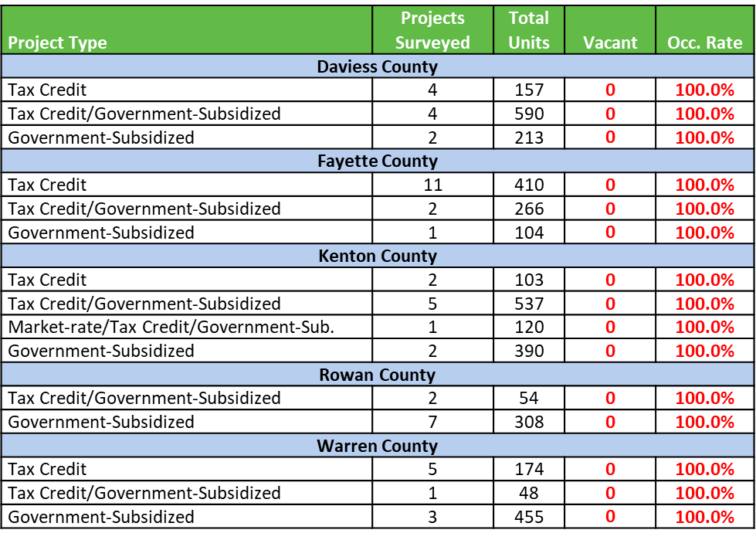
Affordable Rental Housing – Sample Surveys
Bowen National Research conducted a sample phone survey of 52 affordable properties in August 2023.
This sample survey revealed there are NO vacancies among any of the surveyed affordable rental properties.

Slide 20
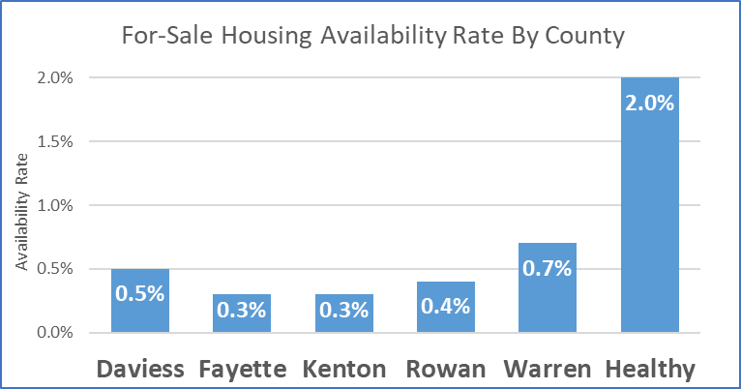
For-Sale Housing – Current Listings
Source: Realtor.com (8/9/2023)
Over half (55.1%) of the available housing units are priced over $300,000.
Availability rates among selected communities are 0.7% or lower (healthy markets are b/w 2%-3%)

Slide 21
Employer Surveys
Employer Surveys Overview
Surveys conducted from May 2021 to May 2023
14 total surveys conducted
456 total employers participated
Participants employ approximately 51,512 total employees
Topics covered:
Company profile (type of business, number of employees, locations served, etc.)
Housing challenges and needs of employees
How local housing market impacts employer’s business
Level of interest of employers to be involved in housing solutions
Employer surveys included were components in four (4) multi-county regional studies and (10) county-wide studies, encompassing a total of 41 counties in 6 states (Kentucky, Michigan, North Carolina, Ohio, Pennsylvania, and West Virginia).

Slide 22
Employer Survey Results
Over one-half (55.1%) of the 456 employers surveyed stated that local housing issues adversely impact their business
Unknown
NO
YES

Slide 23
Employer Survey Results
While housing issues have a a variety of adverse impacts on employers and their businesses, survey results indicate local housing issues most often impact employers’ ability to attract and retain workers.
Productivity
Morale
Costs
Limits Growth
Retain Workers
Attract Workers

Slide 24
Employer Survey Results
Employers indicated that housing availability and affordability are primary housing challenges their employees face, though the distance between work and home and the lack of quality housing are other issues impacting their employees.
Housing Availability
Rental Affordability
Home Buying
Affordability
Housing/Work Distance
Housing Quality

Slide 25
Employer Survey Results
Nearly two-thirds (63.8%) of employers indicated that they would be Much More Likely or Somewhat Likely to add more employees if local housing issues are resolved.
Unknown
Much More Likely
Not Likely
Somewhat Likely

Slide 26
Employer Survey Results
Surveyed employers would consider some level of involvement in specific approaches to address employee housing issues.
Security Deposit
14.6%
Housing Development
17.4%
Relocation Reimbursement
18.3%
Relocation Assistance/Services
18.6%
Counseling or Placement Services
18.8%

Slide 27
Employer Survey Results
Surveyed employers believe supporting new housing development and redevelopment, and providing renter and homebuyer assistance are important public policy considerations.
Security Deposit
Housing Development
Relocation Reimbursement
Relocation Assistance/Services
Counseling or Placement Services

Slide 28
Conclusions
Key Conclusions:
Close to one-in-five commuters travel over 50 miles to work
Many workers within the most common occupations do not have sufficient wages to afford typical rentals in the market they work and virtually no workers can afford to buy a home in the market they work.
There is limited availability among rental and for-sale housing alternatives, particularly housing affordable to lower income households/workers.
Many employers (nationally) indicate that housing is adversely impacting their businesses, most notably their ability to attract and retain workers; Nearly two-thirds of employers indicate they are more likely to hire workers if local housing issues resolved; Roughly one-in-five employers want to be part of the housing solution.

