Slide 1
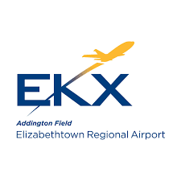
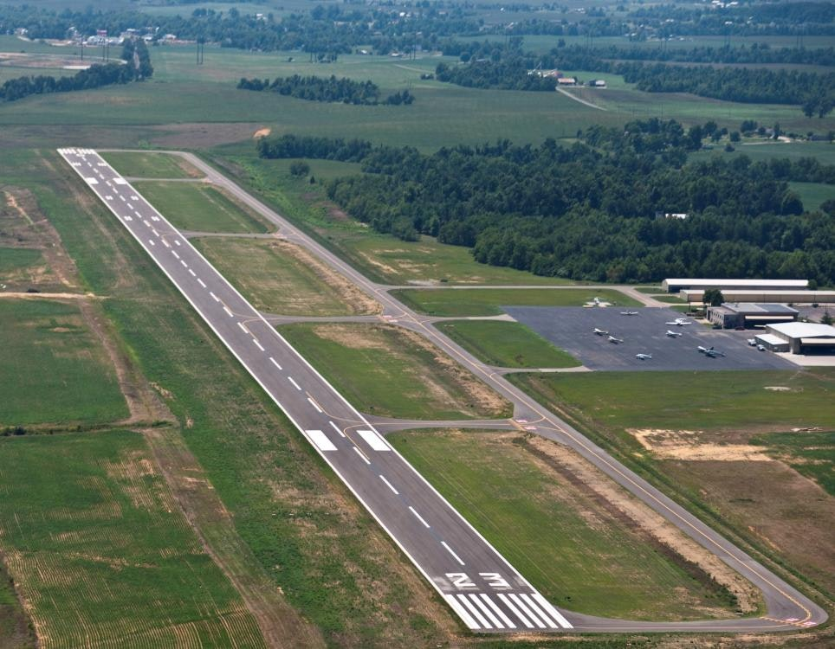
Elizabethtown Regional Airport/
Central Kentucky
Primed for Growth!

Slide 2
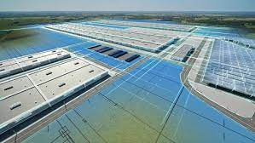
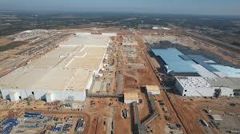
Located on I-65 five miles south of Elizabethtown
Joint venture between The Ford Motor Company and SK On (South Korea)
Two battery plants currently under construction – fully built out by the end of 2026
8.4 million square feet – will be the 10th largest manufacturing site by size in the world
Largest EV electric battery manufacturing site in the world, in terms of investment,
size, employment, and manufacturing capacity
Initial investment: $5.8 billion
Initial employment footprint: 5,000

Slide 3
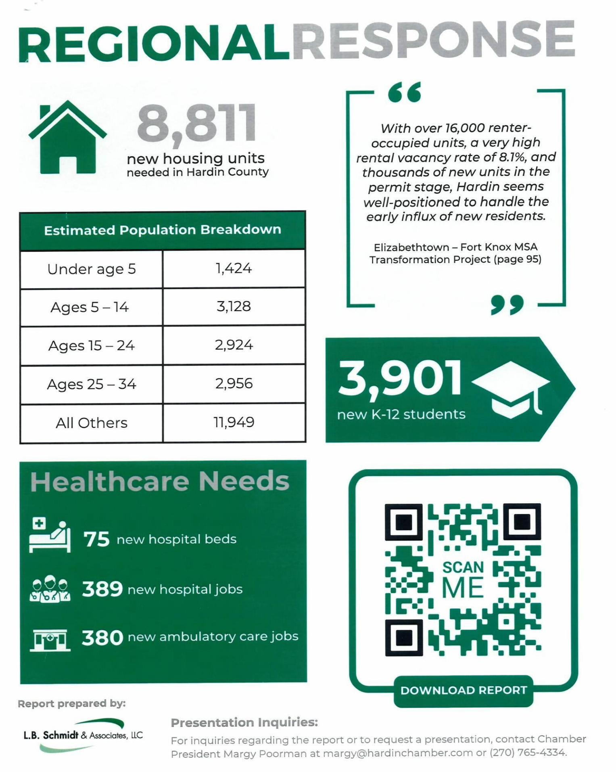
Enormous Impact on the Metro Area

Slide 4
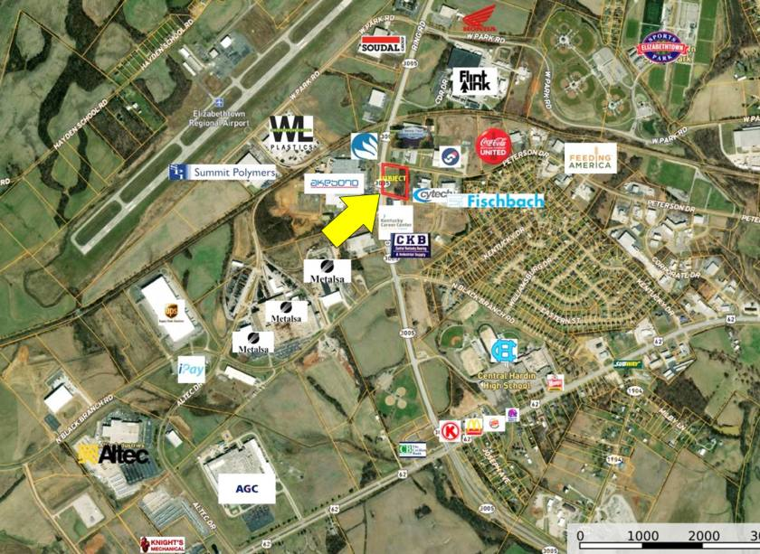
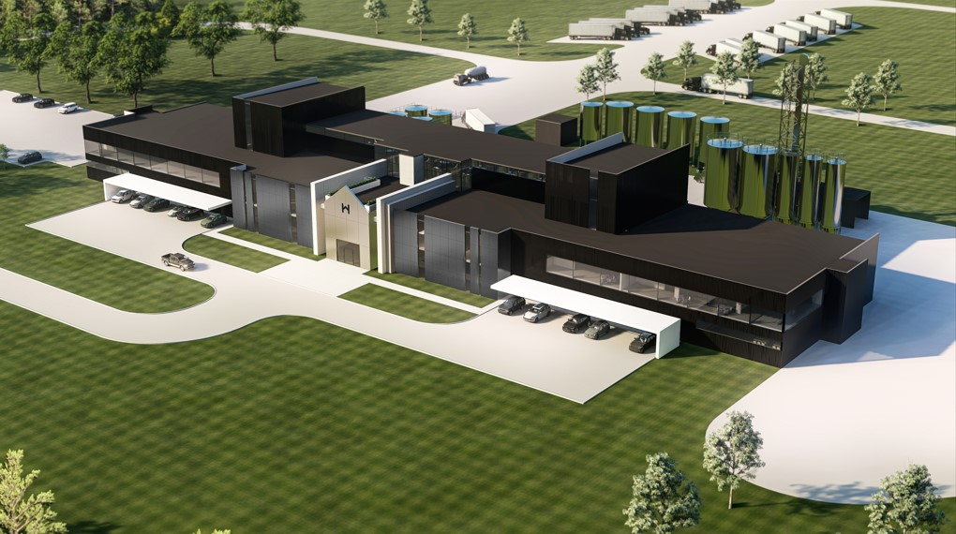
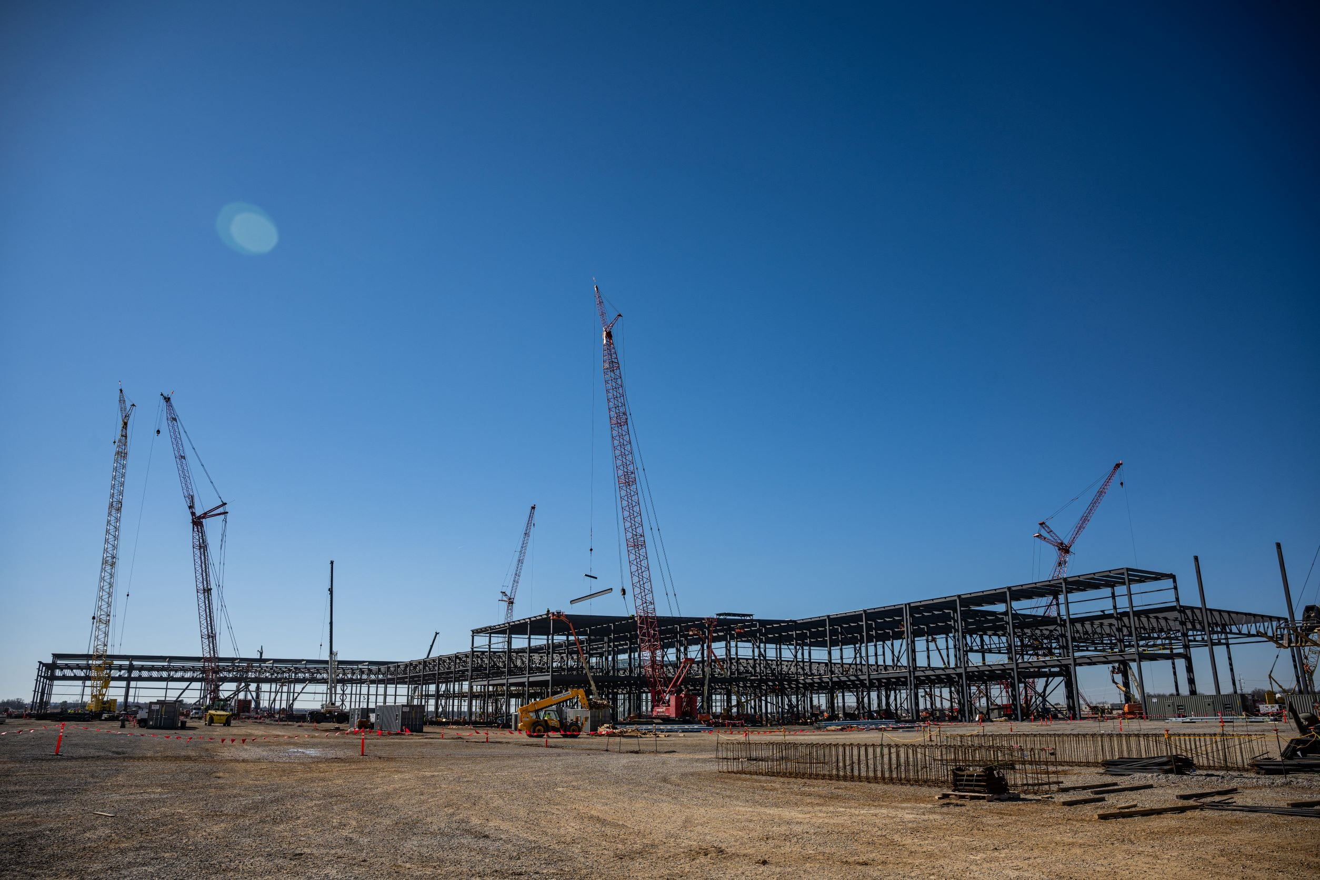
In addition to BOSK…
50 + existing manufacturers employ nearly 10,000 workers
Two BOSK supplier manufacturing centers currently under construction
$350 million distillery under construction

Slide 5
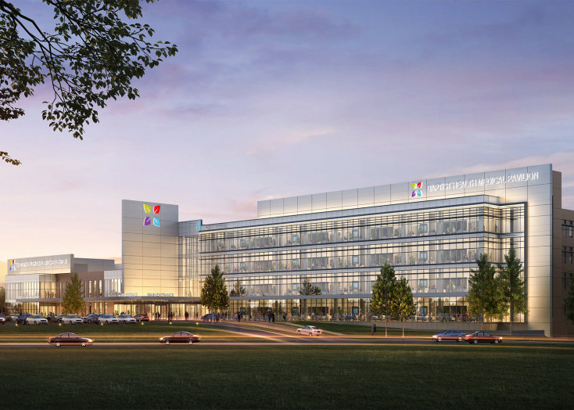
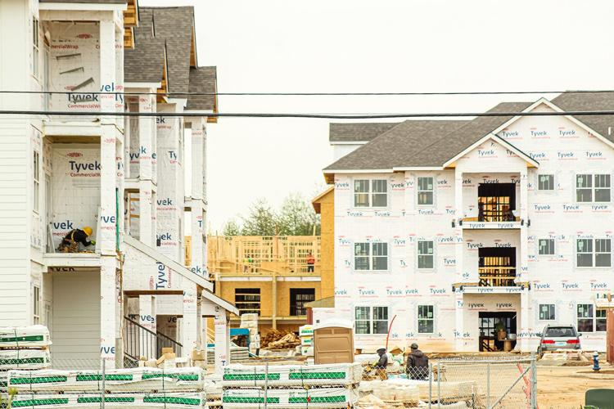
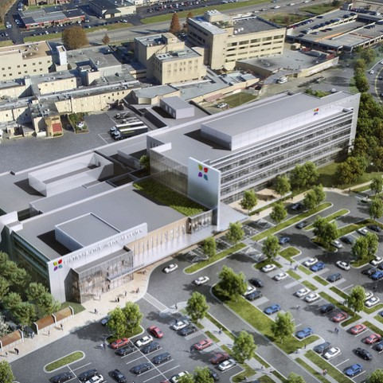
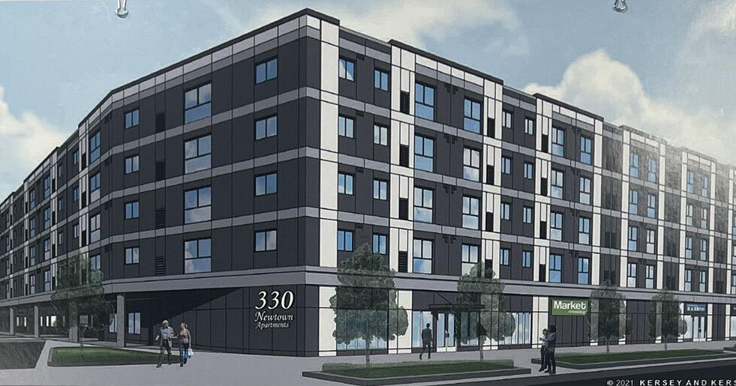
Growth throughout the city…
Baptist Health Hardin expansion will
nearly double the size of the campus
5,000 new apartments in the planning
and construction pipeline
Fourth fire station will be built in 2024
Two additional fire stations planned

Slide 6
Fort Knox – Kentucky’s Second Largest Employer – A Critical Regional Resource

Slide 7
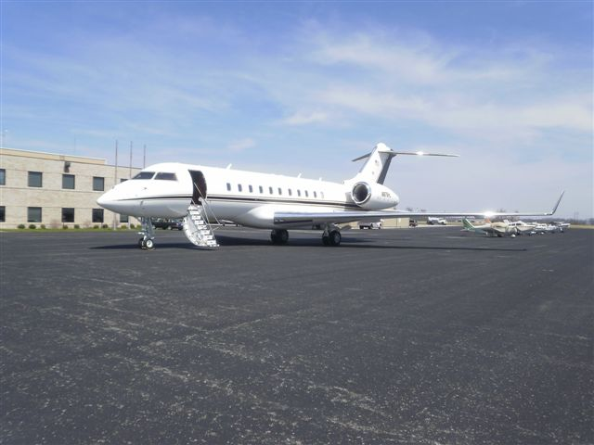
EKX Airport Infrastructure/Statistics
6,000 X 100-foot runway (weight-rated for CRJ-900 aircraft)
Parallel taxiway
MIRL runway lighting
ILS/LOC approach – runway 5
RNAV approach – runways 5/23
Approach/Departure Control: Louisville
CTAF

Slide 8
EKX Airport Infrastructure/Statistics
Aircraft based on field: 56
Single engine: 51
Multi-engine: 4
Helicopter: 1
Airfield Operations
Aircraft operations: 77 per day
42% transient general aviation
31% local general aviation
15% military
12% air taxi
Sources: www.airnav.com
www.virtower.com

Slide 9
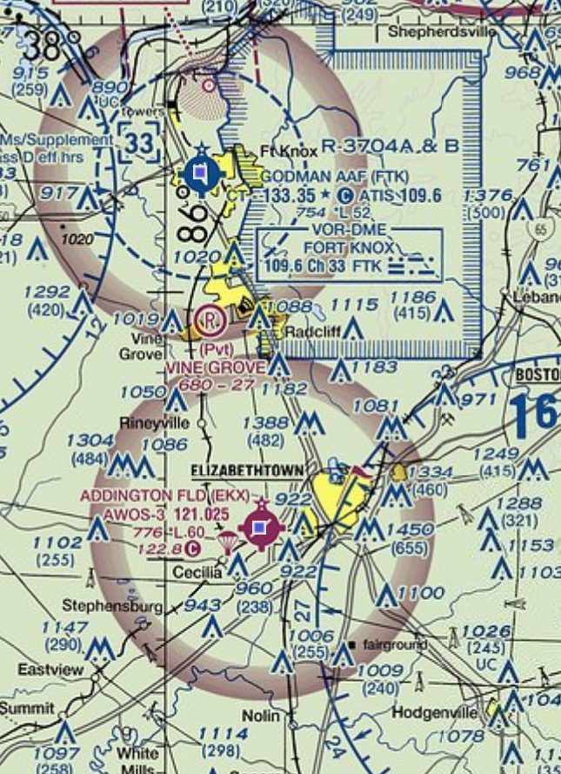
Elizabethtown, Hardin County and Central Kentucky
are growing rapidly…
EKX needs to grow to meet future needs
BOSK is facilitating efforts to establish passenger air service
between KY and TN manufacturing sites and beyond
Air cargo market demand study underway
Terminal renovation under development (can be
adapted for airline use)
New 7,800 X 150-foot runway under development
Existing runway can’t be extended to the West due to
structure impediments
Extended-centerline instrument approaches from the East
to the West (prevailing approach direction) intrudes on
Restricted Air Space at Fort Knox (site of new DAGIR range
which opens in 2024) – THIS CAN’T BE CHANGED!

Slide 10
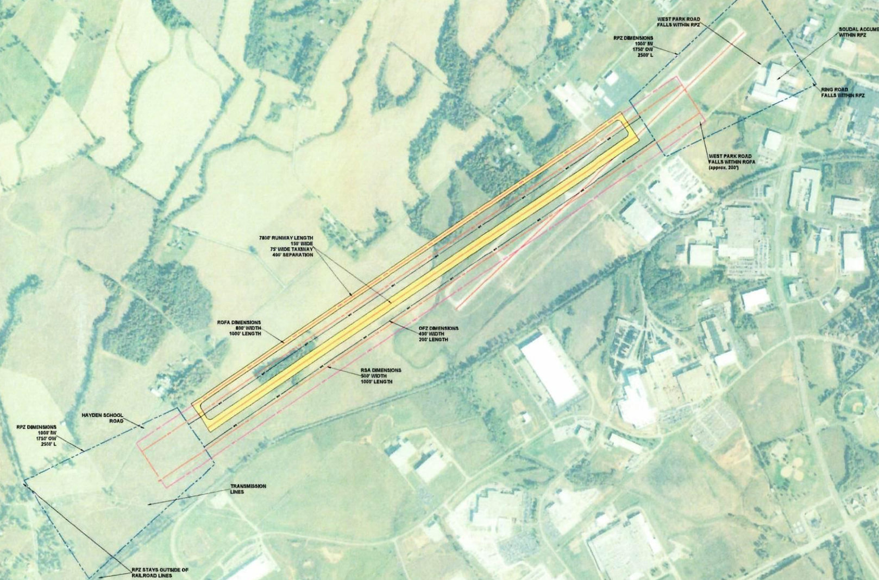
New EKX runway…
Capitalizes on available land
Opens up new heavy air cargo
opportunities for Central Kentucky
Will make “just in time” regional
manufacturing even more
timely throughout Central Kentucky
Will offer full ILS all-weather
approaches from both directions
Will provide critical new deployment/
materiel handling opportunities for
Fort Knox
Will serve as a catalyst for future
investment in Central Kentucky

Slide 11
Thank You!
Questions?

