Slide 1



Slide 2
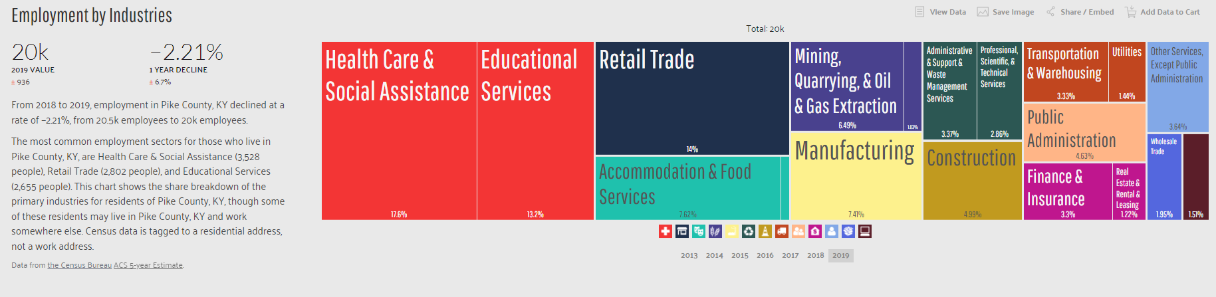
Pike County KY Industry - mirrors the rest of the eastern region
14.0%
17.6%
13.2%
PIKE COUNTY is the largest geographic county in Kentucky and 16th largest in population
PMC Represents:
49.8% of the
City of Pikeville’s
TOTAL OCCUPATIONAL TAXES
PMC ONLY Represents:
27% of the
PIKE County’s
TOTAL WAGES

Slide 3
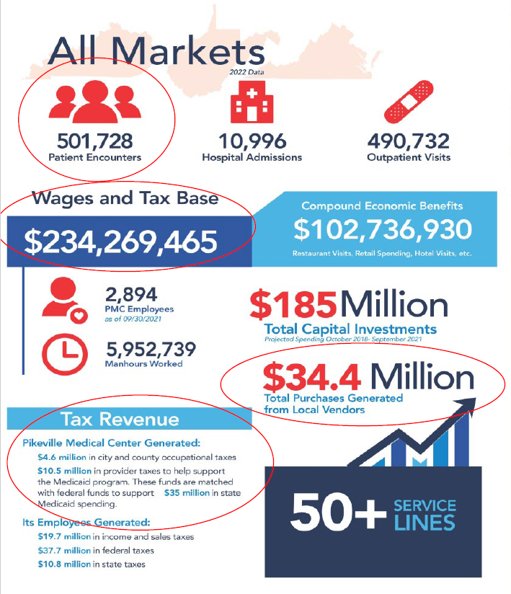
3,100

Slide 4

https://www.beckershospitalreview.com/workforce/us-faces-deficit-of-450-000-nurses-by-2025.html?origin=BHRE&utm_source=BHRE&utm_medium=email&utm_content=newsletter&oly_enc_id=6799J6353967F9A
US faces deficit of 450,000 nurses by 2025

Slide 5
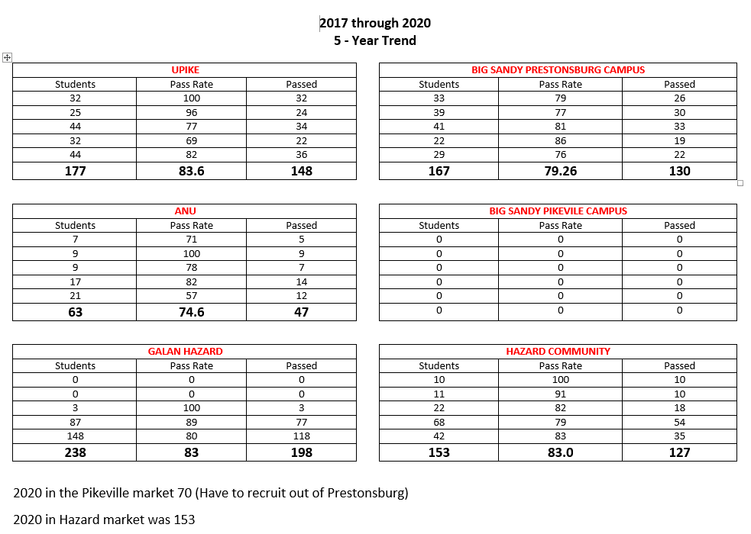
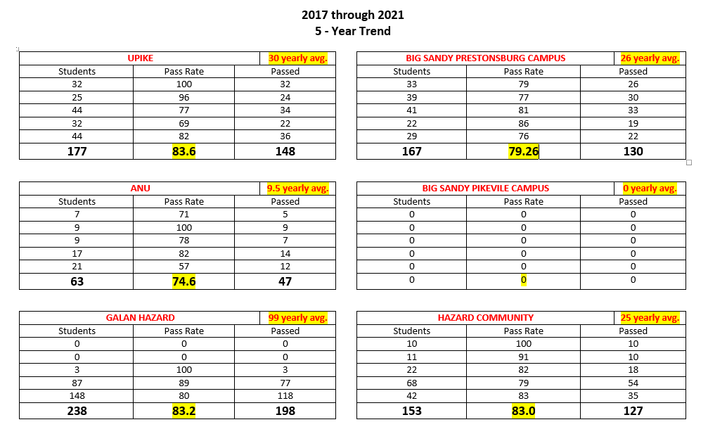
2021
Actual PMC turnover:
Pre & Post Covid Crisis
2021 = 152 PMC nurses turnover
Direct market produced only 48
2022 = 192 PMC nurses turnover
Direct market produced only 68
2017 39 nursing students enrolled-37 passed
2018 34 nursing students enrolled-33 passed
2019 53 nursing students enrolled-41 passed
2020 49 nursing students enrolled-36 passed
2021 65 nursing students enrolled-48 passed
2020
110 seats available
-vs-
2023
315 seats available

Slide 6


Pikeville Medical Center’s
Innovative Approach to Increasing Our Region's Talent Pipeline
Notes:
Hospitals nationwide are struggling to recover from the financial implications of the pandemic. Extension of federal stimulus money is not expected, and most hospitals are in a financial crisis, as a result. Hospitals are forced with difficult decisions to cut service lines, lay off employees or permanently close their doors.
PMC, like other Eastern Kentucky hospitals are facing unique challenges due to limited educational infrastructure in place to train healthcare professionals. As a regional healthcare facility, we needed to develop an immediate plan of action to prevent cutting service lines or laying off employees. Reduction of critical service lines would result in decreased access to care for the members of our community.

Slide 7
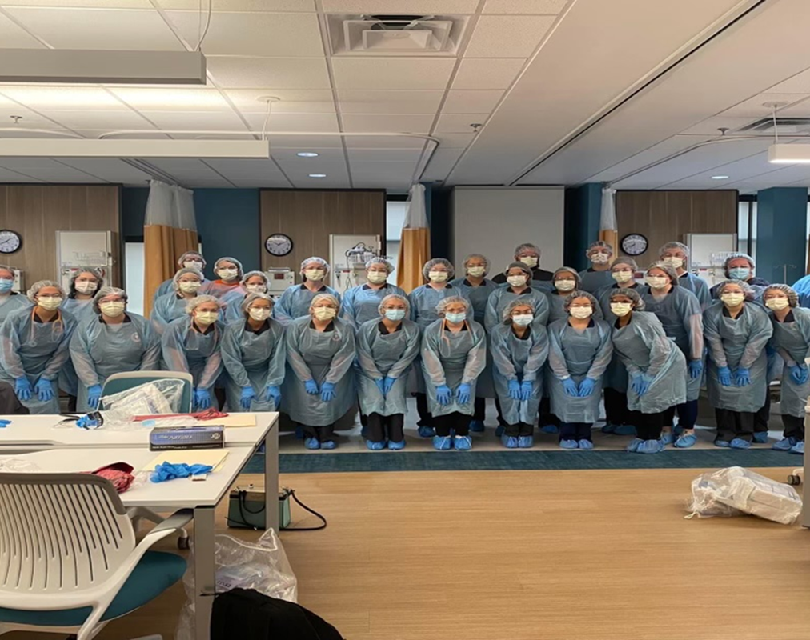
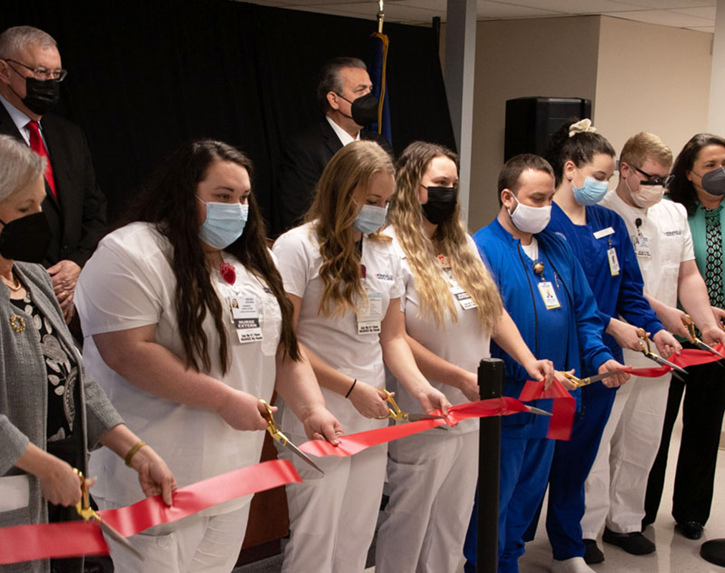


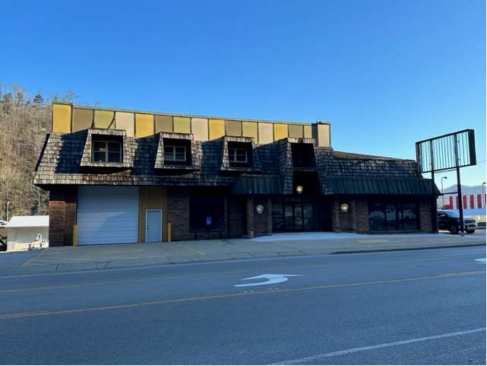




New & Expanded Nursing Partnerships Programs Created Under Project HEART
- The University of Pikeville Elliott School of Nursing grows nursing program by increasing enrollment from 60 to 120 students.
- PMC announced its partnership with BSCTC to create a space that houses the new Big Sandy Community & Technical College School of Nursing with 45 new seats .
- Galen College of Nursing and PMC announced a new LPN School on PMC’s campus, with 100 LPN seats.
PMC provided the building, construction and equipment.
ANU relocated onto PMC’s campus expanding their nursing to 50 seats while introducing new allied health offering.
PMC provided the building, construction and some equipment.

Slide 8

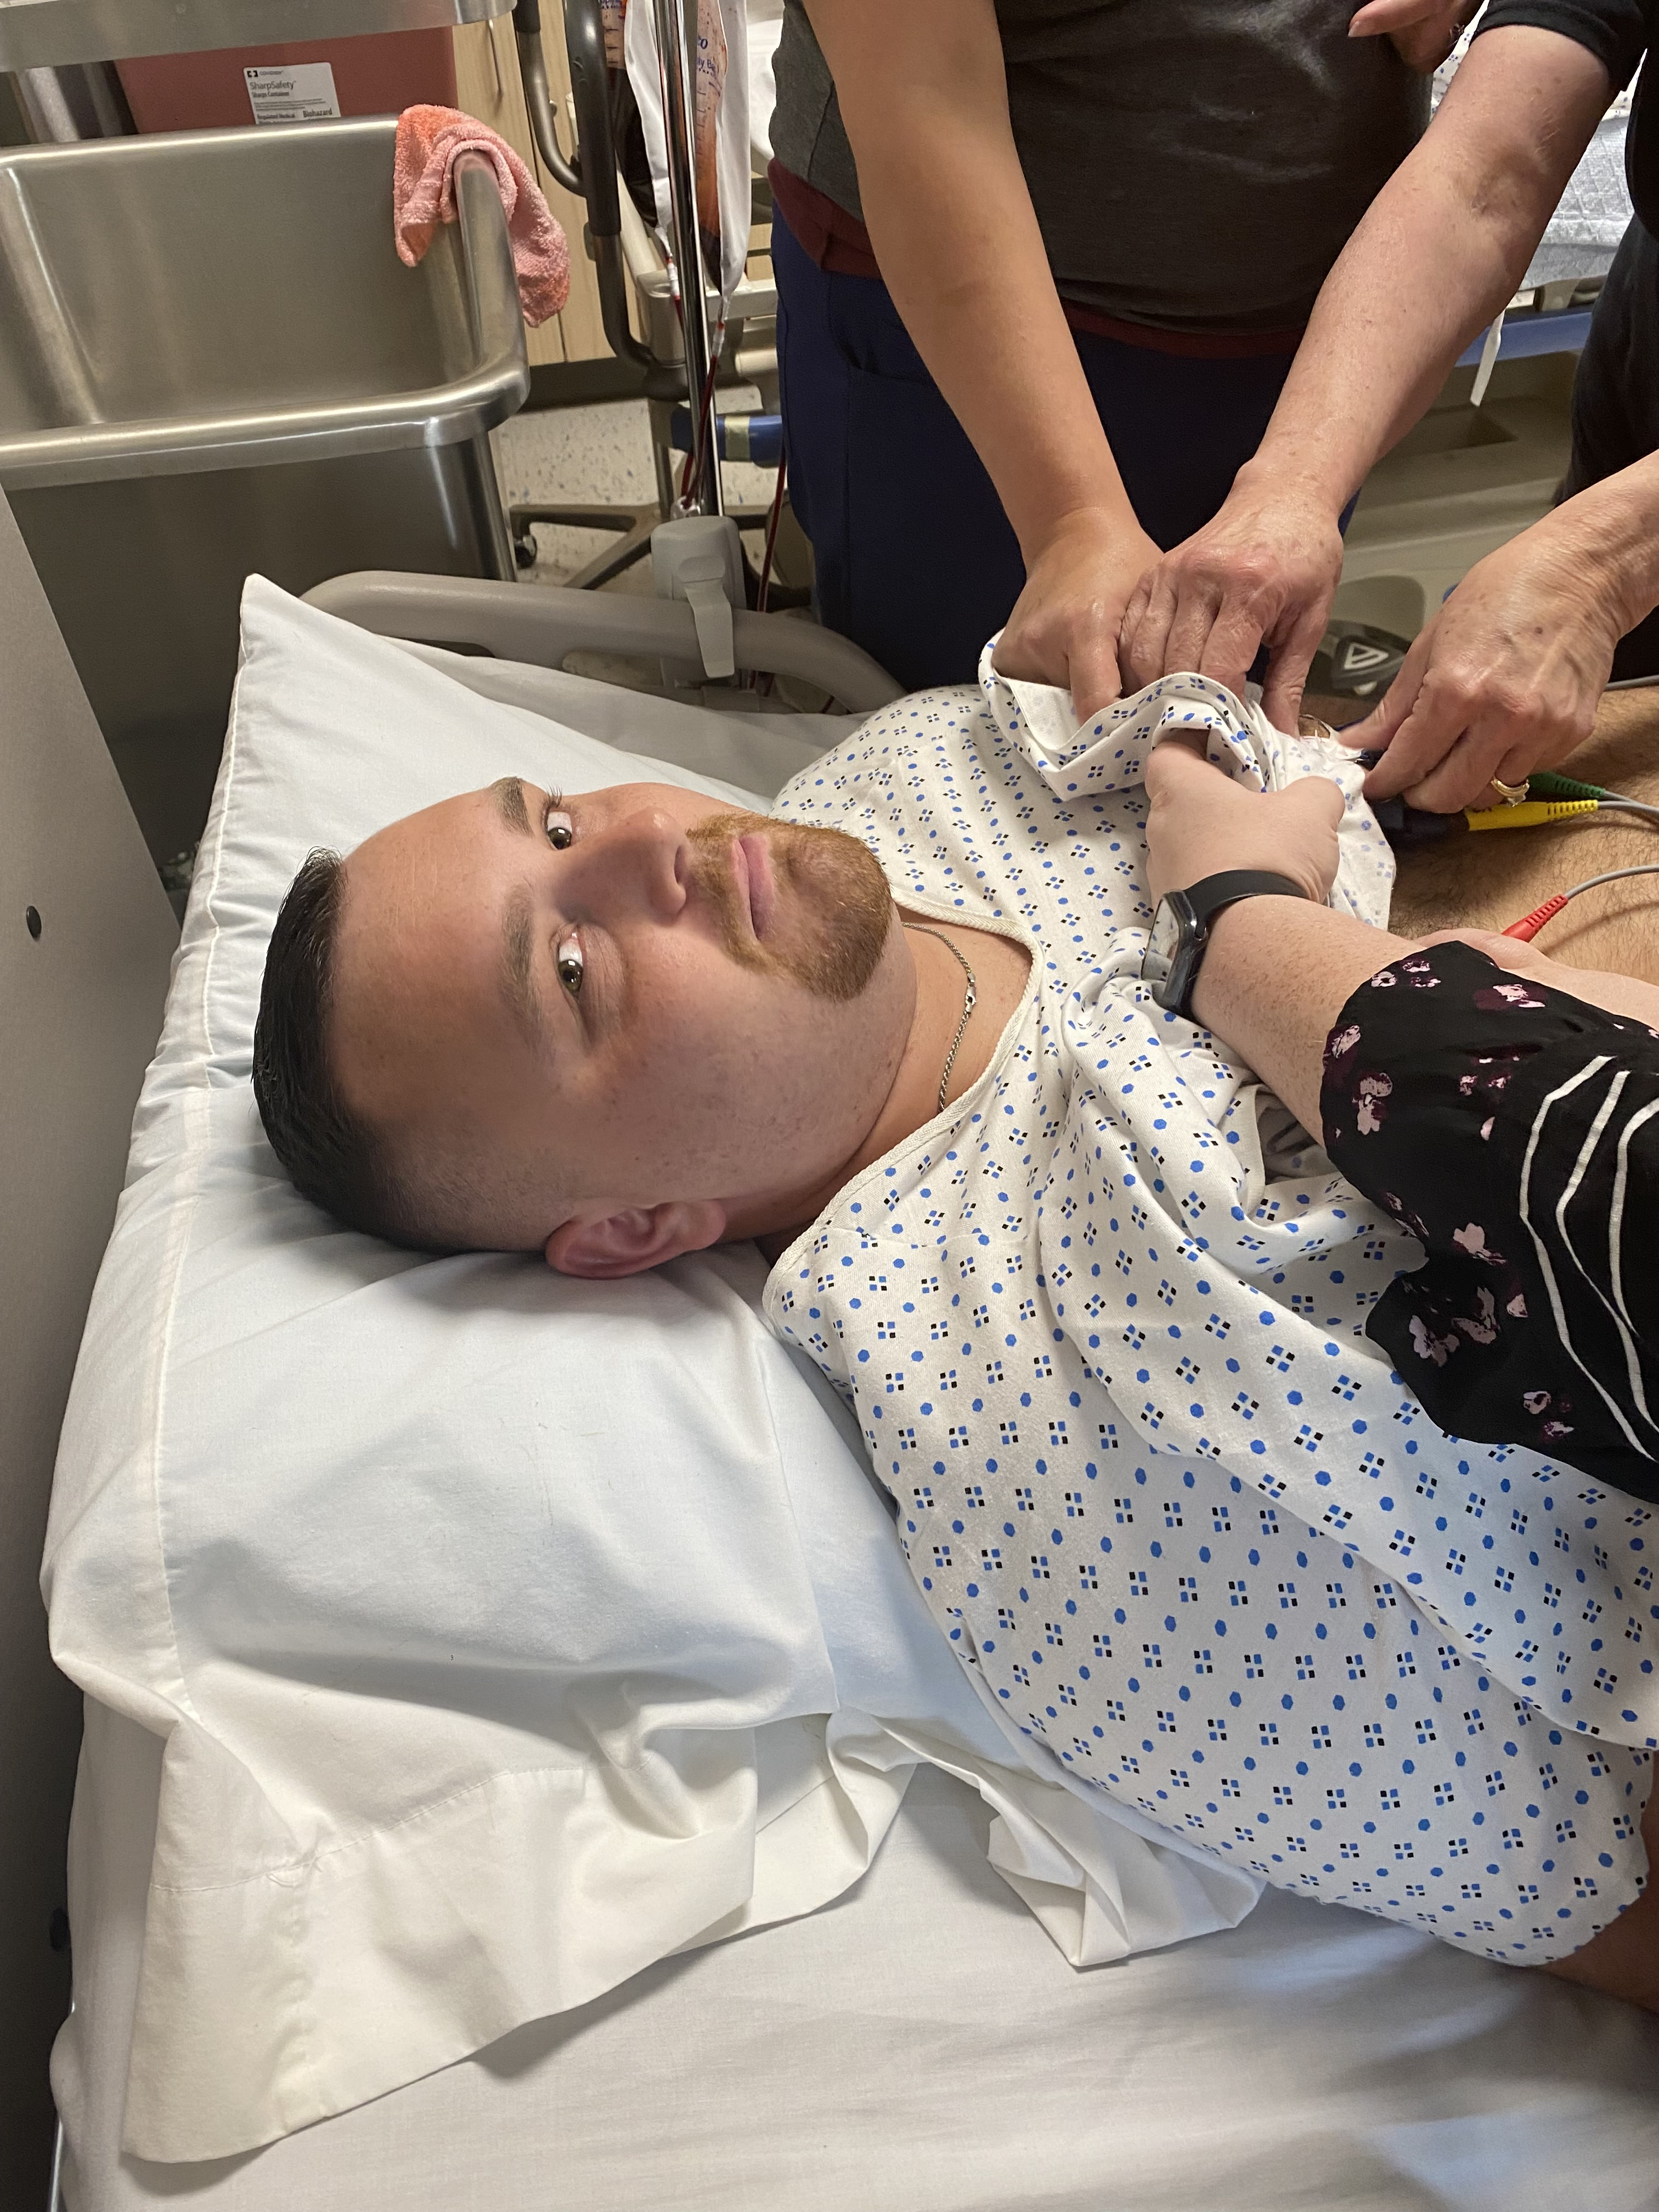
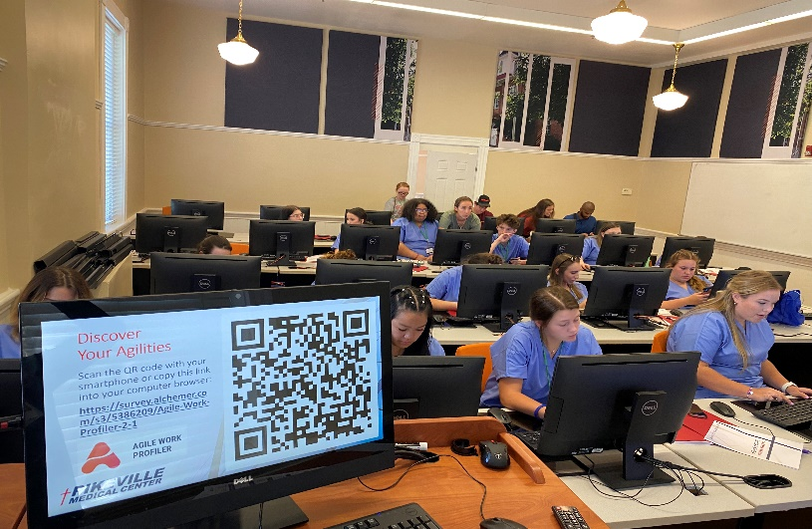
Development of Customized & On The Job Training Programs
  KCTCS TRAINS Program
    Patient Care Technician
    Medical Office Technician
    Pharmacy Technician
    Certified Nursing Assistant
  Vocational High School
    Pike County Schools awarded
    $14.8M grant for new vocational
    school
  Paramedic Program
  EMT Program

Slide 9
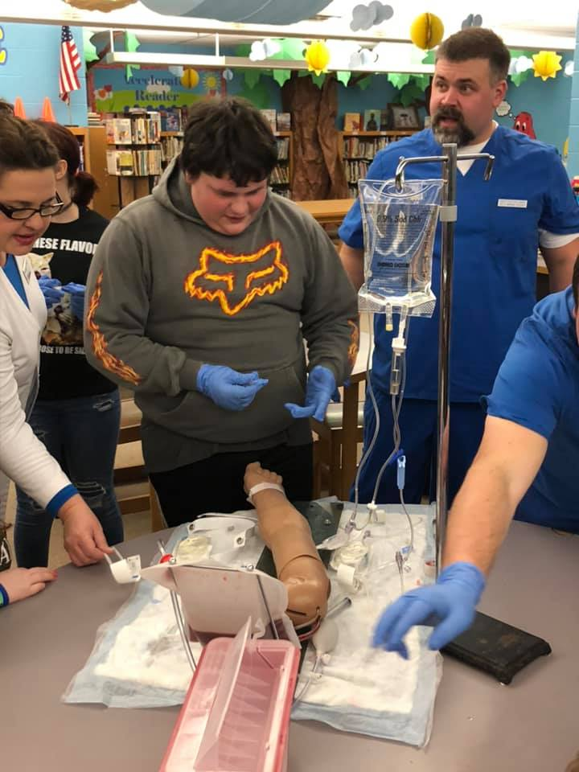

Target Grade Level:
My FUTURE Fridays is designed to connect and invest in students in 8th grade. The 8th grade students in turn teach and share their newly acquired knowledge to their peers in 7th and 6th grades.
Instructors:
College Professors / Pikeville Medical Center Staff sharing their passion for their expertise through hands-on activities and heartfelt discussion.

Slide 10

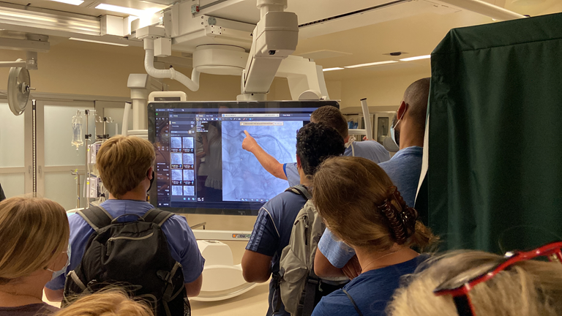
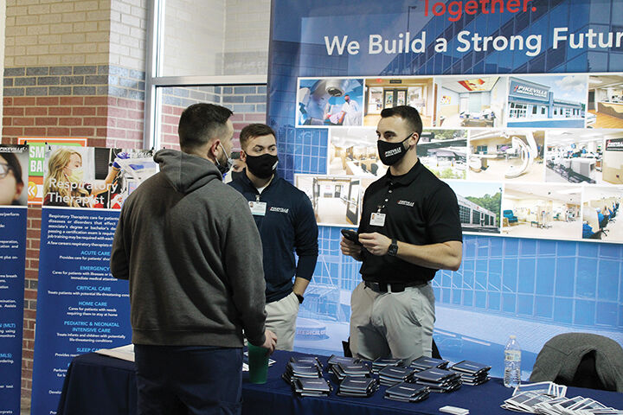
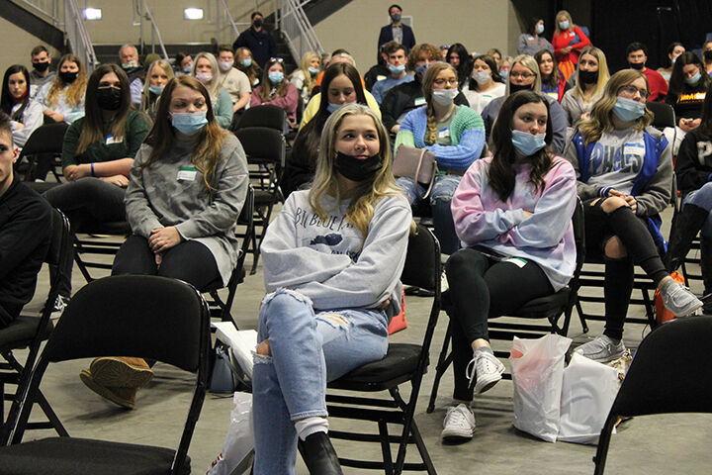
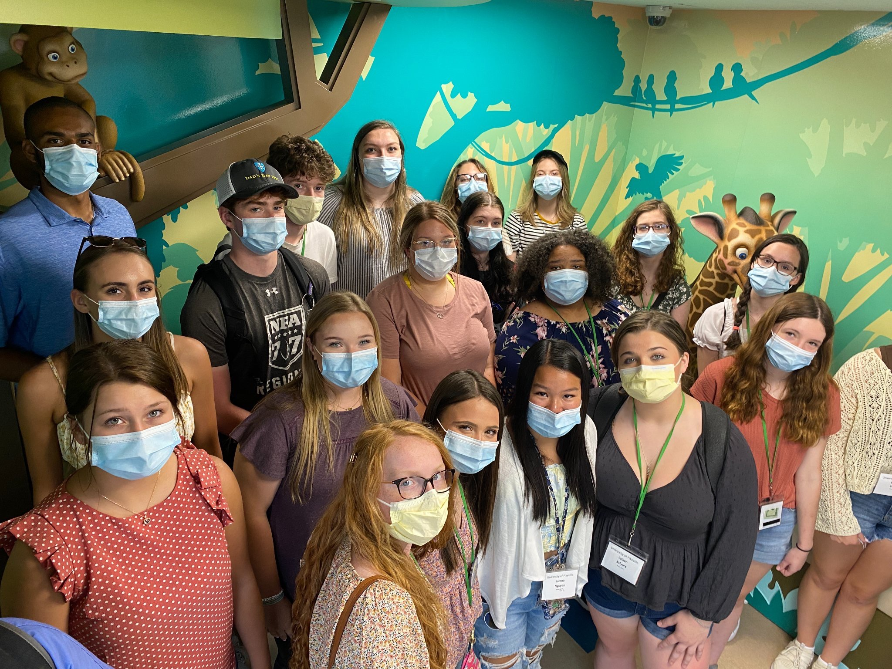
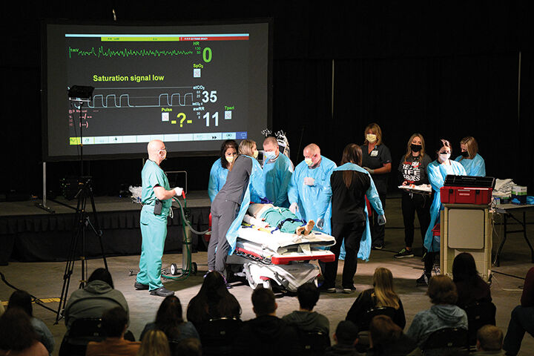
SOAR
Regional Healthcare Career Fair
Hundreds of East Kentucky high school students gathered at Appalachian Wireless Arena to take part in a healthcare fair on Feb. 25 at the Appalachian Wireless Arena.
SOAR
Appalachian Nursing Academy
For two weeks, selected students throughout the SOAR region are selected to participate with a joint partnership between SOAR, UPIKE and PMC to teach most basic nursing techniques, with a scholarship offering.

Slide 11
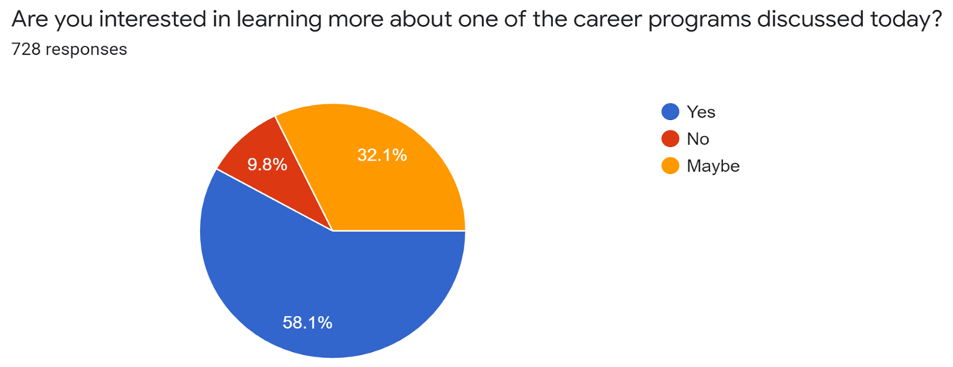
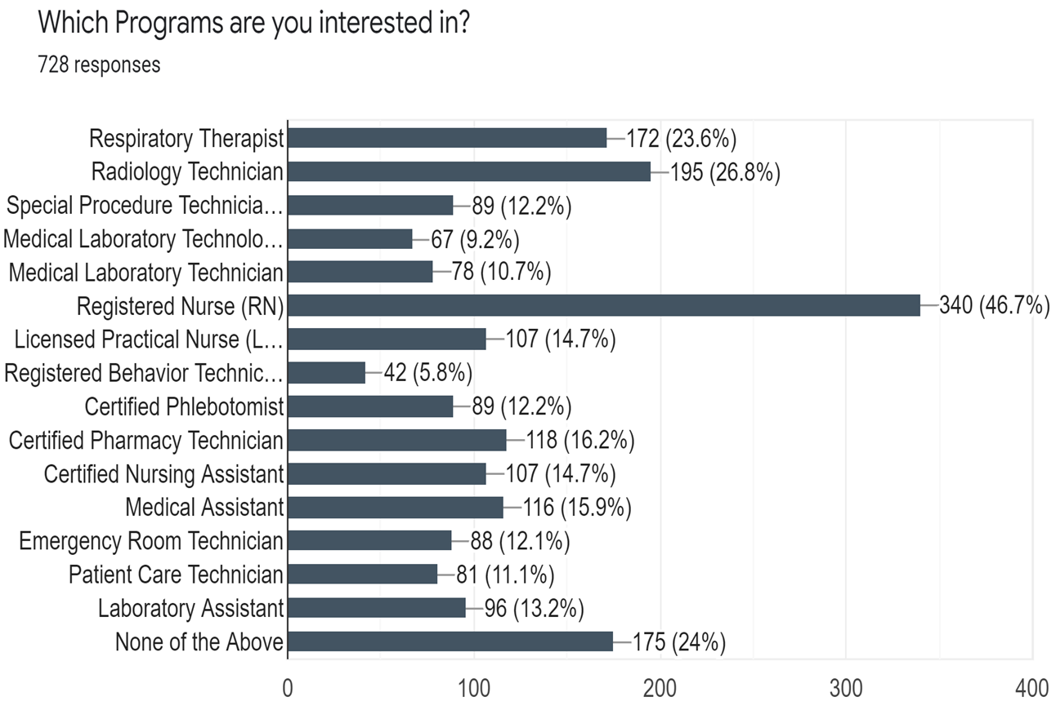
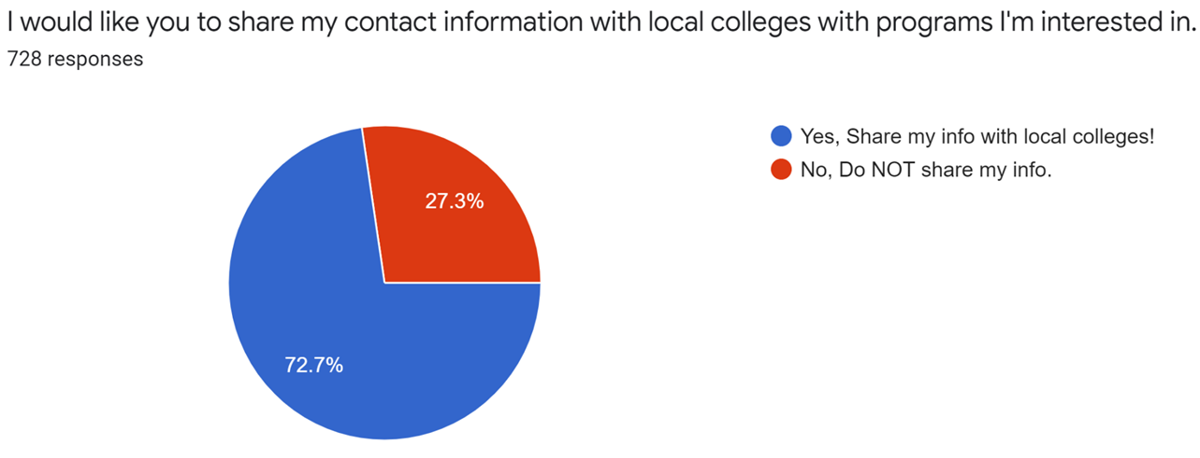

Slide 12
Project HEART Achievements
Respiratory Tech
TOTAL NEW RESPIRATORY SEATS 30
Nursing Seats
TOTAL NURSING SEATS 315
Paramedic
TOTAL NEW PARAMEDIC SEATS 32
Certified Nursing Assistant:
TOTAL NEW CNA SEATS 50
EMT
TOTAL NEW EMT SEATS 12
Radiologic Tech
TOTAL NEW RAD TECH SEATS 26
Pharmacy Tech:
TOTAL NEW PHARMACY TECH SEATS 20
Medical Lab Tech
TOTAL NEW MLT SEATS 35
Plus Many Other Programs

Slide 13
Project HEART Achievements
550 Medical Career
Seats
NOW AVAILABLE

Slide 14


Slide 15
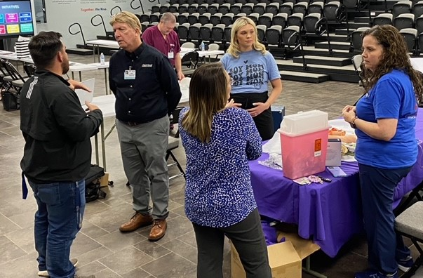
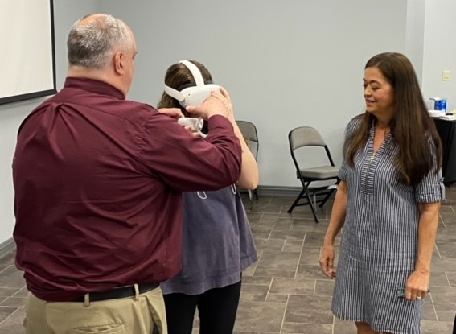
TEACHER Focus Group
May 12, 2023
12 teachers from area schools
Early & Often
Non-clinical opportunities
Age appropriate activities

Slide 16
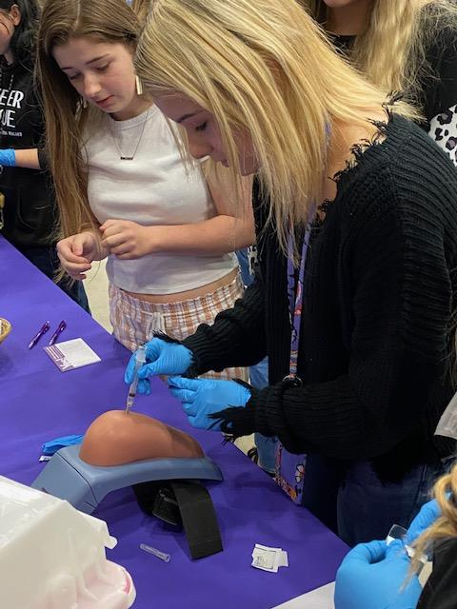
STUDENT Focus Group
May 15, 2023
High School students
Excited with salary potential
Academic & career guidance
Surprised at number of jobs

Slide 17
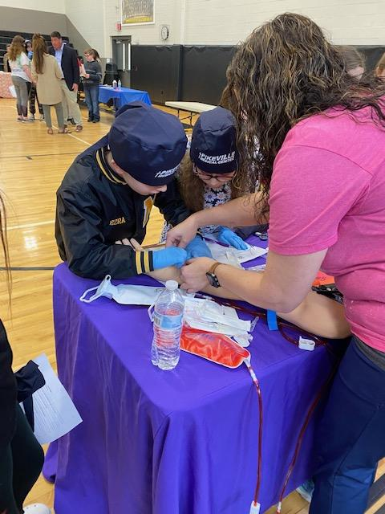

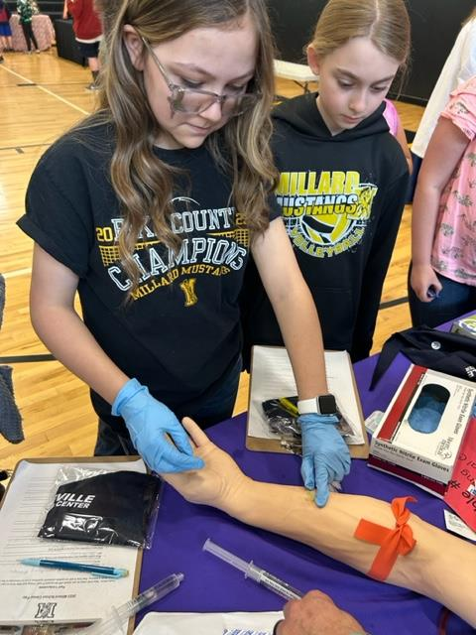
GRADES 6-8
Career exploration
SCHOOL CAREER FAIRS
CHALLENGER LEARNING CENTER
MY FUTURE FRIDAYS
INITIATIVES

Slide 18
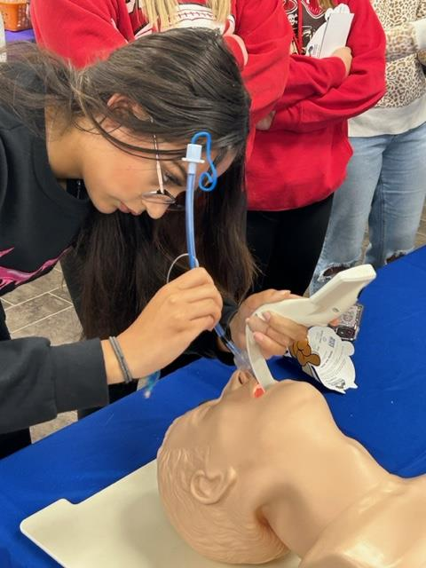
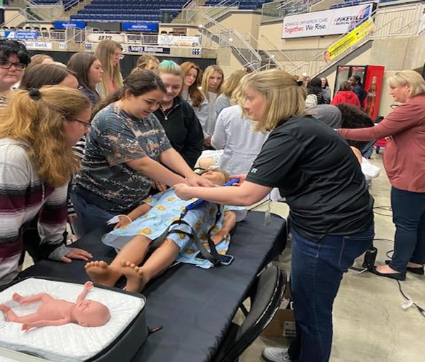
Grades 9-12
HEALTHCARE CAREER SPOTLIGHTS
HOSPITAL TOURS
JOB SHADOWING
VOLUNTEER
JAG
PART-TIME EMPLOYMENT
SCIENCE CLASSES
ATC
Health Science
CAREER & ACADEMIC GUIDANCE

Slide 19

TEACHER CATALOG
All K-12 Programs
Available dates
Links to sign up

Slide 20
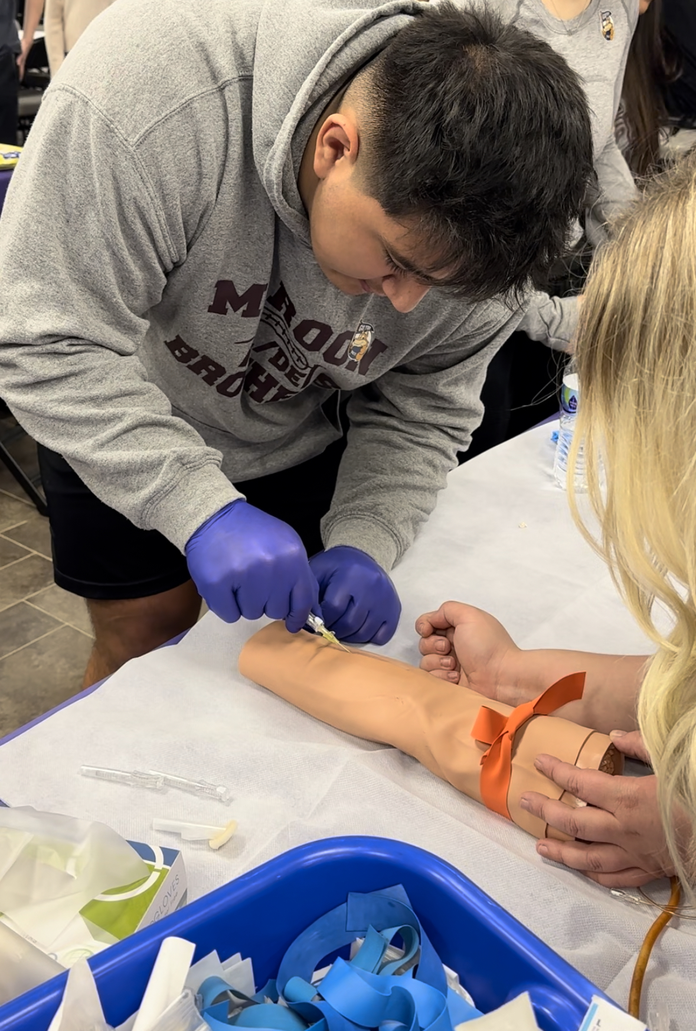
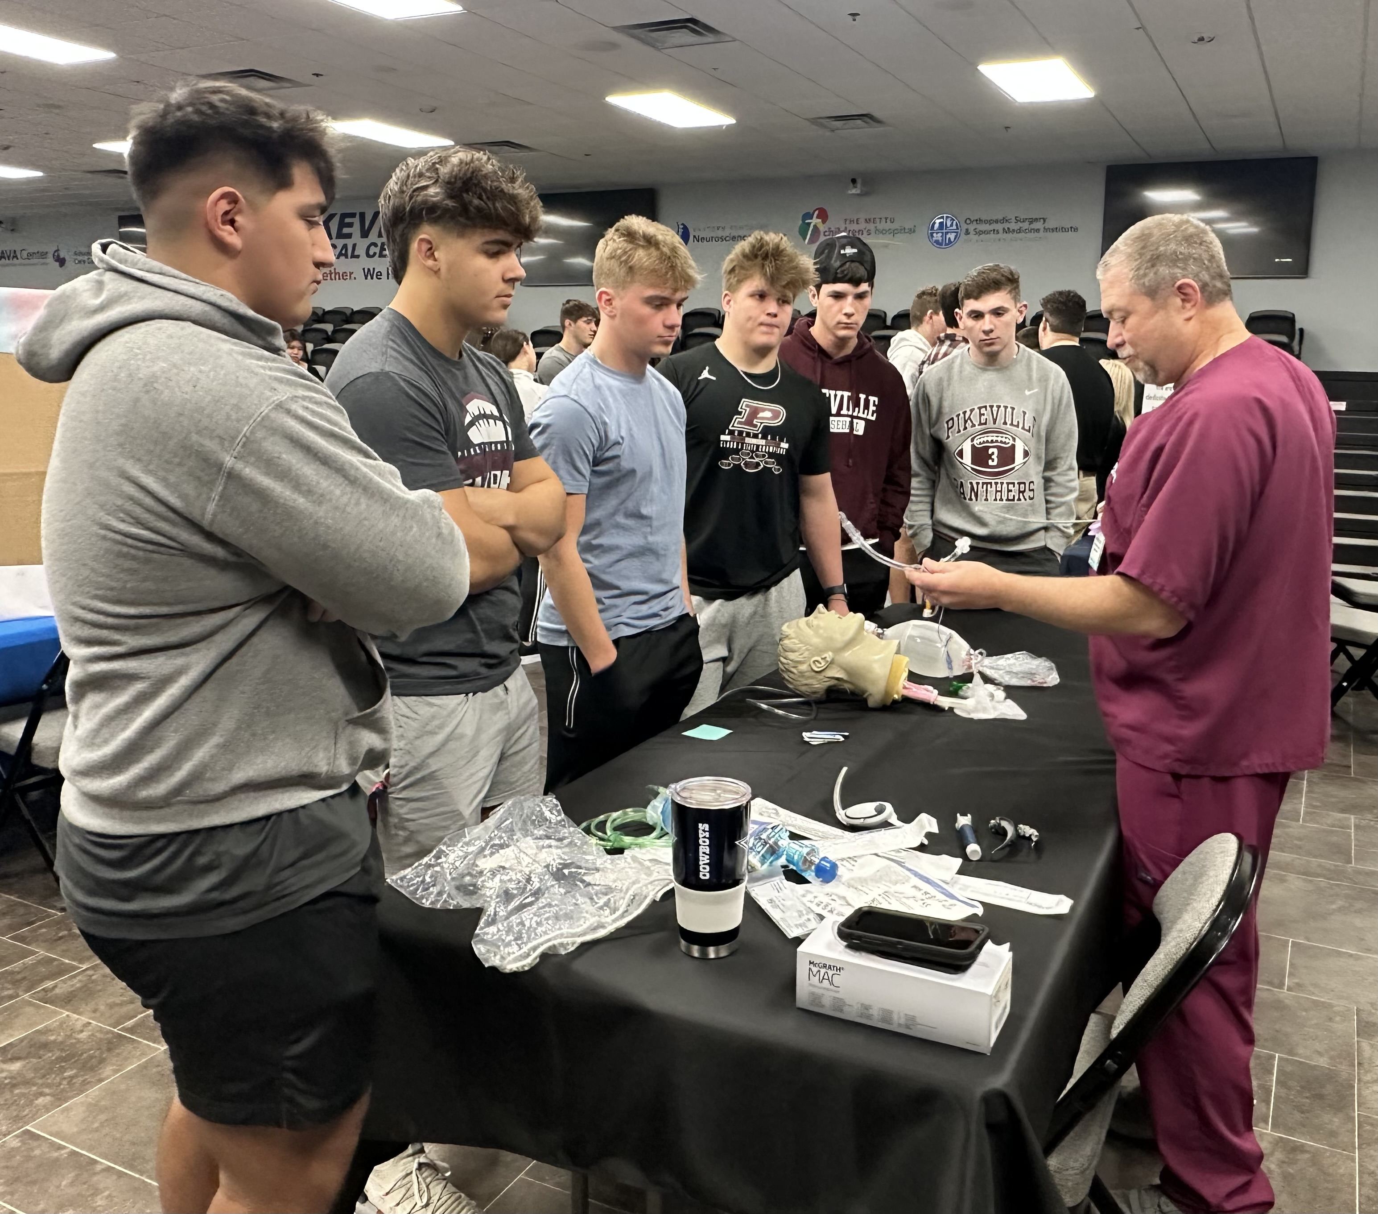
Beyond the classroom
MEDICAL ACADEMY
COLLEGE VISITS
SchoolMate App
PROGRAM DEVELOPMENT
SOCIAL MEDIA
TEACHER OF THE YEAR
INTERNSHIPS
CAREER COUNSELING
TRAINS

Slide 21



College classroom visits
100 Level Science Classes
Create Interest
Recruitment
BEYOND THE CLASSROOM

Slide 22




SchoolMATE APP
School Profile
Personal Profile
Matching Options

Slide 23
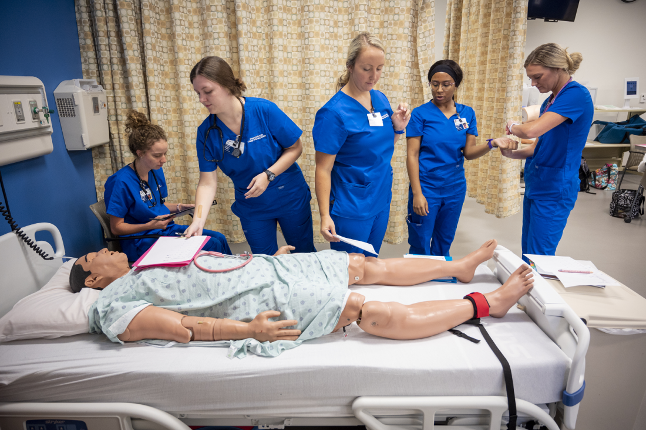
KCTCS-TRAINS PROGRAM
Workforce Development program funded by the
General Assembly
75/25 funding match
plus a 10% admin fee
PMC designs job specific training programs

Slide 24
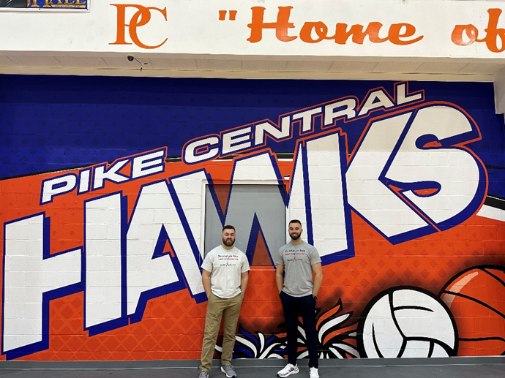
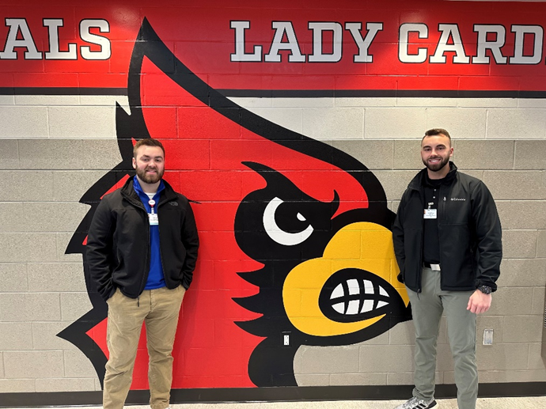
Recruitment Approach
Recruitment efforts are categorized into three main components:
High School Visits
  Job Education
  Educational Assistance
  Great jobs right here at home
  College Visits
    Students will be ready to work within months
    We can secure our future with Educational Assistance – Students can be paid right now!
  Traditional Recruitment
    Job Listings through PMCJobs & LinkedIN
2023
Visited 15 school
Received responses & data from 1,197 students

Slide 25
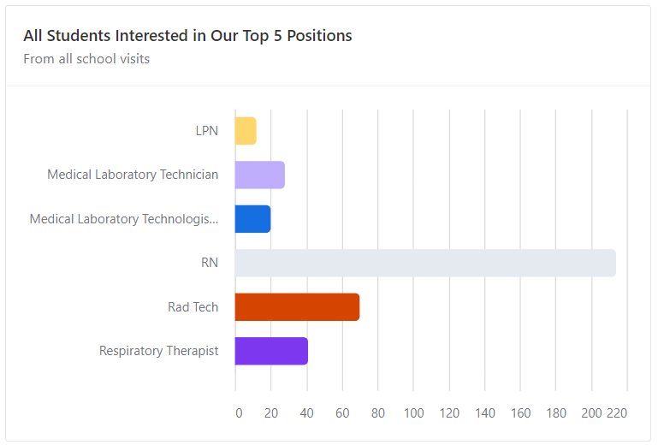

Slide 26
PMC’s Educational Assistance Program:
Offered to college students that are in one of our six pathways
  RNs: Up to $20,000 for 3-year agreement
  LPNs: $2,500 for 1 year agreement
  RN to LPN Bridge: Up to $20k for 3-year agreement
  MLT/MLS: $10,000 for 3-year agreement
  Rad Tech/SPT: $10,000 for 3-year agreement
  RT: $10,000 for 3-year agreement
  This offering has led to huge successes in new-grad recruitment!
  Far better investment long term then hiring agency staff.

Slide 27

2023 College Recruitment Visits
The Recruitment team is actively visiting local colleges to speak with the following programs:
  Nursing
  Radiology
  Medical Lab Technologists
  Respiratory Therapy
  During the visits we inform the students about PMC’s
    Educational Assistance
    Benefits
    Pay
    Shifts & Additional Hospital information

Slide 28


Medical and Dental Insurance
Life Insurance
Long-Term Disability
Death Benefits
Voluntary Benefits
403(b) Retirement Plan
7 paid national holidays
2 personal holidays
Vacation or PTO time
12 annual sick days per year
Payroll Deduction

Slide 29
Licensed Staff Nurse Sign-On Bonuses
  Staff RNs
    1 Year: $10,000
    2 Years: $15,000
    3 Years: $20,000
    3 Years Med Surg: $20,000 + $500 bi-weekly bonus
    4 Years Med Surg: $30,000
  LPN
    1 Year: $2,500
    1 Year Med Surg: $2,500 + $300 bi-weekly bonus
  PMC also offers Refer-A-Friend bonuses

Slide 30




Slide 31
Overall RN Recruitment
RNs | Number
RNs Hired in 2022 | 156
RNs Hired in 2023 as of 7/19 | 129
Student RNs Educational Assistance | 65
Student RNs Upike | 9
Net Total Since 2022 | 359

Slide 32
Job Fairs & New Job Fair Process
Job Fairs have now become a one stop shop for candidates. Candidates now complete:
  Interviews with department directors, managers, or recruiters
  Recruiters make on the spot offers if selected
  New Hire paperwork
  Badge Pictures
  Physicals by Employee Health
New Hiring Process Benefits
On 6/1 Recruiters were given a goal of 150 New Hires in a month
On 7/5 PMC recruitment team crushed the goal with 211 New Hires!
Had our largest single week new-hire orientation class of 36 people

Slide 33



Slide 34

FACT: No sector in our region is creating as many career opportunities as healthcare.
In eastern Kentucky it is
HEALTHCARE
Smart Investment
Incentives
Tech Educational
Training
Jobs
Distributed wealth
Better Health
Greater Return on Investment

Slide 35




