Slide 1

Kentucky Office of Adult Education
Reentry Employment Services

Slide 2

Presenters
Aaron Poynter, Director, Reentry and Employment Services
Mike Uptegraff, Sr. Coordinator, Reentry and Employment Services

Slide 3
Topics to Discuss
Reentry and Employment Services Branch
Putting Kentuckians First
Operations
Data & Statistics
Notes:
Reentry and Employment Services Branch/ Putting Kentuckians First
Mission statement and goals
Timeline and growth
Operations
Putting Kentuckians First
Identification Program
Operations with local/regional detention centers – Pre-Release Classes, Reentry Bootcamps, Credential Training Programs
Behavioral Health Conditional Dismissal Program
Data & Statistics

Slide 4
Reentry and Employment Services Branch
Mission Statement
  Empowering Kentuckians to achieve personal success, met goals, and establish self sufficiency through the Putting Kentuckians First initiative which provides employment, recovery resources, education and training, career services, vocational rehabilitation, and court-ordered programs focused on diversion and re-entry pathways to Kentucky’s workforce.
Vision
  Removing barriers for those in diversion and reentry pathways to Kentucky’s workforce through collaborative resource alignment among state, regional, and local agencies to help Kentuckians achieve their education, employment, and training goals effectively and efficiently.
Notes:
We develop, facilitate and deepen the effectiveness of the partners and organizations focused on the reentry populations, while building a sense of community for participants and providers.
Alignment of State, Regional and Local Partners to serve the Reentry Population – Addressing "Reentry and Recidivism" via by diversionary/ alternatives to confinement for individuals at the local level as a preventative measure and serving individuals who are returning to society.

Slide 5
Reentry and Employment Services Branch
In Summary
  Develop, facilitate and deepen the effectiveness of the partners and organizations focused on the reentry populations, while building a sense of community for participants and providers.
  Alignment of State, Regional and Local Partners to serve the Justice Impacted Population.
  Addressing "Reentry and Recidivism" via diversionary alternatives to confinement for individuals at the local level as a preventative measure and serving individuals who are returning to society.
Notes:
We develop, facilitate and deepen the effectiveness of the partners and organizations focused on the reentry populations, while building a sense of community for participants and providers.
Alignment of State, Regional and Local Partners to serve the Reentry Population – Addressing "Reentry and Recidivism" via by diversionary/ alternatives to confinement for individuals at the local level as a preventative measure and serving individuals who are returning to society.

Slide 6
Timeline and Growth
  2019 – Statewide Reserve Application submitted for Cumberlands & South-Central Workforce Boards Personnel
    Targeted local judicial level
    Focus on employment
  2020-2022 – Expansion and refinement of best practices
    Putting Kentuckians First Pilot
    Targeted local expansion
  2023 – Elevation to the Department of Workforce Development’s Office of Adult Education
    Hiring of additional staff
    Continued expansion
  2024 – Reentry and Employment Services Branch

Slide 7
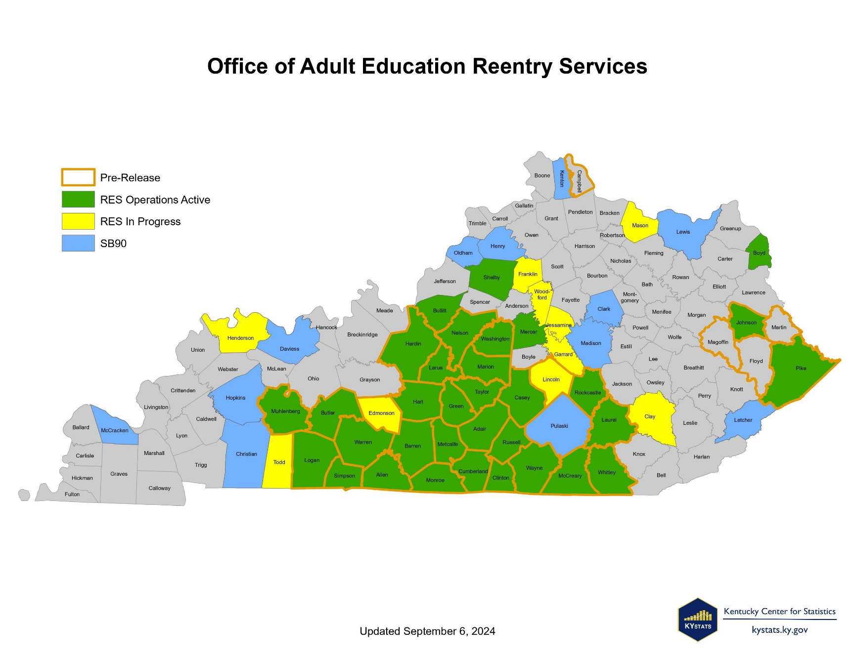

Slide 8
Reentry and Employment Services (RES) Operations
Putting Kentuckians First
  Facilitate targeted orientation classes partnering with local judicial entities (Judges, Jailers, County Attorney Offices, Probation and Parole, Specialty Courts) to create referral and accountability pipelines for individuals using a county-by-county approach.
Behavioral Health Conditional Dismissal Program (SB 90)
  Oversee a component of SB 90 which provides eligible Kentuckians with a behavioral health disorder treatment and recovery support services instead of incarceration, resulting in dismissal of the charges upon successful completion.
ID Services for Individuals enrolled in Reentry Activities/KYAE
  Coordinate with the Kentucky Department of Transportation to facilitate the completion of ID requests for individuals participating in a credentialed training program, Adult Education program or work-release program.
Notes:
Fix spacing

Slide 9
RES Operations for Incarcerated Individuals
Pre-release Classes in Local/Regional Detention Centers
  An educational forum is presented at local detention centers to individuals who are 30/60/90 days from release.
  The pre-release classes are open to both state and county inmates.
  Organizations are allowed into the facility to present information to individuals that will assist them on their transition back into society.
Credential Training in Local Detention Centers
  Plan, coordinate and fund credential training programs at local detention facilities in with local adult education provider and community and technical college.
Apprenticeship & Pre-Apprenticeship Training (Adult Institutions)
  Partnership with Kentucky Department Of Corrections to offer pre-apprenticeship training in Adult Institutions beginning with Trade Unions.

Slide 10
Reentry and Employment Services
Customer Centered Design
    Participants – Align resources, meeting participants where they are
    Employers – Pipeline development, employer education and support
County Specific Approach
    Ensure the most relevant and accessible resources and support are available
    Judicially Motivated vs. Punitive

Slide 11
Reentry and Employment Services Data
More than 2,100 individuals served/impacted in FY 24:
  1,004 incarcerated individuals served with pre-release classes
  420 enrolled in Putting Kentuckians First
  318 enrolled in SB 90
  400 provided with general employment referral assistance (Non-PKF Referrals)
  103 identification credentials obtained
  70%-80% employment retention
  100% Graduation rates from Credential Programs in Detention Centers #5, #6, #7 – Welding, OSHA, CPR, Forklift.
Notes:
83% increase in referrals
82% of referrals participating in Putting Kentuckians First

Slide 12
FY 25: Impact to date
Data as of 11/8/2024
400 enrolled to Putting Kentuckians First – 95% of total FY24
295 – Individuals accepting/participating in Putting Kentuckians First (73.75%)
186 Positive Employment Outcomes – 46.5 Jobs per Navigator
801 incarcerated individuals impacted
77 individuals obtained Identification

Slide 13
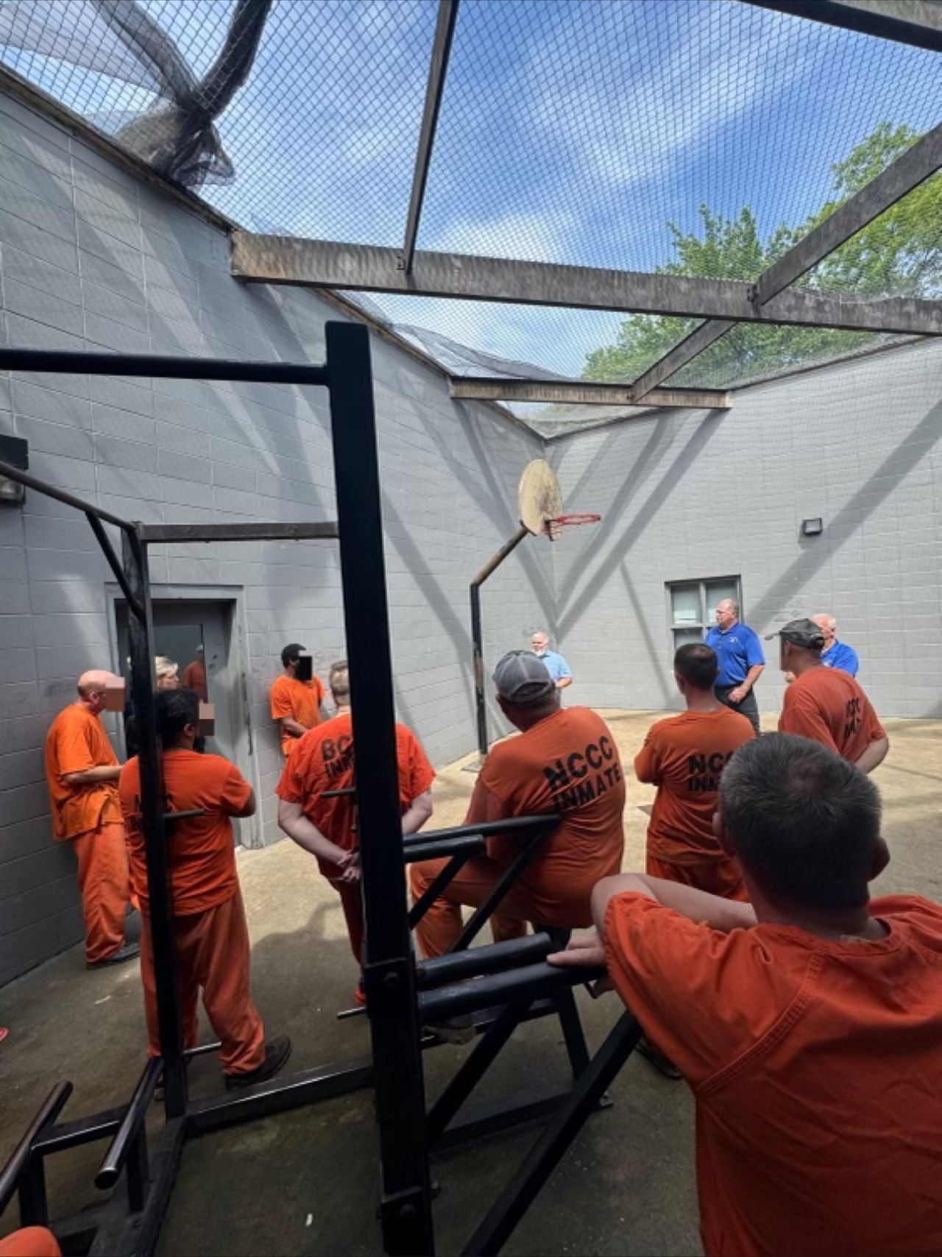
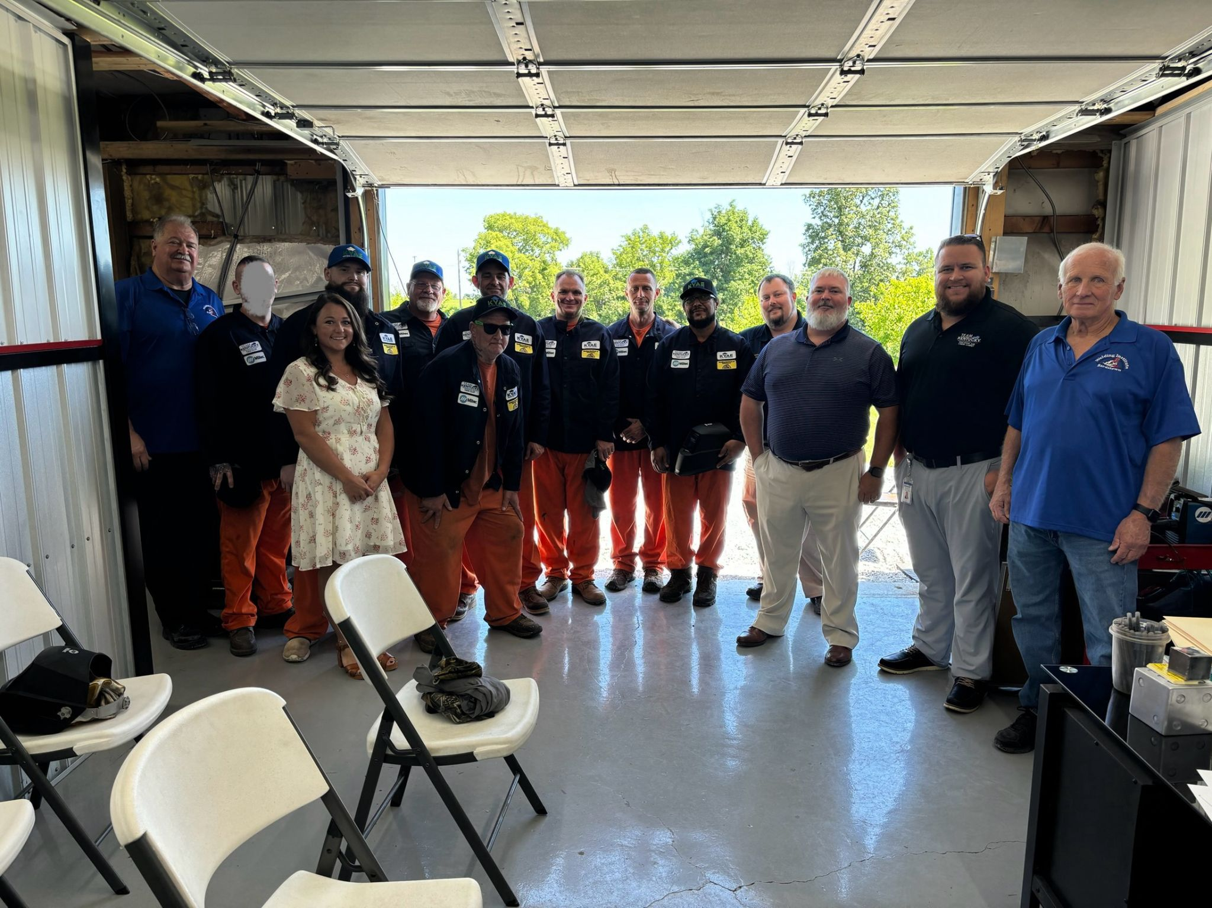
Nelson County Welding Cohort
Notes:
July 2024 – First photo was the information session – 2nd photo was graduation day
2 individuals have been released and within 48 hours of their release they were employed. Salary data?

Slide 14
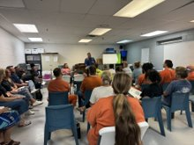
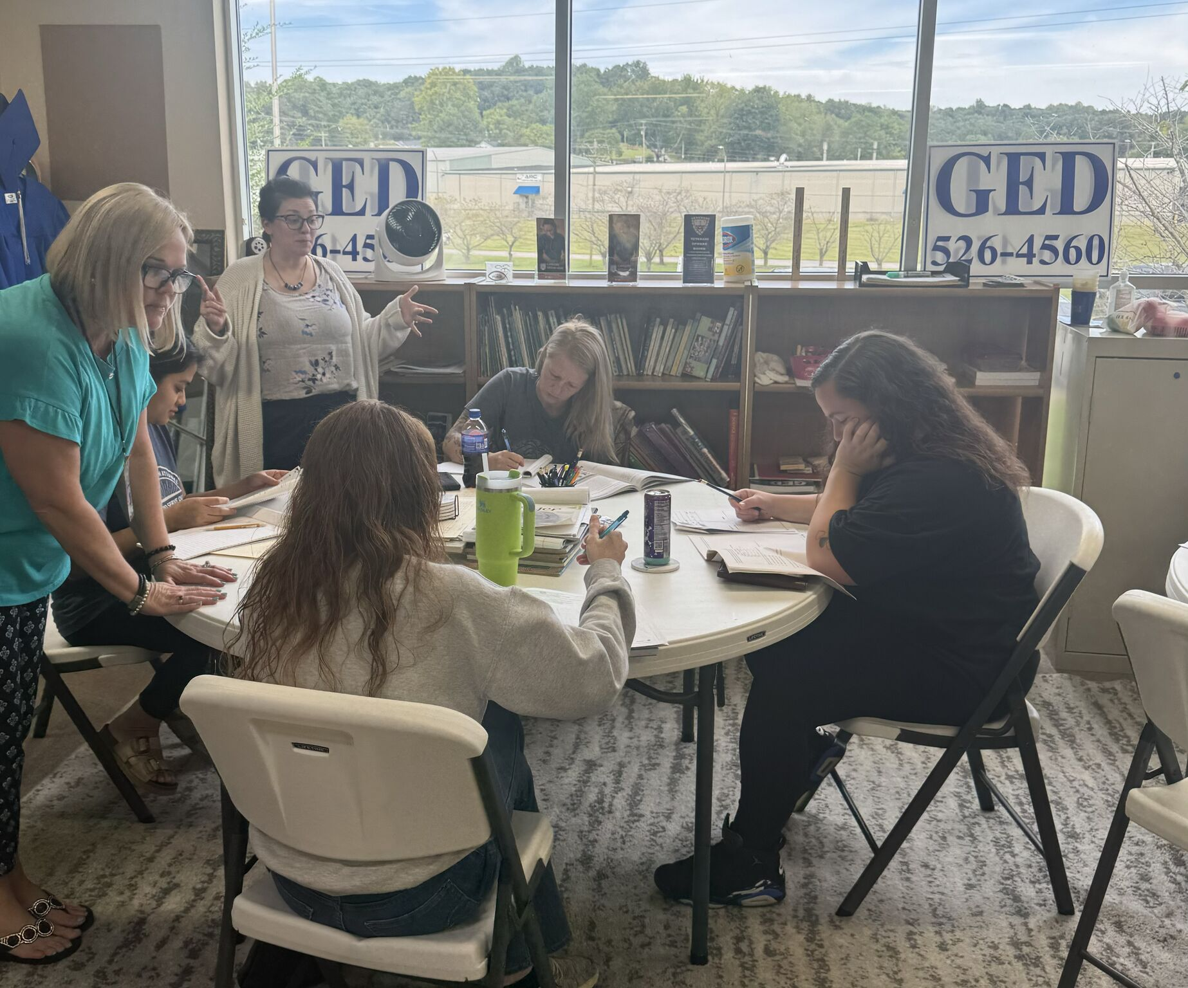
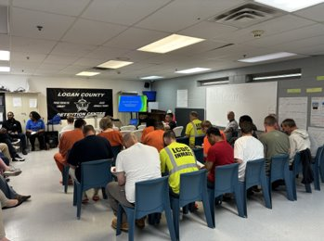
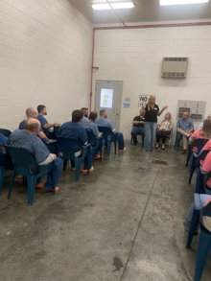
Pre-Release and Targeted Orientation

Slide 15
Thank You!

