Slide 1
Presented for
Interim Joint Committee on Economic Development and Workforce Investment
Thursday, June 20, 2024
MAKING KENTUCKY FIRST IN GOOD BUSINESS
IT PAYS TO DO GOOD BUSINESS

Slide 2
OUR VISION
Make Kentucky first in Good Business
OUR MISSION
Grow Kentucky businesses to
positively impact people, our planet,
and our future

Slide 3
PROFITABILITY
CONSUMERS
70% of US consumers want to know what the brands they support are doing to address social and environmental issues
Purpose-driven companies financially outperform the market by 42%
70%
42%
Source: DDI World 2018
Source: New Paradign Strategy Group & Fortune, 2019
IT PAYS TO DO GOOD BUSINESS
EMPLOYEE ENGAGEMENT
JOB SEEKERS
74%
83% of employees would be more loyal to a company that contributes to social and environmental issues
83%
74% of Linkedin members place a high value on finding work that delivers a sense of purpose
9 out of 10 employees are willing to trade a percentage of their lifetime earnings for greater meaning at work
90%
83% of Gen Z in the US consider a company’s purpose when deciding where to work
83%
Source: Better Up, 2018: Cone Communications Millenial Employee Engagement Study, 2017; Cone/Porter Novelli, 2019
Source: Imperative& Linkedin 2016

Slide 4
TIMELINE
2018
2022
2024
Canopy was born!
Launch of Canopy Certification!
Launch of Canopy Membership!
MILESTONES
Sustained staff and operations through COVID-19
Staff grown to 4 full time, 1 part-time
Board grown from 8 founding members to 17 active, state-wide members, 3 emeritus
Key supporters include Matt Thornton, Ted Smith, Jim Welch, Ted Nixon, Brook Smith, U of L, Metro Louisville, Cherry Bekaert, Chase Bank, Gheens Foundation, Community Foundation of Louisville, James Graham Brown Foundation

Slide 5
OUR TEAM
SCOTT KOLOMS
STEPHANIE KELLEY
BEN SMOCK
ADAM WATSON
CLAIRE JENSEN
BEN SOLLEE
Founder/CEO
Chief of Staff
Director of Development
Director of Education
Verification Specialist
Production Specialist

Slide 6
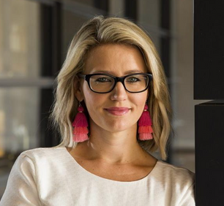
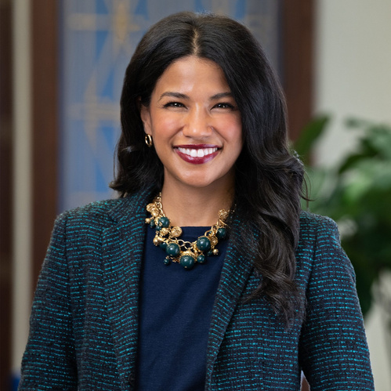
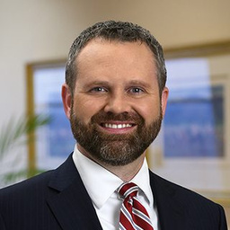
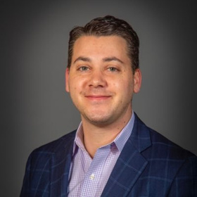
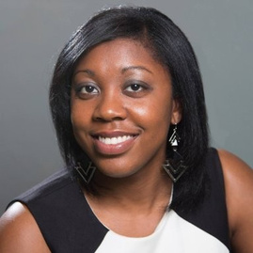
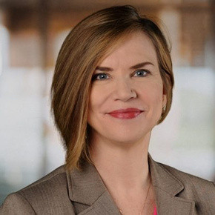
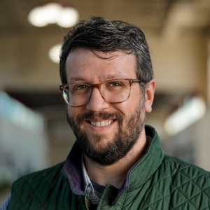
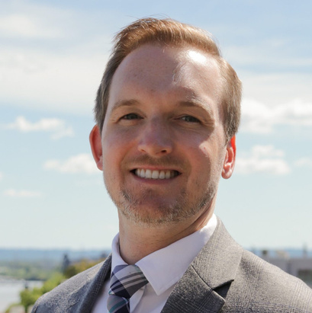
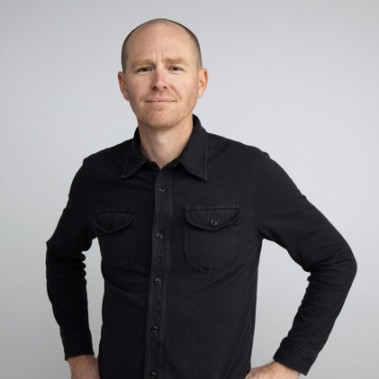
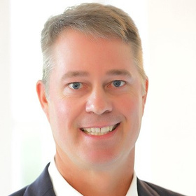
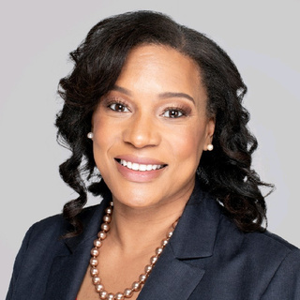
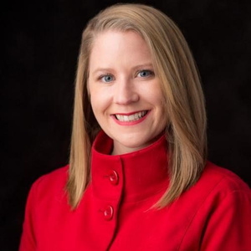
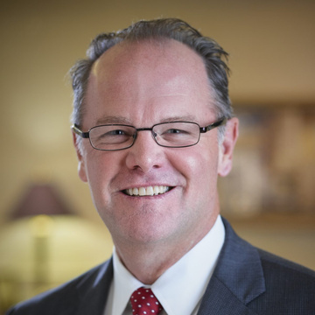
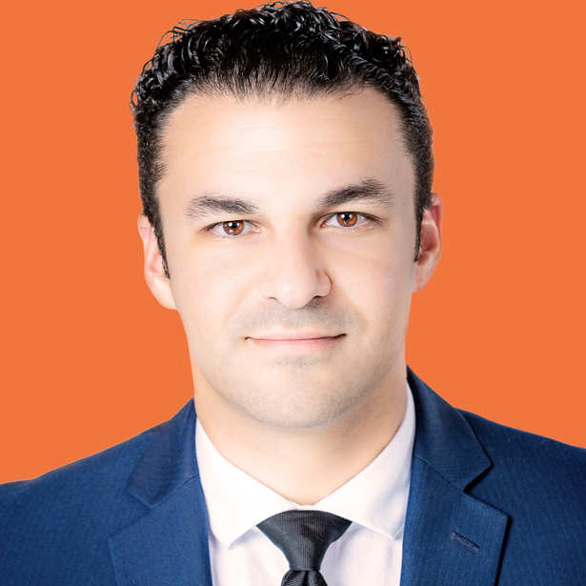
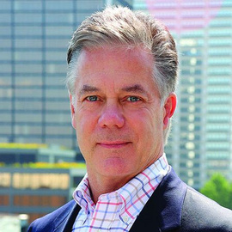
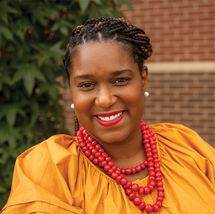
OUR BOARD
✸ Founding Board Members
✸ Jill Wilcox
Co-Chair
J.P. Morgan Chase
Louisville, KY
Seema Sheth
Co-Chair
Federal Reserve Bank of St. Louis
Louisville, KY
Adam Back
Secretary
Stoll Keenon Ogdon PLLC
Lexington, KY
Kevin Trager
Treasurer
Office of Mayor Craig Greenberg
Louisville, KY
✸ Raechele Gray
Lightship Foundation
Louisville, KY
✸ Delene Taylor
Rotary of Louisville
Louisville, KY
Sam Ford
Accelerate KY
Bowling Green, KY
Brian Schneider
Greater Louisville Inc.
Louisville, KY
✸ Scott Koloms
Ex-Officio
Canopy Kentucky
Louisville, KY
✸ Brad Flowers
Emiritus
Bullhorn Creative
Lexington, KY
Mark Kirchdorfer
ISCO Industries
Louisville, KY
Johnetta Roberts
The 40 & 1 Company
Louisville, KY
Brandi Harless
PreventScripts
Paducah, KY
✸ Tom Williams
*Emeritus
Stoll Keenon Ogdon, PLLC
Louisville, KY
Carlos Hernandez Ocampo
Emergence Law, PLLC
Louisville, KY
Kent Oyler
OPM Services
Louisville, KY
Ashley Duncan
Republic Bank
Louisville, KY
Jeffrey Jewell
Danville-Boyle County Chamber of Commerce
Danville, KY

Slide 7
SCOTT’S STORY
Scott Koloms
CEO, FMS & CEO and Founder of Canopy KY
Social entrepreneur and advocate for impact-driven business
Facilities Management Services (FMS):
1st and only janitorial service B-Corp
Real Leaders Top Impact Company for 5 years
Employee turnover is less than half the industry average and FMS enjoys the benefits of “values” aligned customer and employee relationships

Slide 8
THREE PILLARS OF WORK
EDUCATE
CERTIFY
CONNECT
We travel across the state with the Canopy Traveling Roadshow to inspire interest in the new economy and to provide folks from all walks of life the resources to participate.
The Canopy Certification provides a roadmap for Kentucky for-profit businesses to make money and do Good and recognizes them when they do.
We believe a localized, state-wide approach to building a strong Good Business ecosystem is more likely to succeed in KY than a global or even national effort, so we connect folks through events and our online platform.

Slide 9
EDUCATE
Canopy Traveling Roadshow takes our team across the state to talk about the Good Business Movement
Canopy Workshops offer attendees tangible skills and knowledge
Canopy Presents Series invites experts to discuss timely business topics
Best Practice Case Studies provide replicable impact models for Kentucky businesses
Learning Modules offer detailed instruction on Good Business topics

Slide 10
CERTIFY
The Canopy Certification guides Kentucky businesses towards achieving measurable social and environmental Good, operating with high ethical standards, and taking care of all stakeholders along the way while verifying their efforts.
Kentucky businesses use the online Portal to learn, grow, complete the Certification requirements, and continuously improve.

Slide 11
CONNECT
Canopy creates the Good Business movement by connecting stakeholders across the state
Canopy Connect Events gather like-minded individuals and organizations to form impactful partnerships
Canopy Membership offers businesses an opportunity to engage with Canopy’s work and fellow members
The Canopy Good Business Summit is the largest annual gathering of our network and offers inspiration, education and collaborative opportunities

Slide 12
MEMBERSHIP
Canopy Membership is a vital asset for Kentucky, empowering businesses to thrive in our region. We work for our members by:
Making Kentucky and your business attractive to top talent, bolstering our workforce and fostering an innovative, vibrant business community
Growing Kentucky’s national reputation as a premier destination for business operations, attracting investment and driving economic growth
Advocating for legislative incentives that benefit businesses
Facilitating programming designed to connect you to potential talent, clients and consumer bases

Slide 13
CANOPY CERTIFIED TRACKS
Leadership
Governance
External Impact
Culture

Slide 14
CANOPY CERTIFIED PORTAL

Slide 15
CANOPY LIBRARY

Slide 16
3700+
NEWSLETTER SUBSCRIBERS
38
CERTIFIED COMPANIES
25K+
32
PEOPLE EDUCATED
MEMBER COMPANIES

Slide 17
CERTIFIED COMPANIES

Slide 18
MEMBER COMPANIES

Slide 19
PROFITABILITY
CONSUMERS
70% of US consumers want to know what the brands they support are doing to address social and environmental issues
Purpose-driven companies financially outperform the market by 42%
70%
42%
Source: DDI World 2018
Source: New Paradign Strategy Group & Fortune, 2019
IT PAYS TO DO GOOD BUSINESS
EMPLOYEE ENGAGEMENT
JOB SEEKERS
74%
83% of employees would be more loyal to a company that contributes to social and environmental issues
83%
74% of Linkedin members place a high value on finding work that delivers a sense of purpose
9 out of 10 employees are willing to trade a percentage of their lifetime earnings for greater meaning at work
90%
83% of Gen Z in the US consider a company’s purpose when deciding where to work
83%
Source: Better Up, 2018: Cone Communications Millenial Employee Engagement Study, 2017; Cone/Porter Novelli, 2019
Source: Imperative& Linkedin 2016

Slide 20
WORKFORCE IMPACT
57
Providing guidance and resources for companies to design their own social and environmental engagement programs
Providing guidance and resources for companies to design their own values and mission statements
Providing a foundational checklist for companies to self-evaluate their policies and practices and a roadmap for continuous improvement
Educational Resources include:
Employee Feedback and Input Systems
Honors and Awards Programs
Ethical Supply Chain Management
Organizational Climate
Employee Mental Health Basics
and many more
ENGAGED COMPANIES
10K+
FTE’S

Slide 21
CONNECT WITH US!
www.canopyky.org
502-741-5672
info@canopyky.org
1500 Lytle Street,
Louisville, KY 40203

