Slide 1
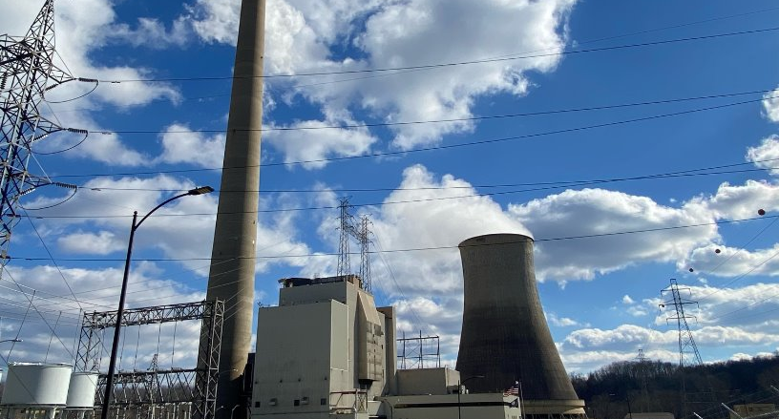
The Importance of Utilities in Economic Development

Slide 2
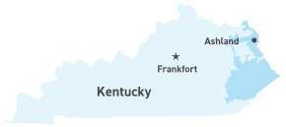
Kentucky Power in the Community
Customers: 161,700
Employees: 241
State and Local Taxes: $12 million
Federal Taxes: $4.8 million
Philanthropic Giving in Kentucky: $420,000
Local and Regional Economic Development Contributions: $600,000
Aid to Customers in Need: $280,000 for weatherization
$945,000 in energy assistance for Home Energy Assistance in Reduced Temperatures and Temporary Heating Assistance in Winter

Slide 3
Why is economic development important to Kentucky Power?
For our customers and communities
Job creation
Increased tax base for our communities
The potential to lower rates

Slide 4
Kentucky Power in Economic Development
Competitive energy pricing
Optional Tariffs
Assisting partners and local governments
Kentucky Power Economic Growth Grant
Site Development
Recruitment

Slide 5
Rate Incentives
Interruptible rates
Discounted rates for the possibility of service interruption during times of peak demand
Economic Development Rider
Reduced demand rates for projects or expansions above 500 kW

Slide 6
Kentucky Power Economic Growth Grant
Economic Development training for 70 elected officials and 11 local economic developers
Site Development
Kentucky Build Ready Certification for East Park Site B and Hager Hill Industrial Site
PDI pilot launch and KPDI annual funding to KAED
Road to Build Ready site at EastPark
Revitalization plans for six cities
Expansion of SOAR's Remote EKY program
Workforce studies used to market the region
Targeted recruitment

Slide 8
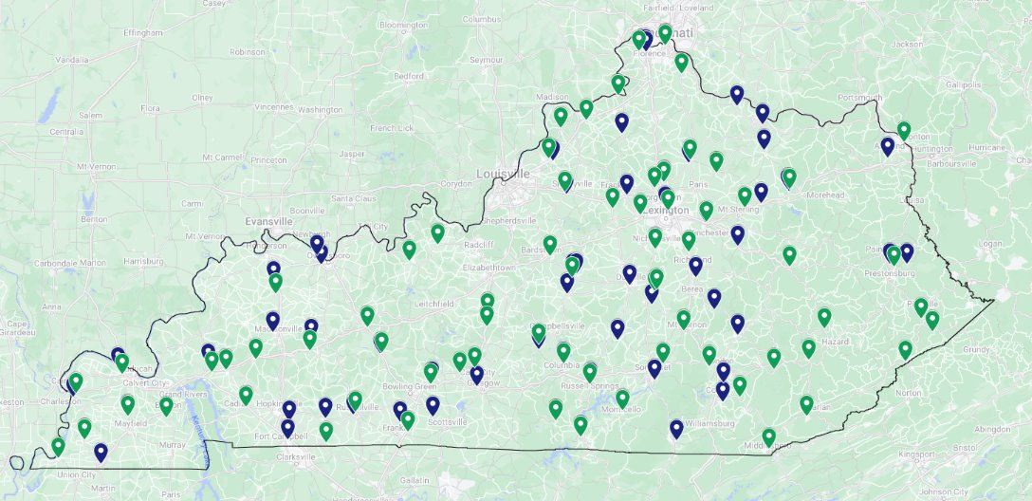
2022 & 2023 KPDI Applicants
Round​ | Sites ​ | Regional Projects​
Round 1 ​ (2022)​ | 73​ | 9​
Round 2​ (2023)​ | 69​ | 11​

Slide 9
In the works….
8 active projects
30 projects in the pipeline
Recently announced Wurltand Oil Works, LLC in Greenup County.
$25 million capital investment and 75 new jobs.

Slide 10
THANK YOU!
Support of the Kentucky Product Development Initiative
Funding of incentives needed for recruitment
Ongoing partnership opportunities

