Slide 1
Department of Workforce Development
Interim Joint Committee on Economic Development & Workforce Investment
July 31, 2024

Slide 2
Presenters
Jamie Link, Secretary
Beth Brinly, Deputy Secretary & Acting Commissioner, Department of Workforce Development
Jorden Jones, Executive Director, Office of Legislative Services

Slide 3
Topics to Discuss
Department of Workforce Development Overview
Workforce Outlook
Workforce Innovation & Opportunity Act State Plan
Services
Programs

Slide 4
Department of Workforce Development
Department of Workforce Development
Office of Adult Education
Career Development Office
Office of Vocational Rehabilitation
Office of Employer & Apprenticeship Services
Office of Educational Programs
Kentucky Workforce Innovation Board
Mission
The Department of Workforce Development connects Kentuckians to employment, workforce information, education, and training.

Slide 5
Department of Workforce Development
Workforce Outlook
The best four-year period of economic growth in the Commonwealth’s history:
Over 1,000 new business locations and expansions
Nearly $32B in private investments
More than 54,700 new jobs created
Highest average incentivized wage of $26.67/hour
The opportunity to build equitable pathways to good quality jobs in a wide array of industries is better now than at any time in Kentucky’s history.

Slide 6
Workforce Innovation & Opportunity Act (WIOA) State Plan
Overview
Every four years, all states must submit a WIOA State Plan that outlines the strategic and operational direction for workforce development.
The established partnerships across the workforce development system are well-positioned to serve all Kentuckians – including target populations and talent pools WIOA was designed to serve.
Employer Engagement
Workforce Participation
Education Attainment
Resource Alignment
Notes:
The Kentucky Strategic Plan is the north star of the plan with the four goals serving as pillars: employer engagement, education attainment, workforce participation, and resource alignment.
Contribution from local listening sessions is included throughout the plan; contributors included: local businesses, local elected officials, community-based organizations, system partners, and individual customers.

Slide 7
Target Populations
Notes:
Job Corps participants
Justice-involved individuals
Refugees
ESL
Foster Youth
Transitioning military
Individuals with disabilities
Those unemployed
Individuals without a high school degree
Individuals with a substance abuse disorder
These categories of individuals are closely aligned with the list WIOA proides for individuals with barriers for employment.

Slide 8
Our Services
17,016
676
Dislocated Worker Participants
3,040
Youth & Young Adult Participants
Adult Education Participants
27,429
Wagner Peyser Participants
47,670
Vocational Rehabilitation Participants
95,831
Kentuckians Served in FY24
=

Slide 9
Office of Vocational Rehabilitation (OVR)
Empowering Kentuckians with disabilities to maximize independence and economic security through competitive, integrated employment.
Helps people with disabilities get the support they need to enter or return to the workforce.
Assists businesses and employers recruit, retain and accommodate employees with disabilities.
Provides support to wide range of customers, including adults with disabilities, youth and students with disabilities, and businesses and employers.

Slide 10
Office of Vocational Rehabilitation
Services in FY 24
Vocational Guidance & Counseling
Job Placement & Job Readiness
College or Vocational Training
Supported Employment Services
Benefits Counseling
Transition Services
Skills & On-the-Job Training
Job Coaching
Transportation
Interpreter & Translator Services
Assistive Rehabilitation Technology
Referral Services
43,501
4,169
$21.51
33.91
Individuals Served
Exited in Employment
Average Wage
Average Hours Worked

Slide 11
Office of Vocational Rehabilitation
Retaining Employment & Talent After Injury or Illness (RETAIN)
US Department of Labor grant focused on assisting people who have non-work-related injuries or illnesses continue to work.
Supports the Commonwealth's commitment to the health and wellbeing of our citizens and economic development.
Connects Kentuckians to the workforce and reduces their need for long-term federal disability benefits.
3,000
113
93%
Participants
Participating
Counties
Return to Work
Notes:
Multiple Referring Organizations (Healthcare, Self Referrals, Absence Management Organizations, Employers, and Office of Vocational Rehabilitation)
Age 18 or older living in Kentucky who have had non- work-related illnesses, injuries or impairments that impact their ability to work or perform their jobs; and
Employed now or have worked in the last year
Individuals can refer themselves for RETAIN services or get more information by Calling 859-562-3251 or visiting our website at www.kyretain.org

Slide 12
Office of Vocational Rehabilitation (OVR)
Pre-Employment Services (Pre-ETS) in FY24
Assists students with disabilities from age 14 to 21 years old.
Guides students in exploring careers and gaining experience in work-related activities.
Develops "504 Plans" for students through accommodation services (Section 504 in the Rehabilitation Act).
Services include:
Job exploration counseling
Work-based learning experiences
Post-secondary opportunities
Work readiness training
Self-advocacy instruction
Notes:
Students who are eligible, as well as students who are considered potentially eligible for Vocational Rehabilitation services may receive Pre-ETS.
https://youtu.be/FQYweZxBdC4

Slide 13
Office of Adult Education (KYAE)
Assists adults in obtaining knowledge and skills for employment and economic self-sufficiency.
Assists adults in attaining a secondary school diploma or high-school-equivalency (GED).
Helps in transition to postsecondary education and training to include career pathways.
Supports individuals who are English language learners.
Surpassed all U.S. Department of Education goals in FY23.
3,082
14,195
48%
GED’s Obtained
Currently Enrolled
Measurable Skills Goals Met
Notes:
KYAE assists adults who are parents or family members to obtain education and skills to become full partners in educational development of their children in support of sustainable improvements in the economic opportunities of their family

Slide 14
Office of Adult Education
Putting Kentuckians First Program
Uses a county-by-county approach to help current and former inmates become strong candidates for the labor market.
Creates workforce pipelines within the judicial system through pre-release skills training, exposure to job opportunities.
Supports employment upon release through connections with businesses and provides post-employment support services to ensure retention.
58 participating counties.
2,100
Individuals Served
70-80%
Employment Retention
Notes:
Putting Kentuckians First
•A County-by-County approach with our core program Putting Kentuckians First and our facilitated Targeted Orientation Classes by partnering with local Judicial entities (Judges, Jailers, County Attorney Offices, Probation and Parole, Specialty Courts) to create referral and accountability pipelines for individuals.
12 to 58 county expansion in FY24
2,100+ individuals served
1,086 incarcerated individuals
420 enrolled into Putting Kentuckians First - Not incarcerated – Judicially involved - Receiving in depth case management
318 Enrolled in SB 90 Program (KRS 533.270-.290)
400 separate individual clients assisted – non PKF Case management - Those are individuals referred to the RES branch that require low level assistance - perhaps a job referral, simple application assistance, or other supportive service.
103 ID’s/SSN/Birth Certificates - Identification credentials assistance
Employment and Retention Data Range 70%-80% consistently program total

Slide 15
Office of Employer & Apprenticeship Services
Connects businesses to workforce services that spark innovative hiring, training, and retaining a workforce.
Offers an alternative path to postsecondary education that drives Kentucky's growth and competitiveness.
Aligns programs with community college courses
Free consultative services for employers include:
Recruitment
Training
Upskilling
6,698
Registered Apprentices
290
Registered Programs
257
Unique Occupations
Retention Strategies
Financial Incentives
Diversity Hiring

Slide 16
Office of Employer & Apprenticeship Services
Early Childhood Apprenticeships
Offers apprenticeship programs for Childcare Development Specialists, Early Childhood Instructors, and Early Childhood Administrator Directors.
Sponsored by the Governor's Office of Early Childhood.
Partners with 46 early childhood employers in public pre-K, HeadStart and childcare facilities.
59 completions since 2022.
80
59
90
229
Childcare Development Specialist Apprentices
Early Childhood Instructor Apprentices
Early Childhood Administrator Director Apprentices
Enrolled in Various Child Care Apprenticeship Programs

Slide 17
Career Development Office/Kentucky Career Centers
Serves as the Commonwealth's comprehensive
workforce system.
Services in FY24 Include:
Jobs for Veterans State Grant
Wagner-Peyser Act Employment Services
Foreign Labor Certification
Reemployment Services and Eligibility Assessments
Foreign Labor Certified Employers
7,366
H-2A Visa Applications
1,887
RESEA Orientations
1,917
Individualized Employment Plans Completed
4,090
Veterans & Transitioning Service Members
807
Notes:
Wagner Peyser
Provides general employment services for all job seekers and assists employers in meeting their hiring needs
Foreign Labor Certification (H-2A)
Provides services for temporary agricultural workers and assists employers to fill their workforce needs during peak seasons
Jobs for Veterans State Grant (JVSG)
Provides individualized career and training-related services to eligible veterans and spouses with significant barriers to employment as well as assisting employers to fill their workforce needs with job-seeking veterans. Aids veterans with barriers to employment, as determined by U.S. DOL.
Services are available to eligible veterans and eligible spouses.
Employment Services at Fort Campbell
Assistance for Transitioning Service Members (TSMs) and their families/spouses
Veterans, Transitioning Services Members, & other eligible persons hired as a result of job development: 153
Number of Job Ready Veterans, Transitioning Services Members, & other eligible persons referred to employers: 445
Reemployment Services and Eligibility Assessments (RESEA)
Provides evidence-based reemployment interventions and strategies and acts as an entry point to other workforce system partners, helping Unemployment Insurance claimants return to work more quickly.
Unemployment Insurance Services
Basic functions permitted
ID.me assistance
User login & claim filing assistance
Rights & responsibilities
Suitable work & work search requirements
Answering general UI questions

Slide 18
Kentucky Workforce Innovation Board
Serves as an advisory board to the Governor on workforce training and development issues.
Comprises a 40-member board of Kentucky business leaders, and education, labor, state and local government, and community-based organizations.
Assists in developing and executing the Governor’s Workforce Innovation & Opportunity Act (WIOA) State Plan
Helps create a statewide vision for workforce development and adopting a plan to move Kentucky forward through workforce training and development.
Employer Engagement
Workforce Participation
Education Attainment
Resource Alignment
Four Pillars of WIOA State Plan

Slide 19
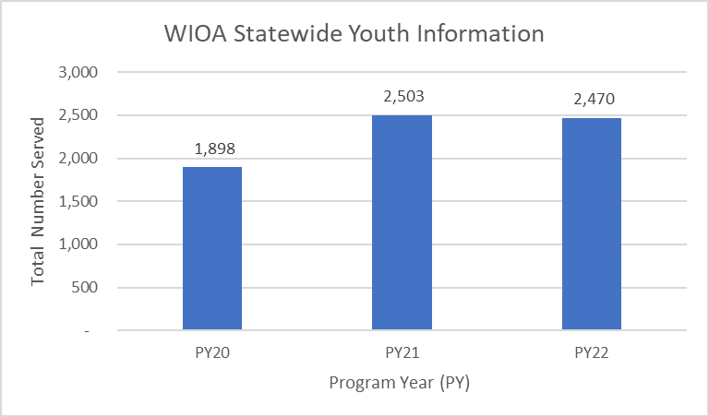
Youth Services
Aids several youth and young adult-focused programs and initiatives across the Commonwealth with various partners.
Offers career pathway and supportive services to help youth complete training programs.
Provides youth with work-based learning opportunities and internships through partnerships between Local Workforce Innovation Boards and employers across the state.
Assists youth with mental health support through comprehensive guidance and counseling.
Supports essential leadership and skills development.

Slide 20
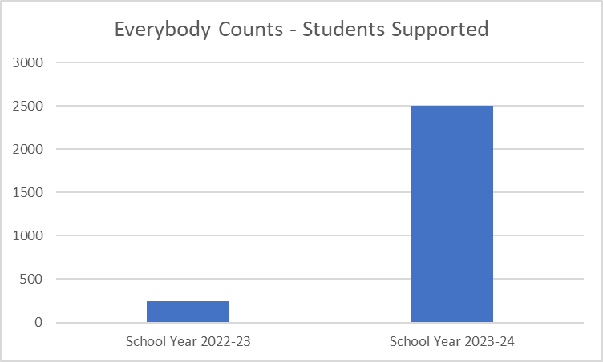
Youth Services
Everybody Counts Initiative
Provides over 2,000 eligible young adults with over 100 career and education exploration activities and events.
Partners with 15 businesses to assist young adults with employment opportunities post-high school.
Awards funding to support over 500 scholarships.
Removes barriers for students to enter post-secondary education.

Slide 21
Digital Equity (DE) Strategic Plan
Broadband Equity Access & Deployment (BEAD) Program
Commonwealth's DE plan was approved in April by the U.S. Department of Commerce.
DE Capacity Grant Program application was submitted in May and currently is under review.
DE Capacity Grant will fund execution of the approved DE Plan focusing on the covered populations and partnership with the Office of Broadband Development for digital upskilling and remote work opportunities.
Covered populations include:
Veterans, aging individuals (60+), incarcerated individuals, individuals with disabilities, individuals with a language barrier, individuals who are a racial or ethnic minority, low-income individuals and individuals living in rural areas.

Slide 22
New Resource
Ready For Industry ®
Provides courses to achieve an industry-based certification for high school, post secondary, and industry learners.
Creates a bridge between standard education and the knowledge and specialized skills needed to succeed in industry.
Available through local workforce entities like the Kentucky Career Centers, KCTCS, and others across the state.
Provides separate 15–20-hour courses for each of the 5 highest-demand industries:
Healthcare
Manufacturing
Logistics
Construction
Information Technology (IT)

Slide 23
Thank You!

