Slide 1
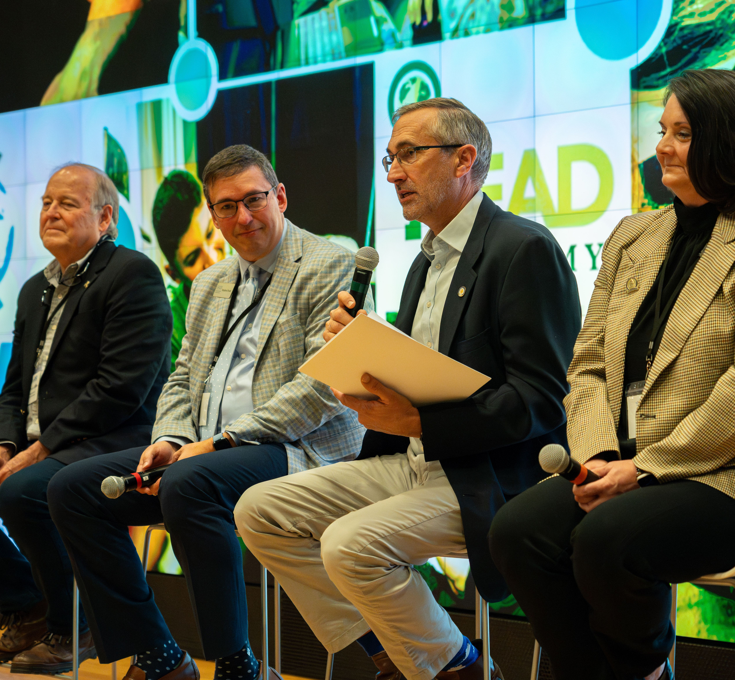
Building Kentucky’s Tech Talent Pipeline
www.weleadcs.org

Slide 2
3,427
Open computing jobs in Kentucky each month
Average annual salary
$77,189
www.weleadcs.org

Slide 3
Talent Gap
783 high school industry certs in CS
A significant shortage of workers to fill Kentucky’s open computing jobs
42% aligned to KY’s lowest growth tech jobs
371 CS associate degrees
940 CS bachelor’s degrees

Slide 4
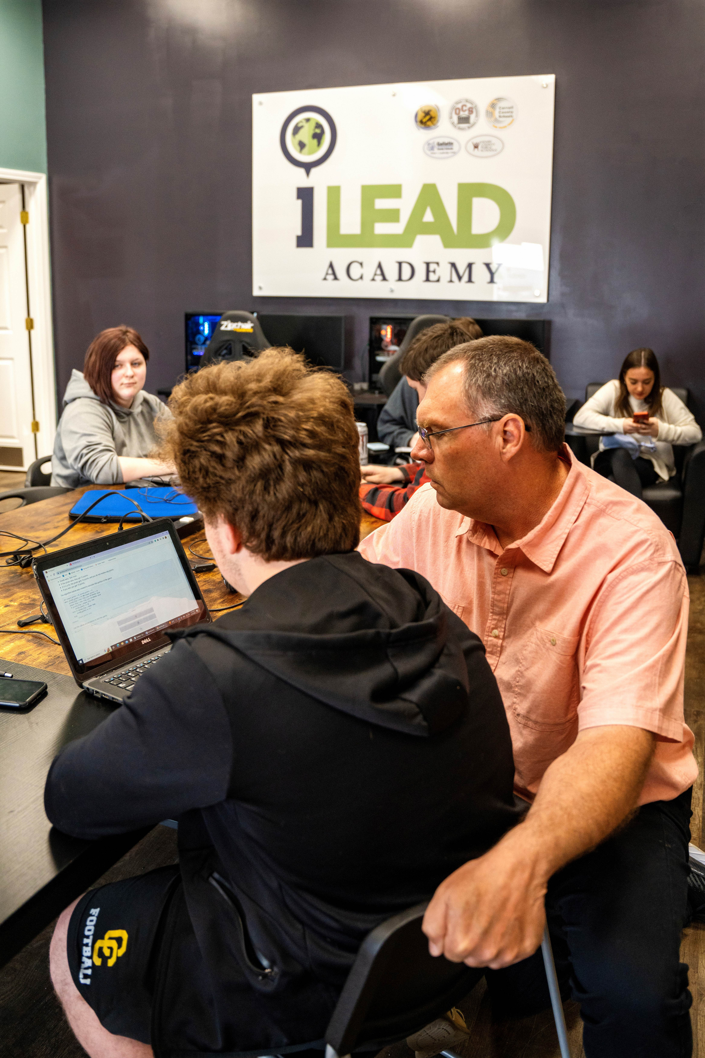
Solutions
We Lead CS virtual computer science career academy
Graduate 250-300 students a year with 18-21 hours college credit for CS degree completion
Connect employers and We Lead CS students in innovative, virtual work based learning and internships
www.weleadcs.org

Slide 5
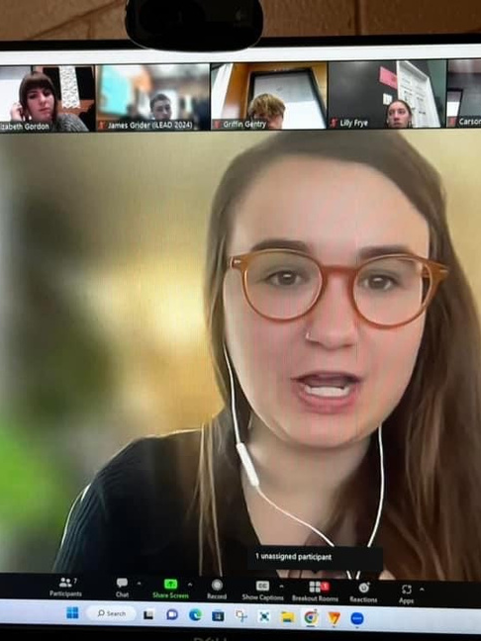
Strategies
$100,000 Take the Lead Grant Program for Kentucky Chambers of Commerce
Expansion of the INTERalliance and its talent pipeline development approach into Kentucky
Recruit 300 additional students for 2025-2026 school year
www.weleadcs.org

Slide 6
The INTERalliance has cracked the code on putting high school students to work in tech internships in corporate America
2023-24 BY THE NUMBERS
www.weleadcs.org

Slide 7
Get in Touch
Contact us for more information
info@weleadcs.org
205-A Capital Avenue Frankfort, KY
502-255-1310
www.weleadcs.org

