Slide 1
Kentucky's Unified Business Strategy: Statewide Workforce and Talent Team (SWATT)

Slide 2
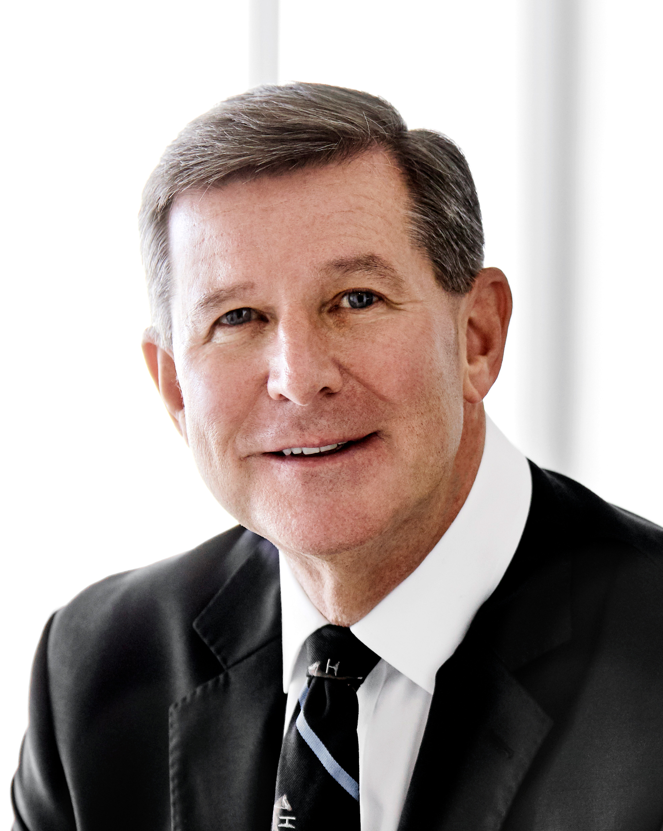
Kentucky’s SWATT Initiative
Secretary Jamie Link Kentucky Education
and Labor Cabinet
Secretary Jeff Noel
Kentucky Cabinet for Economic Development

Slide 3
What is SWATT?
How
What
Why
Develop a sustainable and effective workforce system responsive to the needs of Kentucky businesses and citizens
By working in tandem with regional communities to collaborate and align the delivery of workforce solutions
To develop a streamlined workforce development system that delivers actionable solutions for employers and citizens

Slide 4
SWATT’s Key Objectives
Workforce Strategies: Deliver impactful solutions to companies tailored to industry demands.
Coordination: Improve communication and confidence among workforce entities.
Employer Relationships: Foster and maintain strong ties to address workforce needs.
Business-centric: Adopt an industry-focused, data-driven approach to address workforce challenges.

Slide 5
Economic Impact and Workforce Needs
Secretary Jeff Noel
Kentucky Cabinet for
Economic Development

Slide 6
TEAM KENTUCKY: BUILDING A BETTER TOMORROW
A stable job is the beginning, a safe place to live and a community to call home allows us to dream bigger, do better and create more opportunities for future generations who live in the special place we call Kentucky.

Slide 8
SWATT
Statewide Workforce and Talent Team
“Meeting the need, together”
We are voluntarily united by a common resolve to deliver workforce solutions to employers who provide rewarding careers for all our neighbors.

Slide 9
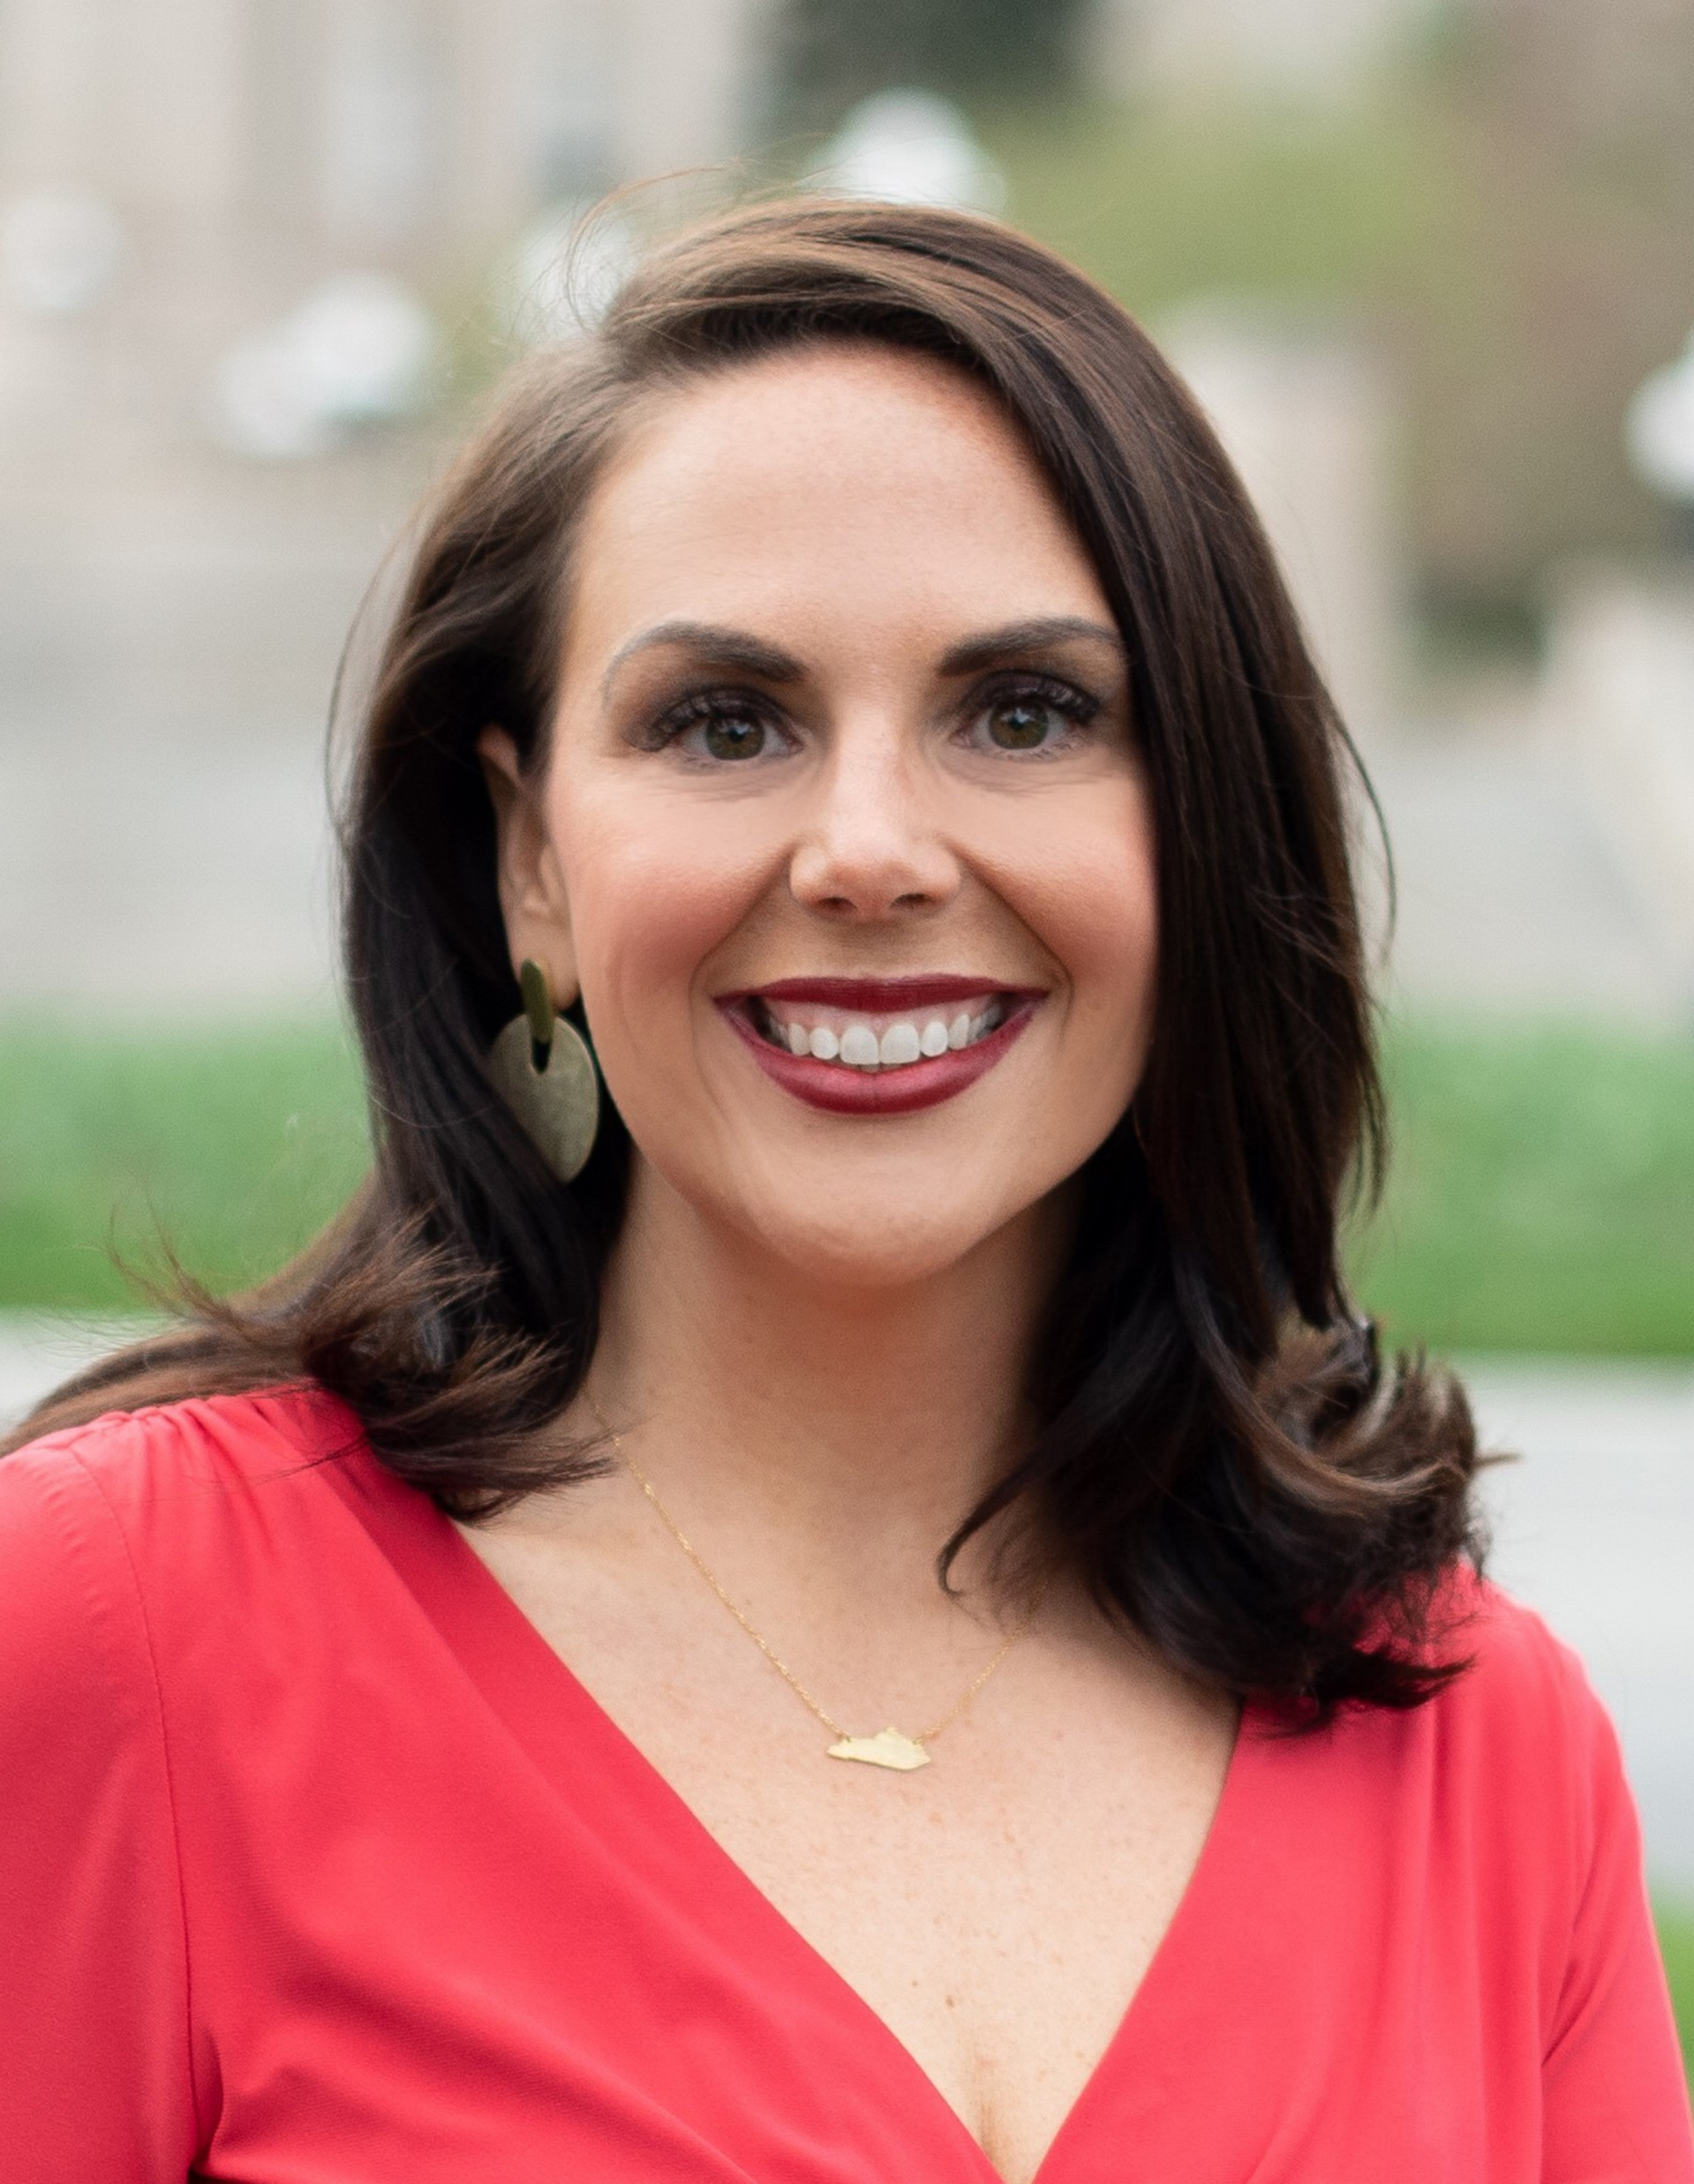
Power of the Public-Private Partnership
Ashli Watts
President and CEO
Kentucky Chamber
of Commerce

Slide 10
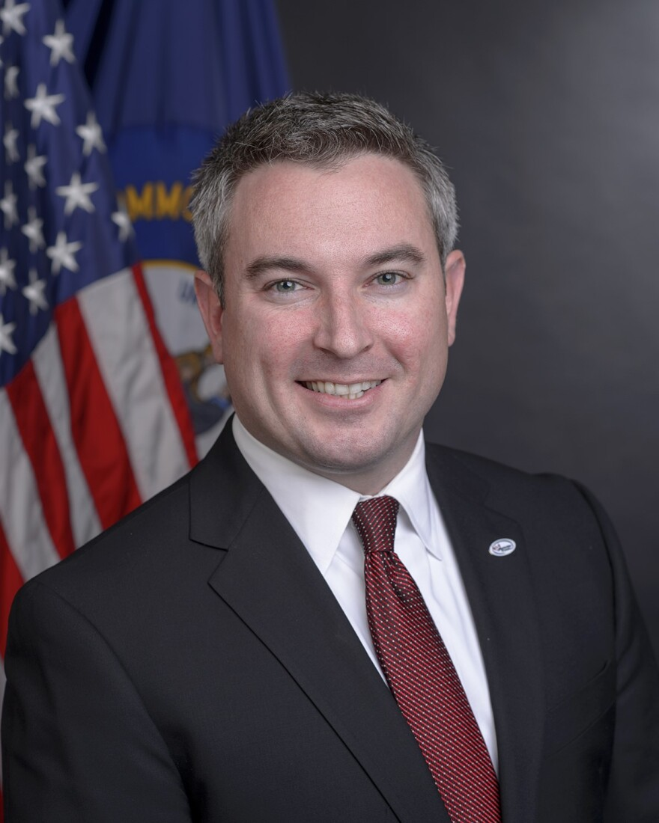
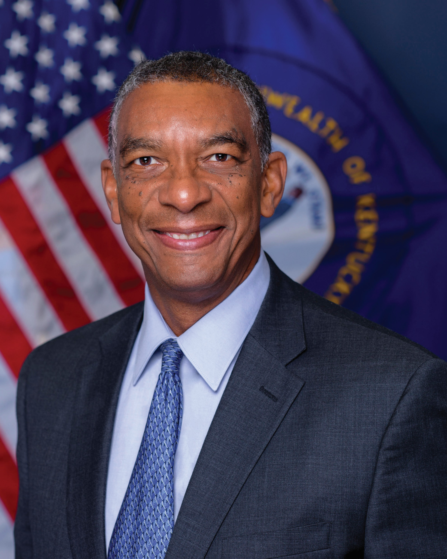
Educational and Workforce Alignment
Dr. Ryan Quarles
President
Kentucky Community and Technical College System
Dr. Aaron Thompson
President
Kentucky Council on Postsecondary Education

Slide 11
Unified Business Service Strategy and Integration
Secretary Jamie Link Kentucky Education
and Labor Cabinet

Slide 12
Business Leaders
SWATT Partners
State Legislators
Local and Regional Partners
Stronger
Together:
A Collective
Impact

