Slide 1
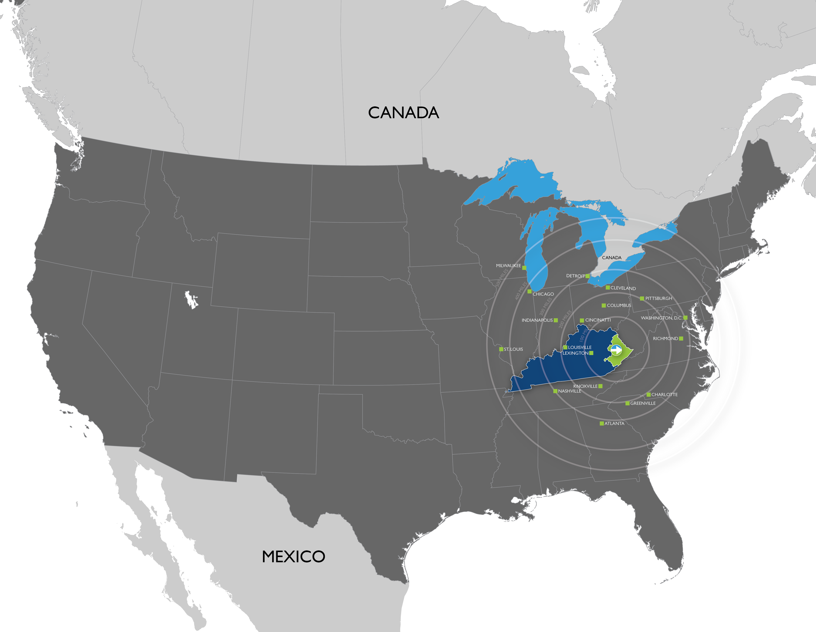



Slide 2
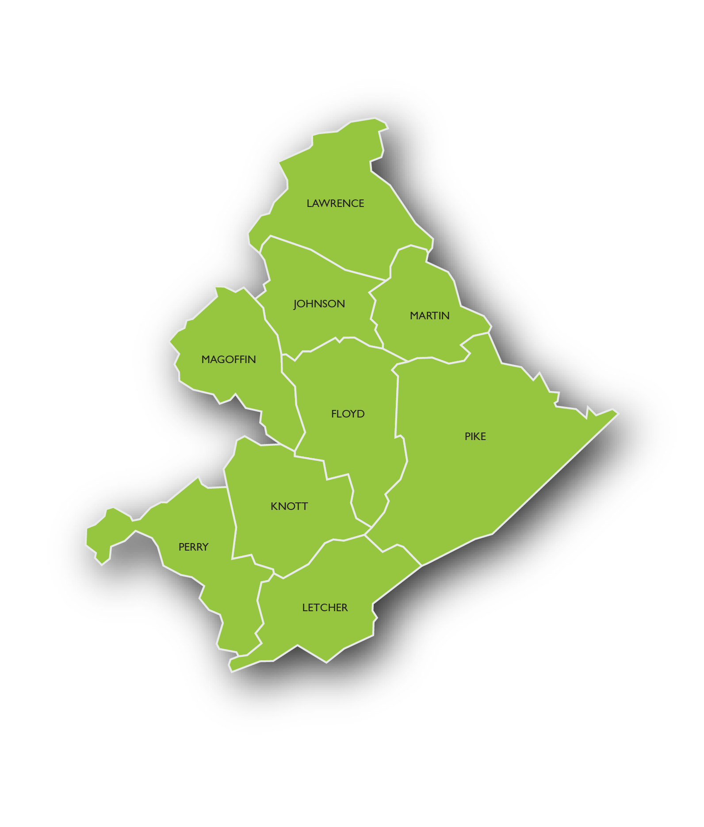
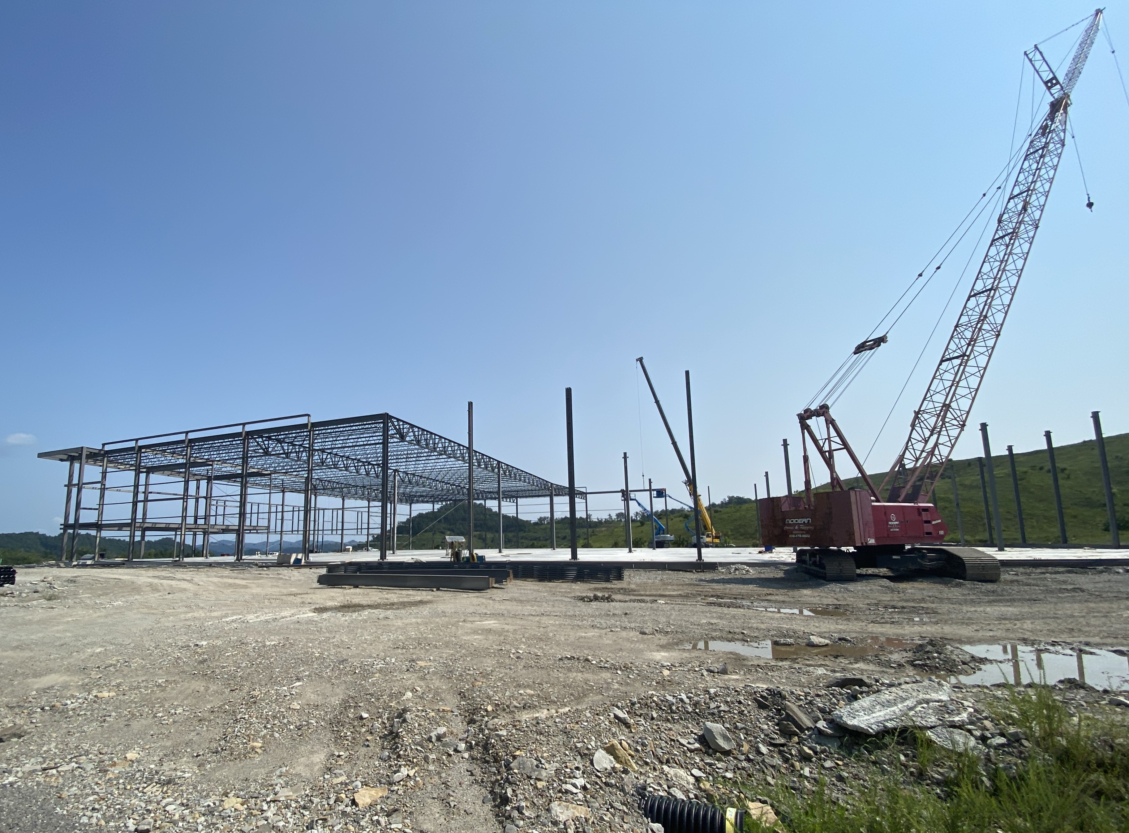
EAST KENTUCKY’S
CENTER OF ECONOMIC
DEVELOPMENT EXCELLENCE
ABOUT OEK
In 2015, One East Kentucky was established as East Kentucky’s first regional economic development organization. The not so simple goal? To recruit new industry, jobs and investment to the nine-county region making up the heart of Appalachia: Floyd, Johnson, Knott, Lawrence, Letcher, Magoffin, Martin, Perry and Pike Counties.
As a 501(c)3, OEK is funded and governed entirely by the region’s business community. Our success is directly correlated to the valuable contributions, forethought and wherewithal of our board of directors and investors - those that shape our vision, mission and values.

Slide 3
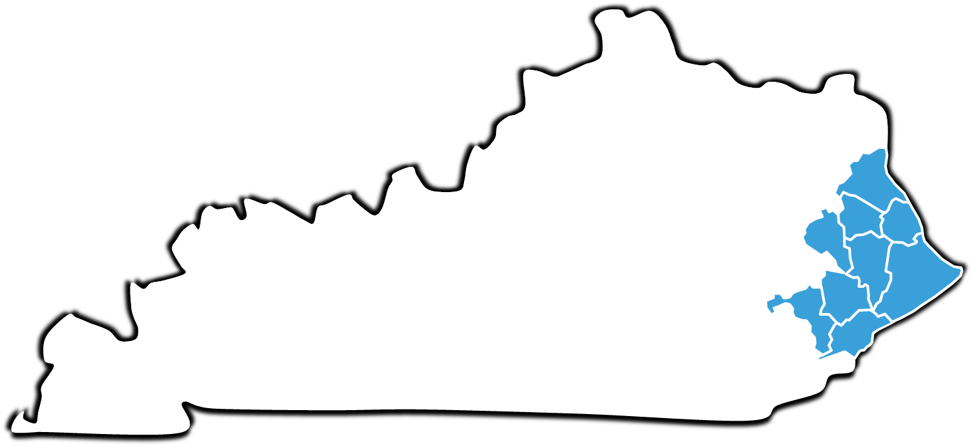




























EAST KENTUCKY’S
CENTER OF ECONOMIC
DEVELOPMENT EXCELLENCE
PRIVATE INVESTORS: FUNDING OUR STRATEGY
Barrett Clark, LLC

Slide 4





















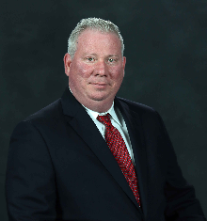






2025 BOARD OF DIRECTORS
PERMANENT EX-OFFICIO
IMMEDIATE PAST-CHAIR
CHAIRMAN
PAUL PATTON
CINDY WISEMAN
TYLER BURKE
CHAIR-ELECT
SECRETARY-TREASURER
MIKE JOHNSON
DAVID TACKETT
DIRECTOR
DIRECTOR
DIRECTOR
DIRECTOR
DIRECTOR
DIRECTOR
DIRECTOR
KATHY KING ALLEN
JAMES AYERS
AMANDA CLARK
NIKA LARIAN
JENNIFER PERKINS
JAMES ROBINSON
WES SMITH
DIRECTOR
EX-OFFICIO
EX-OFFICIO
EX-OFFICIO
EX-OFFICIO
EX-OFFICIO
FREDDIE WILLIAMS
LEE HARRISON
JENNIFER LINDON
TODD BRAND
KATHY WALKER
BURTON WEBB

Slide 5
Improvements to Kentucky’s Incentive Programs

Slide 6
Counties w/ Jobs or Investment Announcement During Post-COVID Recovery
Jobs: 43,549
Investment: $28,099,773,000
Updated: August 12, 2025

Slide 7

Jobs Announced/Incentivized in the Post-COVID Recovery
1-50 Jobs
50-100 Jobs
100-500 Jobs
500-1000 Jobs
1000-5000 Jobs
5000+ Jobs

Slide 8
Counties w/ Persistent Poverty: US Census
Defined as having a poverty rate of greater than 20% for the three decades from 1989 to 2019.
https://www.census.gov/library/stories/2023/05/persistent-poverty-areas-with-long-term-high-poverty.html

Slide 9
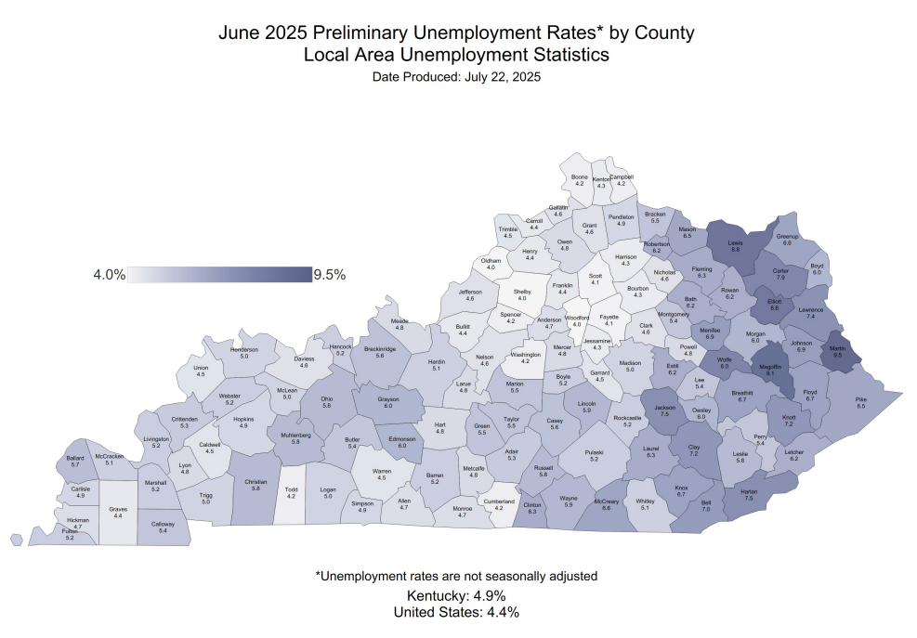

Slide 10
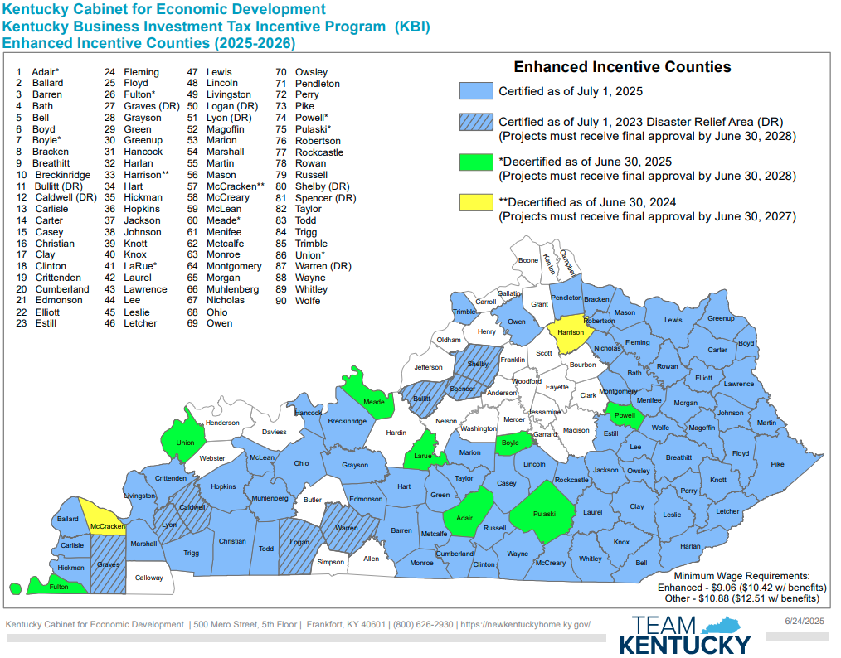

Slide 11
Jobs Announced
1-50 Jobs
50-100 Jobs
100-500 Jobs
500-1000 Jobs
1000-5000 Jobs
5000+ Jobs

Slide 12


Slide 13
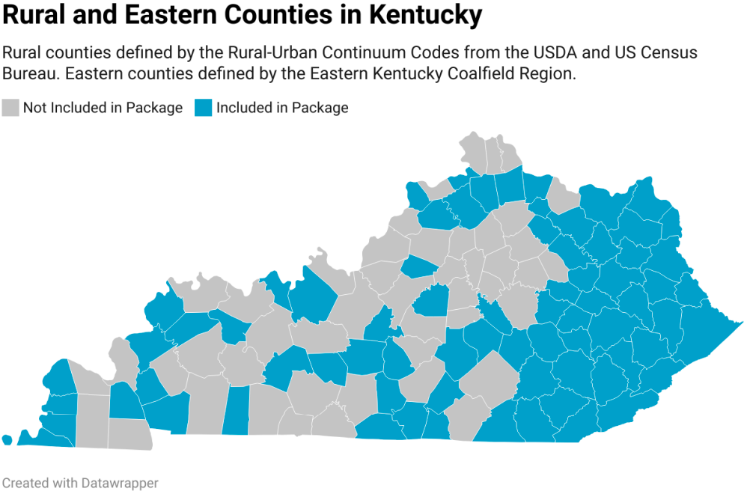

Slide 14
Our Proposal

Slide 15
Counties sorted by 50/50 weight of Normalized 5-yr Avg. Unemployment and Median Household Income
Sources:
https://kystats.ky.gov/KYLMI/LAUSUnemployment
https://fred.stlouisfed.org/series/MHIKY21001A052NCEN#
Category
Tier I
Tier II
Tier III
Tier IV

Slide 16
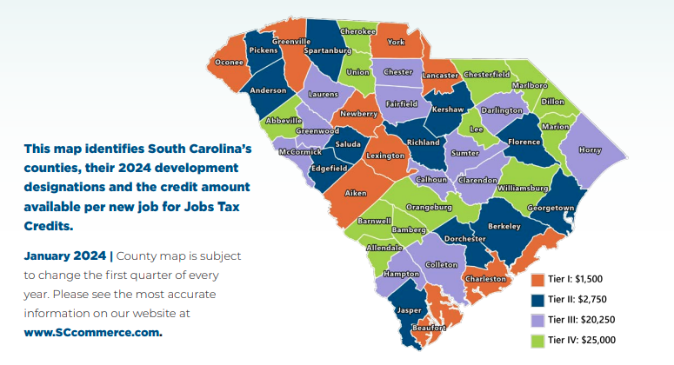

Slide 17
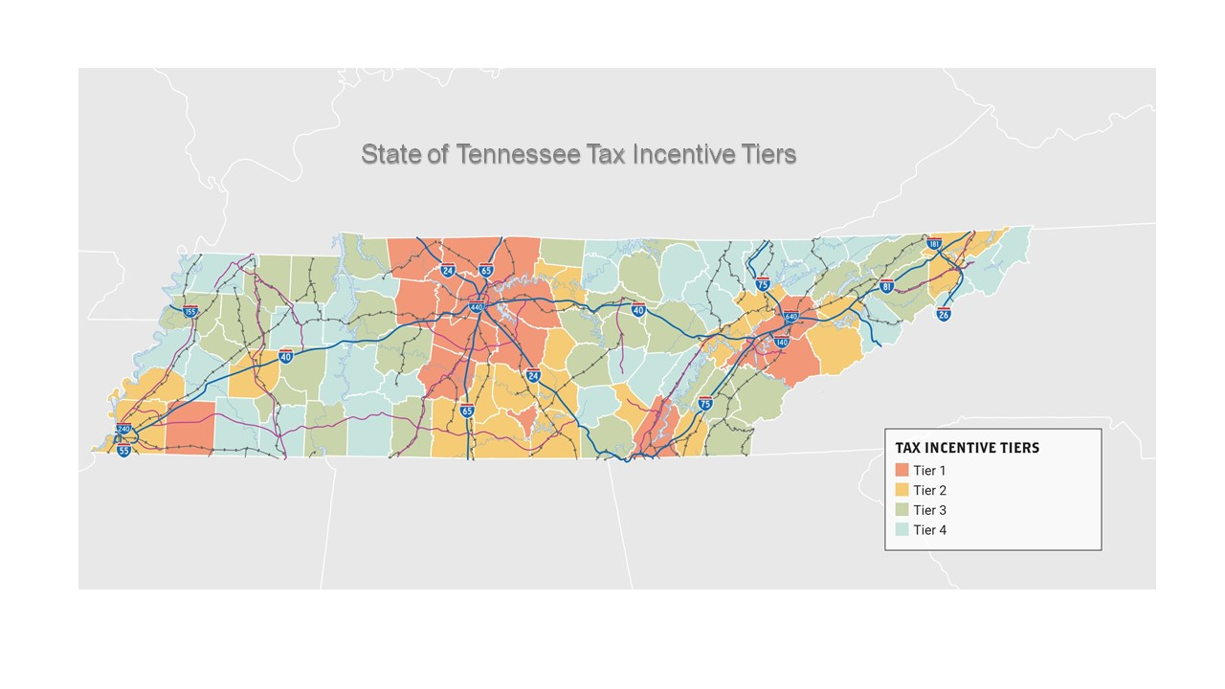

Slide 18
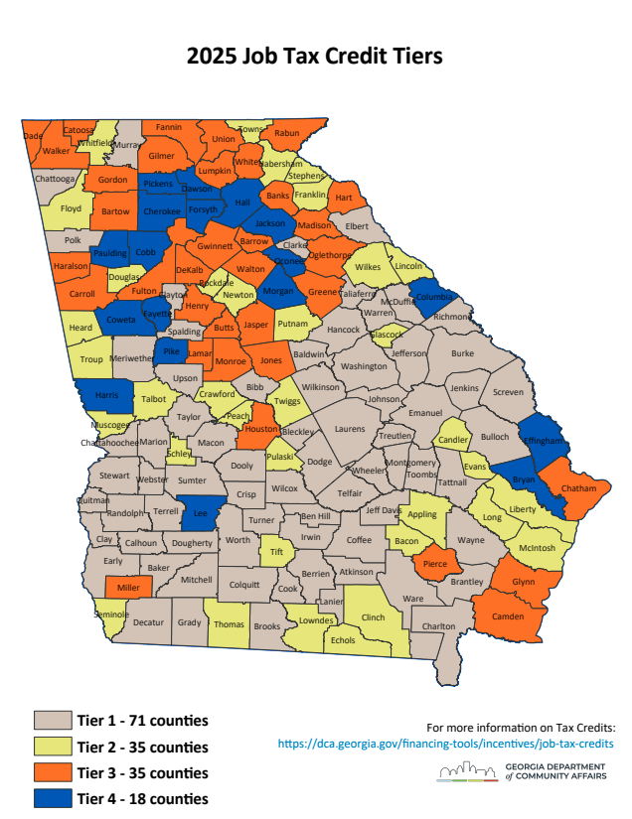

Slide 19
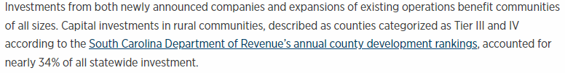
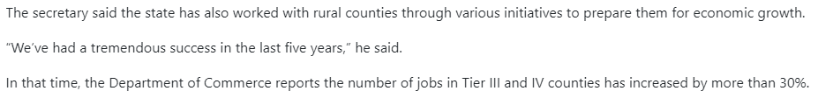
Results
https://www.live5news.com/2023/10/02/sc-works-ensure-rural-counties-play-role-economic-development-surge/
https://www.sccommerce.com/newsletter/south-carolina-achieves-impressive-economic-development-2023-including-922b-announced

Slide 20
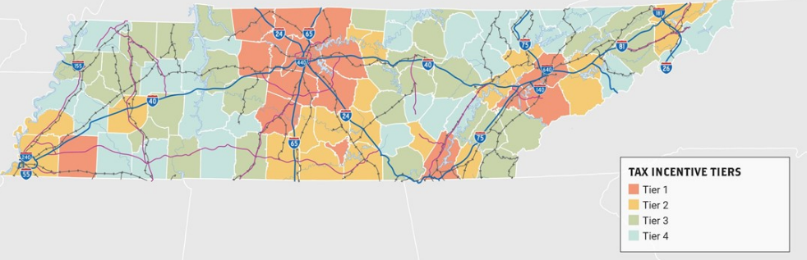
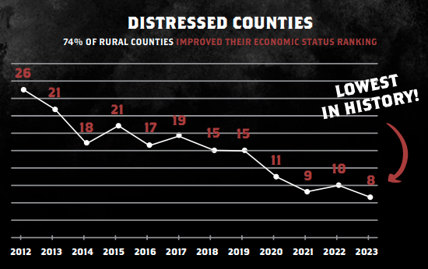
Results
In 2023, Tennessee announced 20 projects in Tier 3 & 4 counties representing 2,521 new jobs and $1.17 Billion in new capital investment.
https://tnecd.com/wp-content/uploads/2024/03/ECD-Report-Card-9.pdf

Slide 21
Counties sorted by 50/50 weight of Normalized 5-yr Avg. Unemployment and Median Household Income
Sources:
https://kystats.ky.gov/KYLMI/LAUSUnemployment
https://fred.stlouisfed.org/series/MHIKY21001A052NCEN#
Category
Tier I
Tier II
Tier III
Tier IV

Slide 22


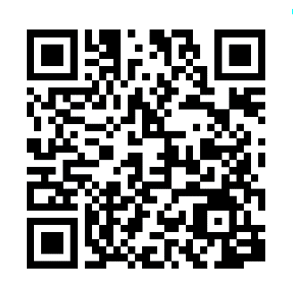
Questions?

