Slide 1
Local 502 Plumbers, Pipefitters & HVAC Techs
Apprenticeship Program

Slide 2
Who We Are
Plumbers
Pipefitters
Welders
HVAC-R Service Technicians

Slide 3
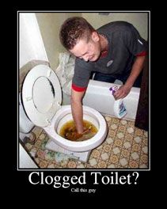
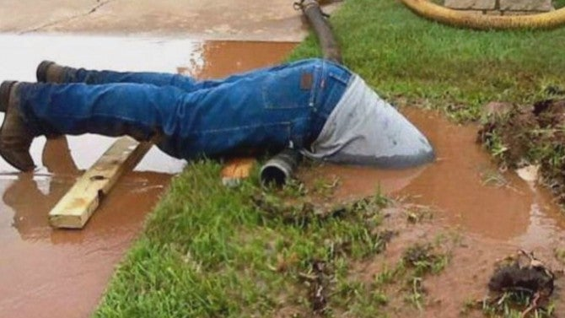
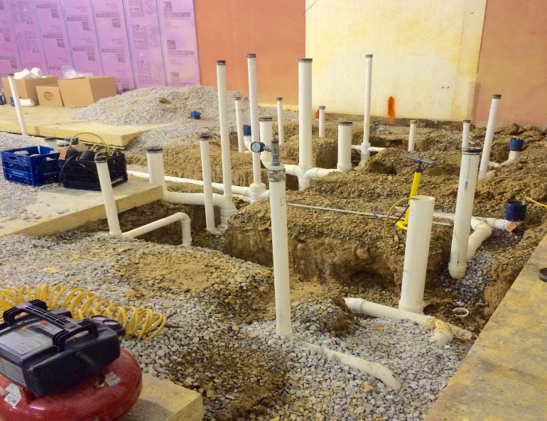
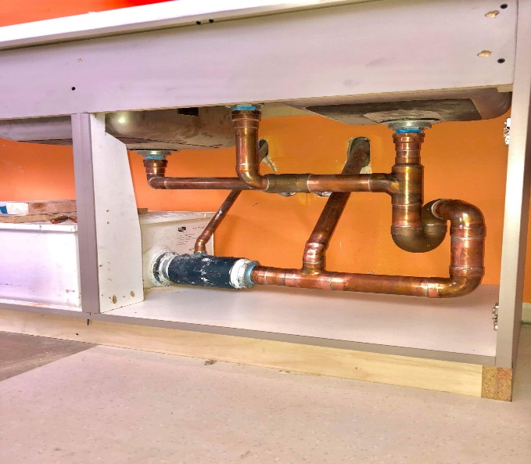
PLUMBERS
Primarily installs new, never used piping systems such as:
          City Water
          Natural Gas
          Medical Gas Systems
          Backflow Preventers
A small percentage of our plumbers perform service work, and it’s always optional!

Slide 4
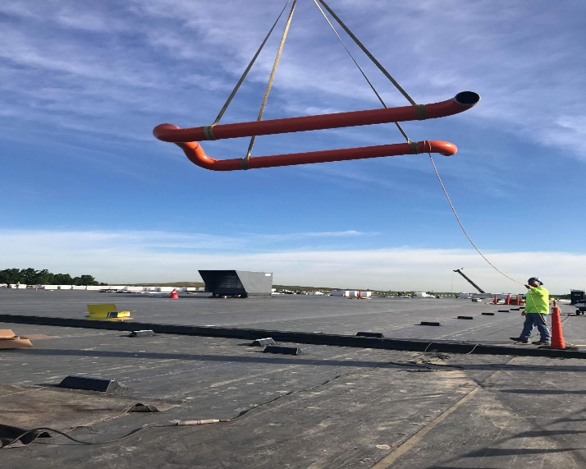
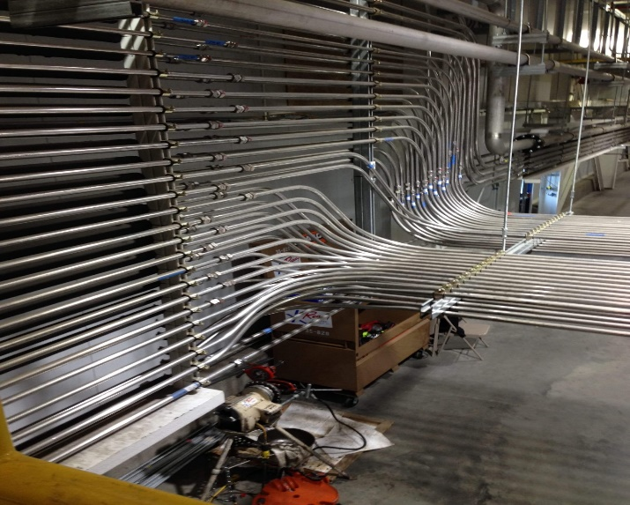
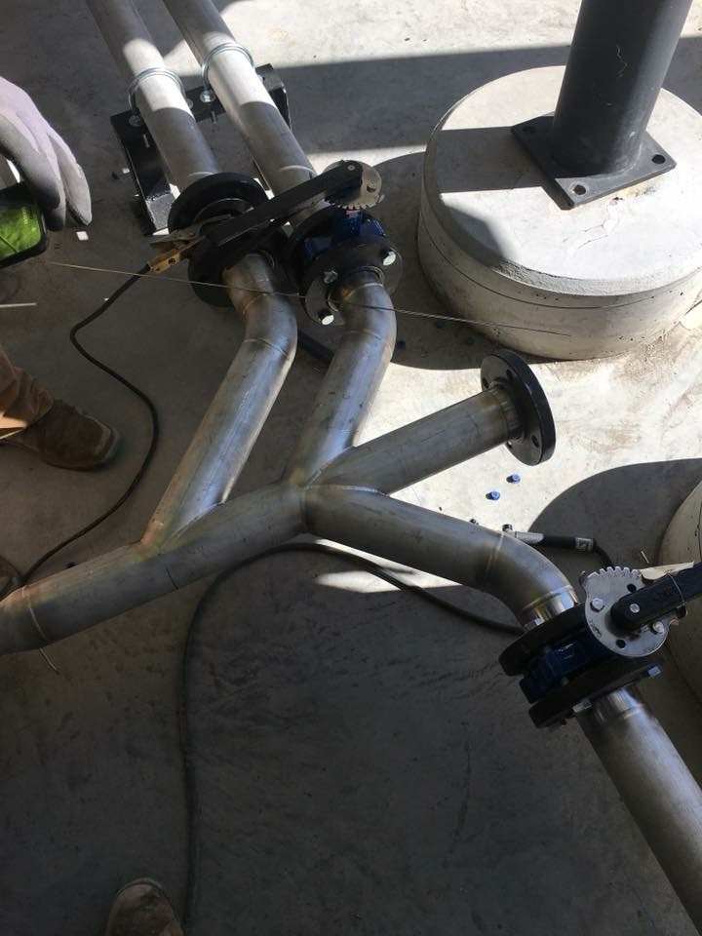
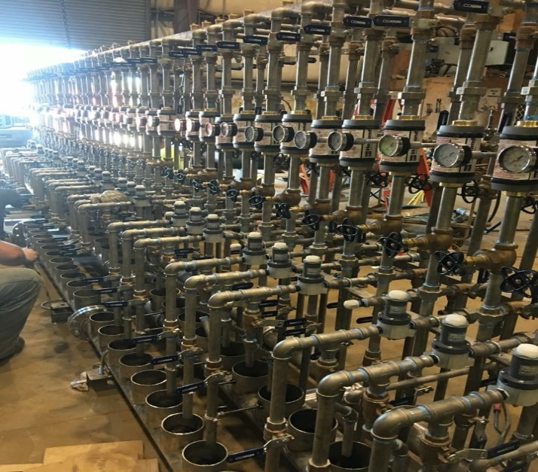
PIPEFITTERS
Pipefitters install and maintain piping systems in commercial/industrial settings such as power plants, chemical plants, oil refineries, or any business involved in manufacturing.
Pipefitters:
      Must be trained and knowledgeable in the different piping materials (steel/plastic/copper pipe)
      Must also know the different methods of joining pipe (welded/glued/soldered/brazed)
      Must be certified and trained in rigging operations, in order to lift heavy pieces of equipment and material
      Must be knowledgeable in proper installation practices of various types of piping systems for gas/steam/air/water

Slide 5
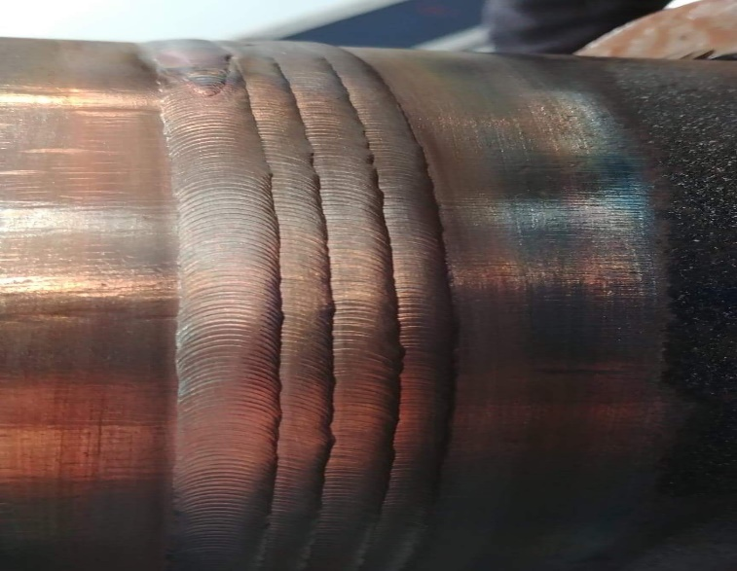
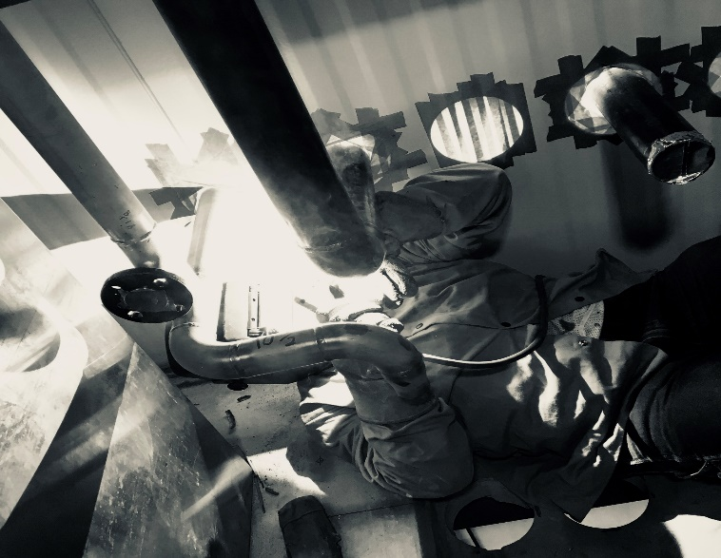
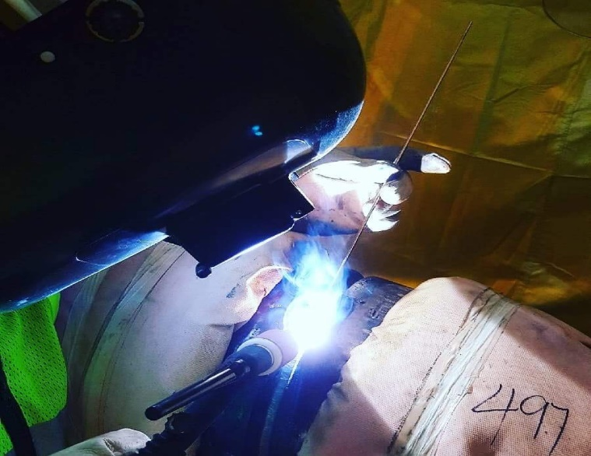
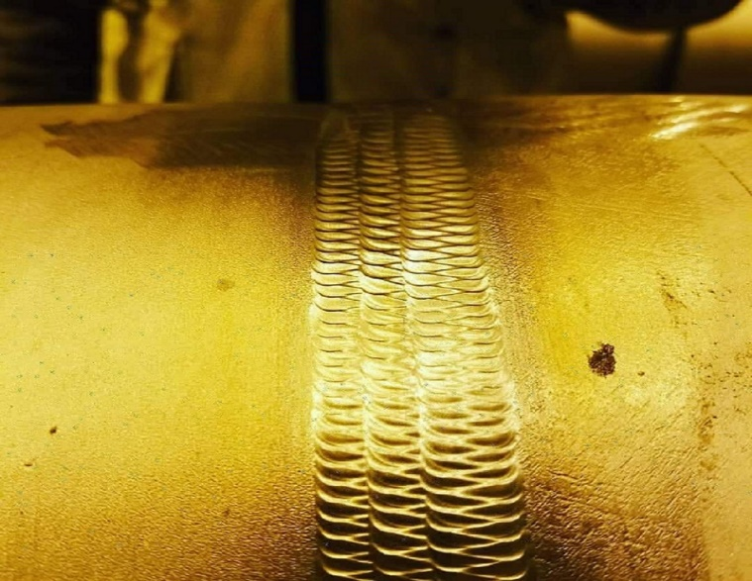
WELDERS
Welders work closely with Pipefitters, and many times, are one in the same.
Welders will be trained and certified in all processes:
      SMAW (Stick)
      GTAW (Tig)
      GMAW (Mig)
      FCAW (Flux core/Dual shield)
Welders will be trained and certified to weld on a variety of metals

Slide 6
HVAC-R
SERVICE TECHNICIANS
HVAC-R stands for:
      Heating
      Ventilation
      Air Conditioning
      Refrigeration
HVAC-R Service Technicians install and maintain the systems that make your home and other buildings comfortable to inhabit

Slide 7
Program Details

Slide 8
Program Details
Earn while you Learn!
      Local 502 will place you at a job with one of our signatory contractors
      Apprentices will work during the day, and attend classes at the Training Center in the evening
      Classes are held from 5:00 pm to 8:30 pm, twice per week
      Apprentices will attend classes from late August to early May, for 5 years
Certifications, Licenses and a Degree
      We will train you in all aspects of the piping industry, and provide a pathway to gain all required licenses and certifications
      All apprentices will have an opportunity to gain an Associates Degree in Applied Science through IVY Tech Community College
DEBT-FREE EDUCATION!!!
      The cost of our program is carried by our members. They all pay a small percentage of their paycheck each week, to ensure that a new generation of piping professionals will take their place when they retire
      The only out-of-pocket expense for the apprentices is $200 per year, for books and testing fees.

Slide 9
Pay Rates
1st Year Apprentices…………………………………………………………………………………….$23.68
2nd Year Apprentices……………………………………………………………………………………$25.81
3rd Year Apprentices…………………………………………………………………………………....$27.95
4th Year Apprentices………………………………………………………………………………........$30.09
5th Year Apprentices…………………………………………………………………………………….$32.23
Journeyman…………………………………………………………………….…………………………$42.90

Slide 10
Benefits
Health Insurance
Full health/dental/vision insurance provided at no additional cost
Pension
Provided at no additional cost
Unlike a 401K, a pension will pay you until the day you die
The benefit package provided to our members equates to approximately $20/hr.

Slide 11
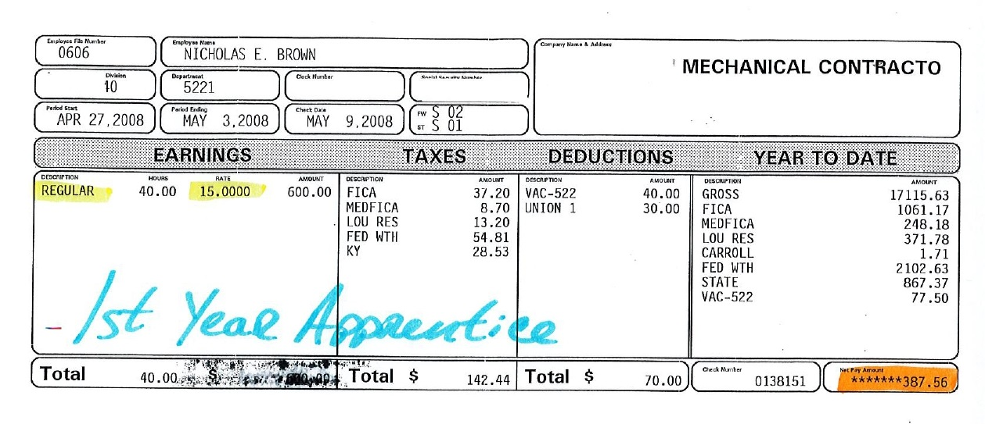
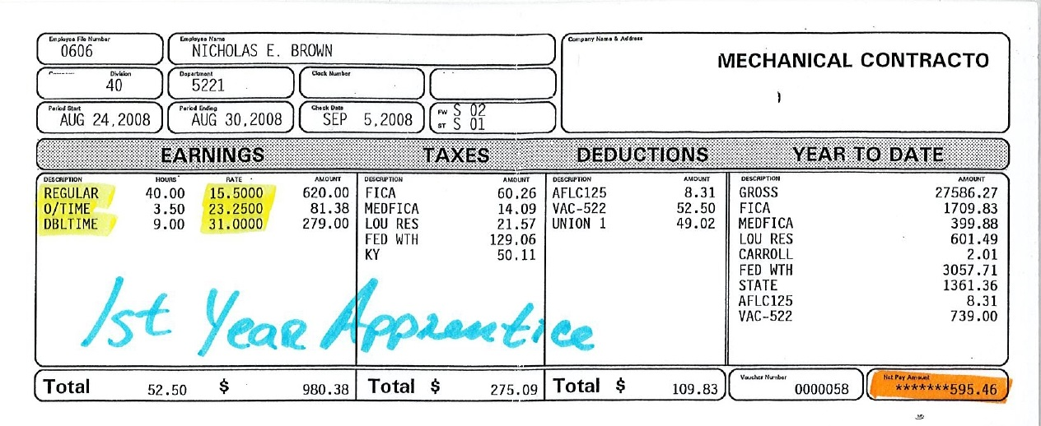
PROOF!!!

Slide 12
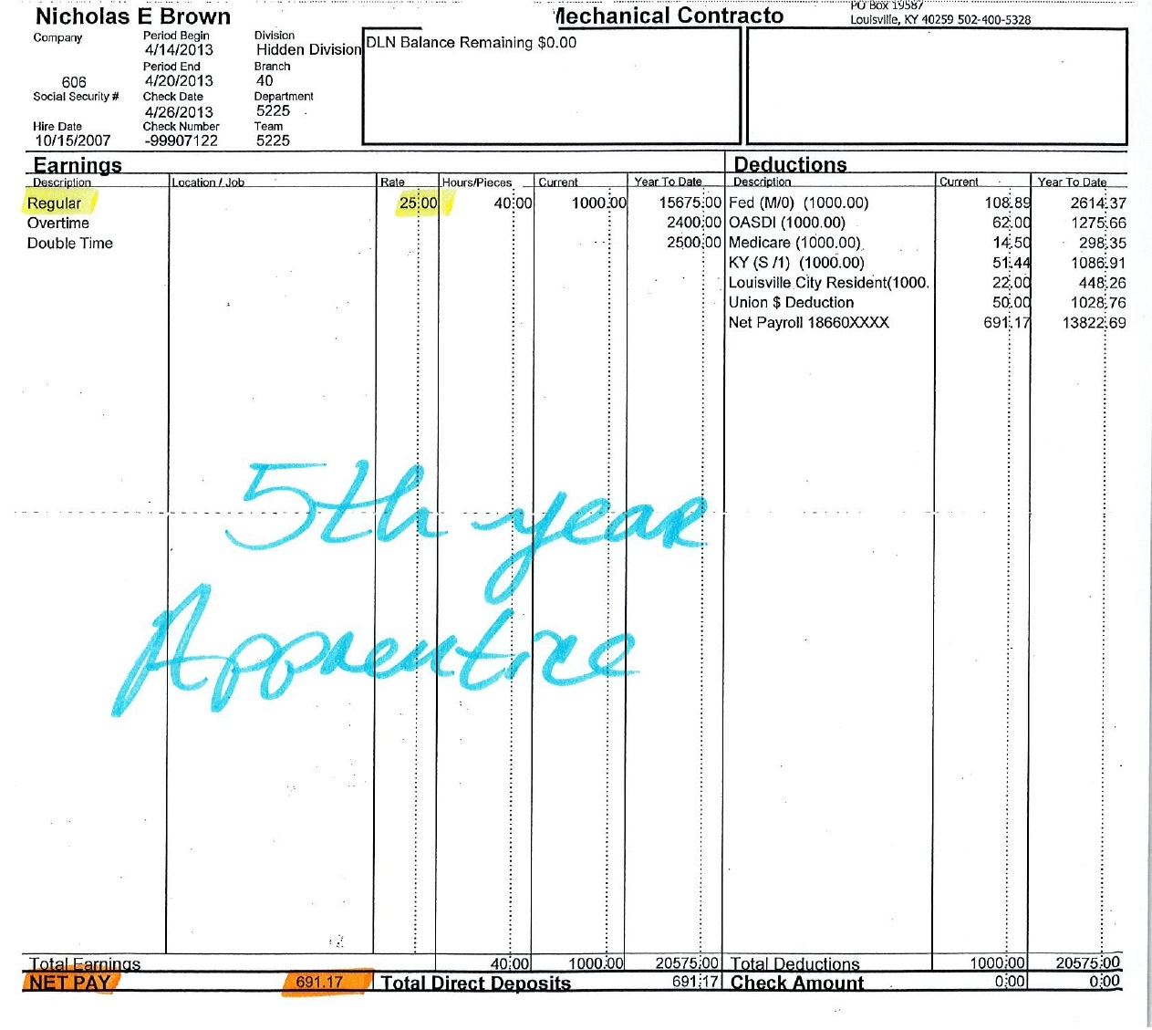
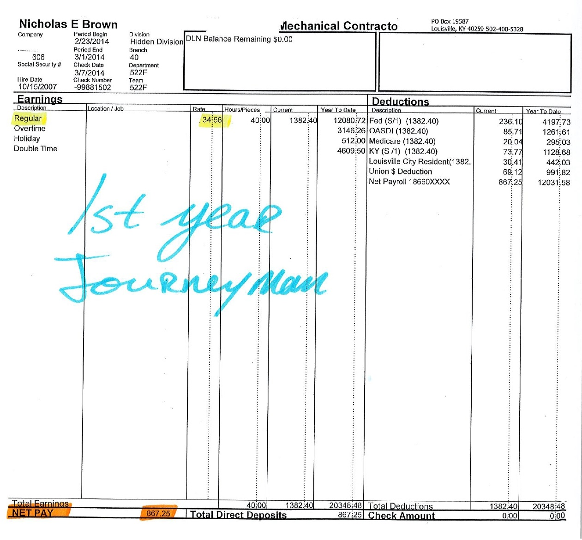
More PROOF!!!

Slide 13
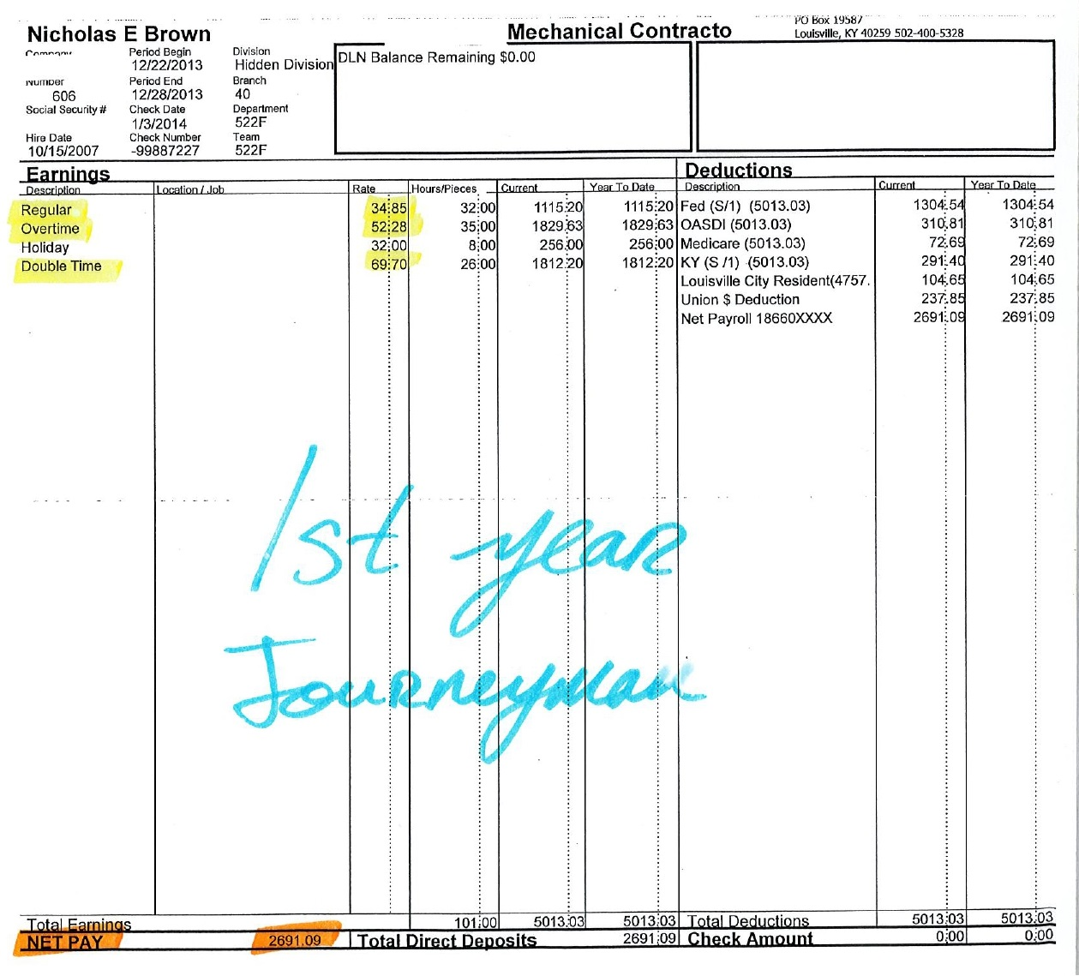
SACRIFICE

Slide 14
Requirements
What do I need to apply to
Local 502 Apprenticeship Program?

Slide 15
Requirements
Good Work Ethic
      Show up to work, everyday and on time!
      Stay busy, and look for things to do
      Stay off of your cell phone during work hours
Positive Attitude
      Eagerness to learn
Remain Drug Free
      All of our apprentices are drug tested yearly, and at times, randomly
Work ethic, attitude, and being drug free can’t be taught…
…WE CAN TEACH YOU THE REST!

Slide 16
The UNION Reputation
We are very aware that the title of “Union” comes with a reputation. To some, that reputation is a good one. To some, it’s a bad one…
To clarify:
We are a skilled trade Union. That means:
      We are NOT the UAW or Teamsters
      If you aren’t skilled, you won’t work
      If you are lazy, you won’t work
We do not have “seniority”
The Union will NOT fight for you to keep your job, if you’ve been rightfully terminated
The Union doesn’t strike very often
The majority of our work is located within an hour of the airport; most of our members NEVER travel, and remain employed year round

Slide 17
What does the Union offer?
It is true, we pay Union dues! Those dues pay for things such as:
Training
      From our Union dues, the apprenticeship program is funded
      Our wages are due largely in part to being highly skilled craftsman
Representation
      We make the money we make because we’re not only highly trained, but because we are united as a membership. Because we are united and skilled, we get to negotiate our wages with our contractors.
Management
      All of our benefits such as health insurance and our pension requires management. These funds, sometimes totaling to hundreds of millions, requires constant oversight, and split-minute decision making. Our Union dues pay the salaries of our officers to manage our benefits.

