Slide 1


Slide 2


Slide 3
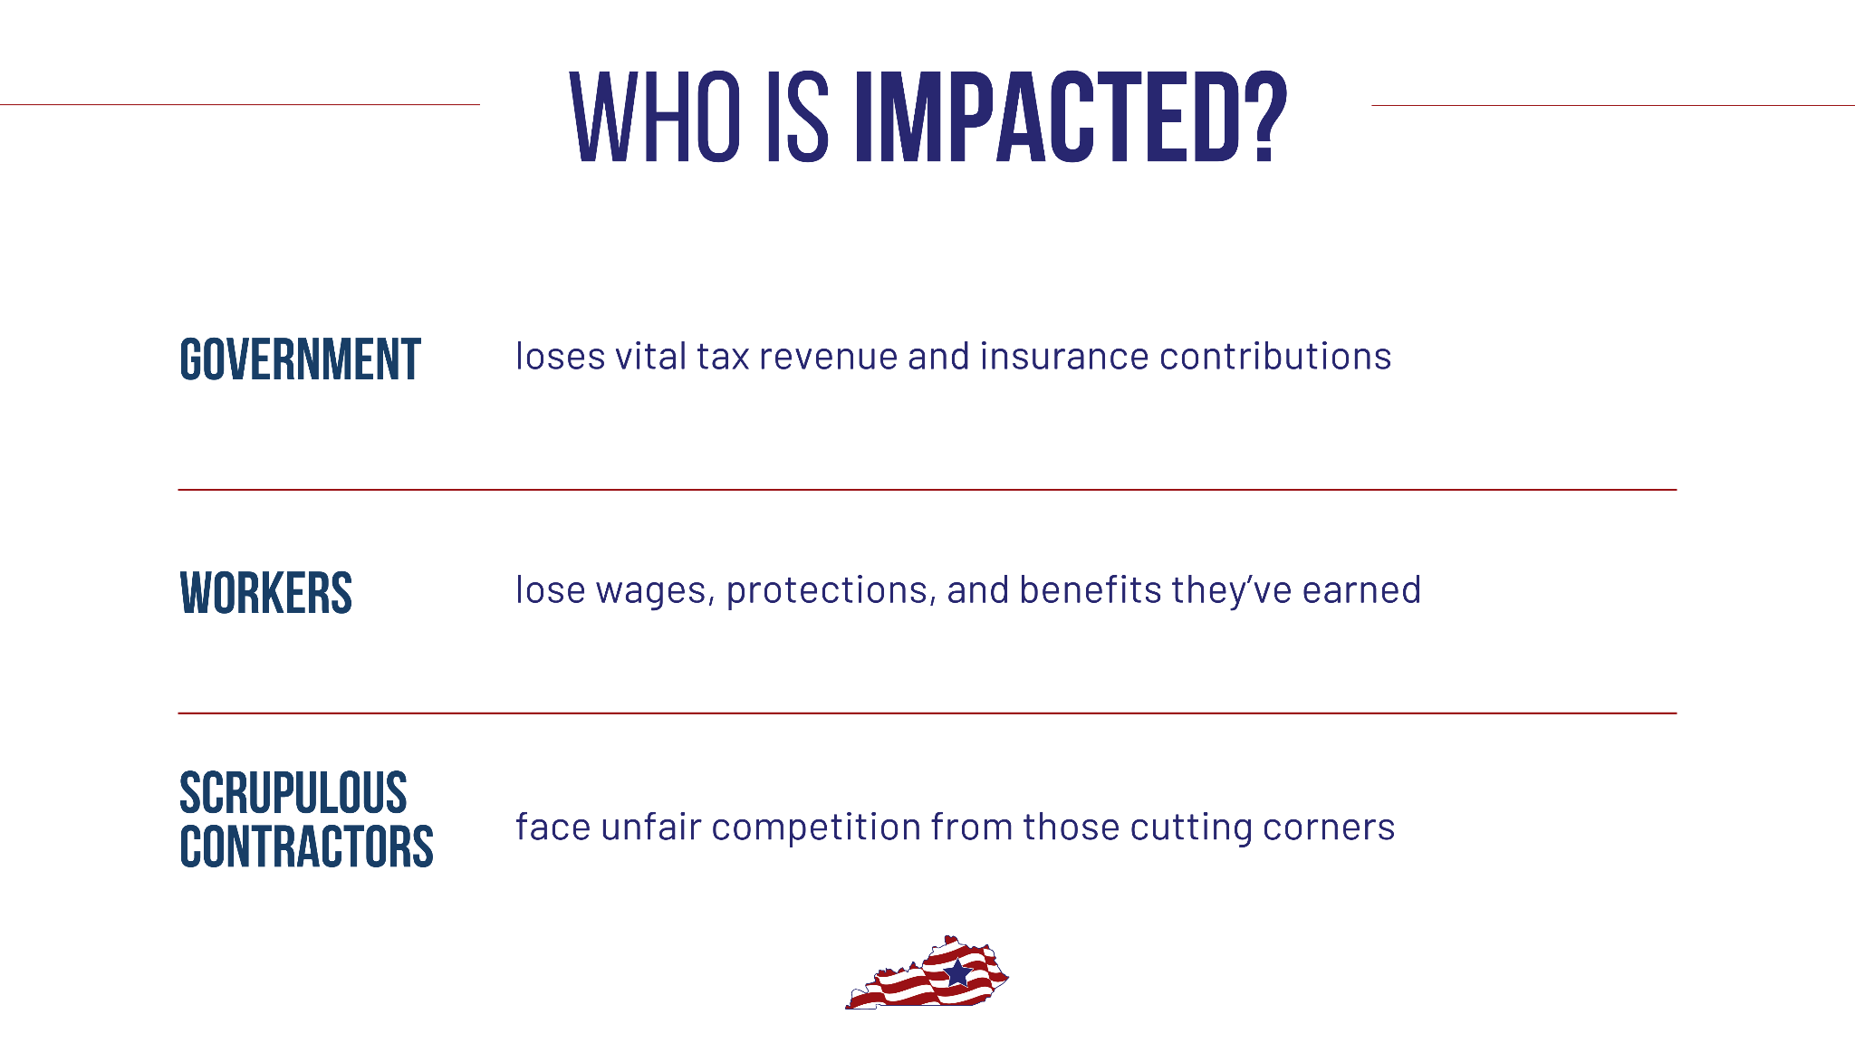

Slide 4


Slide 5


Slide 6


Slide 7


Slide 8

For more information, visit us at kentuckybuildingtrades.com

