Slide 1
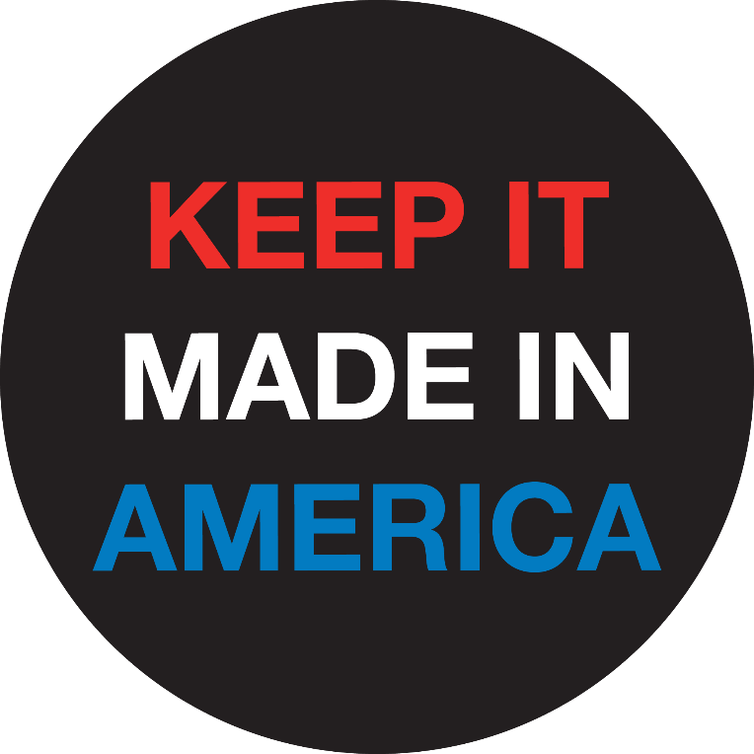
Kentucky Buy American Act
Creates new sections of KRS Chapters 45A, 56, and 65 requiring that state and local contracts contain a provision that any iron, steel, aluminum, manufactured goods used in all state and local projects be manufactured in the United States unless a waiver is granted

Slide 2
Buy America Policy
Establishes a procurement preference for U.S.-produced goods
Iron / Steel / Aluminum
Manufactured Products (e.g., a product with 2+ inputs)
Waivers allow foreign purchases to overcome short-term market limitations (e.g., excess cost / nonavailability / public interest)
Operates within international trade obligations to maximize the return on taxpayer spending
Notes:
Origin Standards in HB345:
- In the case of an iron, steel, or aluminum product, all manufacturing has taken place in the United States, except metallurgical processes involving the refinement of steel additives; and
- In the case of a manufactured good, all the manufacturing processes for the product and its components have taken place in the United States, regardless of the origin of a component's subcomponents;
Coverage:
- each contract for construction or maintenance of a public building or public works made by a governmental body after August 1, 2025, shall contain a provision that the iron, steel, aluminum, or manufactured goods used or supplied as a primary component in the performance of the contract and any subcontract shall be manufactured in the United States...
Waivers:
- request filed with purchasing agent
- Public comment period used to identify domestic sources before waiver is granted
Criteria for waiver approval
Inconsistent with the public interest
not manufactured in the United States in sufficient and reasonably available quantities or of a satisfactory quality
will increase the cost of the overall contract by more than ten percent (10%)
NOTE: The federal waiver threshold is 25%
Trade Obligatons:
Kentucky deliberately chose NOT to sign onto the Government Procurement Agreement (GPA), which means that its state and local procurement activities are not bound by GPA obligations. This allows Kentucky to maintain preferences for domestic (U.S.-made) goods without violating any international agreements.
The federal government also has reserved infrastructure projects from any international coverage, meaning Buy America laws are fully compliant with U.S. international obligations.

Slide 3
Jobs and a Stronger Economy
Reinvests tax dollars into the local and national economy
Promotes growth and expands the tax base
Creates more job opportunities for middle-class Americans
More jobs mean less demand for social safety net programs

Slide 4
More Factory Investments
Maximizes the return on taxpayer expenditures by reinvesting back into the local and national economy
Domestic preference promotes factory expansions in Kentucky and nationwide
Levels the playing field for domestic manufacturers who comply with U.S. environmental and labor standards but compete against unregulated imports

Slide 5
Stop Rewarding Outsourcing
Without a state Buy America law in place…
Kentucky’s tax dollars are creating jobs in China, India, and other countries
Kentucky’s spending strengthens China’s defense industrial base
Kentucky’s spending conflicts with its own public policy priorities (e.g., clean air and water, safe work environments, job creation)
Tax dollars reward companies that shift production overseas

Slide 6
Kentucky Already Complies with Federal Buy America
Compliance with a proposed state Buy American law means relying on existing compliance procedures with federal requirements
KY already complies with broader federal Buy America rules on federally assisted infrastructure projects
Federal Buy America laws have been in place for decades
The 2021 Build America, Buy America Act expanded existing Buy America rules to a) cover all projects and b) cover all materials and manufactured products
Note: The Kentucky bill is weaker than federal requirements.

Slide 7
Dozens of States Have Buy American Laws
Dozens of states have Buy America laws that create a procurement preference for American-made goods when they are available in sufficient quality and quantity and are competitively priced in the global marketplace
In the last 10 years Colorado, Illinois, Maryland, New Jersey, New Hampshire, New York, Pennsylvania, and Texas all joined the Made in America movement, and other states are close behind

Slide 8
HB345 Supporters
United Steelworkers (USW)
Alliance for American Manufacturing (AAM)
82% agree that taxpayer dollars should go toward infrastructure projects that utilize American-made products like iron, steel, and other construction materials versus foreign imported products (Morning Consult / Nov. 2024)
Presidents Trump and Biden have both advanced Buy America policies

Slide 9
Legislative History
February 2025: Rep. Flanery introduced HB345
January 2024: Rep. Blanton introduced HB326
February 2022: Rep. Miller introduced HB417

Slide 10
HB345 Sponsors
Republicans (6)
Patrick Flannery (District 96)
John Blanton (District 92)
Emily Callaway (District 37)
Scott Sharp (District 100)
Aaron Thompson (District 98)
Wade Williams (District 4)
Democrats (3)
Chad Aull (District 79)
Al Gentry (District 46)
Rachel Roarx (District 38)

Slide 11
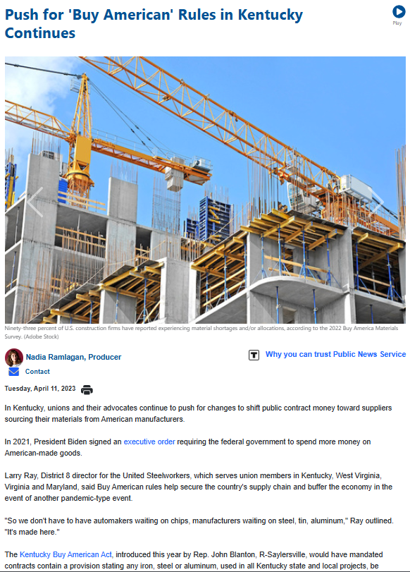
Pass the Kentucky Buy American Act

