Slide 1
Putting Young Kentuckians to Work
Myra Wilson
Cumberlands
Michael Gritton
KentuckianaWorks
First Year Update
November 20, 2025

Slide 2
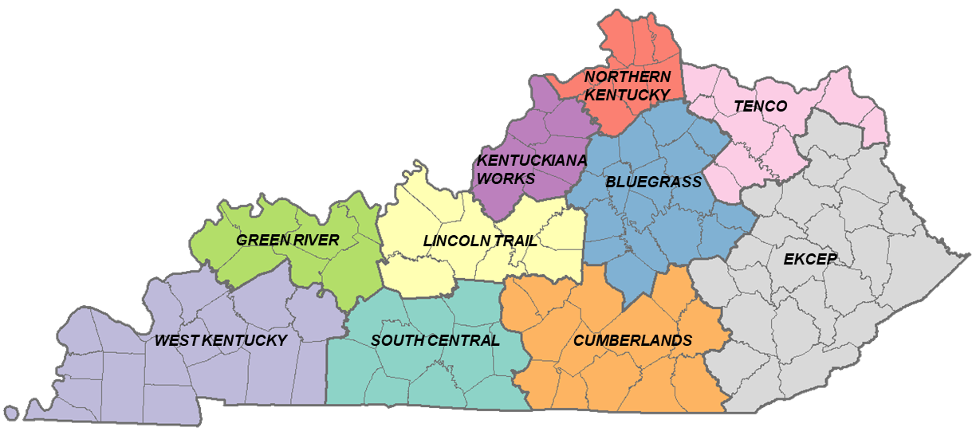
Funding under 2024 HB1
General assembly invested general funds in the state’s 10 local Workforce Development Boards for the first time under HB1 in 2024
$10 million a year for two years

Slide 3
Putting Young Kentuckians to Work
Funding provided an opportunity for local boards to:
Expand capacity to serve disconnected youth– 16-24 year-olds not enrolled in school and not working
Invest in high school seniors without a postsecondary plan that puts them on a path to stable employment
Local boards could be flexible in solving workforce challenges in their communities, but the end goal for all areas is Putting Young Kentuckians to Work
Goal of 3,604 job placement over two years

Slide 4
The need is great
If not successfully transitioning to stable employment, young people run the risk of becoming disconnected
12% of the state’s young adults were disconnected from work and school in 2023, nearly 64,000 people (Source: IPUMS)
Kentucky’s employers need talent
Two-thirds of KY employers said there is not an ample supply of trained workers (Source: KY Chamber)
Employers most frequently cited workforce development as a priority policy issue (Source: KY Chamber)

Slide 5
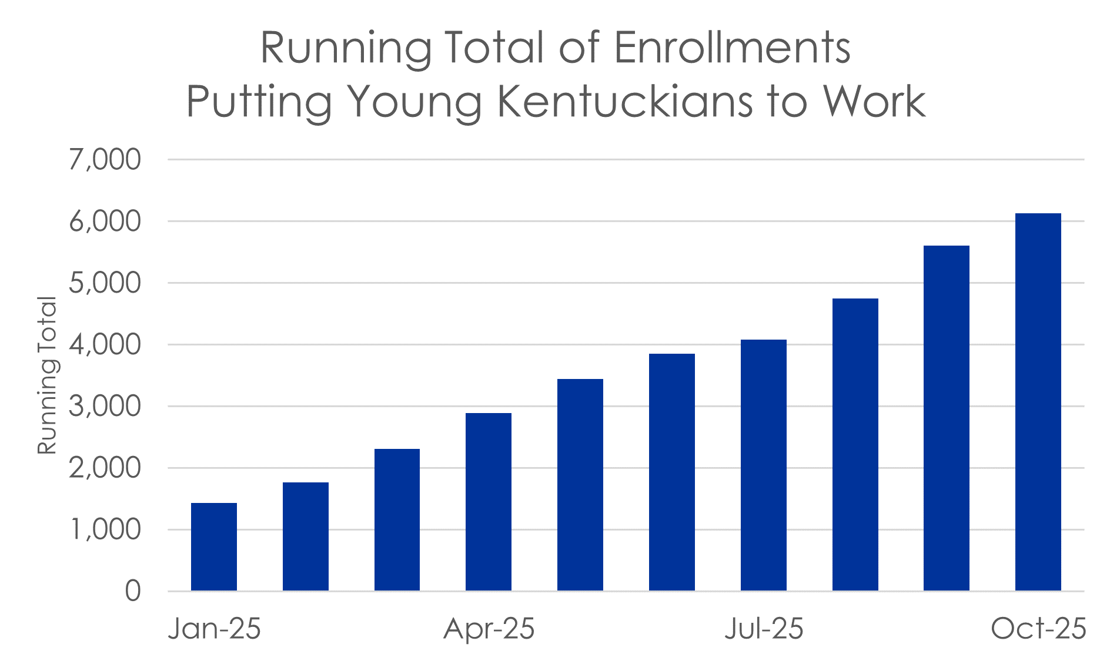
Enrollment growth shows a promising pipeline
Typical services received after enrollment include:
Custom career planning
Career/Skills/Interest assessment
Career exploration
Labor market information
Resume development

Slide 6
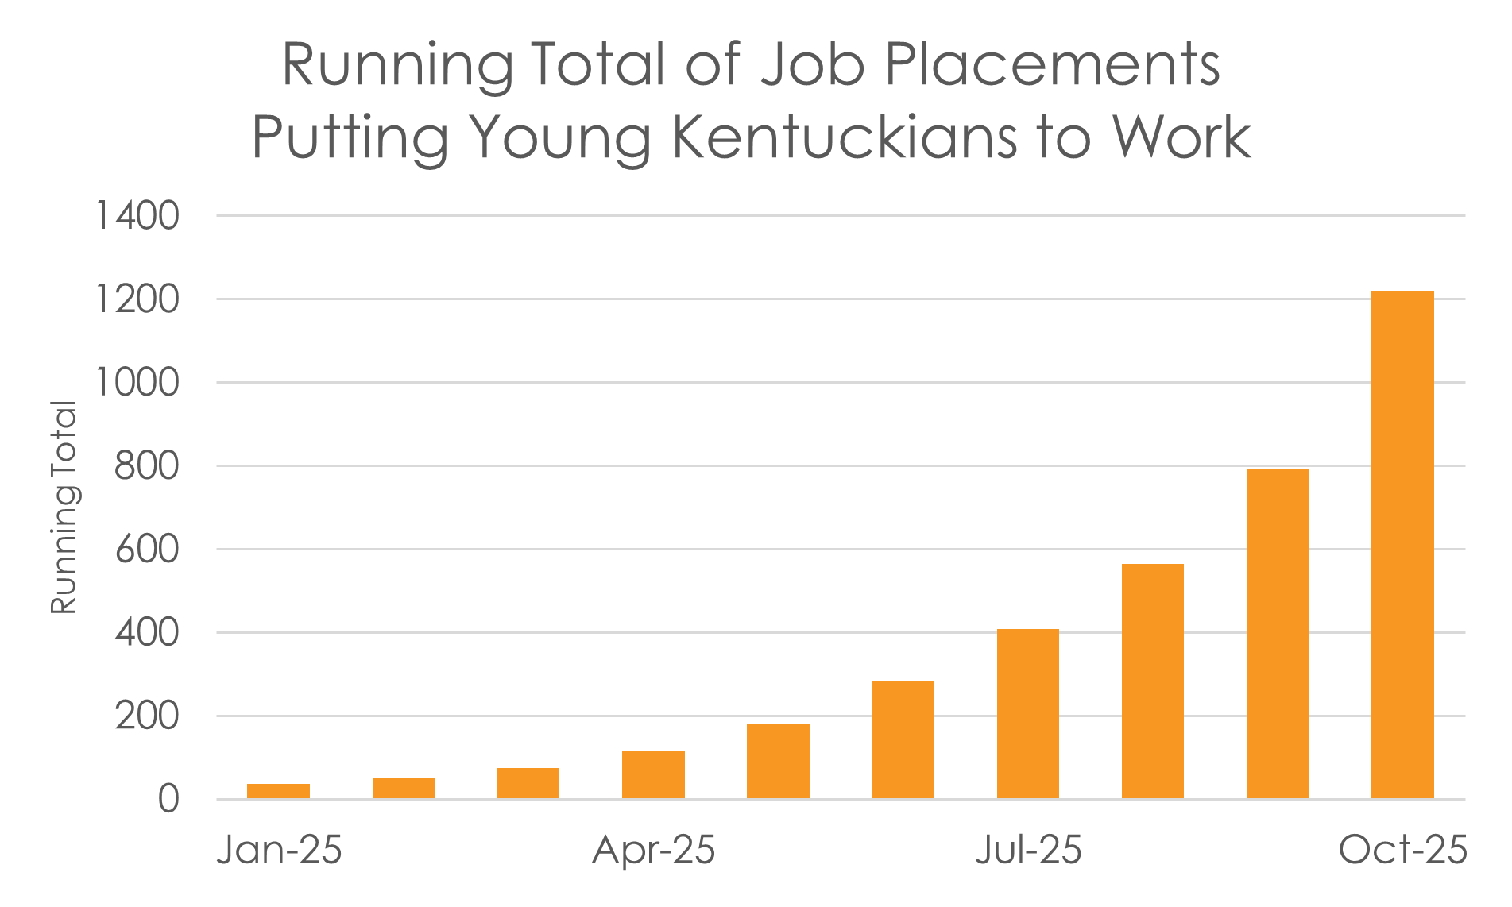
Job placements have increased significantly this FY
1,218
JOB PLACEMENTS
through October 2025

Slide 7
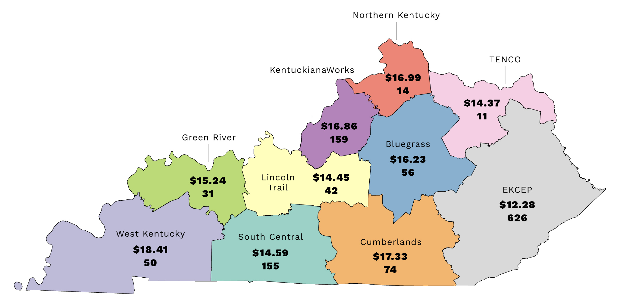
Average wage and
job placements
by region

Slide 8
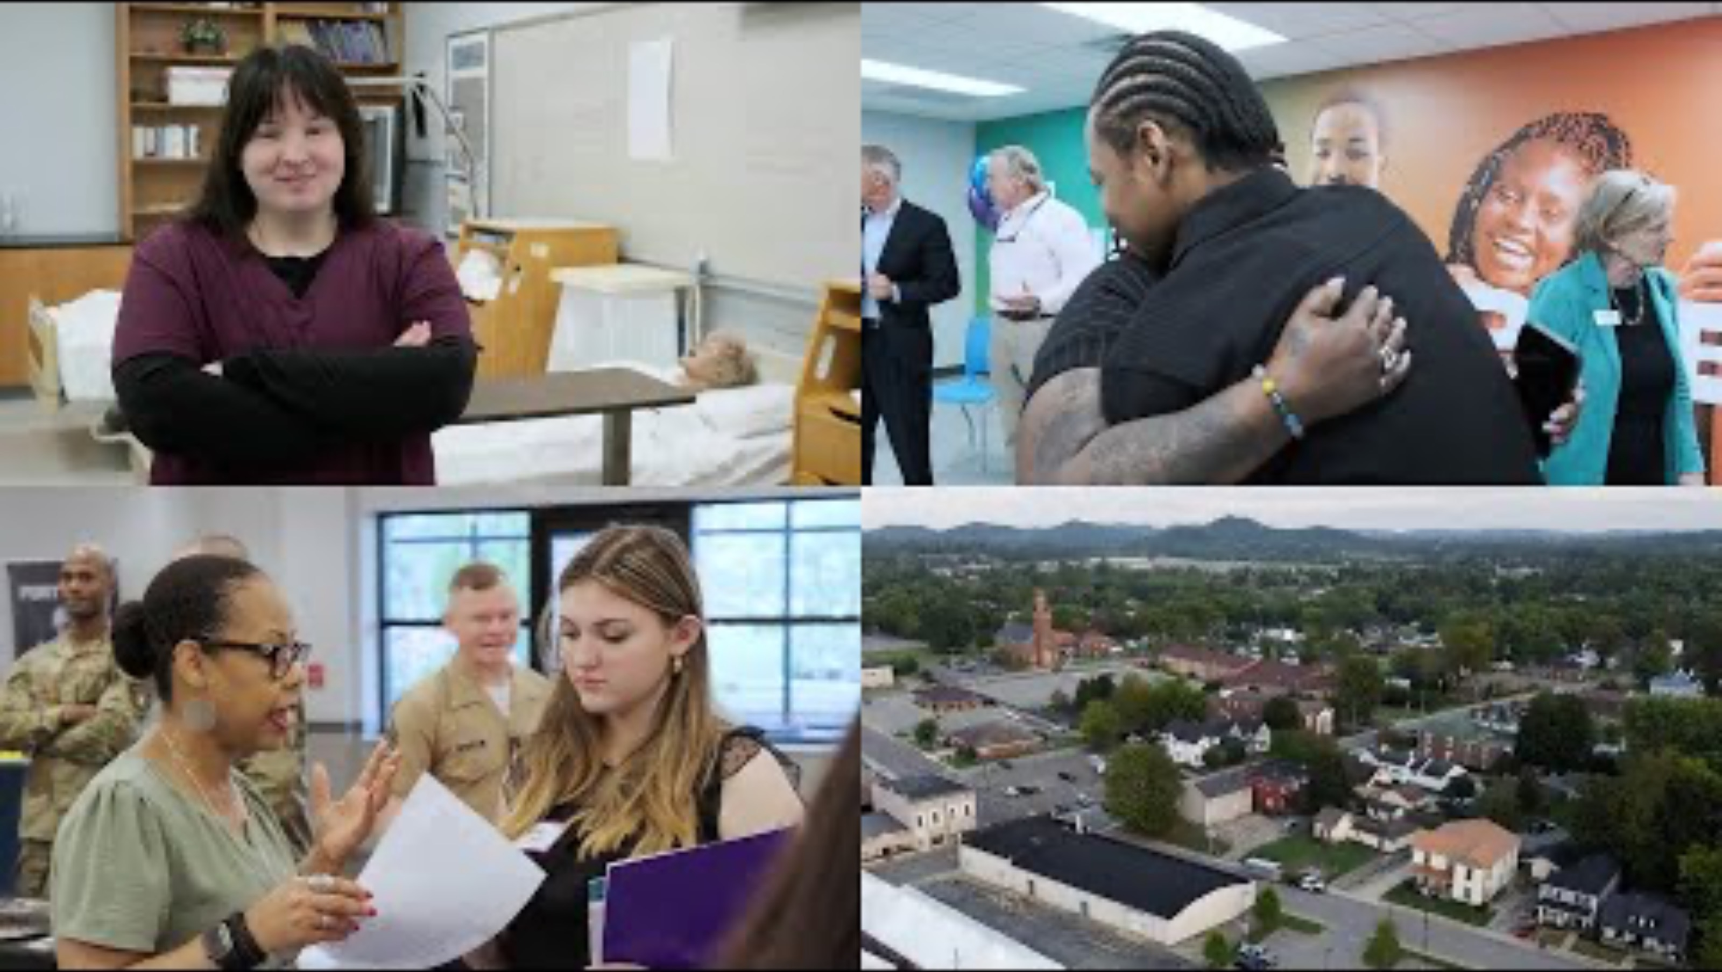

Slide 9
Local solutions for local challenges
Learn how Putting Young Kentuckians to Work is being implemented across the Commonwealth

Slide 10
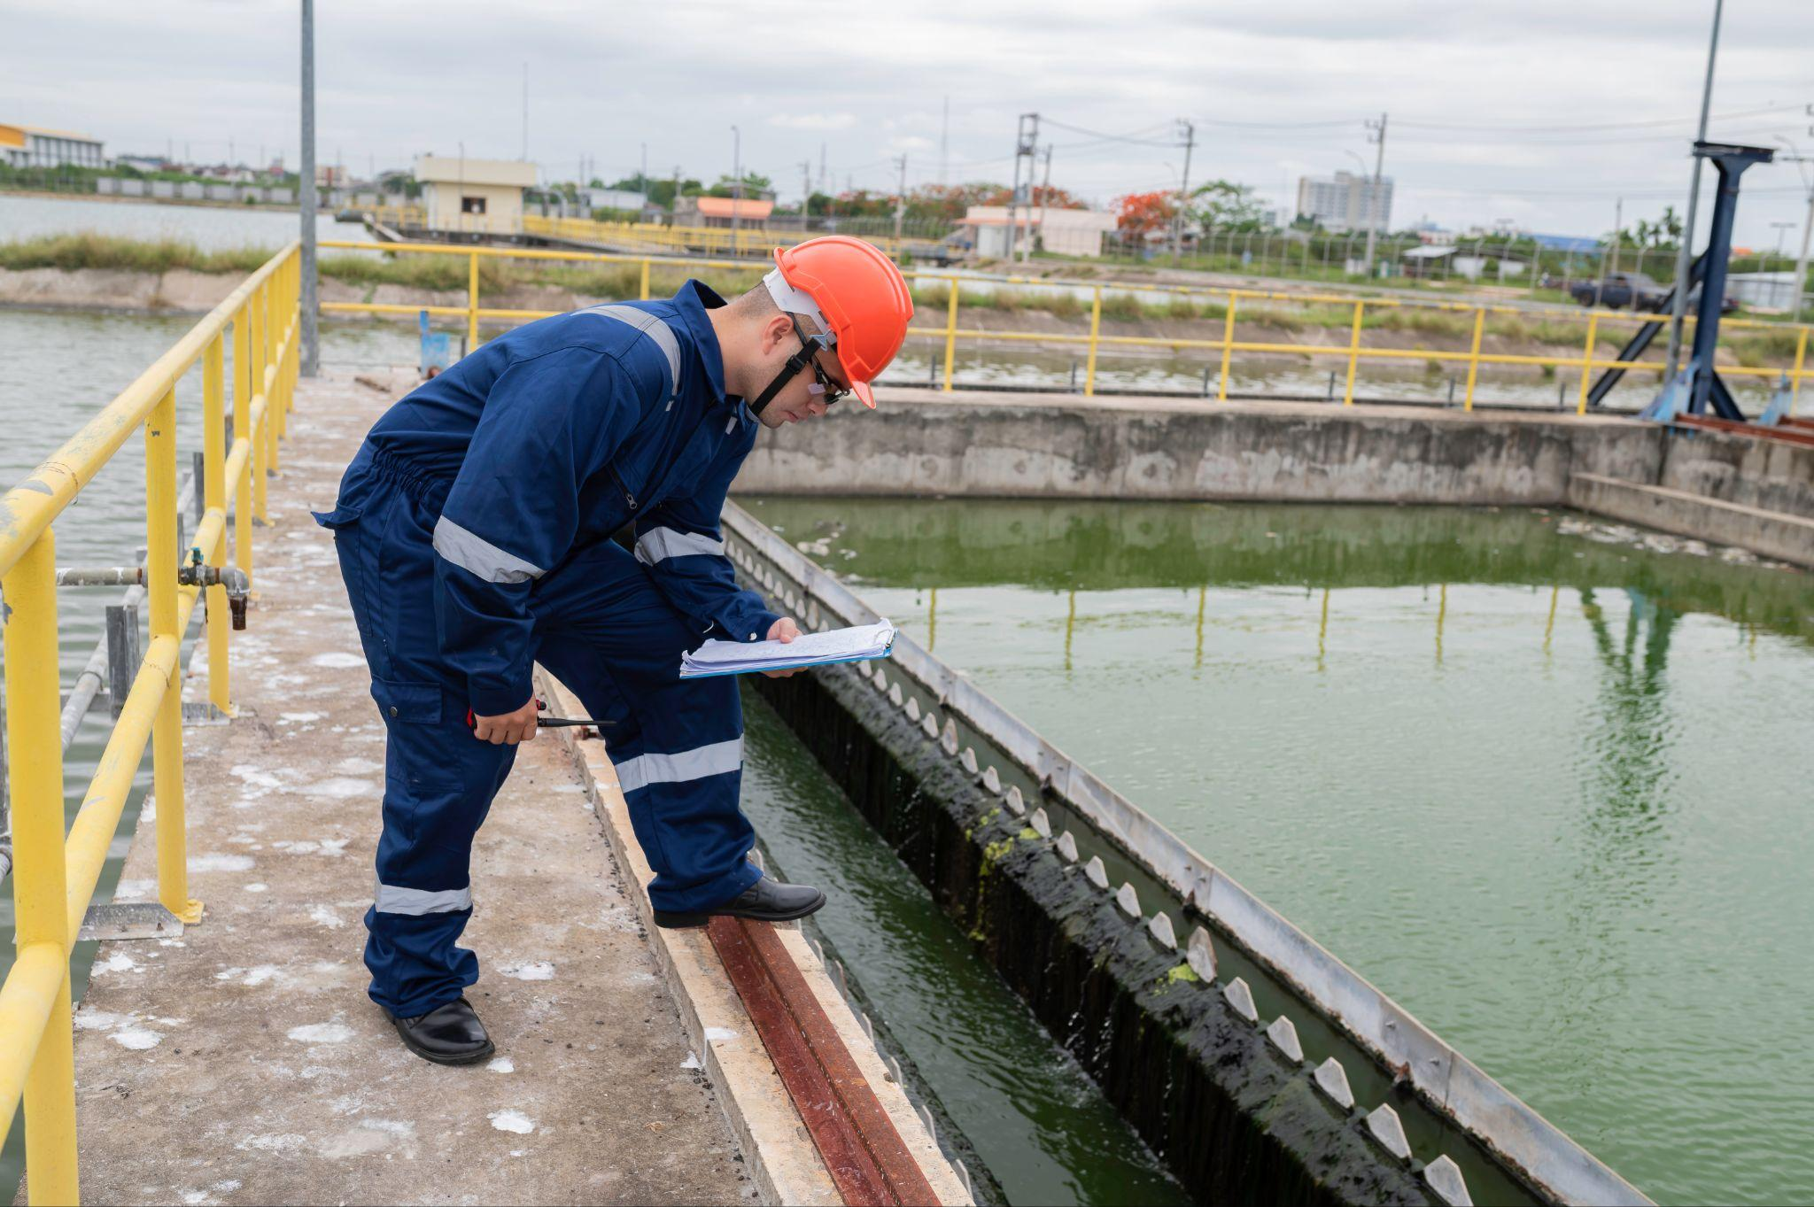
Bluegrass
Anderson, Bourbon, Boyle, Clark, Estill, Fayette, Franklin, Garrard, Harrison, Jessamine, Lincoln, Madison, Mercer, Nicholas, Powell, Scott, Woodford
“I had the opportunity to take a school field trip to the water plant. I really needed a job and a good career plan for when I finished school. As we were touring, I really thought this was something I could do for a career. I am not sure what I would be doing for work if I hadn’t done this.” - Trinton, Putting Young Kentuckians to Work participant
Job training pipelines for young adults in fields like healthcare and the skilled trades

Slide 11

Cumberlands
Adair, Casey, Clinton, Cumberland, Green, Laurel, McCreary, Pulaski, Rockcastle, Russell, Taylor, Wayne, Whitley
Job training to help young adults earn CDLs, certifications to become electrical linemen, and other in-demand occupations
“This certification has enabled me to instruct students on flying a plane in reference to instruments…I appreciate the assistance of the program and being one step closer to a Commercial Airline Pilot.” - Cameron, Putting Young Kentuckians to Work participant

Slide 12
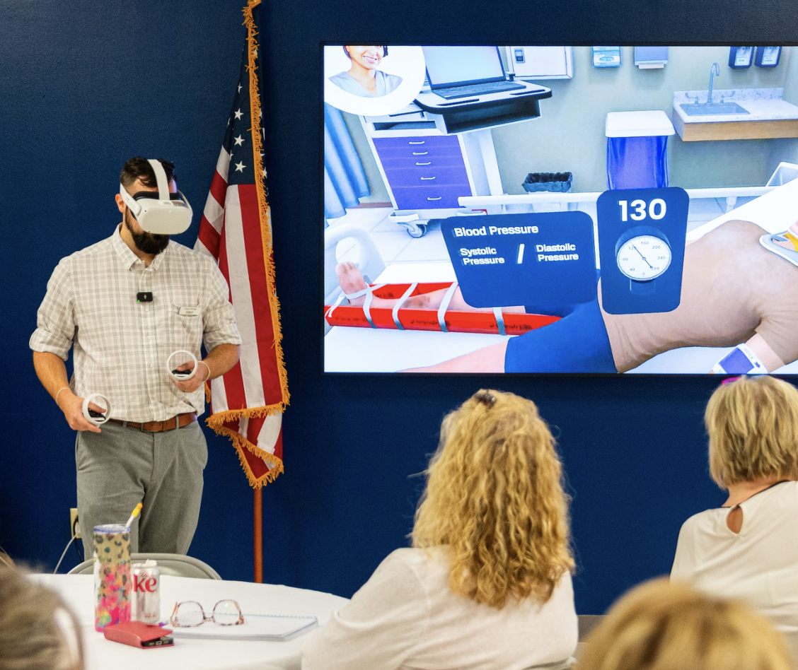
EKCEP
Bell, Breathitt, Carter, Clay, Elliott, Floyd, Harlan, Jackson, Johnson, Knott, Knox, Lawrence, Lee, Leslie, Letcher, Magoffin, Martin, Menifee, Morgan, Owsley, Perry, Pike, Wolfe
Paid internships for hundreds of high school seniors
Career exploration with virtual reality kits
One-on-one career planning with certified career development specialists
Prosper Appalachia is empowering high school students in Eastern Kentucky with the skills and resources needed to succeed in the modern workforce and providing opportunities to enter careers close to home.

Slide 13

Green River
Daviess, Hancock, Henderson, McLean, Ohio, Union, Webster
“Thanks to the Putting Young Kentuckians to Work program, I found meaningful work after being turned away elsewhere due to my disability. I finally feel empowered to pursue the things I enjoy…This program gave me the chance to work and thrive where others saw only limitations.” - Omarion
Work-based learning opportunities, job search assistance, supportive services, and soft skills development

Slide 14
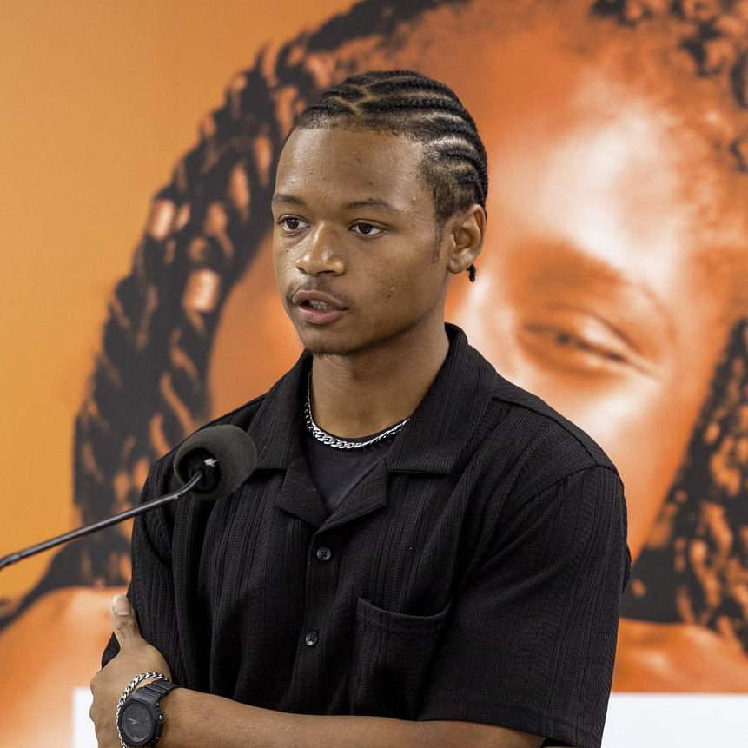
KentuckianaWorks
Bullitt, Henry, Jefferson, Oldham, Shelby, Spencer, Trimble
“
Custom hiring fairs for high school seniors
Expanded young adult opportunity center (a partnership with Goodwill Kentucky) for disconnected 16-24 year olds
“
“My goal was to get certified in a trade and that’s what they helped me with…This has changed the trajectory of my career.” - LaVar

Slide 15

Lincoln Trail
Breckinridge, Grayson, Hardin, LaRue, Marion, Meade, Nelson, Washington
Comprehensive youth career services program
Short-term training programs in healthcare, transportation, construction, and electrical line work
“”
School can only give you so much…this really helped me get a better grasp on what I was doing and I’m very, very thankful.
Hannah

Slide 16

Northern Kentucky
Boone, Campbell, Carroll, Gallatin, Grant, Kenton, Owen, Pendleton
New online platform for work-based learning opportunities
Bringing educators to tour companies in high-demand sectors
“I have moved out of my parents house, I am making more money than I ever have, and I now have a career path I enjoy coming to every day.” - Shelby, Putting Young Kentuckians to Work participant

Slide 17
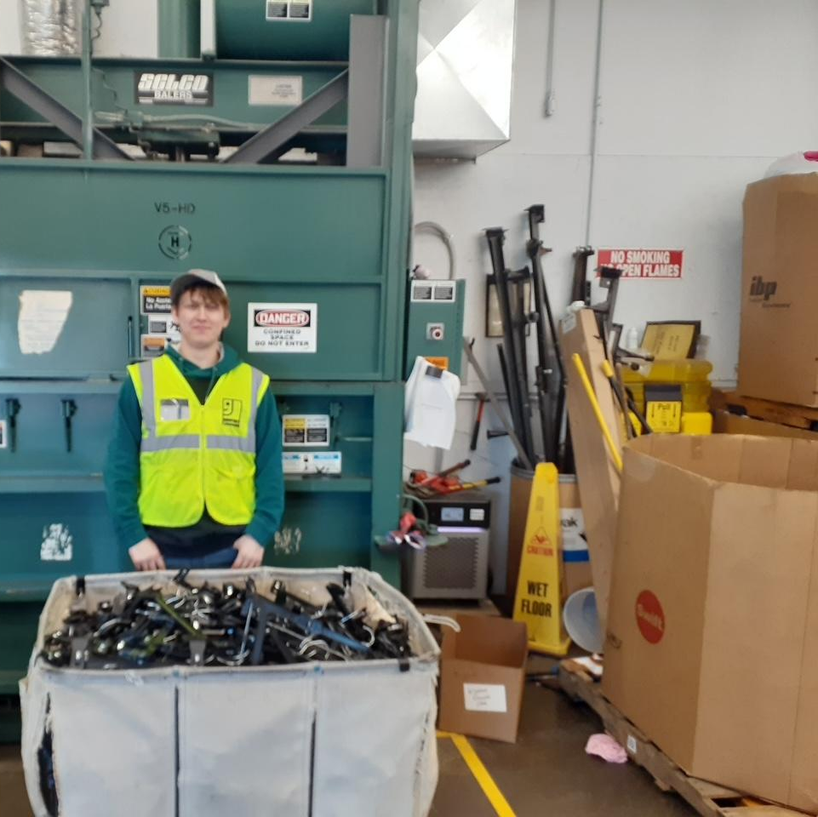
South Central
Allen, Barren, Butler, Edmonson, Hart, Logan, Metcalfe, Monroe, Simpson, Warren
Career coaching and job placement, plus ongoing soft skills support
Abram had no resume, no formal work history, and few vital documents. He left school in junior high and spent his teenage years involved with drugs and the justice system. With our help in removing barriers, he was hired as a Material Handler, now working 30–40 hours weekly and planning for his first vehicle purchase.

Slide 18
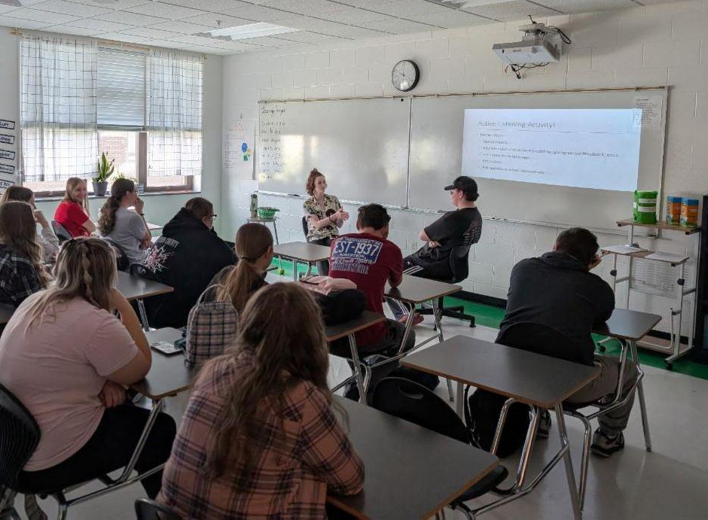
TENCO
Bath, Boyd, Bracken, Fleming, Greenup, Lewis, Mason, Montgomery, Robertson, Rowan
Pathways that help young people gain work readiness skills, short-term training, and hands-on experience through subsidized work experiences and on-the-job training
Photo: Putting Young Kentuckians Career Coach holds an interviewing workshop with Robertson County Schools. Workshops offered for students include career exploration, job preparation, and professionalism and social etiquette.

Slide 19
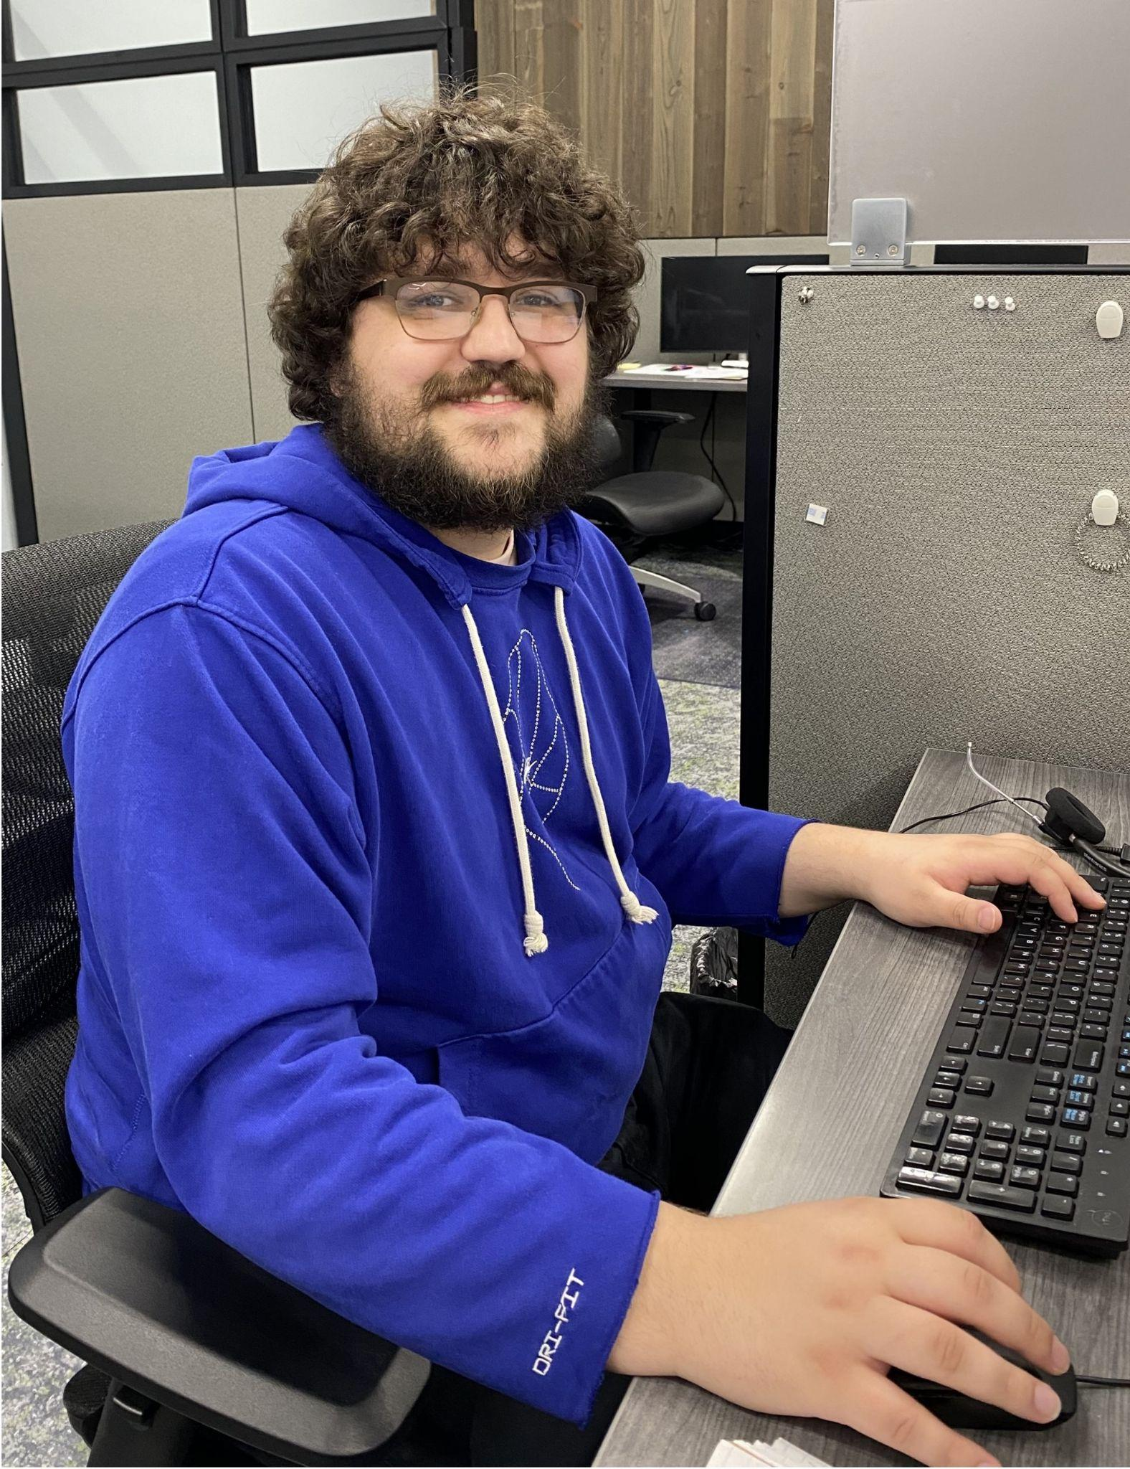
West Kentucky
Ballard, Caldwell, Calloway, Carlisle, Christian, Crittenden, Fulton, Graves, Hickman, Hopkins, Livingston, Lyon, Marshall, McCracken, Muhlenberg, Todd, Trigg
Individual training scholarships for welding, healthcare, and transportation
Funding for on-the-job training
Alec, an Army Veteran, was eligible for On-the-Job Training through Putting Young Kentuckians to Work. He now works for Paschall Truck Lines in Murray, Kentucky where he assists drivers with problems they encounter on the road.

