Slide 1
Kentucky Manufacturing Extension Partnership KY-MEP
“We Solve Manufacturing Problems”
uofl.edu/manufacturing | (502)852.9621 | KYMEP@louisville.edu

Slide 2
We Solve Manufacturing Problems
Mission
Solving Kentucky manufacturers problems through operational efficiencies, automation technologies, development of leaders, and igniting innovative growth.
Vision
Strengthen Kentucky manufacturers with world class, emboldened resources.

Slide 3

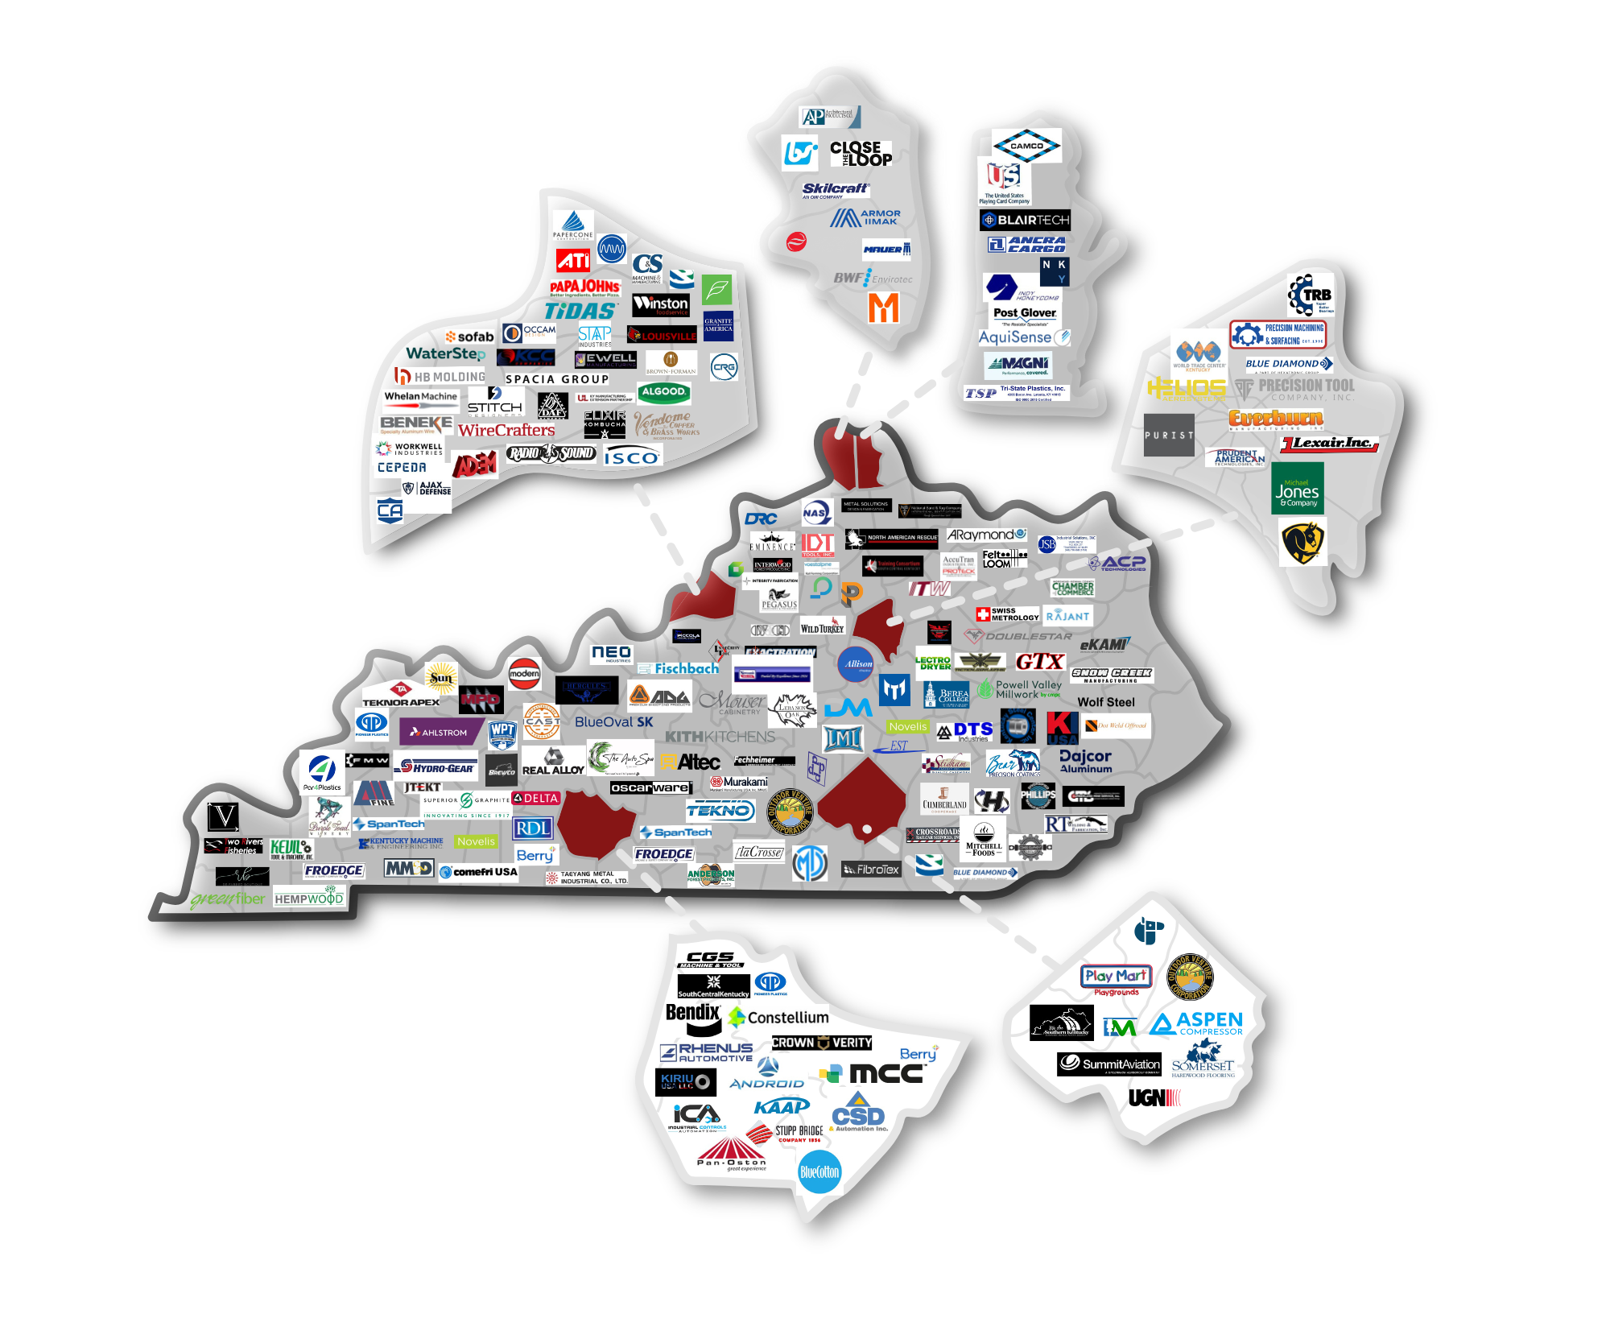


KY-MEP Stakeholders

Slide 4
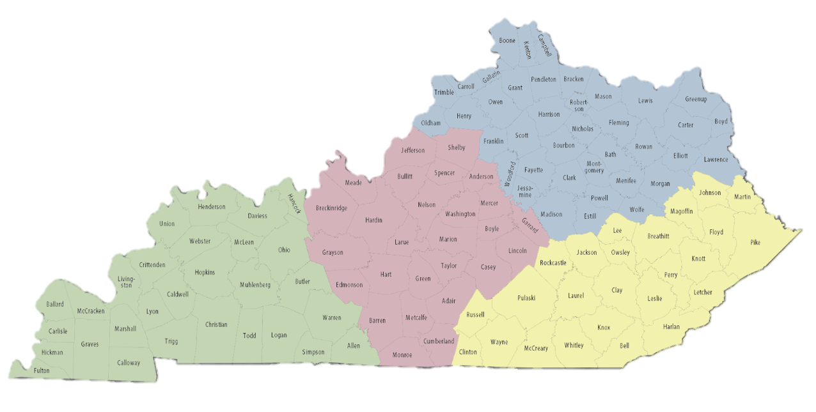
Regional Structure
Divided into 4 outreach regions
Each with Client Services Manager
Managed by Director of Client Services
Northern KY Region
Central KY Region
Eastern KY Region
Western KY Region

Slide 5
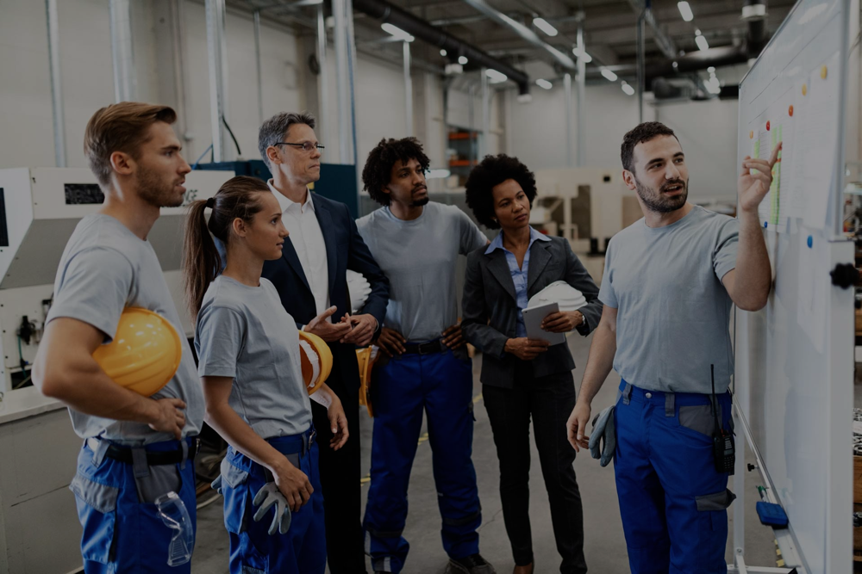
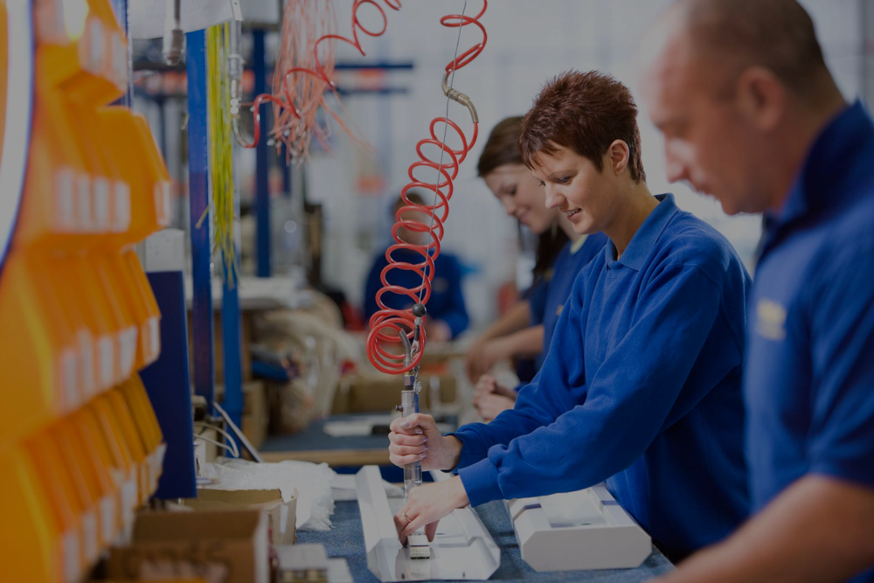
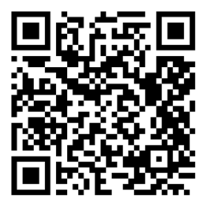
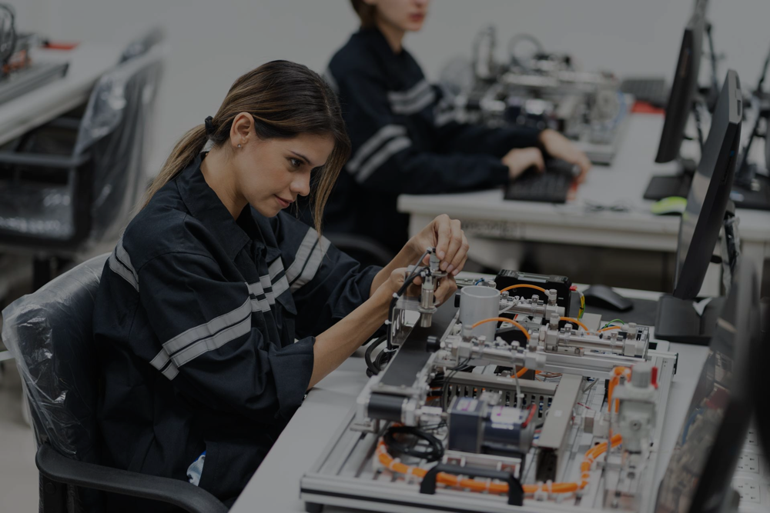
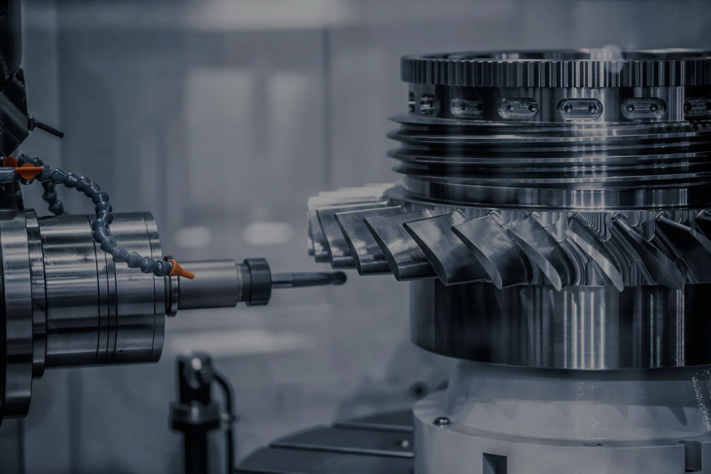
We Solve Manufacturing Problems
LEADERSHIP AND CULTURE
GROWTH AND INNOVATION
OPERATIONS AND EFFICIENCY
AUTOMATION TECHNOLOGIES

Slide 10
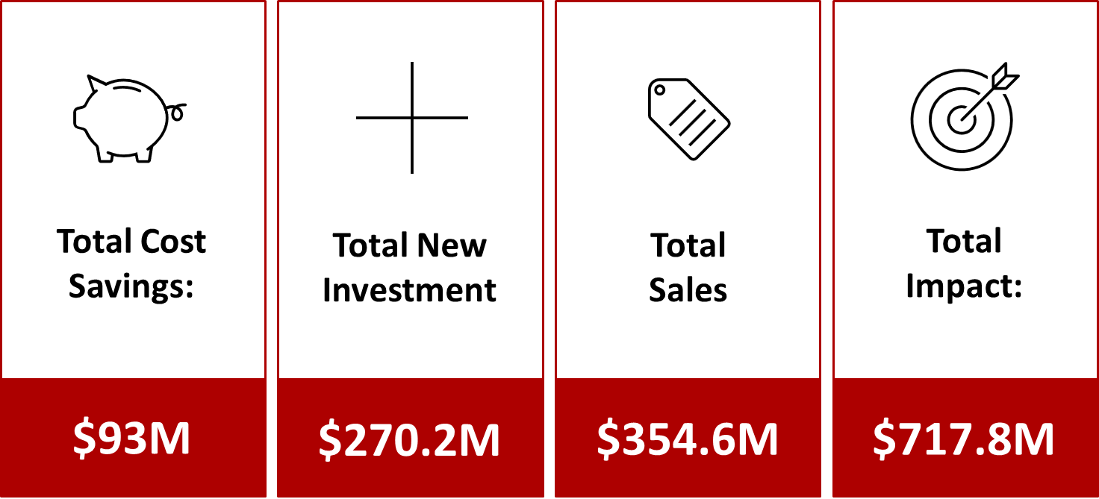
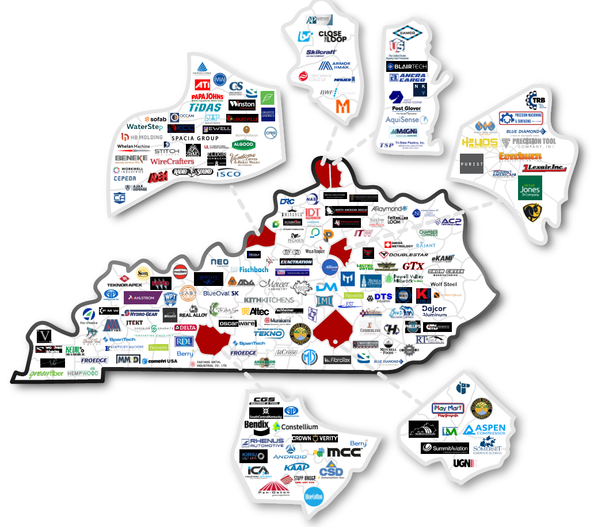
5-Year Heat Map of KY-MEP Clients

Slide 11
”Working with the KY-MEP has been a rewarding learning experience and helped NAS to understand and implement Value Stream Mapping principles to Material Handling Movements.”
“We’ve seen a major cost savings of over $23,000/ month. The tools that are taught can apply to almost any process.”
“The Relationship that we have with this outstanding group of professionals continues to grow. The KY-MEP has assisted our staff with training that is not only relevant now, but it heling us build a strong cornerstone for our operations for many years to come.”

Slide 12
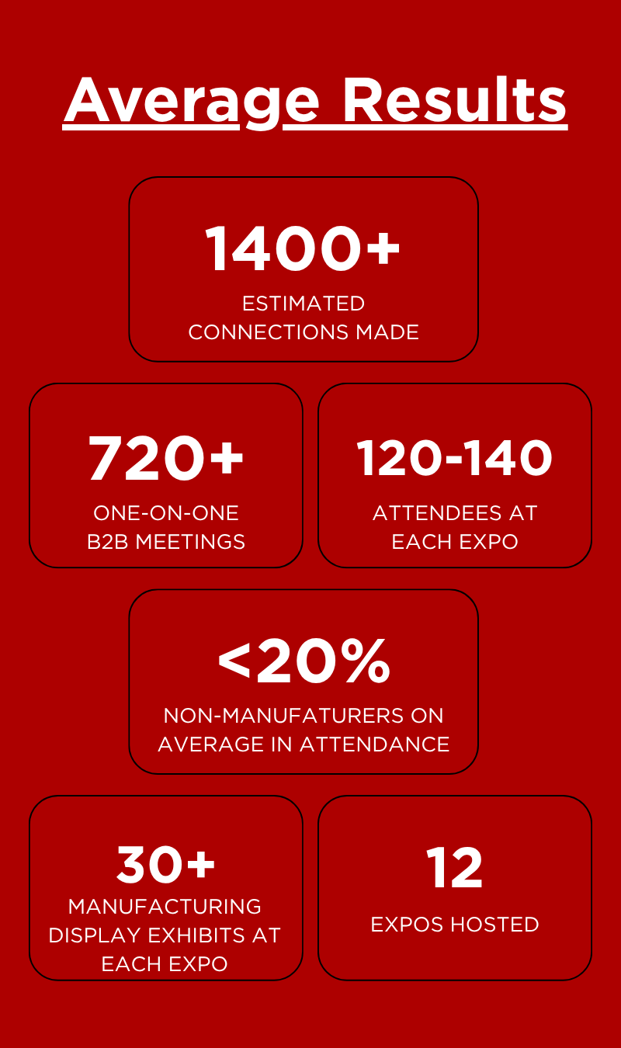
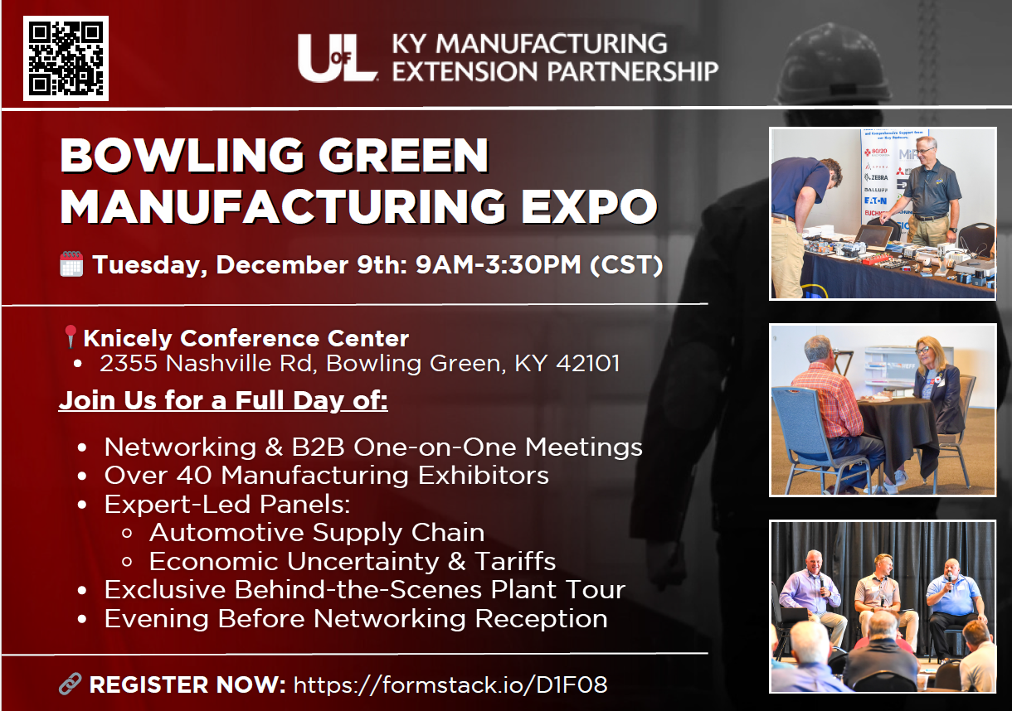
Manufacturing Expos in partnership with KY Cabinet for Economic Development
2024-2025 Expo Locations
Louisville
Lexington
Florence
Murray
Somerset
Owensboro
Richmond

Slide 13
Quotes from expo participants
Kelly McCane, General Manager, FITS Trailer Rentals- Panelist & Exhibitor
“As soon I finished the panel discussion, I had a potential client come right over to me to introduce herself and say that you had no idea about the solutions a trailer rental company could provide. Since I met her, I have had 2 meetings with them, and we are in final stages of a deal for her company.”
Chase Barker, Operations Manager, Machine Time Inc – Panelist, Exhibitor, & Sponsor
“The most valuable aspect of the event for us it to meet other manufacturers in the state and develop those relationships. These events are free, which is a huge deal, I have spoken to many companies that talk about how they are not doing events because you always must pay $500+ to get a booth.“
Ryan Cook, Plant Manager, Pioneer Plastics – Exhibitor & Attendee
“The event helped me achieve my business goals by putting me face to face with others not only in my industry but within industries that I can help. I am currently in talks with a few companies that I had spoken to at the Expo. I am very optimistic that the meaningful conversations had at the Expo will flourish into a long-term collaboration.”
Bill Plutnick, Founder, Swiss Metrology – Repeat Exhibitor & Attendee
“Do you know how much time and money it would take me to be in the same room with this many people let along talk to them? I am unaware of any other opportunity to do this. We walk away from each event with real leads and opportunities.”

Slide 14
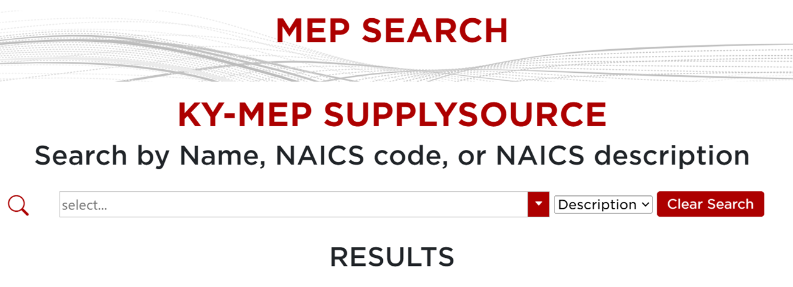
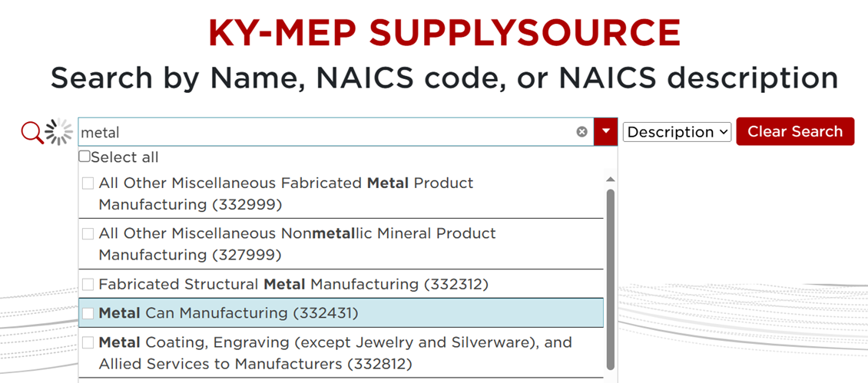
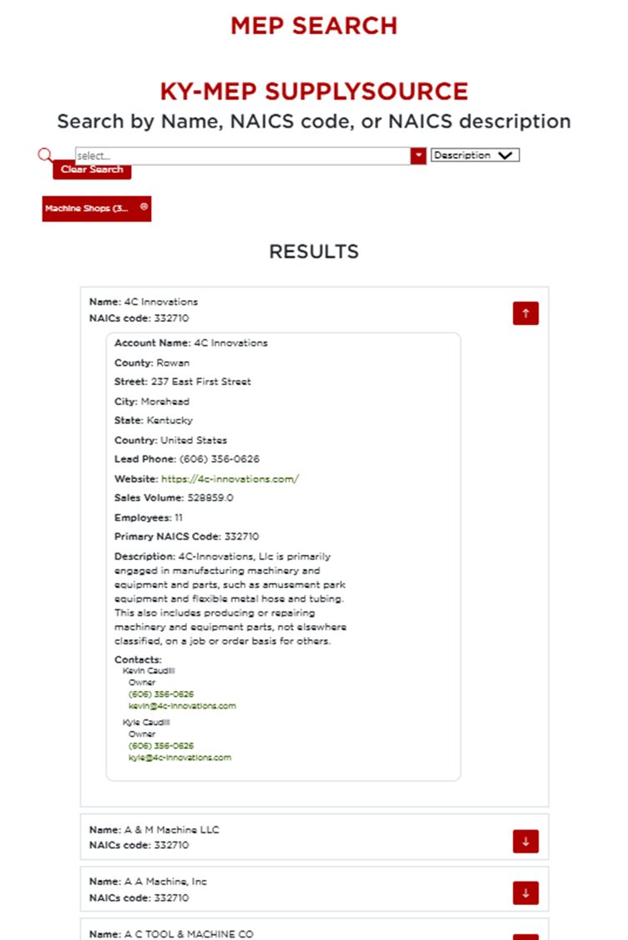
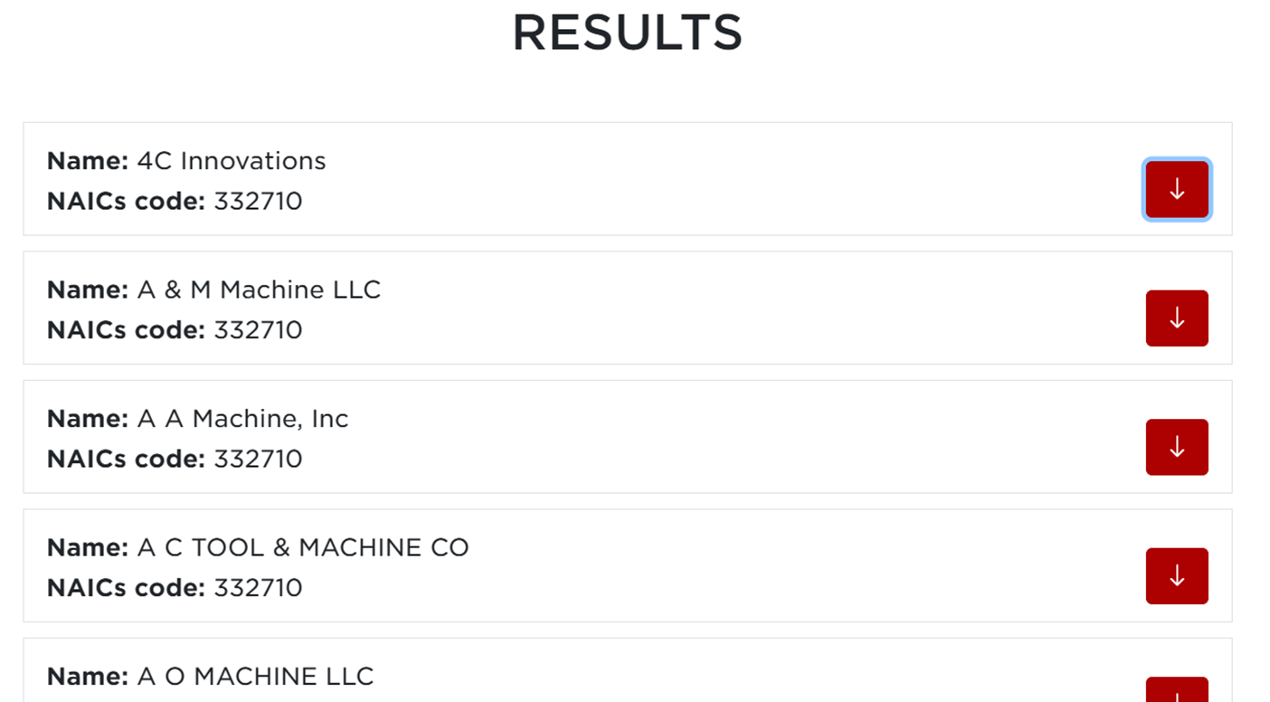
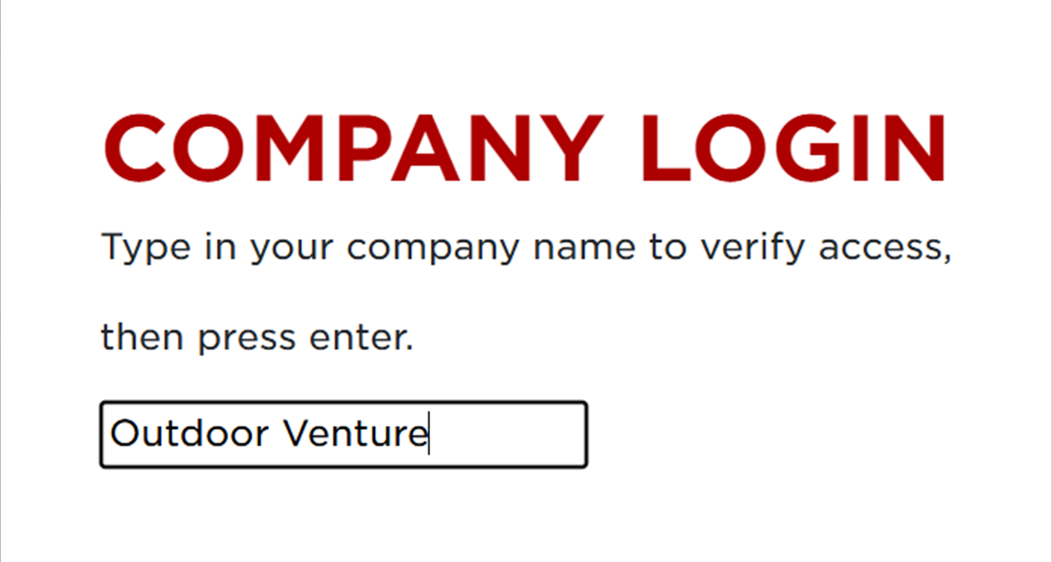
Created a Statewide Supply Chain Database in partnership with KY Cabinet for Economic Development
Database Features
Functional
Pulls from KY-MEP Salesforce
4573 KY SME’s
12K+ contacts
(added 2920+ new contacts in past 10 months alone)

Slide 15
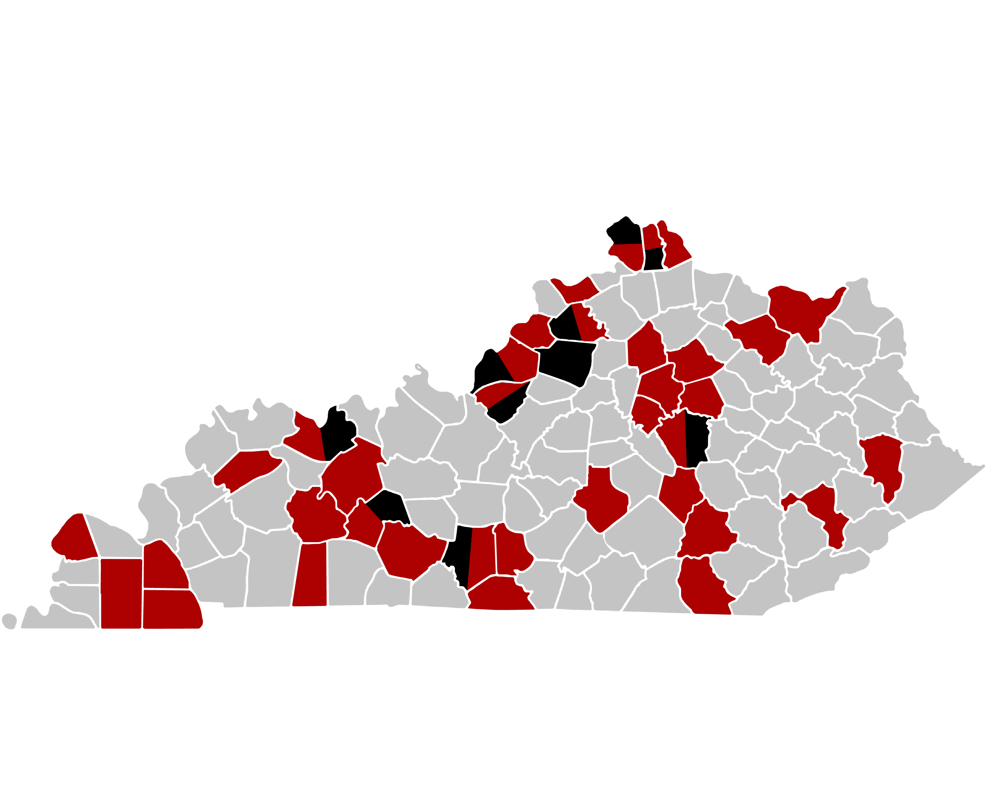
Catalyst Equipment Match (CEM)
Year 1 Statistics
Year 2 Statistics
(July 1, 2025 – October 31, 2025)
$12.5
Total ROI
120
Jobs Created
5.4:1
Leverage Ratio
$8.8M
Total ROI
135
Jobs Created
15.5:1
Leverage Ratio
$3.45M
Total Match (Funding)
$6.9M
New Wage Growth
$21.7M
Project Budgets Supported
$1.09M
Total Match (Funding)
$8.65M
New Wage Growth
$34.5M
Project Budgets Supported

Slide 16
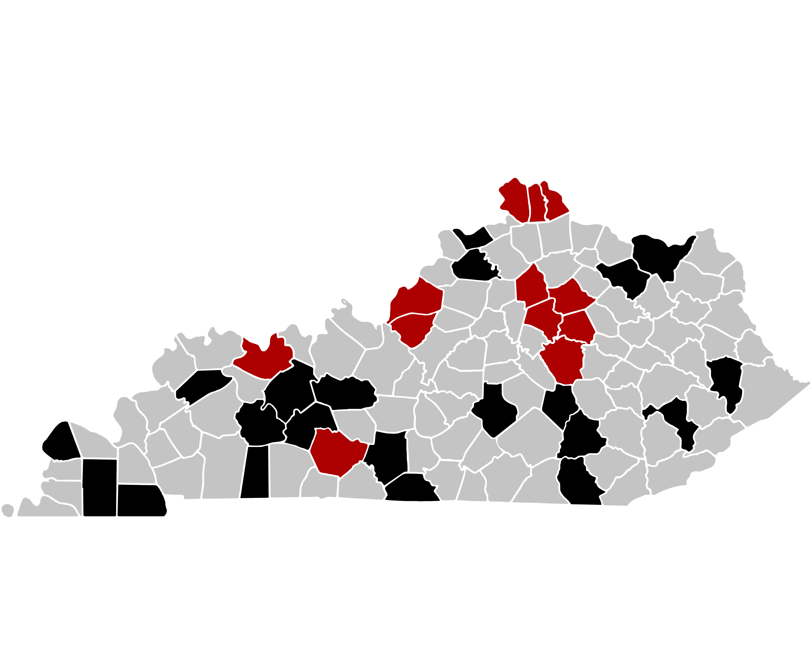
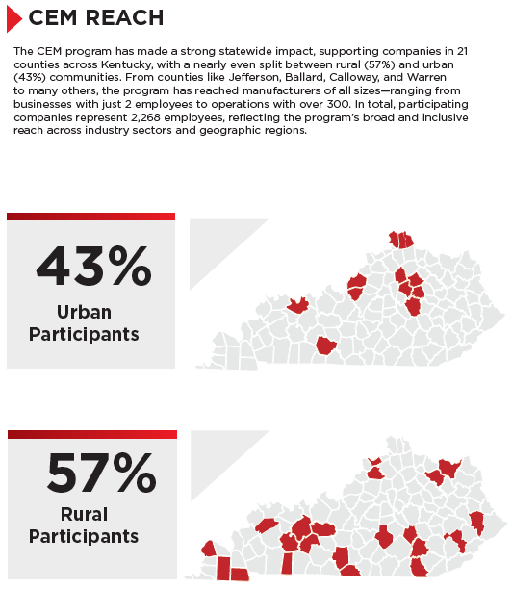
Catalyst Equipment Match (CEM)
Two Years of Impact
(July 1, 2024-Oct1, 2025)
103
Total Applications
41
Total Awards
31
Total Counties
$4.54M
Total Match (Funding)
$203.1K
Average Match Awarded
$56.2M
Project Budgets Supported

Slide 17
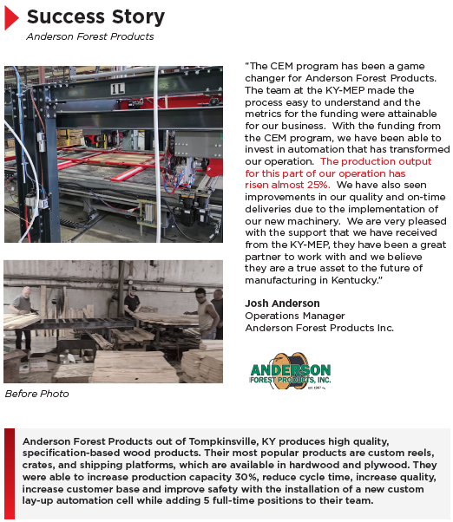
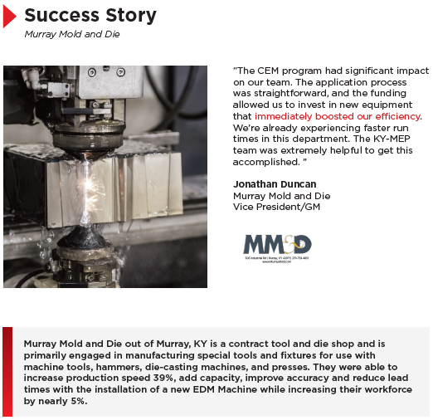
Catalyst Equipment Match (CEM) Success Stories

Slide 18
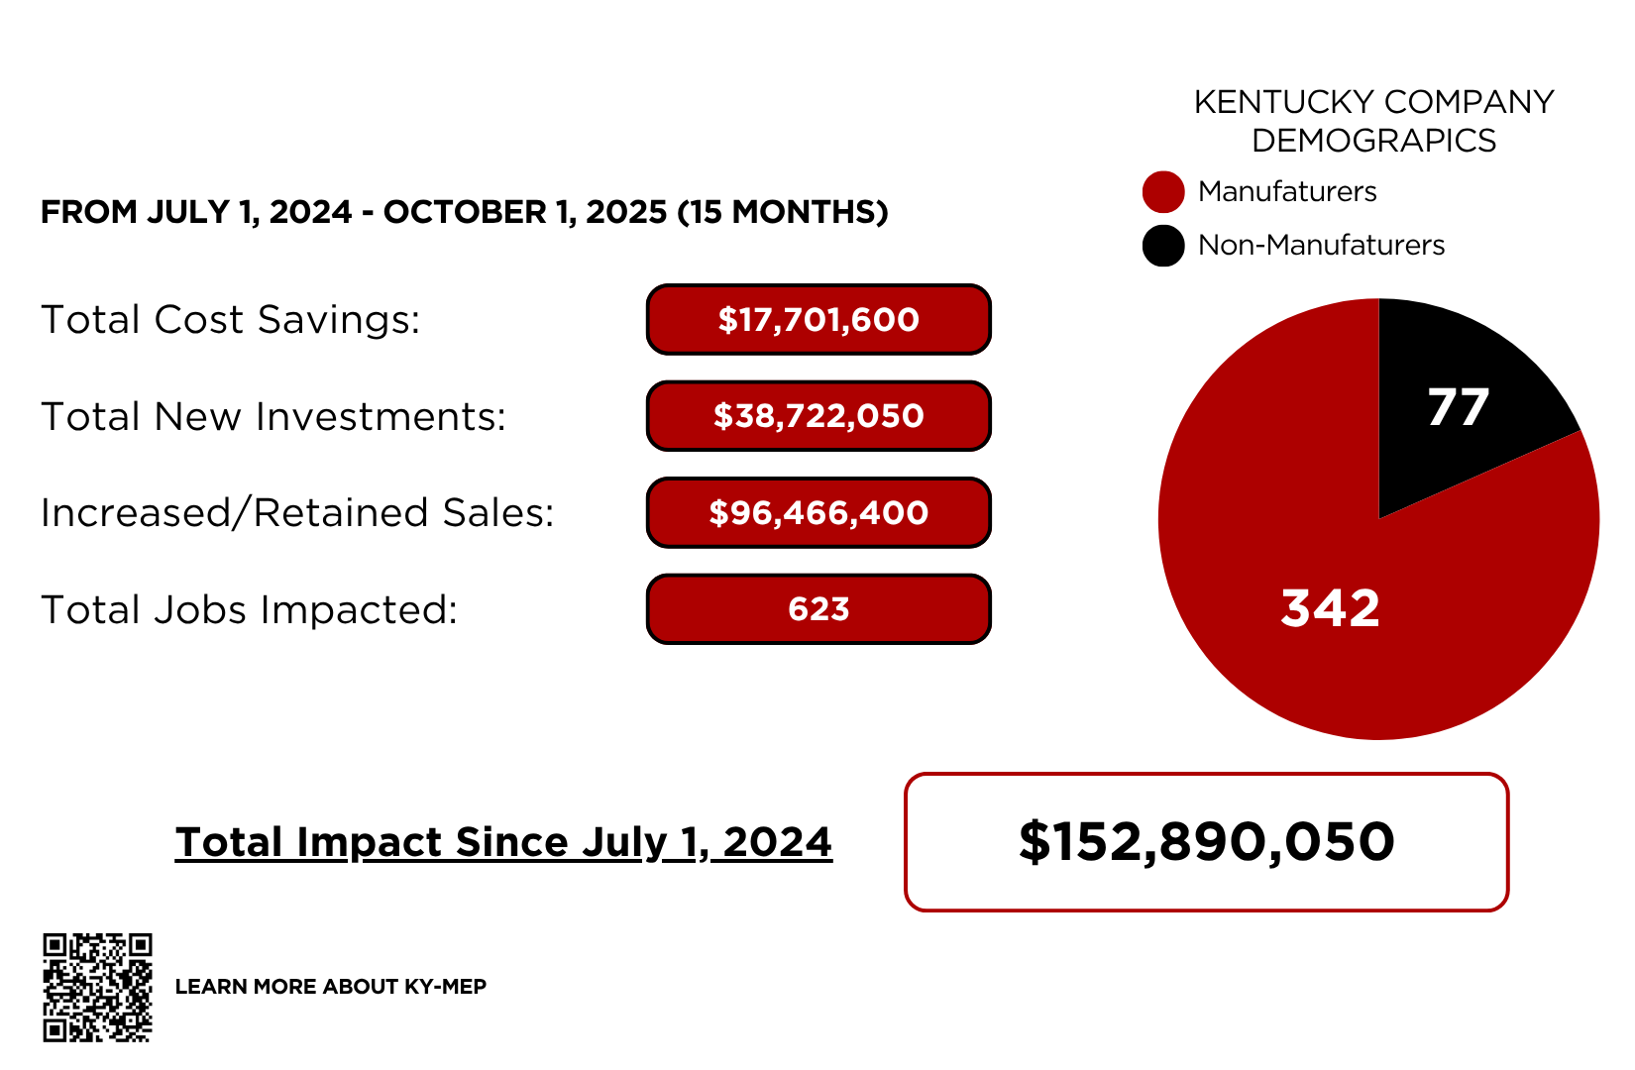
Direct impacts from state appropriation

