Slide 1
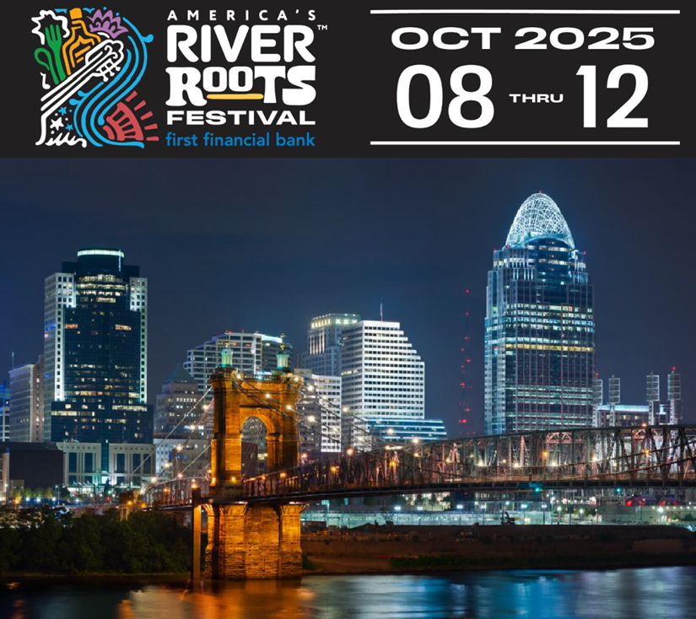
LARGE FESTIVAL IMPACT IN THE COMMONWEALTH AND THE AMERICA’S RIVER ROOTS EVENT IN NKY

Slide 3
FESTIVAL IMPACT
Expecting over 1 million attendees, 30% coming from outside the Cincy Region
Estimating $150 million in economic impact
New visitors to the Commonwealth experiencing the best of our culture are a target rich environment for talent.

Slide 5
EIGHT STAGES. UNLIMITED MEMORIES.
Cincy carries us away on the musicology of the Ohio River where 8 stages await with national, emerging and local musical artists on both sides of the river. Be moved by the rhythms that carve into our collective soul. Immerse yourself in sound. The River Awaits.
Artists branching into Blues, Jazz, Bluegrass, Gospel, Zydeco, Folk, Roots Rock and Latin
8 stages on the Ohio and Kentucky Riverfronts River Roots Gospel Revival
Cincinnati Black Music Walk of Fame Kings of the River

Slide 6
TASTES FROM ALL OVER. RIGHT HERE.
Drink in America’s River Roots at the trailhead of taste. Be transported on this river city’s eclectic palette and savor the creations of experienced chefs at the gateway of the famed Kentucky Bourbon Trail. Enjoy a conﬂuence of excellence of brewmasters and distillers alike. Wet your whistle and nourish your roots through unique tastings and ﬂavor here, where the Ohio River pours into every cup! The River Awaits.
Kentucky Bourbon Distiller Tastings Craft Brewmaster Experience
Cuisine Experiences at Metropolitan Club and Anderson Pavilion Good and Local Bridge Bazaar
Multicultural Food Trucks and Restaurant Row

Slide 7
EXPLORE. LEARN. IMMERSE.
Dig into your River Roots as the Ohio River transports you from our indigenous beginnings through America’s Steamboat age. Discover the northward freedom journey made on the rails of courage. Slice through the landscape shaped by waves of immigrants and innovations. Encounter history ﬁrst-hand in tours where an unrivaled arts scene thrives today. Move amongst ecological wonders of the region by foot, wheel and paddle. The River Awaits.
Freedom Journey App Riverwalk Experience App
Sounds From the River Educational Program River Cities Expo
National Underground Freedom Center Speaker Series.

Slide 8
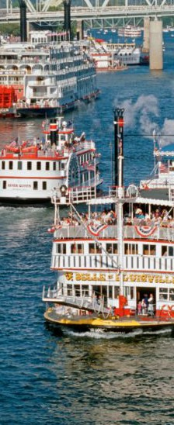
RIDE THE CURRENTS. SOAK IN CULTURE.
Sail away with America’s River Roots upon nine majestic riverboats from seven of our nation’s historic river cities. Ride the currents and be transported through authentic regional cuisine and music, bringing the best of America to the Ohio River. Take it all in from the best seats on the river. The River Awaits.
9 Majestic Riverboats from 7 River Cities Brunch, Lunch, Dinner Cruises Sightseeing and Late Night Cruises Parade of Riverboats
Riverboat Races
Individual, Group and Charter Sales Available

Slide 9
Our Request
Please think about attending the event and enjoying a historic cruise.
Encourage your local cities to participate in the city showcase.
Continue to support all local events as they are big drivers of visitors and a front door to talent acquisition.

