Slide 1



Dr. Charles Aull
Vice President of Policy and Research Kentucky Chamber
July 2026

Slide 2
Pro-Entrepreneur Policy and Programming in Kentucky
Tax Reform
Program Modernization
Funding for Entrepreneurial Infrastructure
Regulatory Reforms
Workforce Solutions
Kentucky Innovation Hubs
Kentucky Science & Technology Corporation
Endeavor Southeast

Slide 3
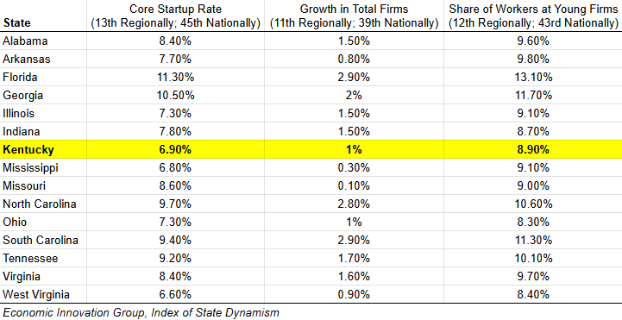
New firms make up a smaller share of our business and employment mix than in most other states.

Slide 4
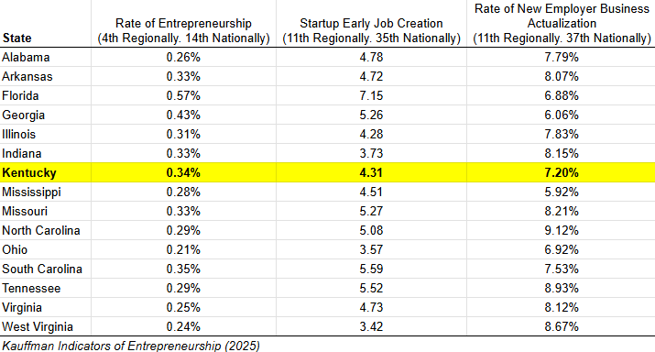
Kentuckians are entrepreneurial, but entrepreneurs in other states create new direct jobs faster.

Slide 5
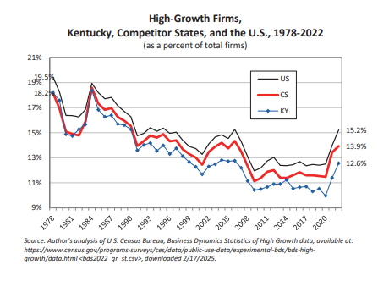
A smaller share of businesses in Kentucky are “high-growth” businesses compared to other states.
UK, 2026 Annual Economic Report

Slide 6
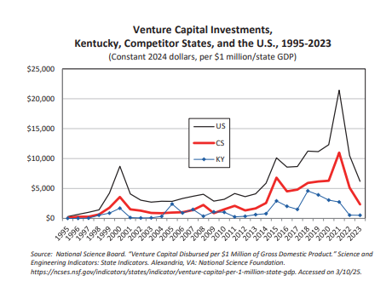
Far more venture capital is flowing to other states in our region than to Kentucky.
UK, 2026 Annual Economic Report

Slide 7
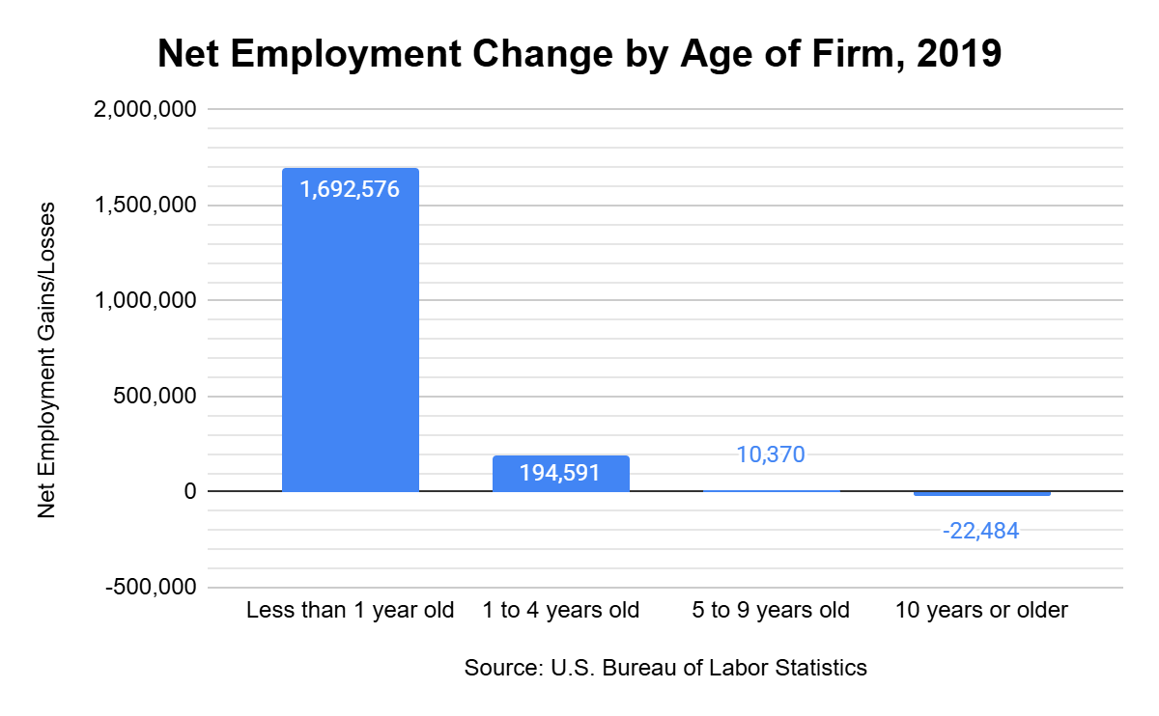
Why we should fix this problem
Entrepreneurship is a major engine for job growth and punches far above its economic weight.

Slide 8
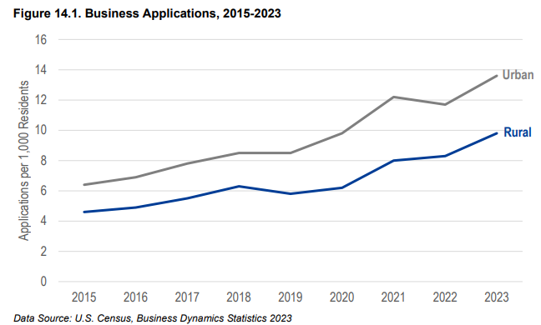
Why we should fix this problem
We can capitalize on a growing interest in entrepreneurship (and innovation) in rural Kentucky to help drive job creation.
Blueprint KY, 2025 Report on Kentucky’s Rural Economy

Slide 9
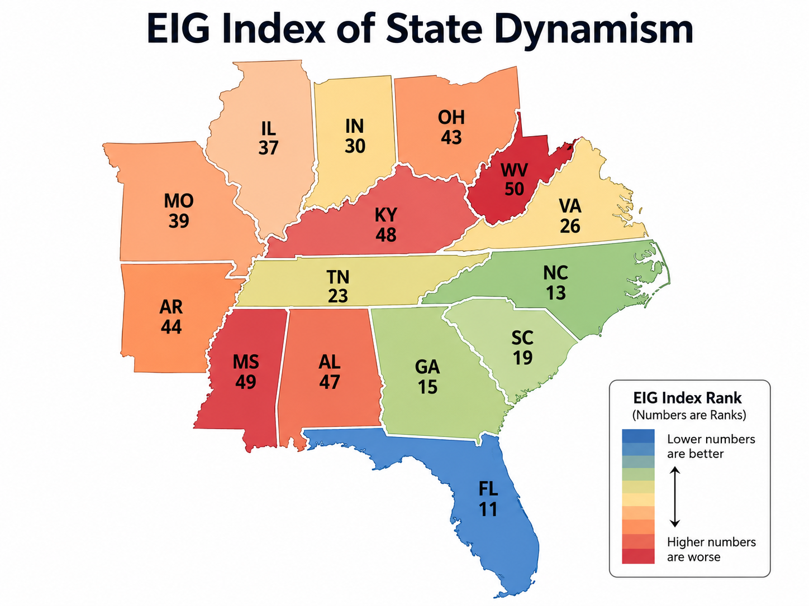
Why we should fix this problem
We can make Kentucky’s economy more dynamic – leading to more jobs, innovation, and economic resiliency.
Economic Innovation Group, Index of State Dynamism

Slide 11



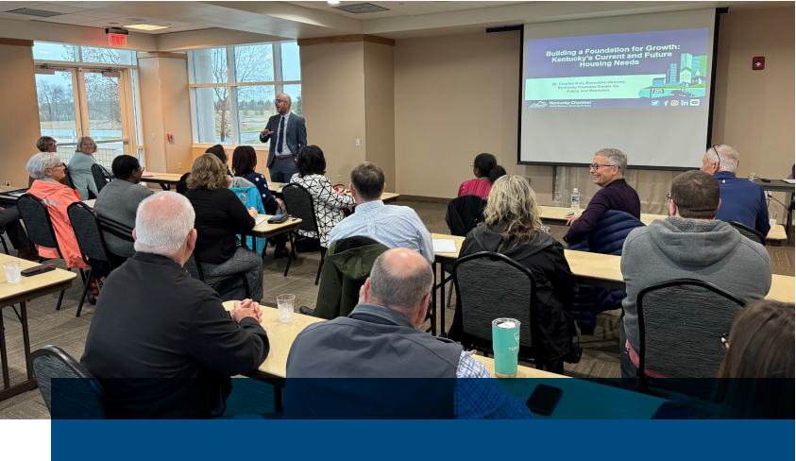
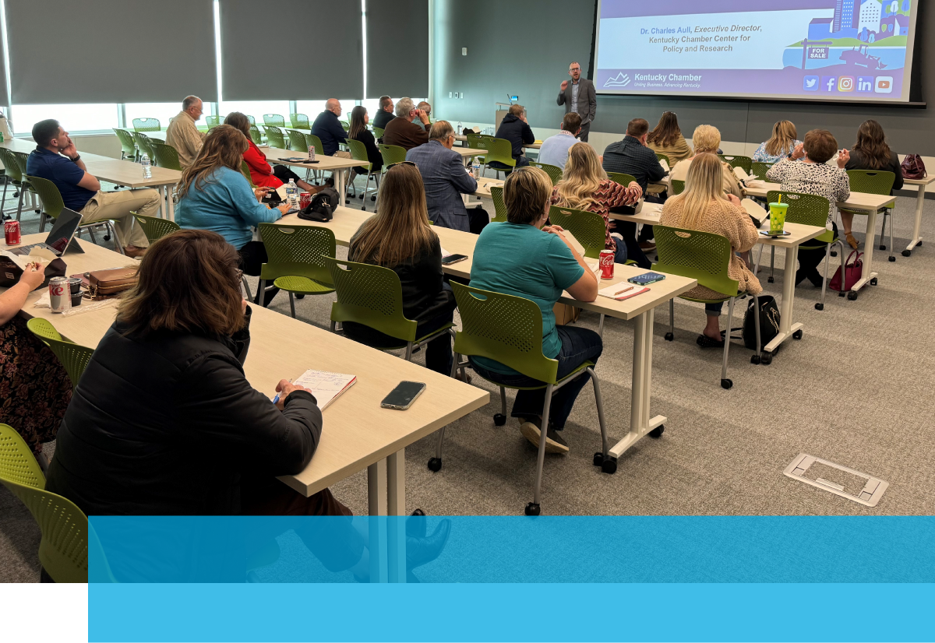
Community Engagement Sessions on Entrepreneurship
In partnership with

Slide 12
Key Questions
What is the status of Kentucky’s entrepreneurial ecosystem?
How do we compare to other states?
What barriers do Kentucky-based entrepreneurs face?
What are the needs and challenges facing rural entrepreneurs?
How does our policy landscape compare to competitor states?
What policies or reforms are needed in Kentucky?
What private-sector actions and programs are needed?

Slide 13
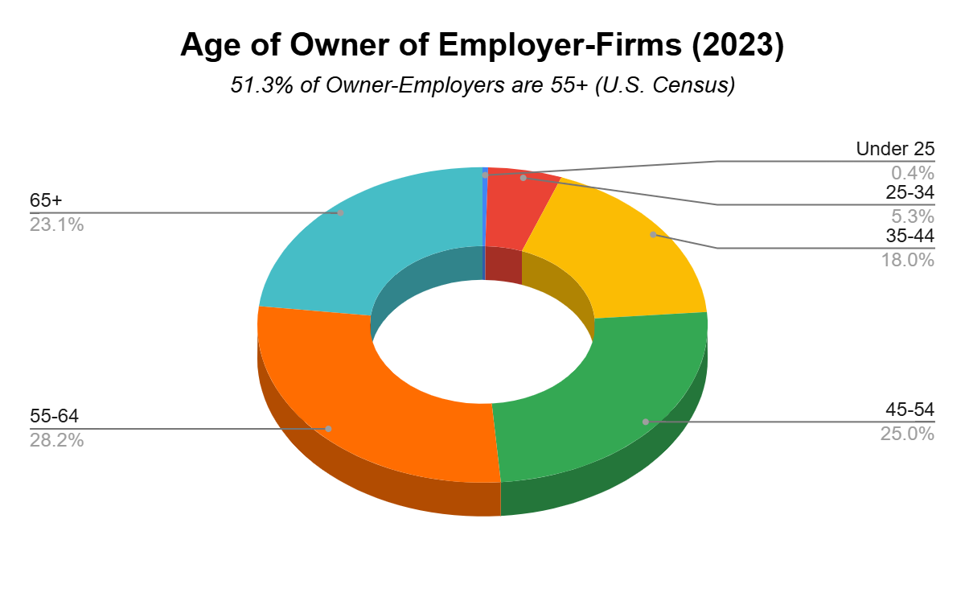
Focus Areas
Entrepreneurship across all industries
Early-stage entrepreneurs
Growth-phase firms
Direct and indirect employment impacts
Entrepreneurship-
through-Acquisition

Slide 14
Timelines and How You Can Help
July-September: Research and Relationship Building
October-November: Community Engagement Sessions
December-May 2027: Follow-ups and Synthesis
June 2027: Report of Findings
Participate in Community Engagement Sessions
Share your Feedback

