Slide 1

Entrepreneur Led Economic Development: Kentucky’s Path Forward
Dave Knox
Executive Director
Blue North

Slide 2
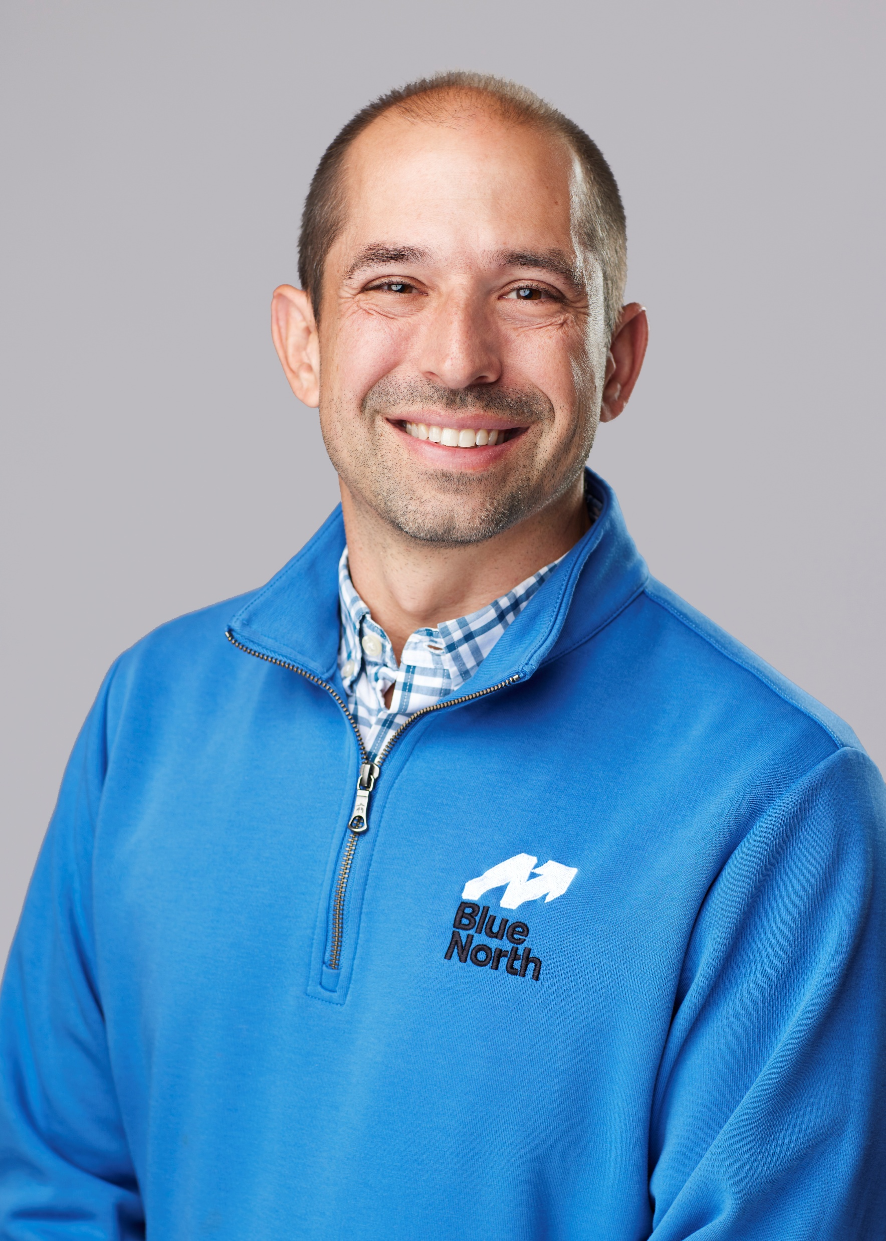

About Me
Executive Director of Blue North since July 2022
2024 Mentor of the Year Kentucky Entrepreneur Hall of Fame
CMO of the Year Cincinnati Business Courier
ETA Owner of Nature’s Willow, a natural pain relief cream
Chief Marketing Officer at Rockfish: Grew from $6 million to $70+ million and sold to WPP in London
Founder of The Brandery, Top 10 Startup Accelerator in the US
Started Procter & Gamble’s Corporate Digital Strategy Team
Author – Predicting The Turn: The High Stakes Game of Business Between Startups and Blue Chips

Slide 3
Entrepreneur Led Economic Development is the path forward for Kentucky
Traditional Economic Development
Site evaluation services, including detailed physical characteristics of Build-Ready sites.
Detailed community data on utilities services, business costs, local government services, and labor availability.
Accompany officials to Kentucky communities for confidential community/site evaluations.
Liaison with state and local government agencies, utility companies, and other organizations.
Preparation of financial packages including, training, tax incentives and other project inducements.
Coordination of public announcements for location decisions, groundbreaking, and grand openings.
Entrepreneur Led Economic Development
Capital Access: Introductions to angel investors, VCs, and revenue-based lenders; programs that help founders become investable.
Talent and Leadership Development through executive coaching, fractional leaders, and founder peer networks like the CIC Founders Circle.
Customer and Revenue Growth through go-to-market refinement and enterprise customer introductions, including KY-anchored corporations.
Scalable Operating Infrastructure in finance, legal, HR, and IT; including SparkHaus and LifeSciKY as physical hubs.
Strategic Mentorship and Board Development from operators who have built and scaled companies, not transactional consultants.
Traditional ED chases the deal. ELED builds the engine. Kentucky needs both, with ELED as the primary growth driver in 2027 and beyond.

Slide 4
Kentuckians are already building companies at record pace
Kentucky Secretary of State entity formations, FY12 to FY26 (surviving entities, dated by KY authority date)
FY
Statewide
KY LLCs
KY Corps
Foreign regs
DE-home regs
Tech-named
FY12
27,198
16,839 (62%)
4,183 (15%)
5,736 (21.1%)
1,452 (5.3%)
554 (2.0%)
FY15
29,513
19,173 (65%)
3,928 (13%)
6,036 (20.5%)
1,672 (5.7%)
634 (2.1%)
FY18
34,969
24,860 (71%)
3,656 (10%)
5,983 (17.1%)
1,739 (5.0%)
643 (1.8%)
FY20
37,948
27,436 (72%)
3,403 (9%)
6,659 (17.5%)
2,019 (5.3%)
703 (1.9%)
FY21
54,536 (+44%)
41,264 (76%)
3,808 (7%)
8,796 (16.1%)
2,650 (4.9%)
917 (1.7%)
FY22
56,112
42,599 (76%)
3,825 (7%)
9,100 (16.2%)
2,987 (5.3%)
987 (1.8%)
FY23
60,632
47,497 (78%)
4,035 (7%)
8,498 (14.0%)
2,736 (4.5%)
985 (1.6%)
FY24
64,689
51,381 (79%)
4,462 (7%)
8,339 (12.9%)
2,558 (4.0%)
1,042 (1.6%)
FY25
66,934
53,101 (79%)
5,231 (8%)
8,155 (12.2%)
2,392 (3.6%)
1,710 (2.6%)
FY26
85,276 (+27%)
69,415 (81%)
7,771 (9%)
7,606 (8.9%)
2,349 (2.8%)
2,489 (2.9%)
FORMATIONS TRIPLED
TECH COMPANIES BOOMING
SOLOPRENEURS DRIVING IT
3.1x
27,198 (FY12) to 85,276 (FY26). FY26 alone was the largest single-year jump on record, +18k entities.
2.4x
Tech-named formations flat for a decade, then 1,042 (FY24) to 2,489 (FY26). Kentucky is part of an AI-driven national solopreneur wave.
81%
Kentucky LLCs jumped from 62% to 81% of formations. Locally-addressed filings grew +38.7% YoY.
Sources: Kentucky Secretary of State entity registrations, all surviving entities snapshot (FY12 to FY26), Blue North analysis rev. 2026-07-13. National context from Stripe Economics, "The age of the solopreneur" (June 2026), and US Census Bureau Business Formation Statistics.

Slide 5
Kentucky has built a strong foundation for Entrepreneur Led Economic Development
Infrastructure Investment
LifeSciKY Wet Lab: $15M for initial construction and infrastructure.
An additional $2M in 2026 for equipment investment to keep the lab on the leading edge.
SparkHaus (Covington): $6M state investment in a $16.5M project, completed with charitable donations and historic tax credits.
Statutory & Financial Support
SB 139 (2024): Registered Investment Advisor exemption that allowed Blue North to attract firms like Fireroad to SparkHaus.
HB 577 (2026): Modernized the Kentucky Entrepreneurship and Innovation Hub Program, expanded the Enterprise Fund, and updated Angel Investor program.
HB 900 (2026): $6M over 2 years for Innovation Hub strategy and statewide pilots.
Venture Capital : $15M for Kentucky venture capital, including:
  $5M for the Kentucky Enterprise Fund.
  $5M dedicated to LifeSciKY BioInnovation Fund
  $5M to KEDFA
In just two years, the General Assembly has built the physical, statutory, and financial foundation for Entrepreneur Led Economic Development.

Slide 6



Unified statewide entrepreneurship organizations
Peer states have built unified organizations AND brands to solely lead startup ecosystem strategy and funding
TENNESSEE
ALABAMA
LOUISIANA
LaunchTN
Innovate Alabama
Nexus Louisiana
$150M+
$130M+
1,000
InvestTN capital deployed since 2017
capital allocated to startups since 2022
high-growth startups goal by 2035
Public-private nonprofit established in 2010
Single statewide convener for entrepreneurship
Federates 9 Regional Entrepreneur Centers across the state
Operates the InvestTN venture fund and Network Partners program
Public benefit corporation established in 2021
Cabinet-level voice for entrepreneurship
Coordinates supplemental matching grants statewide
Founded by act of the Alabama Legislature
Statewide nonprofit chartered by the Louisiana Legislature in 1992
New CEO Tony Zanders re-launched the org in 2025 after a 2020 rebrand
Stealthmode Startup School converts domain experts into founders
Anchors with $160M FUEL energy innovation initiative (NSF + LED)
THE PATTERN: Every state outpacing Kentucky has a unified statewide public/private entrepreneurship organization exclusively focused on the needs for launching, growing, and scaling Startups and High Growth companies.
Sources: launchtn.org; innovatealabama.org; nexusla.org; Technical.ly coverage of Nexus Louisiana relaunch, June 2026.

Slide 7


What Kentucky should explore
Kentucky’s entrepreneur resources sit across many unconnected organizations today. Three questions worth exploring.
How does a unified statewide brand for entrepreneurs and startups impact the community?
Tennessee, Alabama, and Louisiana built single public-private organizations as the front door. Previously we have “KY Innovation” as a brand within the Cabinet for Economic Development. What might Kentucky’s look like in the future to compete with peer states?
Old Brand
New Brand
1
How do needs differ between research and commercialization vs launching and scaling companies?
These activities require different teams, timelines, and programs. Peer states most often organize them as distinct functions.
2
What are the distinct lanes for small business and high-growth?
SBDCs and local Chambers continue to serve small business. What infrastructure best serves high-growth and venture-backed companies?
3
Reflects the unified-organization recommendation in this presentation. Peer-state models referenced from the prior slide.

Slide 8
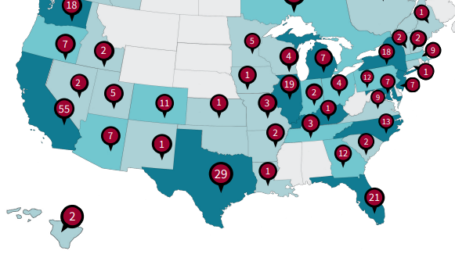
The Silver Tsunami & ETA
The Silver Tsunami refers to the wave of Baby Boomer business owners now approaching retirement. Entrepreneurship Through Acquisition (ETA) is how a new generation of Kentucky founders can take over and grow these businesses.
Most owners lack a succession plan. Without ETA buyers, these businesses risk closing. With ETA, they become engines of high-growth Kentucky job creation.
In Kentucky:
190k
79%
1
Business Owners Retiring In Next 10 Years
Of Businesses Have No Transition Plan
Number of ETA Search Fund Deals in KY in ‘24

Slide 9

ETA infrastructure | what other states are doing
Two states have built dedicated programs around the Silver Tsunami of retiring business owners
COLORADO
INDIANA
Employee Ownership Office
Keep IN + Office of Entrepreneurship and Innovation
57+
906K
employee ownership conversions since 2021
Indiana jobs tied to owners 55+ over the next decade
Office inside the Colorado Office of Economic Development
Tax credit covers up to 75% of conversion costs (HB 25-1021)
New capital gains subtraction starting tax year 2027
$3M annual aggregate cap; authorized through 2031
Office of Entrepreneurship and Innovation created July 2025
Keep IN launched May 2026 by Gov. Braun for succession planning
SMB.co (a KY startup) pilot in 3 regions: free valuations and exit tools. Expanding statewide in 2H 2026
gBETA Main Street accelerator with gener8tor, IEDC, Indiana SBDC
THE PATTERN: Colorado leads with tax incentives. Indiana leads with a portfolio approach. Kentucky has the underlying opportunity but statewide effort or infrastructure
Sources: oedit.colorado.gov; HB 25-1021; events.in.gov (Keep IN launch May 2026); gener8tor.com.

Slide 10
What Kentucky should explore
Build statewide ETA infrastructure on top of communities that already exist
Establish the Kentucky ETA Foundation
Regional launch grants for community-led ETA groups; annual ecosystem-builder summit. Kentucky has the model. CincyETA (Blue North) is the largest regional ETA group in the country. Indiana has hired SMB.co (a Kentucky-based Startup) to power their statewide effort.
1
Launch an annual Kentucky ETA Conference
Co-host with the Kentucky Chamber to reach retiring owners statewide; recruit searchers.
2
Fund a Kentucky ETA Searcher Fellowship
Stipends and mentorship for in-state acquirers; modeled on top university search fund programs.
3
Build ETA curriculum at Kentucky universities
Partner with our universities and KCTCS to teach acquisition entrepreneurship.
4
Create the Kentucky Employee Ownership Initiative
Tax credits for retiring owners selling to employees, modeled on Colorado HB 25-1021 and our existing Kentucky Selling Farmer Tax Credit (KSFTC)
5
Reflects Pillar 2 of the Blue North Phase 2 framework. CincyETA (100+ members) and ETA Louisville already provide the community foundation.

Slide 11
Entrepreneurial workforce | what other states are doing
Three peer states fund three distinct talent strategies: build it, attract it, develop it
TENNESSEE
OHIO
INDIANA
LaunchTN Summer Internship
JobsOhio Relocation Incentive
TechPoint Xtern and Sales bootCAMP
BUILD
ATTRACT
DEVELOP
392
$15K
500+
internships placed in FY2025
per qualifying STEM or technical hire from out of state
Xtern interns placed annually
State-funded internships matching students with TN startups
25% of interns convert to full-time roles at host companies
Operated through LaunchTN with Network Partners statewide
Pairs explicitly with high-growth ventures, not large employers
Direct payment to employer for each STEM hire who relocates to Ohio
Up to $225K per company (15 hires); no strings attached
First-come, first-served until program funds are depleted
Covers ten priority sectors including technology, healthcare, energy
Xtern: paid summer internship and immersive talent program
Sales bootCAMP: 8-week launchpad into tech sales careers
TechPoint operates as the talent arm of Elevate Ventures
State-funded coordination between universities and Indiana startups
THE PATTERN: Peer states deliberately fund three distinct talent strategies. Kentucky has no dedicated startup-talent pipeline of any kind today.
Sources: launchtn.org/summer-internship; jobsohio.com/workforce-talent/jobsohio-relocation-incentives; techpoint.org/xtern; techpoint.org/sales-bootcamp.

Slide 12
What Kentucky should explore
Build a workforce pipeline aligned with the startup economy
Fund a Kentucky entrepreneurial internship program
Replicate the LaunchTN model: state-funded summer internships matching KY students with KY startups. Consider how the Hubs play a stronger role engaging our workforce pipeline for high school and college.
1
Make AI training universally available
Direct workforce development funding to AI fluency for founders, workers, educators, and 120 county leaders. Our Startup founders are leading practitioners.
2
Activate Innovation Hubs as training venues
Use SparkHaus and the other physical innovation hubs to scale founder workshops and applied technical curriculum.
3
Build a Boomerang Kentuckians database and fellowship
Targeted attraction program for Kentucky natives ready to come home to launch companies.
4
Reflects recommendation #5 in this presentation. Builds on existing SparkHaus AI workshops and the SBDC delivery footprint.

Slide 13
Bonus Startups solve problems. And can inspire policy.
A Kentucky example before we close: AquiSense Technologies, Erlanger KY
THE COMPANY
Erlanger-based and Keyhorse Capital backed AquiSense is the global leader in UV-C LED water disinfection. 500,000+ installations worldwide. The only Kentucky-based UV manufacturer.
1
THE MOMENT
Mercury is banned under the UN Minamata Convention (US-ratified). Mercury UV lamps could be banned for sale as soon as February 2027. The current global supply runs through China, Canada, and Germany.
2
THE POLICY OPPORTUNITY
Kentucky can lead the country by opening state water treatment bids to mercury-free alternatives. AquiSense delivers equivalent performance and cost, Buy-America-compliant.
3
THE ADJACENT BENEFITS
The same Kentucky-made technology can serve bourbon distilleries (water purity, no mercury breakage risk) and could address water quality concerns at the heart of Kentucky’s data center debate (Google is using the technology at their data center in Las Vegas).
4
THE POINT: Startups are built to solve problems. The best ones in turn inspire policy and economic development that ripples across the Commonwealth, from strengthening bourbon to addressing challenges in data center development.
Sources: AquiSense Technologies (Oliver Lawal, CEO); UN Minamata Convention on Mercury at treaties.un.org; aquisense.com.

Slide 14
The 2027 Path Forward
Five recommendations aligned to the four themes you just heard
ENTREPRENEUR LED ECONOMIC DEVELOPMENT
Adopt Entrepreneur Led Economic Development
Make ELED a primary Kentucky strategy alongside traditional recruitment and relocation. Focus on the unique needs of startups and high-growth companies launching and scaling.
1
FOUNDATION
Build on the Foundation
Reinforce continued infrastructure, statutory, and financial support for ELED, including the Kentucky Innovation Hub Network and the Kentucky Enterprise Fund (KEF).
2
UNIFIED STATEWIDE ENTREPRENEURSHIP ORGANIZATION
Explore a unified statewide brand for entrepreneurs
Examine distinct lanes for research, commercialization, small business, and high-growth. Learn from peer states.
3
ENTREPRENEURSHIP THROUGH ACQUISITION
Establish statewide ETA infrastructure
Foundation, conference, searcher fellowship, university curriculum, and employee ownership initiative.
4
WORKFORCE
Build Kentucky’s startup-talent pipeline
Fund internships, attract Kentuckians home, activate Innovation Hubs as training venues, advance AI training.
5
Each recommendation maps to a theme from this presentation: ELED (slide 4), Foundation (slide 3), Unified Org (slides 5-6), ETA (slides 7-9), Workforce (slides 10-11).

Slide 15
Thank you!
Dave Knox
dave@bluenorthky.com

