Slide 1

Let Kentucky Build
Bold Housing Reforms to Renew the
American Dream in Kentucky
Kentucky Chamber of Commerce
Interim Joint Committee on Economic Development and Workforce Investment
September 17, 2026
Kate Shanks, Senior Vice President, Public Affairs
Charles Aull, Vice President, Policy and Research

Slide 2
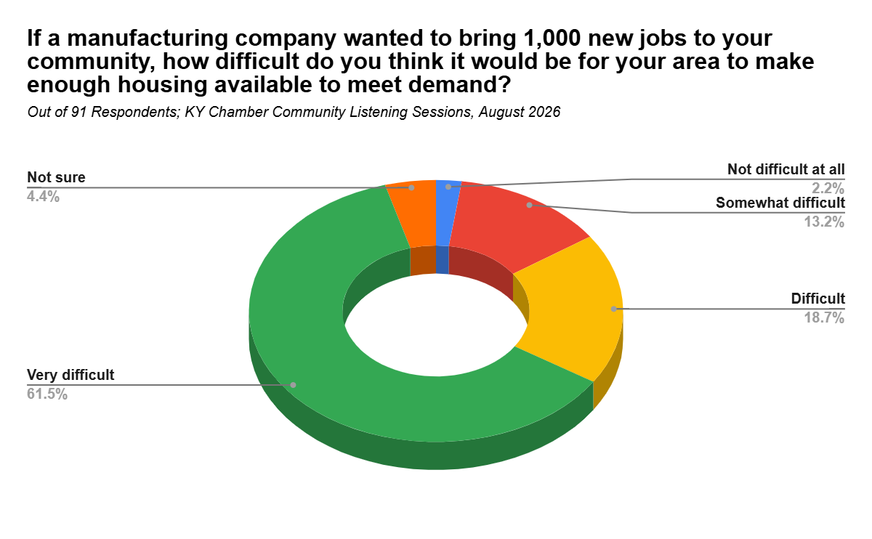

Community leaders view housing challenges as a serious threat to economic development

Slide 3
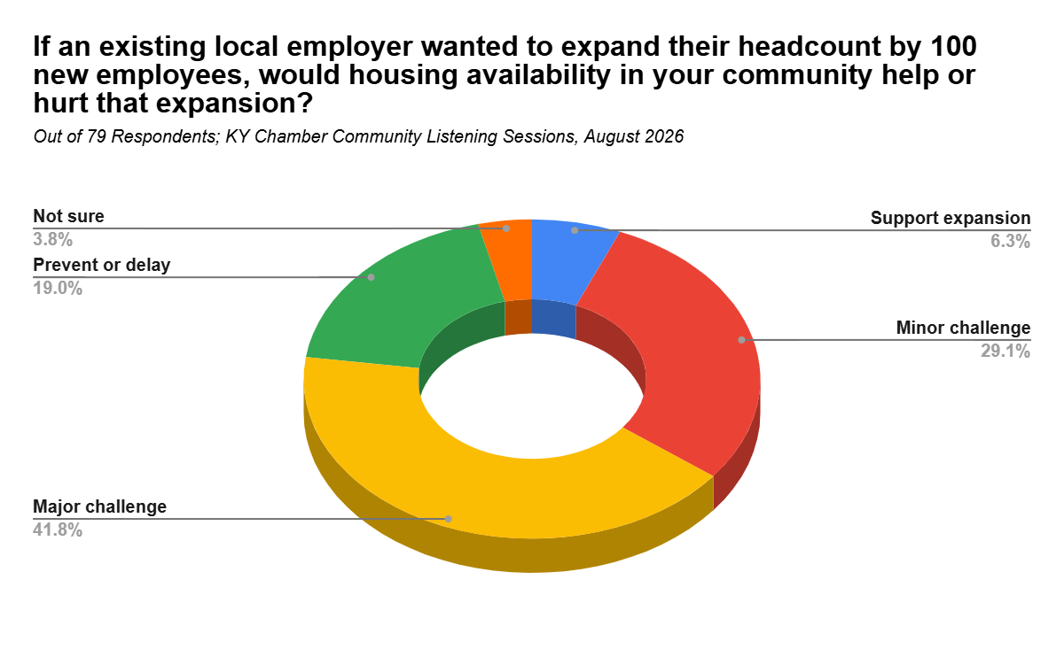
Community leaders are worried about housing for even modest economic development investments

Slide 4
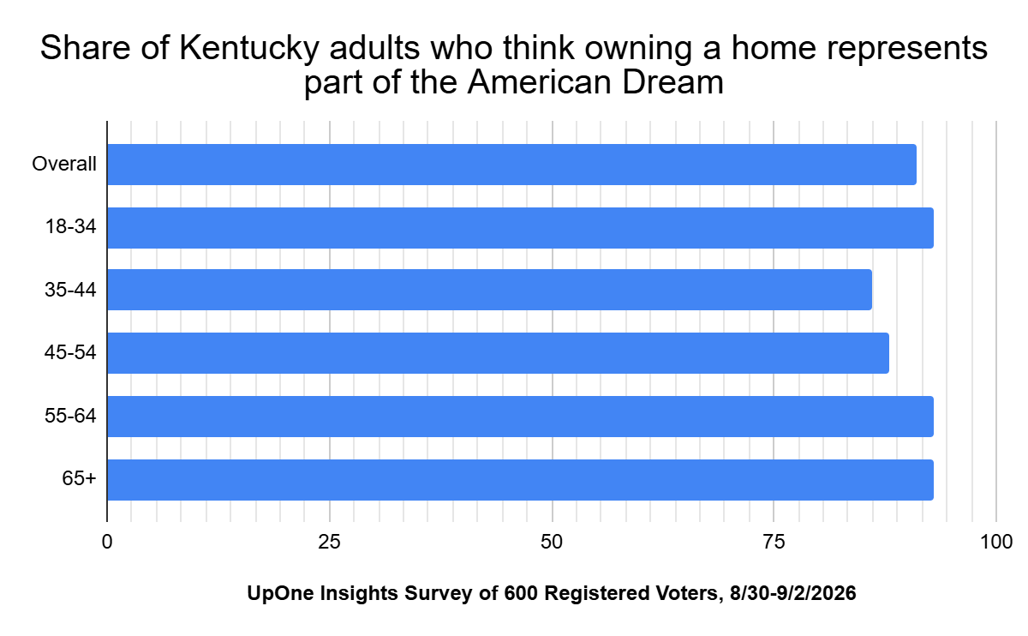
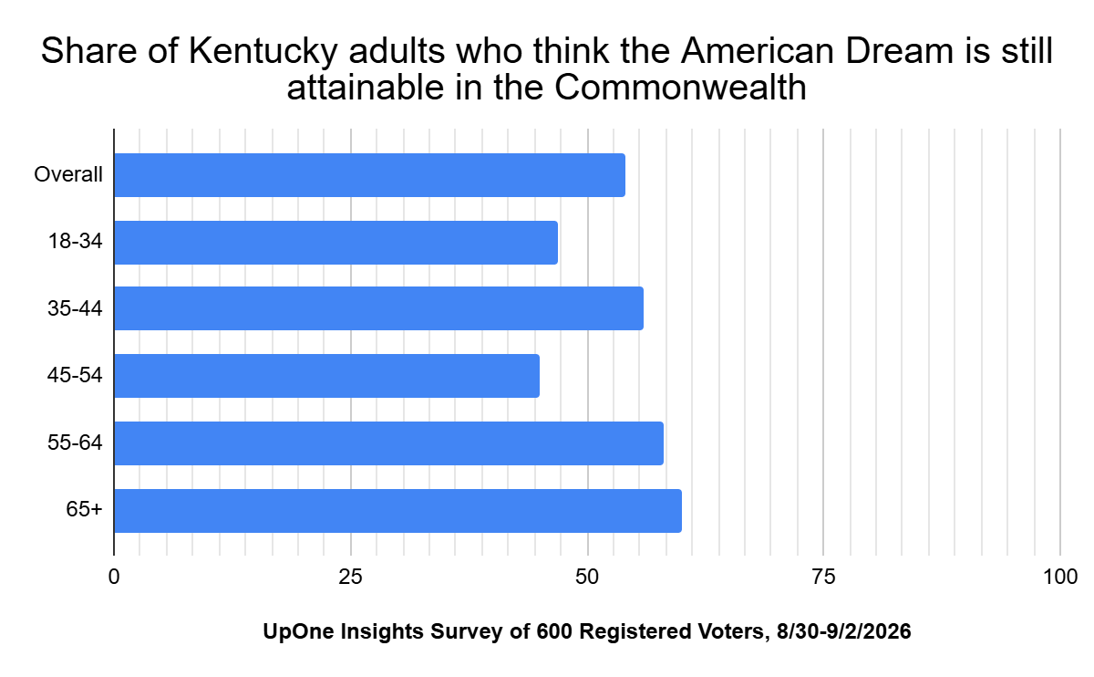
Kentuckians are losing hope in the American Dream

Slide 5

Key Findings
Since our 2024 report, housing conditions in most Kentucky communities have worsened or stagnated.
This conclusion is supported by feedback from community listening sessions, industry experts, a scientific survey, and data analysis.

Slide 6
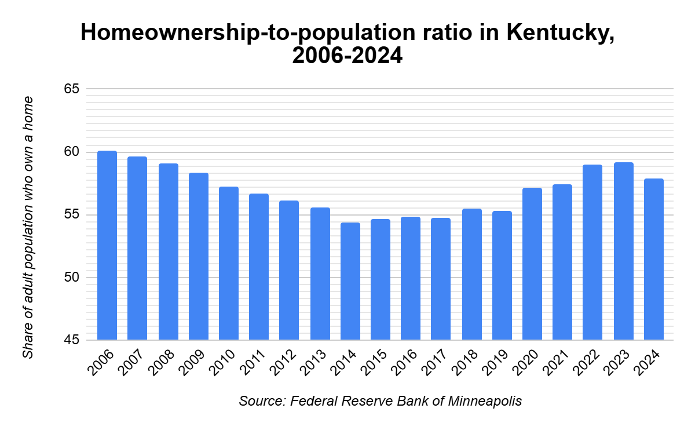
Fewer Kentuckians own their own home than you might think.
1.5 million Kentucky adults do not own a home.

Slide 7
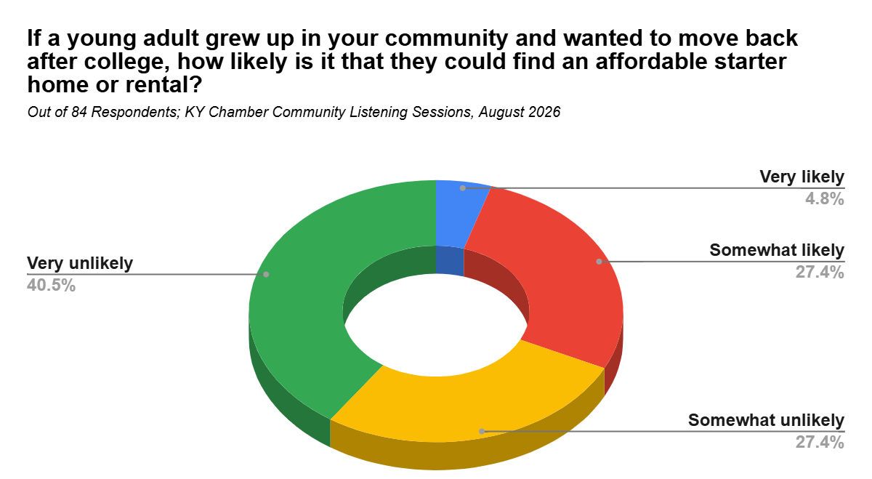
Homeownership is particularly difficult for young adults

Slide 8
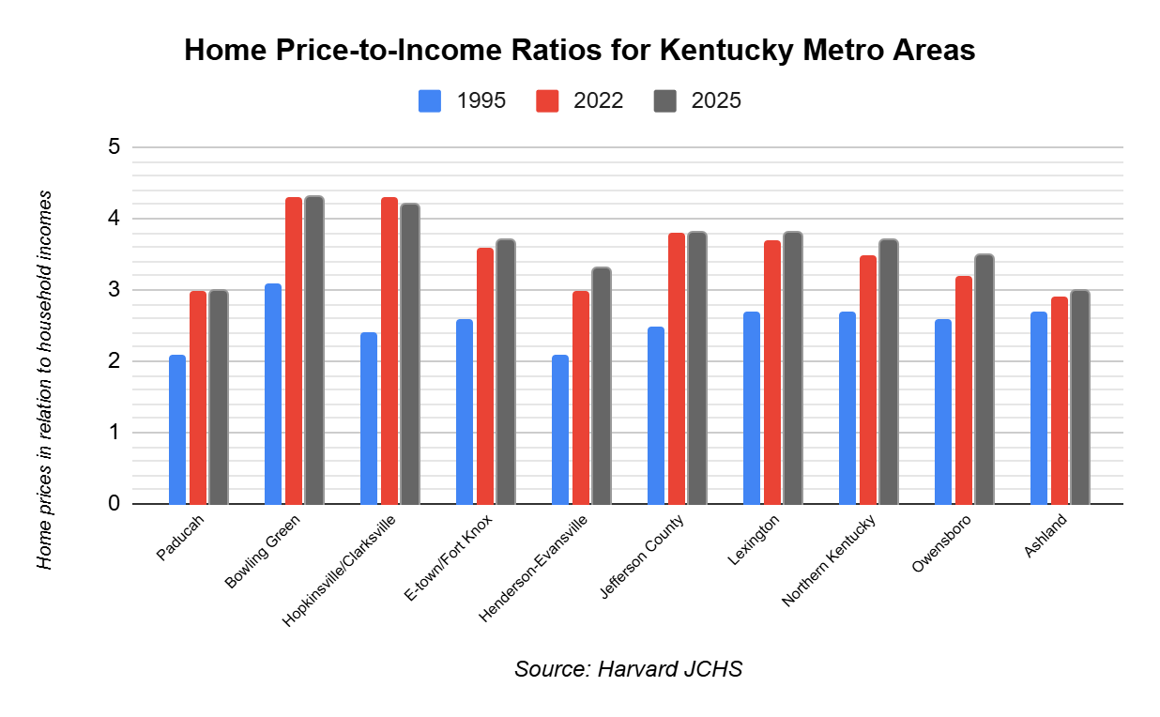
Home prices continue to outpace household incomes

Slide 9
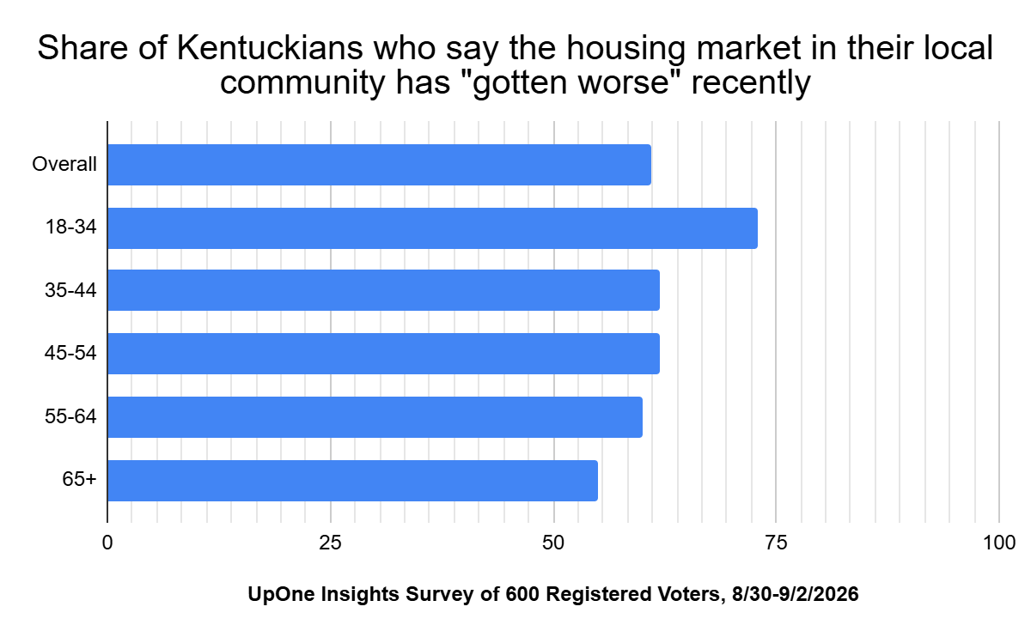
Kentuckians are feeling this pressure, with many saying their local markets have “gotten worse.”

Slide 10
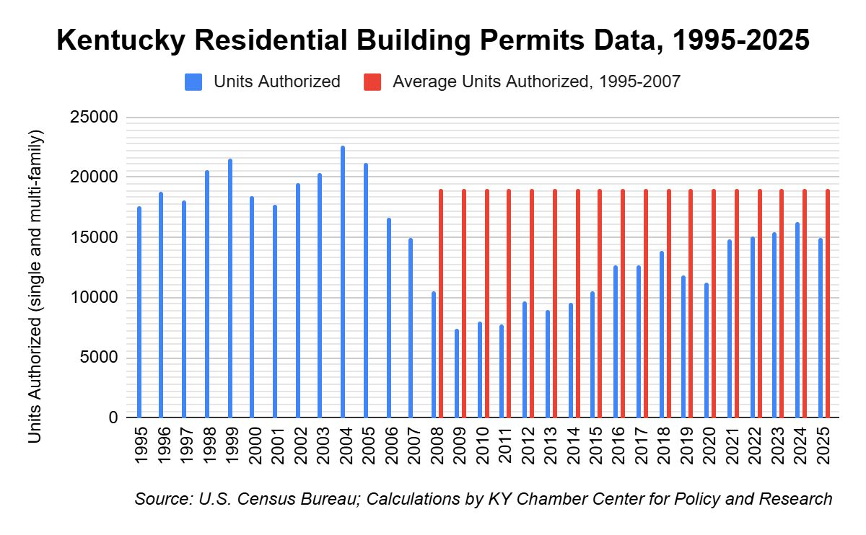
After the Great Recession, Kentucky stopped building homes like it used to.
This has led to
an imbalance between supply and demand.

Slide 11
America’s Housing Crisis is a Supply Challenge
Think tanks across the spectrum agree:
American Enterprise Institute
Heritage Foundation
America First Policy Institute
Center for American Progress
Bipartisan Policy Center
Restrictive regulations are making homes harder to build and harder to afford.
Regulations are driving up prices amid a 4M+ unit shortage.
Millions of young buyers are chasing too few available homes.
Affordability won't improve without scaling up home building.
15 years of underbuilding is hurting communities of every kind.

Slide 12
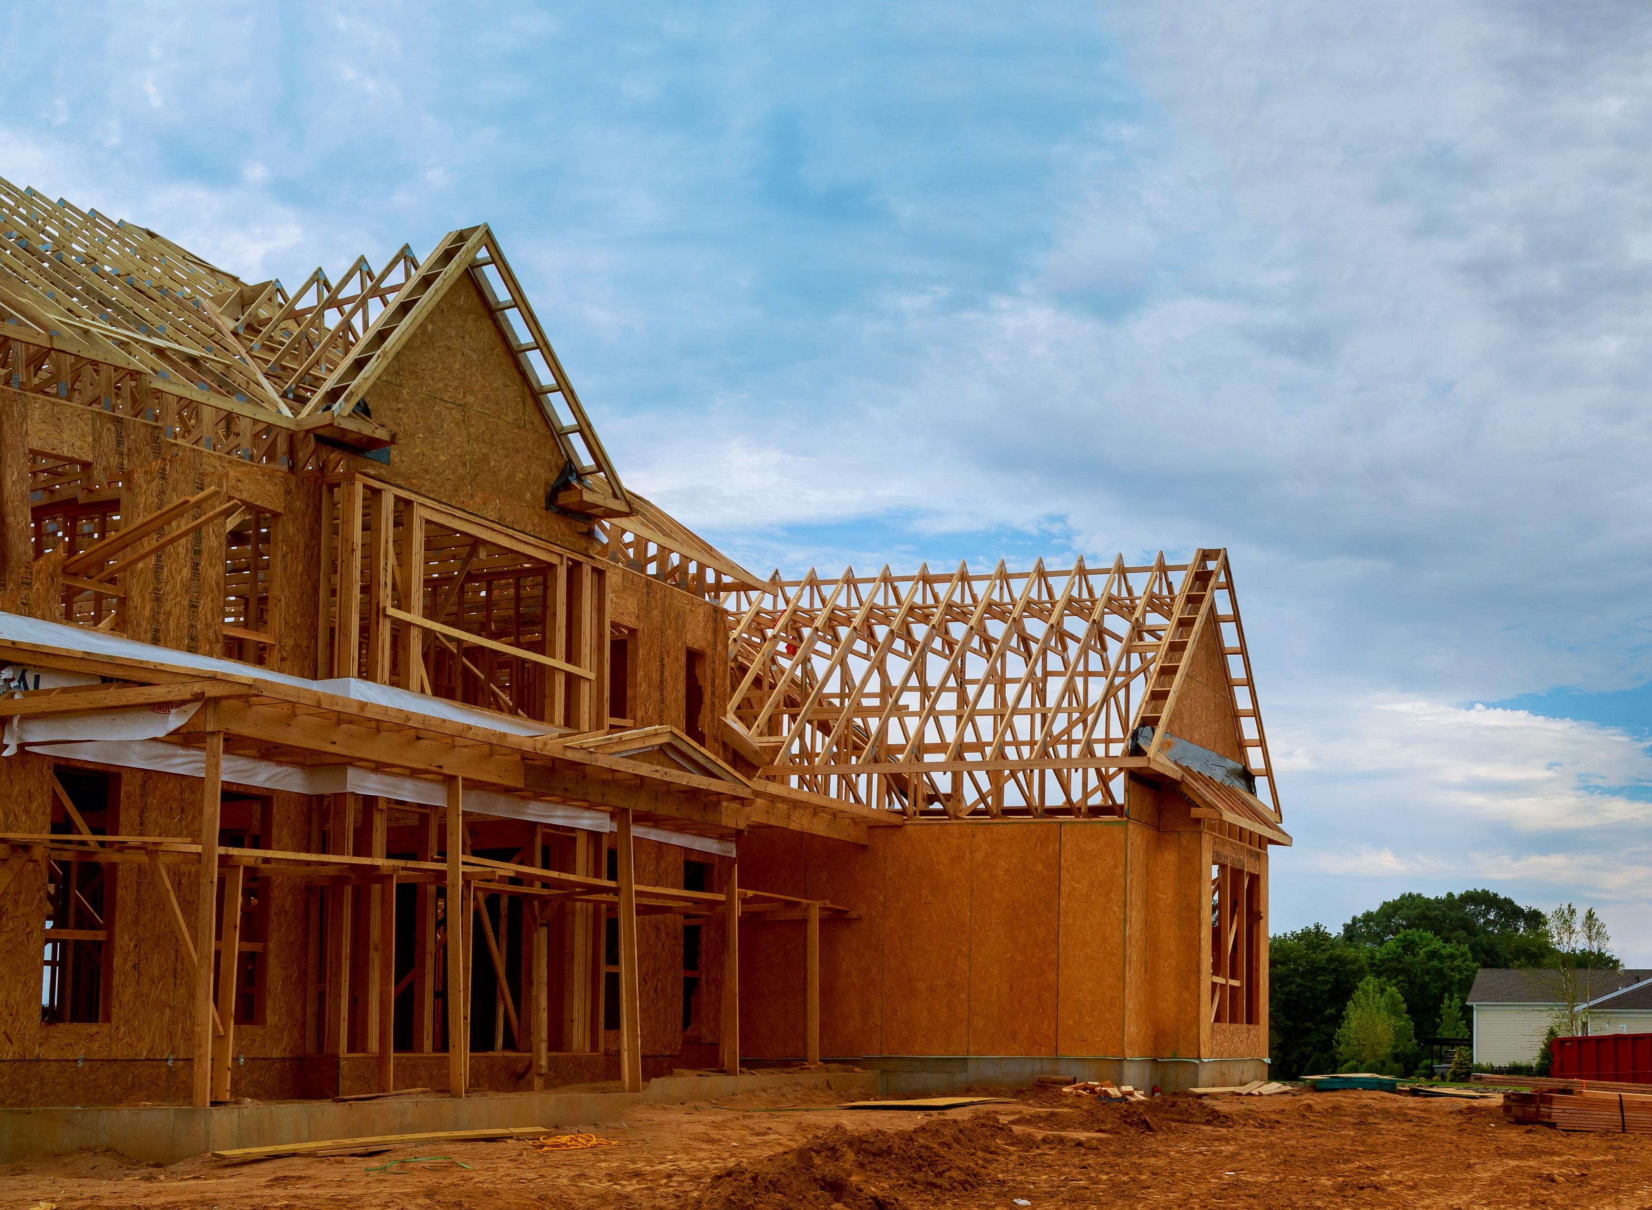
What We Learned from Industry Experts
Builders face barriers to building new homes
Government regulations
Infrastructure mandates
Bureaucratic and legal delays
Each $1,000 increase = 2,112 “priced-out” Kentucky households

Slide 13
Housing Reform Principles
Cut red tape and give builders more flexibility to provide what the market wants.
Reduce delays and streamline bureaucracy.
Support public-private partnerships, especially for residential infrastructure.

Slide 14
Learn More
Kychamber.com/housing

