Slide 1

The Impact of Repealing Prevailing Wage on Kentucky’s Construction Market
Frank Manzo IV
Midwest Economic Policy Institute

Slide 2

Prevailing wage laws
Description
Local-area minimum wages for skilled tradespeople on taxpayer-funded construction projects
Purpose
To create a level playing field for contractors by ensuring that taxpayer dollars reflect local standards of compensation and craftsmanship
Notes:
Executive Director

Slide 3
Repeal of prevailing wage in Kentucky
  Kentucky’ prevailing wage was passed in 1940 but repealed in 2017.
  Prevailing wages applied to state, county, local, and school district projects that cost more than $250,000.
  Today, 29 states and D.C. have prevailing wage laws.
  The Davis-Bacon Act establishes prevailing wages for federally funded and assisted projects, including in Kentucky.
    The law was authored by two Republican lawmakers and signed by a Republican President (Hoover) in 1931
Notes:
Executive Director

Slide 4
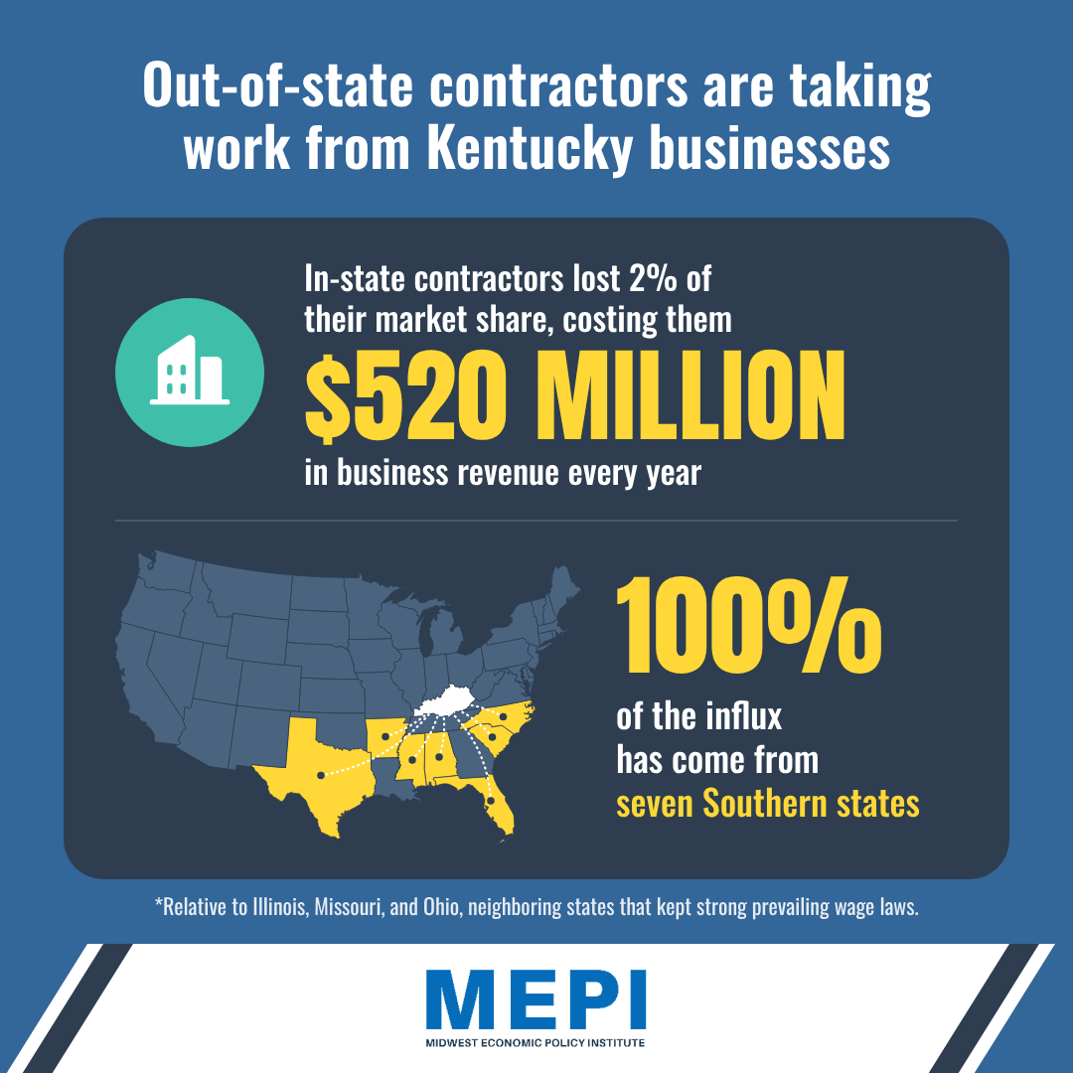
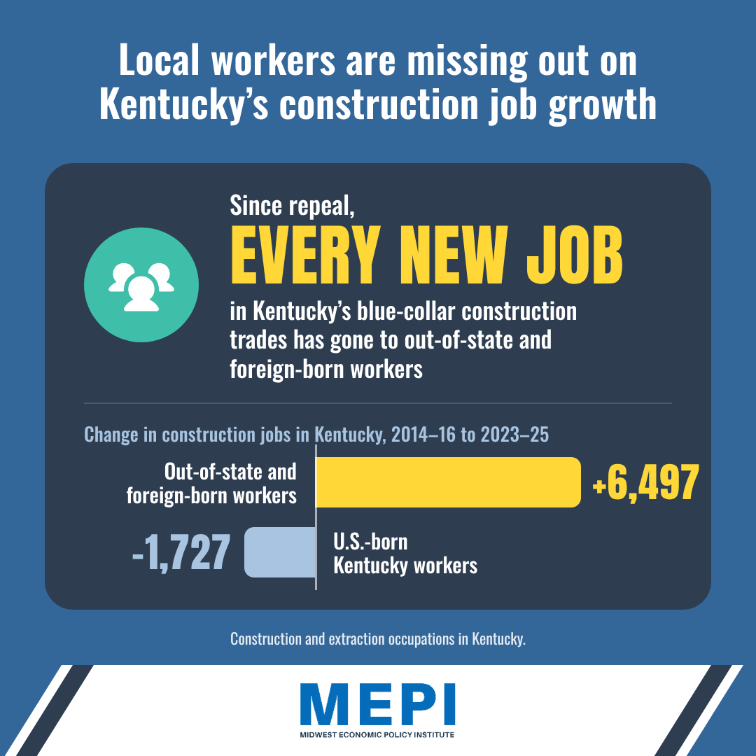
Repeal caused an out-of-state influx
Notes:
Executive Director

Slide 5
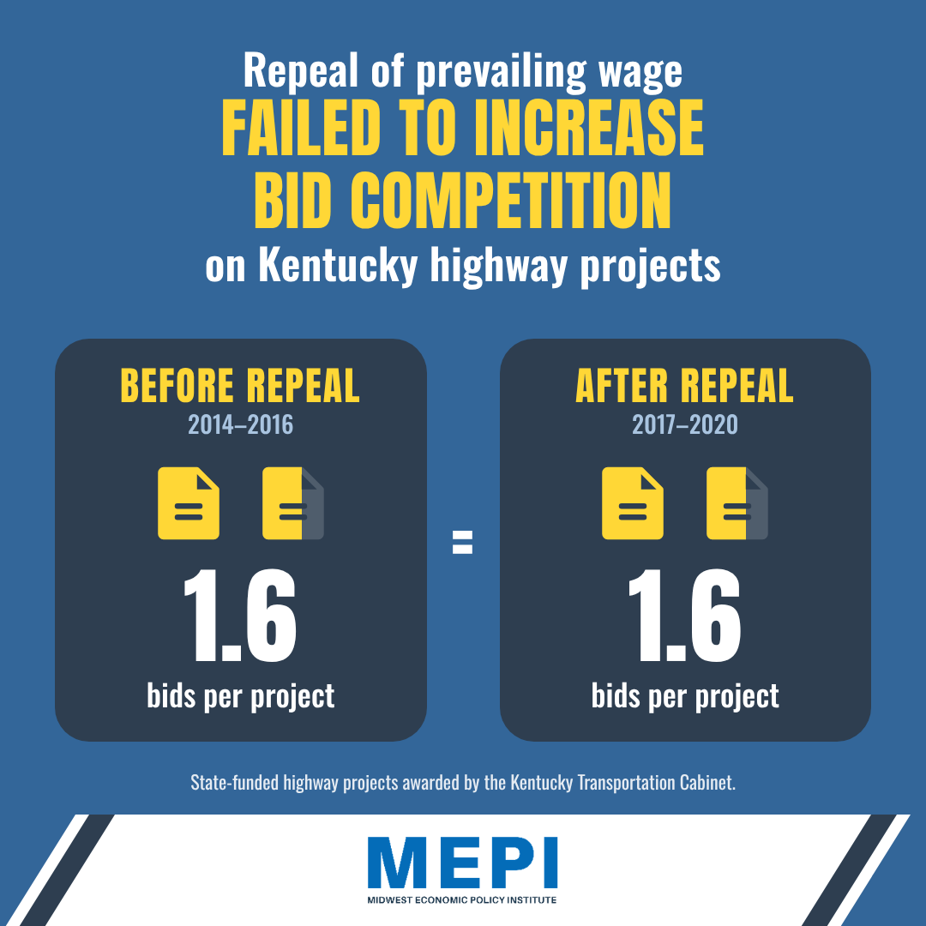
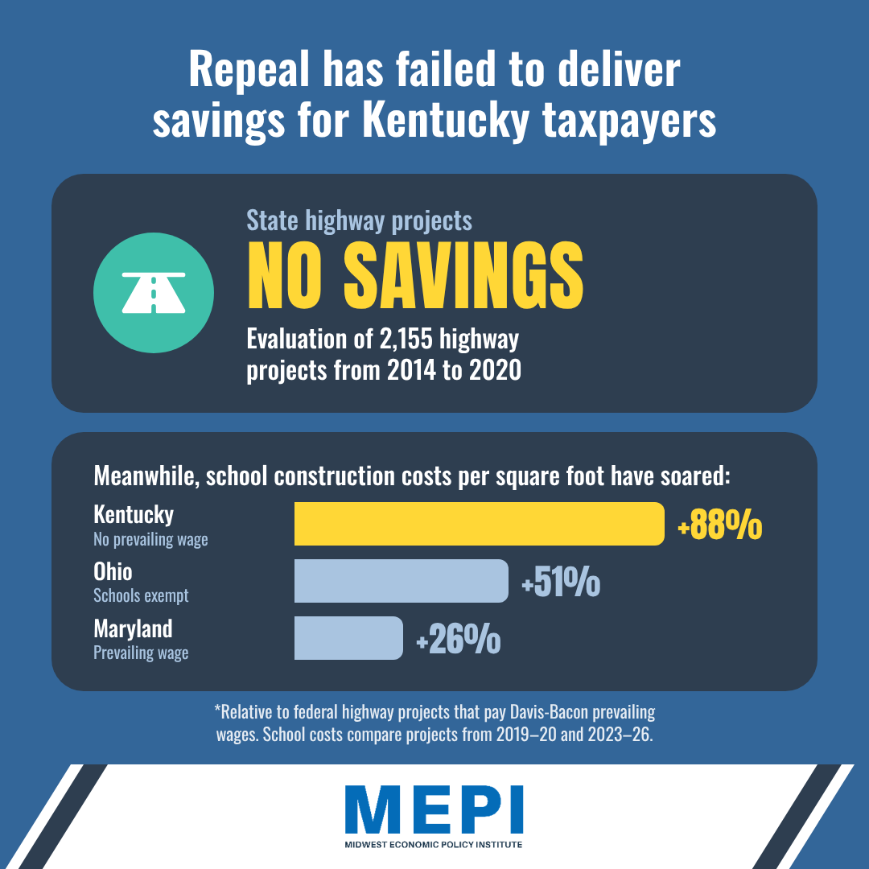
Repeal has not saved taxpayers any money
Notes:
Executive Director

Slide 6
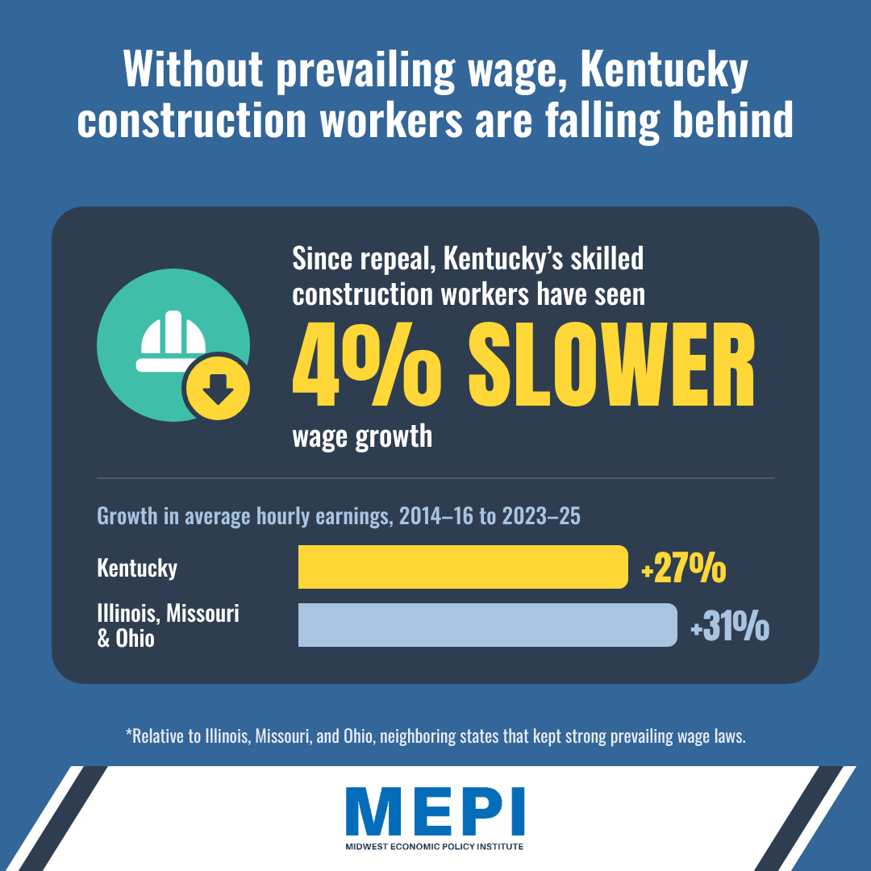
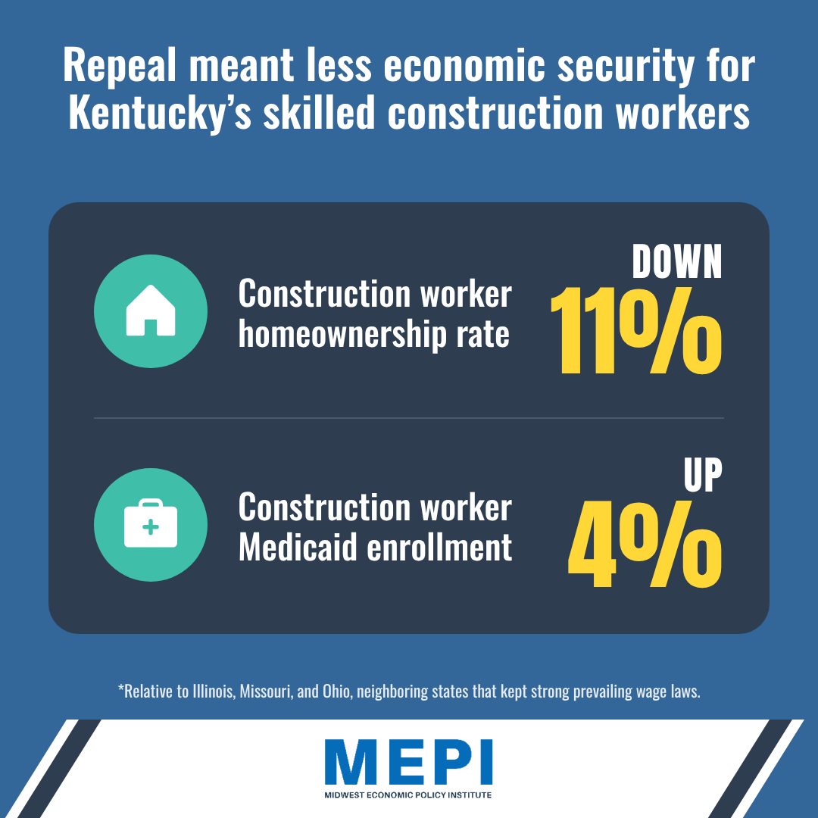
Repeal deteriorated job quality
Notes:
Executive Director

Slide 7
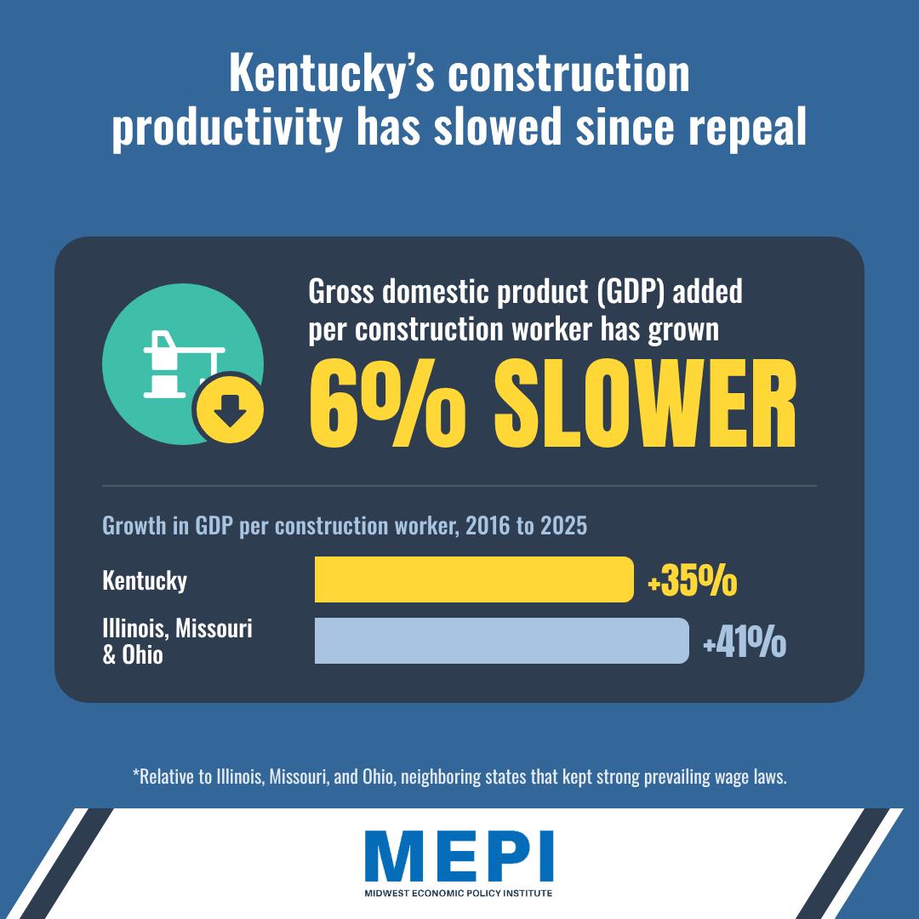
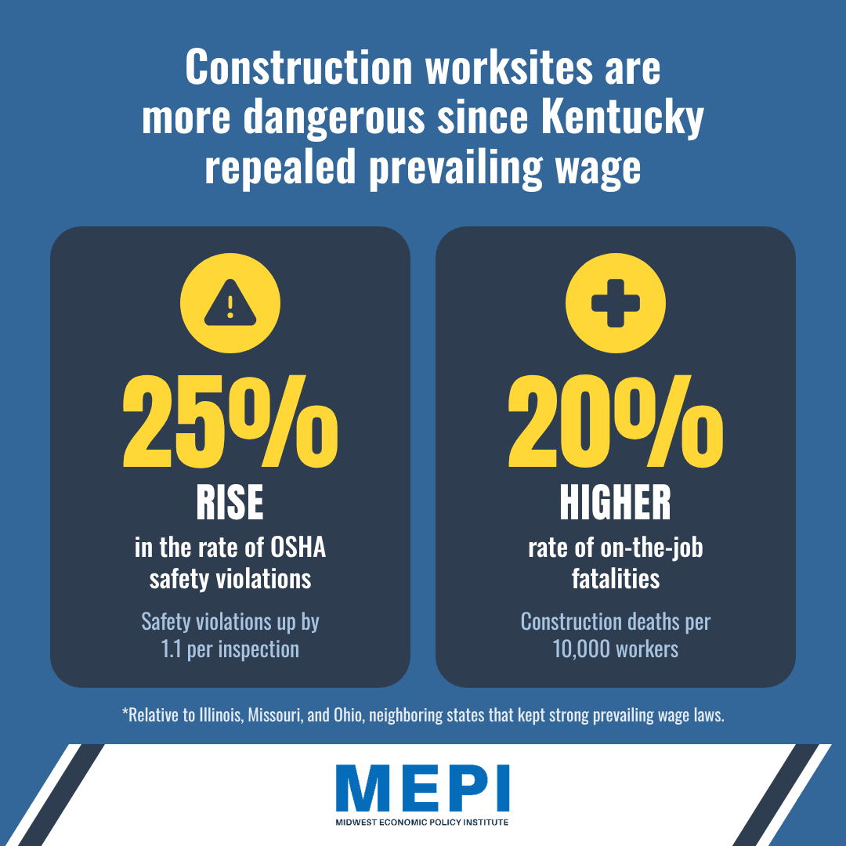
Repeal weakened the construction industry
Notes:
Executive Director

Slide 8
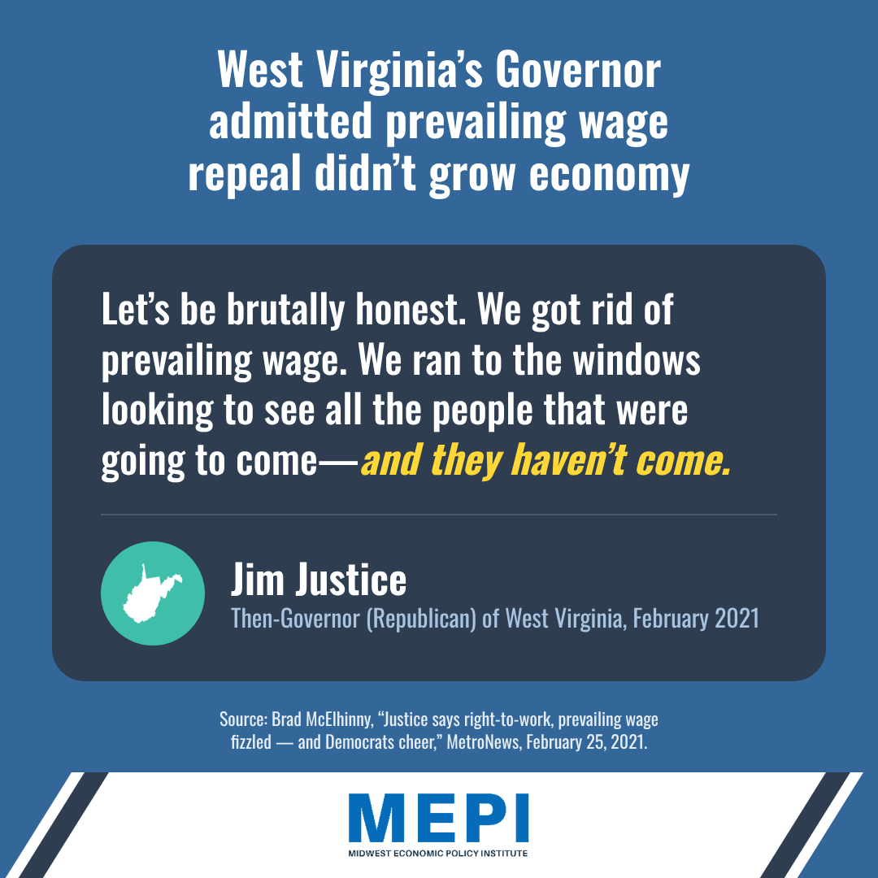
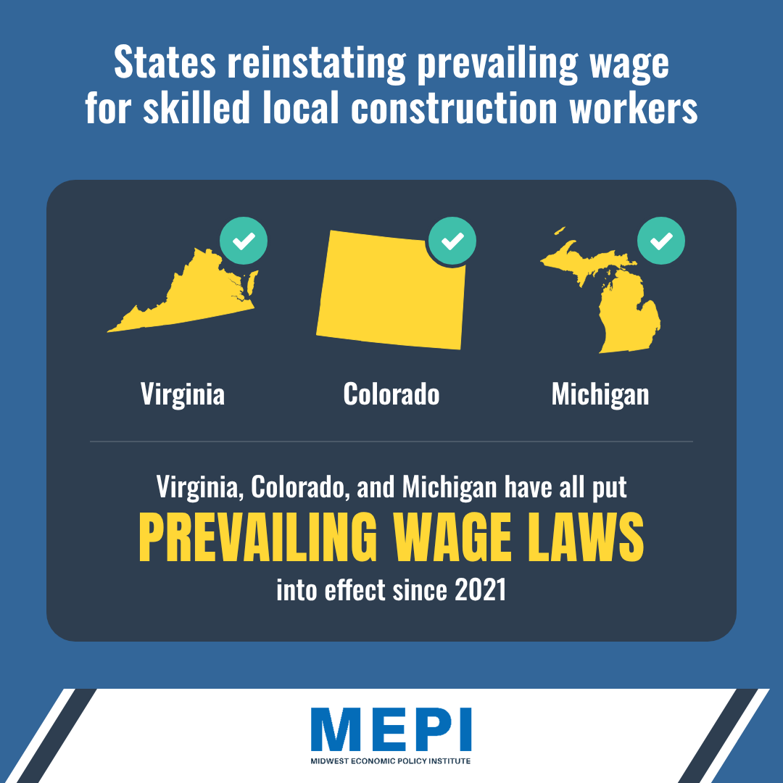
Kentucky is not alone
Notes:
Executive Director

Slide 9




Thank You!
Frank Manzo IV, Economist
P.O. Box 2378
La Grange, IL 60525
(708) 375-1002
fmanzo@midwestepi.org
www.midwestepi.org
Notes:
Executive Director

