Slide 1
Preserving Kentucky's Businesses, Jobs, & Communities Through Employee Ownership
Interim Joint Committee on Economic Development & Workforce Investment

Slide 2
TAMI WILSON
Vice President, Business Advocacy & Government Relations
Northern Kentucky Chamber of Commerce

Slide 3
REP. STEPHANIE DIETZ
District 65
Kentucky House of Representatives

Slide 4




Preserving Kentucky’s Businesses,
Jobs, and Communities through Employee Ownership
Interim Joint Committee on Economic Development and Workforce Investment
OCTOBER 15, 2026

Slide 5
THE PROBLEM
Small businesses face a succession challenge; employee ownership is a solution
THREATS TO SMBs
WHAT EMPLOYEE OWNERSHIP CREATES
CONCENTRATED
ASSET OWNERSHIP
HIGH RETURNS TO CAPITAL, LOW RETURNS TO LABOR
ALTERNATIVE TO CONSOLIDATION
SUPERIOR CORPORATE PERFORMANCE
MINIMAL ECONOMIC CUSHION
OFFSHORING / LOW PRODUCTIVE CAPACITY
WEALTH & RETIREMENT SECURITY
FEWER LAYOFFS
OWNER RETIREMENTS
HIGHER WAGES & BENEFITS
In Kentucky, 51 percent of businesses, and 2,254 manufacturers, have an owner aged 55 or older. When these owners sell, the likeliest buyers are strategic and financial buyers, often from outside the state.
Employee ownership keeps the business in Kentucky. Employee owners aged 28 to 34 earn 33 percent higher median wages, and employee owners were laid off at 1.3 percent, against 9.5 percent of other workers.
Sources: LSI, 535 Insights: Kentucky (2026); Wiefek, Employee Ownership and Economic Well-Being (NCEO, 2017); General Social Survey (2014)

Slide 6
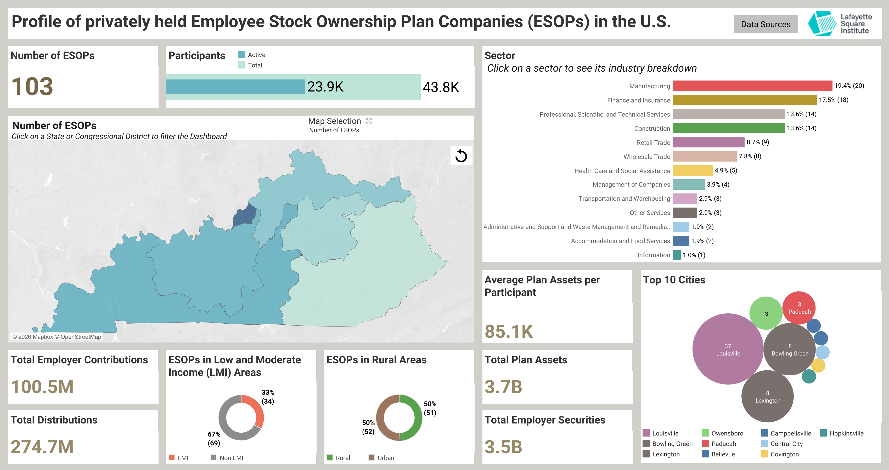
SNAPSHOT
Employee ownership in Kentucky
111
privately held ESOP companies, 18th among the states
46,200
employee owners, 15th among the states
$105,000
average ESOP account balance per employee owner
61%
of working-age Kentuckians have no retirement savings
Sources: LSI, 535 Insights: Kentucky (2026), based on the NCEO ESOP Database (2024 data, privately held companies) and the Census Bureau’s Survey of Income and Program Participation (2024).

Slide 7
THE FINANCING GAP
What a subordinated public or philanthropic lender changes
Illustrative $5 million sale to employees ($ millions)
$2.5M to $4.5M
seller cash at closing
A $2 million subordinated loan cuts the seller note from half the price to a tenth. The senior loan is unchanged.
The fund lends where private capital will not: junior to the bank and senior to the seller note on most transactions, and as senior credit for the smallest firms no bank will finance.
Sources: Moriarty, Financing the Growth of Employee Ownership, "The Financing Gap," 7; Rosenbloom, Employee Ownership as Economic Development, ch. 3. Illustrative; senior leverage depends on cash flow and collateral, not a fixed share of price.

Slide 8
STATE POLICY
A framework for employee ownership in Kentucky
PILLAR 1: INSTITUTIONAL CAPACITY
PILLAR 2: FINANCING AND ASSISTANCE
Director of Employee Ownership
Revolving loan fund
A designated official in the Cabinet for Economic Development who coordinates the Commonwealth’s employee ownership programs, works with owners, lenders, and advisors, pursues federal and philanthropic funding, and reports annually to the Governor and the Legislative Research Commission.
A dedicated fund at KEDFA that lends into employee ownership transitions and lends again as loans are repaid: junior to the bank and senior to the seller note on most deals, senior for the smallest firms no bank will finance. Can accept appropriations, federal grants, and philanthropic and private capital.
Advisory Commission
Technical assistance
Cabinet secretaries and gubernatorial appointees drawn from employee-owned businesses, lenders, professional advisors, and business associations. Advises on strategy and on the fund’s lending policies; members serve without compensation.
Outreach to owners approaching retirement, education for the accountants, attorneys, and bankers they rely on, and help with the cost of feasibility studies and valuations. Delivered by the Director directly or by contract.

Slide 9
POLICY OBJECTIVES
What a Kentucky fund’s financing products are designed to do
A fund at KEDFA could offer each of these products. Direct lending serves all four objectives of employee ownership finance policy; the others extend the fund’s reach through Kentucky banks.
Policy objective | Direct loan | Loan participation | Loan loss reserve | Loan guarantee
Enable seller liquidity on par with strategic and financial buyers | ● | ●
Create competitive risk-adjusted returns for investors | ● | ● | ●
Minimize the cost of capital to the employee-owned firm | ● | ● | ● | ●
Create long-term sustainability for the employee-owned firm | ● |  |  | ●
Sources: Adapted from Rosenbloom, Employee Ownership as Economic Development (2026), Table 1; Moriarty, Financing the Growth of Employee Ownership, “The Financing Gap.”

Slide 10
IMPLEMENTATION
Where each piece sits and how it is funded
Element | Kentucky home | Funding
Director of Employee Ownership | Cabinet for Economic Development | Cabinet budget; federal and philanthropic grants
Advisory Commission | Attached to the Cabinet | Members serve without compensation; expenses only
Revolving loan fund | Kentucky Economic Development Finance Authority (KEDFA) | Appropriation; EDA Economic Adjustment Assistance; philanthropic and private capital; loan repayments
Technical assistance | Director, directly or by contract | U.S. Department of Labor WORK Act grants; philanthropy
Capital that revolves. Each repaid loan finances the next transition, so one capitalization supports many.
No debt of the Commonwealth. Structured so obligations to outside investors are payable only from the fund.
Federal grants. Congress funded WORK Act grants to state employee ownership programs for the first time in fiscal 2026. A Director gives Kentucky a ready applicant.
Sources: SECURE 2.0 Act of 2022, sec. 346; Consolidated Appropriations Act, 2026, Division B joint explanatory statement; Rosenbloom, Employee Ownership as Economic Development (2026).

Slide 11
THANK YOU
Julien Rosenbloom, Lafayette Square Institute
rosenbloom@lafayettesquareinstitute.org

Slide 12
NORMAND DESMARAIS
CEO & Co-Founder
Tier1 Performance

Slide 13
THANK YOU
Questions?

