Slide 1
Shop Healthy Ky
Kentucky Retail Federation
Presentation to
Interim Joint Committee on Tourism, Small Business, and Information Technology
Shannon Stiglitz—Sr. VP Government Affairs
Tod Griffin--President

Slide 2
Kentucky Retail Federation—who are we
Traditional Retail
Grocery
Agribusiness Stores
Propane
Pharmacies
Restaurants
Convenience Stores
Vending Machines

Slide 3
COVID-19 Pandemic and Retail
KRF’s experience navigating COVID-19 Pandemic
No one was prepared for managing business closures, health concerns, product shortages, executive orders, local orders and health department rules.
Our members worked quickly to provide protection for employees
Senior hours for customers vulnerable to COVID-19
Encouraging curbside service
Learning new shopping practices
Self-enforced capacity limits
Coordination with governor’s office
Childcare for essential workers

Slide 4
COVID-19 Pandemic and Retail
Essential Retail
Determinations for what is essential?
CISA List
Grocery
Hardware Stores
Pharmacy
Propane
Convenience Stores
Farm supply stores

Slide 5
COVID-19 and Retail
Product Shortages
Price Increase—meat prices
Local Ordinances
Executive Orders
PPE sourcing and purchasing
Health department enforcement of essential retail orders

Slide 6
COVID-19 and Retailers Stepping Up
Kroger – agreed to let employees wear gloves and masks, and will be installing plexiglass guards at checkout to protect cashiers; restricted the number of customers in the store at one time company-wide; increased workers’ wages $2 an hour; put signage up throughout the store additional resources through the Kroger Family of Companies Helping Hands fund to provide financial assistance to associates who face hardship due to COVID-19, including lack of access to childcare and for those considered higher-risk; and announced a $3 million commitment to rapidly deploy hunger-relief resources to communities disproportionately impacted by the coronavirus (COVID-19) pandemic;
Food City announced $3 million in bonuses to employees;
Wal Mart – Providing masks and gloves for employees; limit five customers per 1,000 square feet, about 20% of capacity; The US retail giant has also pledged $25 million to support organizations that are working on finding ways to detect, manage, and prevent the virus, as well as non-profits that are supporting the most vulnerable;
Target – Limited number of customers and guiding shoppers through store to move them quickly; provided masks and gloves to employees; has pledged $10 million to help various local, national, and global organizations during the coronavirus crisis. It has promised to give $1 million to its most impacted employees, $5 million to state and community nonprofits supporting local populations, $3 million to national nonprofits such as Feeding America, and $1 million to global organizations such as UNICEF.
Texas Roadhouse – CEO and Founder Kent Taylor said he would forego his salary this year to pay employees; some locations selling ready-to-grill steaks
Meijer – Special hours set aside for front-line workers
Home Depot – Extending return policies to 180 days; Suspended seasonal sales and advertising; check workers’ temperatures before starting shifts; Paying full-time employees a $100 a week bonus and part-time employees a $50 a week bonus
Lowe’s – Increased wages; closing on Easter; using a new app so store personnel can monitor foot traffic; increased space for customers using order online and pick up options
Marathon and Speedway – Donated 500,000 PPE items
Walgreens – expanding drive thru services, and planning to expand drive thru testing
Several smaller stores, located in areas not serviced by major retailers, have also adapted their procedures with curbside delivery, taking cards over the phone to minimize contact.
Kroger, Walmart, Home Depot, Target, Lowes—provide additional pay and sick leave

Slide 7
COVID-19 and Pharmacy
Increased Drive thru options
Testing through Executive Order
Enhanced Delivery of Medications
DOI—suspends PBM audits
Allow for dispensing of 30-day supply of medications
Challenges for Pharmacy:
Reimbursements
Healthcare providers
PPE Supplies

Slide 8
COVID-19 Testing
Kroger testing program
Walmart testing program
Walgreens testing program
All of these are open and free to the public in certain communities
State pays for laboratory services
Retailers provide supplies and staff to run drive-thru testing program

Slide 9
Reopening Retail
KRF submitted a plan for reopening retail businesses deemed non-essential. We established principles for reopening based on the experience of essential retailers
Key Principles to Reopening:
Protect our Community
Flexibility in safely reopening
Clear Expectations for Employees and Customers
Statewide Guidelines
Coordination and Collaboration

Slide 10
Retail Reopening
One suggestion to ensure that enforcement is properly being administered is to develop a statewide appeal process for businesses issued closure orders. Currently, there is no such remedy for retailers leaving these businesses without due process or a mechanism to seek such a remedy. It has left businesses trying to navigate a complicated web of regulations from local governments, local health departments and other state agencies. In many instances, KRF has assisted these retailers in seeking a remedy but it is not a quick process and can leave the business closed and employees sent home, even if they were properly following the guidelines.

Slide 11
Retail Reopening
Patchwork quilt of state and local regulations:
The greatest frustration of essential retailers today is the patchwork quilt of guidance and enforcement of social distancing requirements and other Executive Orders. The EOs allow multiple agencies to enforce orders and oftentimes they give conflicting guidance or guidance that does not meet the EO requirements. We would strongly encourage preemption of city and county ordinances as part of the reopening process. In addition, an appeals process should be established for businesses to refute closure orders as there is currently no process in place.

Slide 12
KRF Resources for Retailers
Jobs Website
Sourcing of PPE, cleaning supplies, etc.
Daily COVID-19 Newsletter
Small Business Administration Conference Call on Paycheck Protection Program
Development of Shop Health Ky Campaign

Slide 13
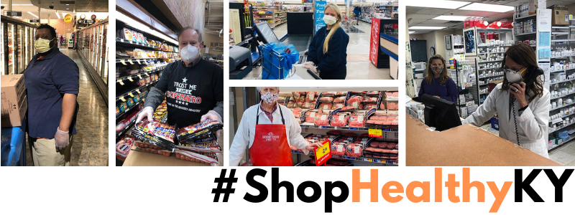
Shop Healthy Ky Campaign
https://www.kyretail.com/shophealthyky

Slide 14
Restaurants
Thank you, General Assembly!
Passed SB 150
Allowed Restaurants to sell alcohol by the package
Allowed Restaurants to sell to-go alcohol by the drink
Allowed Restaurants to sell raw foods and grocery items

Slide 15
Restaurants
Challenges:
Guidance and reopening communications
Social distancing and capacity limits
Loss of customer base
Access to PPE
Patchwork quilt of guidance
Barriers to reopening to 50%
Paycheck protection program

Slide 16
Improvements
Clear communications and expectations statewide
Appeals process for businesses
Clear Lines of communications with public health officials
Collaboration
Development of Business Committee within state government

Slide 17
Conclusions and Questions
Thank you
Shannon Stiglitz
Sr. Vice President of Government Affairs
sstiglitz@kyretail.com
Tod Griffin
KRF President
tgriffin@kyretail.com

