Slide 1
Interim Joint Committee on Tourism, Small Business and Information Technology
July 30, 2020
Tyler Campbell
Executive Director

Slide 2
Who We are
Members consist of 18 independent and cooperatively owned companies, including 2 regional wireless providers delivering reliable voice, video and broadband services to rural Kentucky.
Associate Members – Vendors
Also represent 90-100 associate members that offer a vast array of services to Kentucky’s rural telecom providers.

Slide 3
KTA By the Numbers
Serve all or part of 45 counties – Serve more than 1/3 of the counties in the Commonwealth.
Kentucky rural telecom providers employ more than 1,200 people.
Rural broadband has a direct economic impact of $312.3 million in the Commonwealth. Total overall economic impact estimated at $414.4 million (*Hudson Institute “The Economic Impact of Rural Broadband,” April 2016 briefing paper).

Slide 4
Impact of COVID-19 on Rural Broadband Providers
Gov. Beshear’s Executive Order observes CISA’s critical infrastructure sectors as essential services/essential workers – Telecom deemed essential.
FCC’s “Keep America Connected” Pledge – March 13, 2020 – June 30, 2020
KY PSC Issues Order to Halt Disconnections of Regulated Services (Voice) – March 16, 2020 – Present

Slide 5
Impact of COVID-19 on Rural Broadband Providers
Prioritized health and safety of employees and customers:
Closed lobbies and encouraged business via online or drive-thru.
Established telework/work-from-home procedures to limit employees in offices to practice social distancing.
Worked to secure adequate PPE for employees.

Slide 6
Impact of COVID-19 on Rural Broadband Providers
Prioritized health and safety of employees and customers:
Service calls were limited/reduced. Customers had to answer health screening questions prior to service appointments.
Daily employee temperature checks.

Slide 7
Impact of COVID-19 on Rural Broadband Providers
Examples of actions taken during the first few months of quarantine:
Many companies accepted the FCC’s Keep America Connected Pledge.
Worked with local officials to establish free drive up Wi-Fi hot spots in communities.

Slide 8
Impact of COVID-19 on Rural Broadband Providers
Examples of actions taken during the first few months of quarantine:
Several companies increased download/upload speeds for students and work-from-home customers.
Several companies offered discounted or free internet service during first two months of pandemic for students.

Slide 9
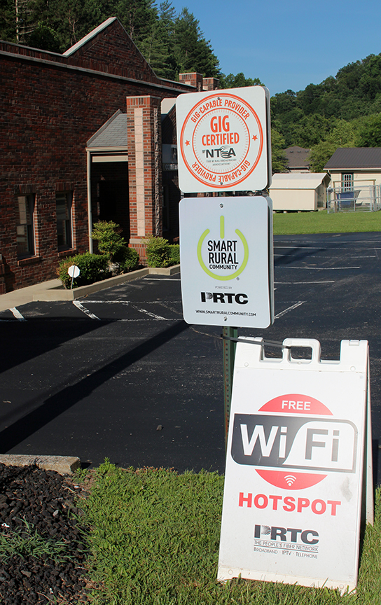

Slide 10
Challenges ahead for rural broadband providers due to covid-19
Backlog of installations
Non-payment of services
Increased demand/rising costs of broadband deployment

Slide 11
Funding Challenges and opportunities Despite COVID-19
In addition to traditional high-cost Universal Service Fund support, Kentucky’s rural broadband providers continue to innovate and seek resources to expand broadband deployment:
USDA’s ReConnect Program
USDA’s Community Connect Grant Program
FCC’s Rural Digital Opportunity Fund
Broadband Pilot Project Partnerships

Slide 13
QUESTIONS?
Tyler Campbell
Kentucky Telecom Association
502-699-2206
Email: tyler@ktaoffice.org

