Slide 1
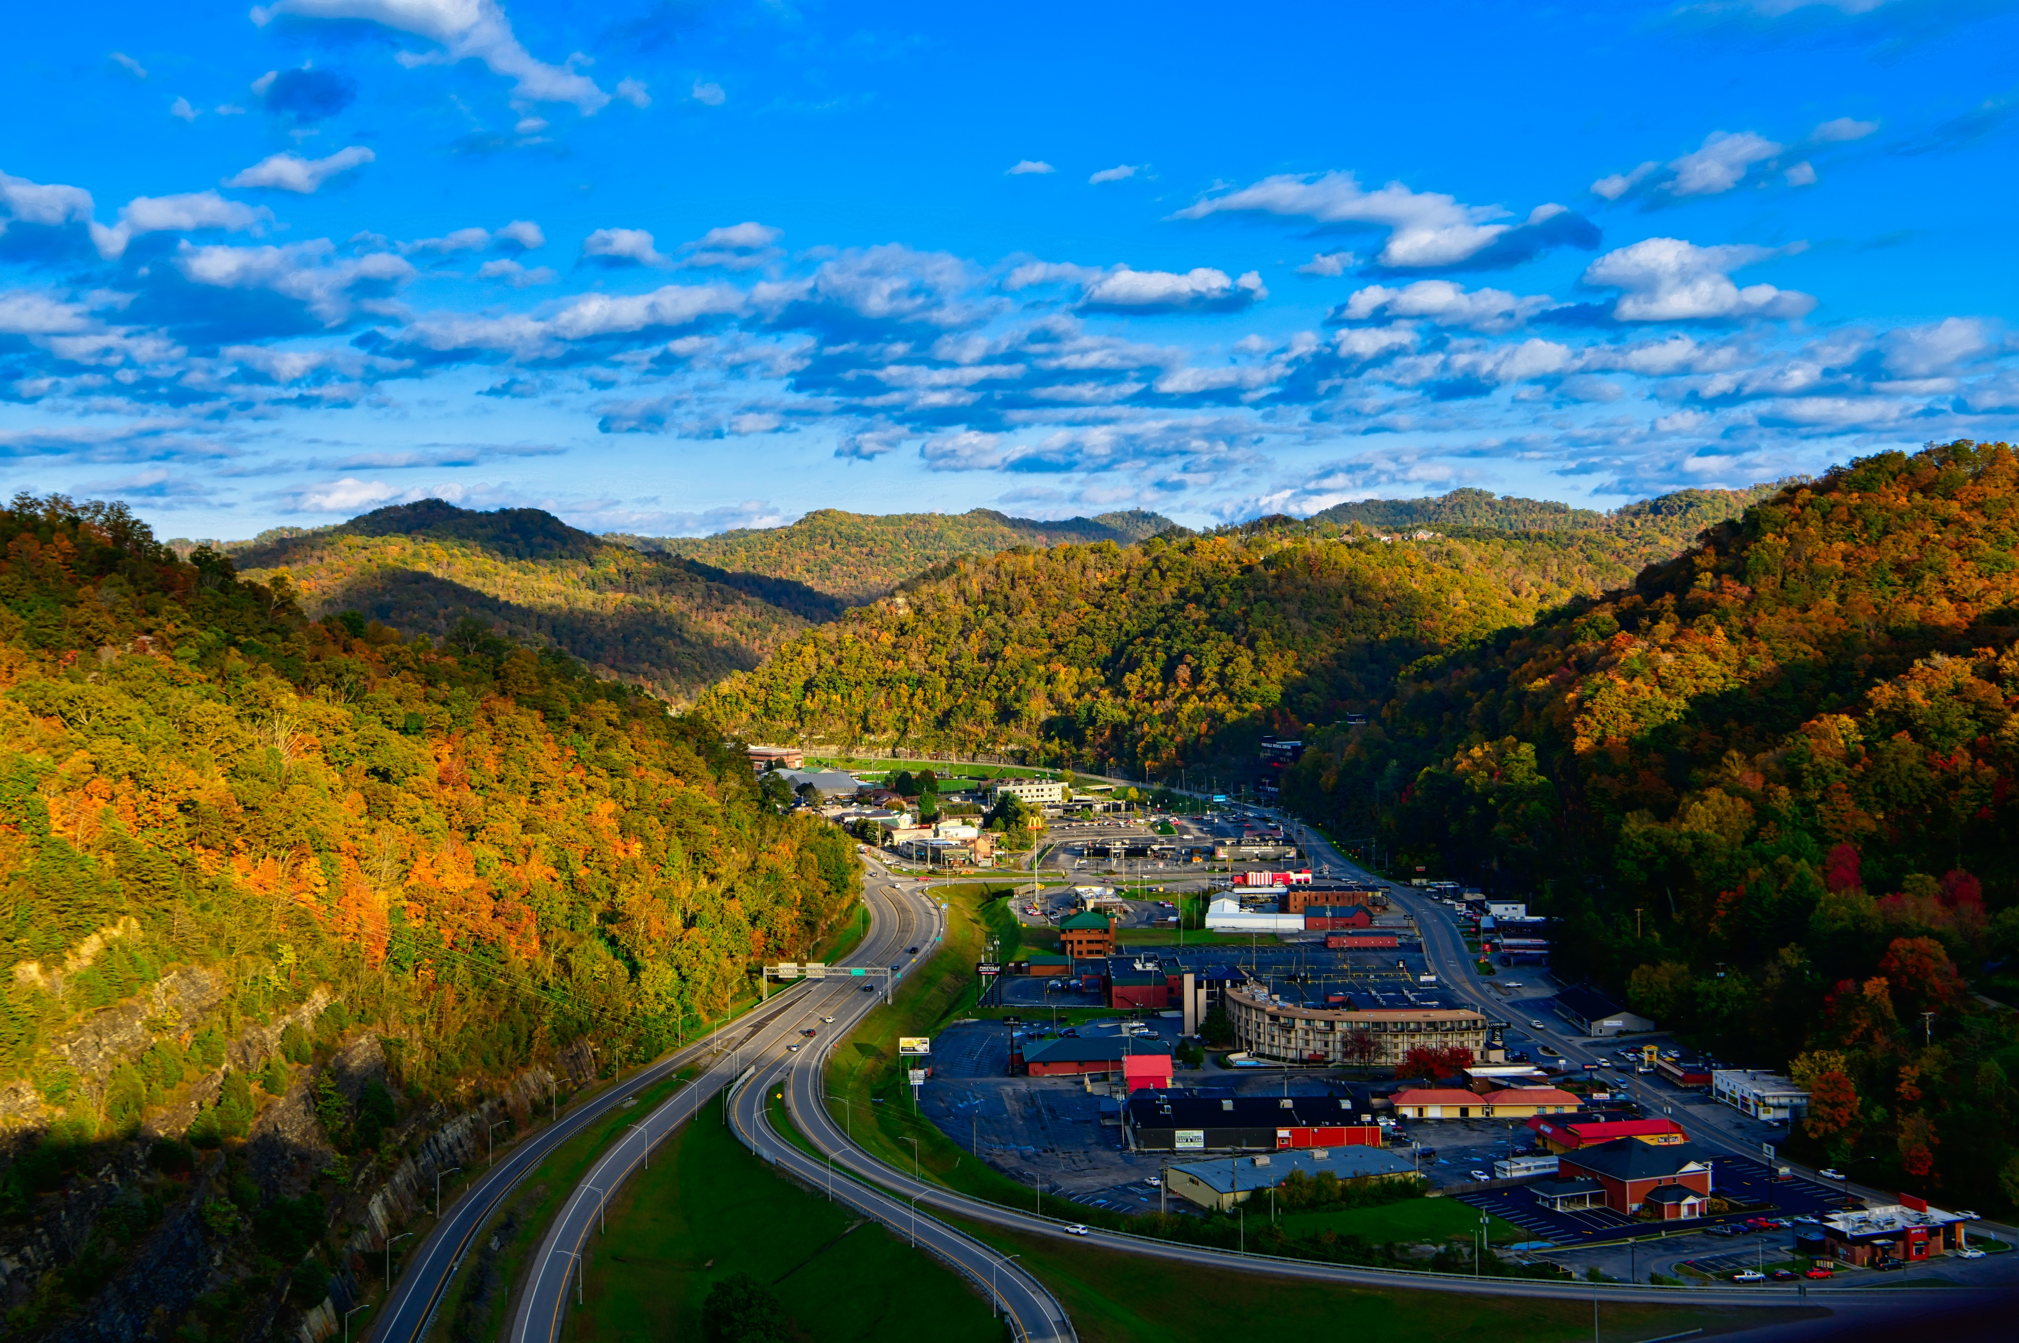
Pikeville, KY
“Let the Mountains move YOU”

Slide 2
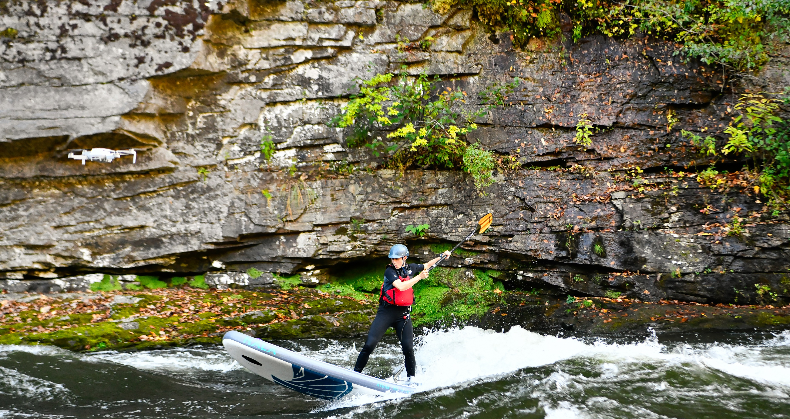
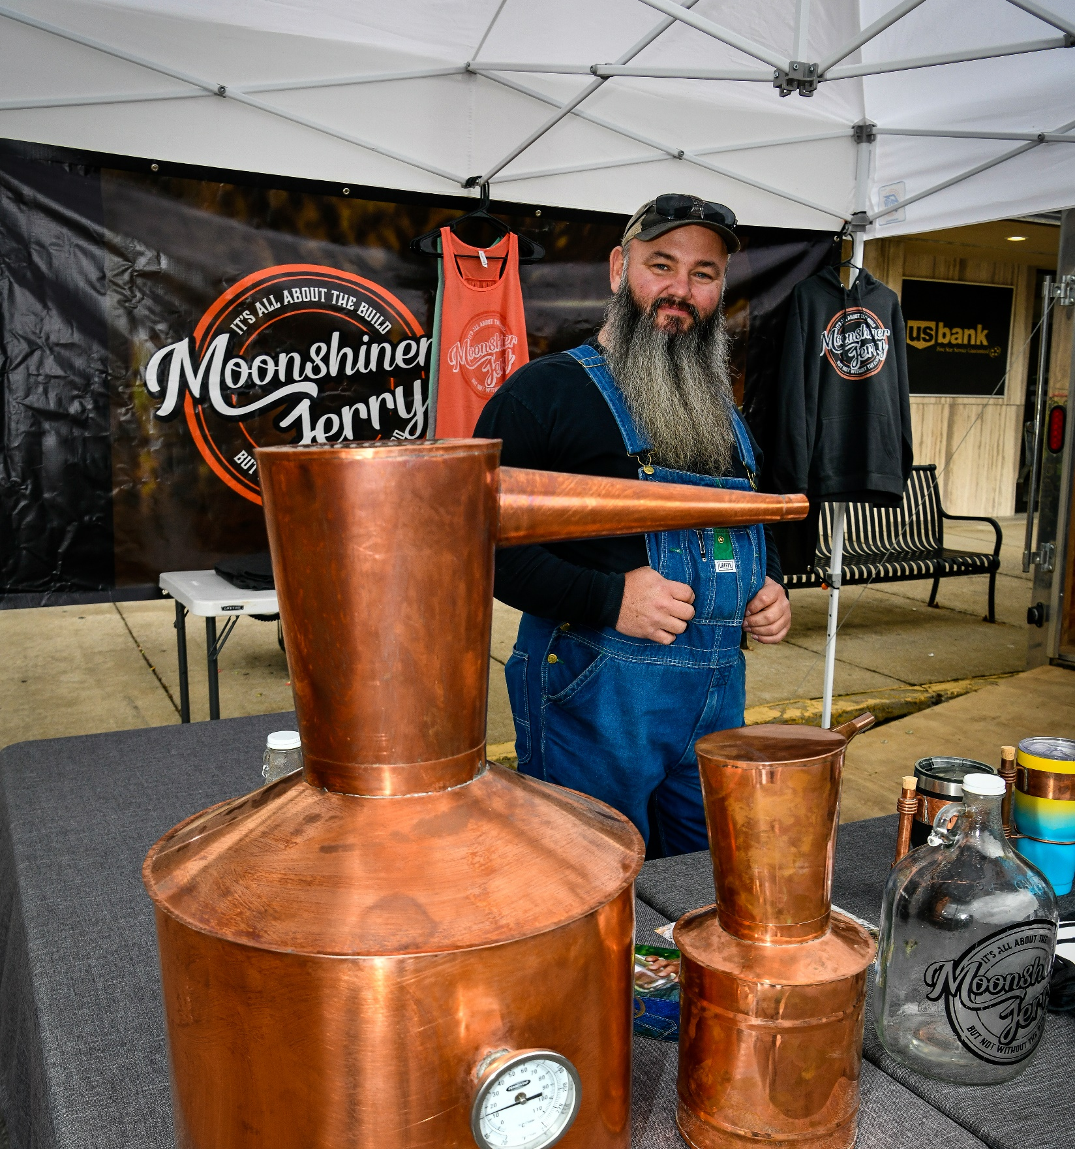
Tourism in the mountains
Outdoor Recreation
Appalachian Heritage
Arts & Culture
Entertainment

Slide 3
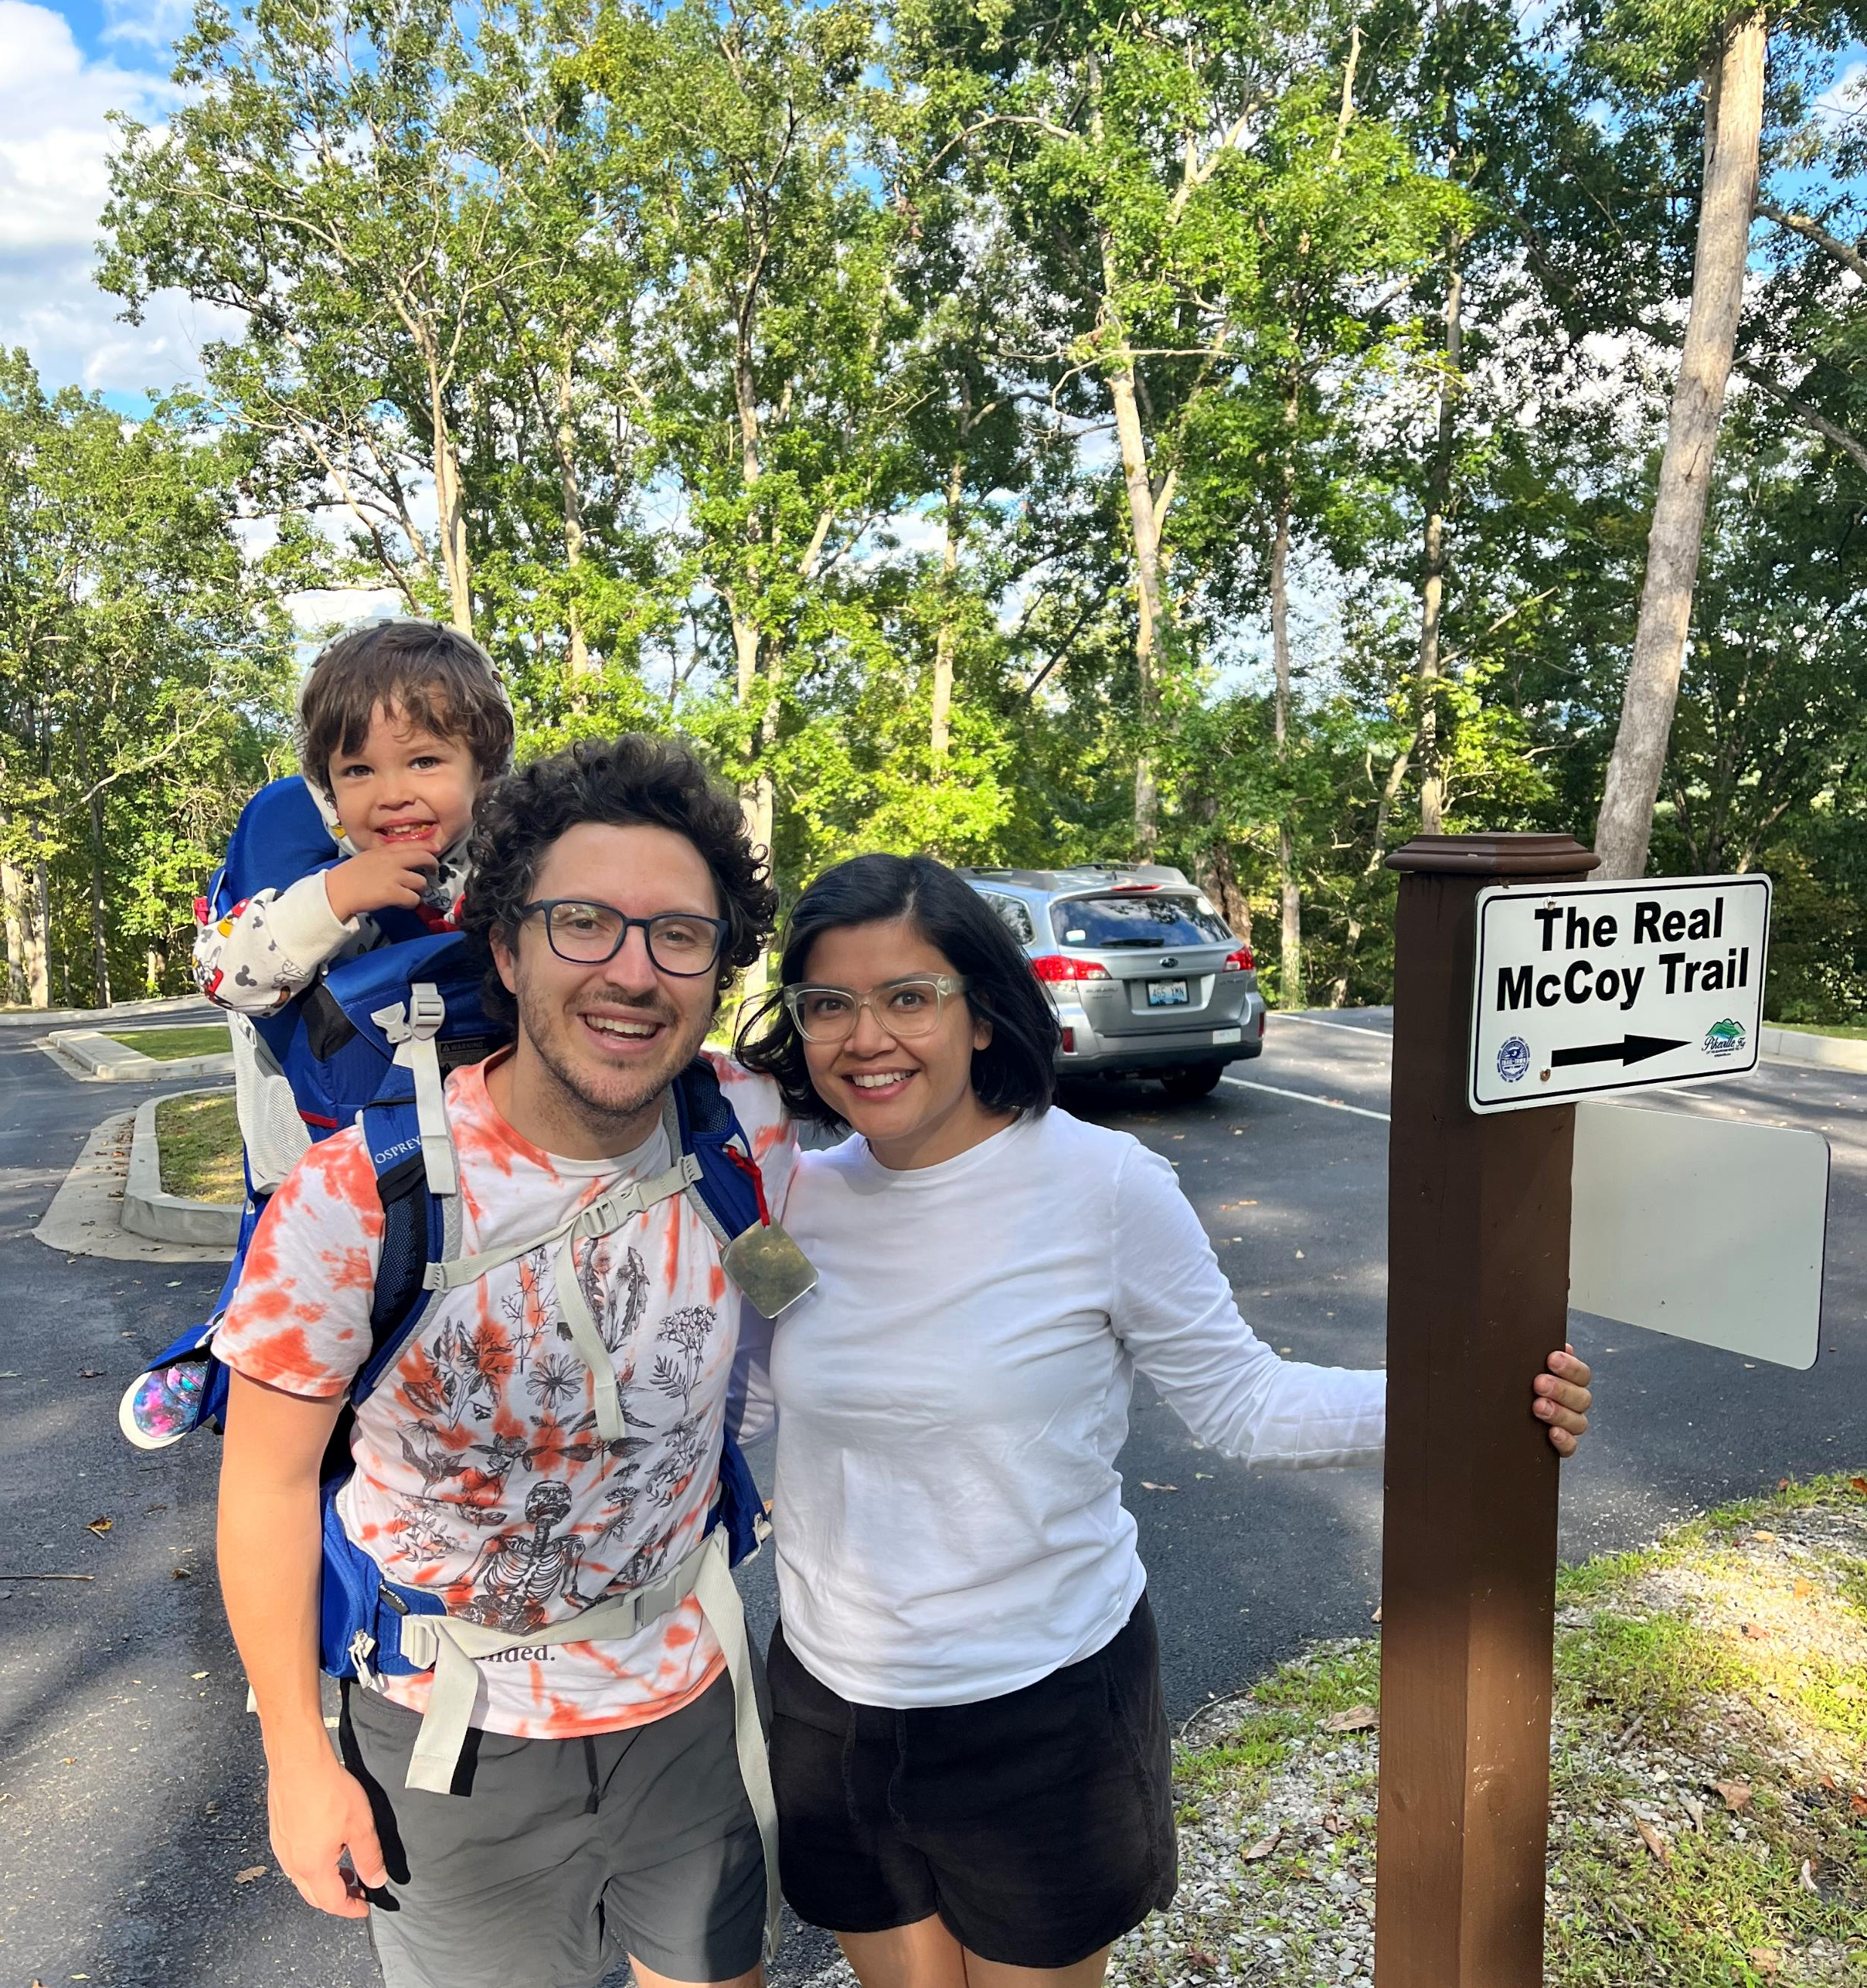
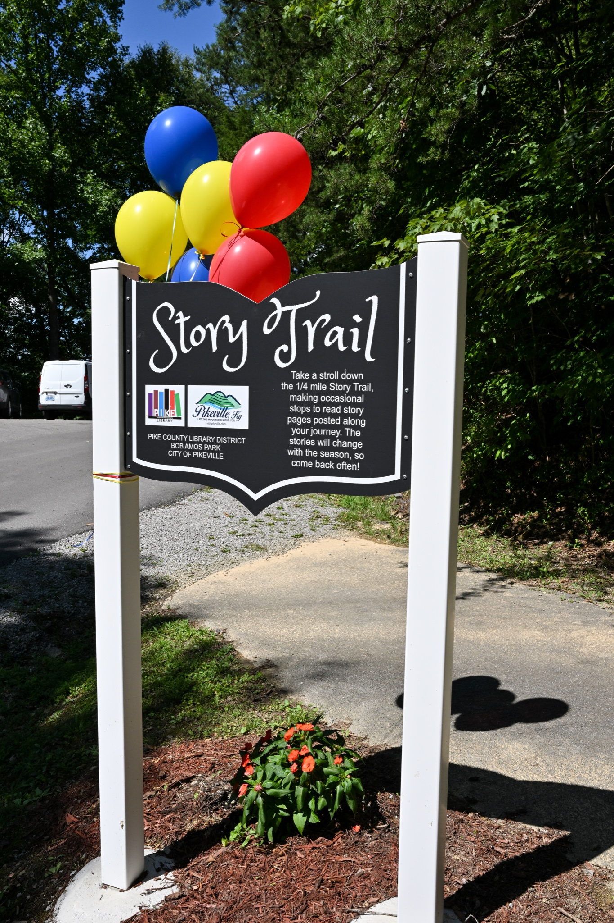
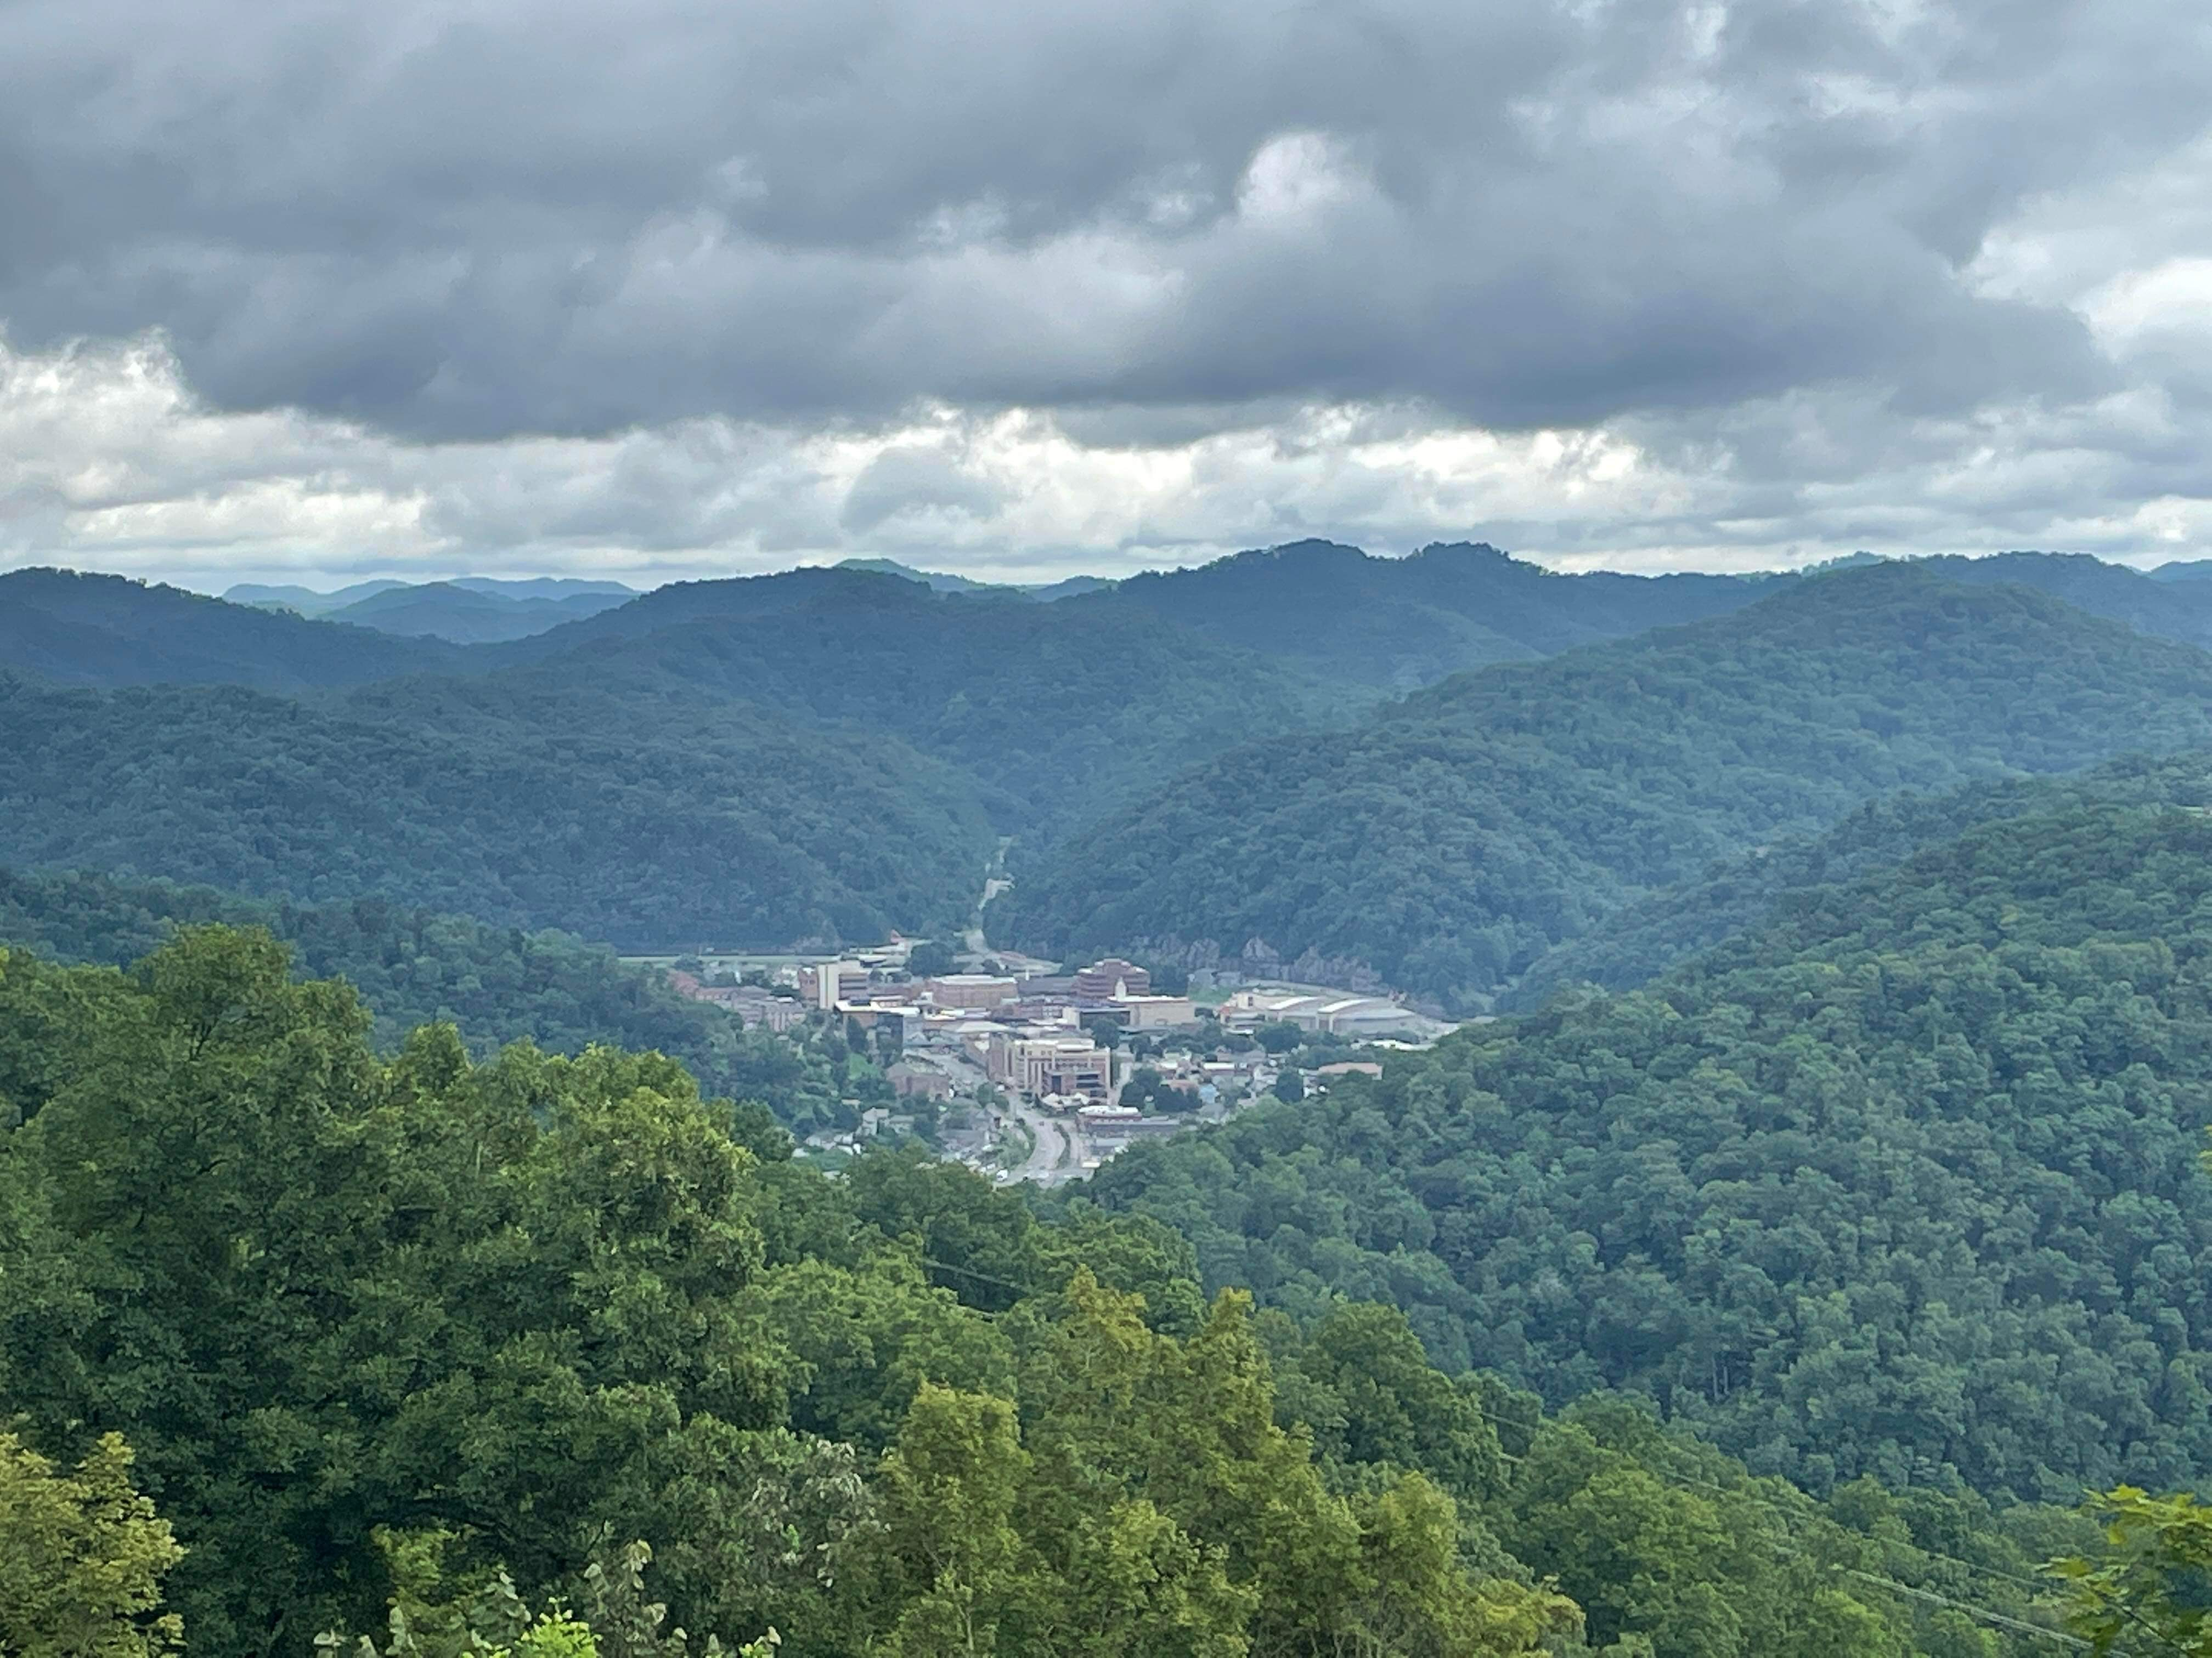
Outdoor Recreation

Slide 4
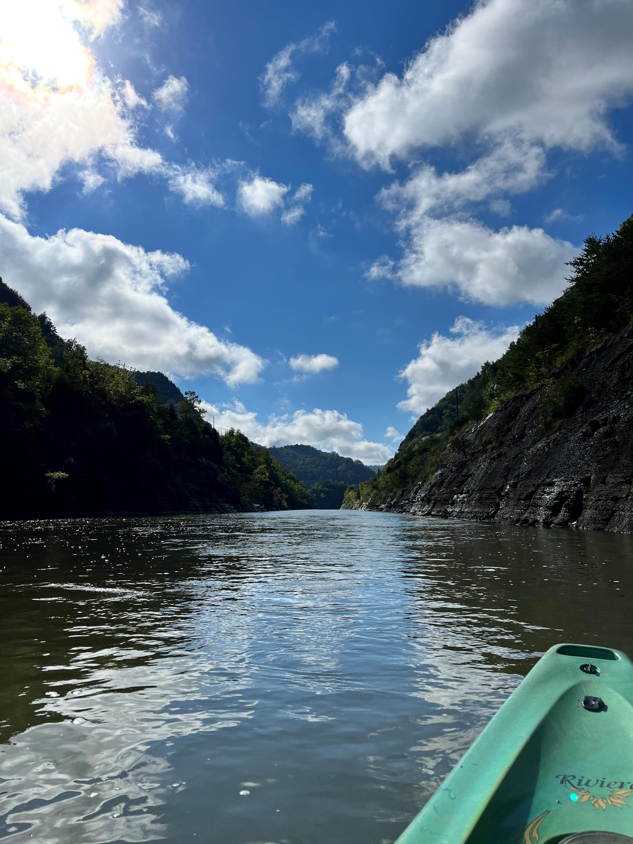
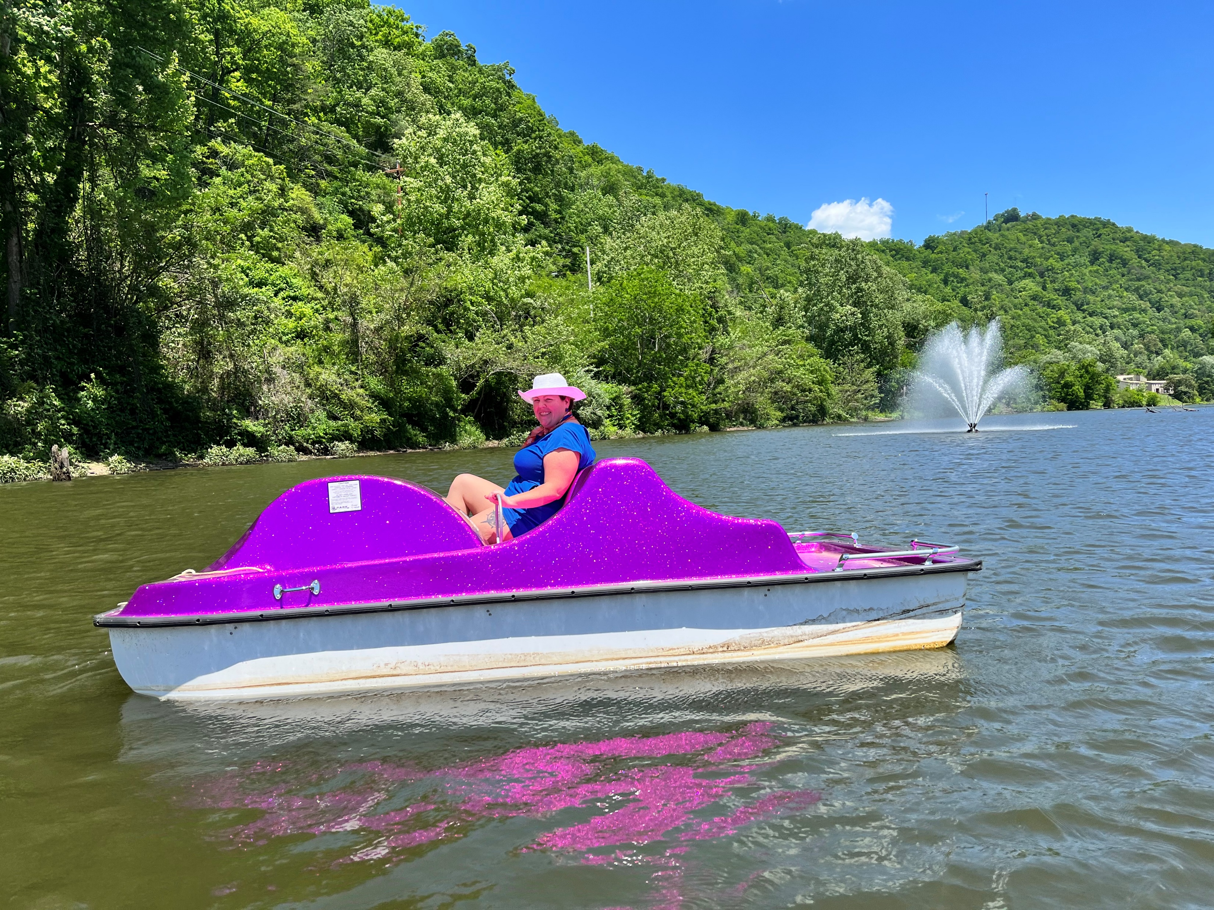
Outdoor Recreation

Slide 5
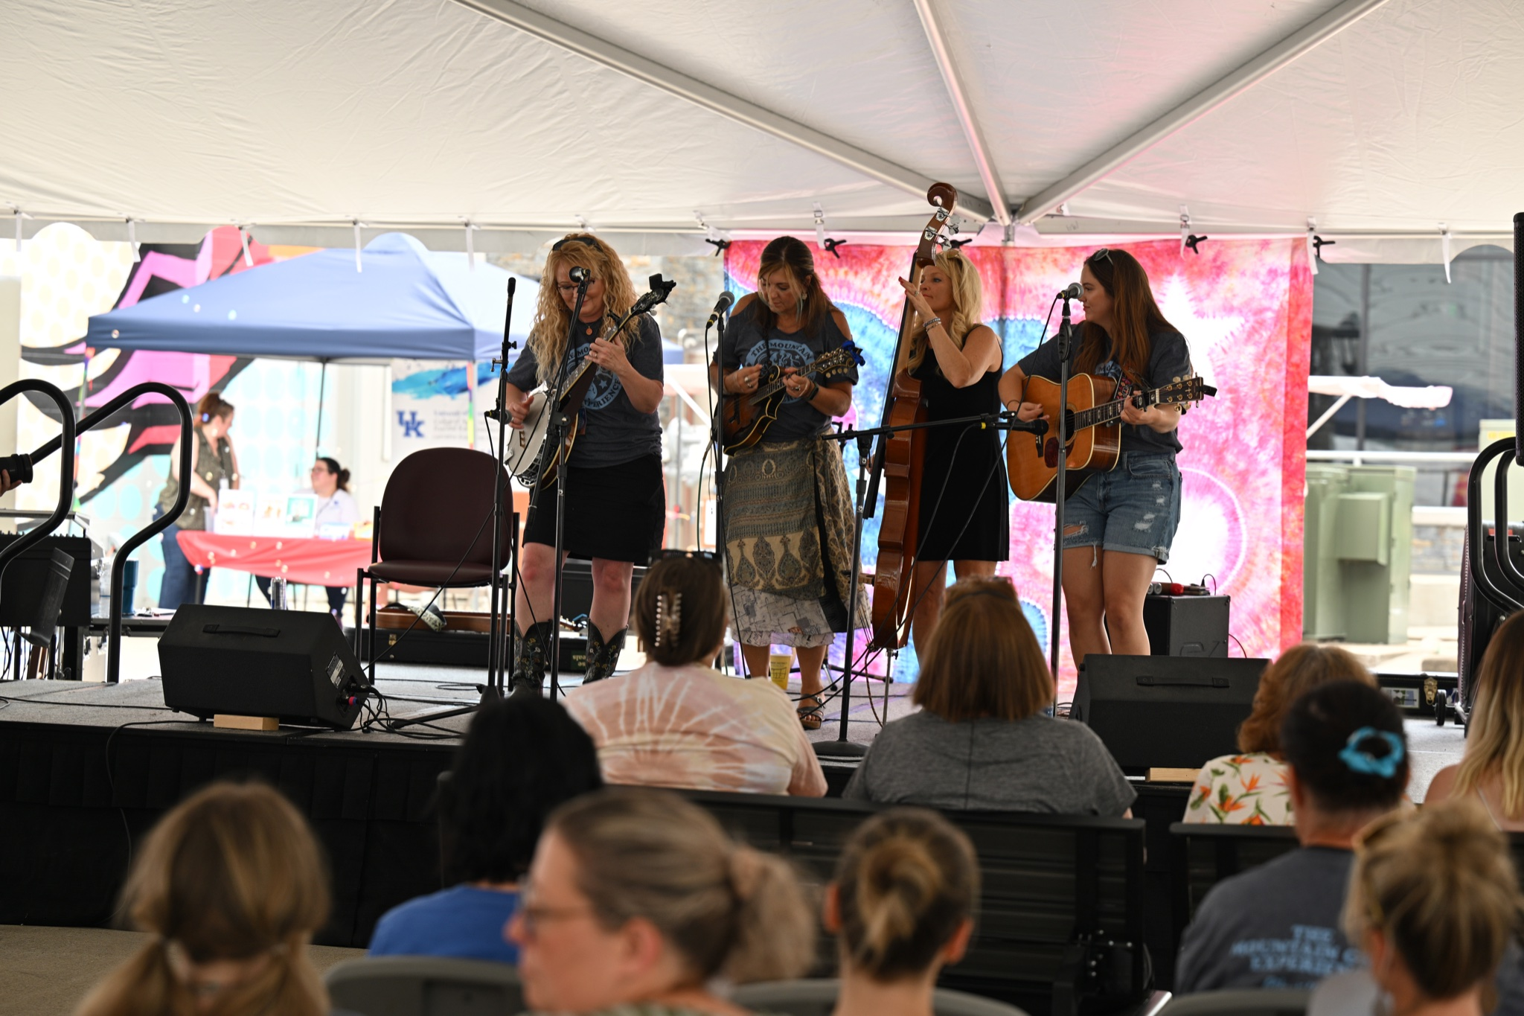
Appalachian Heritage

Slide 6
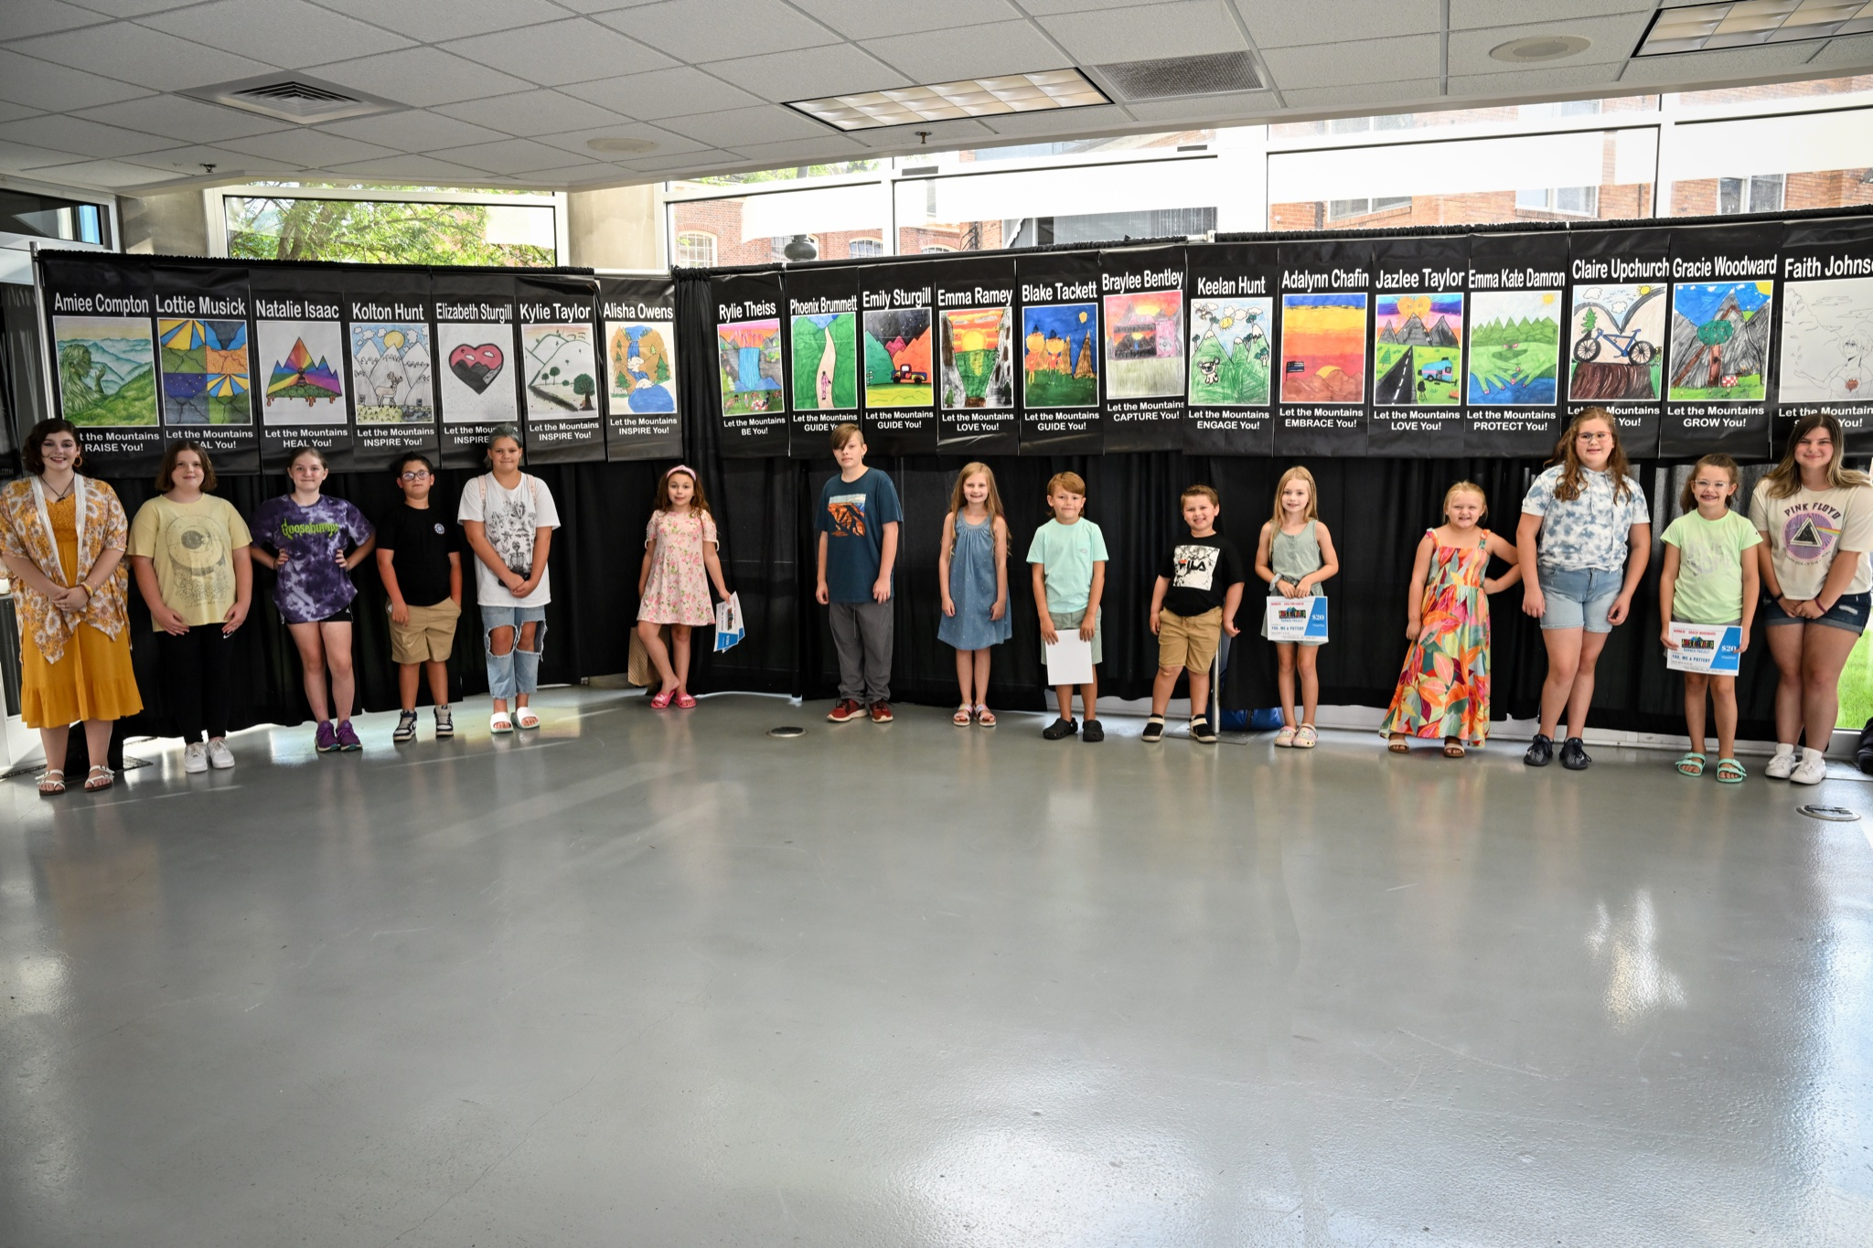
Arts & Culture

Slide 7
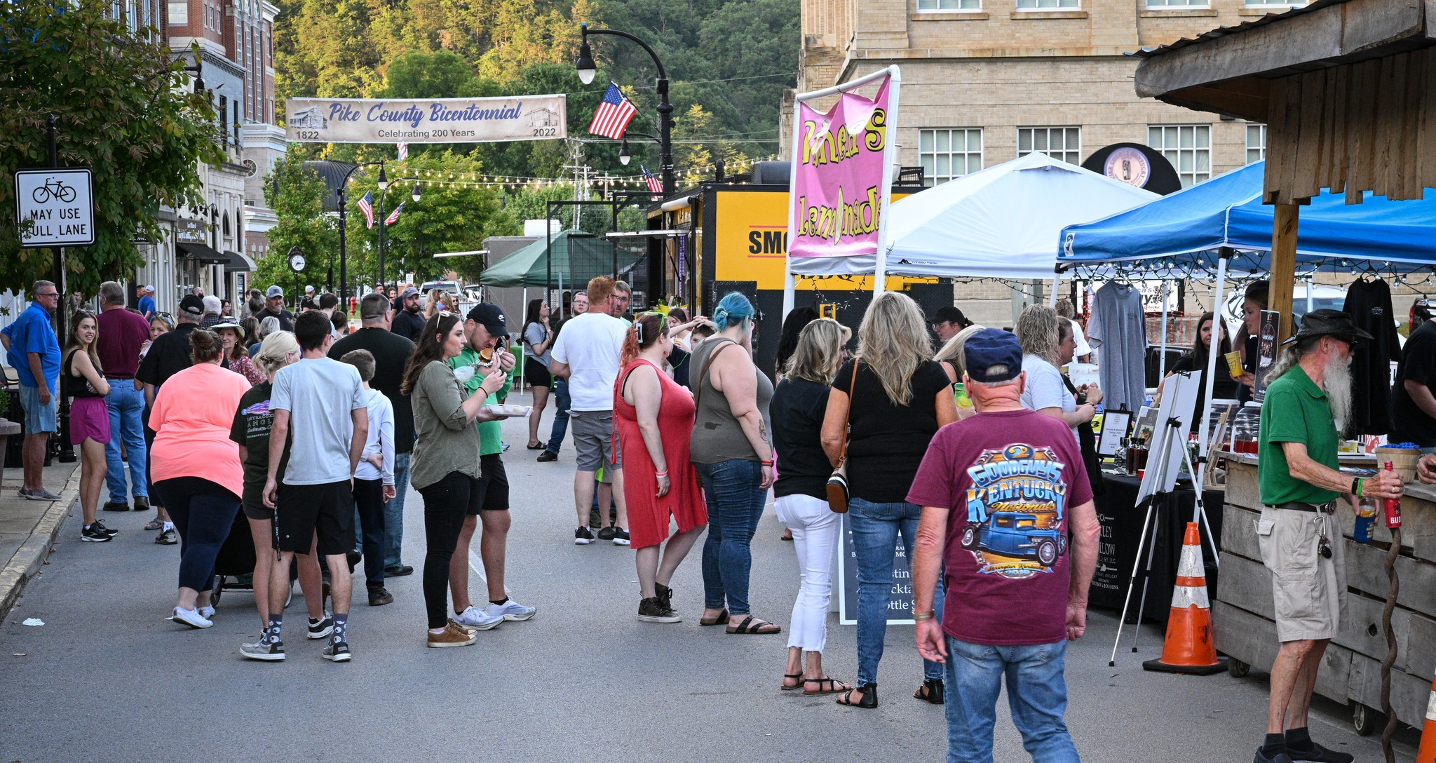
Arts & Culture

Slide 8
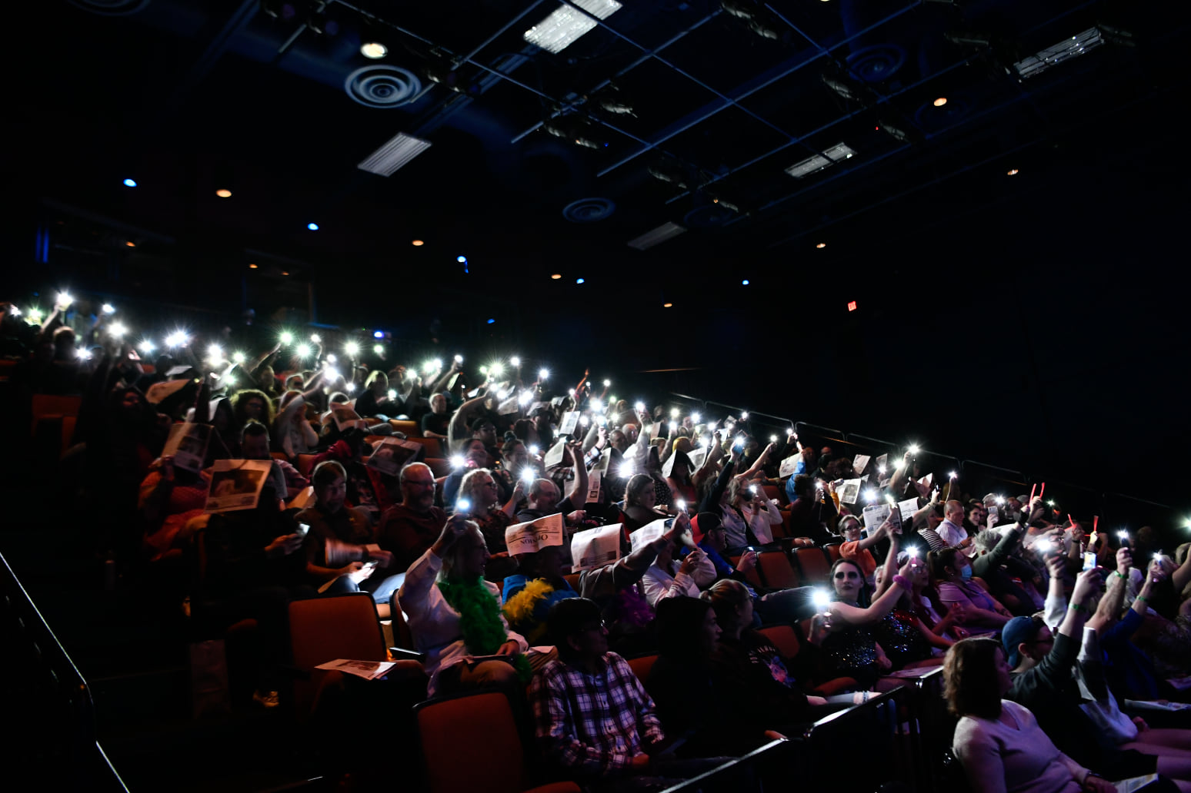
Arts & Entertainment

Slide 9
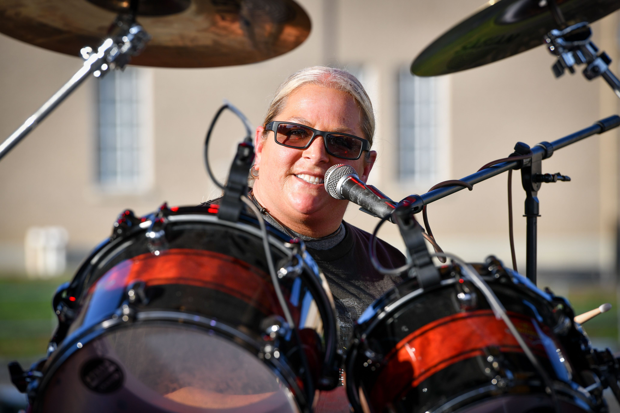
Downtown Entertainment

Slide 10
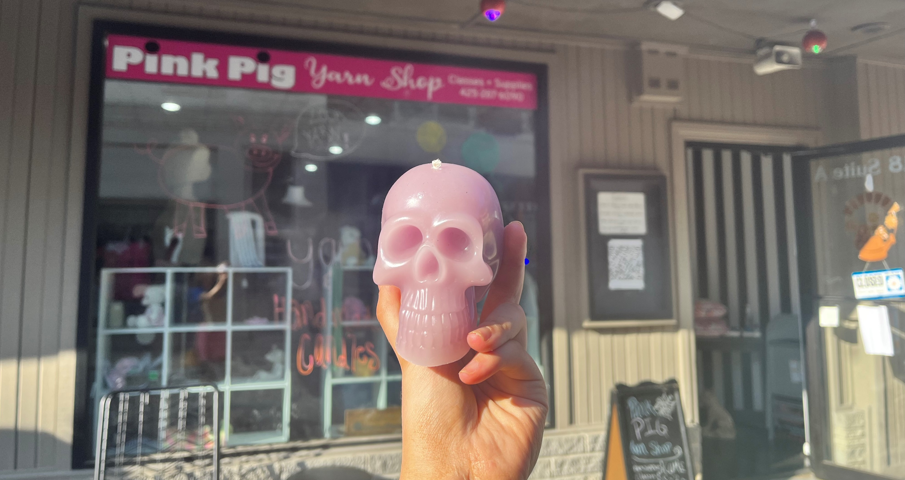
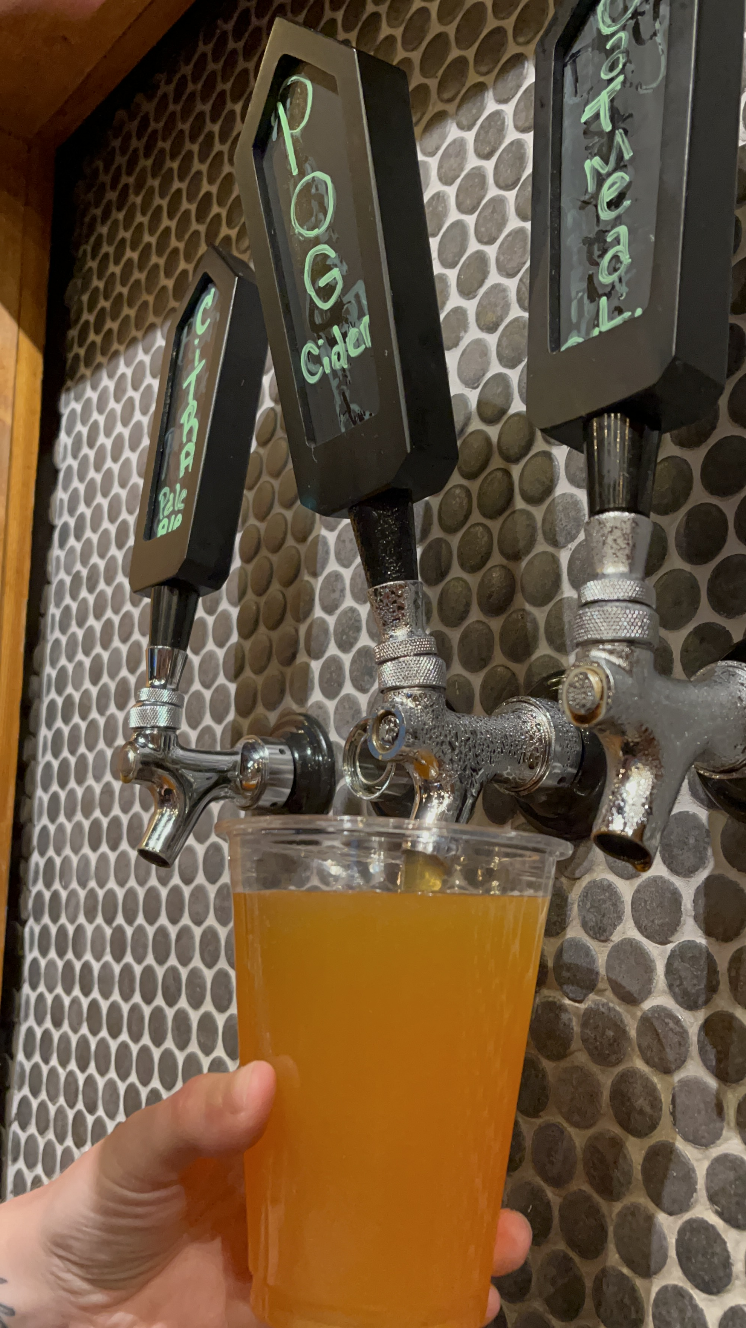
Tourism Tuesdays

Slide 11
Social Media
Facebook – 39k Followers
Instagram – 2,080 Followers
Twitter – 800 Followers
Tiktok – 1,154 Followers

Slide 12
THANK YOU FOR YOUR SUPPORT!

