Slide 1
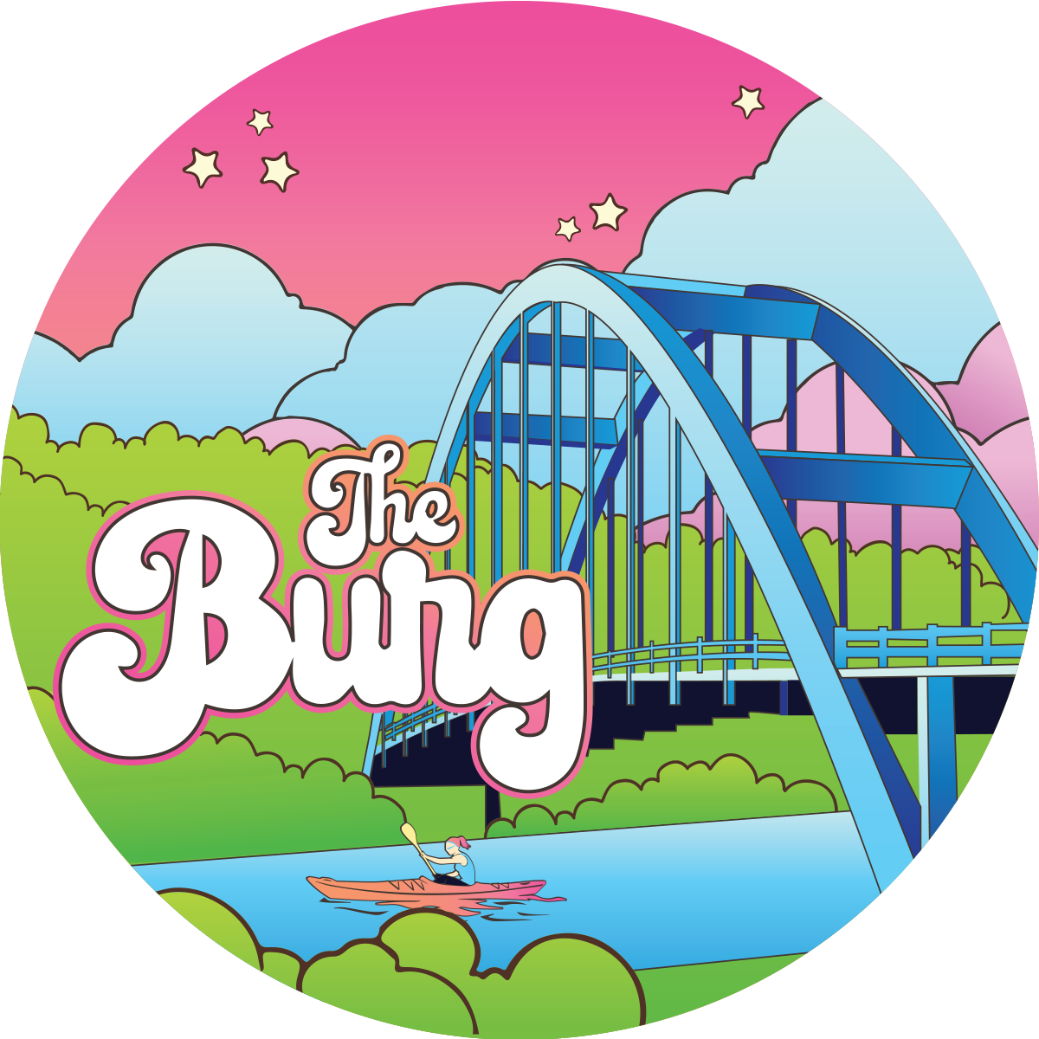

PRESTONSBURG, KY
The Star City

Slide 2
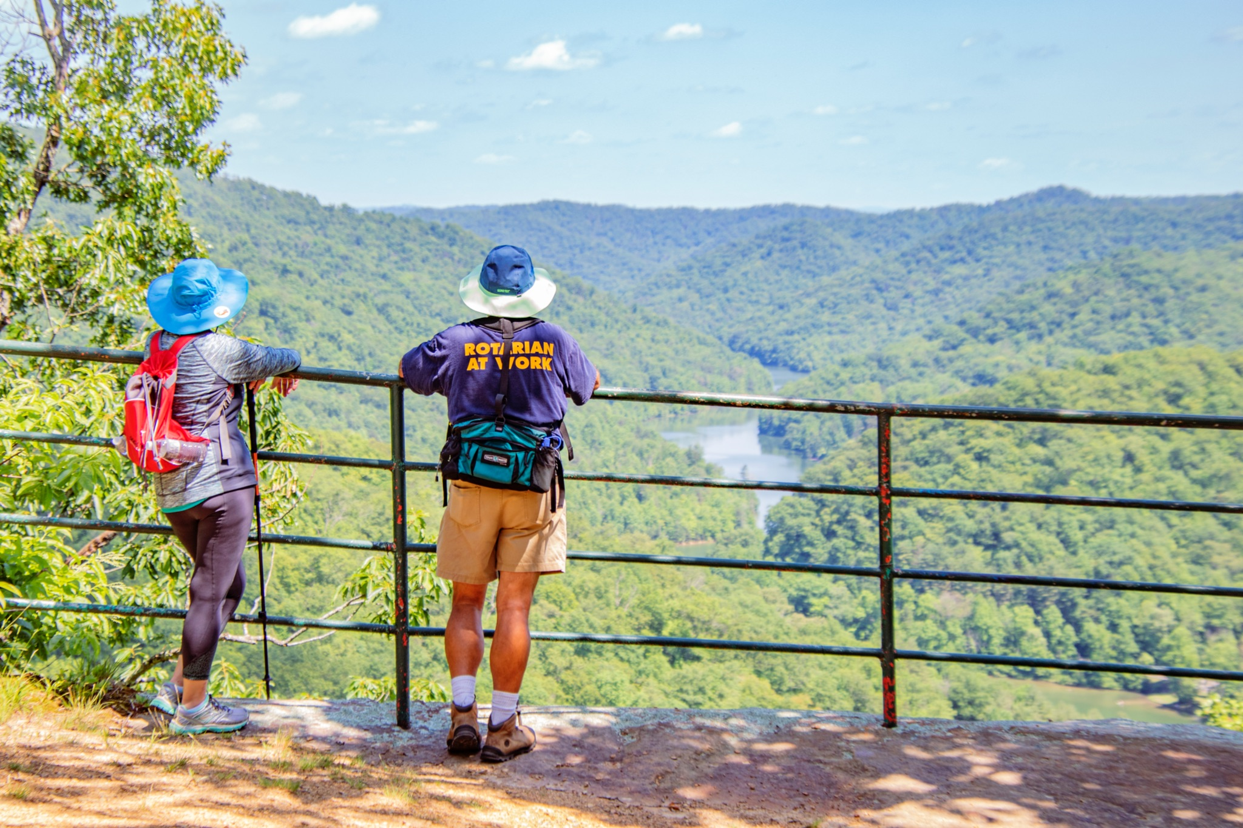

Slide 3
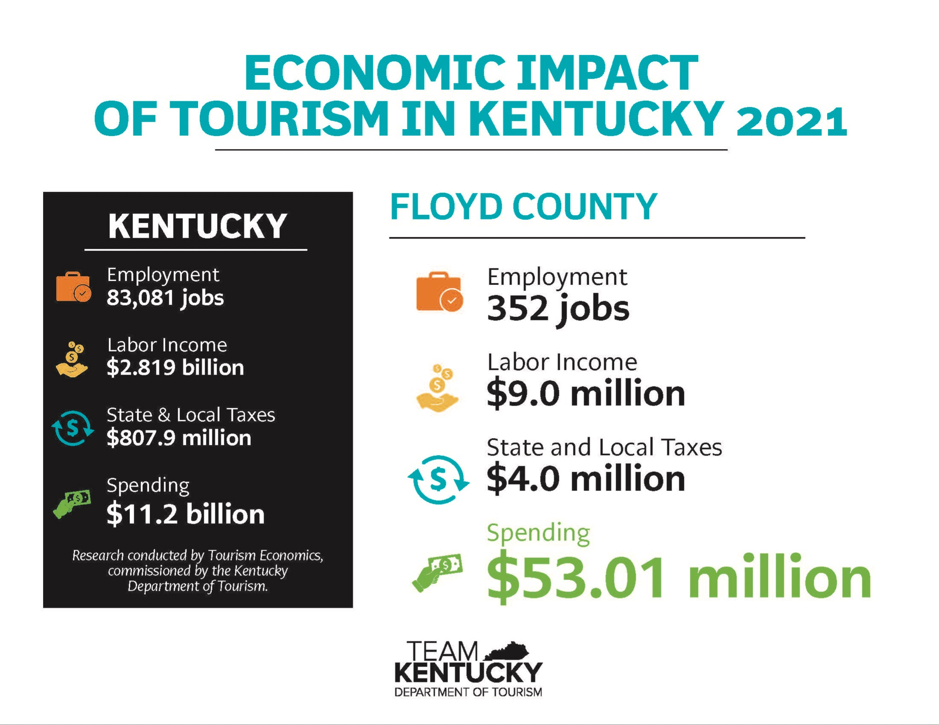

Slide 4
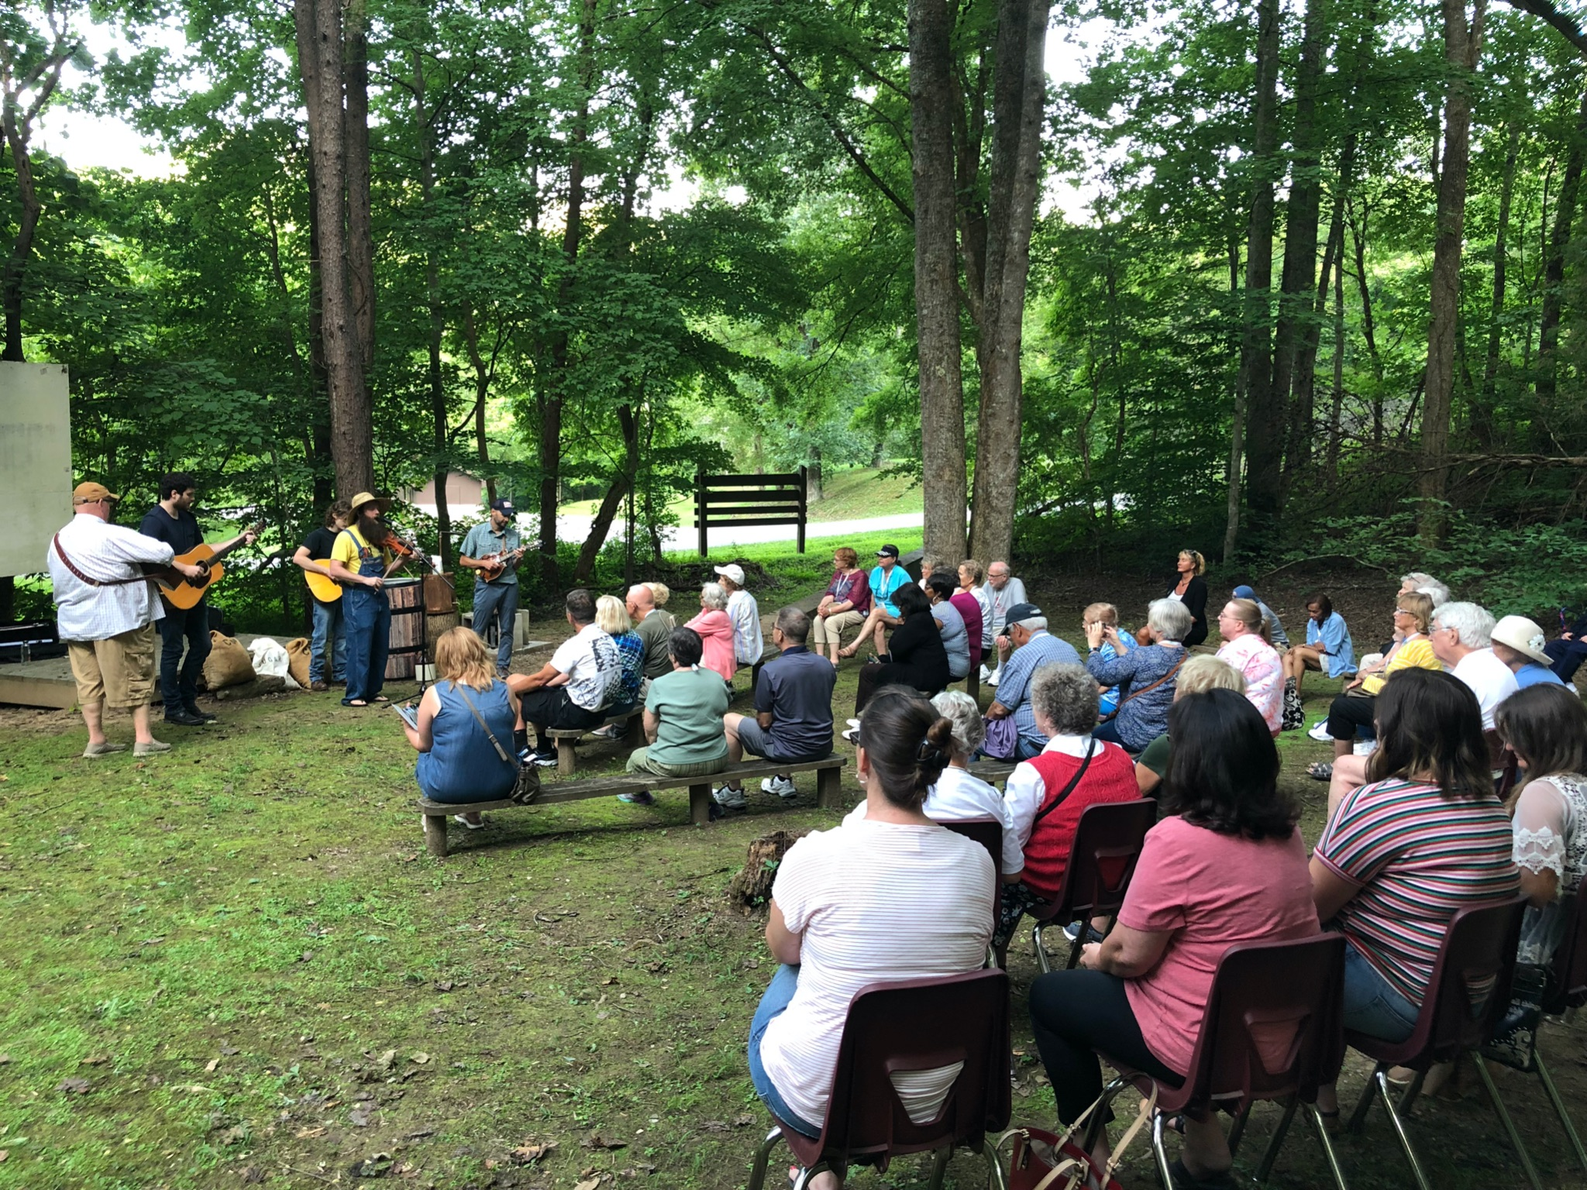

Slide 5
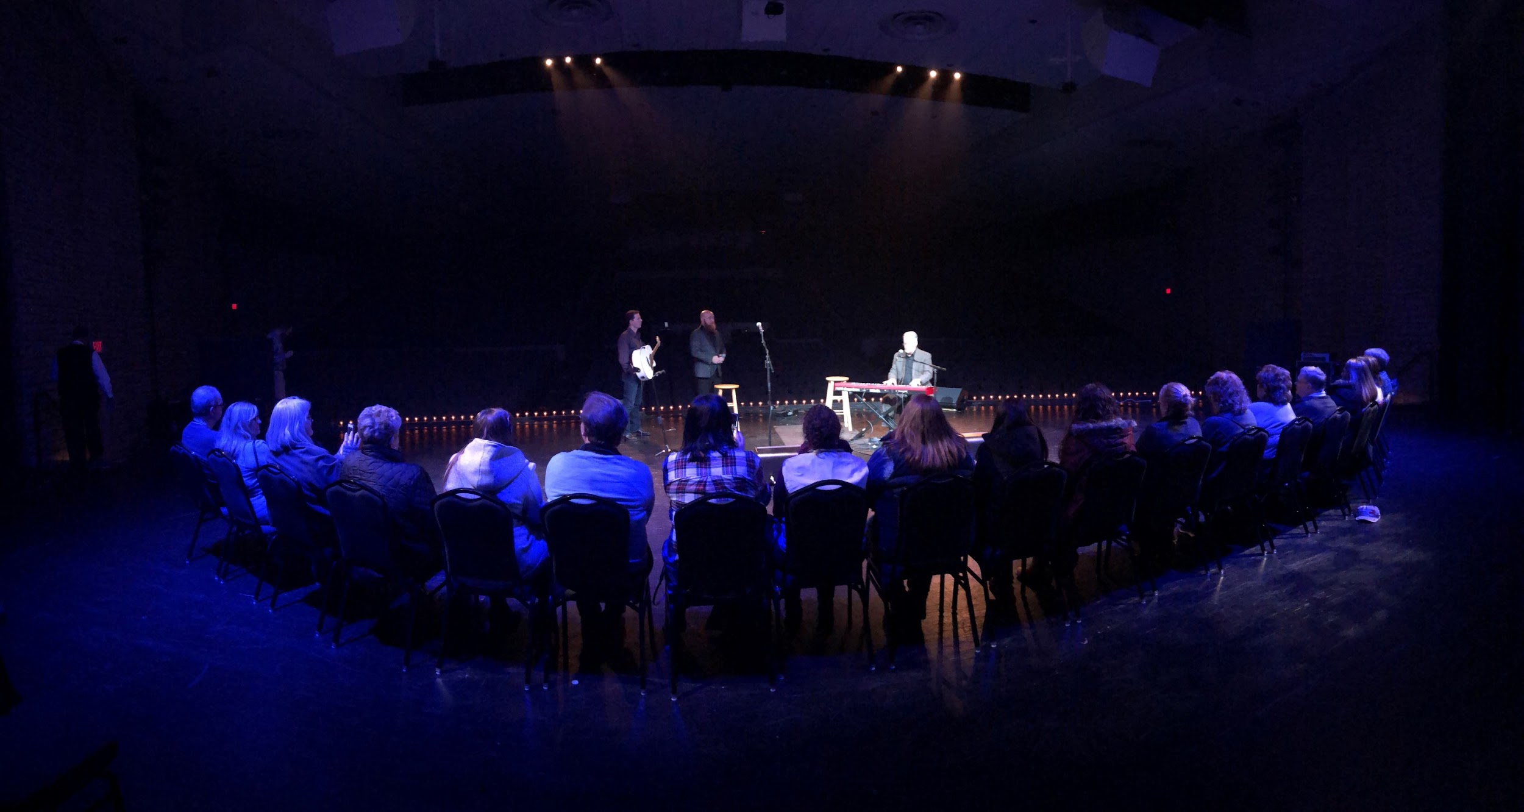

Slide 6
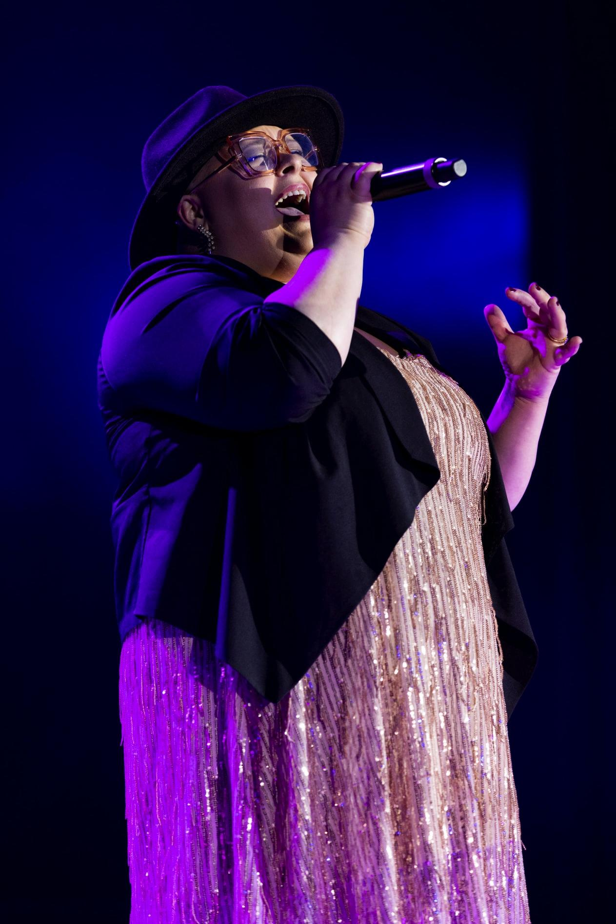
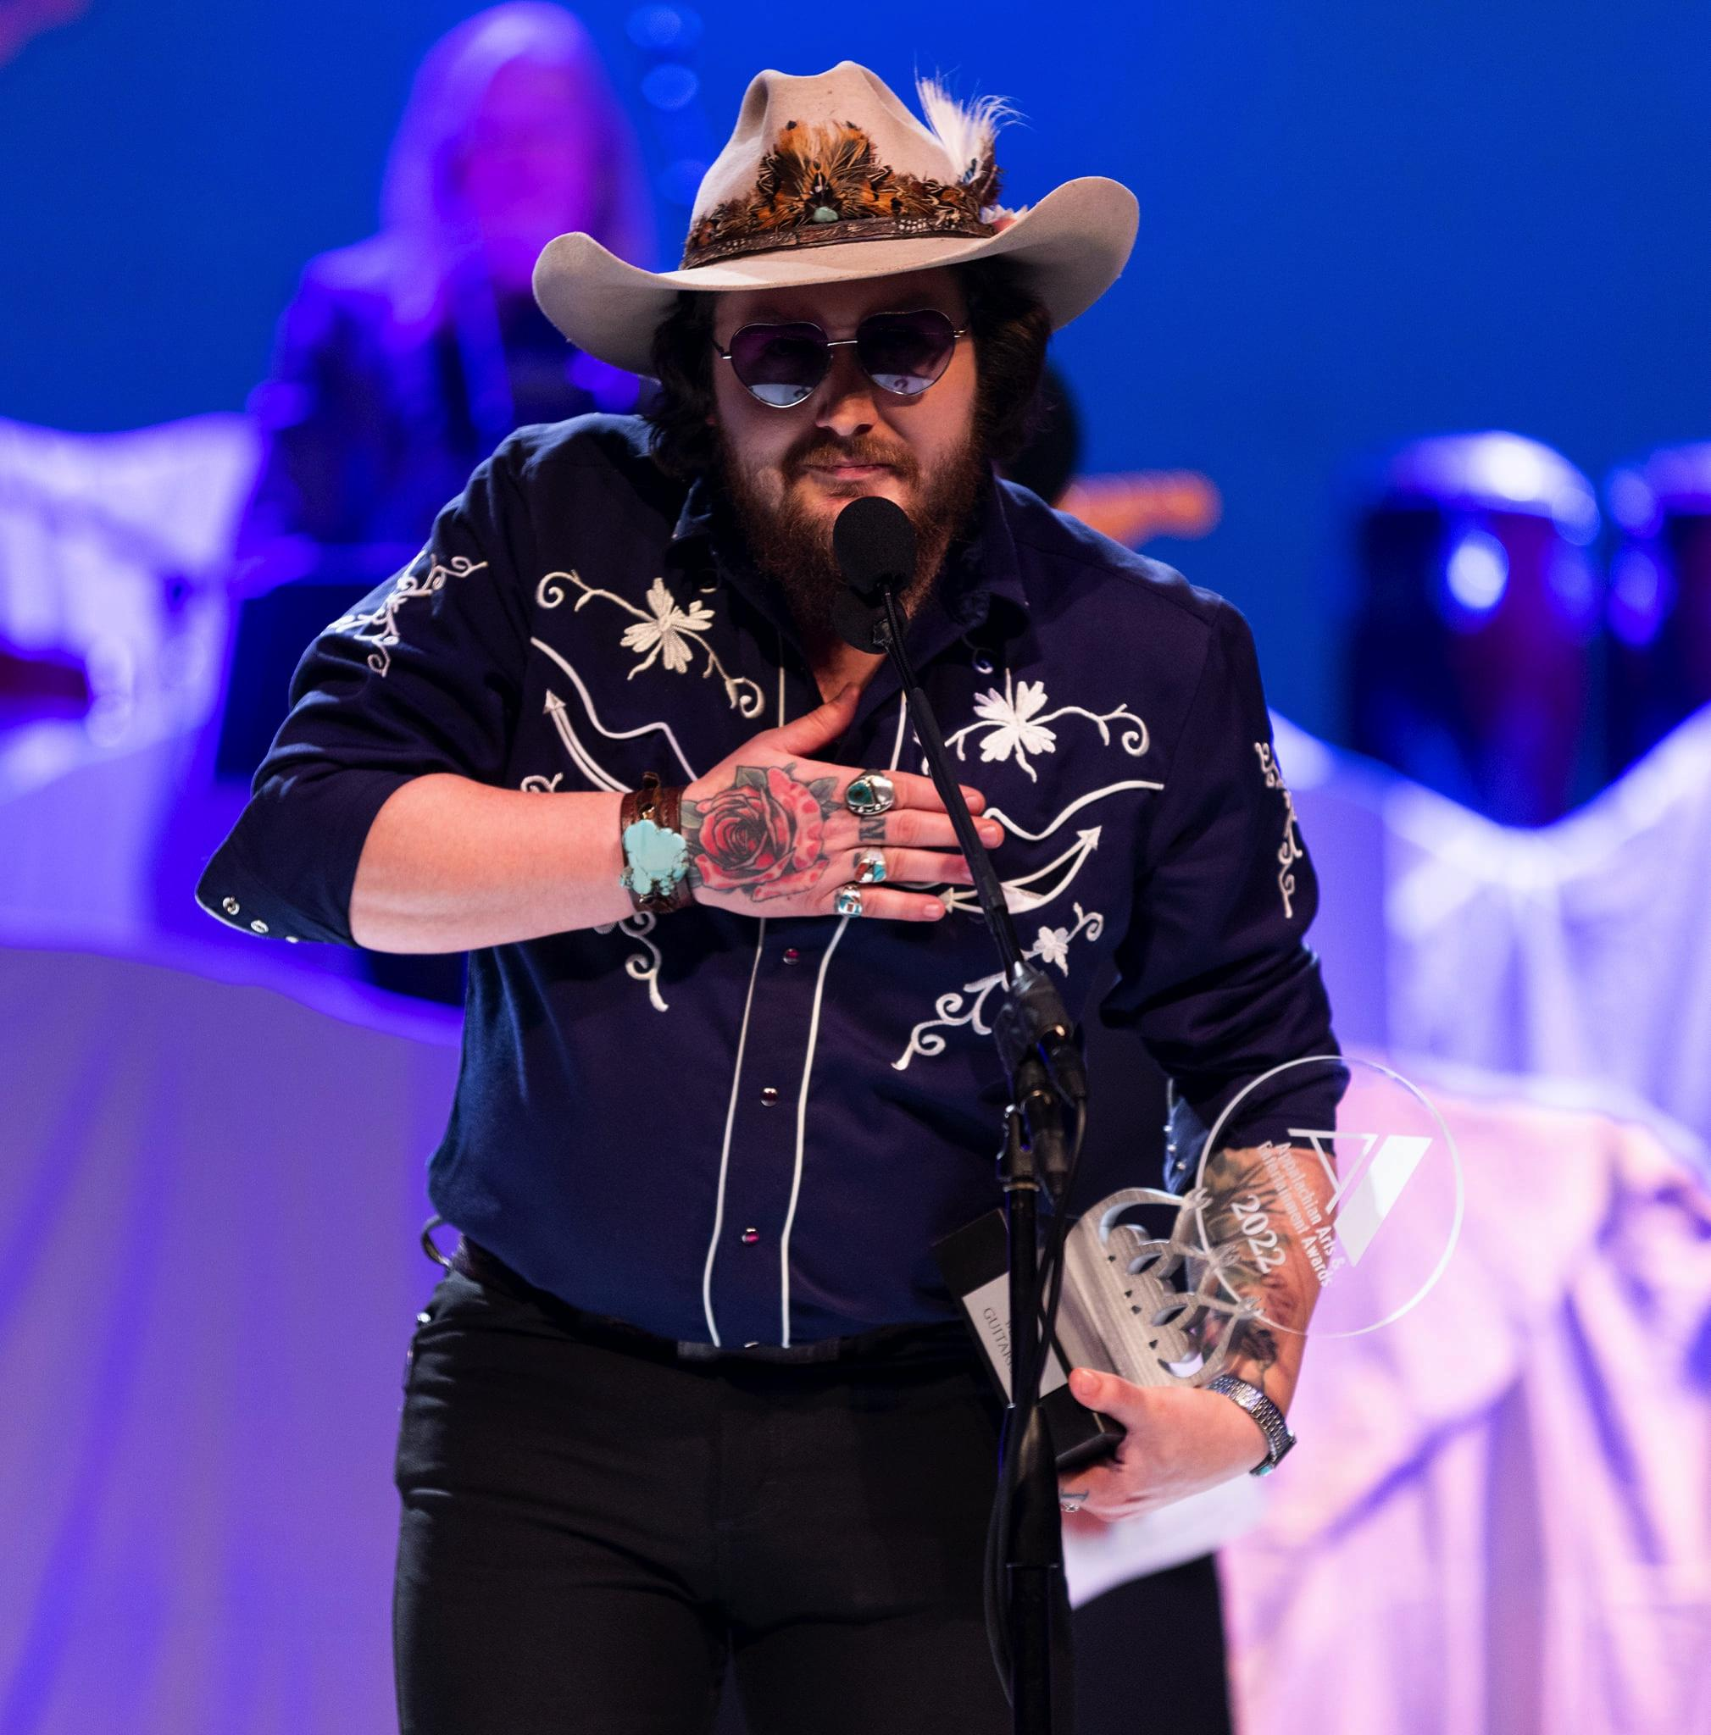
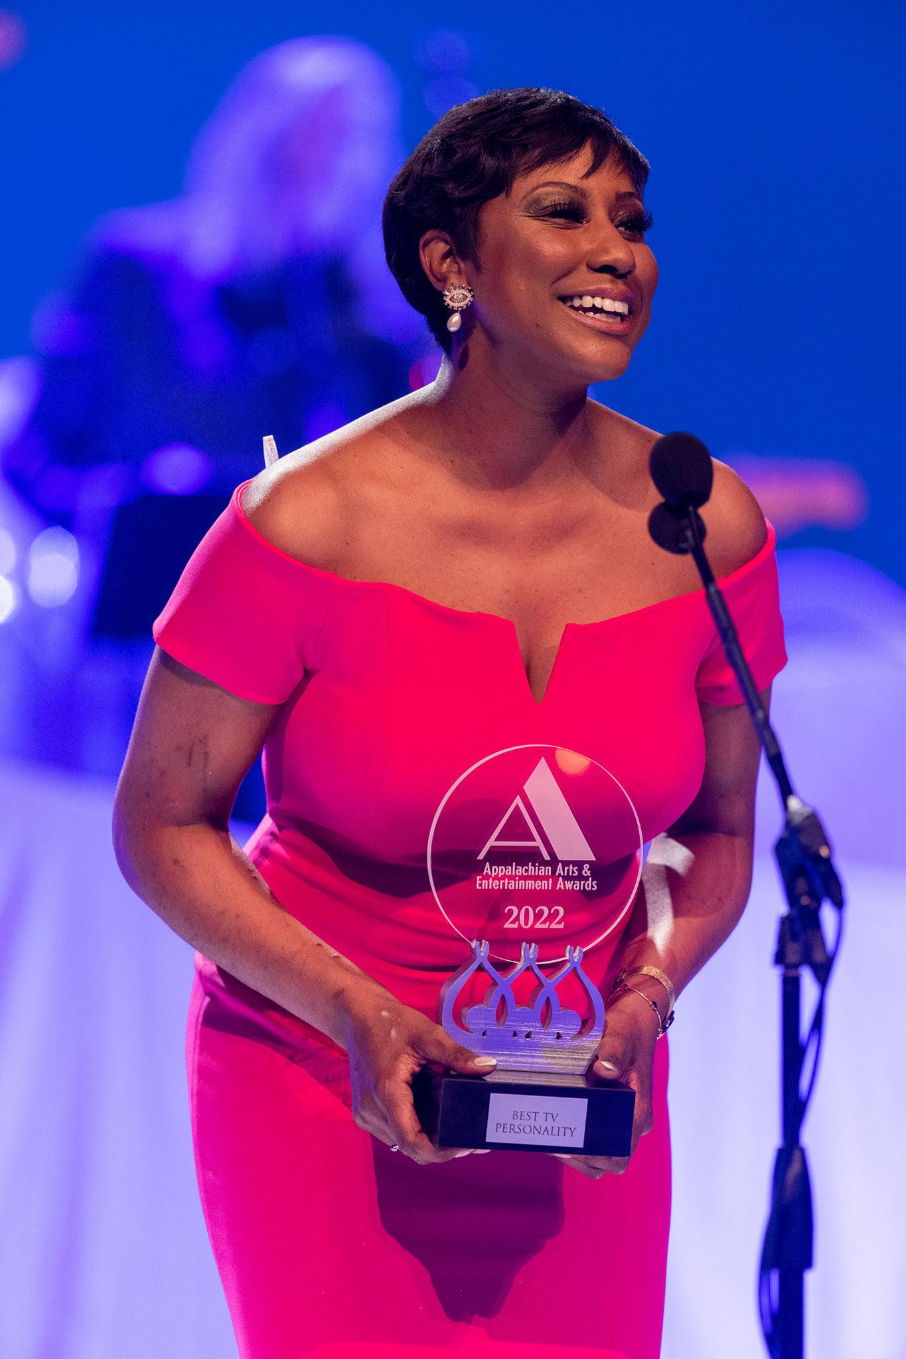
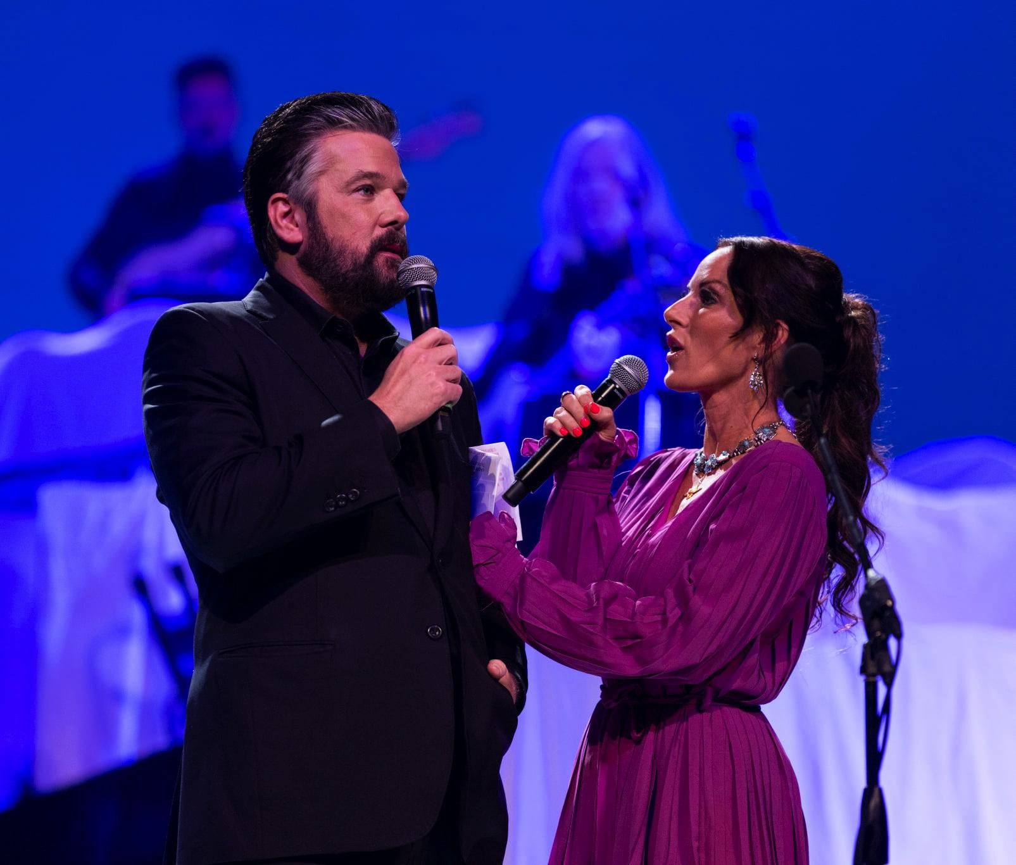
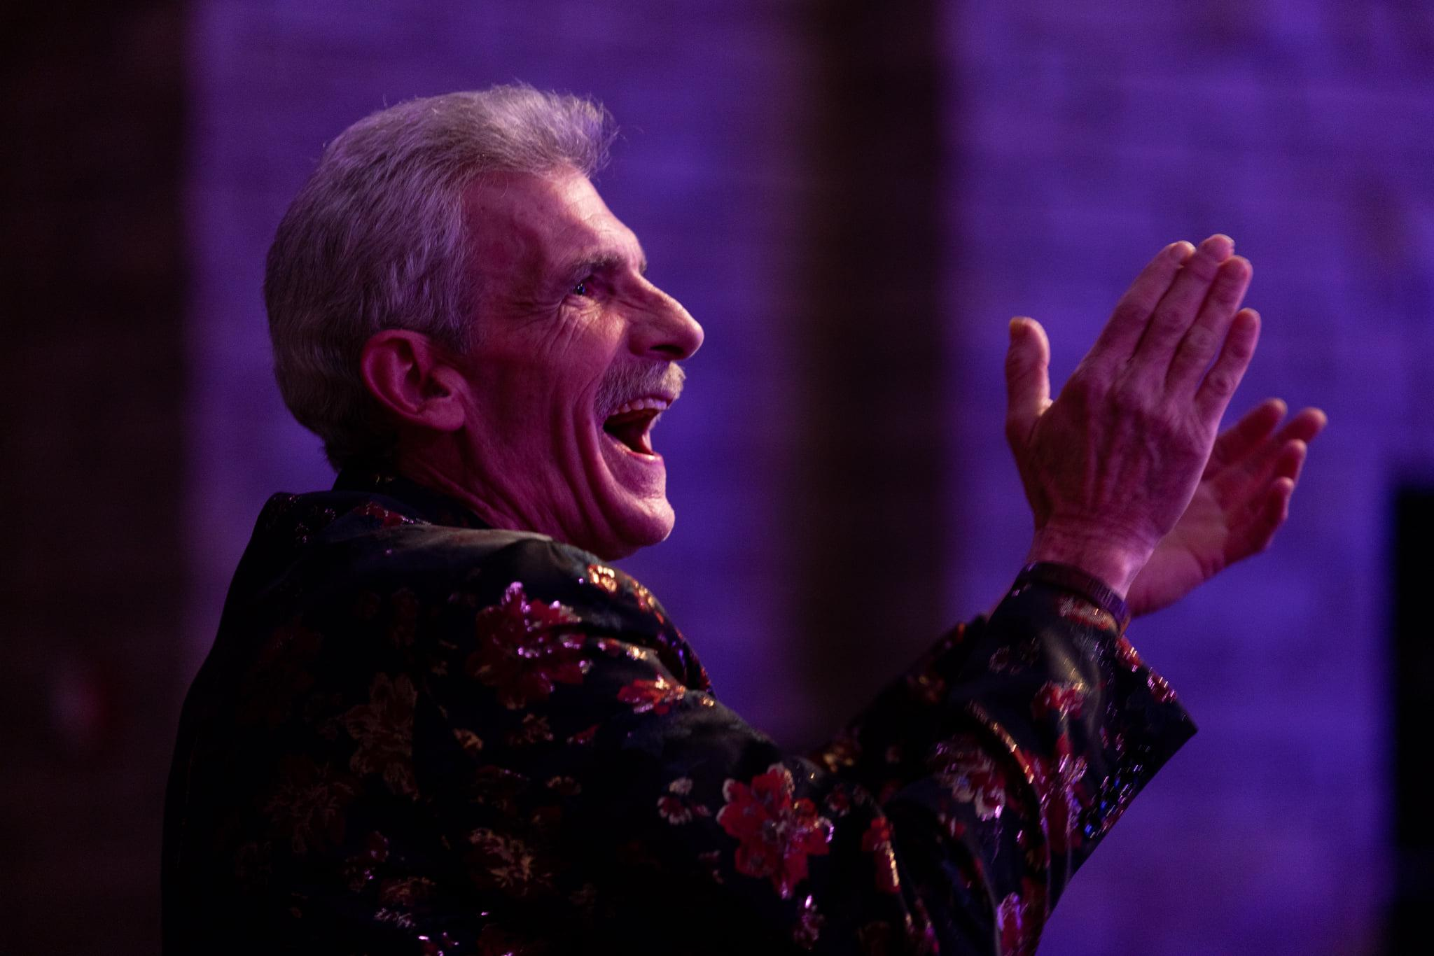

Slide 7
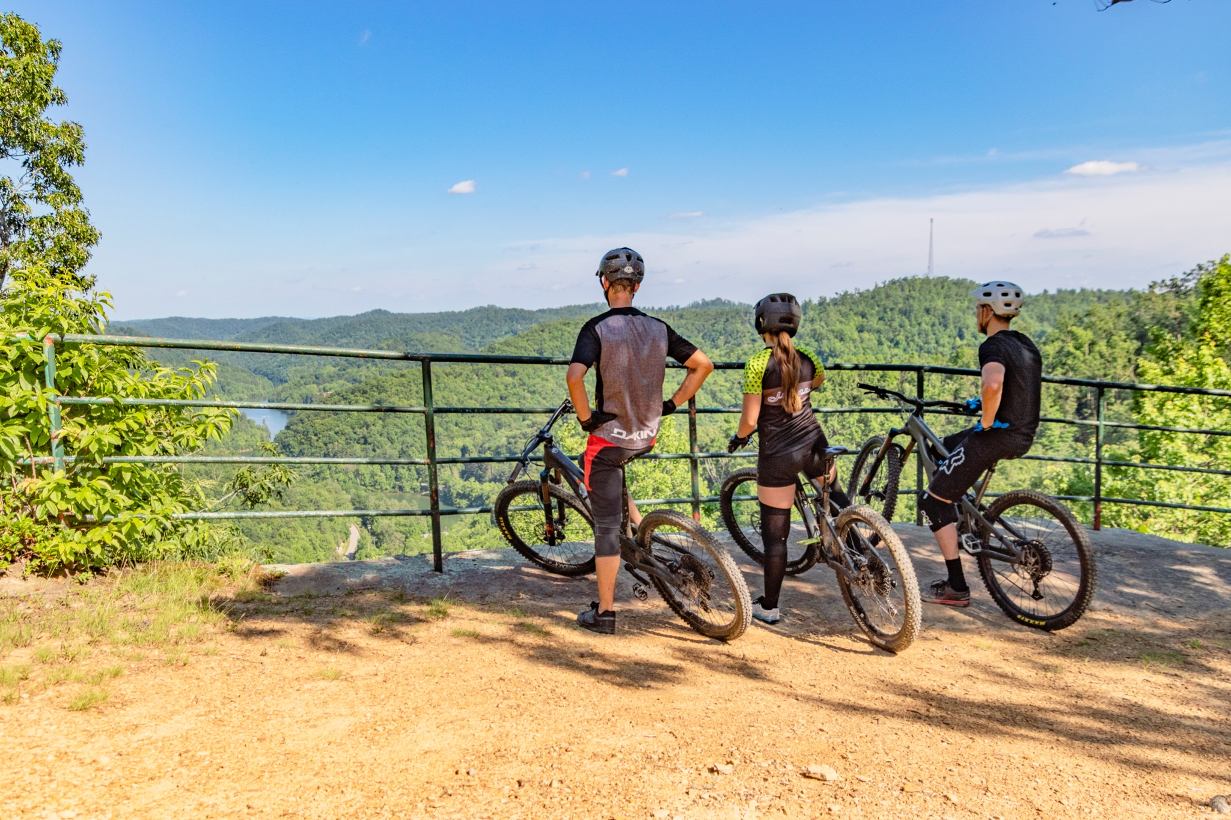

Slide 8
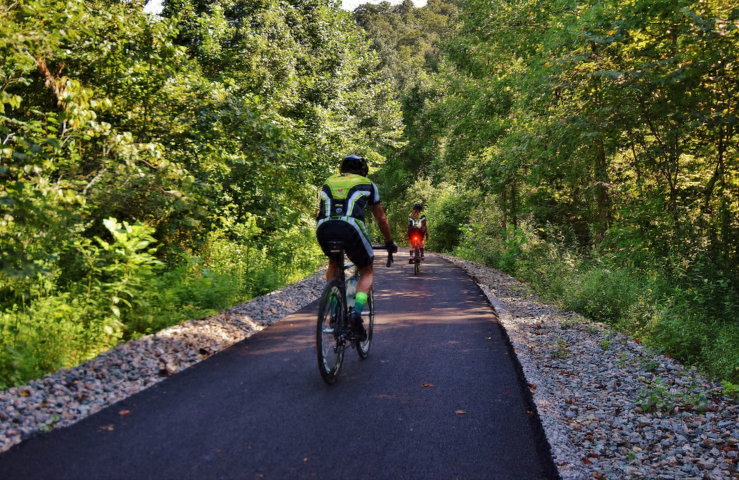

Slide 9
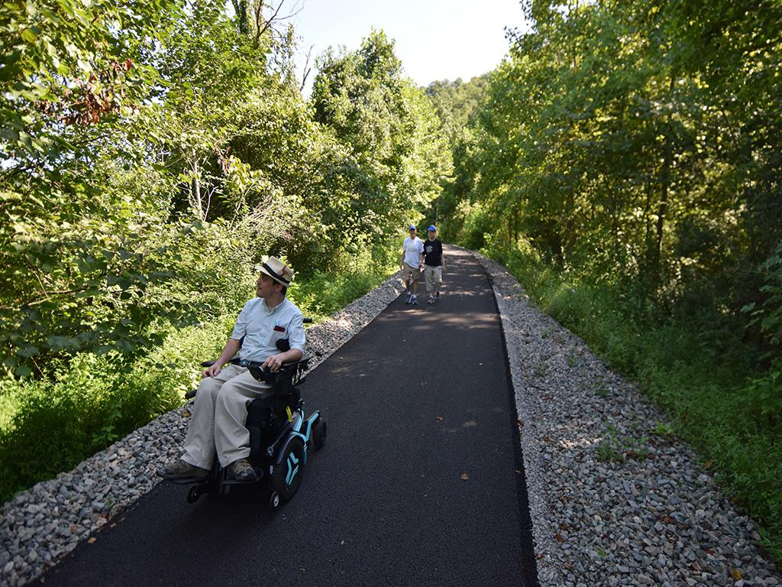

Slide 10


“The body needs to match the soul.”
Focus Question:
How do we physically enhance our public spaces to match the energy and creativity of the people in Prestonsburg?

Slide 11
Destination/Product
Development
Development Must Be:
Unique
Authentic
Desirable
POINTS OF PRIORITY
Generate Newfound Interest in Downtown, Local Establishments, & Engaging Recreation
Increase Foot Traffic
Optimize Safety & Accessibility
Artistry Accessible By All
Develop New Industries/Business while Supporting Current
BIGGEST CHALLENGES
Workforce Shortage
Employment Quarantine
Uniting Varying Viewpoints

Slide 12
ATTENTION
AREAS
Visual projects that would encourage walkability, interest in the central downtown corridor, and public engagement
Foster Increased Safety
Improved Marketing
Encourage Cross-Sector Collaboration

Slide 13
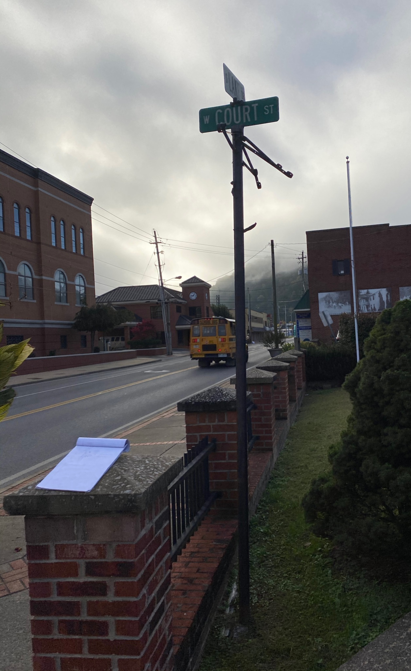
Enhanced Wayfinding
Accomplishments
5 Wayfinding Signs
Colorized Categories
Signage Longevity

Slide 14
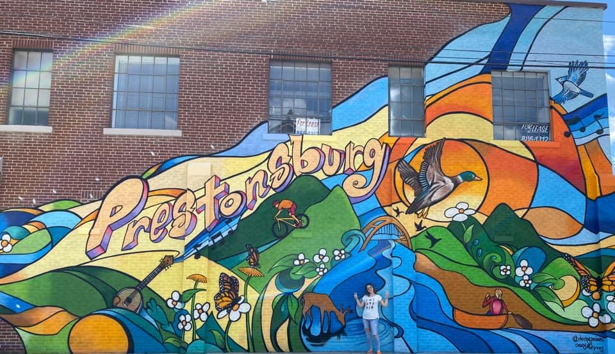
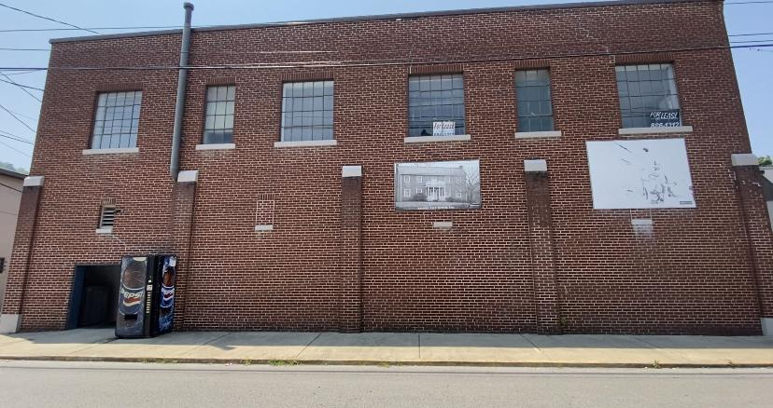
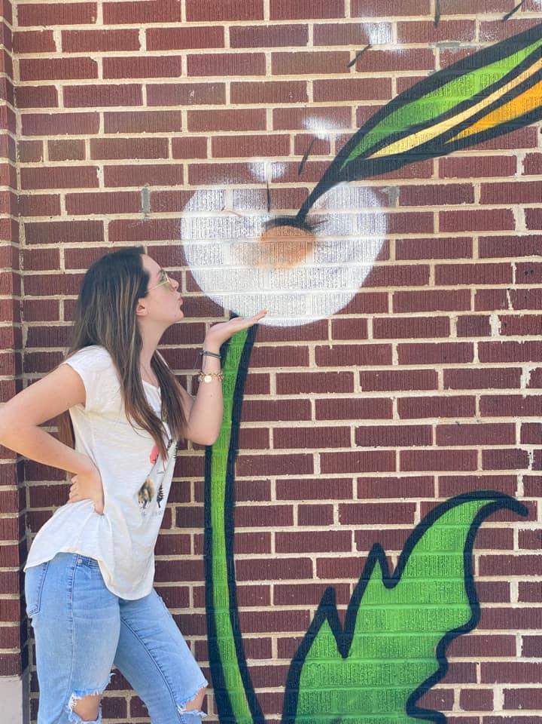
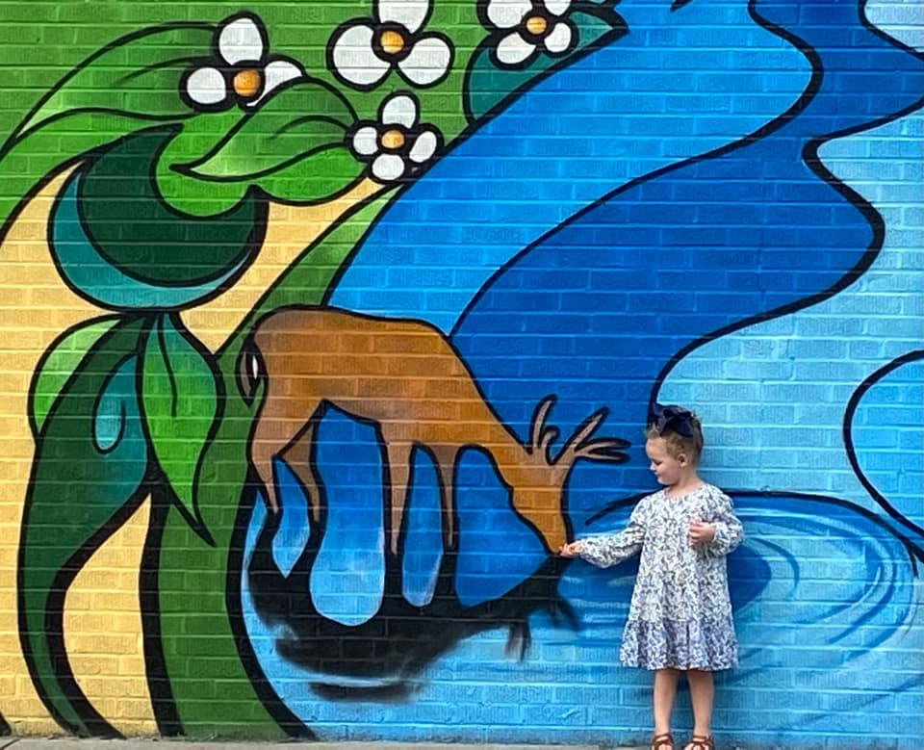
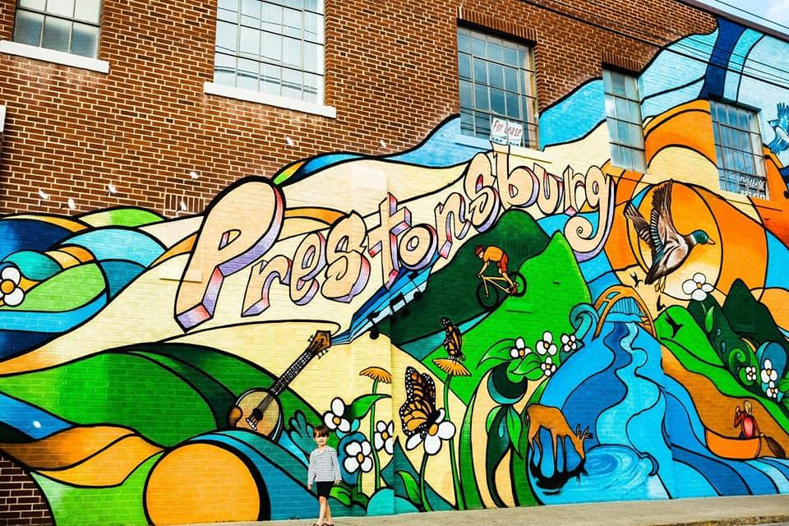
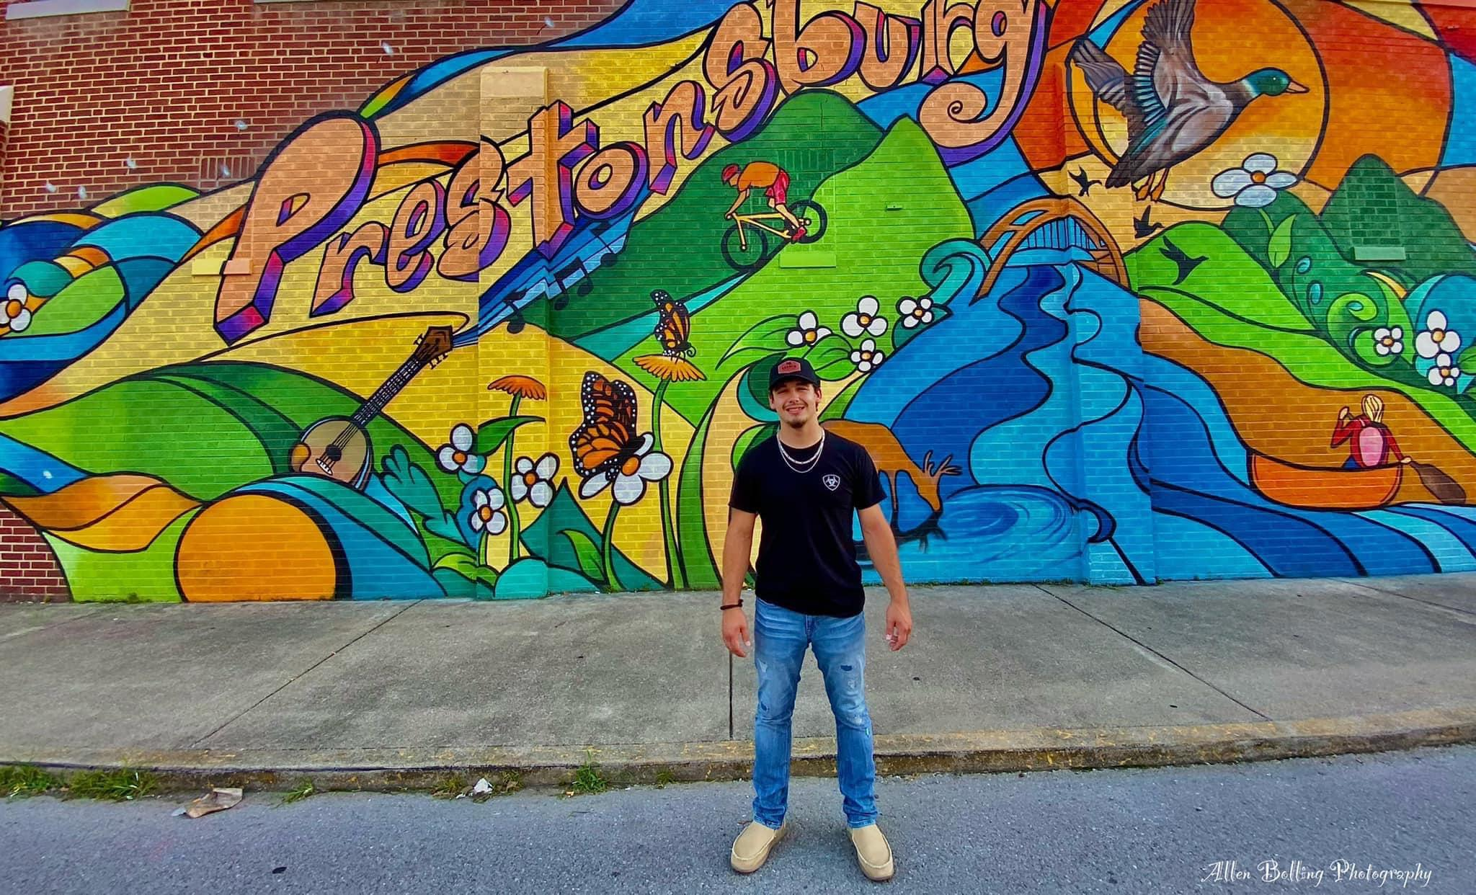
Public Art
Accomplishments
New Mural (w/ local apprenticeship)
Local Art Square Patch

Slide 15
Lighting
Downtown Lighting along Court St & Irene St would create increased safety, allow businesses to stay open later, and enhance public perception with better visual appeal

Slide 16
