Slide 1
Broadband Access Update
October 27th, 2022

Slide 2
ARC’s Strategic Plan has 3 discrete goals for broadband
Objective 3.2: Ensure that all Appalachians have access to quality and affordable telecommunications and broadband services.
The pandemic and resulting need for remote work, school, and telehealth highlighted both the importance of broadband and cellular access and affordability as well as the severe limitations of those services in portions of Appalachia, both rural and urban. Reliable and affordable broadband gives local businesses access to the digital marketplace, facilitates online learning and workforce development, and connects communities. ARC’s investments in broadband and data infrastructure help Appalachian communities – especially those in rural and/or distressed counties and areas – compete and participate in the global economy. Ongoing opportunities exist for convening, coordinating, planning and mapping, and funding investments in broadband deployment and smart grids.
Universal
High-Quality
Affordable

Slide 3
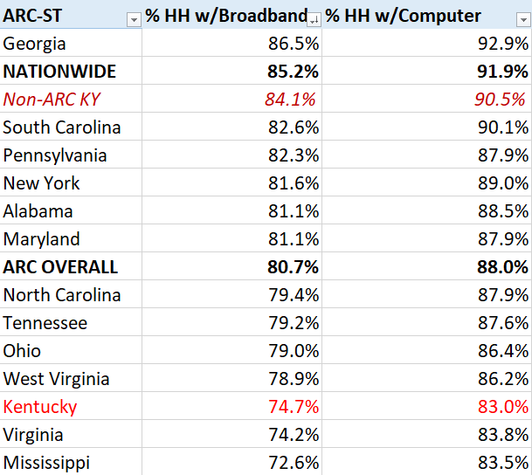
Access Stats (American Community Survey data)

Slide 4
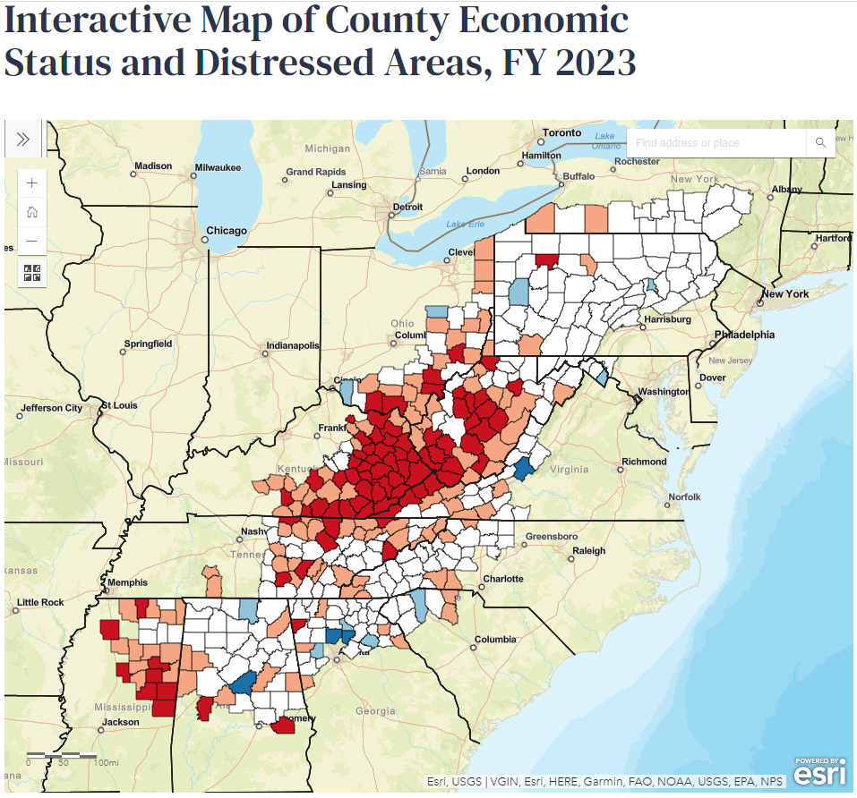
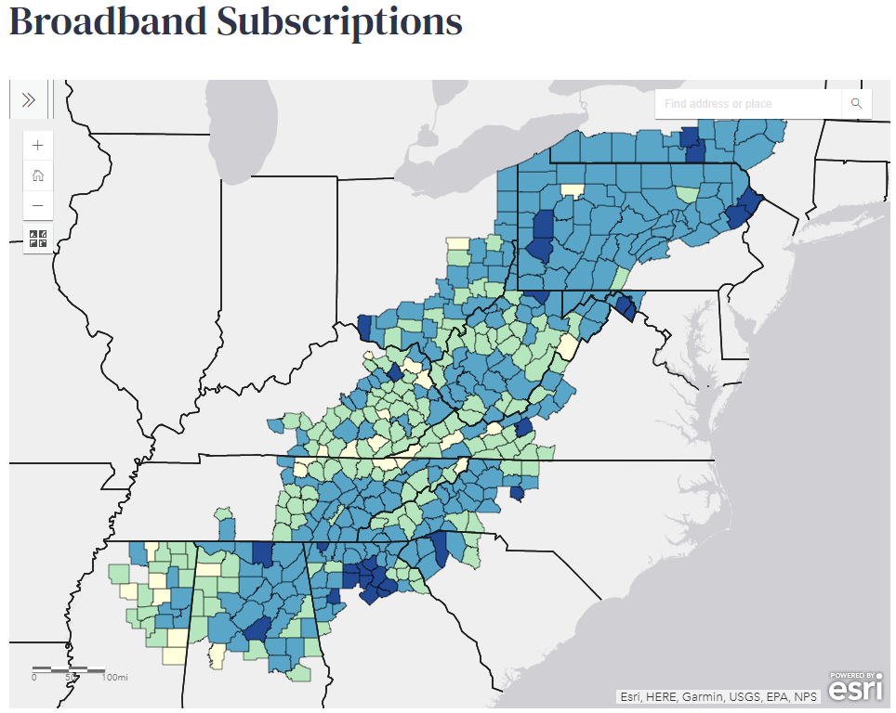
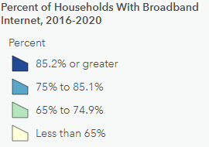
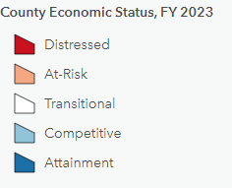
www.arc.gov/computer-and-broadband-access-in-appalachia

Slide 5
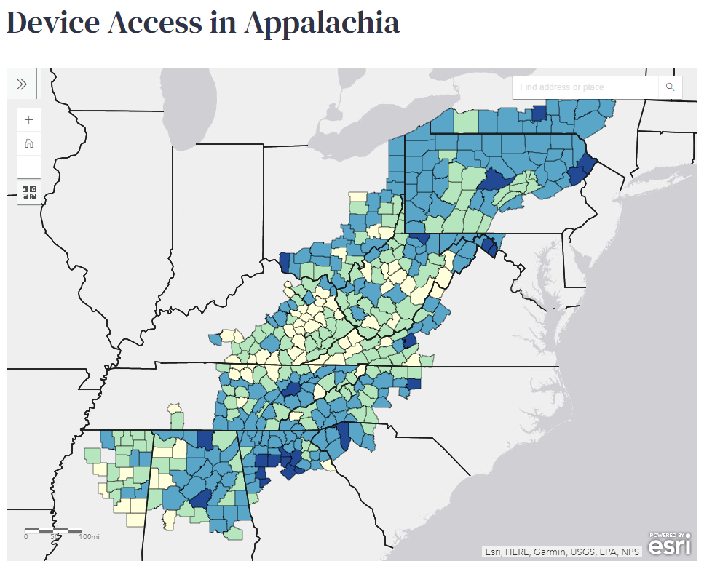
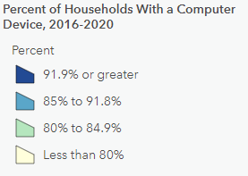
www.arc.gov/computer-and-broadband-access-in-appalachia

Slide 7
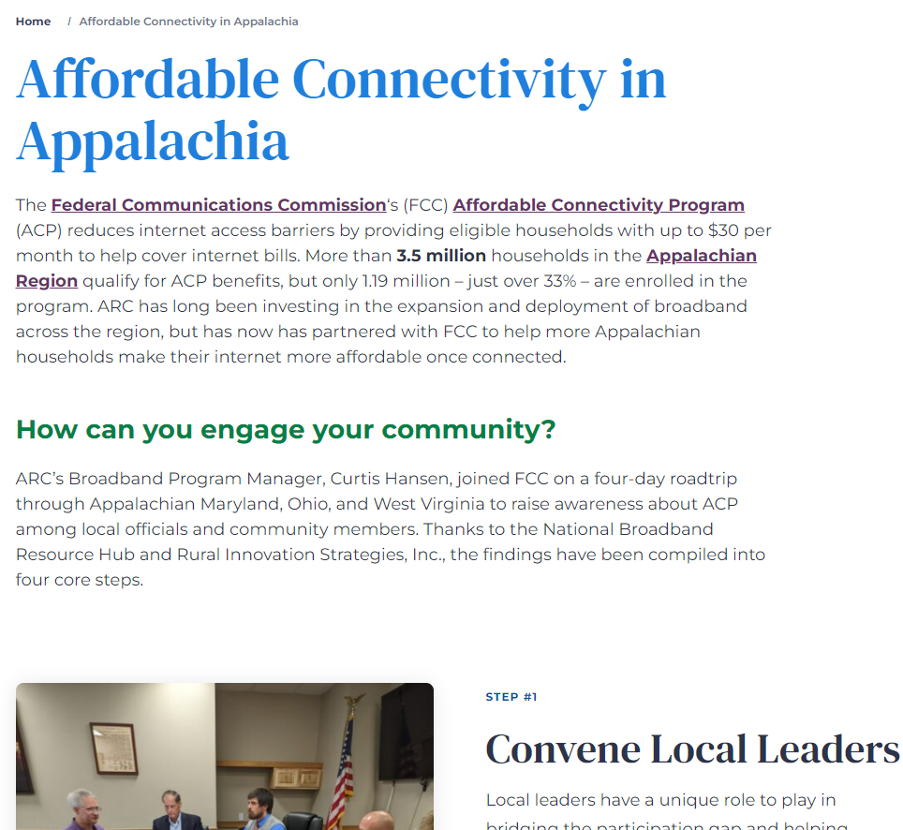
Affordable Connectivity Program Status (Sept 2022)
www.arc.gov/acp

Slide 8
Questions?
Curtis Hansen
Program Manager, Broadband
chansen@arc.gov

