Slide 1
Tourism, Small Business, and Info Technology IJC Meeting
November 17, 2022
The Department of Parks
Commissioner Russ Meyer

Slide 2
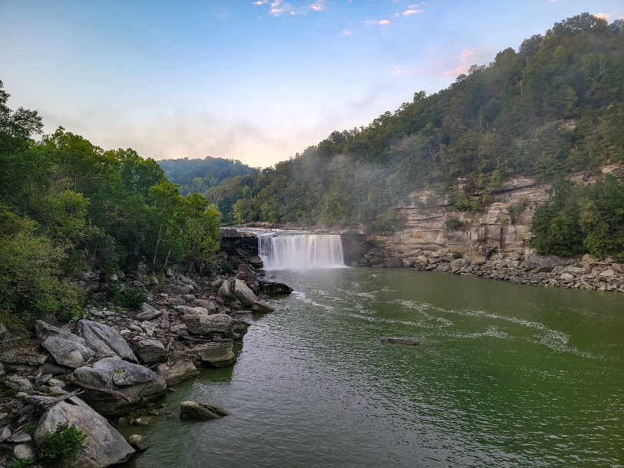
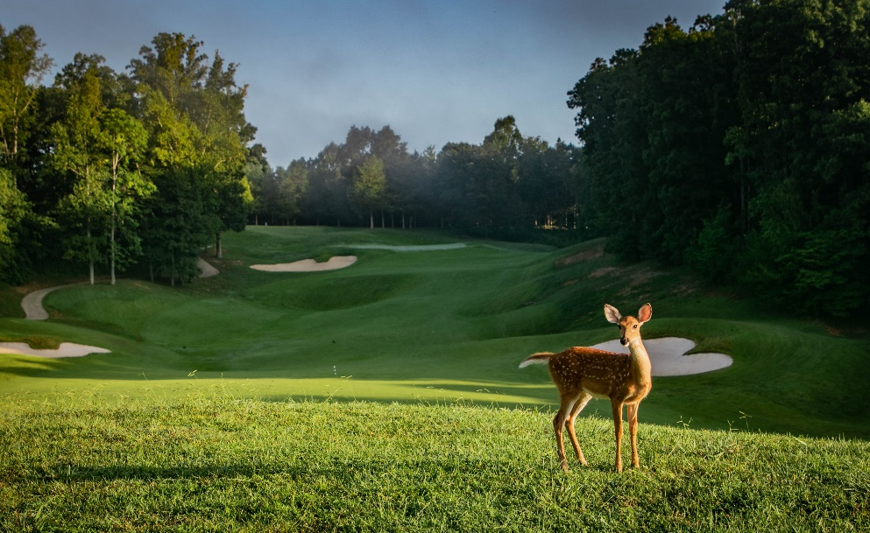
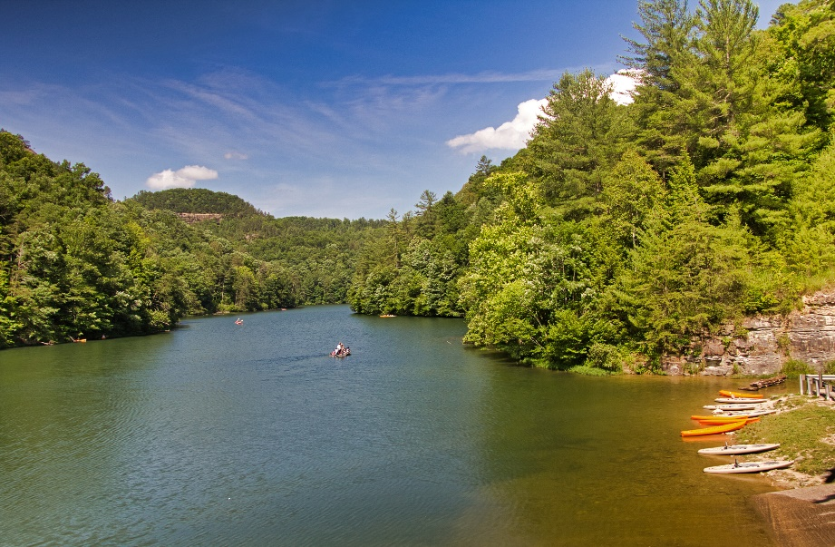
Our Mission
Provide a sustainable system of parks that delivers quality programs, amenities, and services, which create memorable experiences and a sense of place, contributes to the economic growth of the Commonwealth, and preserves the historic and natural integrity, and traditions of our parks for existing and future generations.

Slide 3
Our Vision for Kentucky’s Park System
Promote Kentucky as an inclusive travel experience that welcomes visitors of diverse backgrounds and interests.
Focus advertising efforts on encouraging travelers to take advantage of Kentucky’s outdoor assets.
Build public and private partnerships to ensure that Kentucky State Parks bring both recreational and economic value to the communities that relay on our parks as the primary tourist attraction.
Pursue funding opportunities that will allow Kentucky State Parks to continue to address the continuous maintenance needs at each of state park.
Protect and conserve Kentucky’s natural resources and to be responsible stewards of the “Nation’s Finest” state park system while promoting these opportunities to tourists, sportsmen and sportswomen.

Slide 4
Department of Parks
KY Dept of Parks
Commissioner’s Office
Parks Operations Division
Division of Facilities
Division of Financial Ops
Accounting Br
Division of Sales, Marketing and Customer Srvs
Division of Food Services
Cafeteria Br
Division of Information Technology
Division of Human Resources
Division of Rangers
Internal Audit Br
Planning and Design Br
Sign Shop Br
Special Maint Br
Property Cntrl Sec
All Parks
Food Srvs Eval Br
East Kitchen/Dining Br
West Kitchen/Dining Br
Capital Annex Sec
Division of Engagement
Division of Purchasing
Resource Management Br
Operational Maint Br
7/14/2022

Slide 5
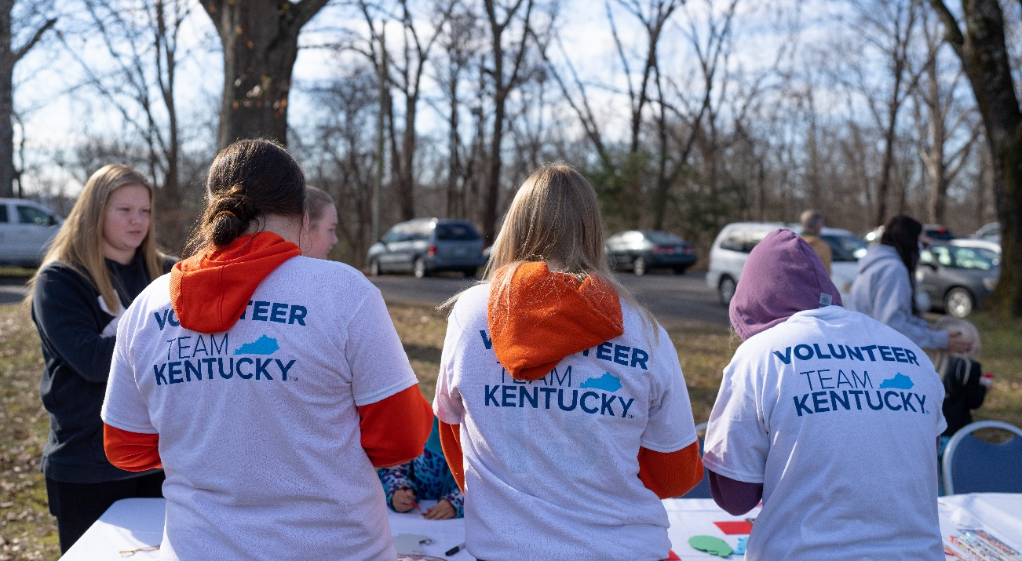
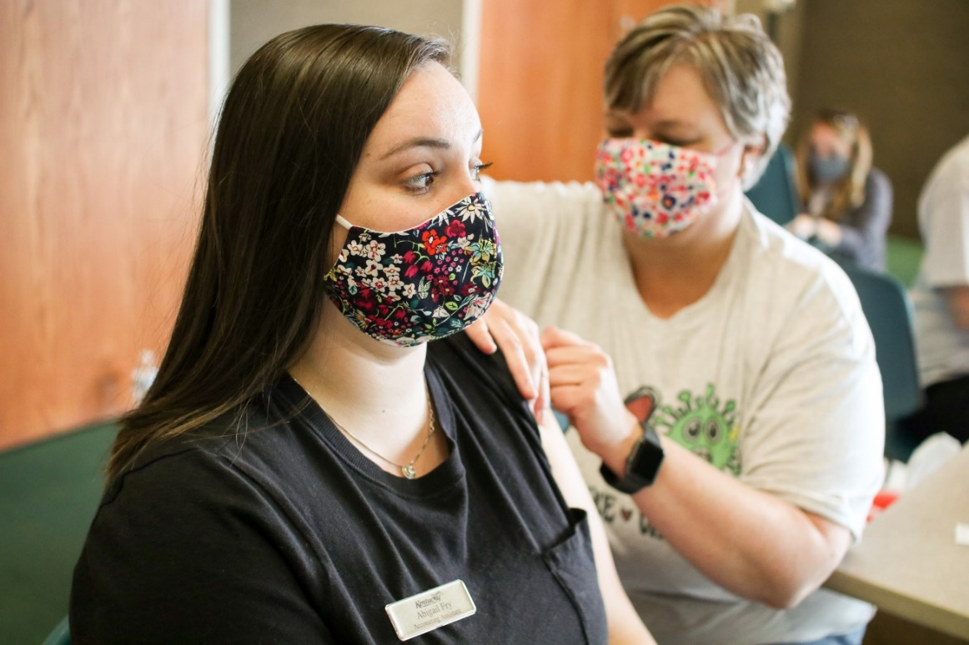
Our Kentucky State Parks play an essential role in our state’s emergency response efforts.
During the pandemic, the array of services provided by our parks created an opportunity for us to provide necessary resources that positioned the commonwealth at advantage for fighting the virus. Four Kentucky State Parks provided temporary housing for first responders, front-line healthcare workers, and low-acuity patients utilizing over 2,000 room nights as a low-acuity shelter. Some of our parks also served as vaccination sites.
The Dec. 11 quad-state tornado was the worst tornado event in state history, with at least four tornados devastating eight Kentucky counties. The devastating event resulted in the Governor declaring a state of emergency. The emergency declaration ensured that federal funding was available to provide emergency resources and rebuild our Western Kentucky communities.

Slide 6
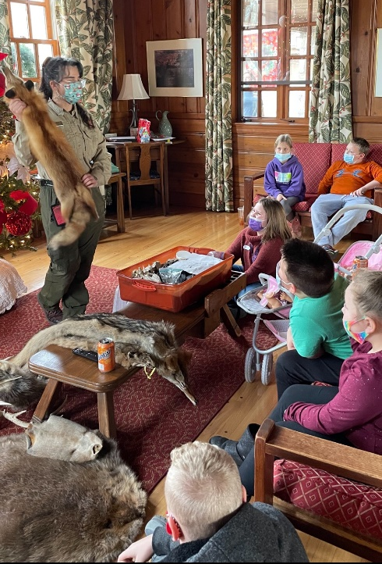
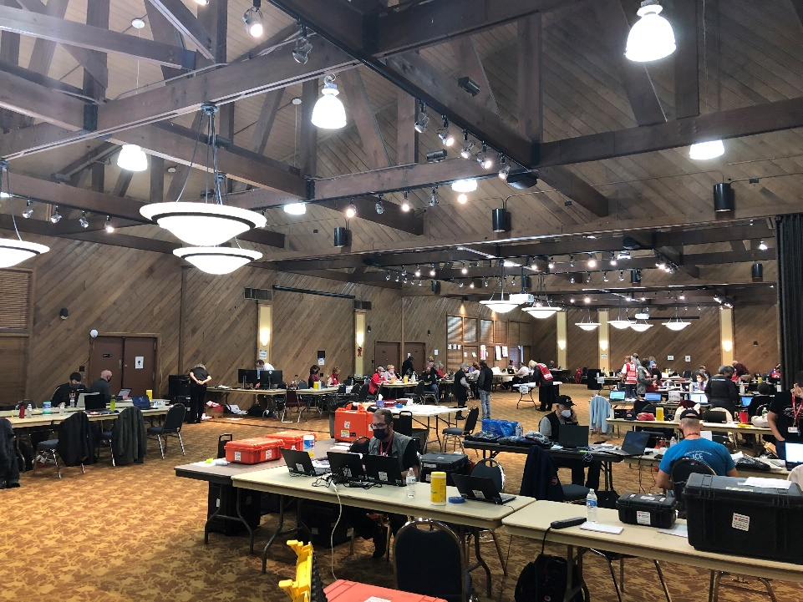
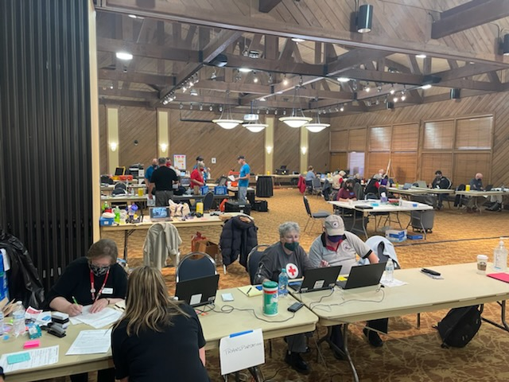
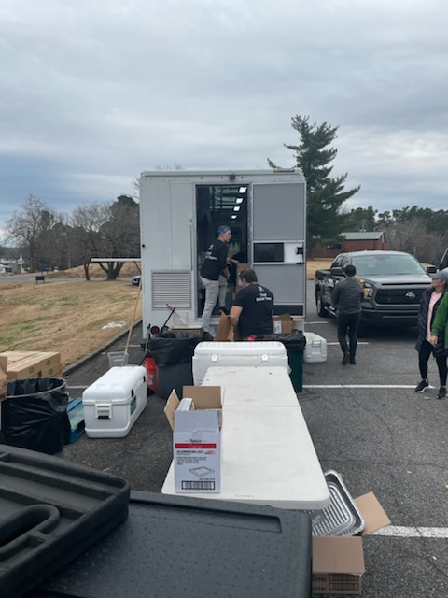
Our ranger division dedicated 33 rangers and 6,868 park ranger hours to support efforts to rebuild our Western Kentucky communities. Park Staff contributed greatly to the overall success.
Our state parks served as a community resource by providing lodging for the American Red Cross, utility crews, first responders, and displaced families.
As part of the state’s emergency response efforts, seven Kentucky State Parks were designated to provide emergency shelter and food services for individuals impacted by the tornado. Our parks offered temporary housing to more than 800 individuals and 250 first responders.
In total, nearly 2,600 individuals were housed by the programs offered through the state, Red Cross and FEMA.

Slide 7
Tornado Relief
Number of overnights at the various western Kentucky State Parks
Kentucky Dam Village: 12/11/21 – 7/17/22 (219 Days) – Relief Rooms – 2,997 1st Responder Rooms – 3,915
Kenlake: 12/12/21 – 4/12/22 (122 Days) = Relief Rooms – 3,122 1st Responder Rooms – 405
Lake Barkley: 12/13/21 – 3/16/22 (94 Days) = Relief Rooms – 2,958 1st Responder Rooms – 375
Pennyrile: 12/10/21 – 7/9/22 (212 Days) = Relief Rooms – 3,689 1st Responder Rooms – 105
Barren River: 12/11/21 – 5/5/22 (146 Days) = Relief Rooms – 444 1st Responder Rooms – 3
Rough River: 12/12/21 – 1/31/22 (51 Days) = Relief Rooms – 83 1st Responder Rooms – 7
John James Audubon: 12/13/21 – 12/16/21 (4 Days) = Relief Rooms – 7 1st Responder Rooms – 5
Total: 12/10 – 7/17/22 (220 Days) = Relief Rooms 13,300 1st Resp. Rooms – 4,815

Slide 8
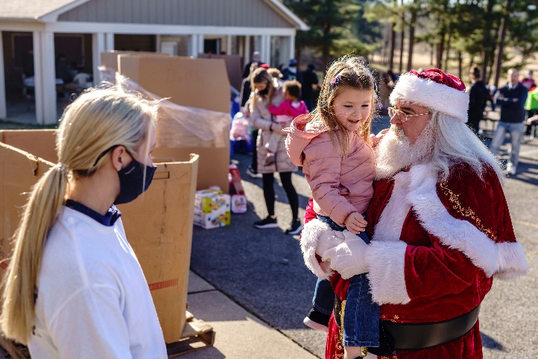
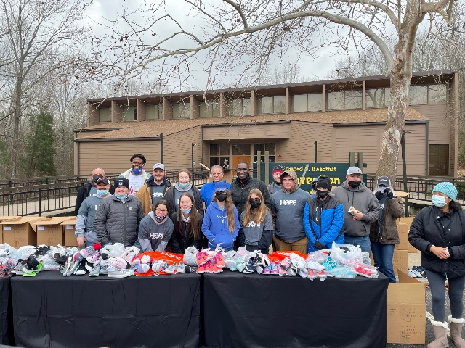
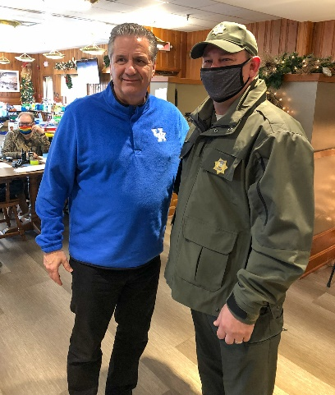
Meals provided:
Approximately 30,000 @ 3 Meals a day from start to when we went back to normal dining ops.
Some meals were provided by Local Churches and Businesses.
Pennyrile Forest State Park had KYEM Trailers for approximately 12 families.
Visits by Governor Andy Beshear and First Lady Britainy Beshear, Coach Cal, former UK Men’s Basketball players and Samaritan Feet.
12/18/21 – Shoe giveaway with Coach Cal, former UK players and Samaritan Feet at Lake Barkley and Pennyrile
KDV and Kenlake Guests were bussed over.
12/21/21 – Christmas Party at Lake Barkley and Pennyrile
12/23/21 – Christmas Party at Kenlake & KDV
Working hand-in-hand with KYEM, Behavioral Health, etc.
FEMA;, American Red Cross; Kentucky Office of Emergency Management; Local County Emergency Management; KY Behavioral Health; Volunteers; Meal Donation Groups; Donation Distribution Centers; Parks Central Office Staff (Vetting Relief Guests for Assistance).

Slide 9
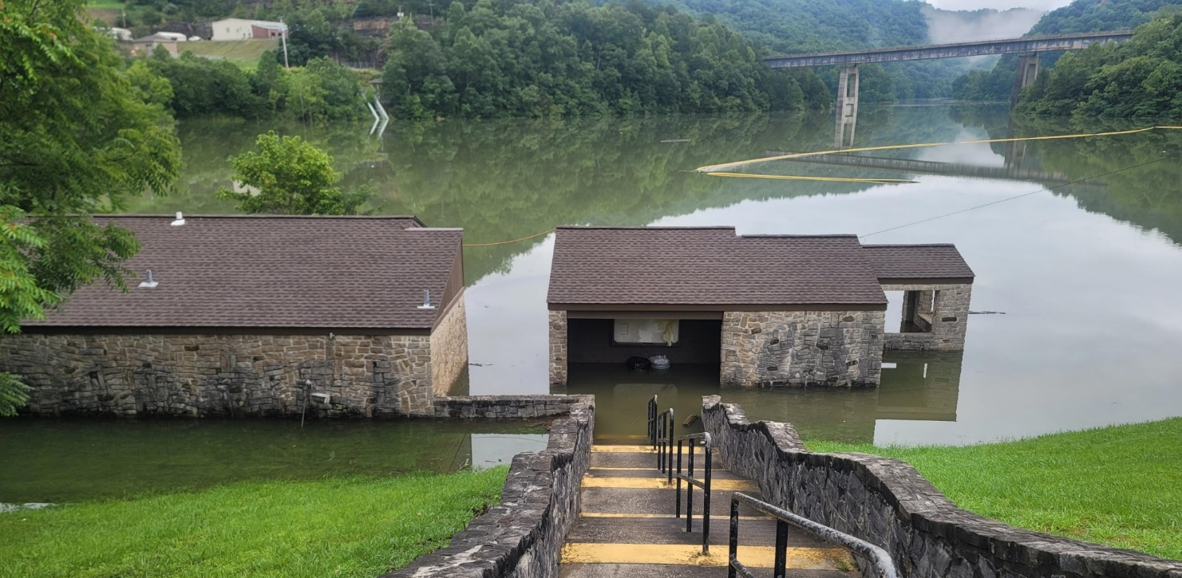
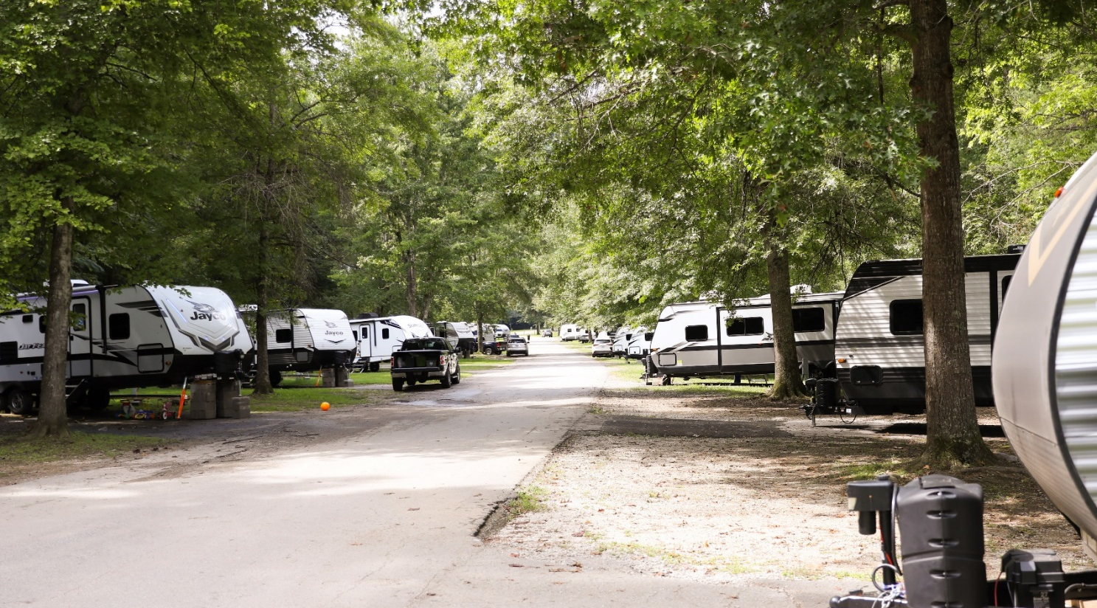
Flood Relief
In July, as part of the state’s emergency response efforts in Eastern Kentucky, four (4) Kentucky State Parks have been designated to provide emergency shelter for individuals impacted by the flooding.
Over 360 people impacted by the flooding have been temporarily housed at our parks in Eastern Kentucky.
Currently, 645 individuals are housed in 320 travel trailers, including 65 travel trailers at Jenny Wiley and Carr Creek State Park.
Since July, our parks staff and volunteers have been working with the American Red Cross, local churches, businesses, and restaurants to ensure individuals impacted by the tornado have basic needs- food, shelter, and clothing.

Slide 10
Flood Relief
Number of overnights at the various eastern Kentucky State Parks
Number of overnights at the various Eastern Kentucky State Parks
Buckhorn Lake: 8/1/22 – 11/13/22 (105 Days) = Relief Rooms – 3,425
Jenny Wiley: 7/28/22 – 11/13/22 (109 Days) = Relief Rooms – 5,554
Pine Mountain 7/29/22 – 8/15/22 & 9/2/22 - 9/6/22 (22 Days) = Relief Rooms – 42
Total: 7/28/22 – 11/13/22 (109 Days) = Relief Rooms 9,021
Visits by the Governor and Mrs. Beshear; visits by Coach Cal; Shoes; etc.
Working hand-in-hand with KYEM, Behavioral Health, etc.
FEMA; American Red Cross; Kentucky Office of Emergency Management; Local County Emergency Management; KY Behavioral Health; Volunteers; Meal Donation Groups; Donation Distribution centers; Parks Central Office Staff (Vetting and Policy Writing); KY Park Rangers; Local Law Enforcement; Rotary Club; Free Haircuts; Local Churches; Save the Children

Slide 11
Questions?

