Slide 1
Harrodsburg’s 250th Anniversary Celebration (Semiquincentennial or Sestercentennial)
June 13-16, 2024

Slide 2
Our Mission
To facilitate the celebration of Harrodsburg’s 250th Anniversary, while leveraging this historic event to foster civic pride, involve local stakeholders in collaborative efforts, support ongoing community initiatives and promote the future cultural, social and economic development of the community.

Slide 3
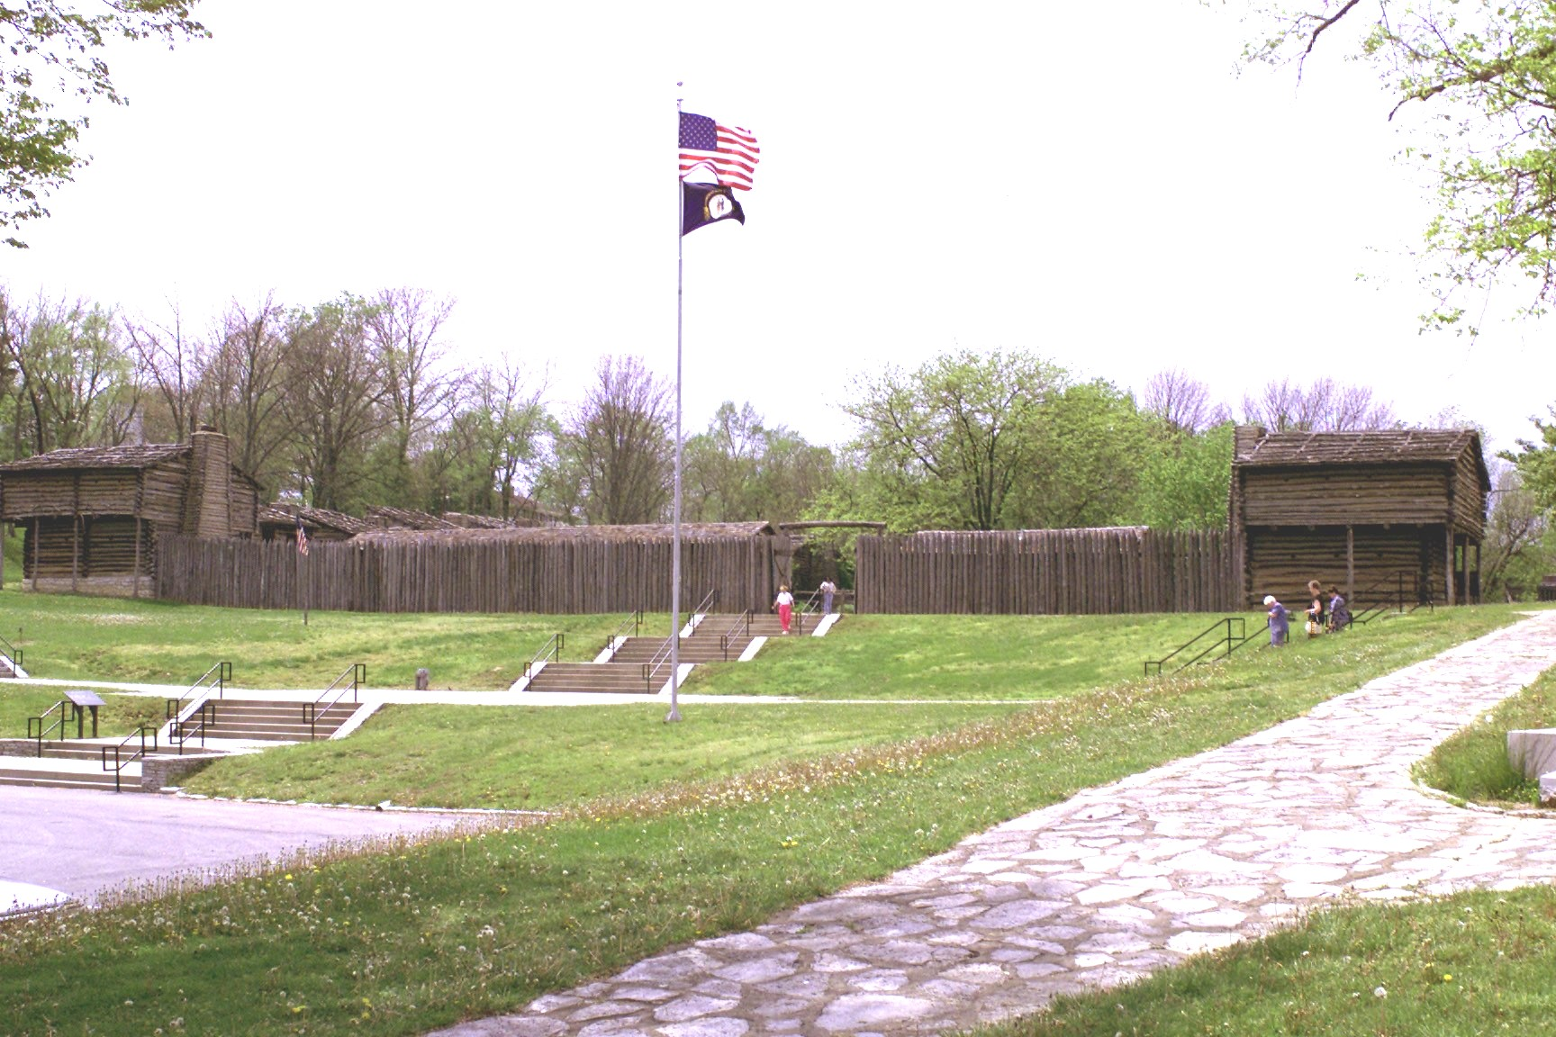
History of Harrodsburg
Kentucky’s Oldest City (Founded 1774)
Founded by James Harrod on June 16, 1774
First Permanent English Settlement west of the Allegheny Mountains
Population:
City of Harrodsburg: 9,112
Mercer County: 22,850
*Both stats as of 2021*

Slide 4
250th Board of Directors
Daarik Gray, Chairman
Jill Cutler, Vice-Chairman
Nancy Hill, Secretary
Noel Turner, Treasurer
Kaitlyn Harder
David Coleman
David Kirkpatrick
Toni Preston
Tony Patterson
LeMayne Ellis
Steve Hadden
Barry Steele
Rosalind Turner
Scott Hammons
Robin Ison
Lois Mateus, Emeritus

Slide 5
250th Committee Scope
4 Committees
- History Committee
- Beautification Committee
- Events Committee
- Marketing Committee
Sub-Committees
- Fundraising Committee
- Abandoned Property Committee
- Murals Committee

Slide 6
250th Celebration Plans
4 Days Festival (June 13-16, 2024
Festival will reach from Main Street, down through Chiles Street, to Old Fort Harrod State Park
Old Fort Harrod State Park will be host to historical re-enactments, speeches, etc.
Main Street will be host to Live Music, Kids Activities, Vendors, etc.
Chiles Street will be set up with info booths, tours of historical Morgan Row, Food Trucks, Vendors, Kids Activities, etc.

Slide 7
History Committee
Children’s Book
One-Hour Documentary
Guided Walking Tours
Book Signings
Chautauqua Re-enactment
Cemetery Homecoming
James Bridges Trial
Historical Food Tastings
Documentary Watch Party
Tea with the Past
Time Capsule
Story Telling Contest
Historic Photo Booth
Church Service at Old Mud Meeting House

Slide 8
Children’s Book

Slide 9
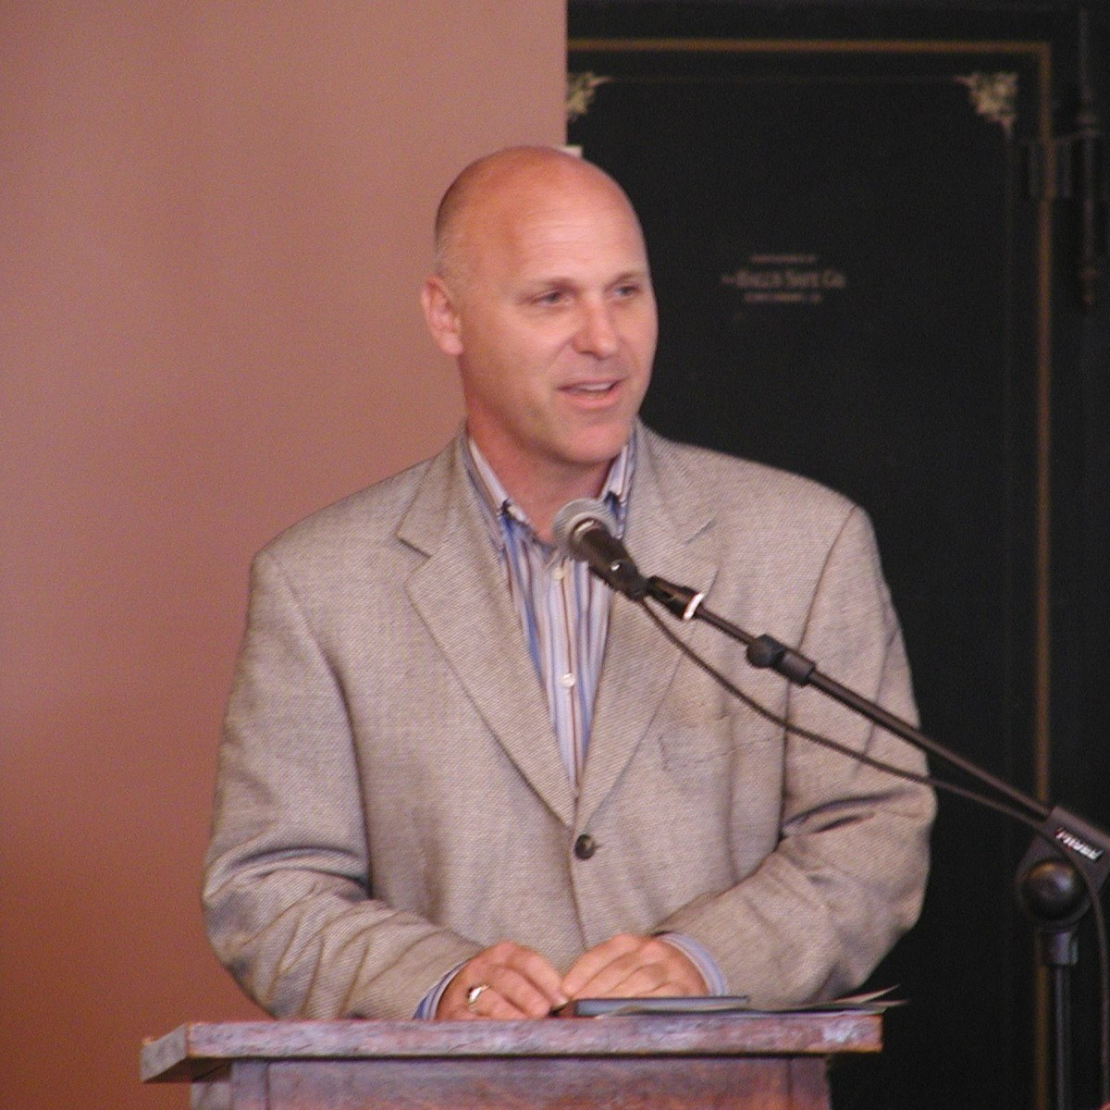
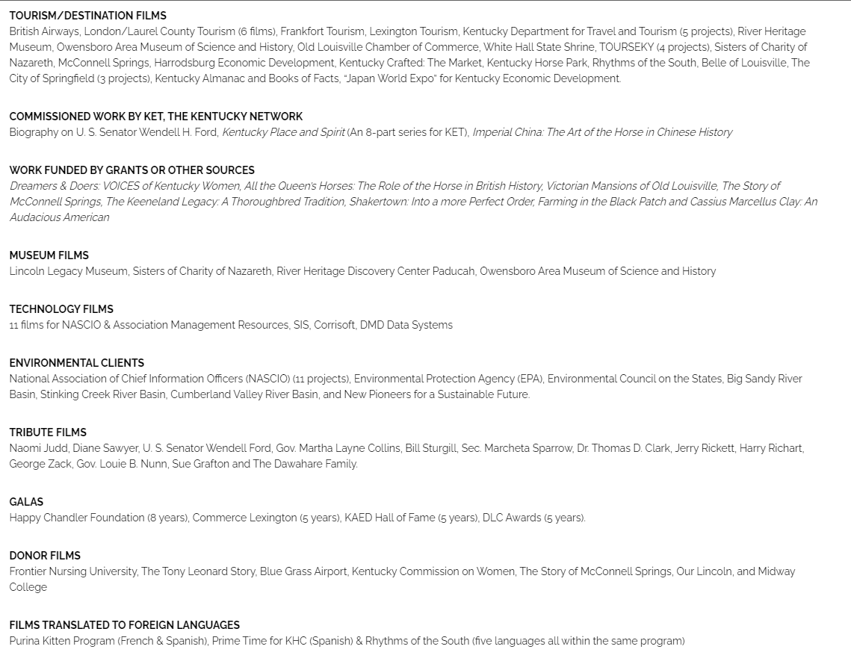
Documentary on Harrodsburg
Production by: Michael Breeding
Based on the past, present and future of Harrodsburg and Mercer County

Slide 10
Beautification Committee
Mural Projects
Clean-Up of Abandoned Property
City Commission Recommended Project to Put in a New Park at Entry Way of Harrodsburg honoring Veterans
Tree Board working on Planting more Trees around Town
Updating Entry Signs to Every Entrance of Harrodsburg (Including Installation of New Sign on HWY 68)
Beautifying and Updating the ‘Warehouse District,’ which plans to host events in 2024
Beautification of Kentucky’s Oldest Street (Broadway)

Slide 11
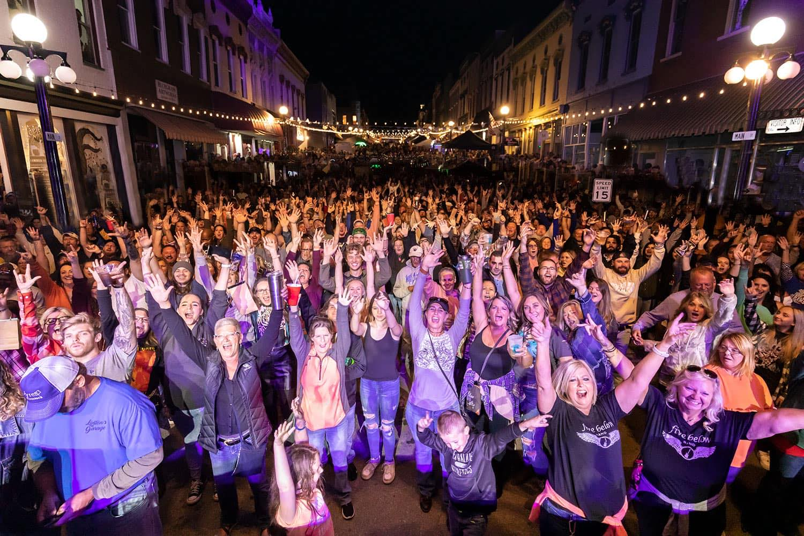
Events Committee
Live Music on Main Street
Re-Enactments at Old Fort Harrod State Park
Events at Shaker Village
Events on Kentucky’s Oldest Street
Events at Anderson Dean Park
Events at The Mercer County Fairgrounds (Home of the Longest Consecutive Horse Show in the Nation)
Events in the Warehouse District
Partnership with Triangle Talent

Slide 12
Marketing Committee
Billboards Throughout Kentucky and Surrounding States
Television Advertisements
Radio Advertisements
Social Media (Facebook, Twitter, Instagram, etc)
Create APP for the Event
Website (https://harrodsburg250th.com/)
Magazines
*Collaborations with the Harrodsburg-Mercer County Tourist Commission
and the Kentucky Department of Tourism*

Slide 13
Fundraising Committee
Current Budget: $41,000
Expected Expenses: $500,000
Reserved funds from Mercer County Tourist Commission: $175,000
Left To Fundraise: $284,000
How do we plan to raise the rest?
Local Business Sponsorships
Grants

Slide 14
Goals of the 250th Anniversary
Showcase the rich history of Kentucky’s Oldest City
Embrace the growth of Harrodsburg and Mercer County since 1774
Prepare for the future of Harrodsburg and Mercer County
Bring visitors from around the state and nation to Mercer County and to Kentucky
Provide education opportunities for students in the surrounding areas, as well as citizens of Kentucky and beyond

