Slide 1
Interim Committee on Tourism, Small Business and Information Technology
Tim Lindahl
President and Chief Executive Officer
Melissa Hagan
Kenergy Member-Owner

Slide 3
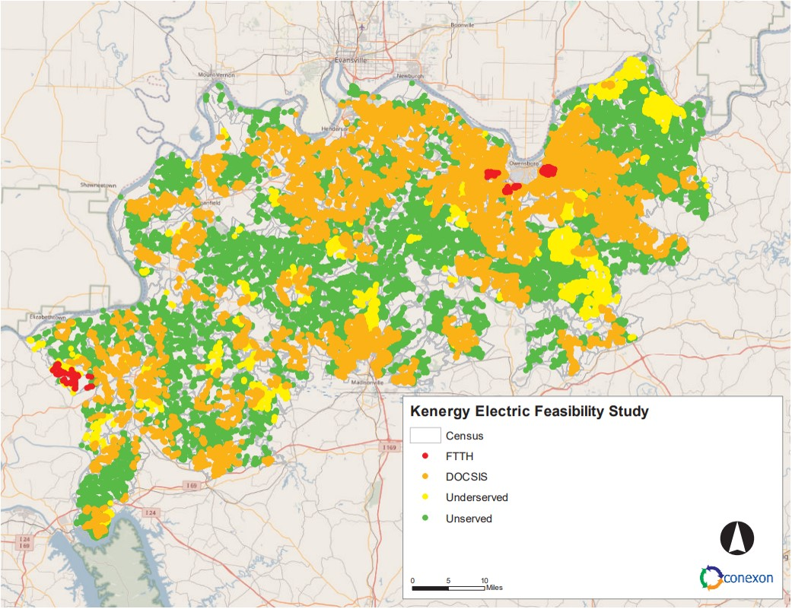

Slide 4
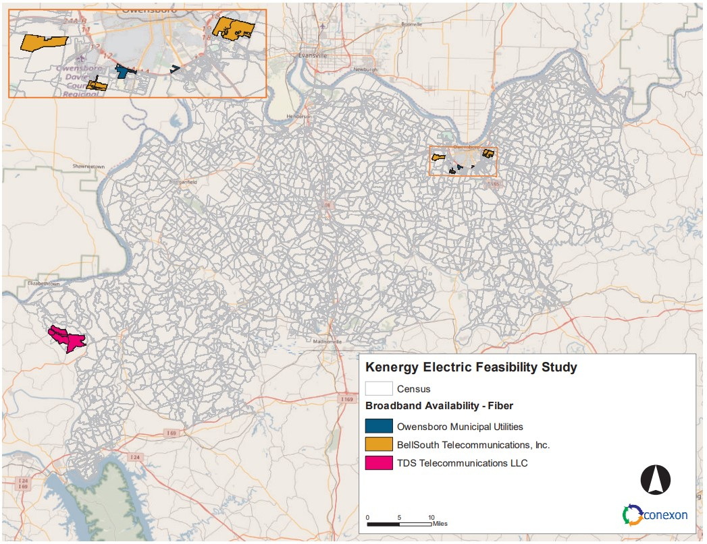

Slide 5
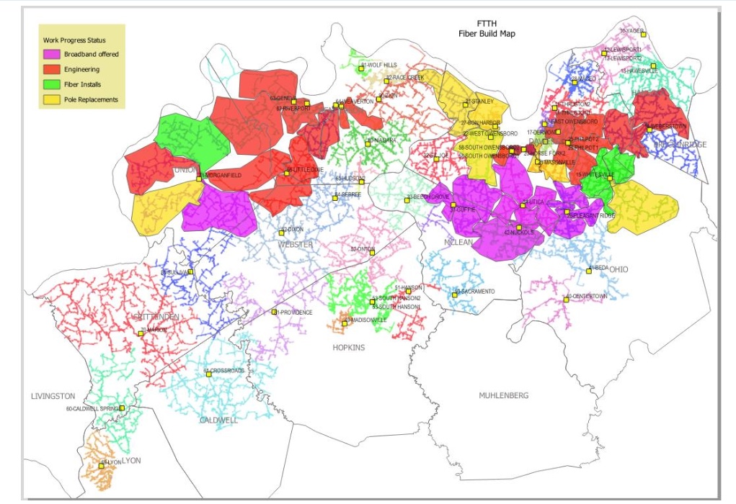
*As of August 29, 2023

