Slide 1
Interim Joint Committee on Tourism, Small Business, and Information Technology
November 9, 2023
Department of Parks Commissioner Russ Meyer
Department of Parks Deputy Commissioner Ron Vanover

Slide 2
Campground Upgrades $40 Million
$3.7 Million
for Project Design for State Park Campgrounds
$34 Million
In-House Construction Costs
$2.2 Million
15 New Projects: 24 Bathhouses & 1 Campground Signage

Slide 3
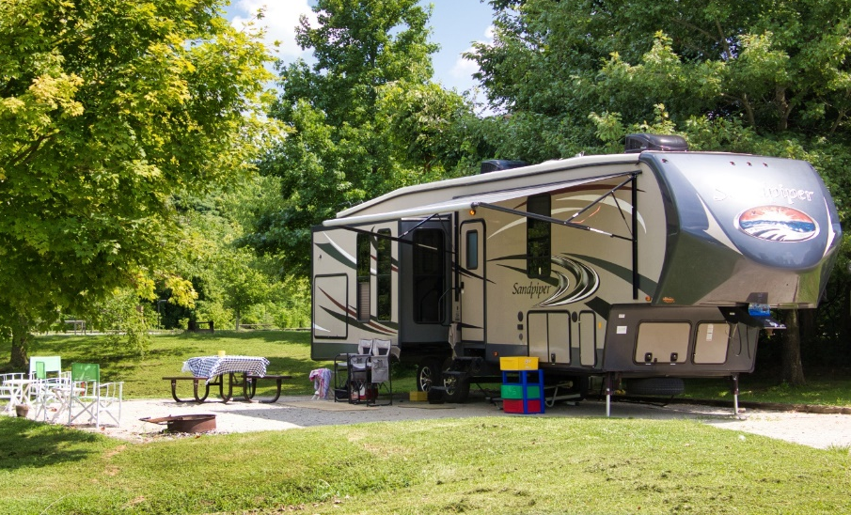
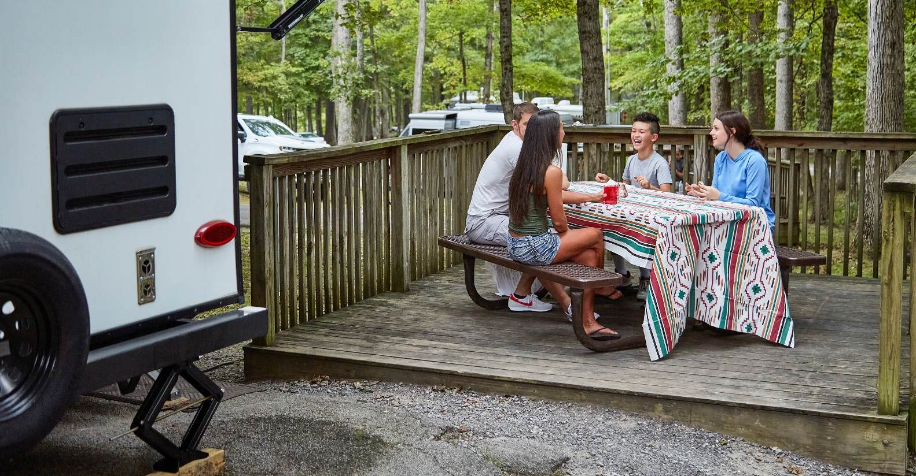
Campground Bathhouse Upgrades $2.2 Million
Carter Caves SRP-Renovation $183,000
Green River SP- Renovation $117,800
Big Bone SP- Renovation $ 82,000
Nolin Lakes SP- Renovation $ 51,000
General Butler SRP-Renovation $154,000
Lake Barkley SRP-Renovation $160,000
Kincaid Lake SP-Renovation $147,700
Natural Bridge SRP Renovation $244,200
Greenbo SRP- Renovation $160,000
Burnside Island SP - Renovation $142,000
Yatesville Lak SP - Renovation $ 92,300
Dale Hollow SRP Signage $ 31,000
Barren River SRP- Renovation $160,000
Jenny Wiley SRP- Renovation $243,500
Cumberland Falls SRP – Clifty Falls Renovation $190,000
TOTAL $2,158,500

Slide 4
Utility Improvements $20 Million
$13 of the $20 Million approved in the proposal to the Legislature for Kentucky State Parks were for electrical initiatives. Based on preliminary estimates from the Western Ky Rural Electric Cooperatives.
Currently, the Department of Parks is in the process of consultation with WKRECC on completing an MOA for an engineering assessment. This MOA engineering assessment for $300,000 is for Kenlake and Kentucky Dam Village State Resort Parks only. The assessments are requirements for the Grid Resilience Grants via the Energy and Environment Cabinet.

Slide 5
Utility Improvements $20 Million
Leveraging these funds to match an $11 million Federal Grid Resilience Grant that will result in a total of $16.5 million for necessary upgrades to the existing electric distribution system to bring them into compliance with electrical safety codes and to be consistent with normal utility construction and maintenance practices, including right-of-way clearings.
The balance of the $20 million will go towards other state parks as electric assessments are completed via partnering with the Kentucky Electrical Cooperatives..

Slide 6
Utility Improvements $20 Million
Additionally, $7 of the $20 Million Utility Improvement funds will fund the repair and replacement of the most critical wastewater plants and lift stations, portable water storage and distribution, and unfunded wastewater sewer plant updates/replacements.
Present movement includes: The design for the replacement of the water storage tank at Greenbo State Resort Park is underway at an estimated cost of $550,000 (to be determined by bid); Moving forward with Phase III design for wastewater treatment plant at Carter Caves State Resort Park estimated at $3.3 Million; Multiple lift station repairs/replacements and bid via DECCA.

Slide 7
Broadband Upgrades $6 Million
$1.4 Million
Dale Hollow – Design complete, contractor visit complete, waiting on contractor quotes.
Paintsville Lake – Design complete, contractor visits being scheduled.
Carter Caves – Design complete, contractor visits being scheduled.
The following campgrounds will be the focus of the remaining funds of $4.6 million:
Big Bone Lick
John James Audubon
Pennyrile
Cumberland Falls
My Old Kentucky Home
Lake Malone
Fort Boonesborough
Lake Cumberland
General Butler
Natural Bridge
Kentucky Dam Village
Kenlake

Slide 8
Lake Barkley and Jenny Wiley State Parks Emergency Structural Repairs
$7.5 Million Lake Barkley State Resort Park Emergency Repairs
$652,700
PROJECT 1: Lake Barkley Lodge Structural Repairs Phase 1 (Urgent)
STATUS: Under Construction
Work includes:
Replacing the column bases with new raised pedestals and redesigned base shoe attachments of the 8 columns at the back porch.
Repairing and stiffening the structures of all the pedestrian bridges leading to guest rooms.
Repairing and replacing all the drainage grates (presents a trip hazard to guests).
Replacing the concrete stairs at the back porch and miscellaneous concrete repairs.

Slide 9
Lake Barkley and Jenny Wiley State Parks Emergency Structural Repairs
$7.5 Million Lake Barkley State Resort Park Emergency Repairs
$619,600 (estimated)
PROJECT 2: Lake Barkley Lodge Structural Repairs Phase 2 (Main Lodge)
STATUS: Engineering Firm for Design will be Contracted under Master Agreement
Work includes:
Repairing and replacing all the guardrails, bringing them up to code with the new infill design incorporated in the fire repairs project.
Replacing all column shoe baseplates with the new design incorporated in the fire repairs project.
Localized beam replacements.
Replacing wood decking as required.
Concrete repairs.
Miscellaneous repairs.

Slide 10
Lake Barkley and Jenny Wiley State Parks Emergency Structural Repairs
$7.5 Million Lake Barkley State Resort Park Emergency Repairs
$6.2 Million (estimated)
PROJECT 3: Lake Barkley Lodge Structural Repairs Phase 3 (Guest Wings)
STATUS: Selection will be required for Architect/Engineering Firm for Design
Work includes:
Replacing all column shoe baseplates with the new design incorporated in the fire repairs project.
Repairing and replacing all the guardrails, bringing them up to code with the new infill design incorporated in the fire repairs project.
Replacing wood decking as required.
Localized beam repairs.
Repair and replacement of the end wall structural elements (East Wing both ends and West Wing pool end).
Concrete repairs.
Miscellaneous repairs.

Slide 11
Lake Barkley and Jenny Wiley State Parks Emergency Structural Repairs
$5.5 Million Jenny Wiley State Resort Park Emergency Repairs
$97,000 (allocated)
PROJECT 1: Jenny Wiley Lodge Emergency Repairs Phase 1 (Urgent)
STATUS: Commencing Design Services
Work includes:
Installing a collar tie for the stability of the structure supporting the main entry roof covering.
Repairing and re-anchoring guardrail posts.
Adding joist hangers to the north walkway of the ABC connector structure.
Conducting a structural analysis of the pool structure.

Slide 12
Lake Barkley and Jenny Wiley State Parks Emergency Structural Repairs
$5.5 Million Jenny Wiley State Resort Park Emergency Repairs
$5.4 Million
PROJECT 2: Jenny Wiley Lodge Emergency Repairs Phase 2
STATUS: Selection will be required for Architect/Engineering Firm for Design
This project will determine the necessary repairs identified in the report to be completed with the current funding available.

Slide 13
Proposal for $71 Million $71 million in Unallocated Funds from the $150 million State Park Improvement Project
$27 Million
Building Systems Improvements
Building Systems Repair & Replace
Barren River State Resort Park | $750,000.00 | Replace building HVAC controls. Current Solidyne controls are obsolete and failing. This system controls all aspects of building heating, cooling, and ventilation equipment operation.
General Butler State Resort Park | $725,000.00
Pennyrile Forest State Resort Park | $725,000.00
Rough River Dam State Resort Park | $800,000.00
Dale Hollow State Resort Park | $800,000.00
Parks listed above | $3,083,200.00 | Building envelope and energy reduction projects. These projects would improve guest experience as well as reduce overall energy costs.
Total | $6,883,200.00

Slide 14
Proposal for $71 Million $71 million in Unallocated Funds from the $150 million State Park Improvement Project
$27 Million
Building Systems Improvements
Life Safety Systems Upgrade & Replace
All KY State Resort Parks | $2,000,000.00 | Project to replace all lodge and guest entry electronic access control systems at all resort parks.
Pennyrile Forest State Resort Park | $500,000.00 | Project to replace fire alarm protection systems, and sprinkler system upgrades.
Kentucky Dam Village State Resort Park | $500,000.00 | Project to replace fire alarm protection systems and sprinkler system upgrades.
Total | $3,000,000.00

Slide 15
Proposal for $71 Million $71 million in Unallocated Funds from the $150 million State Park Improvement Project
$27 Million
Building Systems Improvements
Structural and Safety Repairs
Barren River State Resort Park | $144,000.00 | Concrete repairs, window replacements, and guardrail replacements.
Blue Licks State Resort Park | $173,900.00 | Stair replacement, elevated walkway repairs, balcony repairs, foundation and drainage repairs, slab settlement issues.
Buckhorn State Resort Park | $62,400.00 | Concrete repairs and coatings, stair reconstruction, and steel repairs.
Carter Caves State Resort Park | $70,900.00 | Repairing spalled concrete, foundation repairs, floor framing repairs, and guardrail repairs.
Columbus-Belmont State Park | $15,500.00 | Masonry repairs and carpentry repairs.
Cumberland Falls State Resort Park | $111,500.00 | Concrete repairs, waterproofing, column and beam repairs, and rebuilding retaining walls.
Dale Hollow State Resort Park | $309,300.00 | Concrete pedestrian bridge replacement.
E.P. "Tom" Sawyer State Park | $36,100.00 | Concrete repairs.
Fort Boonesborough State Park | $123,400.00 | Timber repairs.
General Butler State Resort Park | $728,300.00 | Concrete repairs, stair rebuilds, carpentry repairs, and new column construction.
Greenbo Lake State Resort Park | $219,500.00 | Steel repairs, concrete repairs and foundation repairs.
John James Audubon State Park | $360,800.00 | Various masonry repairs, wood column replacements, misc. wood replacement.
Kenlake State Resort Park | $114,500.00 | Wood structural replacements, slab settlement issues.
Kentucky Dam Village State Resort Park | $42,600.00 | Minor repairs to subfloor, roofs, column replacements.
Lake Cumberland State Resort Park | $871,100.00 | Repairing spalled concrete, foundation repairs, and duct opening repairs.
Natural Bridge State Resort Park | $76,500.00 | Retaining walls, steel repairs, deck replacement, beam delamination, and guardrail repairs.
Old Fort Harrod State Park | $1,514,000.00 | Foundation repairs, masonry repairs, timber repairs and replacements
Pennyrile Forest State Resort Park | $52,100.00 | Steel replacement and painting, masonry repairs, foundation repairs, and post replacement.
Perryville Battlefield State Historic Site | $806,000.00 | Foundation repairs, masonry repairs, and carpentry repairs.
Pine Mountain State Resort Park | $151,200.00 | Cmu wall reconstructions, foundation repairs, stair replacements, and guardrail repairs.
Rough River Dam State Resort Park | $1,028,200.00 | Repair and rebuild retaining walls, concrete repairs and sealing, guardrail repairs, masonry repairs, floor settlement repairs, sidewalk replacements, steel cleaning and painting, foundation pier reconstructions, column replacement, foundation repairs and underpinning.
Total | $7,011,800.00

Slide 16
Proposal for $71 Million $71 million in Unallocated Funds from the $150 million State Park Improvement Project
$27 Million
Building Systems Improvements
Statewide ADA mobility Improvements (Phase 1)
Dale Hollow Bridge Pedways | $315,000.00 | Demolish the exposed concrete pedestrian bridge to Lodge Wing A from the parking lot and the covered pedestrian bridge to Lodge Wing A from the Main Lodge.
Cumberland Falls-Clifty Falls Bathroom | $250,000.00 | Renovate to make bathroom facility ADA compliant.
My Old Kentucky Home | $500,000.00 | Demo, design and construction to provide ADA Bathhouse.
Total | $1,065,000.00

Slide 17
Proposal for $71 Million $71 million in Unallocated Funds from the $150 million State Park Improvement Project
$27 Million
Building Systems Improvements
Dam Safety Reconstruction and Repairs
Pennyrile State Resort Park | $3,750,000.00 | Make repairs to CCC dam based on estimates from consulting engineering firm.
Natural Bridge State Resort Park | $1,000,000.00 | Make repairs to CCC dam based on estimates from consulting engineering firm.
Mower equipment for dam maintenance | $250,000.00 | Purchase specialized slope mower, truck and trailer to use statewide to maintain dams as required by regulatory agencies.
Total | $5,000,000.00

Slide 18
Proposal for $71 Million $71 million in Unallocated Funds from the $150 million State Park Improvement Project
$27 Million
Building Systems Improvements
Upgrade Recreational Building-Pool EP Tom Sawyer | $1,280,000.00 | Repairs to building components within the recreational building located adjacent to the community pool at E. P. Tom Sawyer State Park. Work to include but not limited to the following items: exterior and interior upgrades of door and window replacement, mechanical upgrades, upgrade electrical/lighting systems and interior finish and furniture. This building is the main artery for the park and needs a complete renovation.
Lake Barkley - Lodge Wing Interior Upgrades | $2,760,000.00 | Project will address room amenities/bathroom upgrades/room HVAC systems for the 62 rooms.

Slide 19
Proposal for $71 Million $71 million in Unallocated Funds from the $150 million State Park Improvement Project
$22 Million
Accommodation Hospitality Upgrades
Hospitality Upgrades
Barren River State Resort Park | $784,800.00 | Window treatments, flooring, soft goods, and furnishings in cottages. Tables, chairs, and window treatments in the dining room. Update interiors of 22 cottages with flooring, furniture, case goods, paint and décor.
Blue Licks State Resort Park | $903,900.00 | Window treatments, flooring, soft goods, furnishings in 32 lodge rooms, lobby interior upgrades, tables and chairs in dining room
Buckhorn State Resort Park | $1,018,100.00 | Interior finishes, furniture, case goods, flooring, and bedding in 36 lodge rooms. Tables and chairs in the dining room. Lobby furniture and interior updates. Update interiors of all 3 cottages with flooring, furniture, case goods, paint and décor,
Carter Caves State Resort Park | $462,000.00 | Replace flooring, tables, and chairs in the dining room. Update interiors of all 11 cottages with flooring, furniture, case goods, paint and décor,
Cumberland Falls State Resort Park | $1,897,800.00 | Interior finishes, furniture, case goods, flooring, and bedding in the 20 Woodland lodge rooms. Tables and chairs in the dining room. Lobby furniture and interior updates. Update interiors of all 25 cottages with flooring, furniture, case goods, paint and décor,
Dale Hollow State Resort Park | $1,335,500.00 | Update all 60 lodge rooms, including flooring, bedding, case goods, lighting, and décor. Update dining room flooring, tables, and chairs. Update lobby furnishings and décor.
General Butler State Resort Park | $845,800.00 | Dining room updates include tables, flooring, and window treatments. Interior finishes, including furnishings, case goods, lighting, and décor in 24 cottages.
Greenbo State Resort Park | $908,300.00 | Update all 36 lodge rooms, including flooring, bedding, case goods, lighting, and décor. Update dining room flooring, tables, and chairs. Update lobby furnishings and décor.
Jenny Wiley State Resort Park | $587,800.00 | Window treatments in all lodge rooms. Update interiors of all 18 cottages with flooring, furniture, case goods, paint and décor,
John James Audubon State Park | $163,900.00 | Update interiors in each of the 6 cottages with flooring, furniture, case goods, paint and décor,
Kenlake State Resort Park | $2,084,600.00 | Update interiors of all 48 lodge rooms and 34 cottages furnishings, window treatments, case goods, lighting, and décor. Update dining room furniture, flooring, and décor. Update lobby furniture and décor.
Kentucky Dam Village State Resort Park | $3,751,000.00 | Updates to 72 of the lodge rooms, 14 rooms in Village Green that will include flooring, décor, bedding, furniture, and case goods. Update Dining room décor furniture. New interior updates in 42 cottages.
Lake Barkley State Resort Park | $1,757,900.00 | Update interiors of Little River Lodge with new furnishings, décor, lighting, bedding, and case goods. Replace 62 HVAC units in the east wing of the main lodge room. Replace flooring, tables, and chairs in the dining room. Update lodge lobby furnishings, tables, and decor. Replace all furniture, bedding, tables, and appliances in the 13 cottages. Add mini refrigerators, if possible, to all lodge rooms.
Lake Cumberland State Resort Park | $2,102,500.00 | Address 63 of the 76 lodge rooms for interior renovations (13 have recently been updated). Update 14 Pumpkin Creek lodge rooms. Updates to all lodging rooms and 25 cottages to include finishes, décor, soft goods, case goods, lighting, etc. Also, update Lobby décor and furniture.
Natural Bridge State Resort Park | $296,100.00 | Update dining room including tables, chairs and window treatments in 8 cottages.
Pennyrile Forest State Resort Park | $980,400.00 | Replace all furniture, case goods, and bedding in all 24 lodge rooms. Replace tables, chairs, and window treatments in the dining room. Update the 6 cottages to include furniture, bedding, and décor.
Pine Mountain State Resort Park | $1,284,300.00 | Renovate all 30 lodge rooms with new bedding, décor, case goods, and furniture. Update dining room tables and chairs. Update Lobby furniture and tables. Replace furniture, bedding, and tables in 21 cottages.
Rough River State Resort Park | $835,300.00 | Update the dining room, including tables, chairs, and window treatments. Replace the furniture in the lobby. Replace furniture, bedding, and décor in 17 cottages.
Total | $22,000,000.00

Slide 20
Proposal for $71 Million $71 million in Unallocated Funds from the $150 million State Park Improvement Project
$22 Million
Recreational Amenities Upgrades
Pool Improvements and Repairs
Blue Licks State Resort Park | $1,750,000.00 | Blue Licks Community Pool – Built in 1962. Replace main and wading pools with splash pad; consultant stated pool shell has deteriorated and some walls and floors need to be rebuilt.
Dale Hollow State Resort Park | $1,000,000.00 | Dale Hollow Campground Pool - Built in 1974. Needs major renovation or replacement.
Greenbo State Resort Park | $1,500,000.00 | Greenbo Lodge Pool – Built in 1970.
Lake Barkley State Resort Park | $1,500,000.00 | Lake Barkley Lodge Pools - Built in 1962, with many issues over the years. Replace pool body treated with diamond bright surface.
General Burnside State Park | $2,500,000.00 | General Burnside Community Pool- Built in 1978 and closed for the past 20 years.
Ft Boonesborough | $1,450,000.00 | Ft Boonesborough Community Pool- Built in 1995. Needs major renovation after being closed for 3 years.
Barren River State Resort Park | $280,000.00 | Barren River – The project to replace the pool surface had a major replacement 3 years ago. The paint coating failing and needs liner.
Carter Caves State Resort Park | $420,000.00 | Carter Cave Community Pool – Built in 1977. Needs major renovation in Ph C 2023 construction.
Dale Hollow State Resort Park | $30,000.00 | Dale Hollow Lodge Pool – Built 1997. Needs replacement pool covers.
EP Tom Sawyer | $325,000.00 | EP Tom Community Pool - Built in 1991, with major renovations in the past. Needs groundwater remediation and the deck replaced.
General Butler State Resort Park | $280,000.00 | General Butler Lodge Pool – Built in 1995. Replacing a 13-year-old liner system project - currently funded.
Greenbo State Resort Park | $325,000.00 | Greenbo Community Pool – Built in 1997. Needs some renovation.
Lake Cumberland State Resort Park | $280,000.00 | Lake Cumberland Lodge Indoor Pool - Built in 1965. Needs pool surface replaced.
Big Bone | $115,900.00 | Big Bone Campground Pool – Built in 1972. Major upgrade 3 years ago. Minor issues for correction.
Pennyrile Forest State Resort Park | $200,000.00 | Pennyrile Lodge Pool - 3 Filters need to be repaired and new media. Pool still leaking.
Total | $11,955,900.00

Slide 21
Proposal for $71 Million $71 million in Unallocated Funds from the $150 million State Park Improvement Project
$22 Million
Recreational Amenities Upgrades
Golf Course Irrigation Replacement - Multi Parks
Kentucky Dam Village State Resort Park | $1,354,500.00
Lake Barkley State Resort Park | $1,356,750.00
Barren River State Park | $1,320,750.00
My Old Kentucky Home | $1,300,500.00
Total | $5,332,500.00

Slide 22
Proposal for $71 Million $71 million in Unallocated Funds from the $150 million State Park Improvement Project
$22 Million
Recreational Amenities Upgrades
Statewide - Beach Refurbishment
Green River State Park | $40,000.00
Barren River State Park | $108,200.00
Kentucky Dam Village State Resort Park | $49,800.00
Pennyrile Forest State Resort Park | $22,300.00
Buckhorn State Park | $26,000.00
Lake Malone State Park | $11,500.00
Nolin Lake State Park | $24,800.00
Lake Barkley State Resort Park | $64,000.00
Total | $346,600.00

Slide 23
Proposal for $71 Million $71 million in Unallocated Funds from the $150 million State Park Improvement Project
$22 Million
Recreational Amenities Upgrades
Bermuda Greens
Barren River State Park | $400,000.00 | Converting to Ultradwarf Bermudagrass greens will offer an immediate reduction in chemical expenses and an increase in the quality and green speeds desired by the golfers.
Kentucky Dam Village State Resort Park | $175,000 | This course is ready to convert. Bermuda greens will offer an immediate reduction in chemical expenses and an increase in green speeds desired by the golfers.
Total | $575,000.00

Slide 24
Proposal for $71 Million $71 million in Unallocated Funds from the $150 million State Park Improvement Project
$22 Million
Recreational Amenities Upgrades
Playgrounds
Lake Malone State Park | $200,000.00 | Partial sponsorship proposed by Muhlenberg County Tourist Commission
Carter Caves State Park | $150,000.00 | Partial sponsorship proposed by Friends of Carter Caves
Jefferson Davis | $100,000.00
EP Tom Sawyer State Park | $100,000.00
Ft. Boonesborough State Park | $100,000.00
Green River State Park | $100,000.00
Kentucky Dam Village State Resort Park | $100,000.00
Pennyrile Forest State Resort Park | $100,000.00
Big Bone Lick State Park | $100,000.00
Additional Projects | $150,000.00
Total | $1,200,000.00

Slide 25
Proposal for $71 Million $71 million in Unallocated Funds from the $150 million State Park Improvement Project
$22 Million
Recreational Amenities Upgrades
Repair Bunkers at ALL Golf Course Parks
Mineral Mounds | $220,000.00
Dale Hollow State Resort Park | $760,000.00
Grayson Lake State Resort Park | $820,000.00
General Burnside State Park | $260,000.00
My Old Kentucky Home State Park | $260,000.00
Yatesville Lake State Park | $270,000.00
Total | $2,590,000.00

Slide 26
Questions?

