Slide 1
CRITICAL INFRASTRUCTURE SECURITY
Dave Hatter, CISSP, CISA, CISM, CCSP, CSSLP, Security +, Network+, PMP, ITIL
Intrust IT
linkedin.com/in/davehatter
twitter.com/davehatter

Slide 2
About Me
30+ years in technology, primarily software engineering
BS in Information Systems from NKU
Numerous professional certifications
19 years as an adjunct professor
Author/co-author of 12 technology books
Over 100 published articles
Quoted in many publications including WSJ
Regular media contributor
Mayor of Fort Wright
Notes:
Scare the crap out of you!
https://www.zdnet.com/article/the-scariest-hacks-and-vulnerabilities-of-2019/

Slide 3
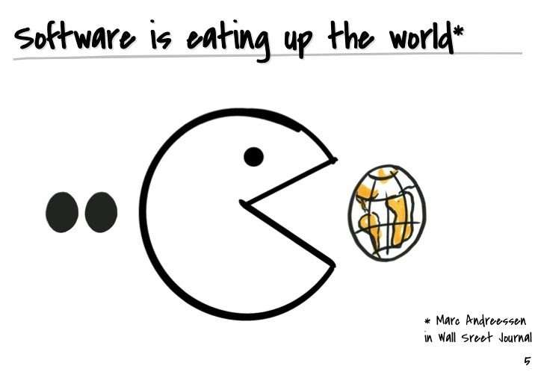
Notes:
https://benitocastrocom.files.wordpress.com/2019/11/e58d3-startups.jpg
500 million apps will be built over the next five years – Microsoft

Slide 4
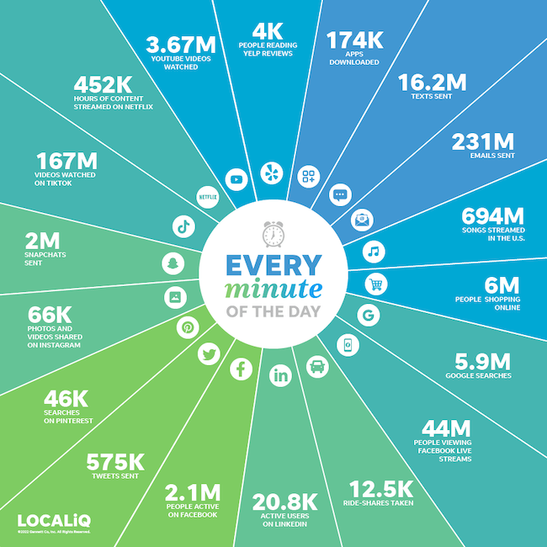
Notes:
“Over 2.5 quintillion bytes of data are created every single day, and it’s only going to grow from there. By 2020, it’s estimated that 1.7MB of data will be created every second for every person on earth.” – Sixth Annual Domo report

Slide 5
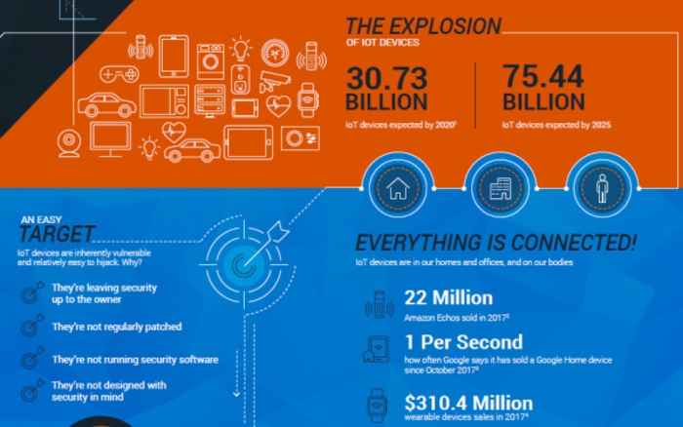
Notes:
IoT

Slide 6
Digital-first Economy
Software Defined Everything (SDE): Traditional, hardware-centric components are abstracted and controlled through software, enabling dynamic provisioning, management, and optimization of resources across various domains. This approach extends across networks, storage, computing, and even security.
Notes:
ChatGPT v3
Ten years after the publication of the oft-quoted Marc Andreessen op-ed ”Why software is eating the world,” lines of code are still revamping industry dynamics and generating fresh revenue streams. Disruption has even accelerated given wider cloud adoption and the influence of AI.
Internet of Everything (IoE)

Slide 7
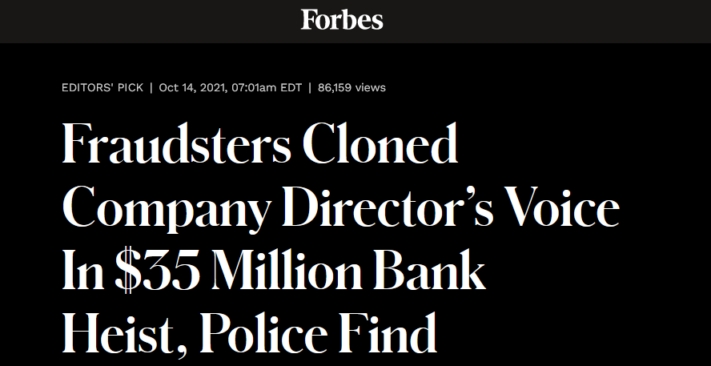
Notes:
ransomware attacks globally surged 40 per cent to reach 199.7 million hits in the third quarter of this year, according to a report from cybersecurity firm SonicWall.
https://phoenixnap.com/blog/ransomware-statistics-facts

Slide 8
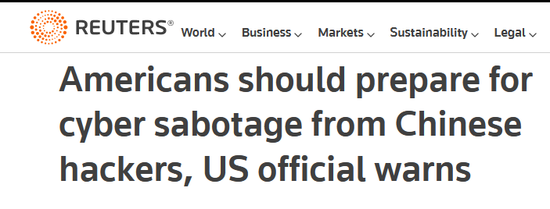
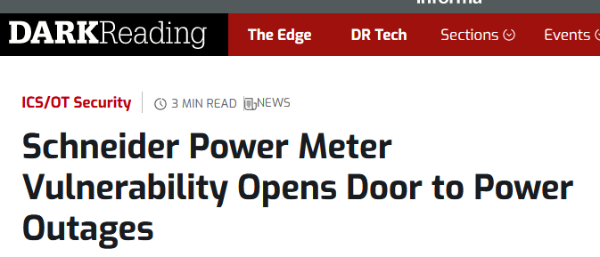

Slide 9
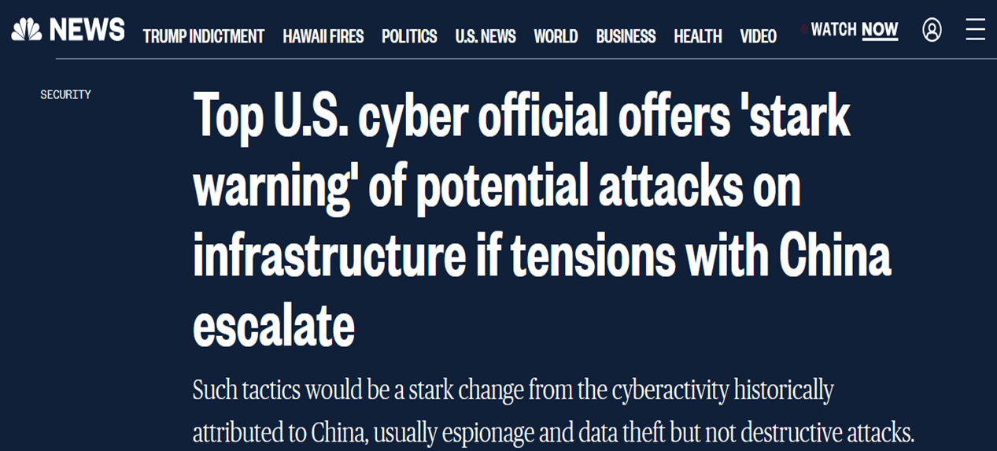
Notes:
Warnings from WH, FBI, DHS

Slide 10
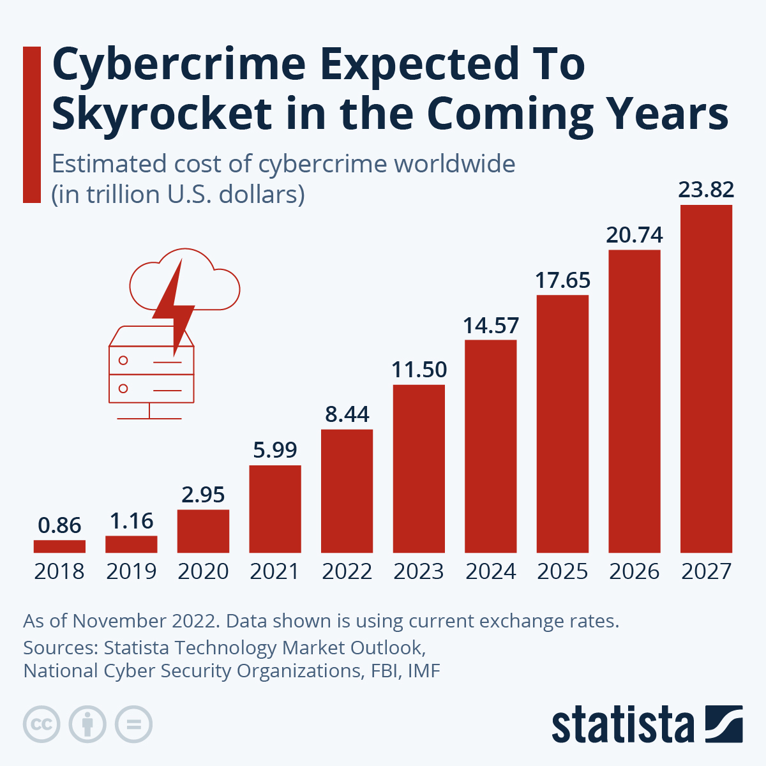
Notes:
Why Now?
Cybercrime is predicted to cost the world $8 trillion USD in 2023, according to Cybersecurity Ventures.
If it were measured as a country, then cybercrime would be the world’s third largest economy after the U.S. and China. Press Release
We expect global cybercrime damage costs to grow by 15 percent per year over the next three years, reaching $10.5 trillion USD annually by 2025, up from $3 trillion USD in 2015.

Slide 11
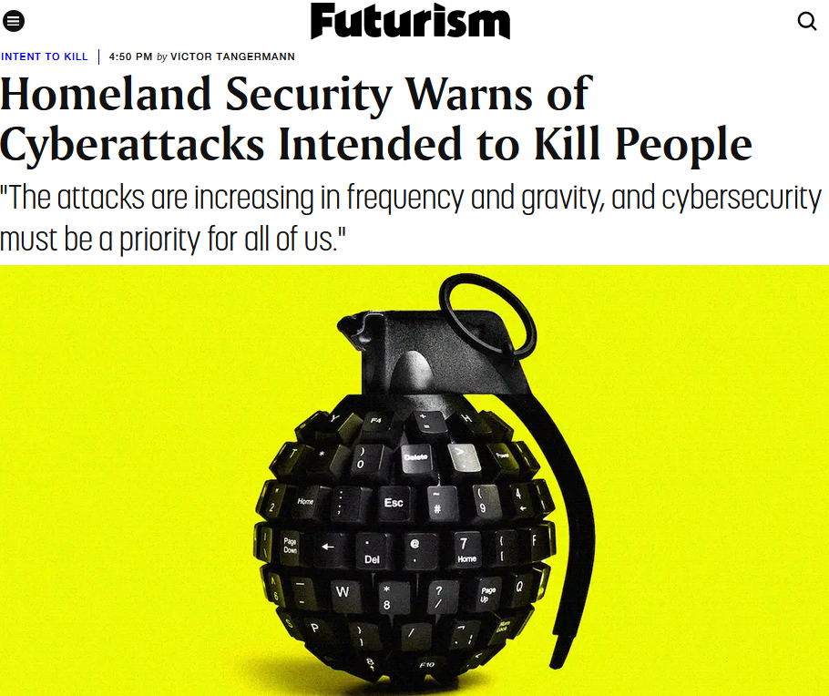
Notes:
Warnings from WH, FBI, DHS

Slide 12
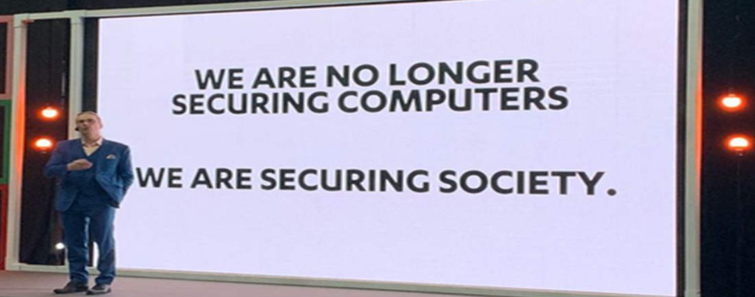
Notes:
Mikko

Slide 13
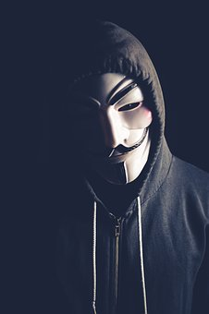
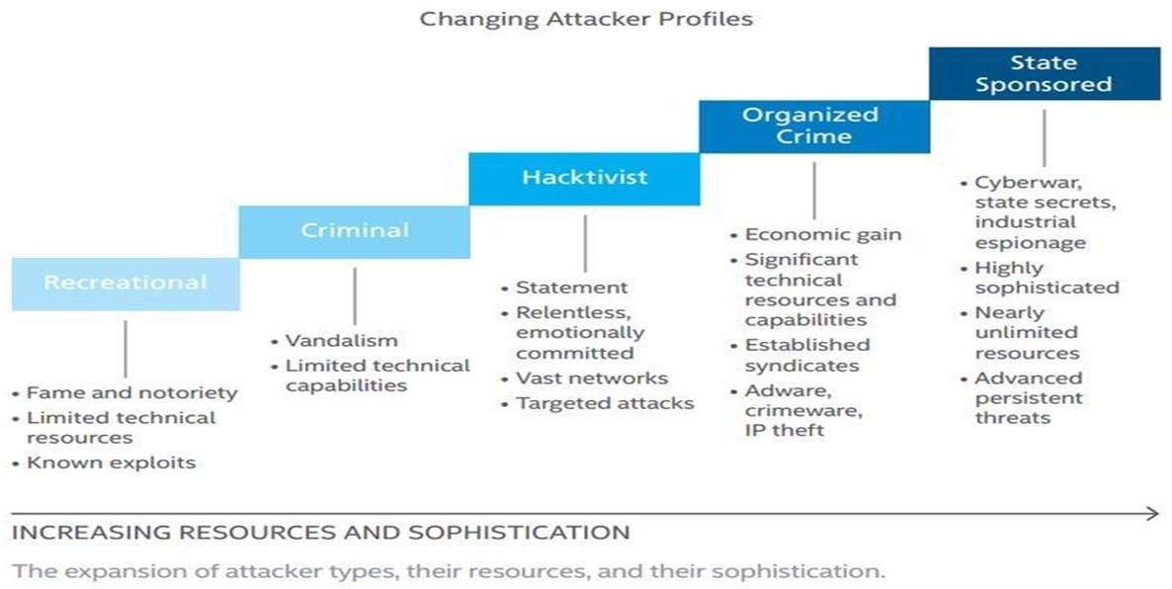
Notes:
Lone Wolf: Paige Thompson –Capital One

Slide 14
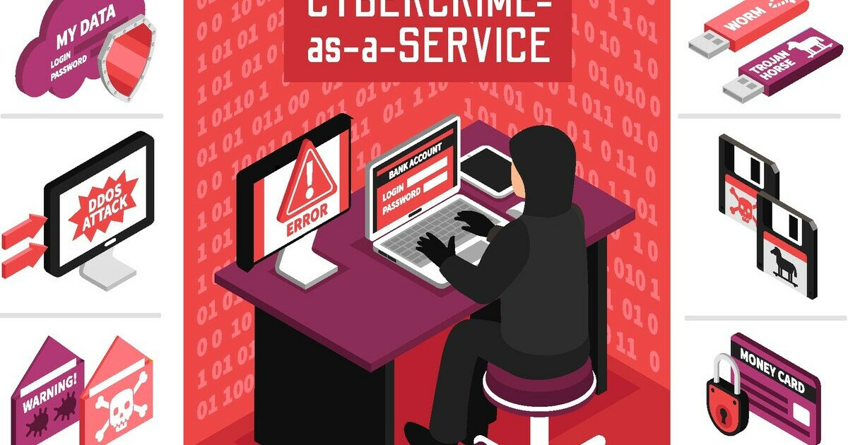
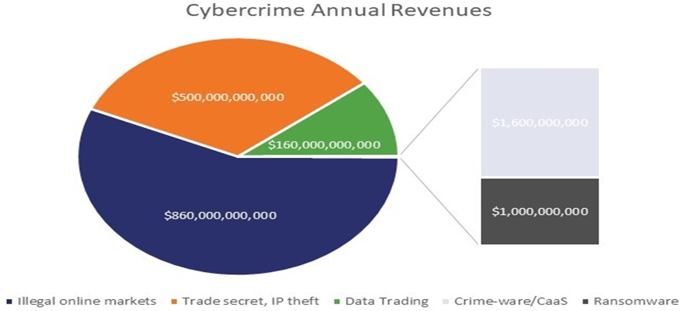
Notes:
Estimated to be $10.5 trillion annually by 2025
In their 2020 Global Risks Report, WEF said that in the US, the likelihood of catching cybercrime actors and hauling them into court is estimated to be as low as 0.05%.
Walmart, generated mind-blowing $514 billion in revenue in 2019
Cybercrime earns 12 times that
More than Tesla, Facebook, Microsoft, Apple, Amazon, and Walmart combined - $1.28 trillion
ZDNet reported that:
Ransomware gangs made at least $350 million in 2020, a 311% increase over ransomware payments recorded in 2019
Initial Kaseya ransom was $70 million!

Slide 15
Security
The protection of information and systems from unauthorized access, use, disclosure, disruption, modification, or destruction. It involves implementing a range of technical, administrative, and physical controls to safeguard against potential threats and vulnerabilities.
Notes:
ChatGPT

Slide 16
Terminology
Operational Technology (OT)
Industrial Control Systems (ICS)
Supervisory control and data acquisition (SCADA)
Industrial Internet of Things (IIoT)
Notes:
ChatGPT

Slide 17
Notes:
CIS: Community Defense Model Version 2.0 attack pattern analysis
https://www.cisecurity.org/insights/blog/renew-your-ransomware-defense-with-cisas-updated-guidance

Slide 18
Notes:
https://www.cisa.gov/sites/default/files/publications/2021-seminars-ics-security-508.pdf

Slide 19
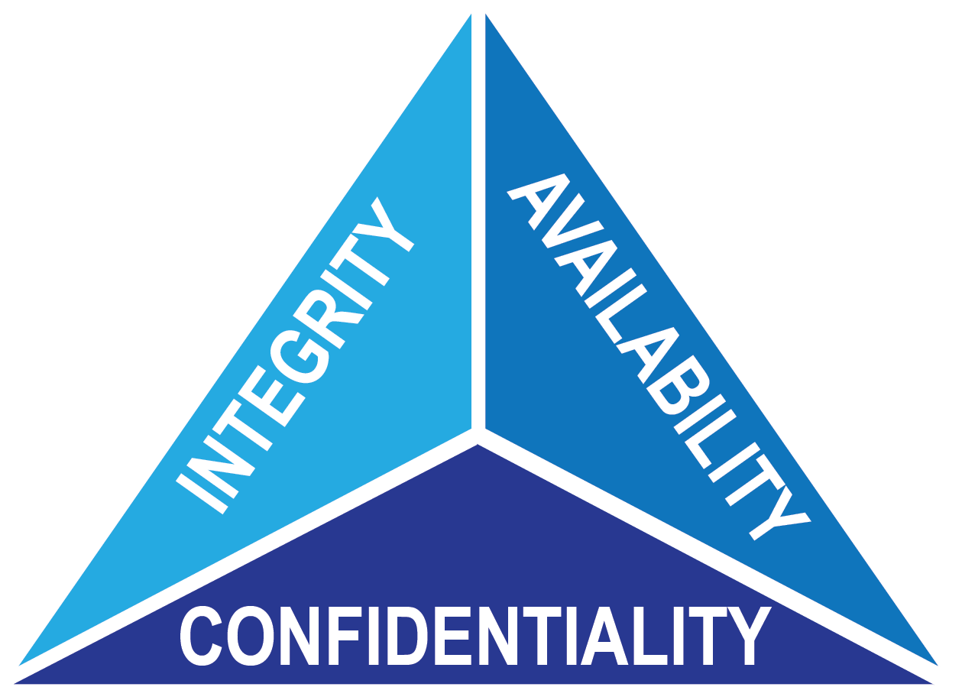
Wetware
Hardware
Software
Notes:
According to the 2018 Verizon Data Breach Investigations Report, 58% of cyberattack victims were small businesses (organizations with fewer than 250 employees). Many small and medium-sized businesses (SMBs) think that the data they have or have access to does not have value. Nothing could be further from the truth.

Slide 20
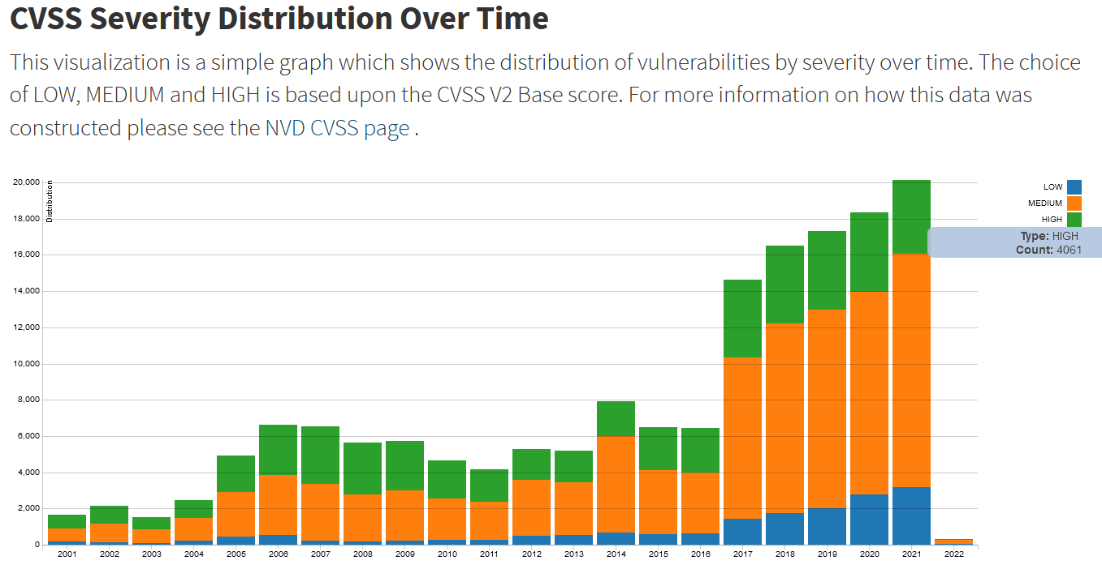

Slide 21
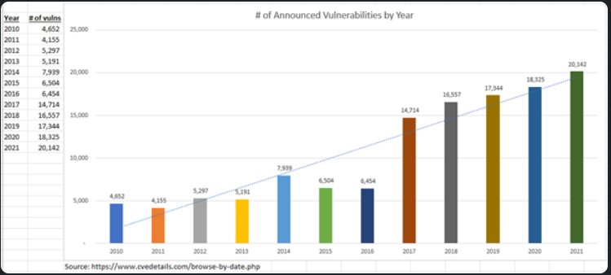
Notes:
Threats: Unpatched Software

Slide 22
OWASP TOP 10
2003, 2004, 2007, 2010, 2013, 2017 and 2021
Common across the years:
Injection, Misconfiguration, Authentication, Access Control
Notes:
Open Web Application Security Project - OWASP Foundation

Slide 23
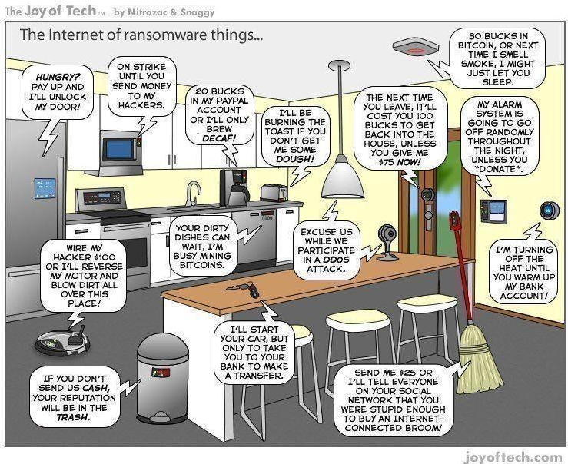
Notes:
Hypponen’s Law: If it’s smart, it’s vulnerable
Internet of Insecure Things
76 billion by 2025
Often not designed with security in mind
Easily found with Shodan
Vector for network attack
Can be used to spy on you & your organization
Can host malware

Slide 24
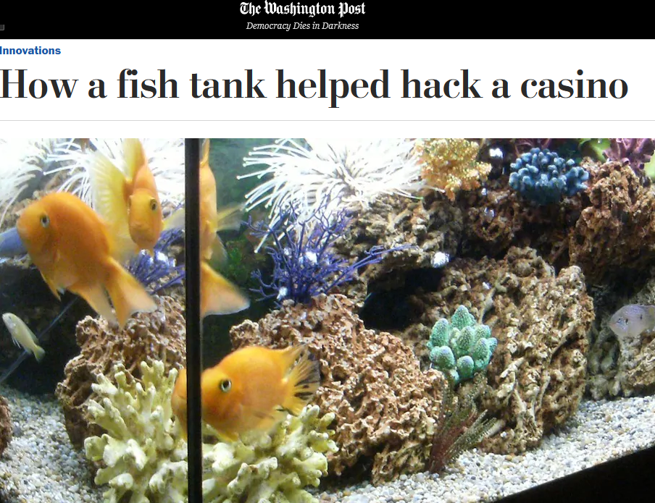
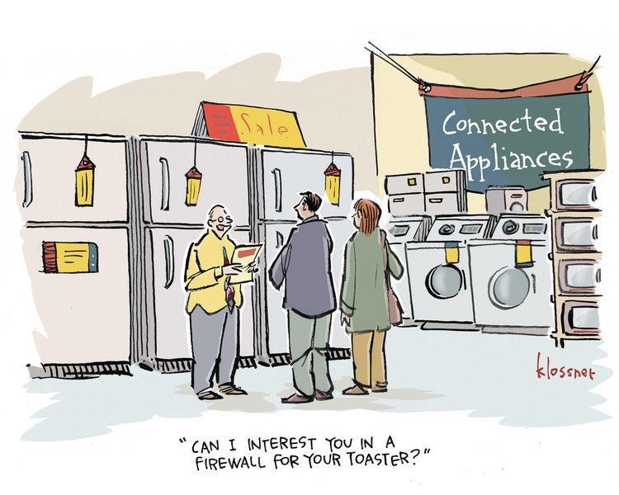
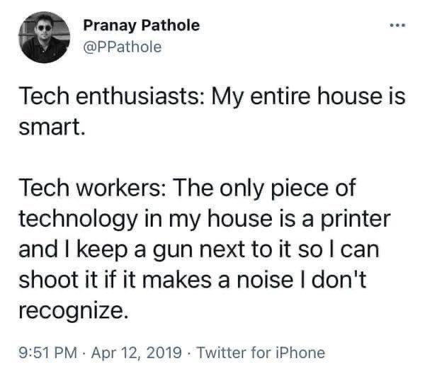
Notes:
Mikko: Asbestos

Slide 25
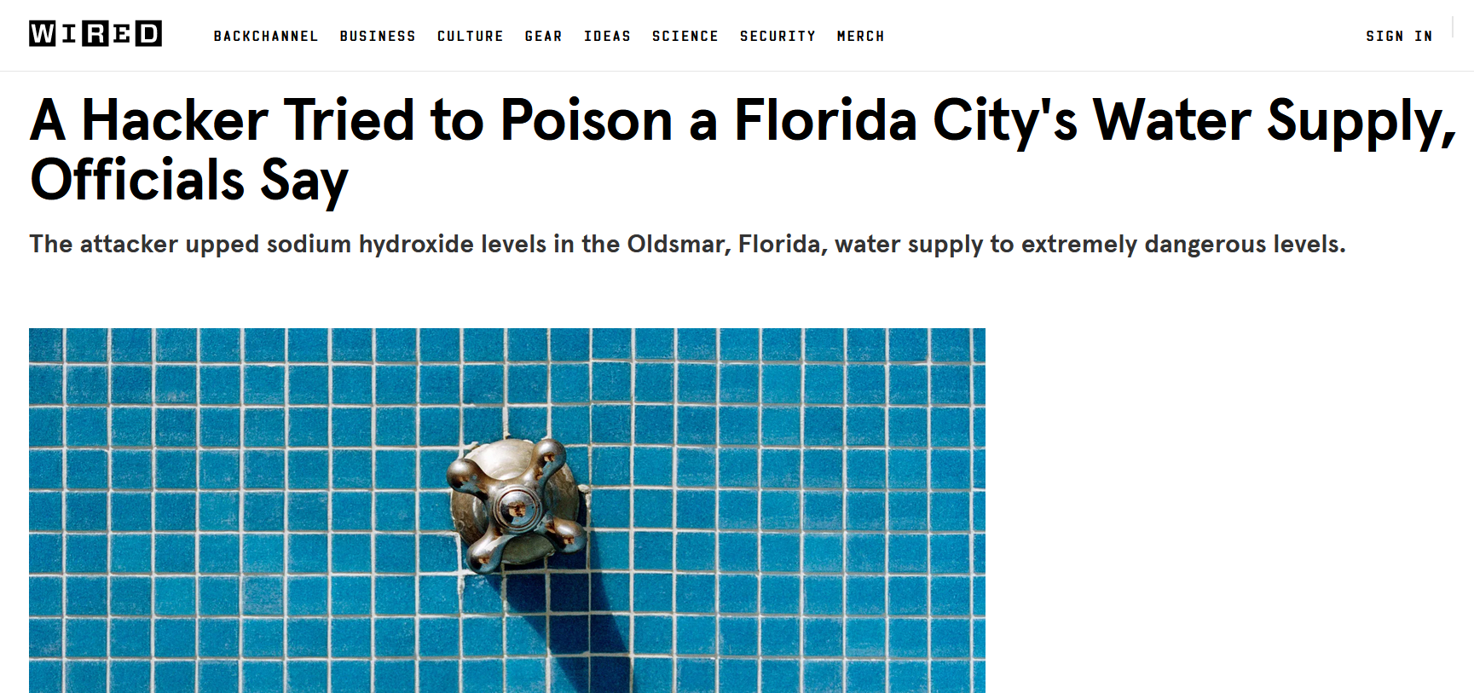
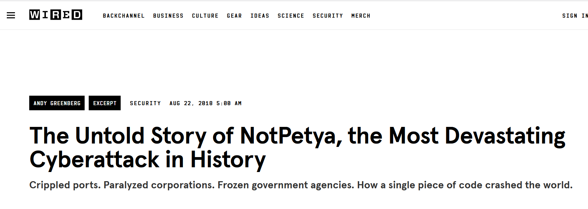
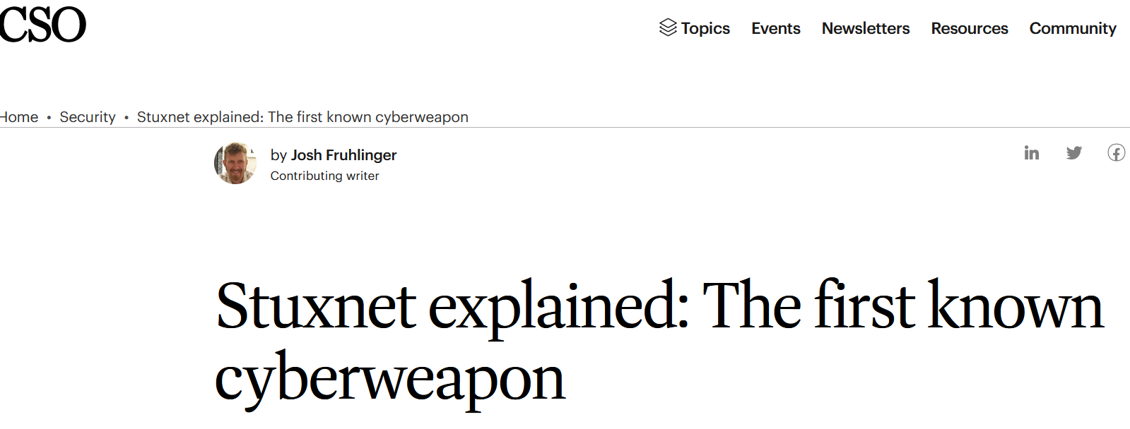
Notes:
Russia v Ukraine
Israel v Hamas
Stuxnets

Slide 26
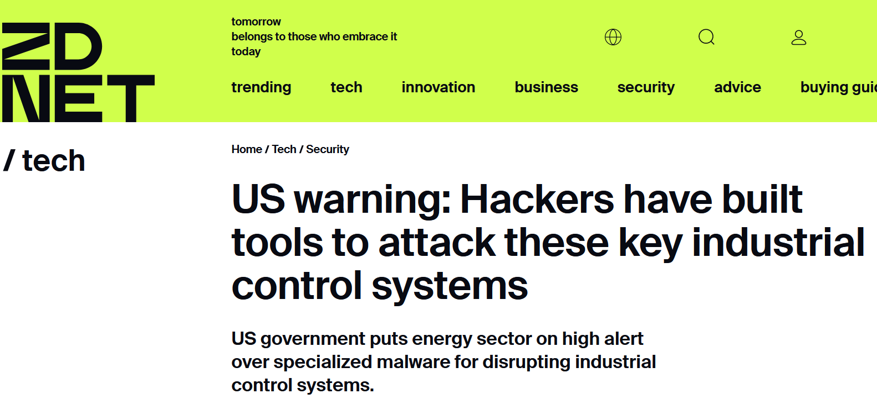
Notes:
Russia v Ukraine
Israel v Hamas

Slide 27
3rd-Party Risk
Some of the world’s worst hacks due to 3rd-parties
New SEC cybersecurity incident disclosure requirements call 3rd-party cyber risk a material business risk
SEC final rule says 98% of organizations use at least one 3rd-party vendor breached in the last two years
SEC final rule mentions “third-party” 39 times

Slide 28
3rd-Party Risk
Synopsys “Open Source Security and Risk Analysis” (OSSRA) audited 1,703 codebases in 2022, 96% contained FOSS
Of 1,481 of audited codebases that included security and operational risk assessments:
84% contained at least one vulnerability
48% contained at least one high-risk vulnerability
Of the 1,703 total audited codebases:
89% contained FOSS that was more than four years out-of-date
54% of audited codebases contained codebases with license conflicts
Notes:
https://www.synopsys.com/blogs/software-security/open-source-trends-ossra-report/
There are justifiable reasons for not keeping software up-to-date, but it’s likely that a large percentage of the 91% is due to DevSecOps teams not being aware that a newer version of an open source component is available.

Slide 29
What Can Be Done?
Education
Best Practices
Incentives
Regulation
Notes:
Training and awareness
https://www.cisa.gov/sites/default/files/2023-10/Shifting-the-Balance-of-Cybersecurity-Risk-Principles-and-Approaches-for-Secure-by-Design-Software.pdf

Slide 30
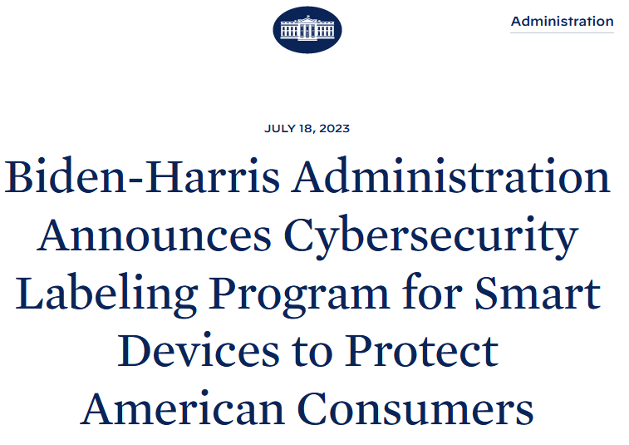
Notes:
Warnings from WH, FBI, DHS

Slide 31
Secure By Design/By Default
“Safety must be front and center in all phases of the technology product lifecycle - with security designed in from the beginning and strong safety features, like seatbelts and airbags, enabled right out of the box, without added costs. Security by Design includes actions like transitioning to memory-safe languages, having a transparent vulnerability disclosure policy, and secure coding practices.“ - Jen Easterly, CISA
Notes:
Training and awareness
https://www.cisa.gov/securebydesign
CISA, the NSA, the FBI and other cybersecurity agencies worldwide have strongly encouraged every technology manufacturer to build their products in a way that prevents customers from having to constantly perform monitoring, routine updates, and damage control on their systems to mitigate cyber intrusions
US Cyber Trust Mark

Slide 32
Secure By Design/By Default
Secure by Design:
Products where the security of the customers is a core business requirement, not just a technical feature
Secure by Default:
Products secure to use out of the box, with little to no configuration changes and are available at no additional cost, such as multi-factor authentication (MFA), gather and log evidence of potential intrusions, and control access to sensitive information
Notes:
Training and awareness
https://www.cisa.gov/sites/default/files/2023-10/Shifting-the-Balance-of-Cybersecurity-Risk-Principles-and-Approaches-for-Secure-by-Design-Software.pdf

Slide 33
Bill of Materials (BOM)
A comprehensive list of components, materials, parts, and sub-assemblies required to manufacture a product. It serves as a crucial document in various industries, including manufacturing, engineering, construction, and product development
Provides a detailed breakdown of the items needed to create a particular product, along with relevant information such as quantities, part numbers, descriptions, and sometimes even costs
Notes:
ChatGPT

Slide 34
Software Bill of Materials (SBOM)
Formal record containing the details and supply chain relationships of various components used in building software
Enumerates components in a product
Allows the developer to
Ensure components are up to date
Respond quickly to new vulnerabilities
Notes:
EO 14028

Slide 35
Notes:
Microsoft Digital Defense Report 2023
https://www.microsoft.com/en-us/security/security-insider/microsoft-digital-defense-report-2023#modal2

Slide 36
Hardening
Notes:
The CIS Benchmarks are prescriptive configuration recommendations for more than 25+ vendor product families.
https://www.cisecurity.org/cis-benchmarks
MS 365 Security Checklist: https://www.intrust-it.com/?s=365+check+list

Slide 37
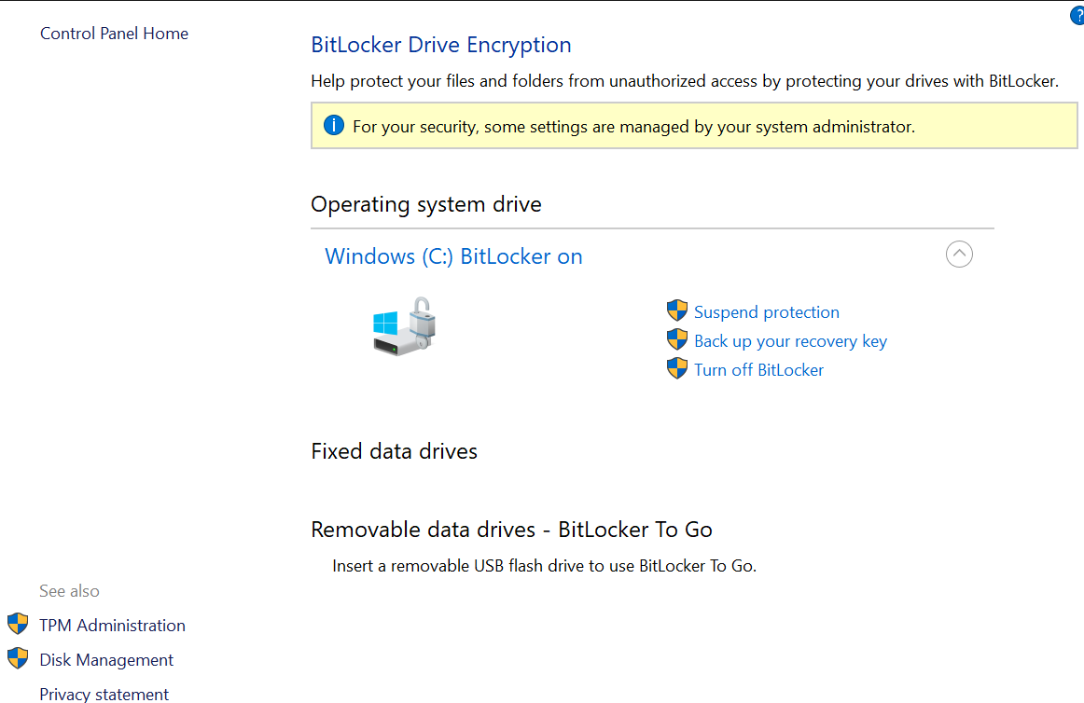
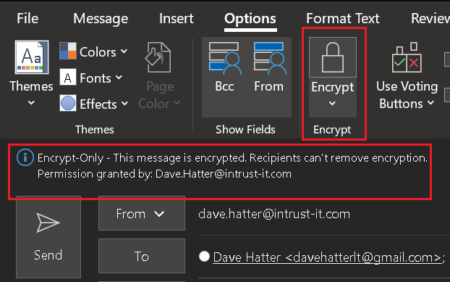
Encryption
Scrambles data so that it can only be unscrambled with the appropriate key
Encrypt data at rest and in transit
Notes:
E2E

Slide 38
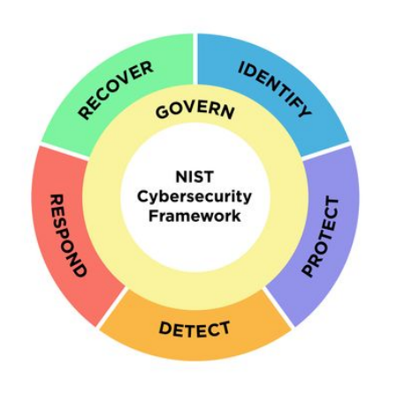
Frameworks
Notes:
Ohio Enacts Cybersecurity Safe Harbor Law
https://www.alstonprivacy.com/ohio-enacts-cybersecurity-safe-harbor-law/

Slide 39
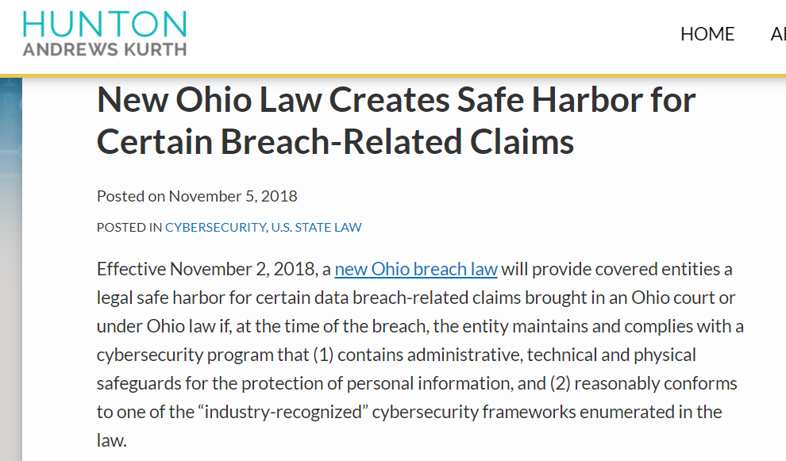
Safe Harbor
Notes:
https://www.huntonprivacyblog.com/2018/11/05/new-ohio-law-creates-safe-harbor-certain-breach-related-claims/

Slide 40
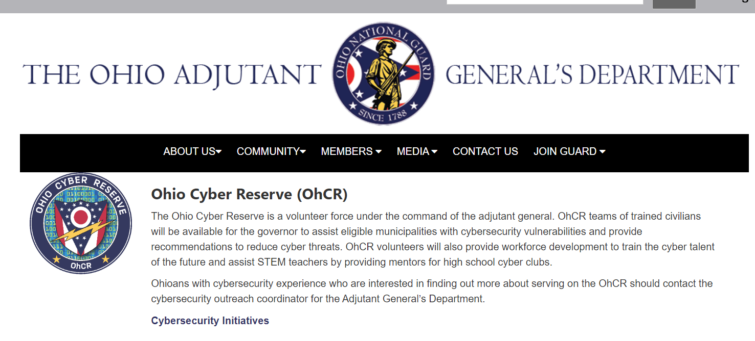
Cyber Reserve
Notes:
https://www.ong.ohio.gov/special-units/cyber/ohcr/index.html

Slide 41
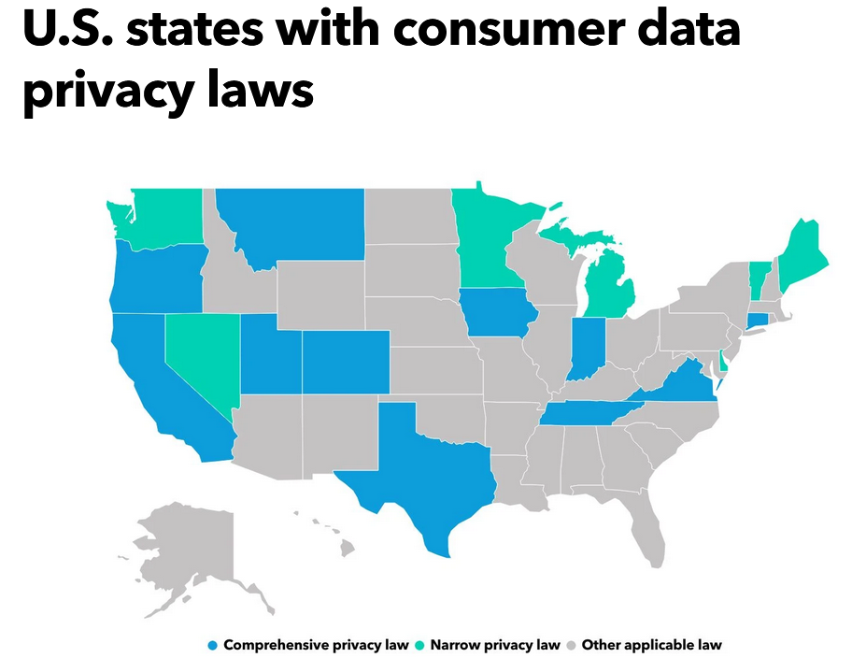
Senate Bill 15
Kentucky Consumer Data Protection Act
Notes:
https://apps.legislature.ky.gov/record/23RS/sb15.html

Slide 42
Notes:
Mikko

Slide 43
Notes:
Skepticism and Security

Slide 44
For more information:
Bruce Schneier:@schneierblog
US-CERT: @USCERT_gov
SecurityWeek: @SecurityWeek
Center for Internet Security: @CISecurity
MSRC: @msftsecresponse
NIST Cyber: @NISTcyber
Intrust IT: @IntrustIT
CISA: @CISAgov
MSRC: @msftsecresponse
Microsoft Secure: @msftsecurity
RSA: @RSAsecurity
Mikko Hypponen: @mikko
Troy Hunt: @troyhunt
CSOnline: @CSOonline
Me: @DaveHatter

Slide 45
Additional Resources
www.microsoft.com/security
security.microsoft.com/securescore
securityscorecard.com
www.twofactorauth.org
www.safer-networking.org
www.webopedia.com
www.opendns.com
www.hackerwatch.org
www.haveibeenpwned.com
www.twofactorauth.org
www.knowbe4.com
www.antiphishing.org
www.idtheftcenter.org/facts.shtml
www.cisa.gov
www.ic3.gov/default.aspx
www.ftc.gov/bcp/conline/pubs/alerts/phishingalrt.htm
enterprise.verizon.com/resources/reports/dbir/
www.sans.org
www.us-cert.gov/ncas/current-activity/2019/11/06/cisa-launches-cyber-essentials-small-businesses-and-small-sltt
www.nist.gov/cyberframework
www.cisecurity.org
www.ftc.gov/tips-advice/business-center/small-businesses/cybersecurity
www.pcmag.com/roundup/256703/the-best-antivirus-protection
www.knowbe4.com/ransomware-simulator
www.zdnet.com
www.cnet.com
www.techradar.com

Slide 46
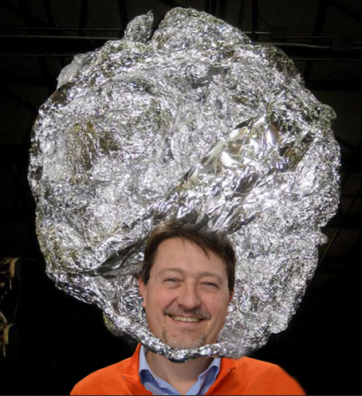
Q & A
“Cybersecurity is national security”
- NSA Director General Paul Nakasone
Notes:
“If you spend more on coffee than on IT security, you will be hacked. What's more, you deserve to be hacked” - Richard Clarke, Special Advisor to the President on cybersecurity and cyberterrorism, Bush Administration

Slide 47
Thank You!
Dave Hatter, CISSP, CISA, CISM, CCSP, CSSLP, Security +, Network+, PMP, ITIL
Intrust IT
linkedin.com/in/davehatter
twitter.com/davehatter
Get our checklist: https://www.intrust-it.com/cyber-security/cyber-essentials-checklist/
Ask for a no-cost, no-obligation consultation.
Catch Tech Friday live on 55KRC at 6:30 AM every Friday on 550 AM or http://55krc.iheart.com
Catch Cyber Monday live on WTVG at 6:30 AM and Tech Support at 9:00AM every Monday on 13 ABC or https://www.13abc.com/

