Slide 1
How Kentucky Businesses View the Economy, Public Policy, and Government
Charles Aull, Executive Director,
Kentucky Chamber Center for Policy & Research

Slide 2
Kentucky Chamber Partnership with the Siena College Research Institute
Partnership with Siena College Research Institute
Survey of business leaders and CEOs across Kentucky
Distributed by Kentucky Chamber and local chambers: July- August 2023
Responses from 300 Kentucky CEOs and business leaders
Small (65 percent), medium (31 percent), and large firms (4 percent)
All major industry categories
Not a scientifically-determined representative sample
Questions on the economy, business decisions, public policy, and government

Slide 3
How Kentucky Employers View the Economy
37 percent expect the economy to be better a year from now
32 percent expect it to be the same
31 percent expect it to be worse
58 percent are planning to invest in fixed assets
Only 5 percent anticipate decreasing the size of their workforce
40 percent expect to increase their workforce
55 percent expect their workforce to remain the same size

Slide 4
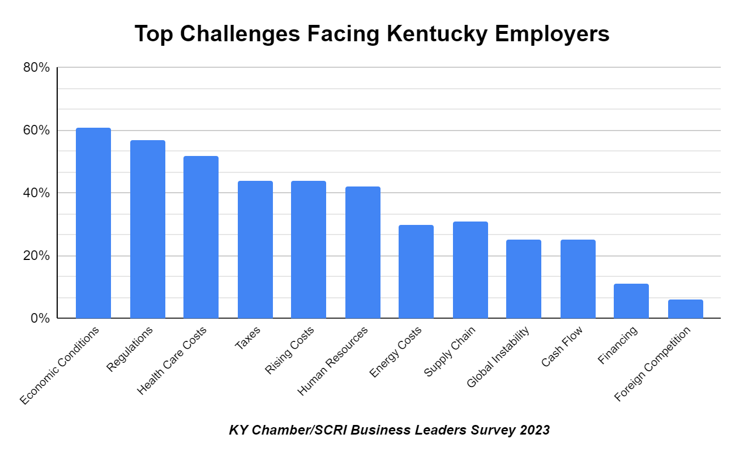

Slide 5
Workforce Challenges in Kentucky
80 percent of employers say there is NOT an ample supply of workers in their local area
Finding skilled and semi-skilled workers is the most difficult
Trouble finding skilled workers: 64 percent
Trouble finding semi-skilled workers: 62 percent
Trouble finding non-skilled workers: 36 percent
79 percent of employers have increased wages to retain workers
62 percent of employers have increased starting wages to attract workers

Slide 6
Employer Views on Doing Business in Kentucky
79 percent of Kentucky employers anticipate still being in the state 10 years from now
6 percent said No
If they could “do it all over again,” 77 percent would still start their business in Kentucky
12 percent said “somewhere else”
Top relocation states:
Florida: 20 percent
Tennessee: 20 percent
Indiana: 16 percent
California: 16 percent

Slide 7
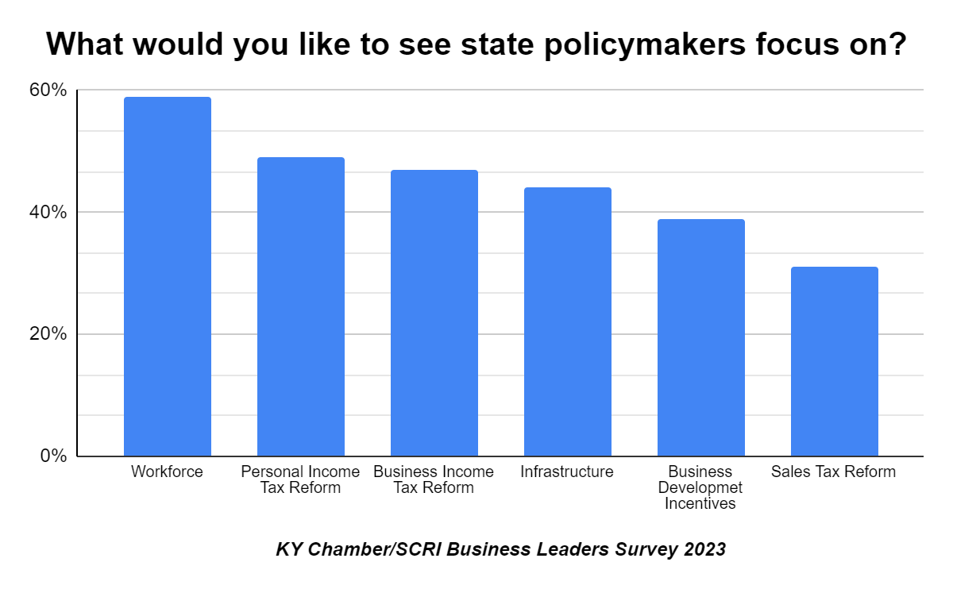

Slide 8
How Kentucky Employers View Government
51 percent say our state government is doing an “excellent” or “good” job in creating a strong business climate
49 percent say “fair” or “poor”
55 percent are “very confident” or “somewhat confident” in the ability of state government to improve Kentucky’s business climate over the next year
45 percent say “not very confident” or “not confident at all”
19 percent say the federal government is doing an “excellent” or “good” job in creating a strong business climate
25 percent are “very confident” or “somewhat confident” in the ability of the federal government to improve the business climate over the next year

Slide 9
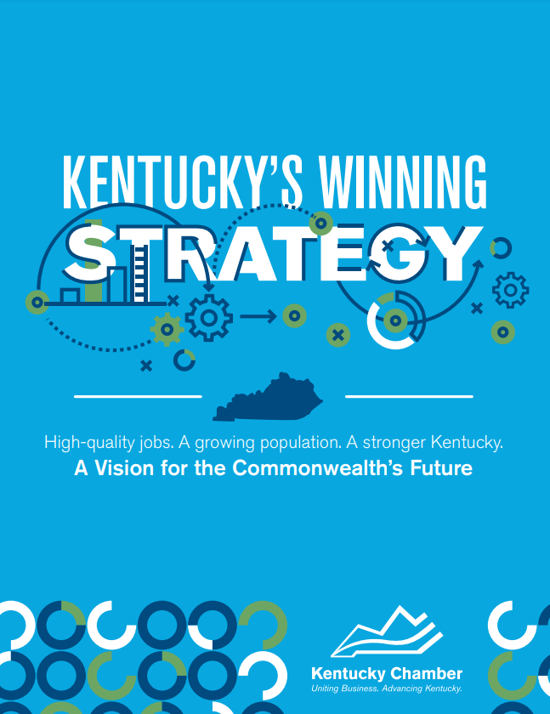
Where to Learn More
Kychamberbottomline.com
Kychamber.com

