Slide 1
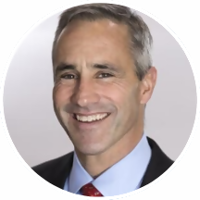
Kentucky General Assembly
Tourism, Small Business, and Information Technology Committee
Tom Sullivan | Vice President Small Business Policy

Slide 2
U.S. CHAMBER OF COMMERCE
Celebrating 110 year anniversary
World’s largest business federation
3 Million Members
1,600 local & state chambers and 500 associations
Majority of Members are small business owners

Slide 3
KENTUCKY CHAMBER LEADERSHIP AND PARTNERSHIP

Slide 4
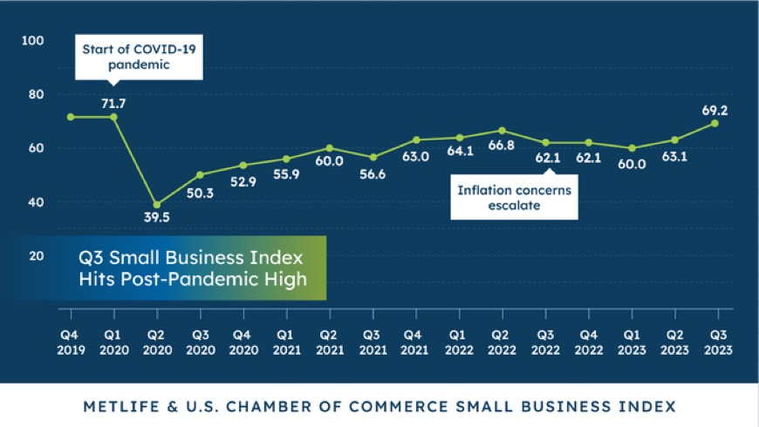
MetLife & U.S. Chamber Small Business Index for 2023 Q3
Small Business Index Score 2017 - 2023
Index is highest level since pandemic.
66% of small business owners are confident in businesses’ health.
72% of small businesses are comfortable with their cash flow.
71% of small business owners anticipate higher revenues in next 12-months.

Slide 5
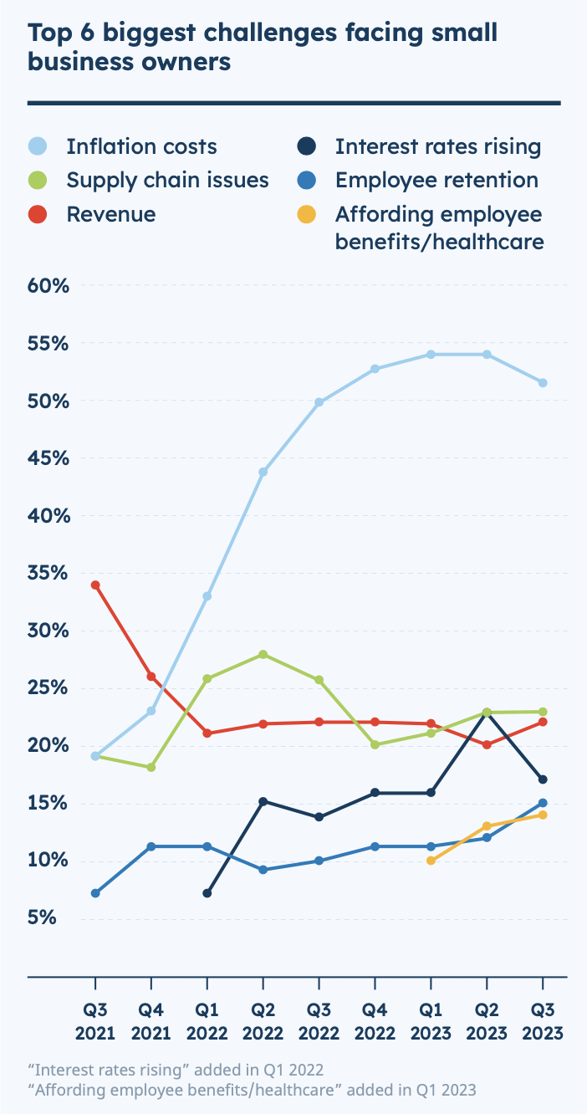
National Outlook
43% of small business owners are negative about the national economy compared to 33% who are positive.
52% of small businesses rank inflation as biggest challenge.
Wage hikes are the top inflationary concern.

Slide 6
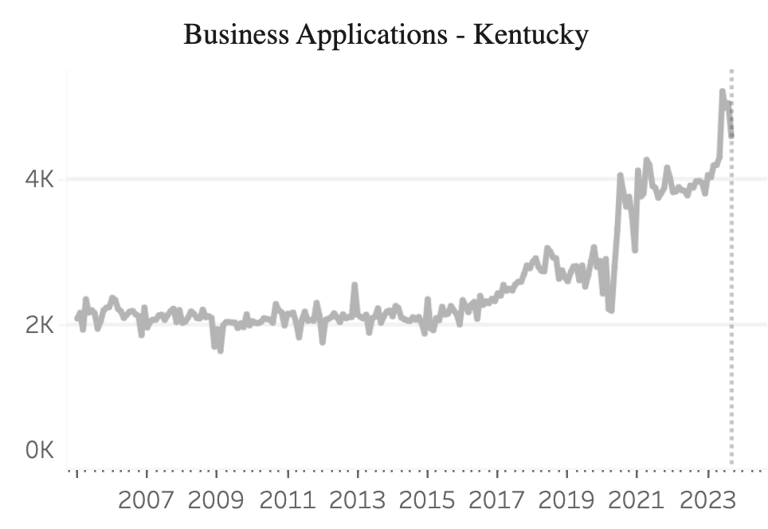
STATE OF SMALL BUSINESS

Slide 8
Small Business Bill of Rights
Right to a competitive and available workforce
Right to run a business free from government interference
Right to operate without fear of lawsuit abuse
Right to be rewarded for hard work
Right to take a risk

Slide 9
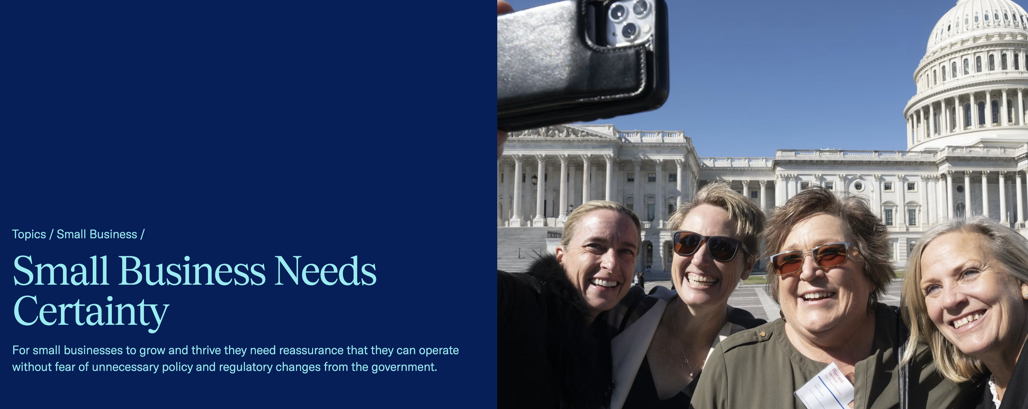

Slide 10
Digital Resources
https://www.uschamber.com

