Slide 1
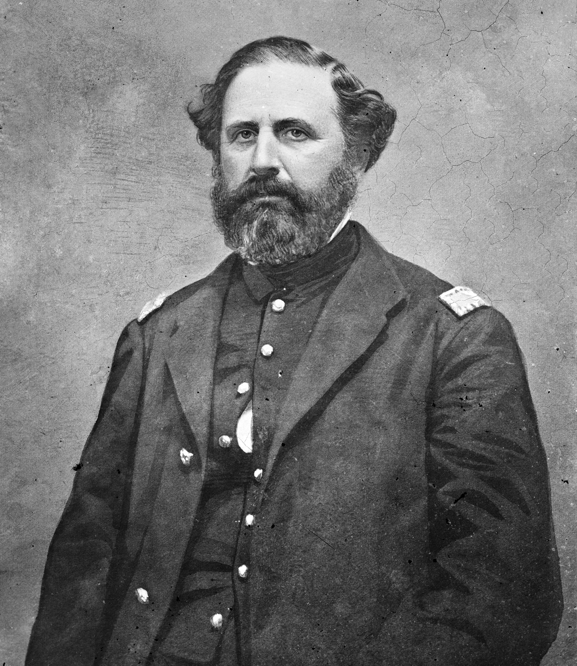
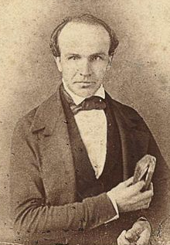
Camp Nelson National Monument
America’s
Complicated
Soul

Slide 2
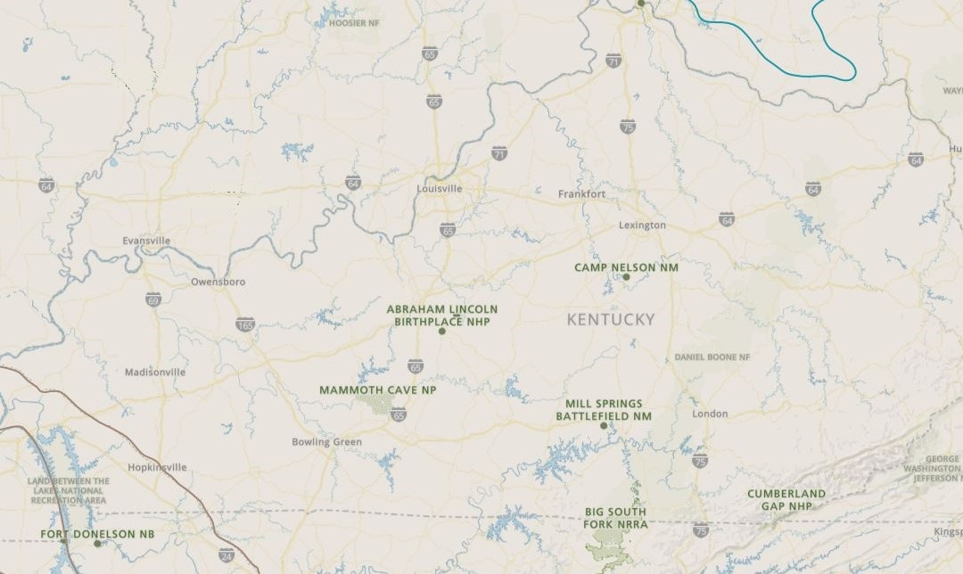
NPS
Camp Nelson History
Numbers
Now
Future
Kentucky’s Magnificent 7

Slide 3
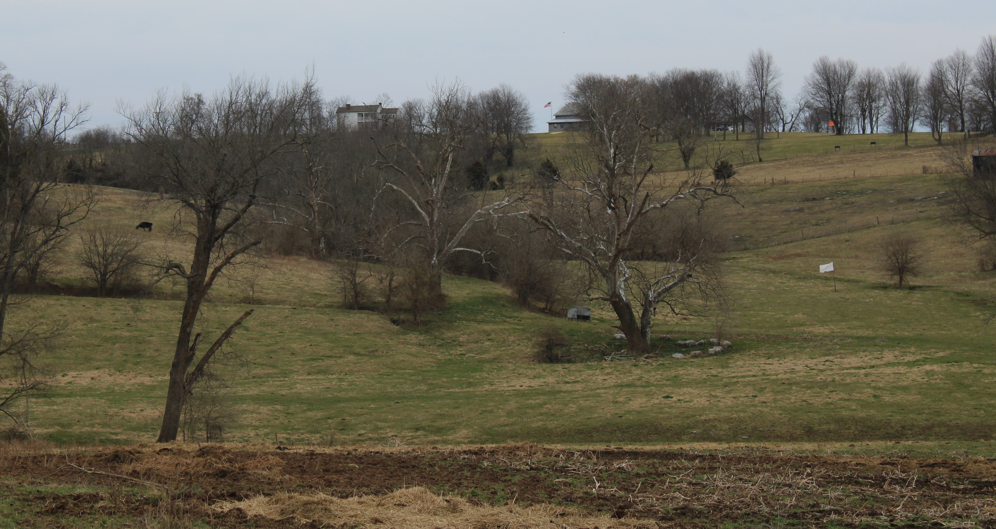
NPS
Camp Nelson History
Numbers
Now
Future
2023

Slide 4
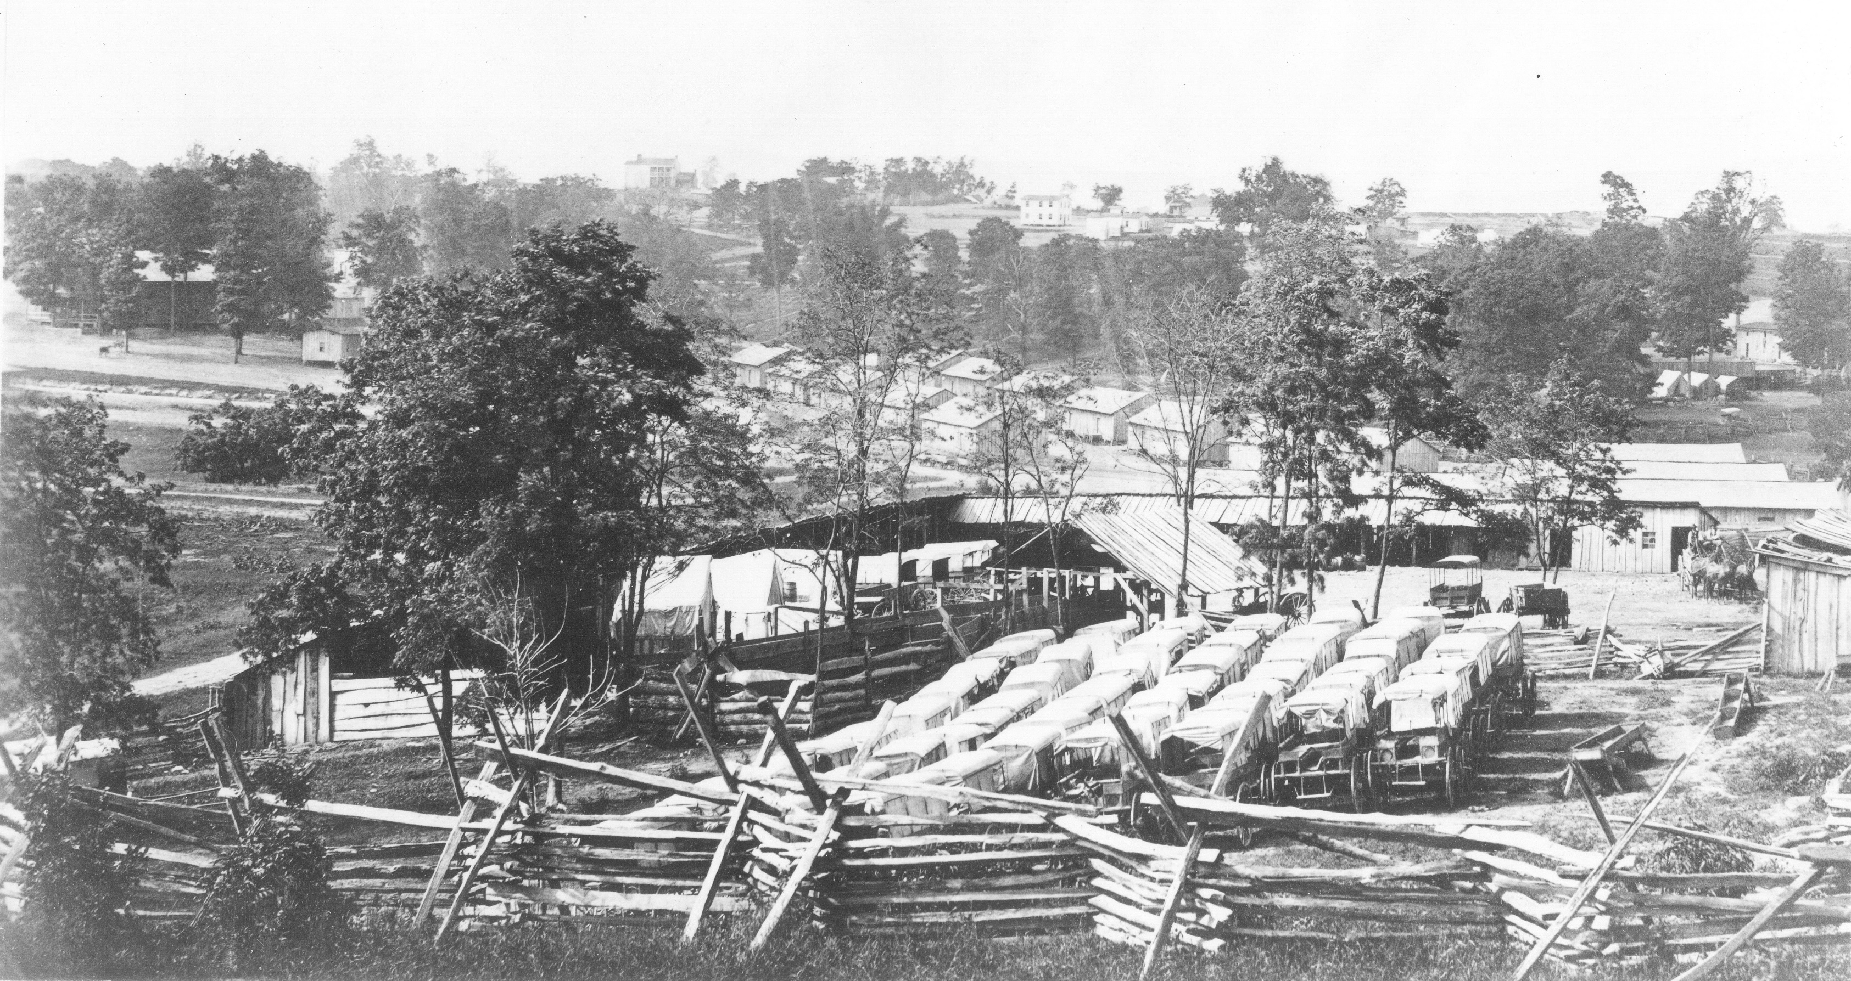
NPS
Camp Nelson History
Numbers
Now
Future
1863

Slide 5
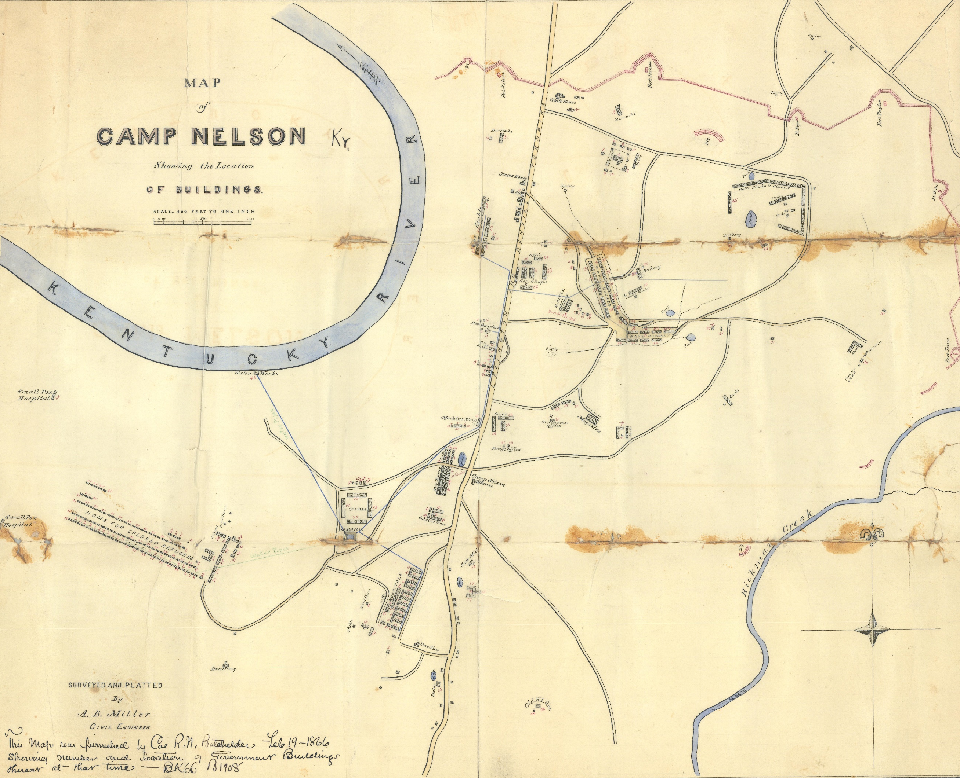
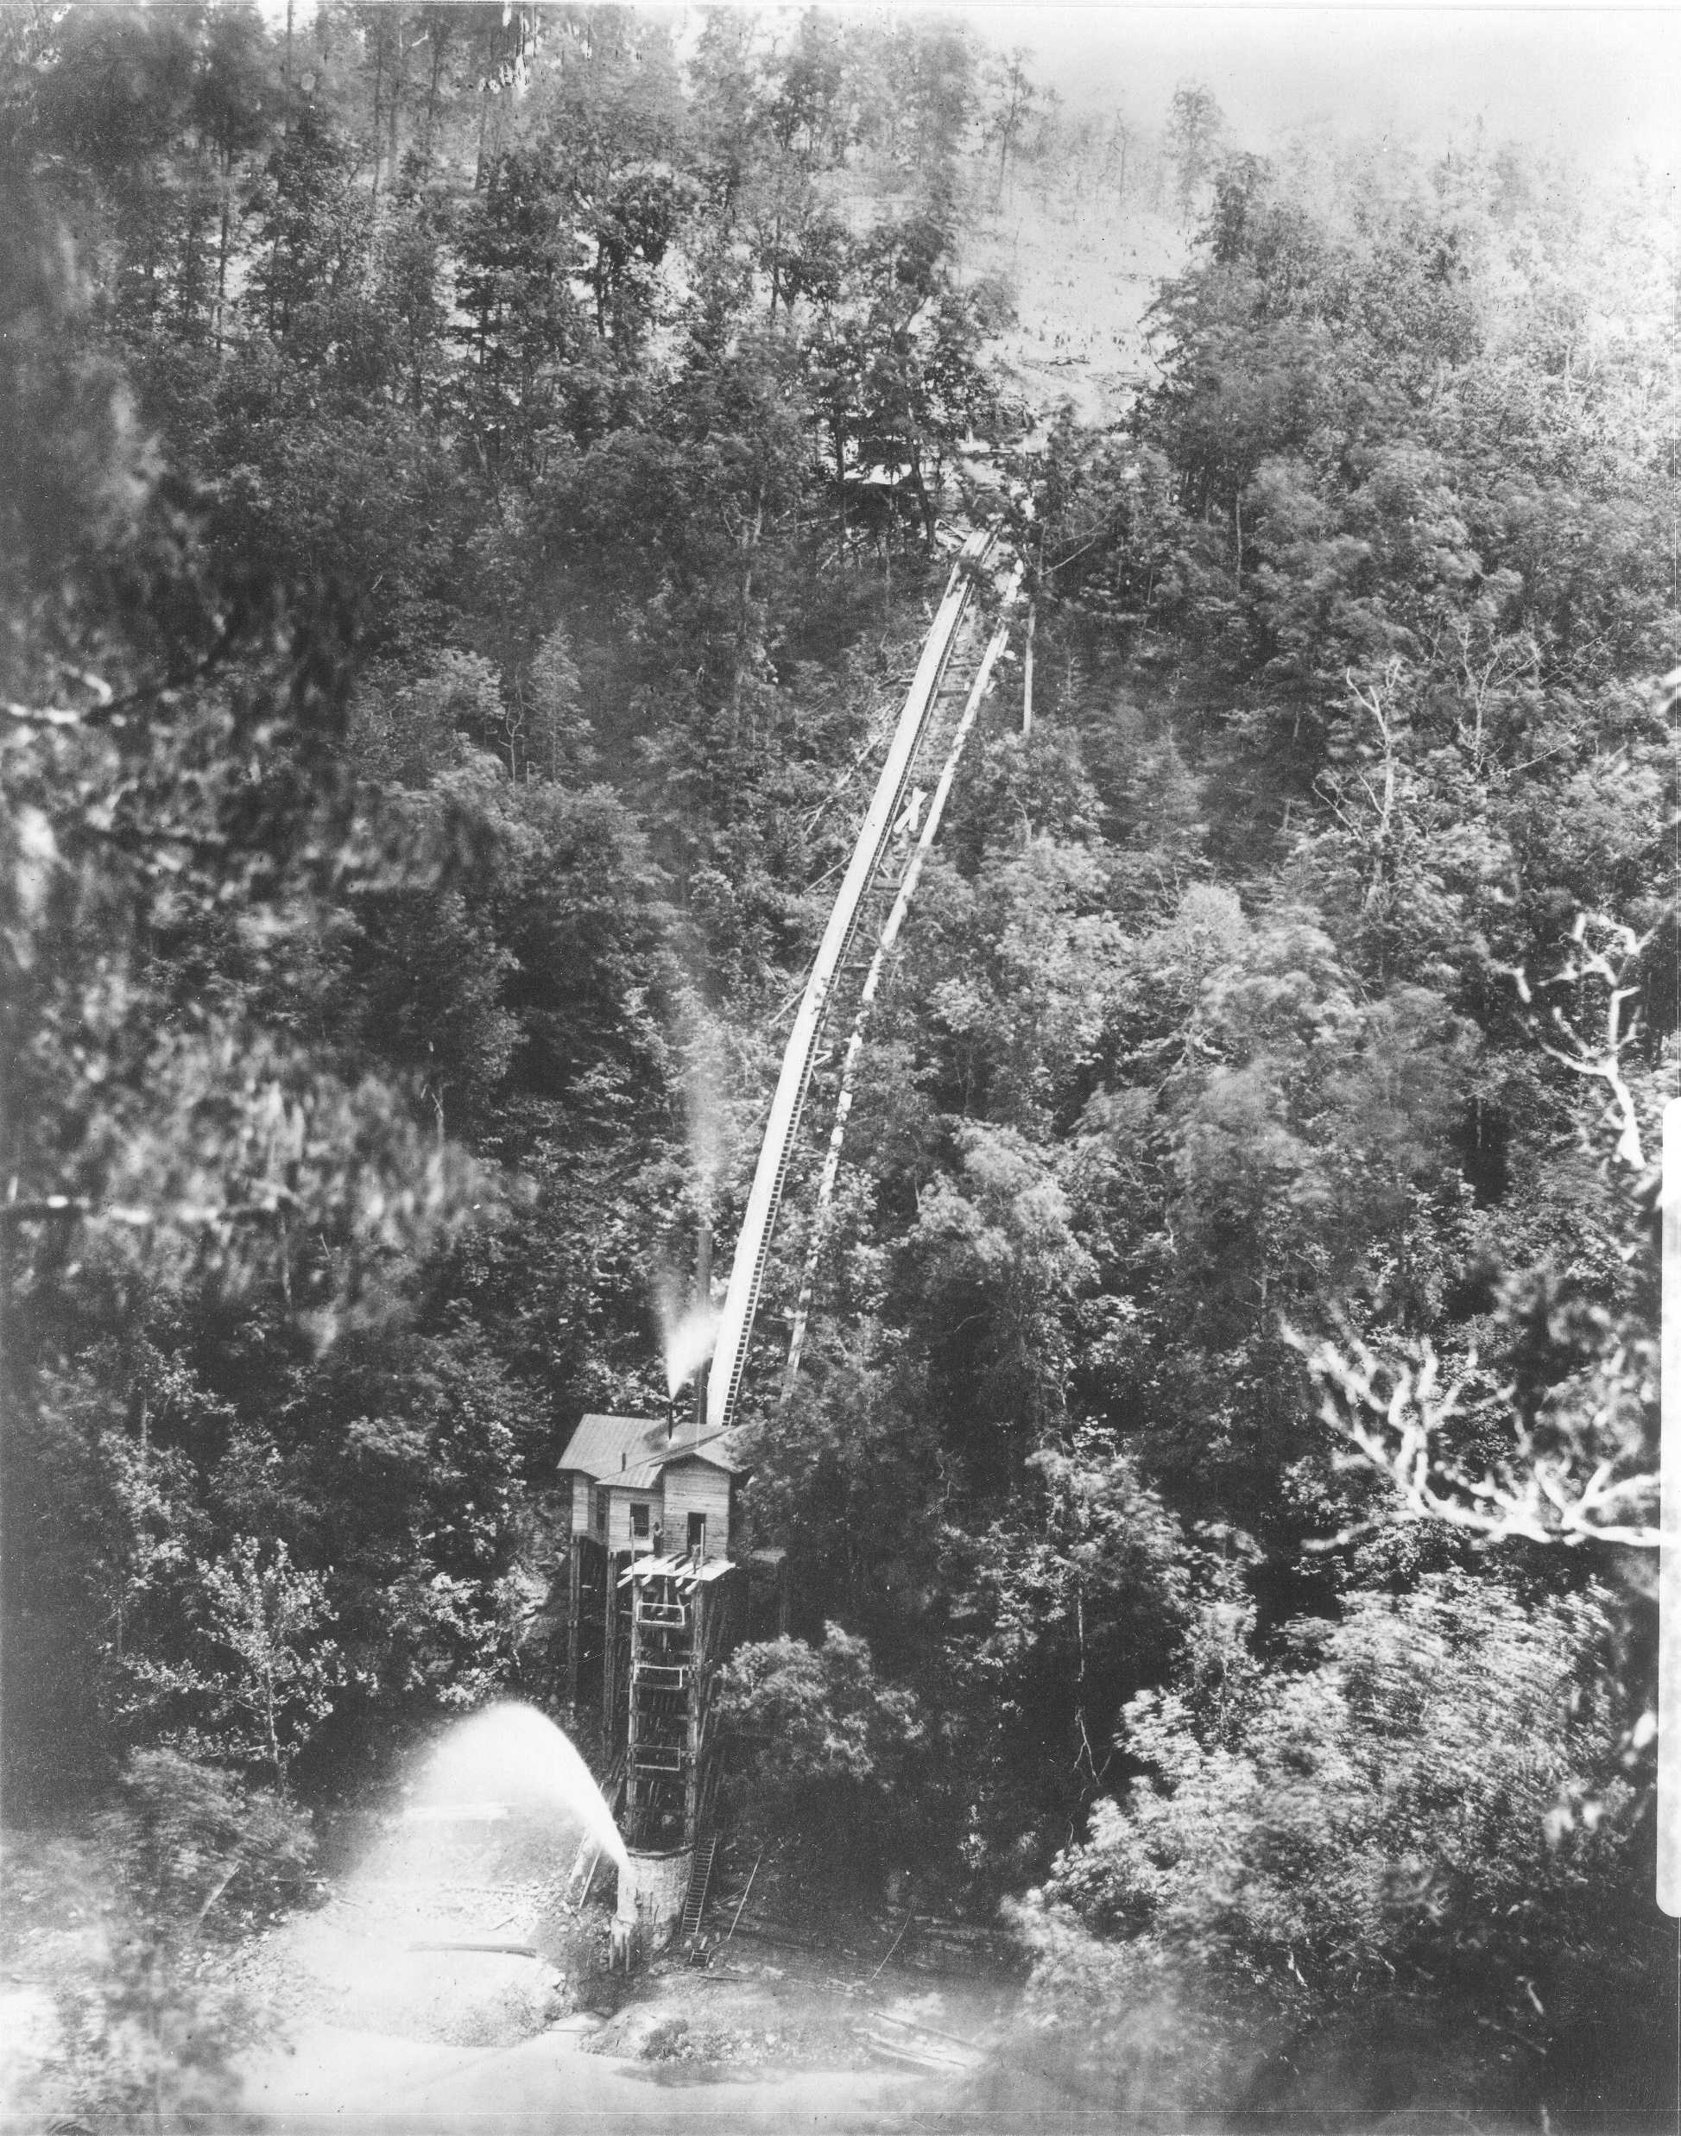
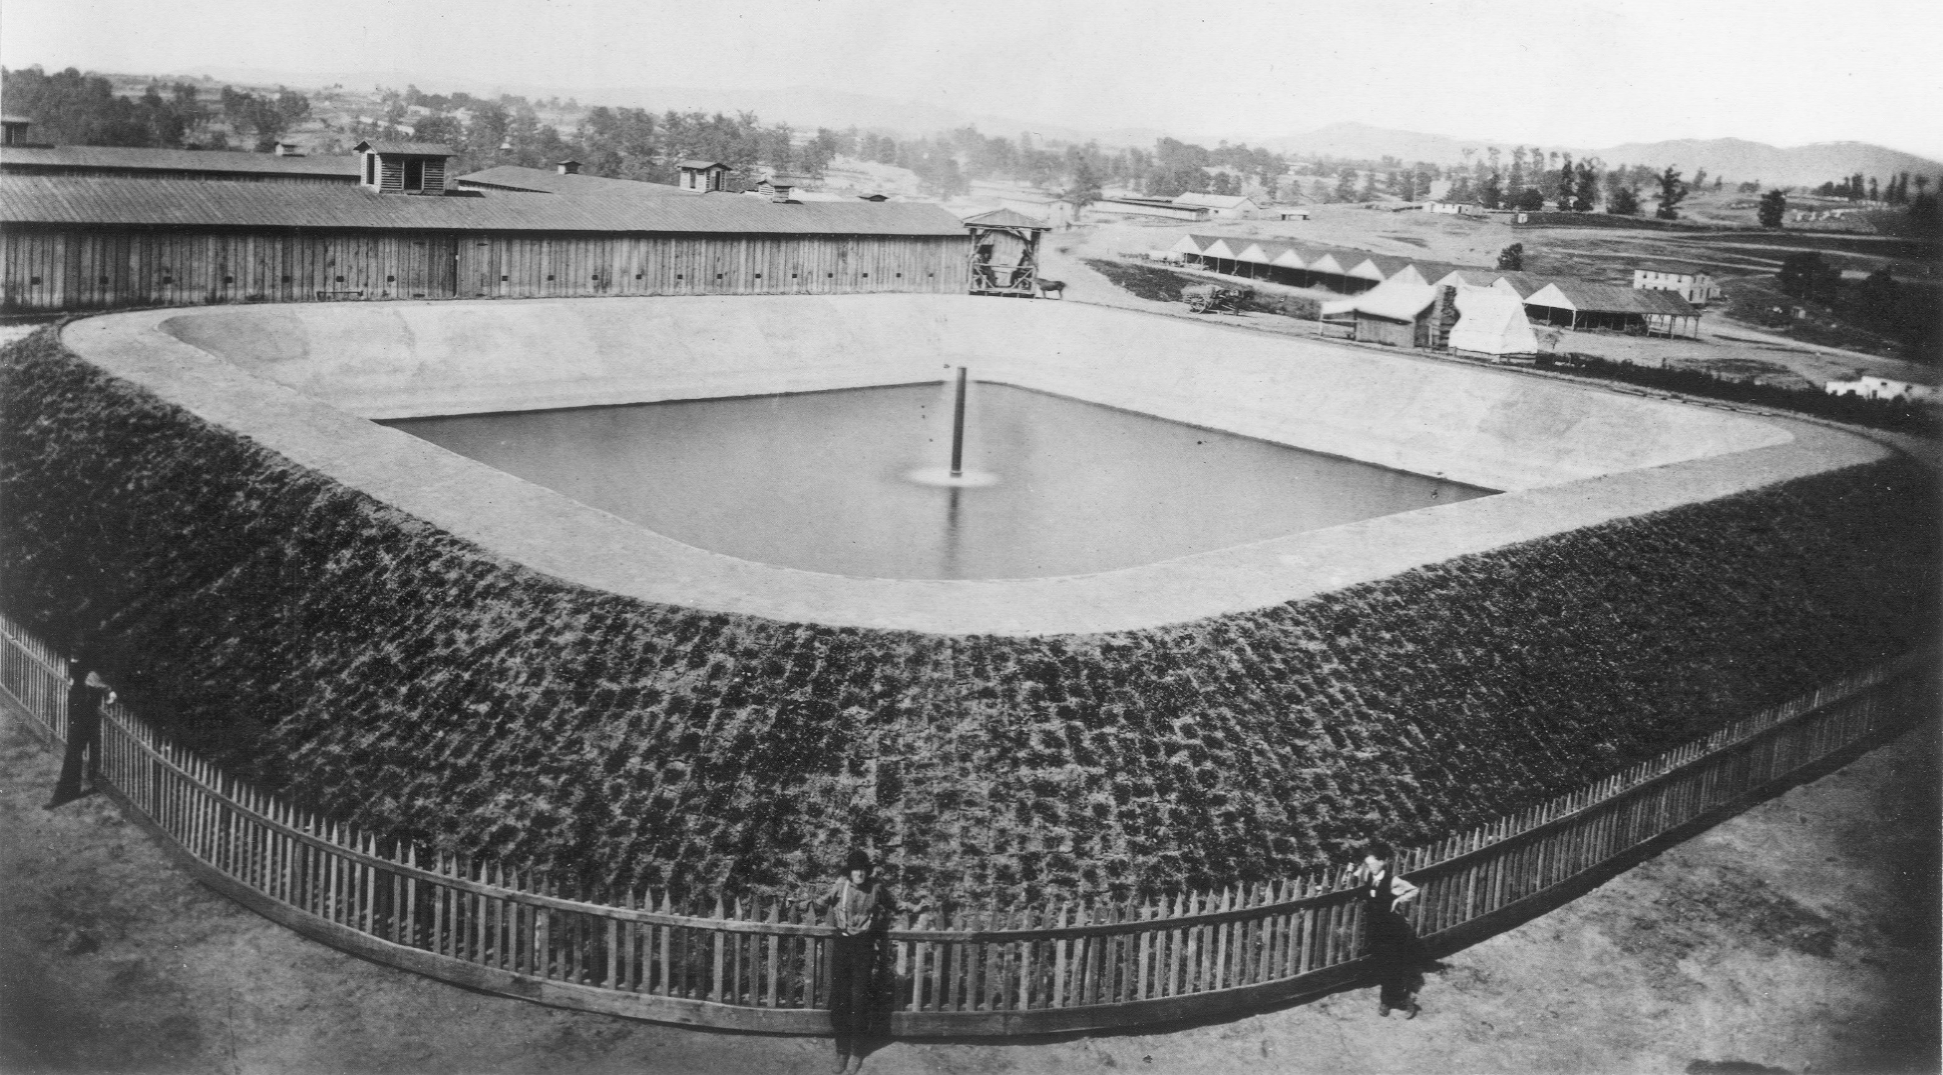
NPS
Camp Nelson History
Numbers
Now
Future
1863

Slide 6
NPS
Camp Nelson History
Numbers
Now
Future
1864

Slide 7
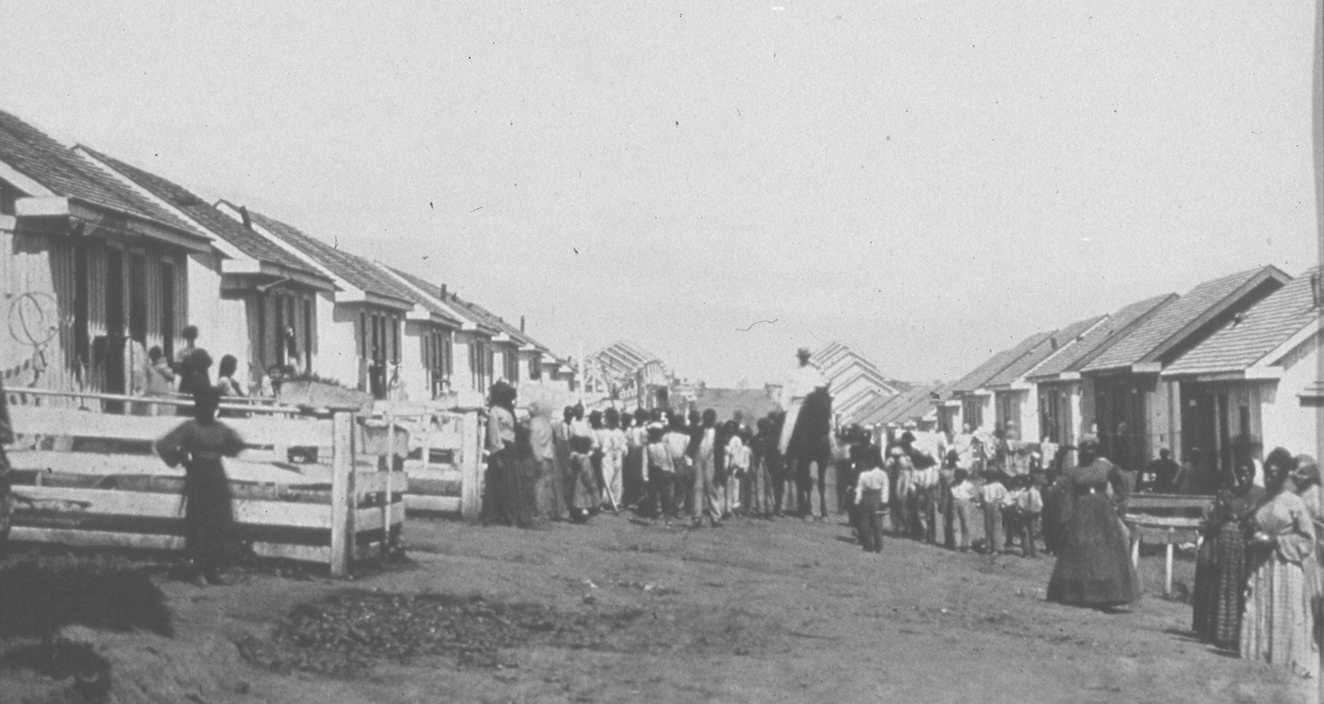
NPS
Camp Nelson History
Numbers
Now
Future
1865

Slide 8
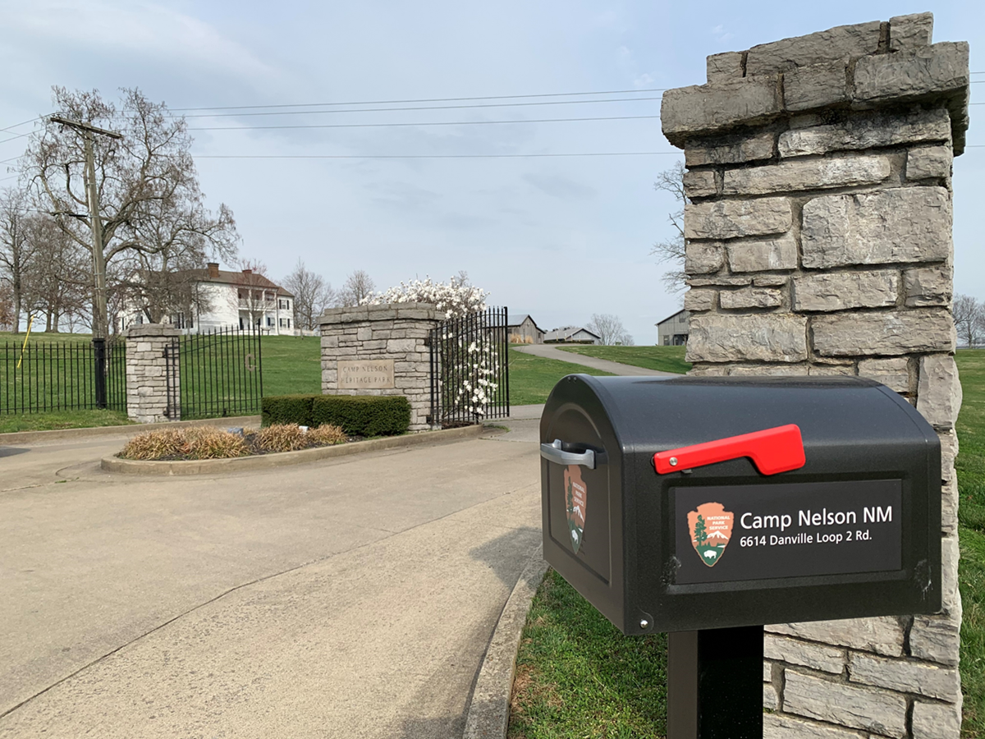
NPS
Camp Nelson History
Numbers
Now
Future
Located 18 miles south of Lexington in southern Jessamine County.
Park was originally created by Jessamine County in 1998.
Added to the NPS by Presidential Proclamation October 26, 2018
3-year co-management agreement between the NPS and Jessamine County until October 2021.
The Park is 465 acres

Slide 9
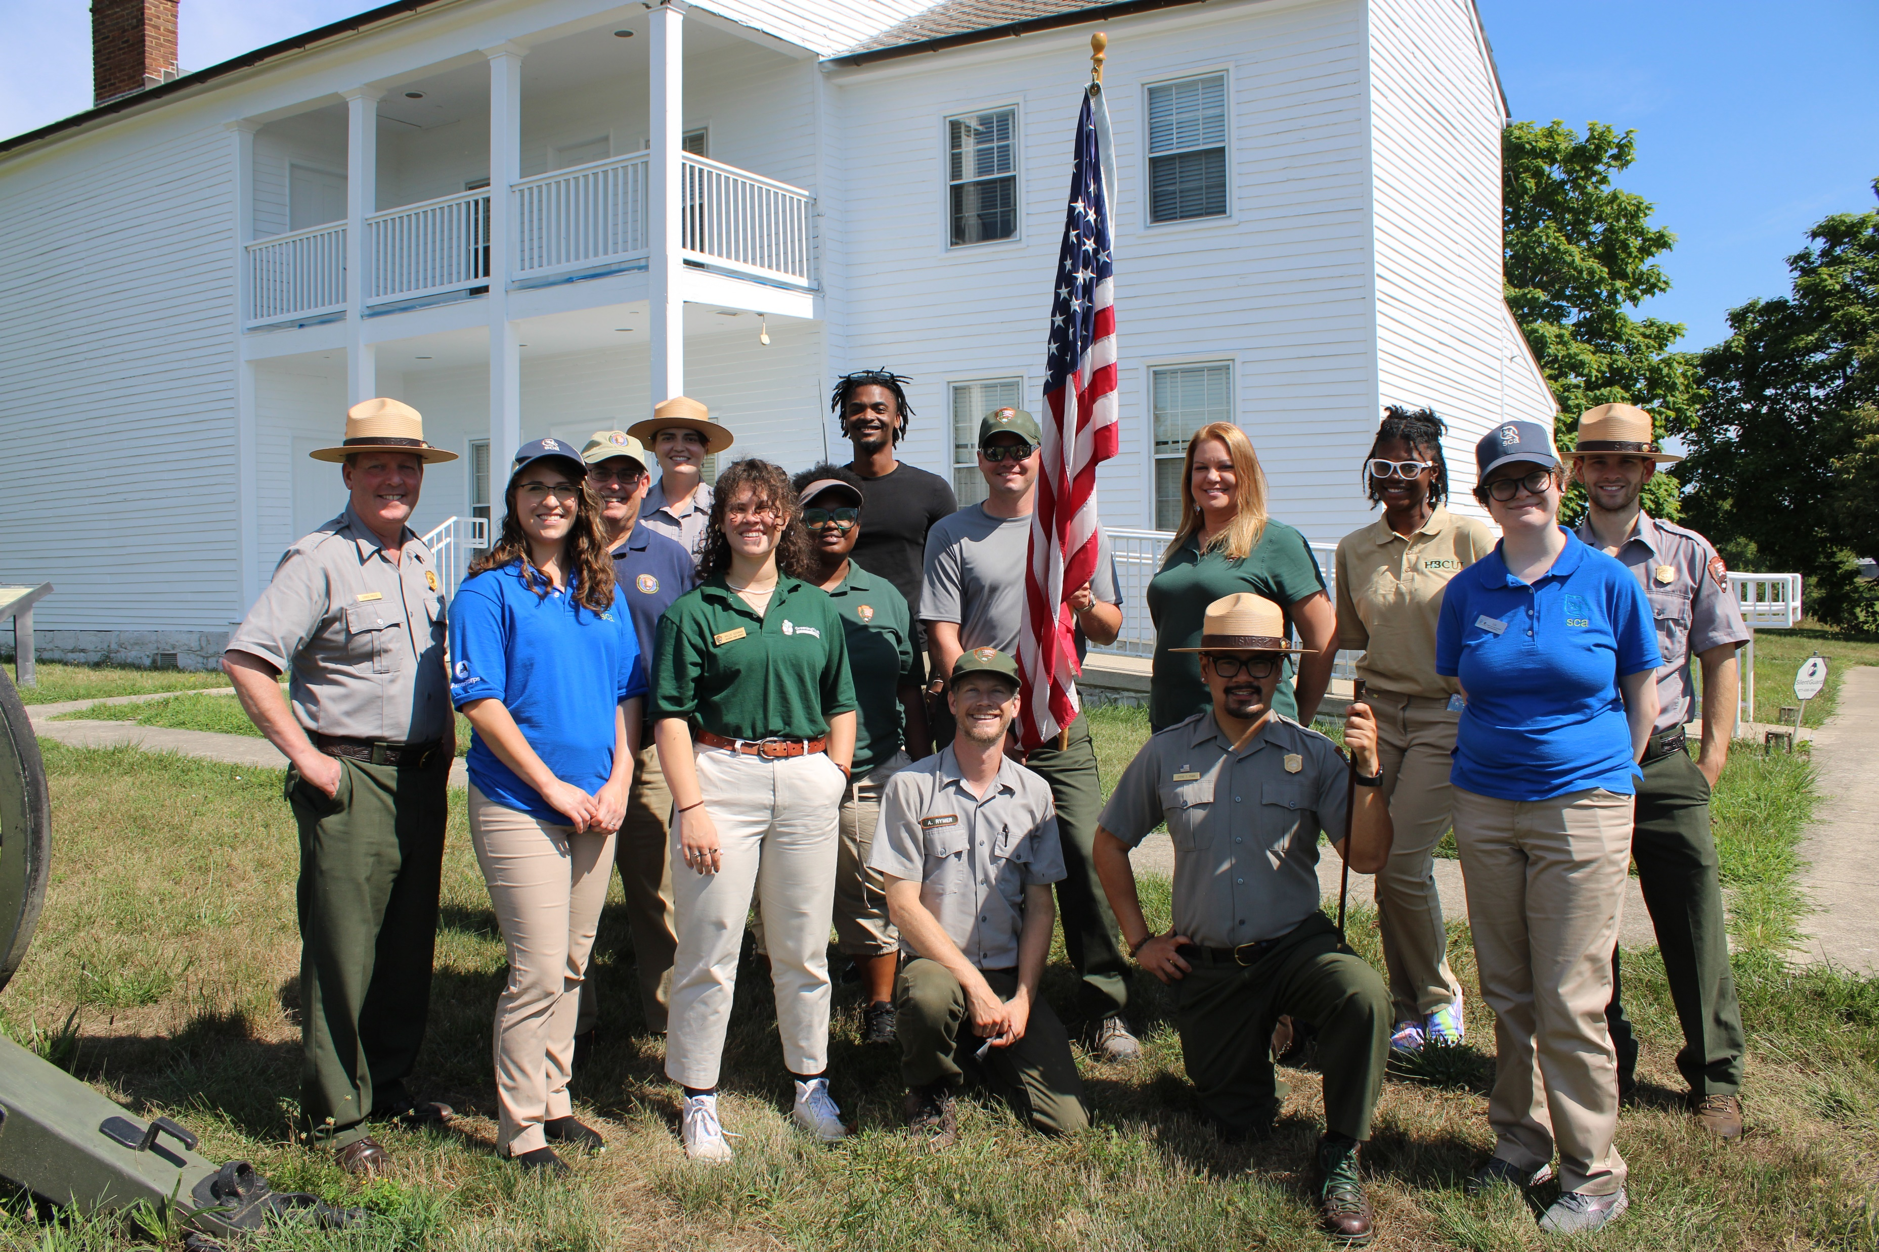
NPS
Camp Nelson History
Numbers
Now
Future
Staffing
9 Permanent Staff
7 part time or seasonal staff
3-5 paid internships
Growing volunteer program

Slide 10
NPS
Camp Nelson History
Numbers
Now
Future

Slide 11
NPS
Camp Nelson History
Numbers
Now
Future
Visitation to the park during the second full year of operation is up 67% over the first year.
(Jun. and Jul. this year are already up 15% over last year.)

Slide 12
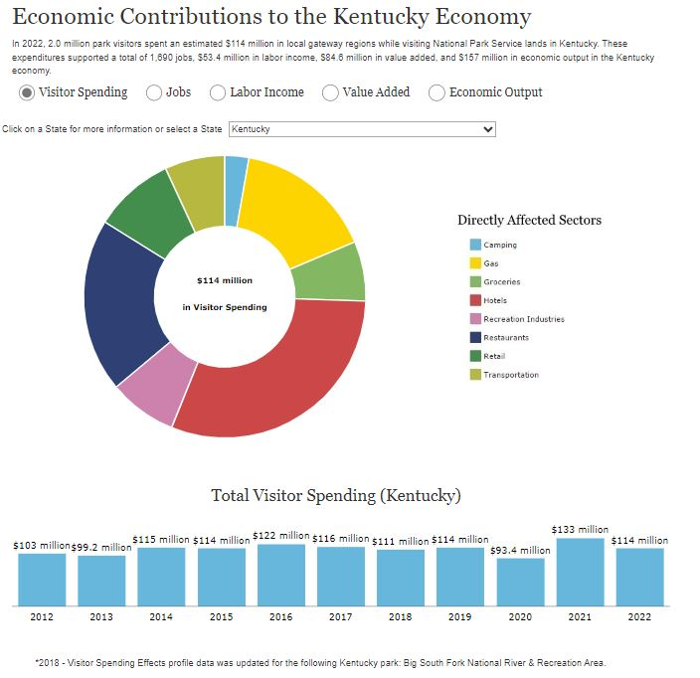
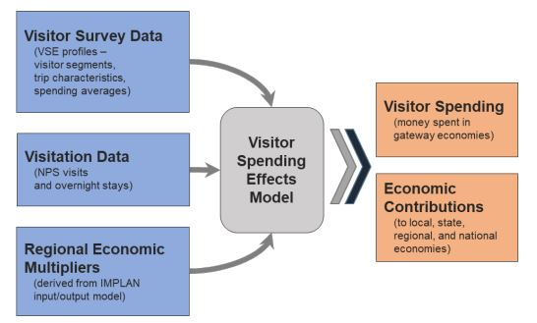
NPS
Camp Nelson History
Numbers
Now
Future
Monday, the National Park Service released the
“2022 National Park Visitor Spending Effects – Economic Contributions to Local Communities, States, and the Nation”

Slide 13
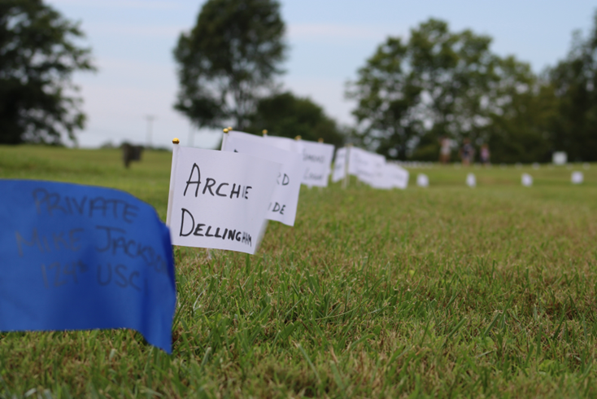
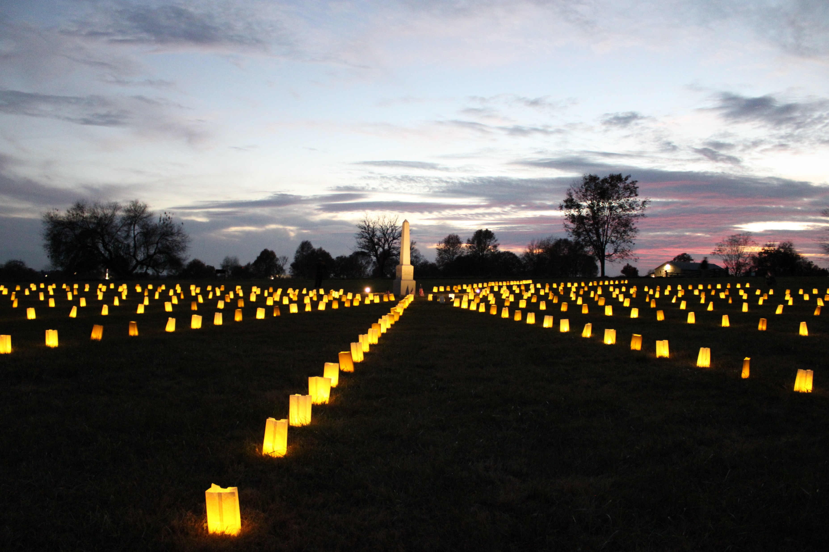
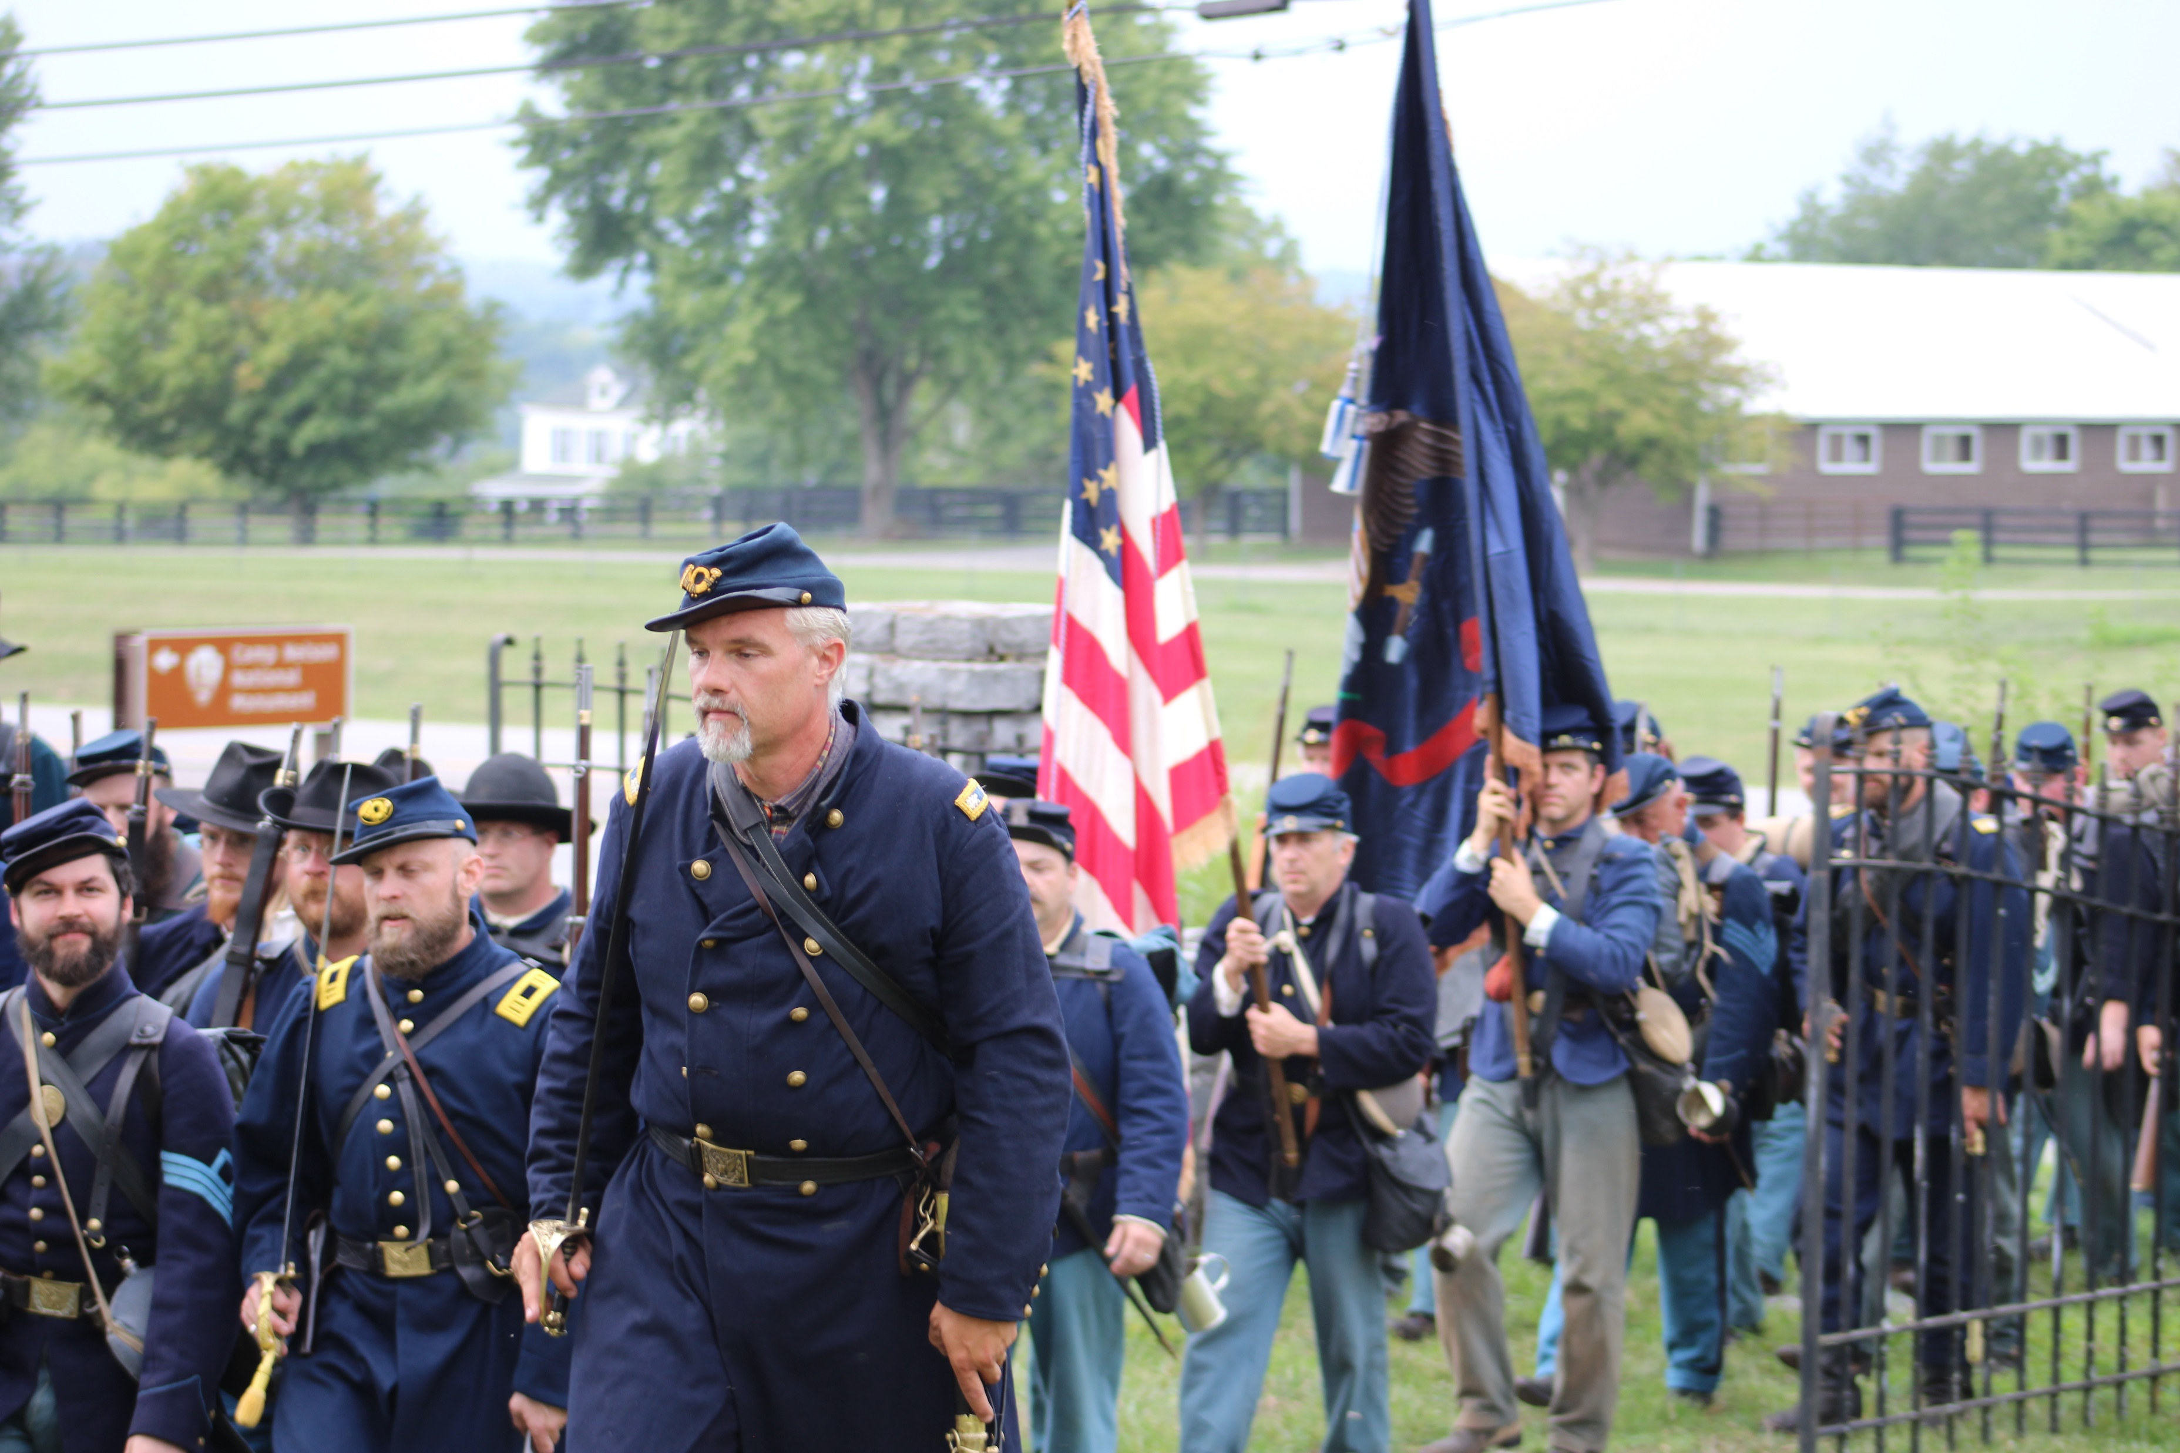
NPS
Camp Nelson History
Numbers
Now
Future
Commemoration
Programs

Slide 14
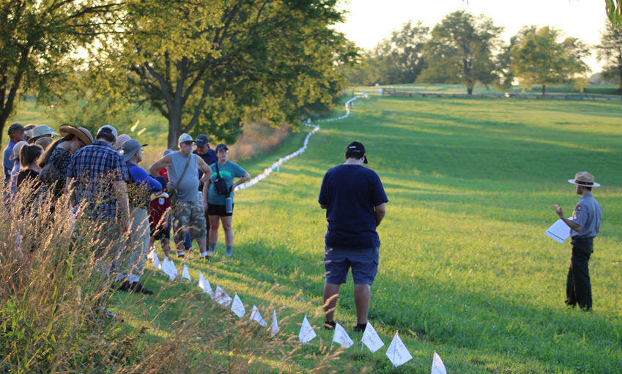
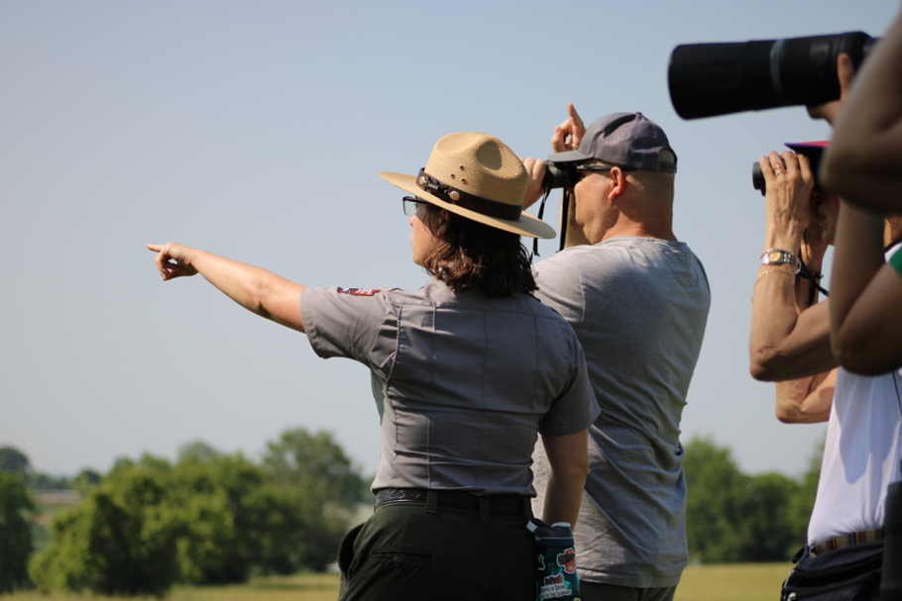
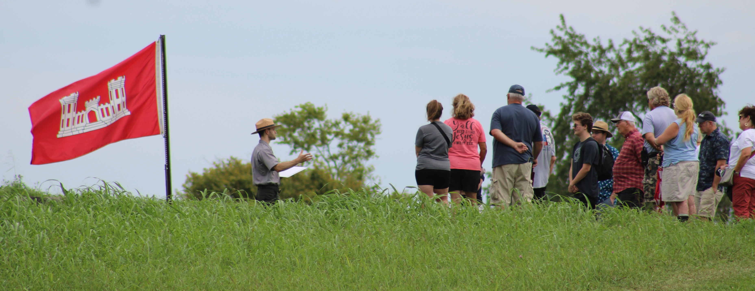
NPS
Camp Nelson History
Numbers
Now
Future
Public
Programs

Slide 15
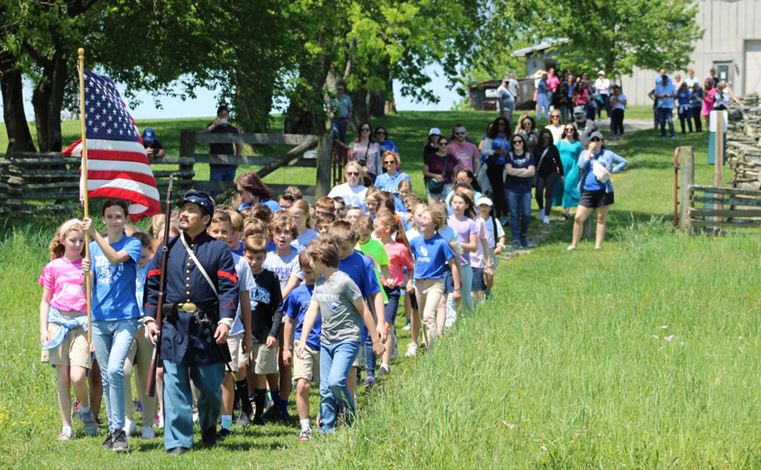
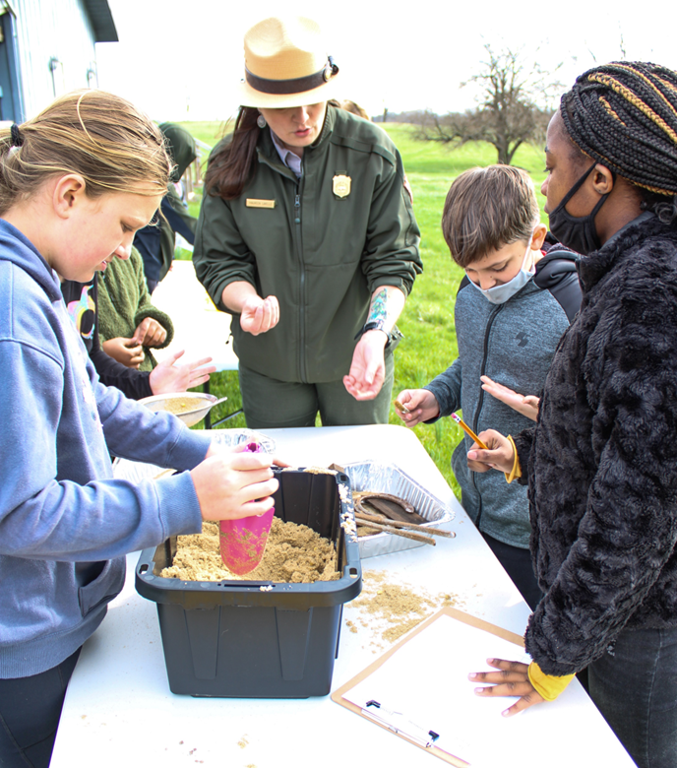
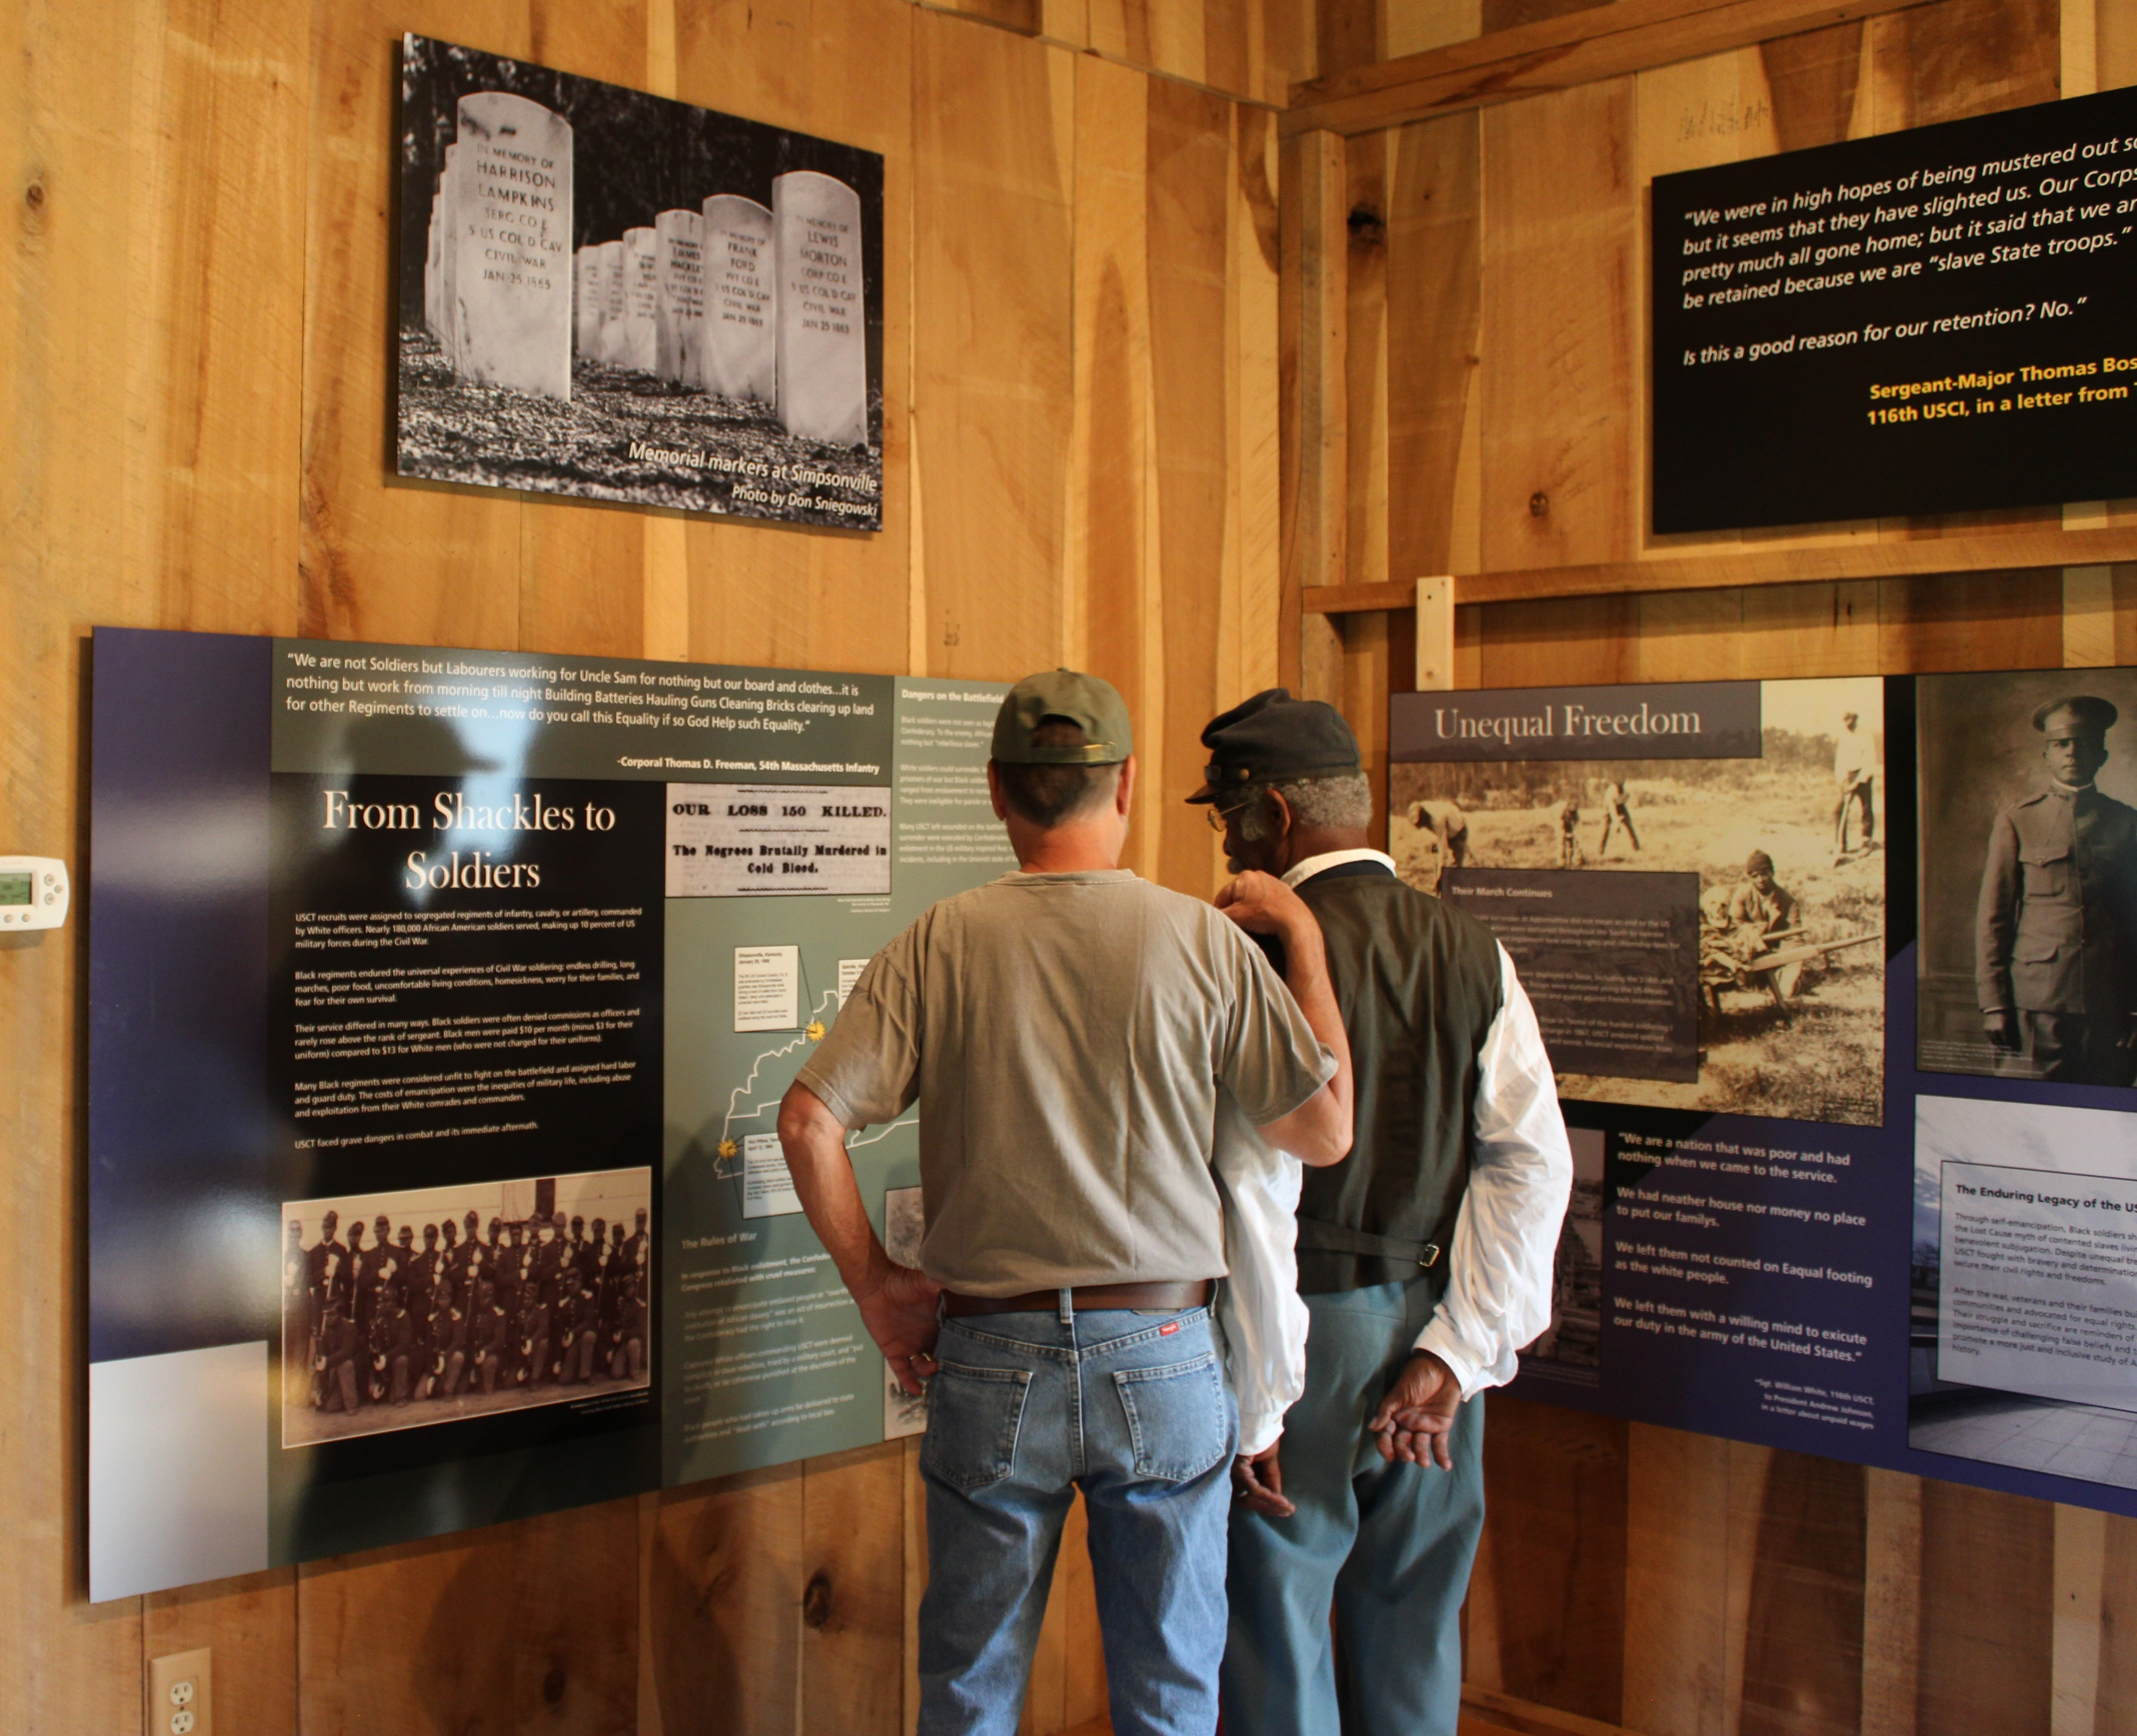
NPS
Camp Nelson History
Numbers
Now
Future
School Programs
New exhibits

Slide 16
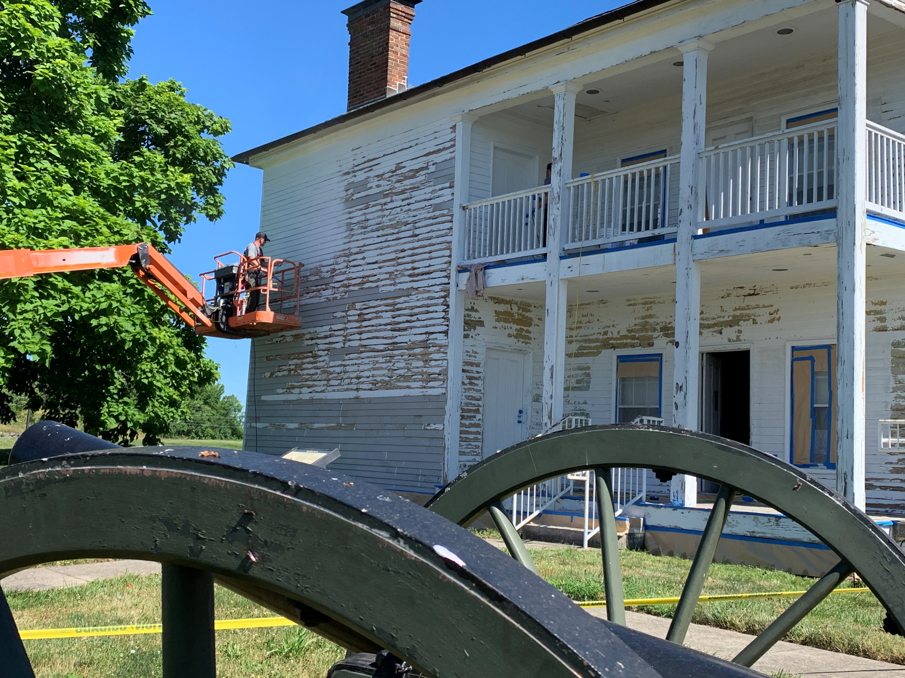
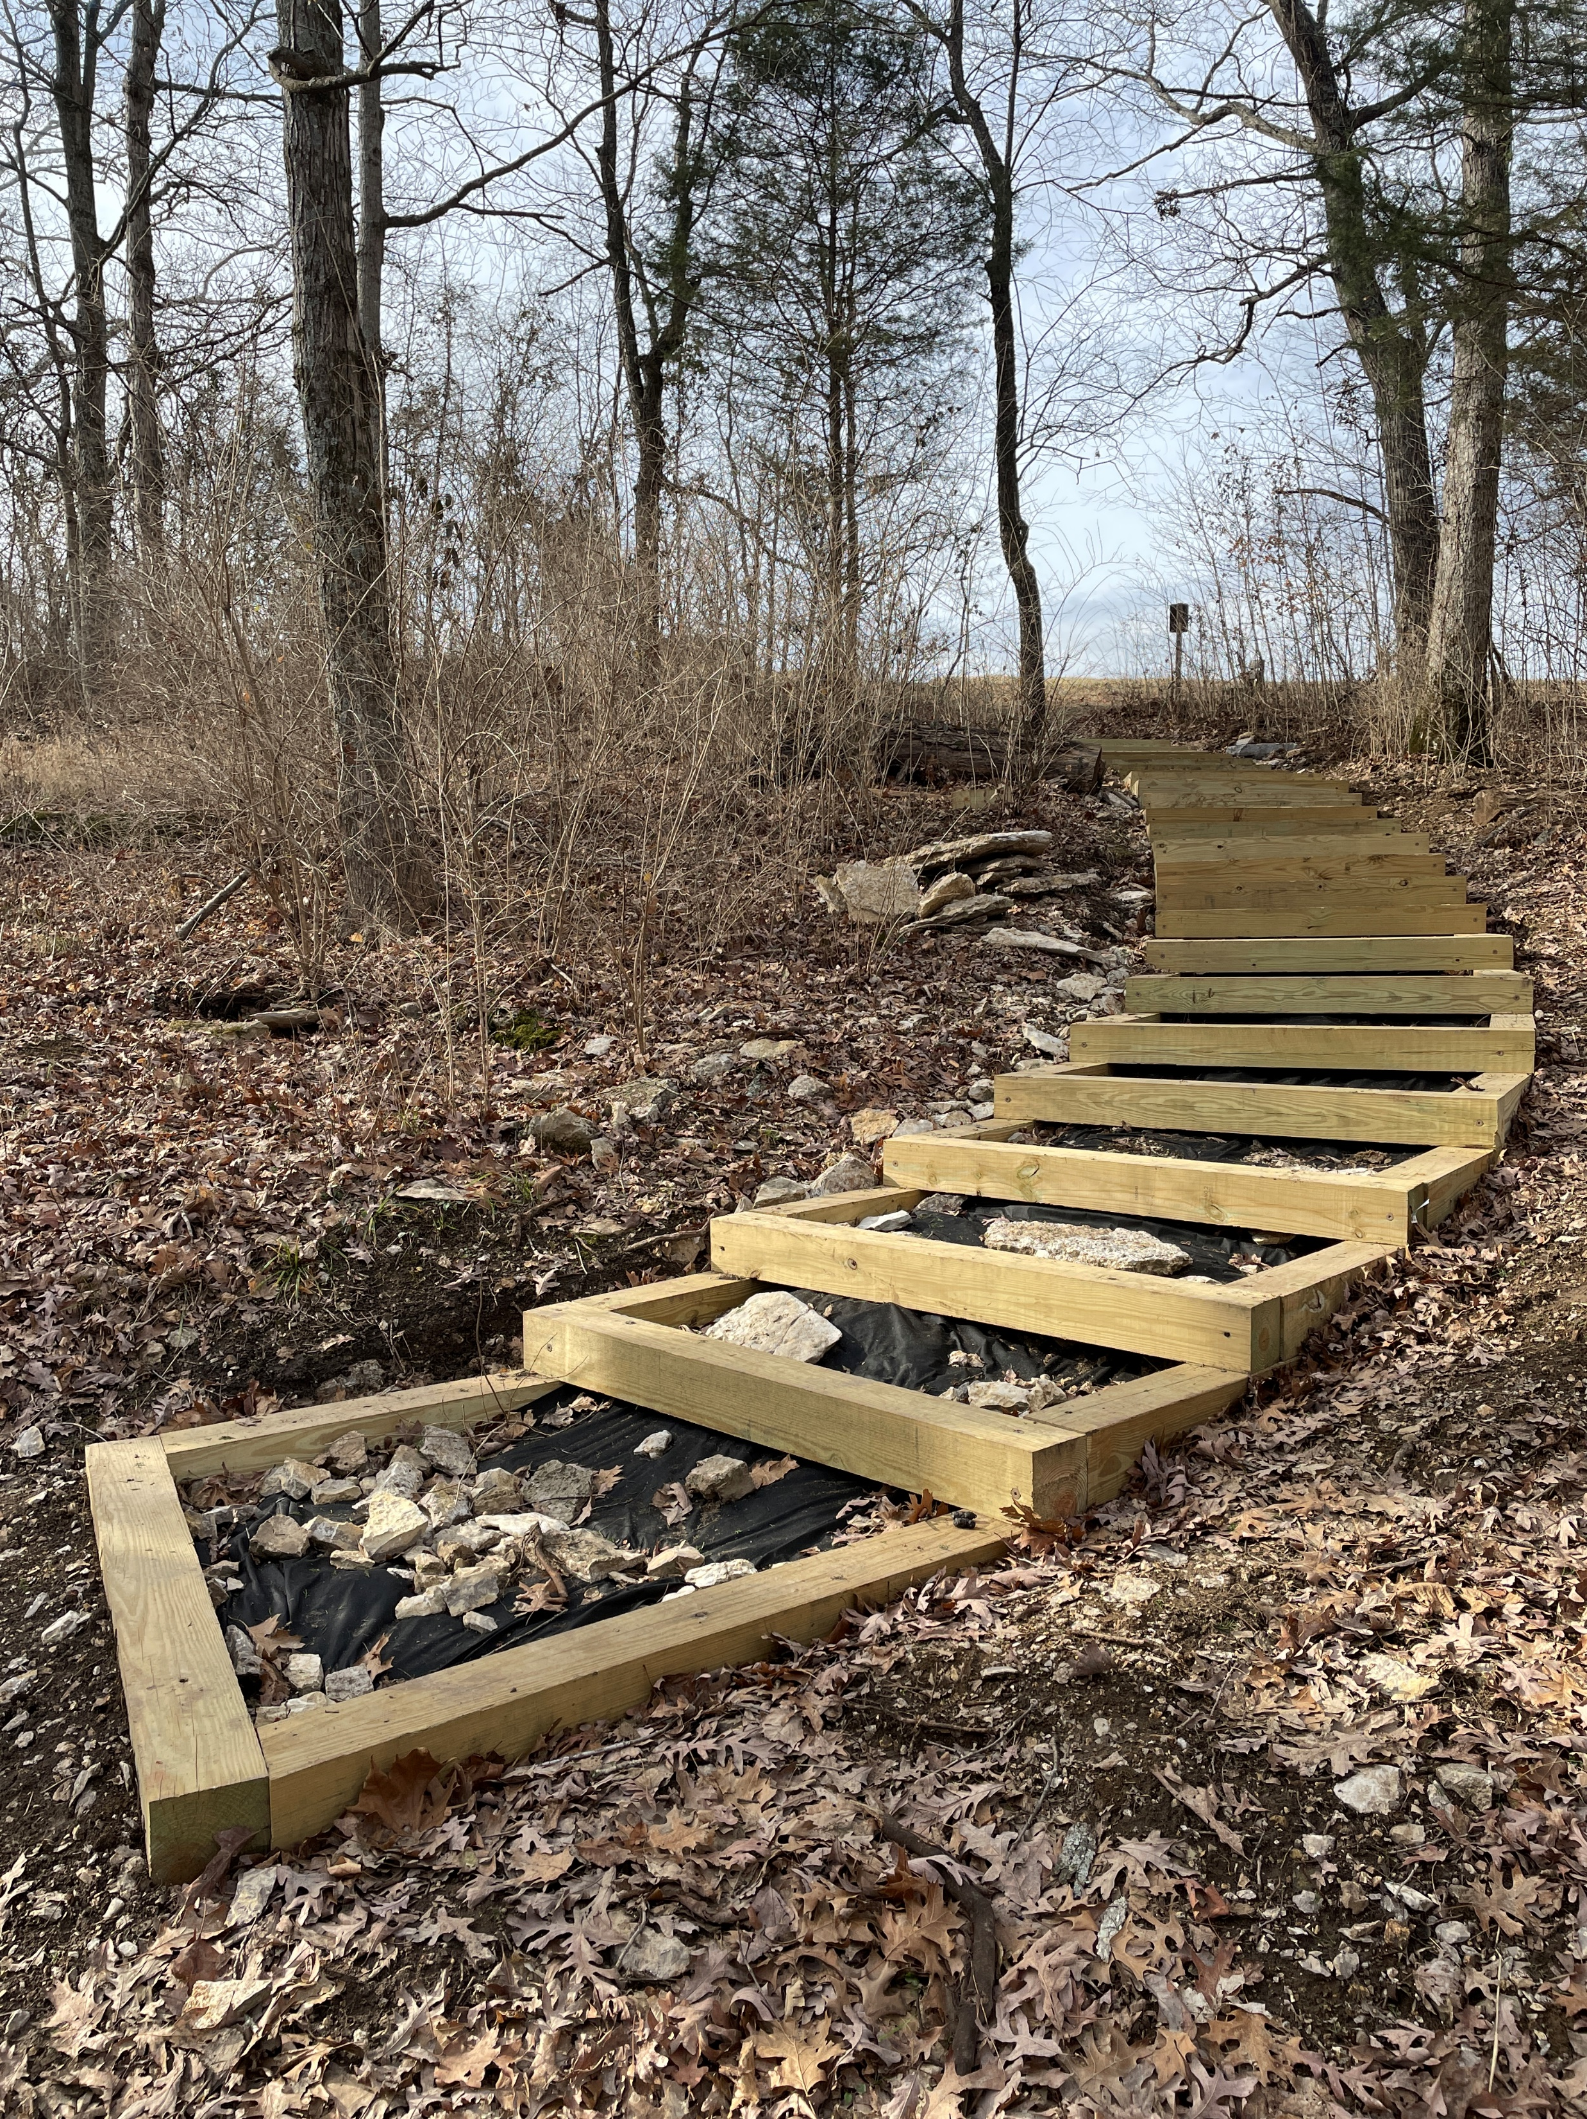
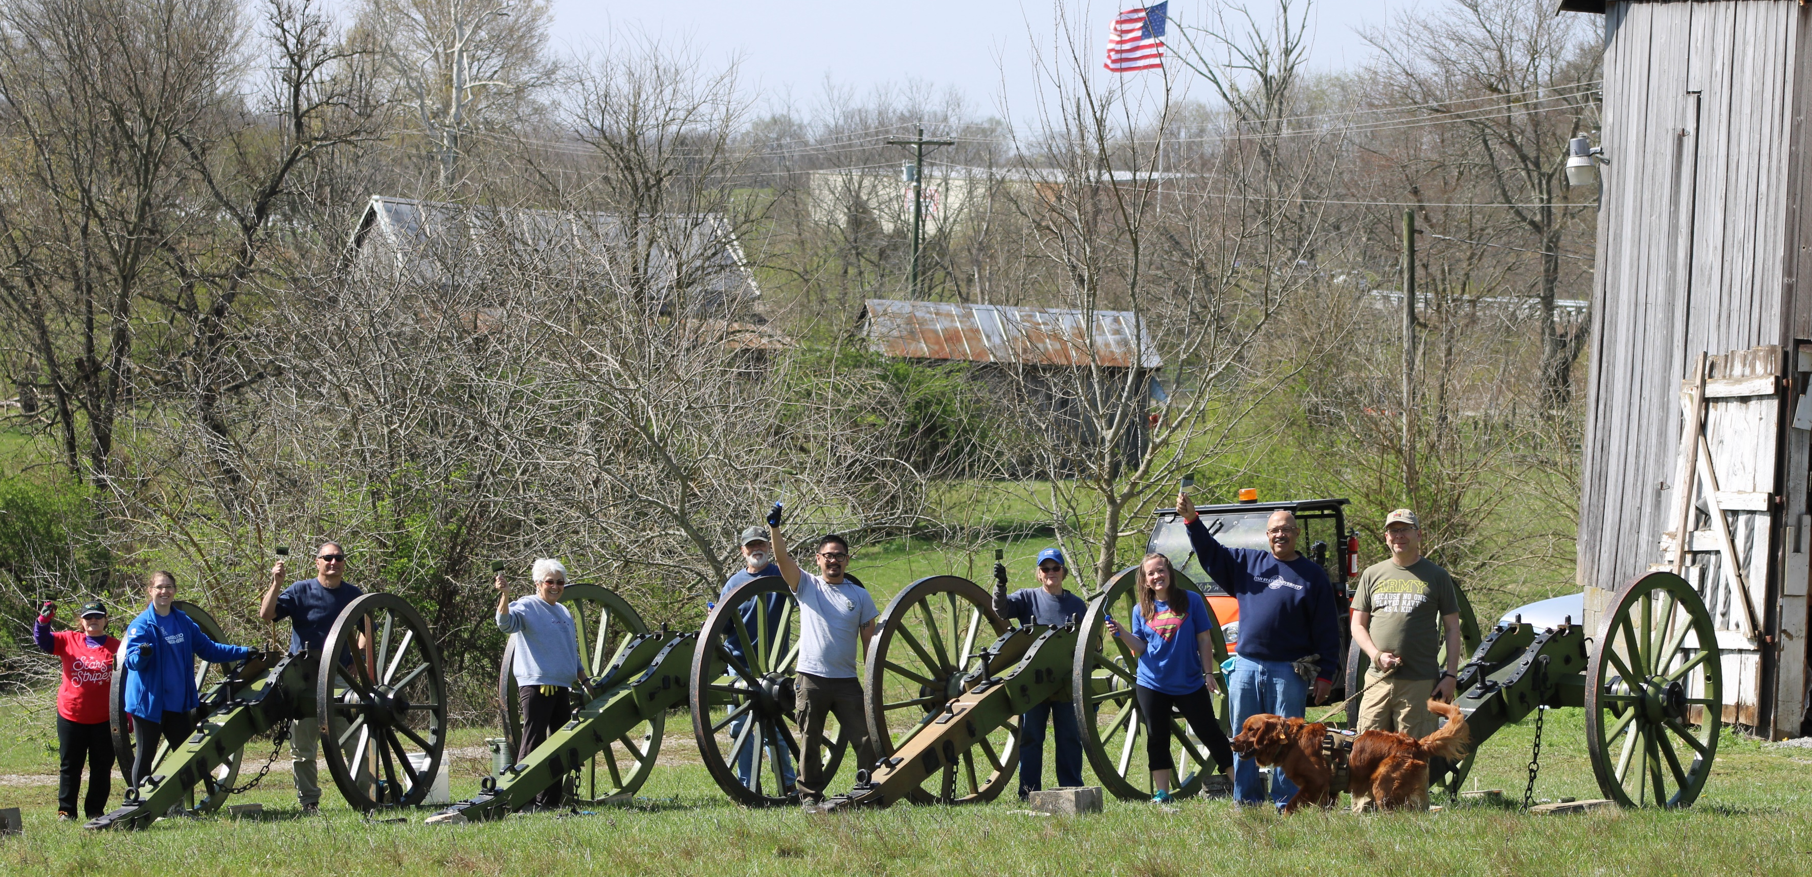
NPS
Camp Nelson History
Numbers
Now
Future
Physical Improvements

Slide 17
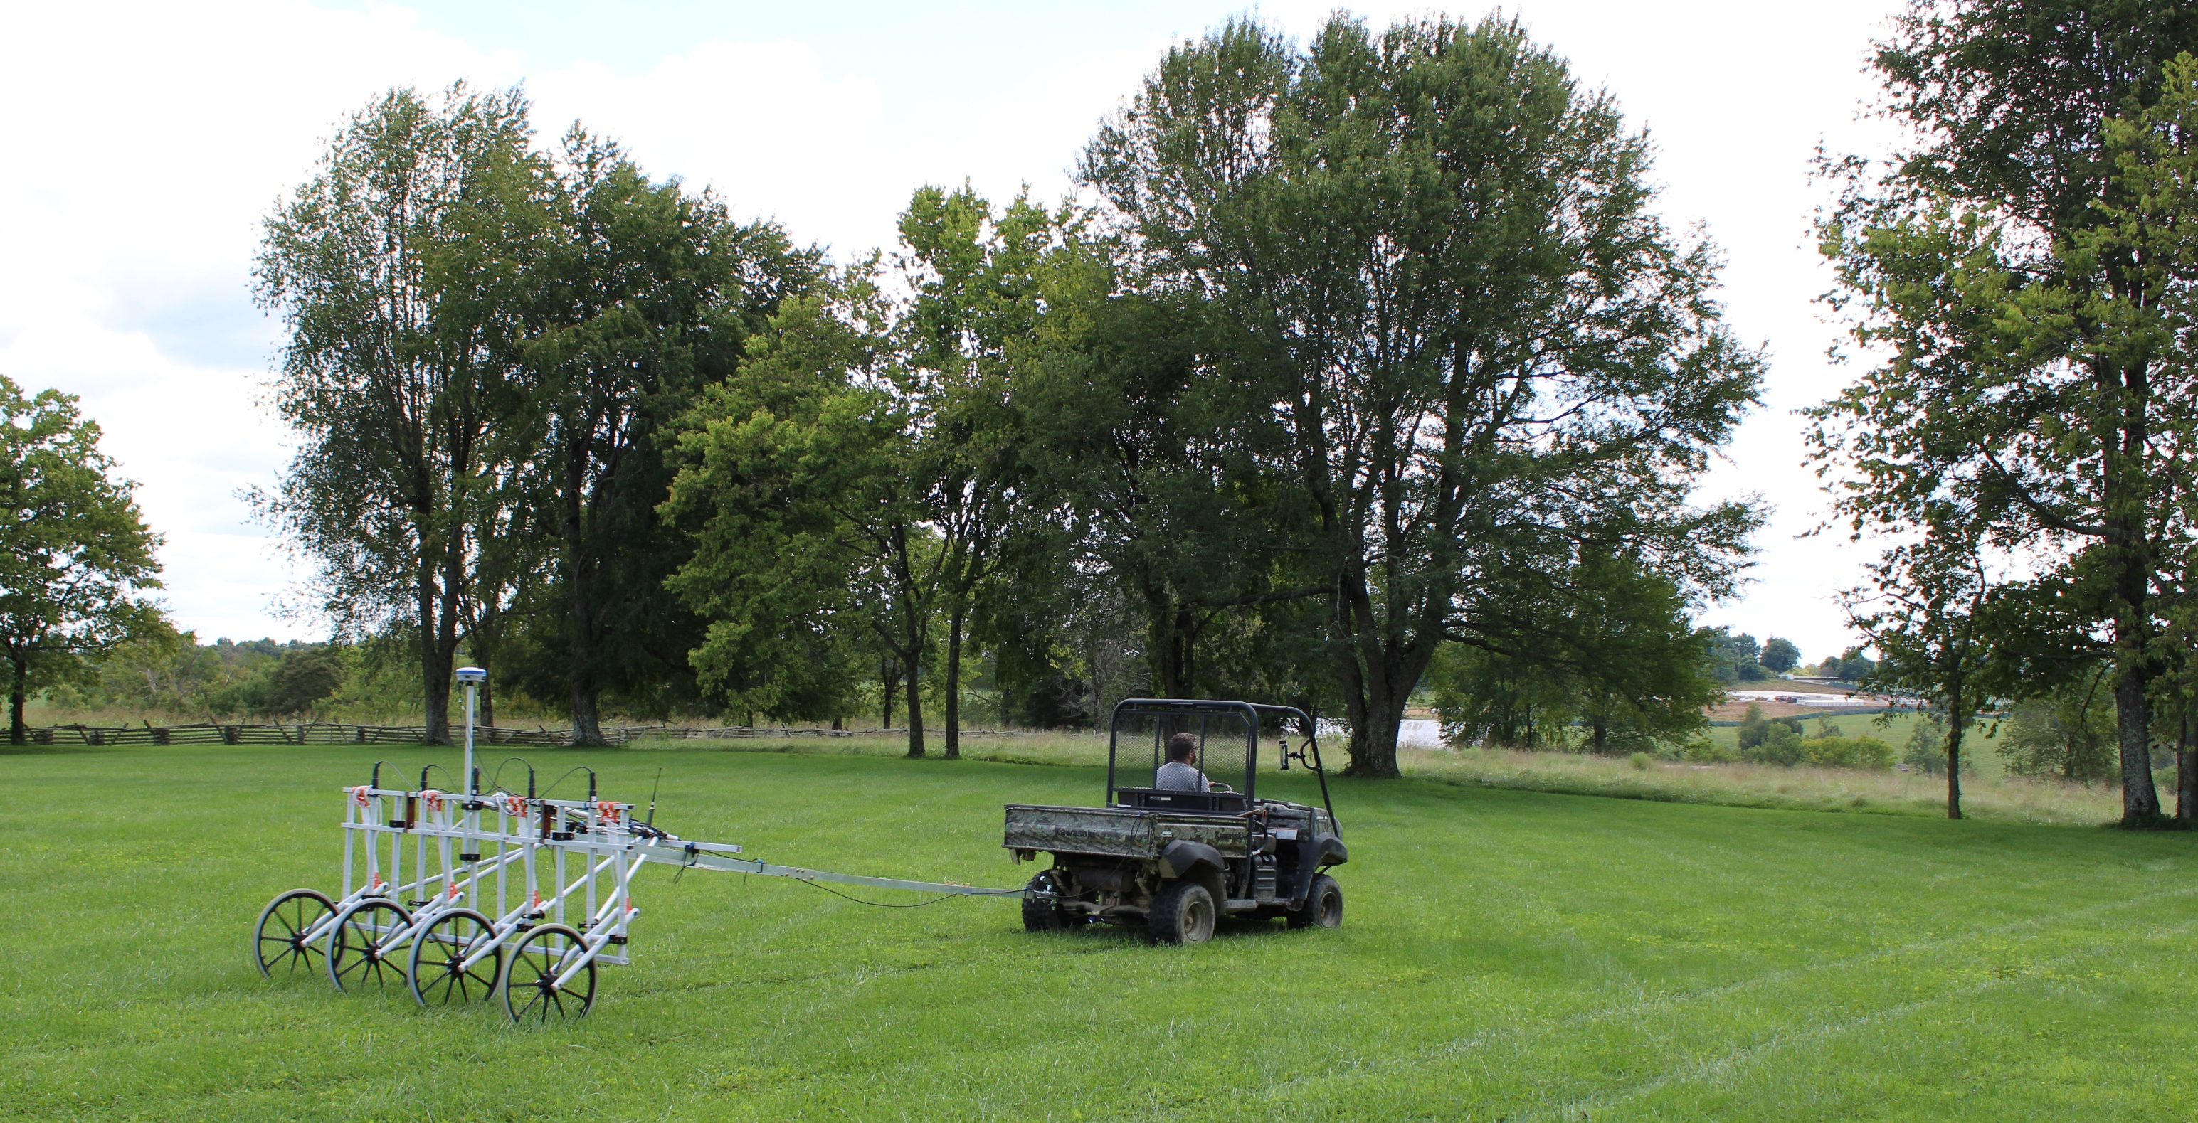
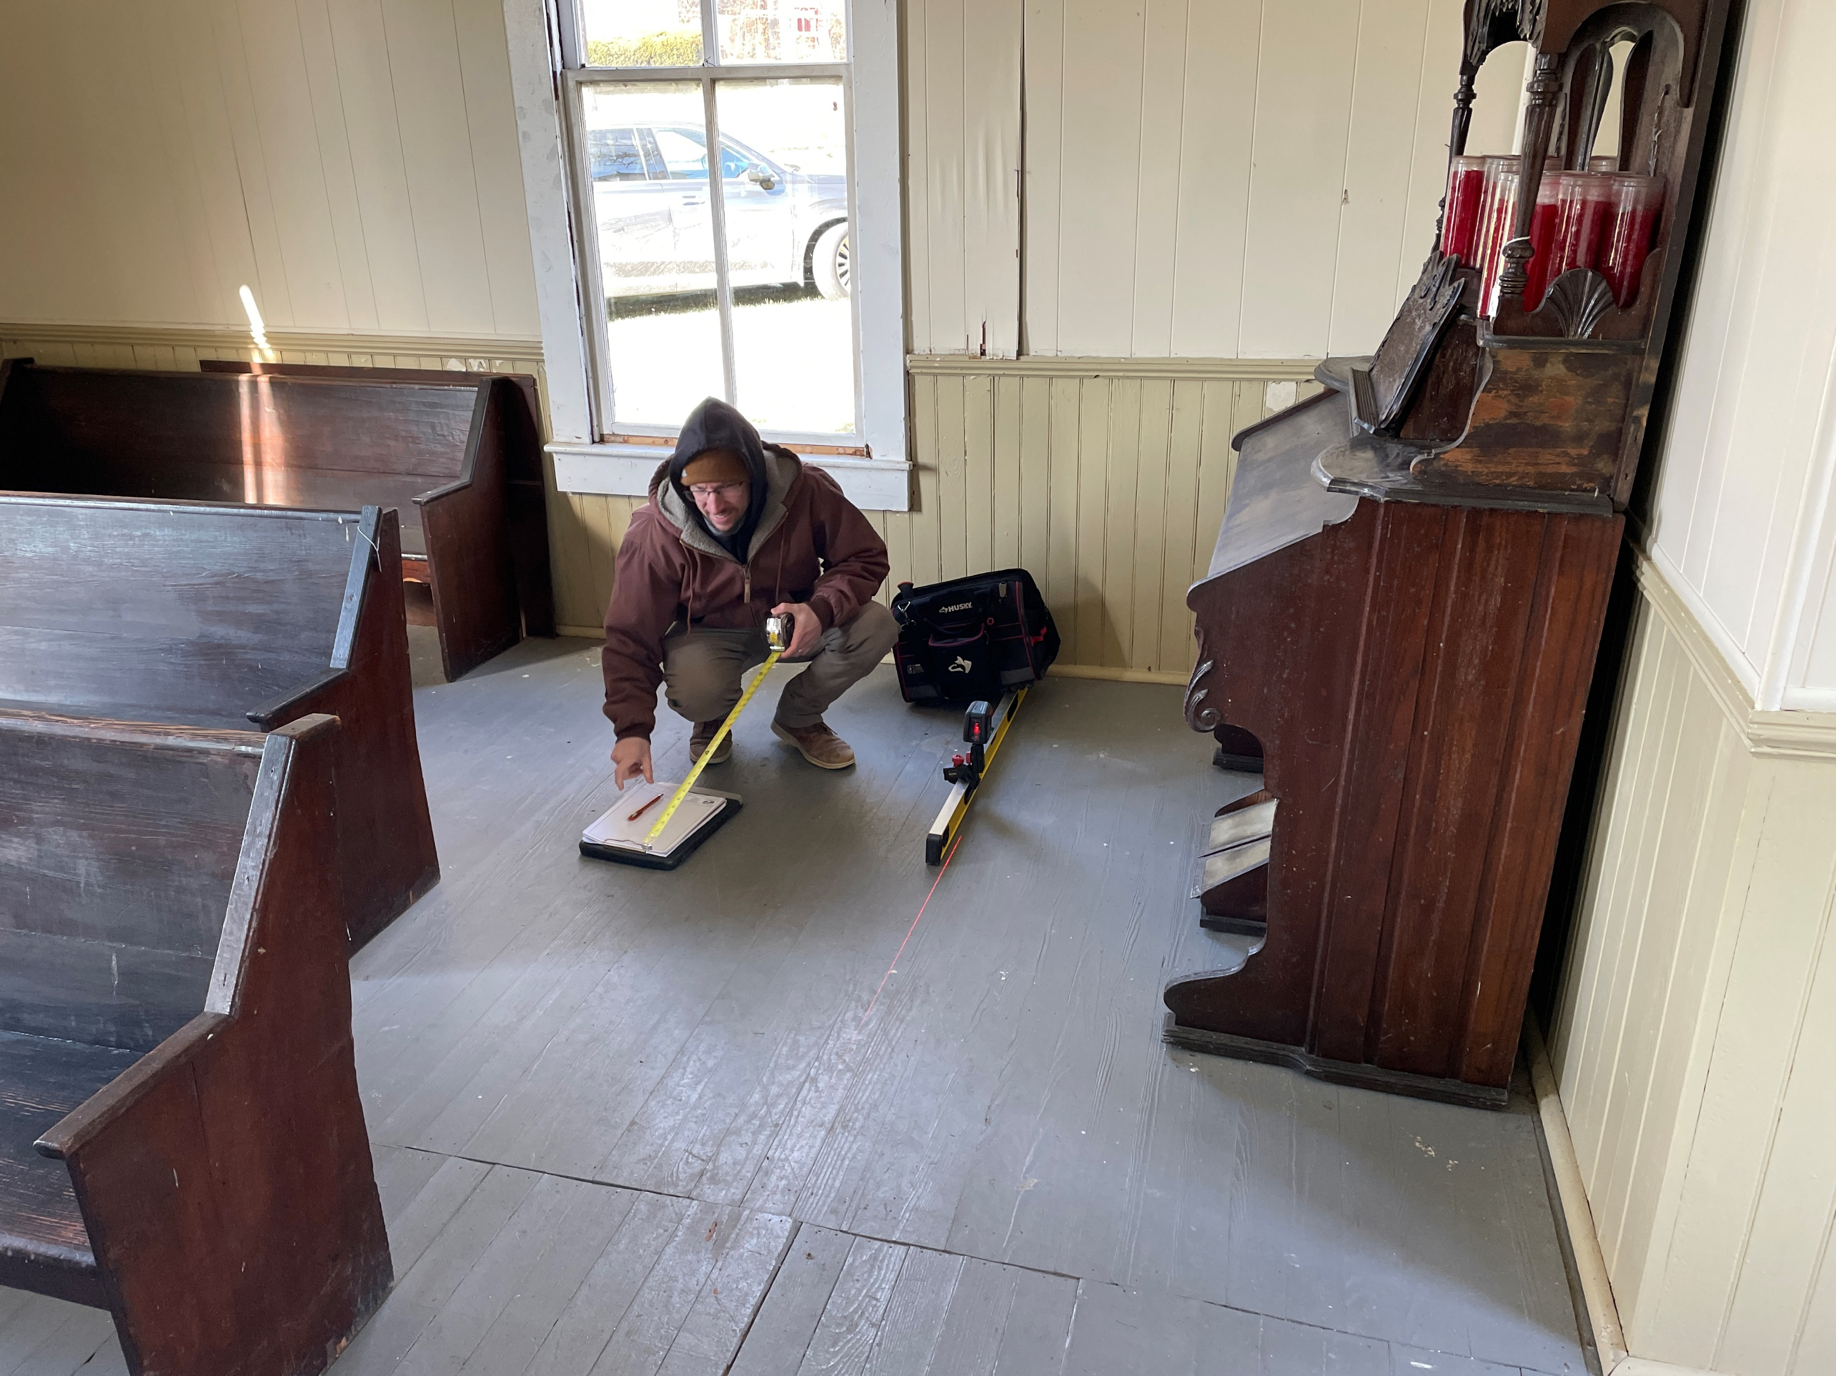
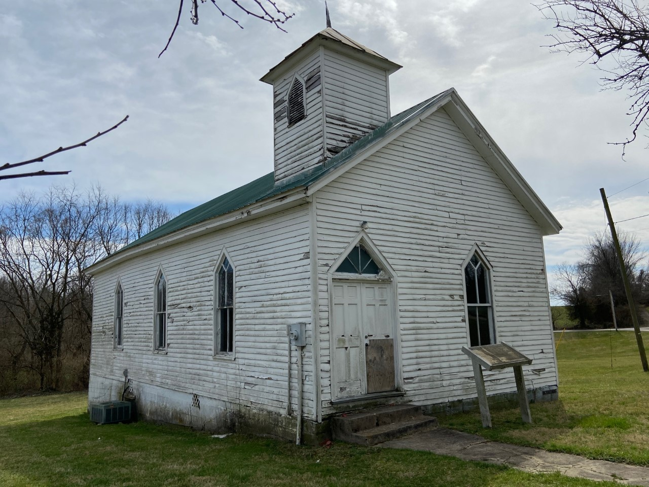
NPS
Camp Nelson History
Numbers
Now
Future
Preservation Work
• HSR and preservation project for the Oliver Perry “White” House
• Preservation project for the Fee Church

Slide 18
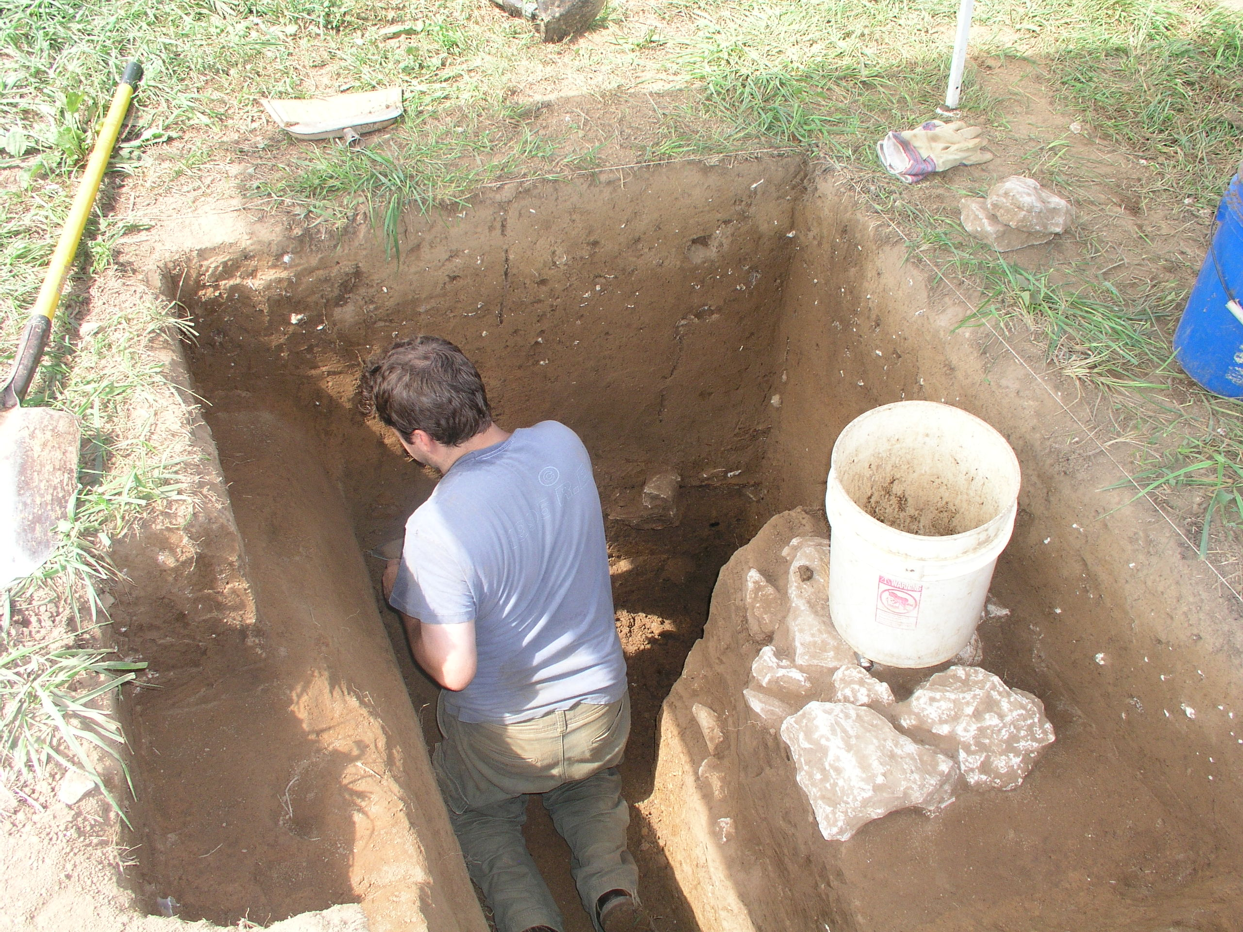
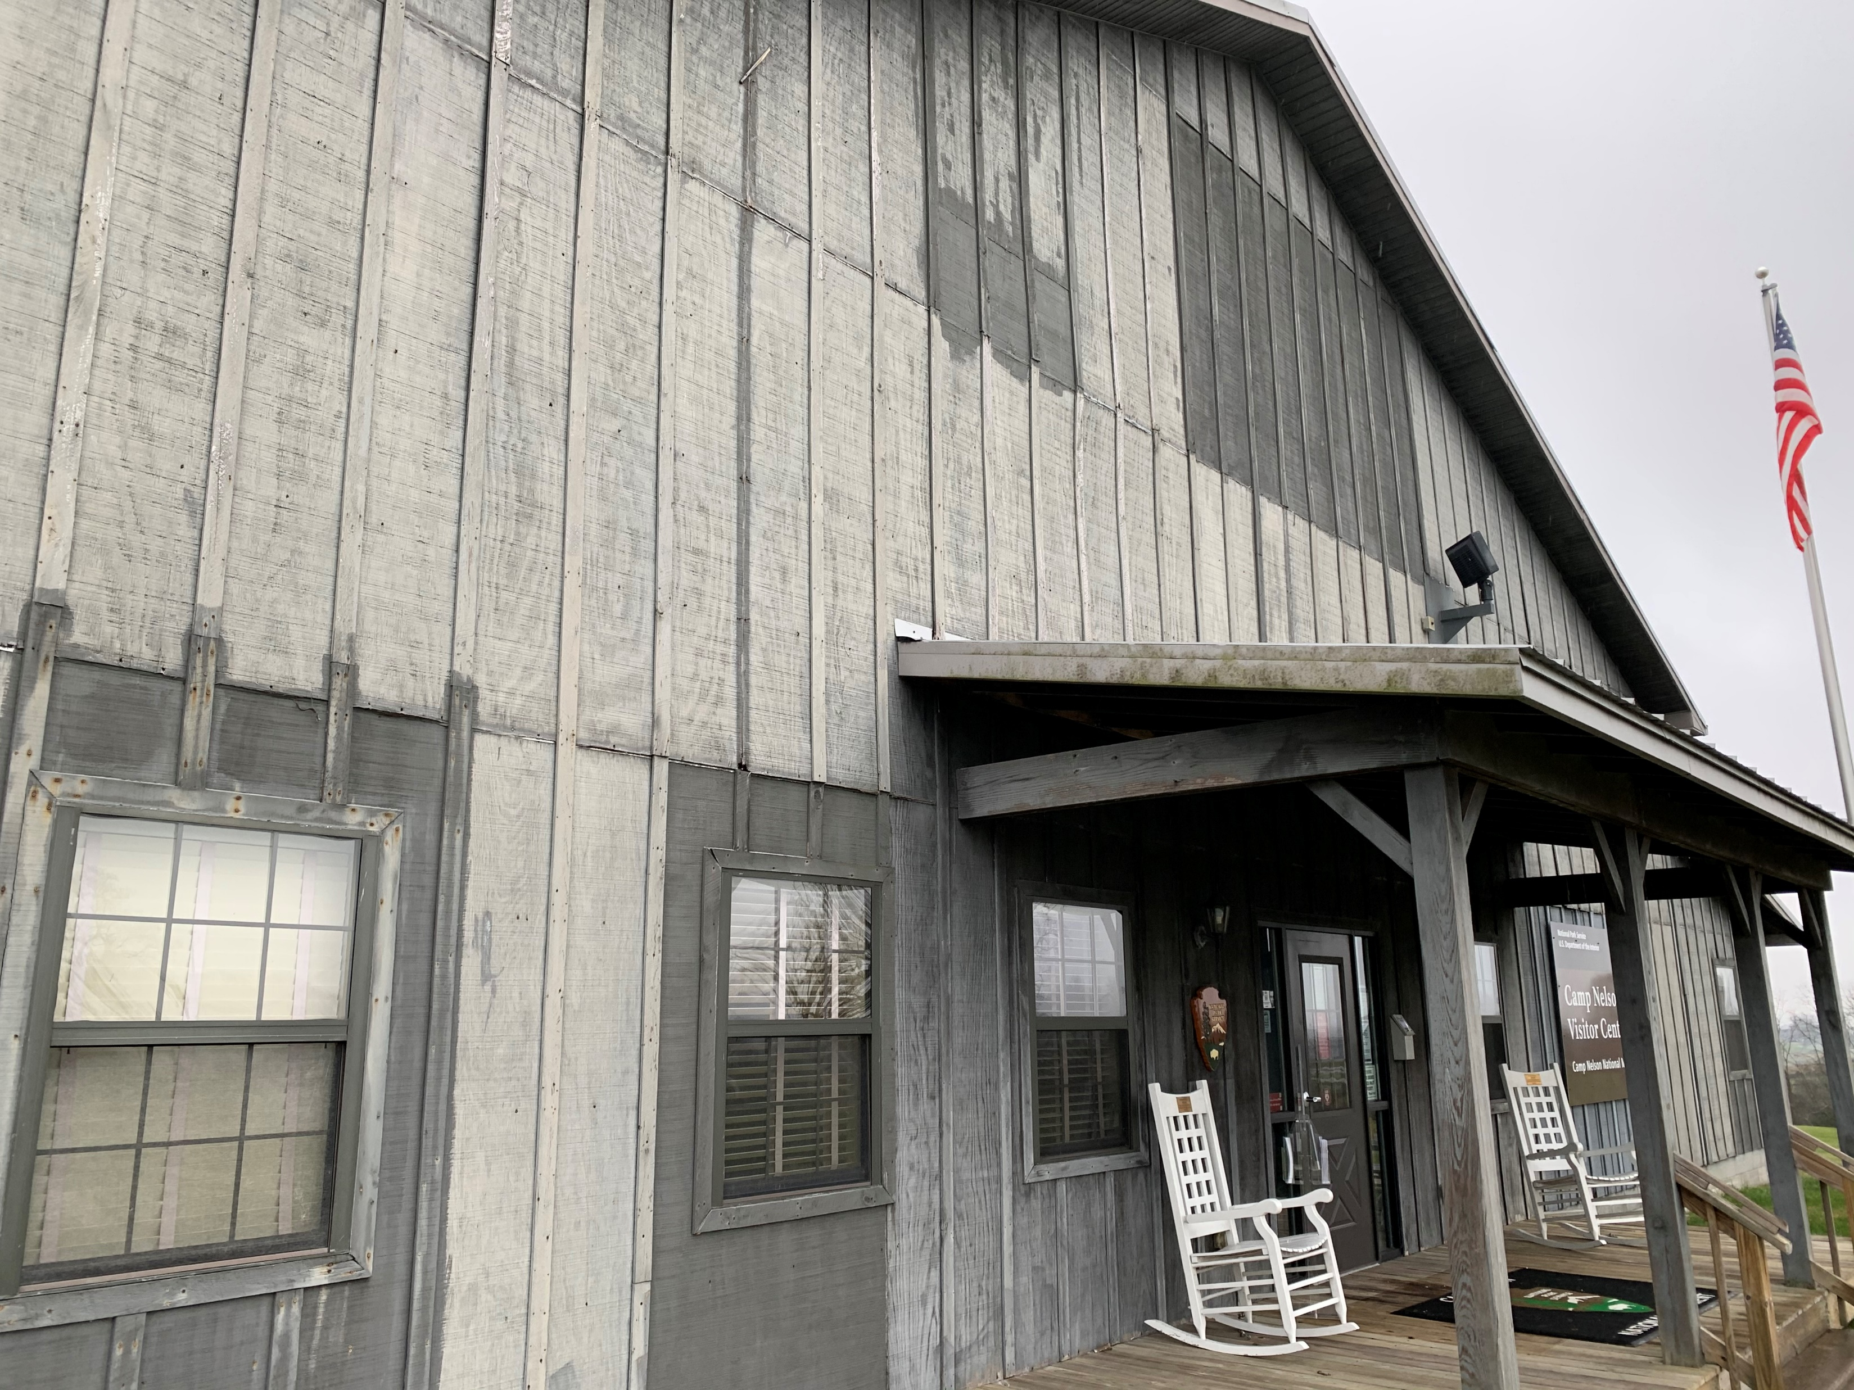
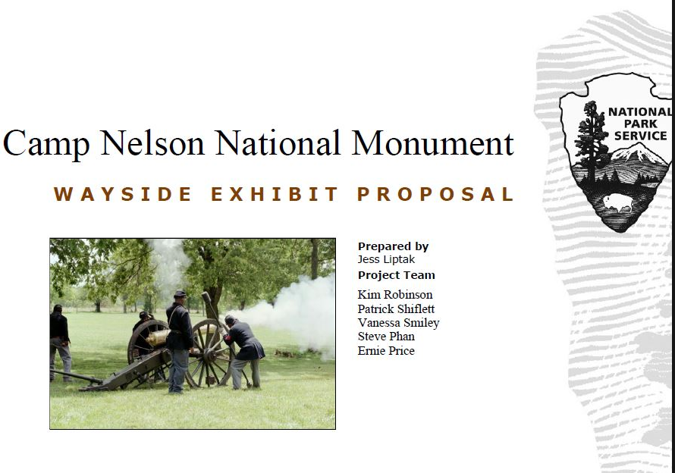
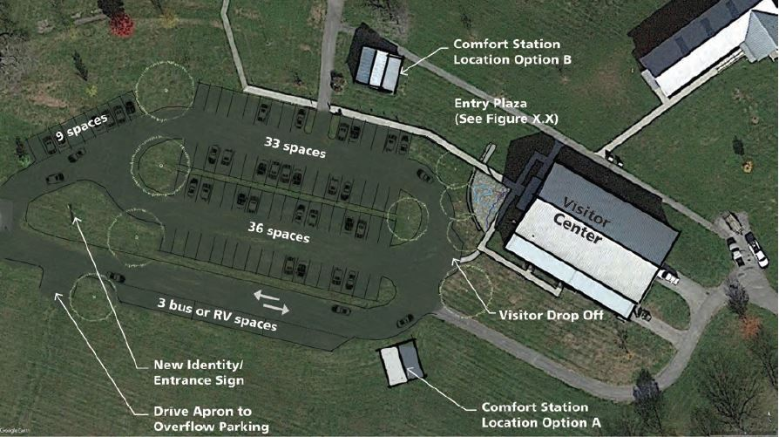
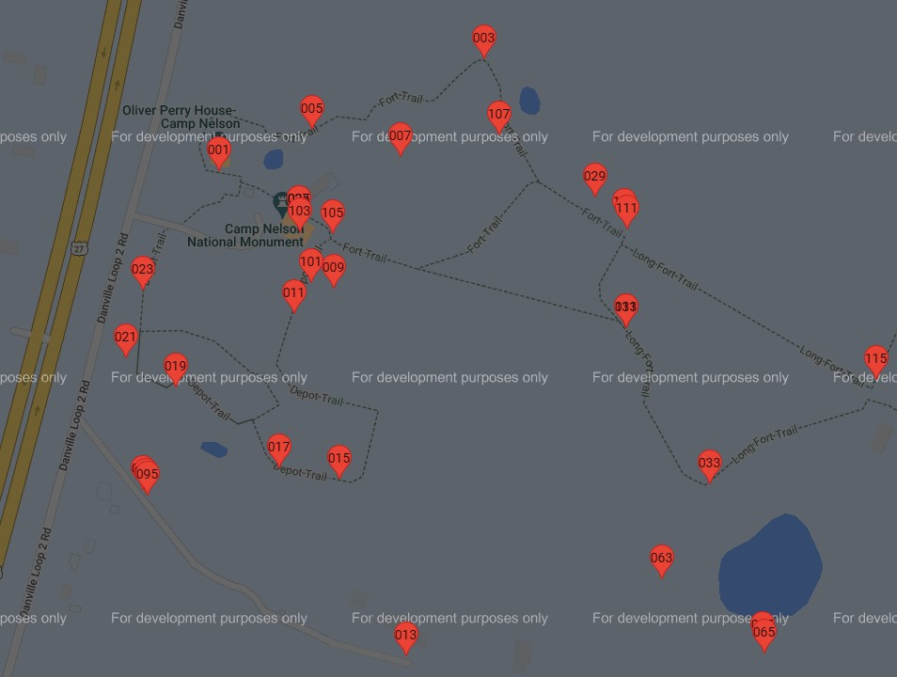
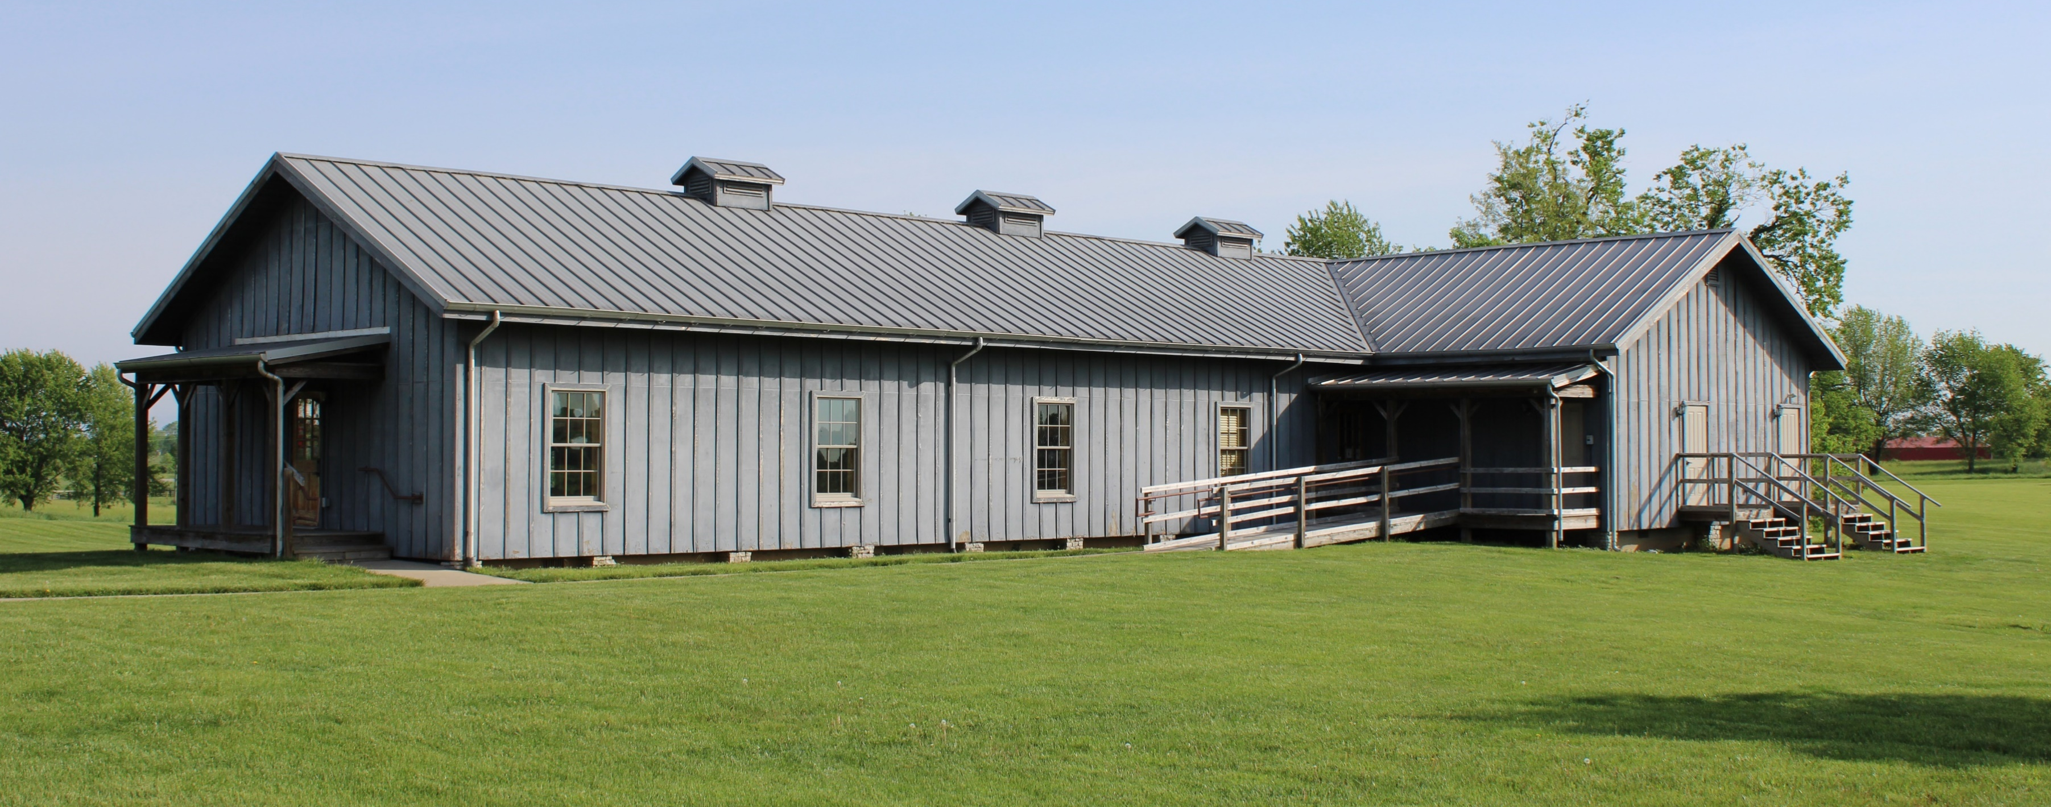
NPS
Camp Nelson History
Numbers
Now
Future
Future Projects
(3 to 5 Years)

Slide 19
NPS
Camp Nelson History
Numbers
Now
Future
Questions?
(about the present or the future)

Slide 20
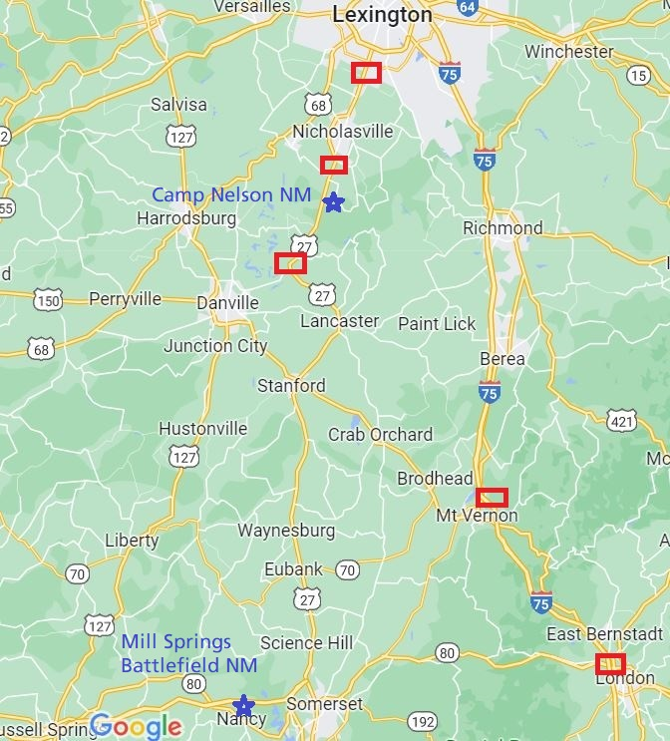
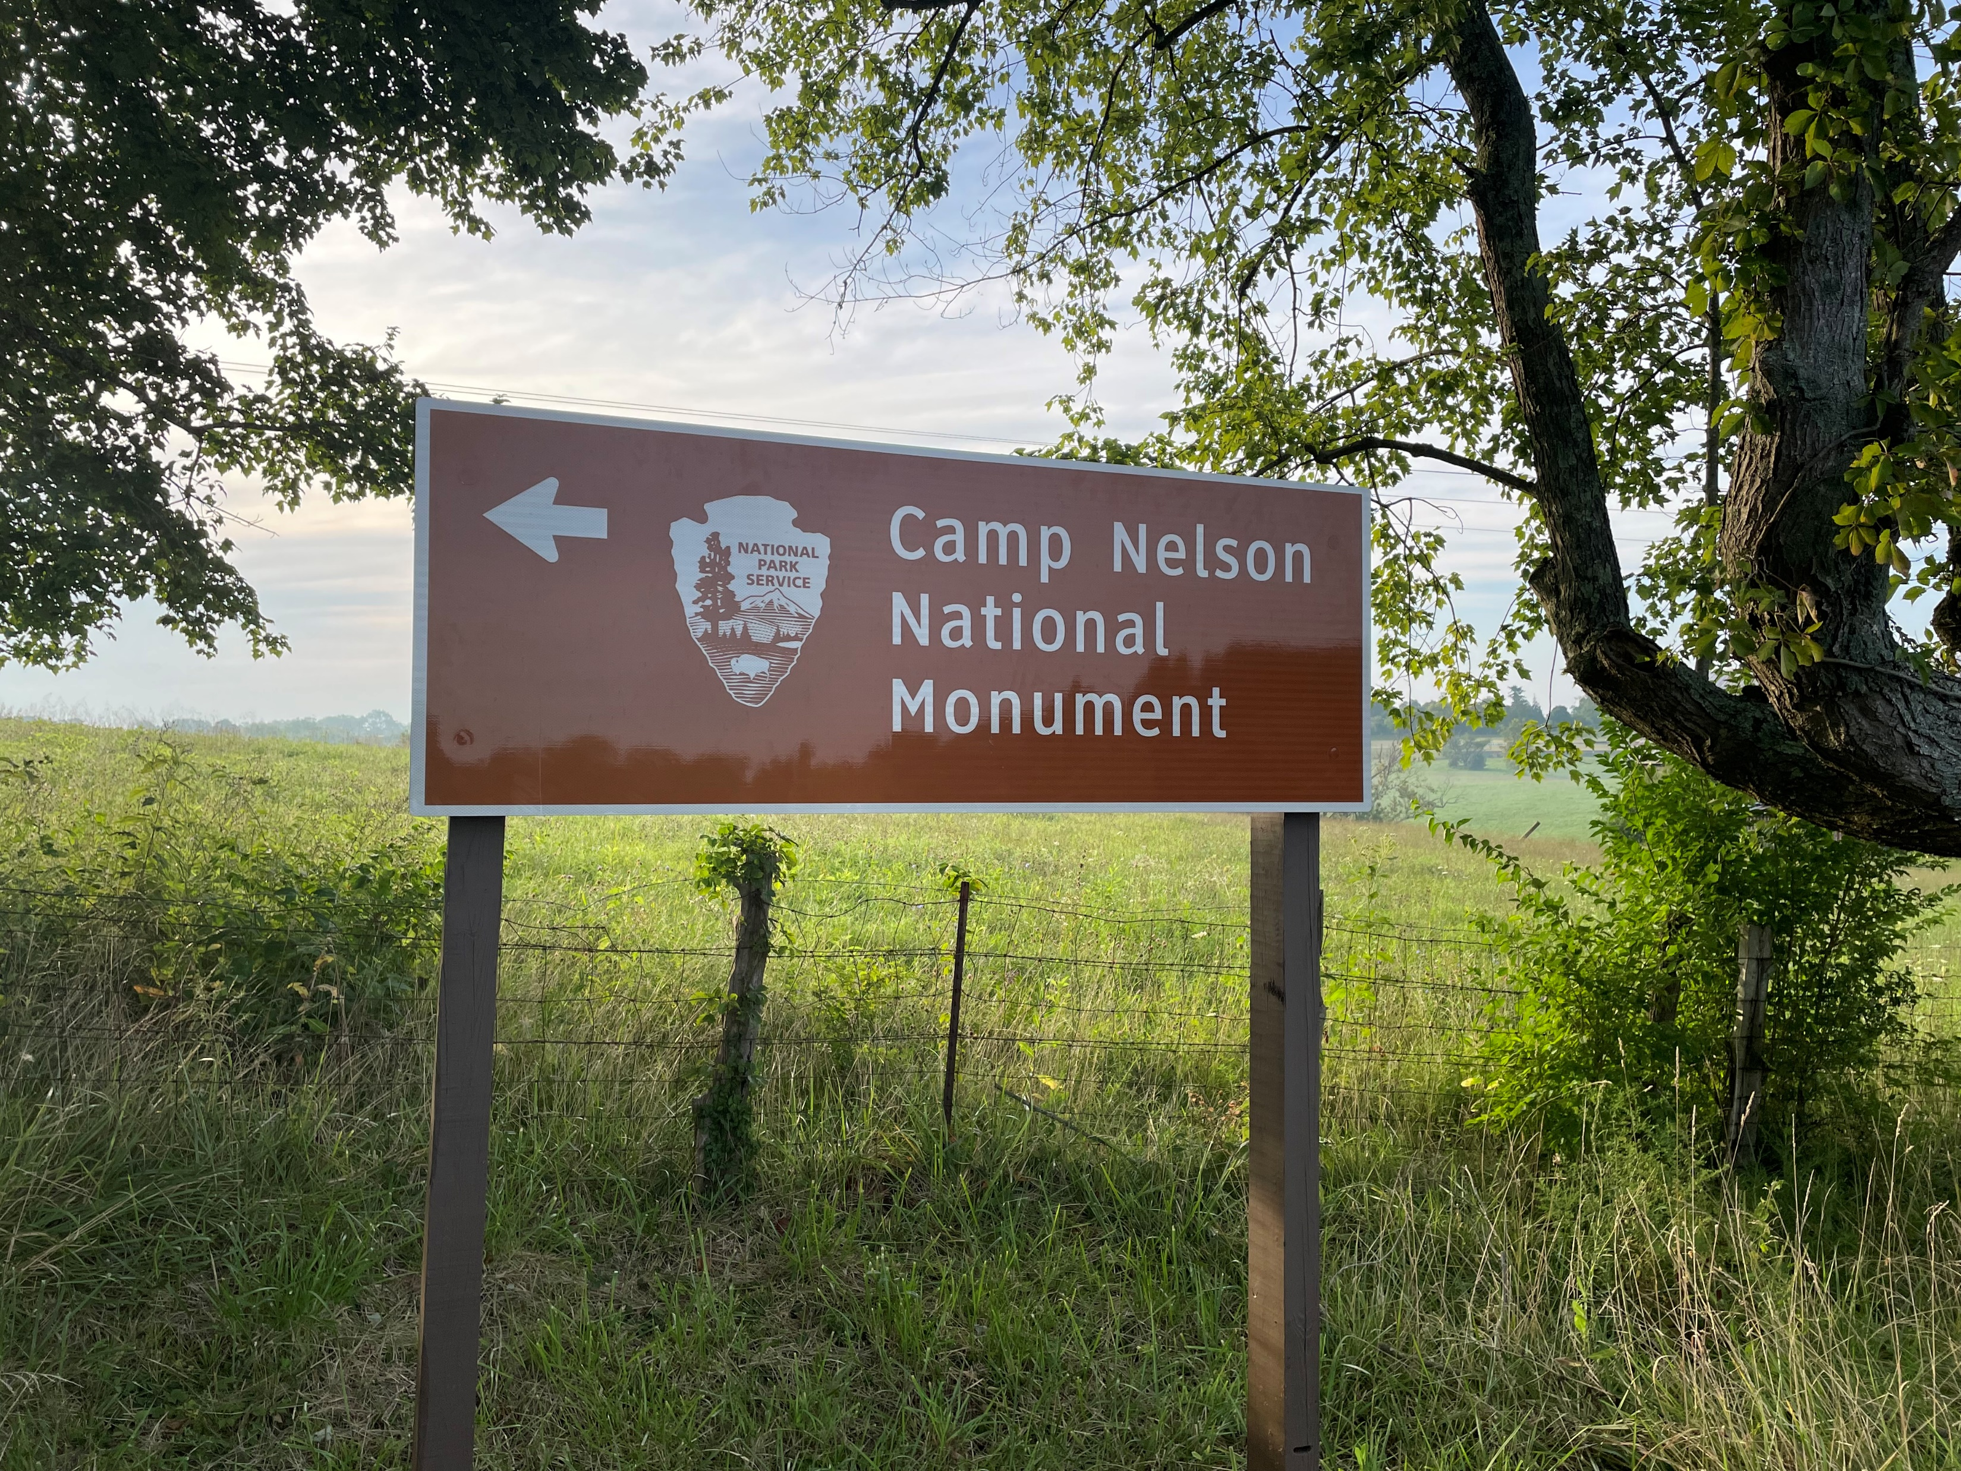
NPS
Camp Nelson History
Numbers
Now
Future
Regional Signage

Slide 21
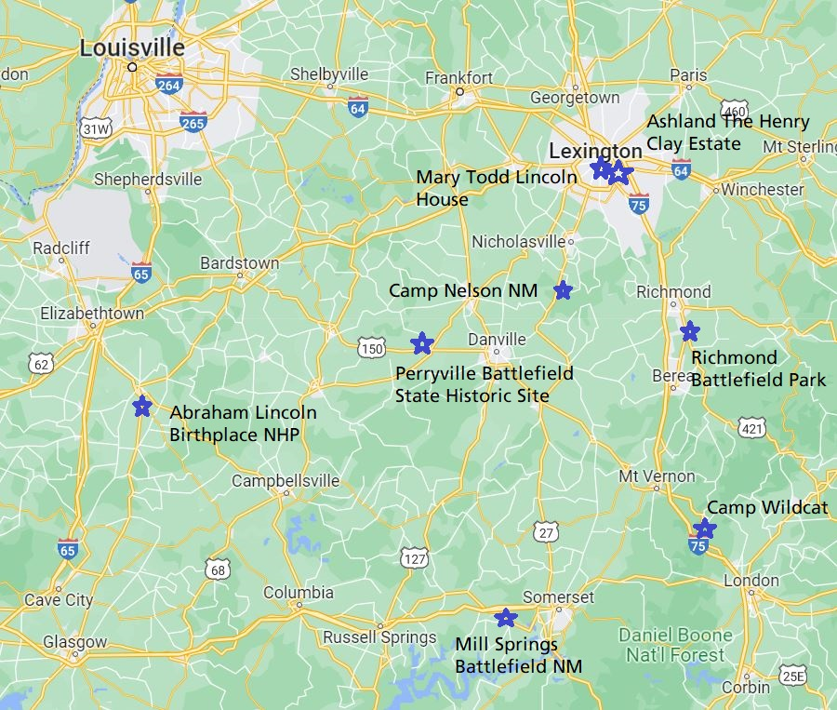
NPS
Camp Nelson History
Numbers
Now
Future
Regional Civil War
Tourism in Central Kentucky

Slide 22
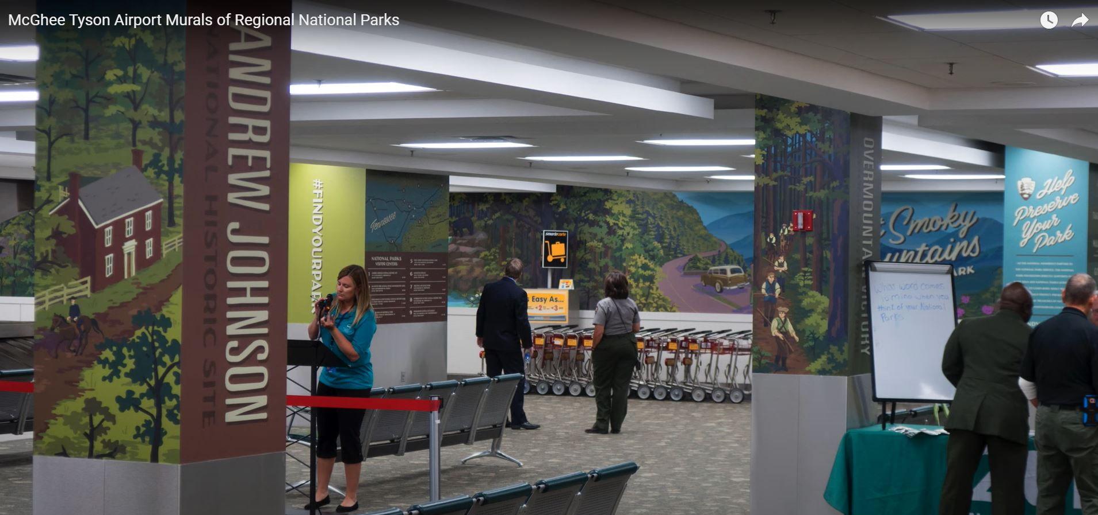
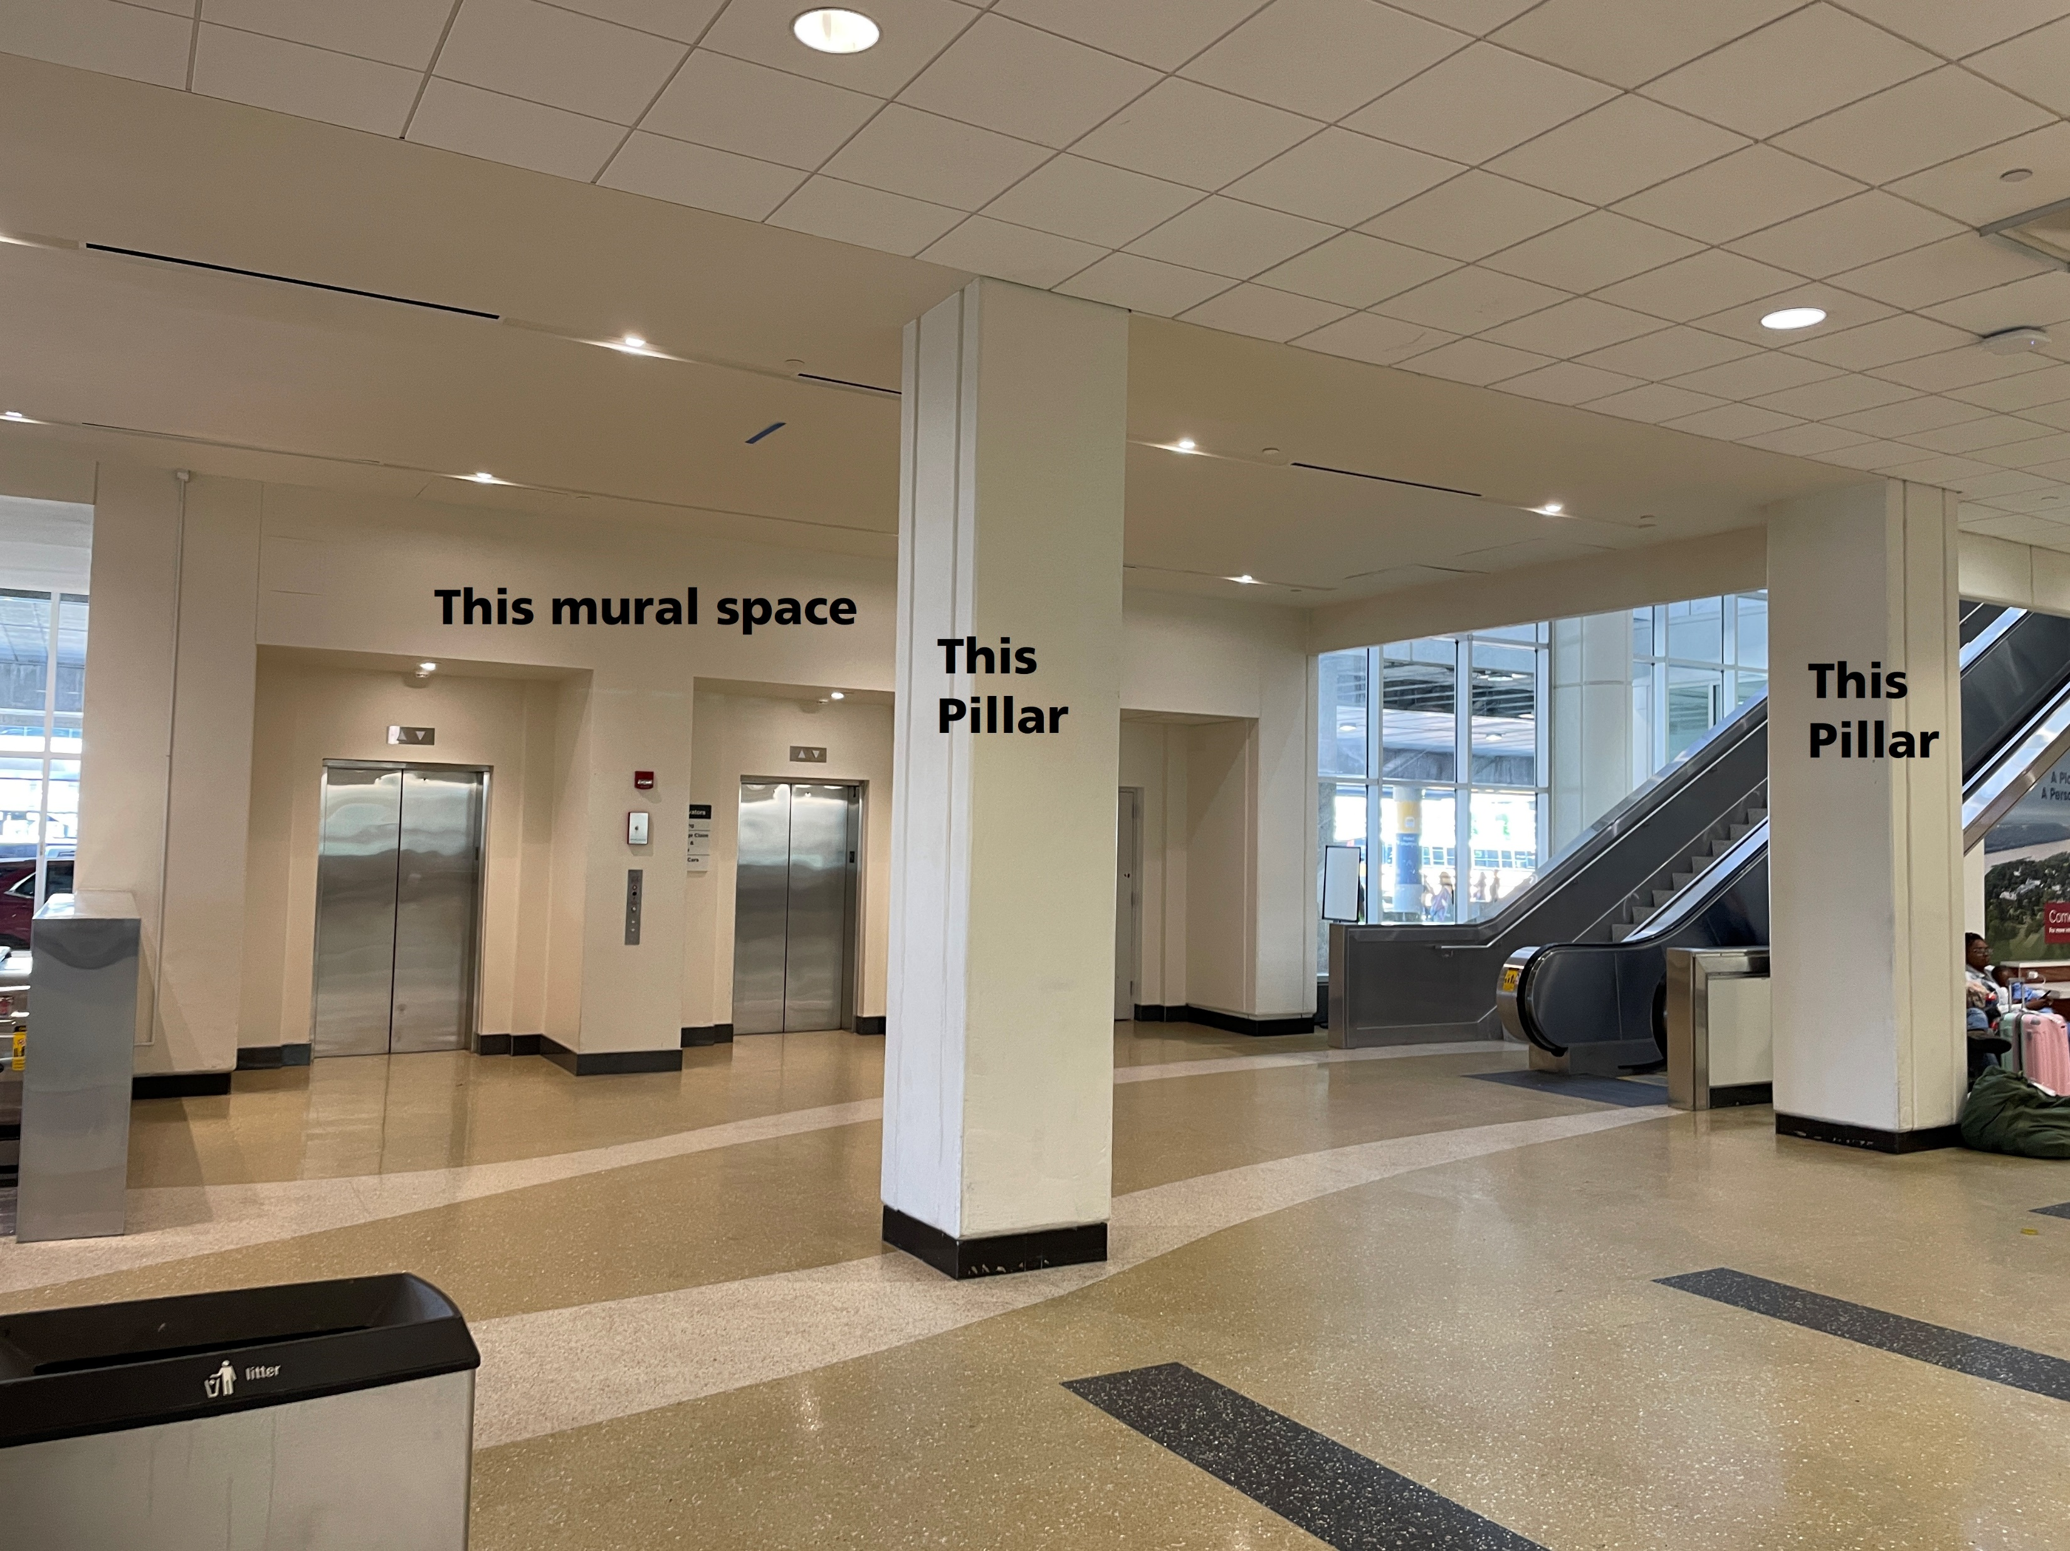
NPS
Camp Nelson History
Numbers
Now
Future
Promote Kentucky’s Magnificent 7 at the Louisville Airport Baggage Claim

Slide 23
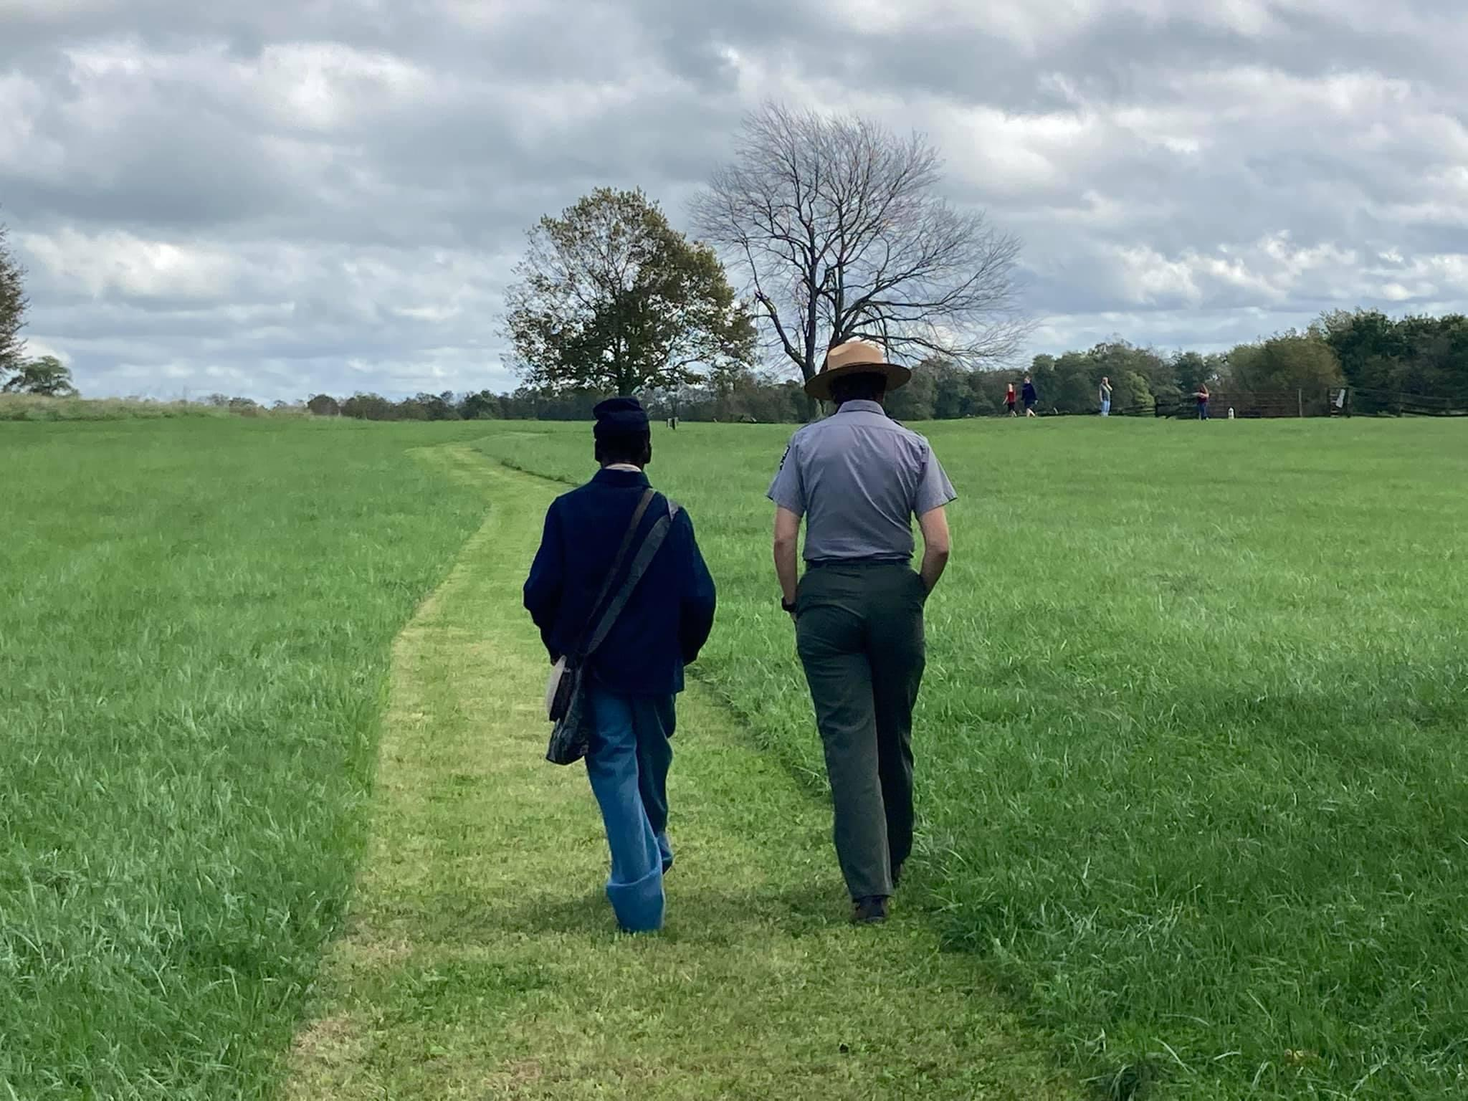
NPS
Camp Nelson History
Numbers
Now
Future
Thank you

