Slide 1
Harrodsburg 250th
Celebration

Slide 2
Beyond Harrodsburg
Create a committee structure that blends local government and volunteers into a cohesive system
Showcase partnerships between organizations that already exist in most Kentucky Communities (public libraries, civic organizations, and historical societies)
Easily edited, emulated, and implemented by other communities in the state

Slide 3
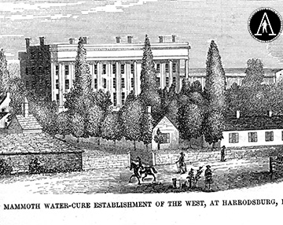
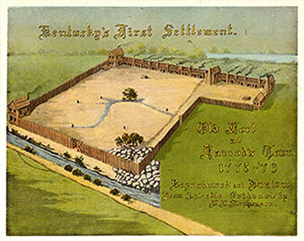
Historical Overview
Harrodsburg was the first settlement west of the Allegheny Mountains and was founded on June 16, 1774
Culturally,
  Was home to multiple Kentucky Derby winners
  Boasted several nationally known resorts like Graham Springs
Militarily,
  the war for American Independence in the west was planned here
  experienced the horrors the Civil War on its doorstep when caring for the wounded from Perryville
  Company D of the 192nd Tank Bn sacrificed so much in the Philippines
Politically,
  served as the county seat for Kentucky County, Virginia
  was home to four governors

Slide 4
Keeping Public Memory Alive
Harrodsburg has taken its public history very seriously from early on in its history
Tried hard not just to remember the past but to celebrate the “pioneering” spirit of innovation it has embodied since the beginning

Slide 5
The past inspires the future
Dix Dam Old Fort Harrod State Park

Slide 6
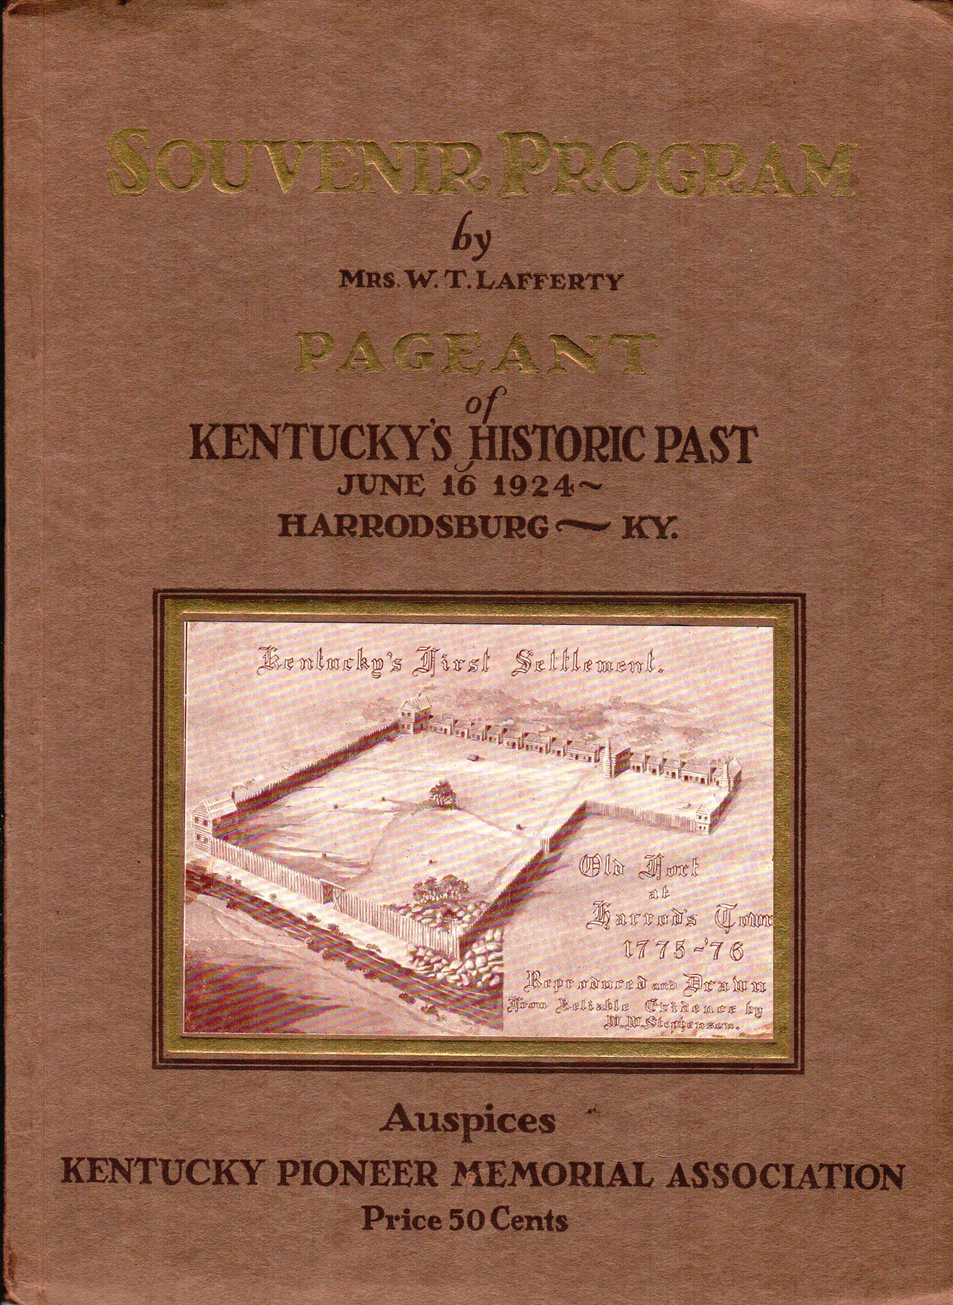
History and the arts

Slide 8
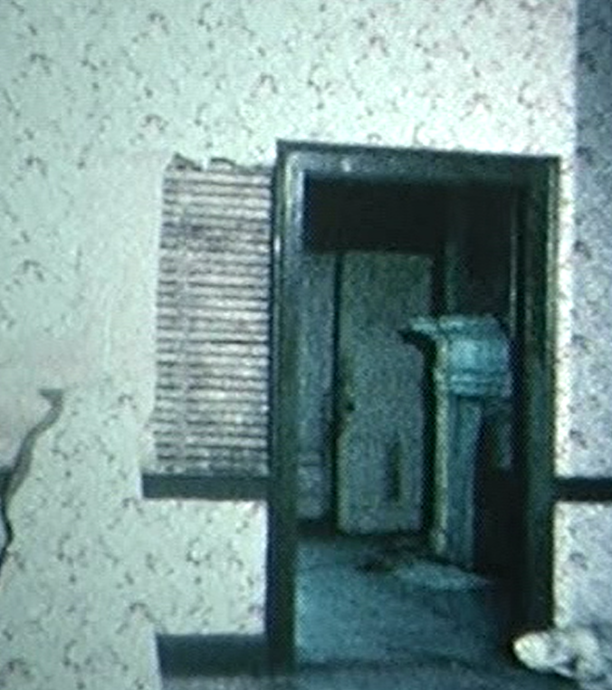
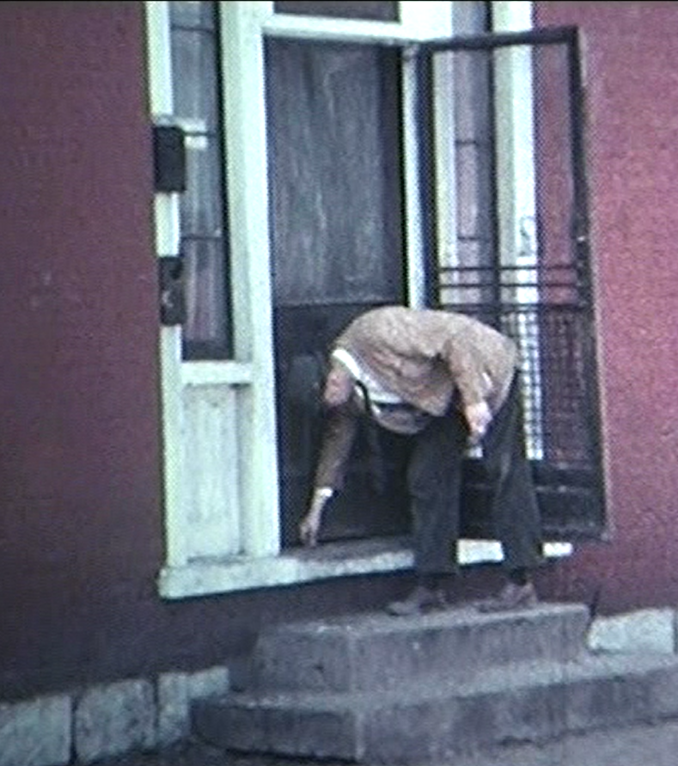
Morgan Row Renovation

Slide 9
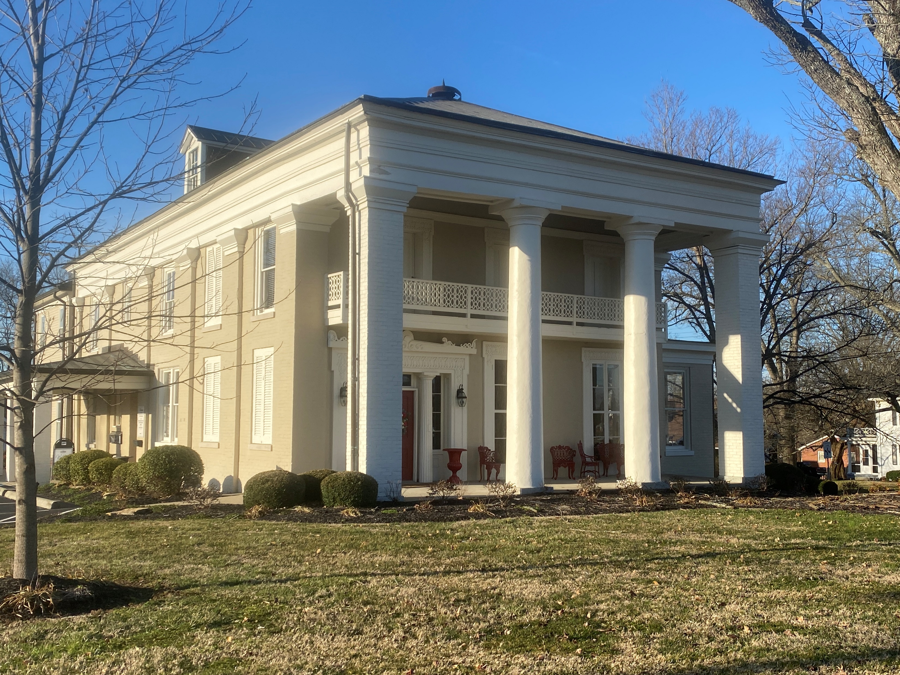
Harrodsburg 250th, Inc.
Monthly Board Meetings
Beautification, Events, History, Publicity Committees
Organization Leaders
as Board Members
Arts Council
Campbellsville University
Chamber of Commerce
Harrodsburg First
Harrodsburg Historical Society
Lions Club
Mercer County Fair & Horse Show
Mercer County Public Library
Old Fort Harrod State Park
Tourism Commission

Slide 10
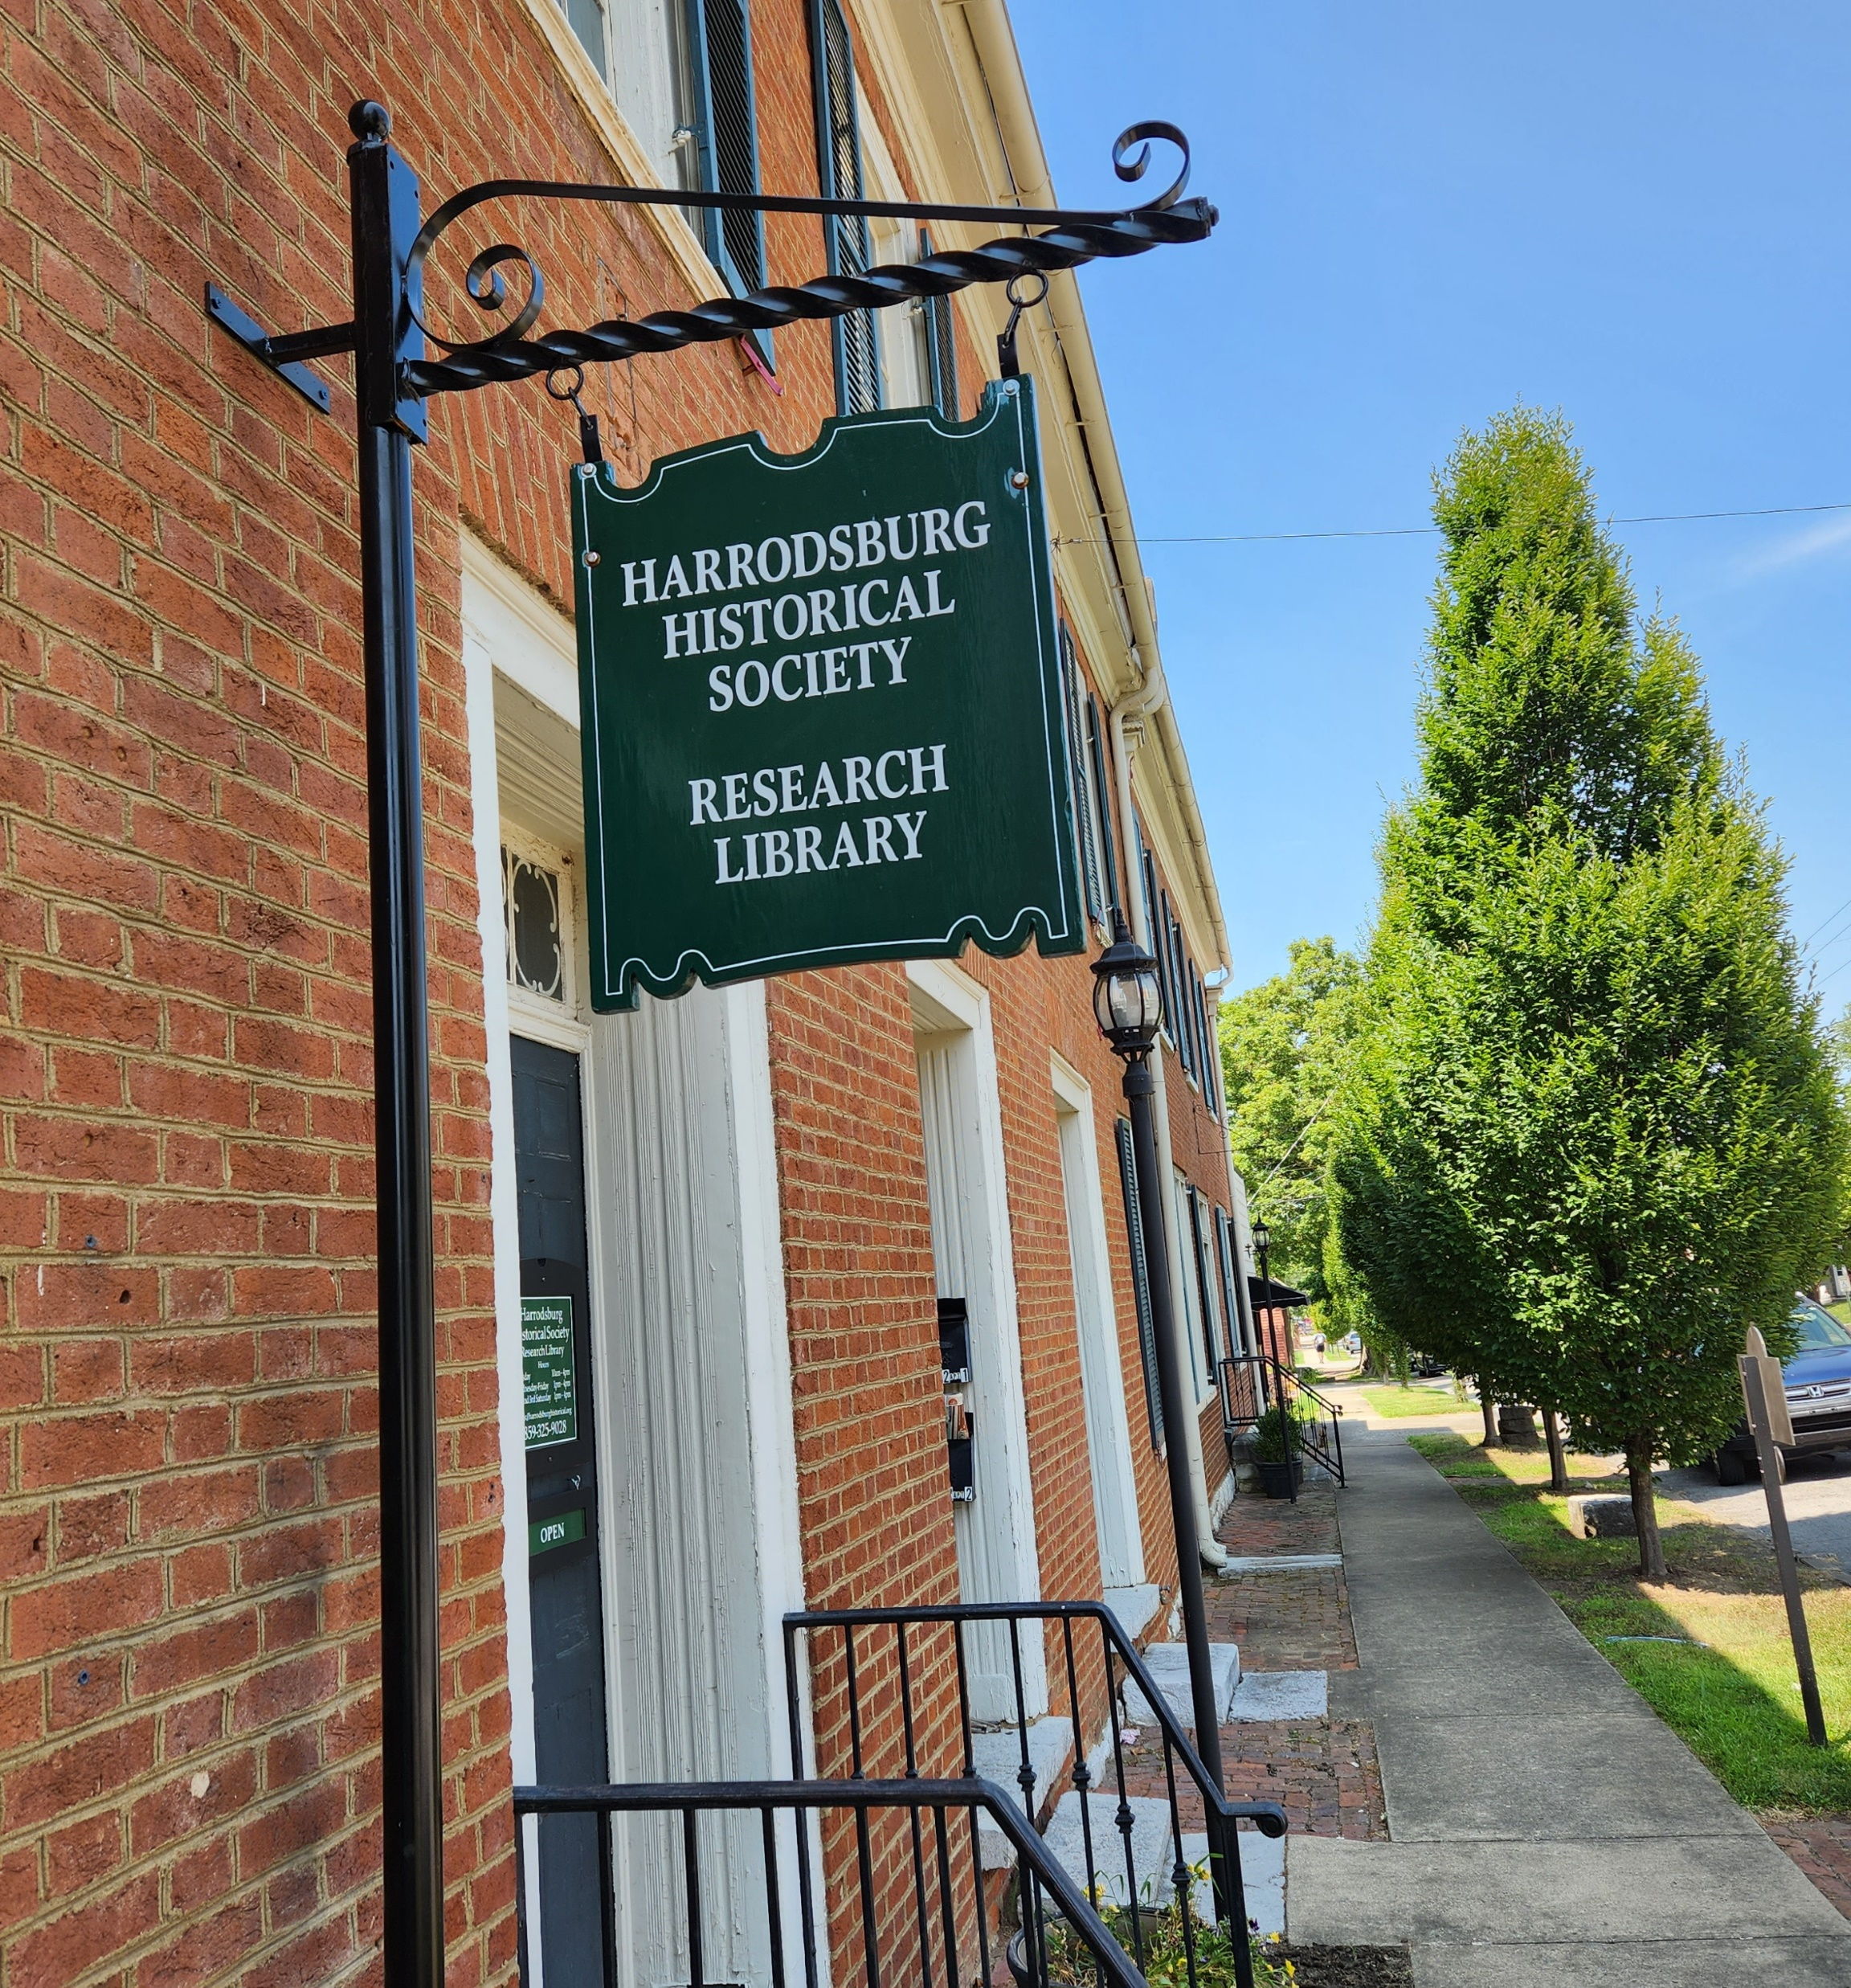
Activities at Morgan Row
Tours of the oldest row house in Kentucky, with all new exhibits
Experience Harrodsburg History through the decades
Tea with historical characters
Historical music program
Book signings
  African Americans of Mercer Co.
  Eve Kahn on Zoe Anderson Norris
Guided, themed walking tours
Ghost walks

Slide 11
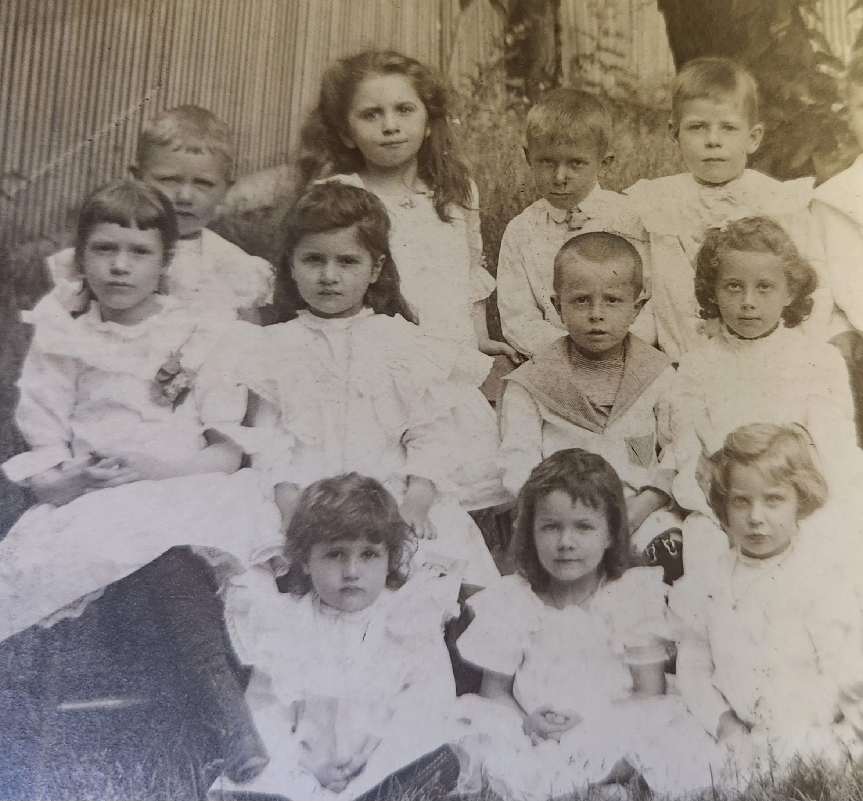
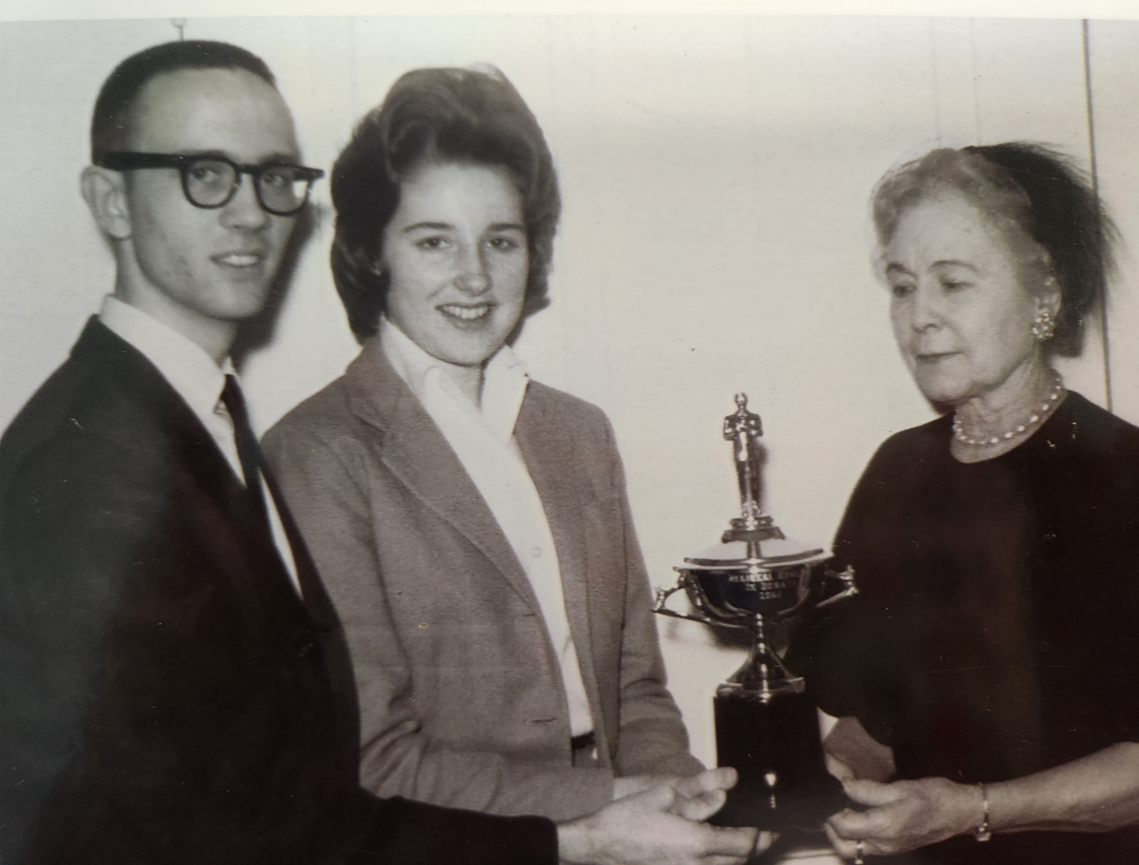
Activities for Children and Youth
Old-Time Games
(with Rotary & Kiwanis)
Recognition of
Student Presentations (with schools)

Slide 12
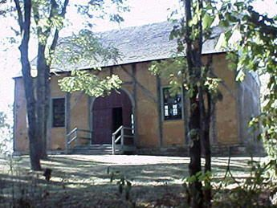
Activities at Old Mud Meeting House
Oldest Dutch Reformed Church (1800) and only wattle-and-daub structure extant in Kentucky
Many Dutch American pioneers and Revolutionary War veterans lie in the cemetery
Church service with period music
Historical music concert (Community Choir)
Ceremony honoring Revolutionary War veterans buried in the Old Mud Cemetery (S.A.R.)

Slide 13

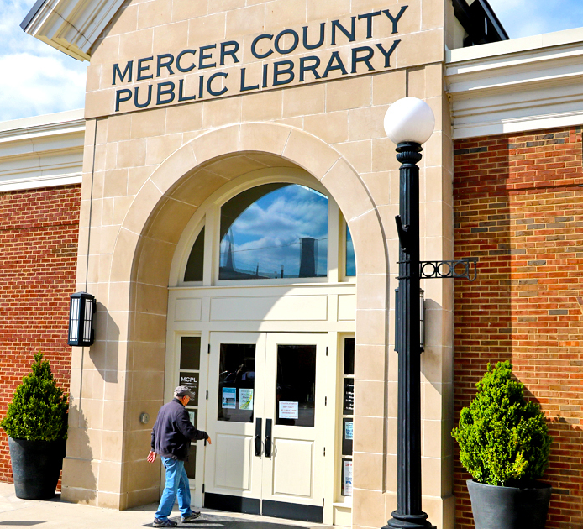
MCPL Events
Trial of James Bridges
Children’s Book about Harrodsburg
3D Timeline
Story telling contest
Time Capsule
Selfie Stations

Slide 14
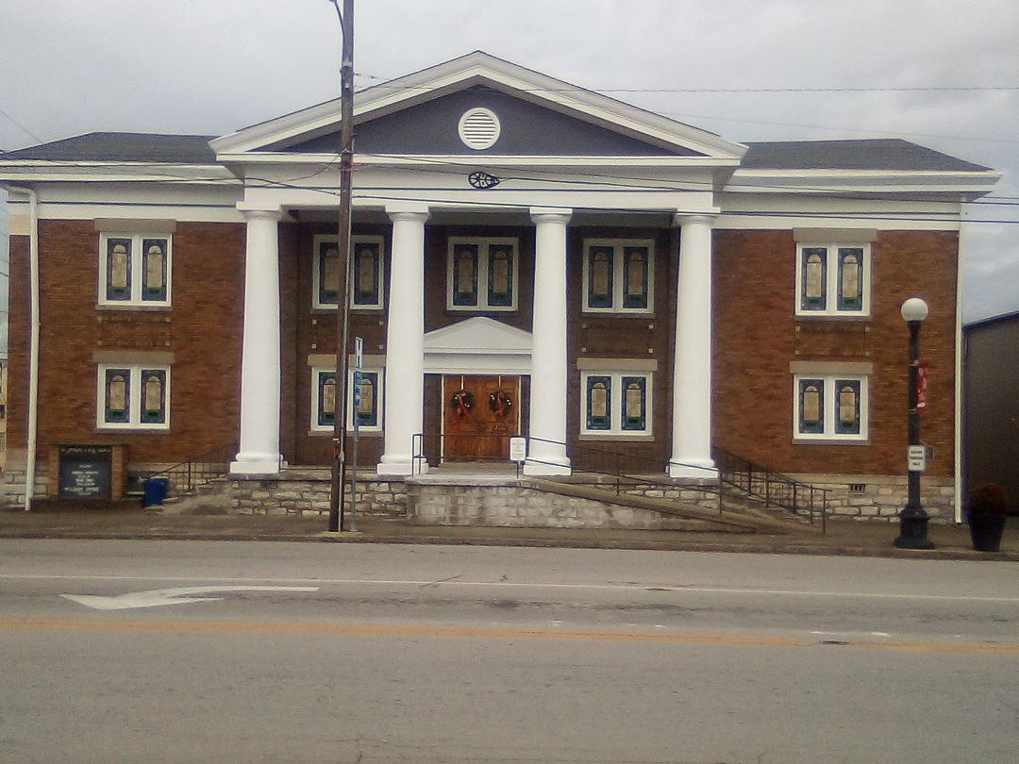
Additional events and Partnerships
The list of partnerships continues to grow as local entities provide additional events and program spaces that carry historical significance

Slide 15
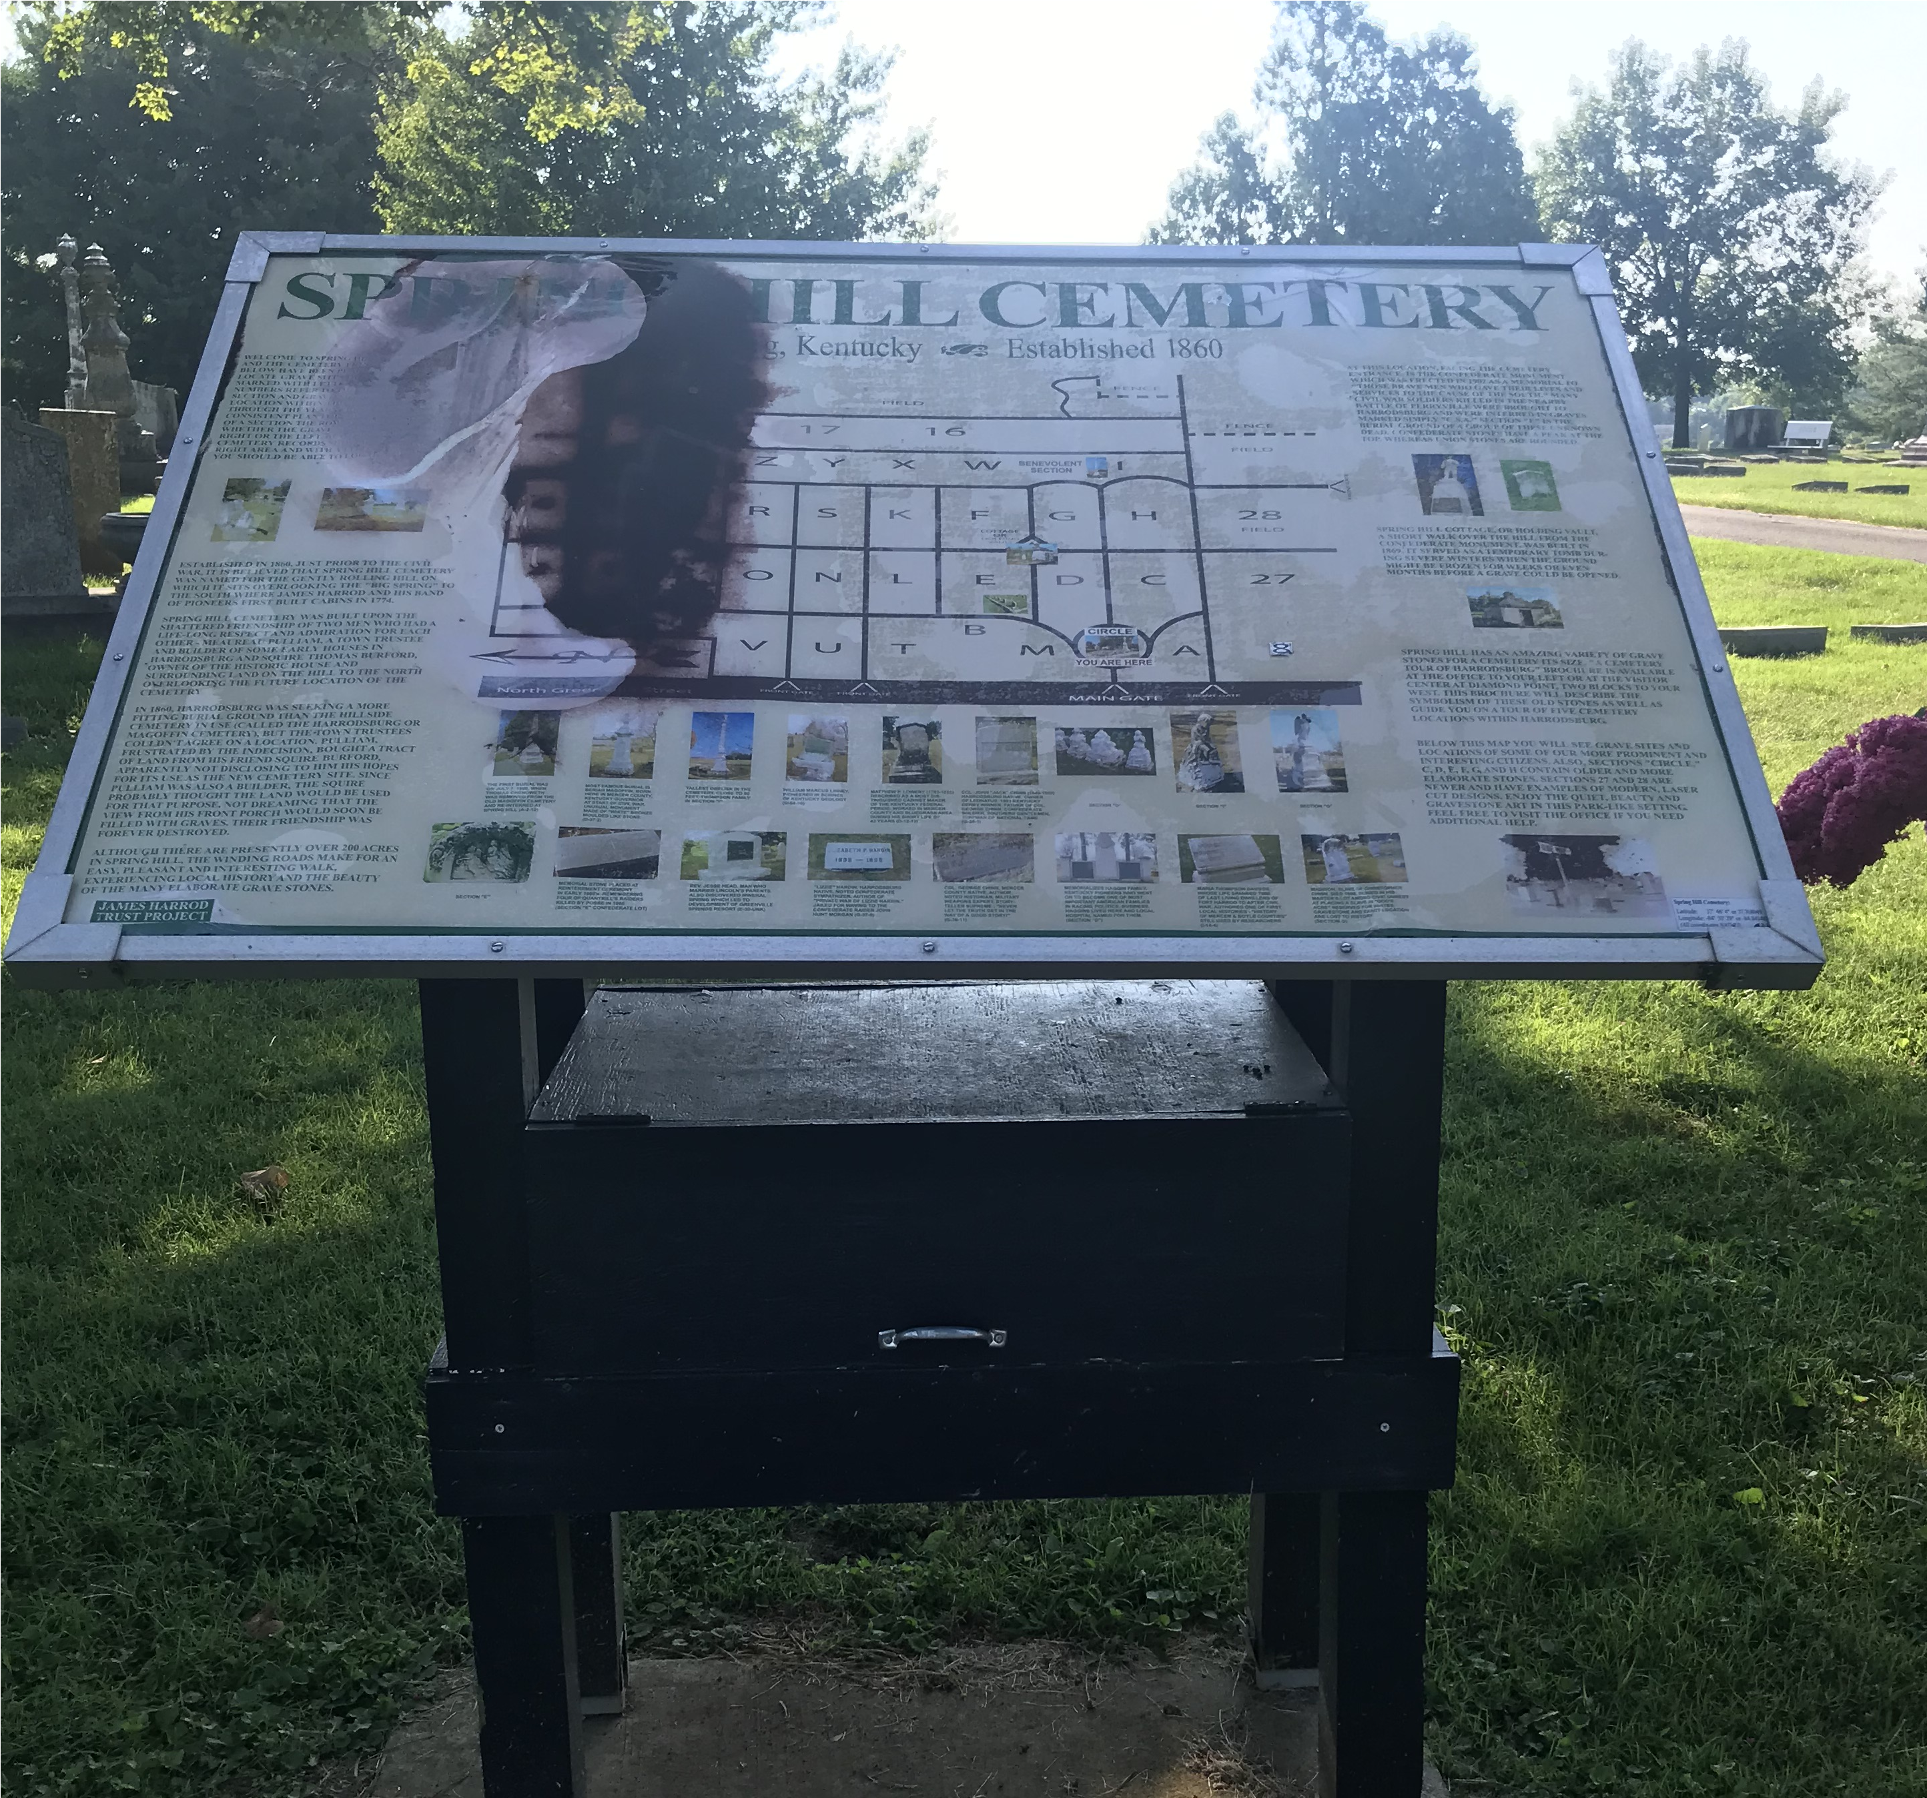
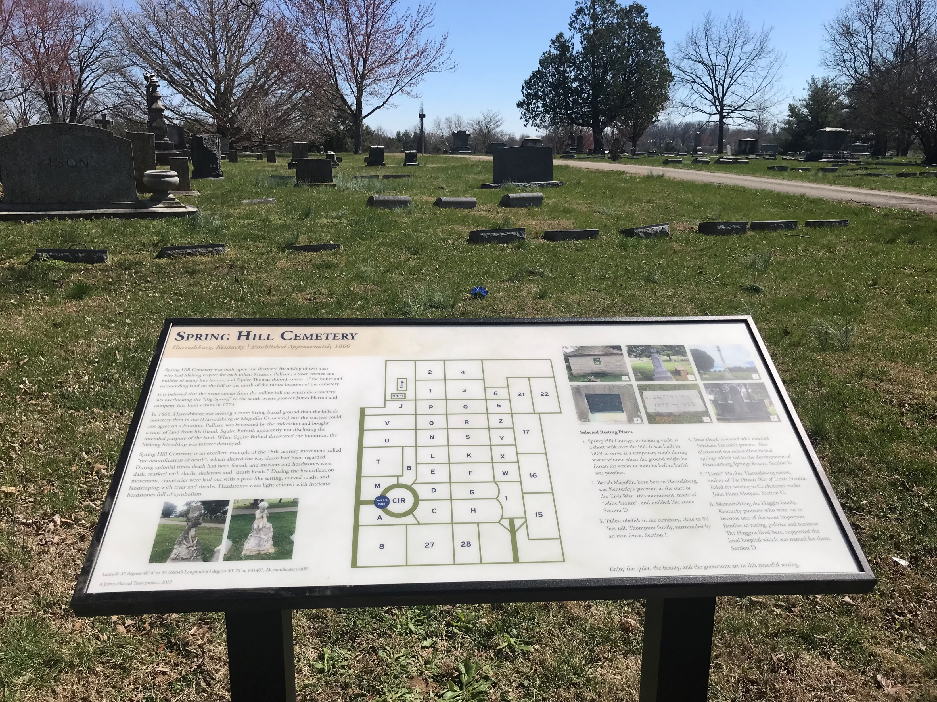
James Harrod Trust
Modernized and promoted our historic walking trails
Conducted “Porch tours” of historic properties
Redid cemetery signs in Harrodsburg’s major cemeteries
Worked with the local Tree Board to plant 60 new trees around FHSP

Slide 16
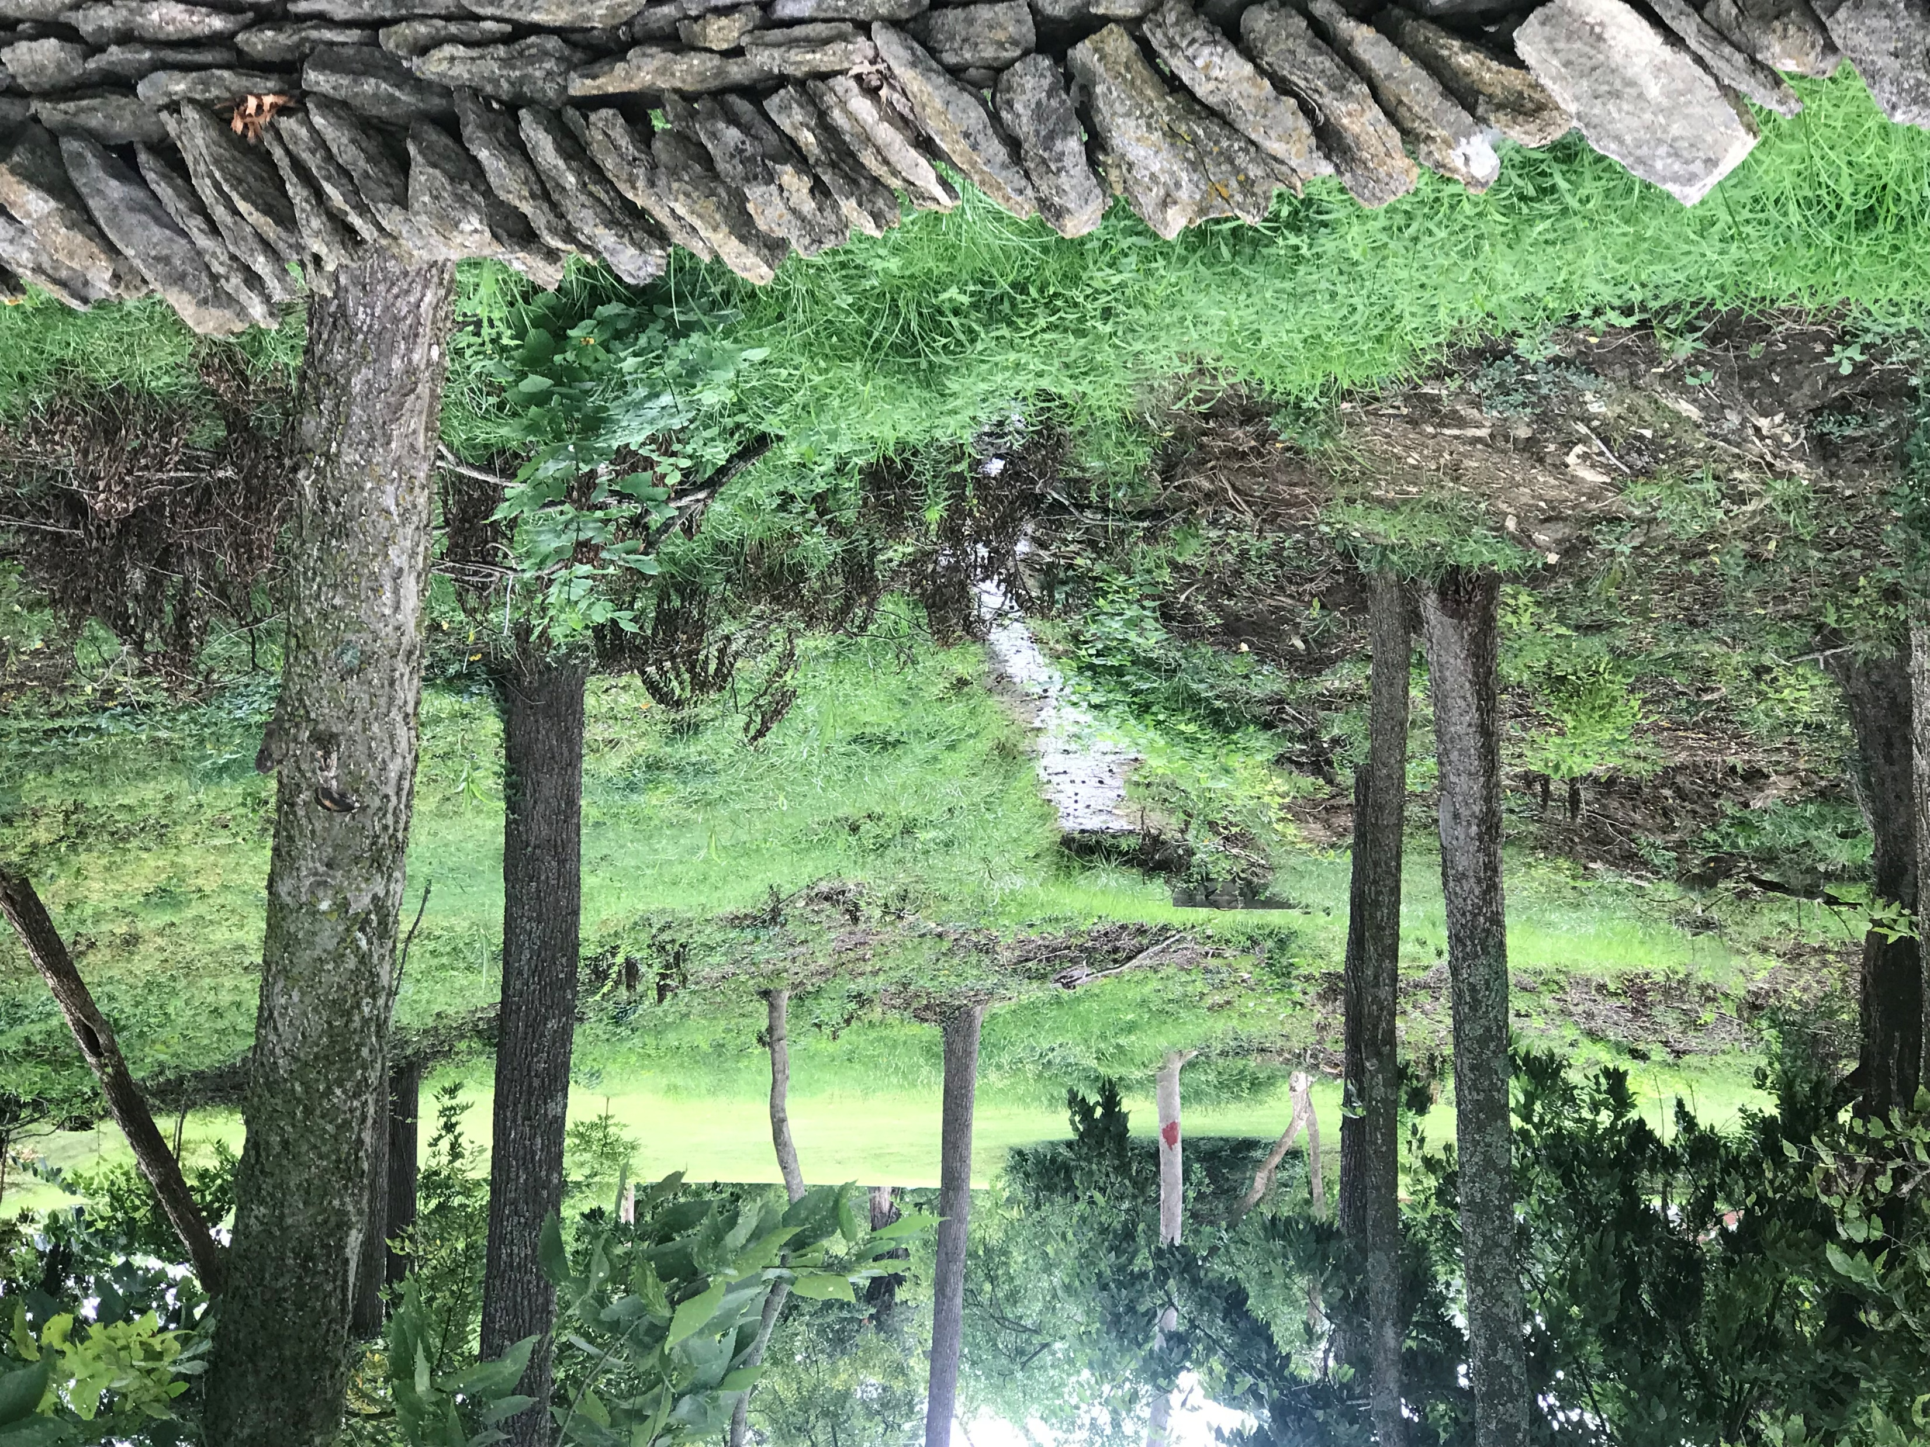
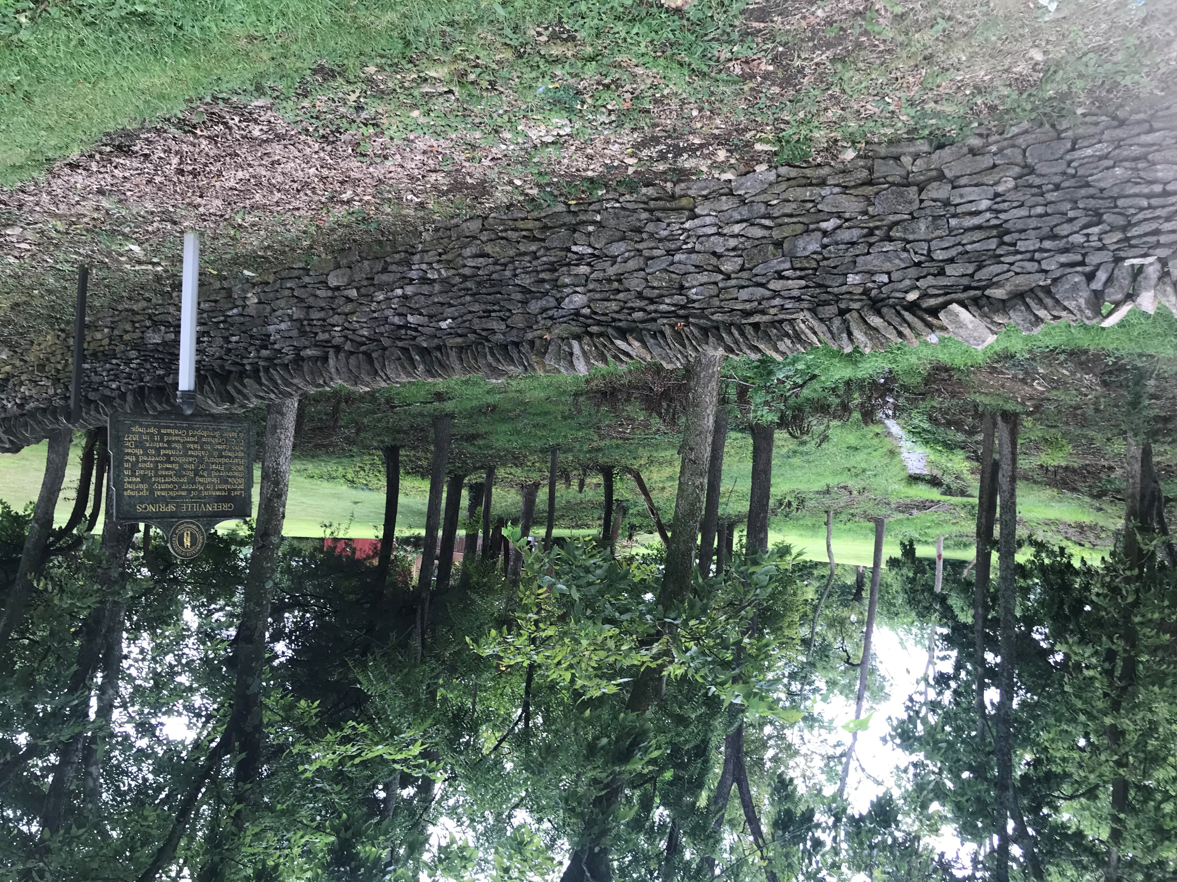
Greenville Springs Preservation

Slide 17
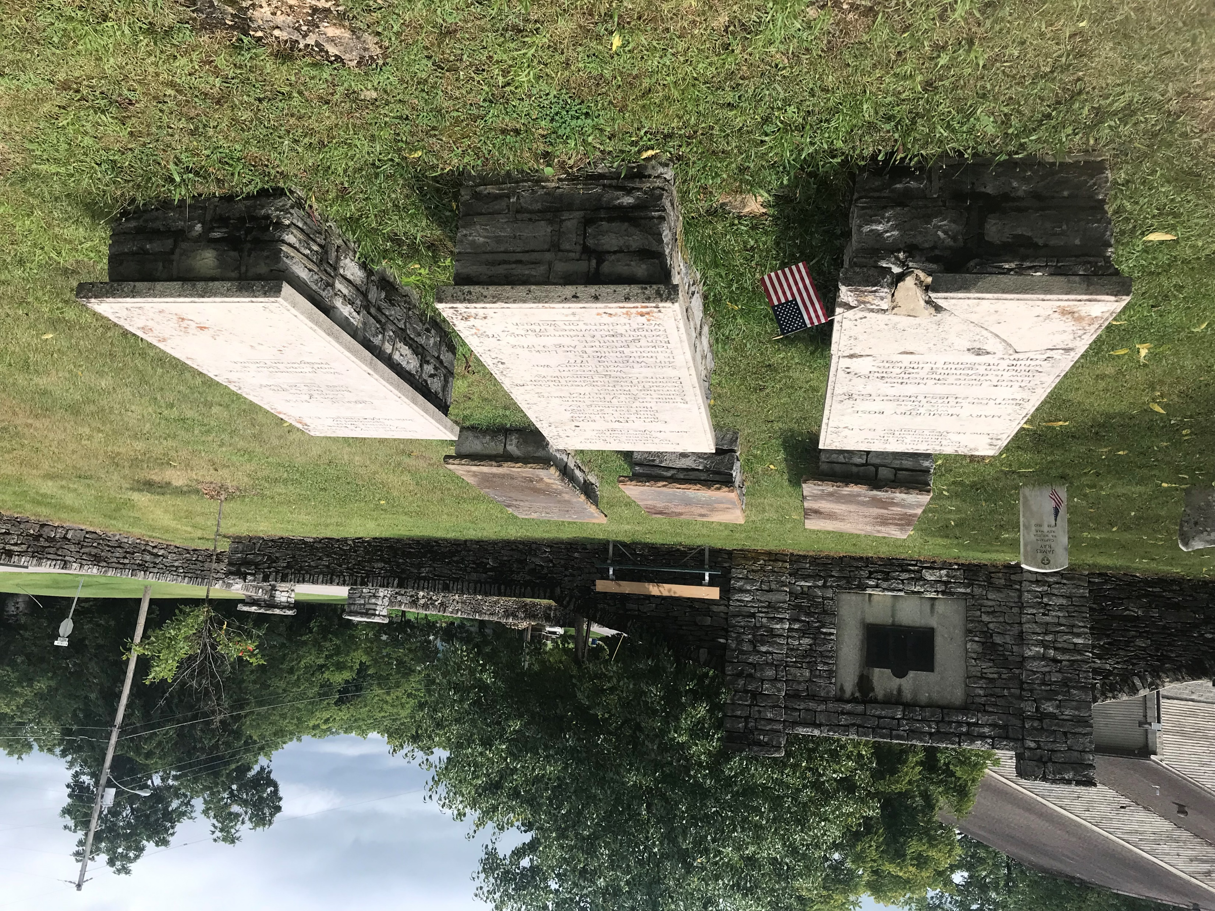
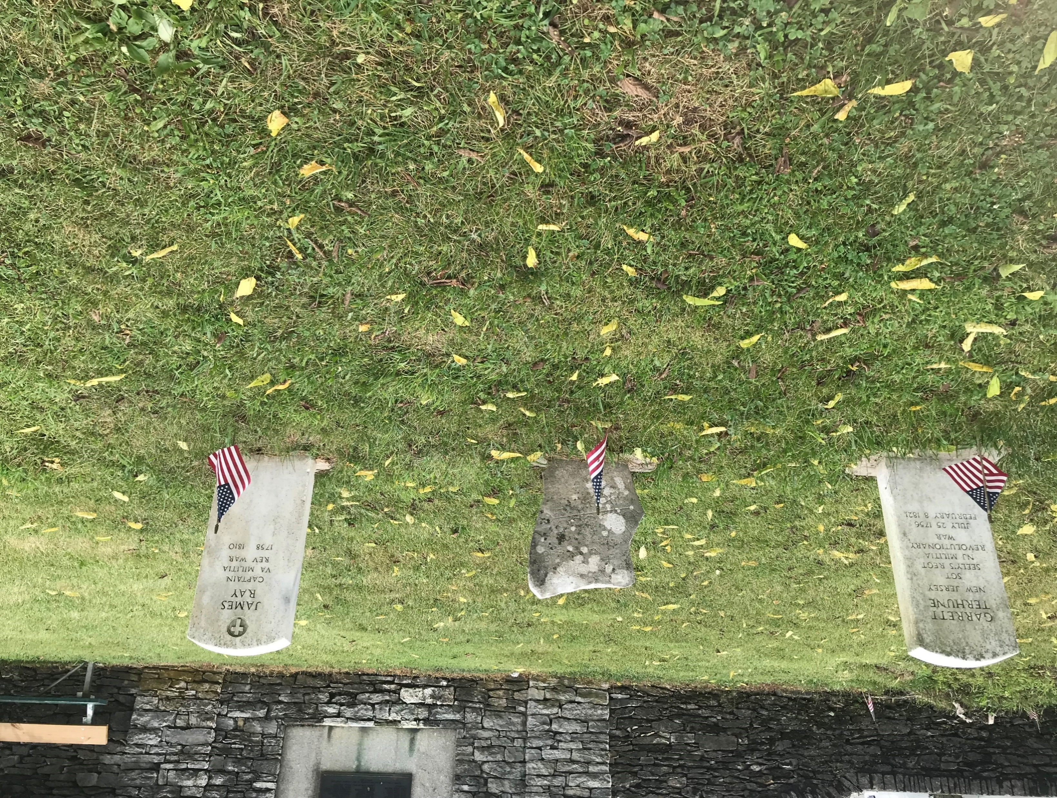
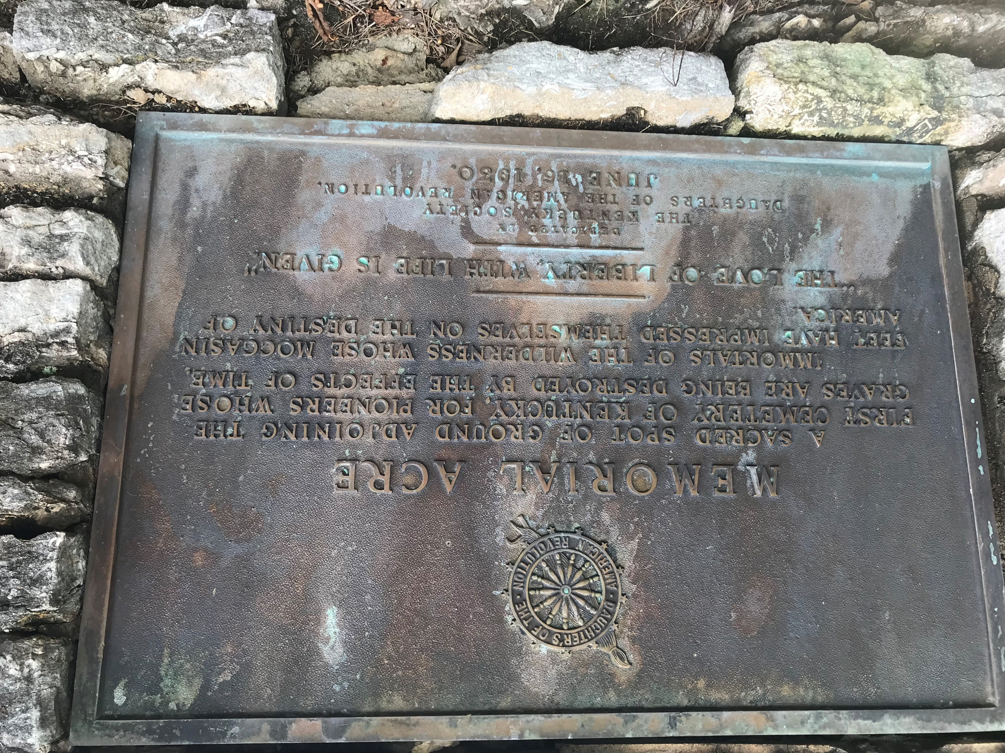
Previous
Preservation
Efforts

Slide 18
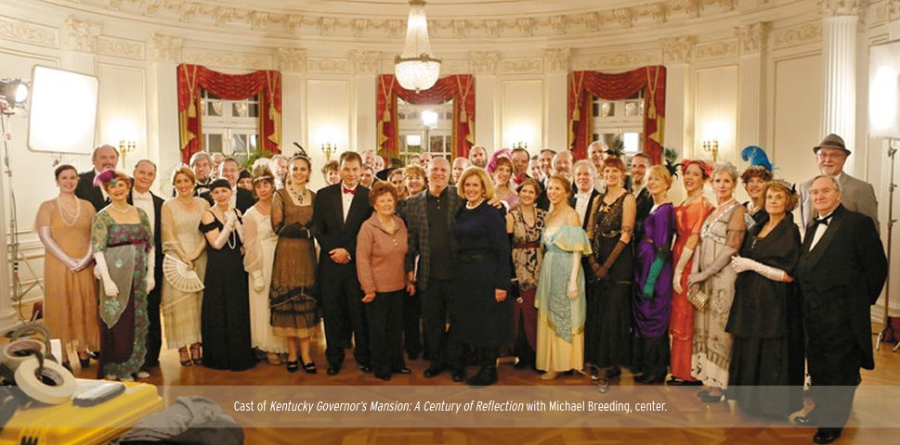
Documentary

Slide 19
Thank you for your time and support
Helen Dedman
250th Commission, Chair
James Harrod Trust
Helenwdedman@gmail.com
( 859) 583-8999
Nancy Hill
Harrodsburg Historical Society
nah1701@yahoo.com
(859) 613-1903
David Kirkpatrick
Mercer Co. Public Library
dak@mcplib.info
(859) 734-3680

