Slide 1
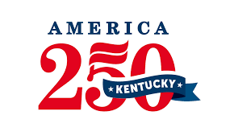
October 8-12, 2025 • Along the Banks of the Ohio River in Cincinnati and Kentucky
©2024 America's River Roots, Inc. All images used for education purposes.

Slide 2
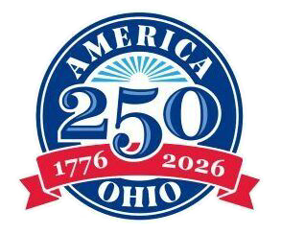
America’s River Roots
OUR STORY
The Ohio River, with its rich history, has played a pivotal role in shaping our nation's growth and diverse cultures. As we approach America's birthday, we are excited to celebrate this heritage and promote cultural tourism.
Promote America’s unique river roots history
A celebration of music, culture & cuisine
Kick off to America’s 250th!
©2024 America's River Roots, Inc. All images used for education purposes.
IN ASSOCIATION WITH:
Notes:
Woody Keown:
Today we are celebrating “Rivers in America’s expansion and the Role the river played in Freedom Journey.

Slide 3
Why America’s River Roots?
Celebrate Our Nation’s 250th
Grow Our Global and National Cultural Tourism Economy
Showcase Our Multicultural Community and World Class Riverfront
Economic Impact, Talent Retention and Attraction
IN ASSOCIATION WITH:
Notes:
Rick Greiwe Slide – Regional goals

Slide 4
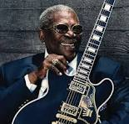
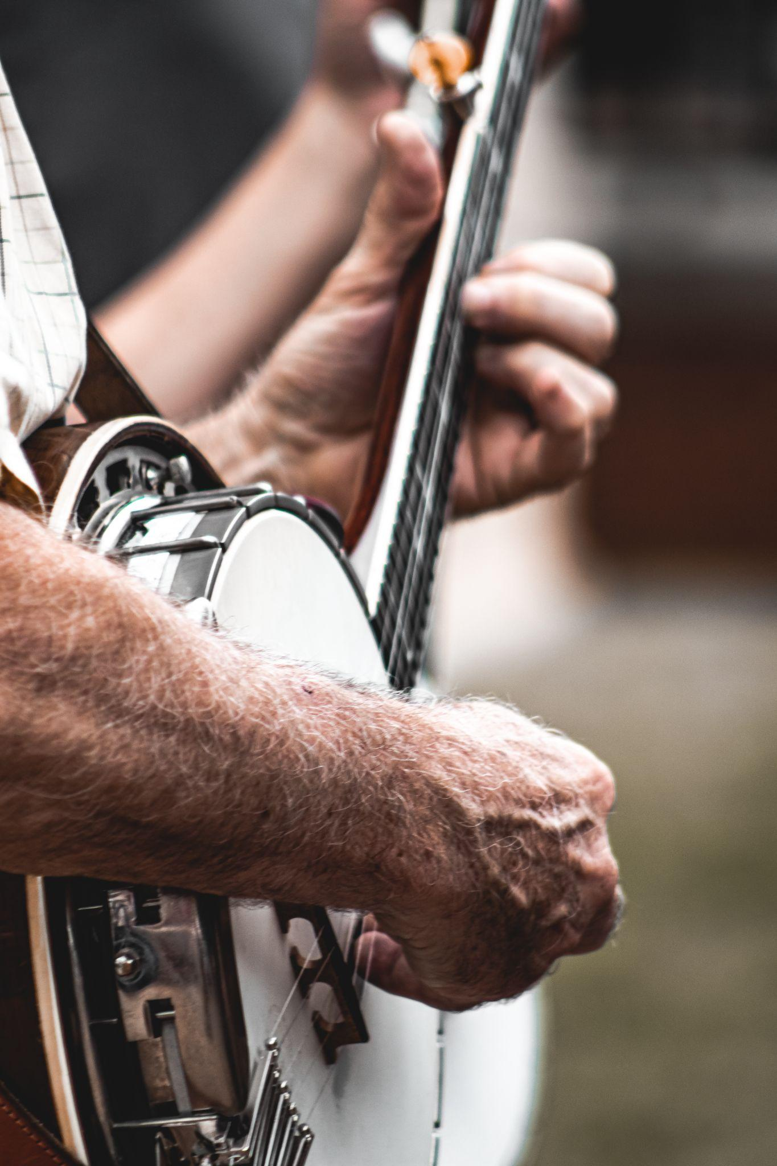
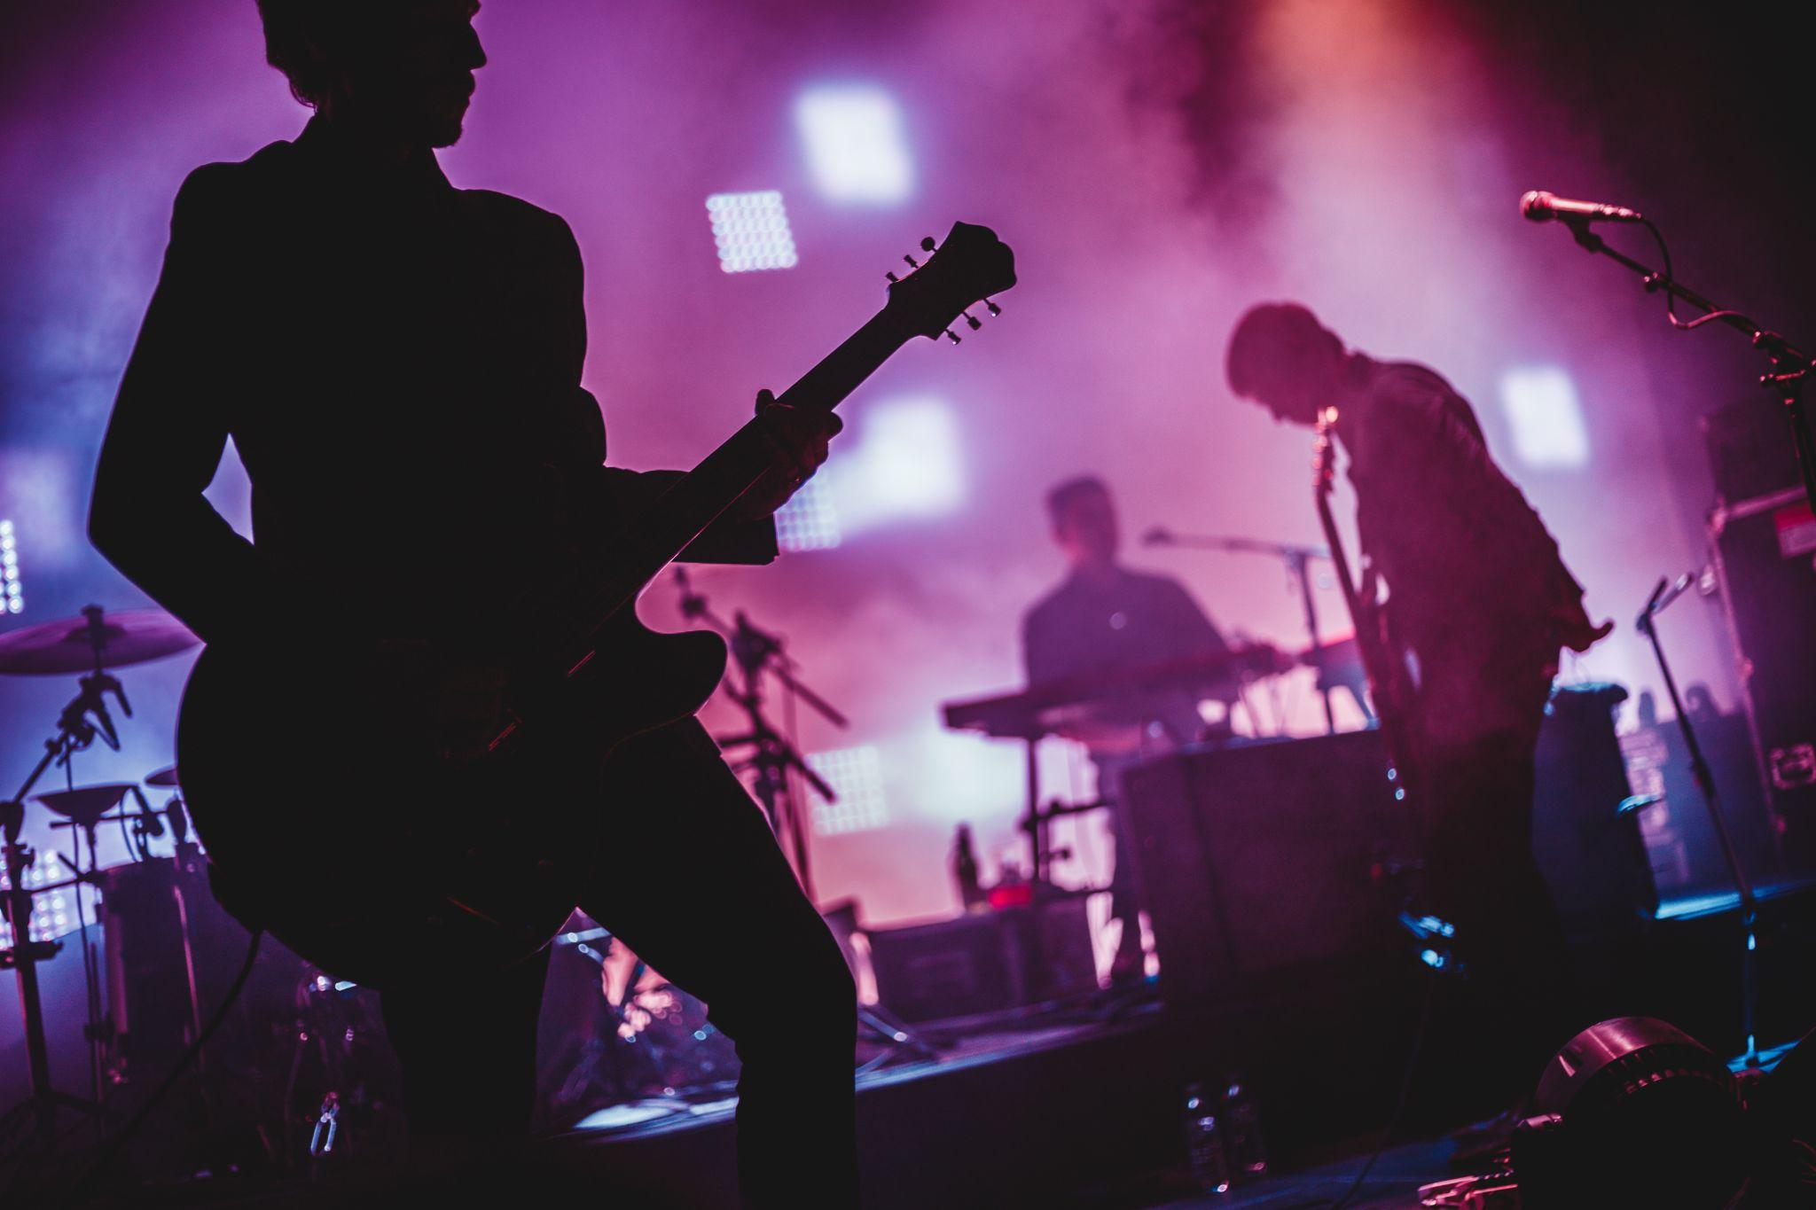
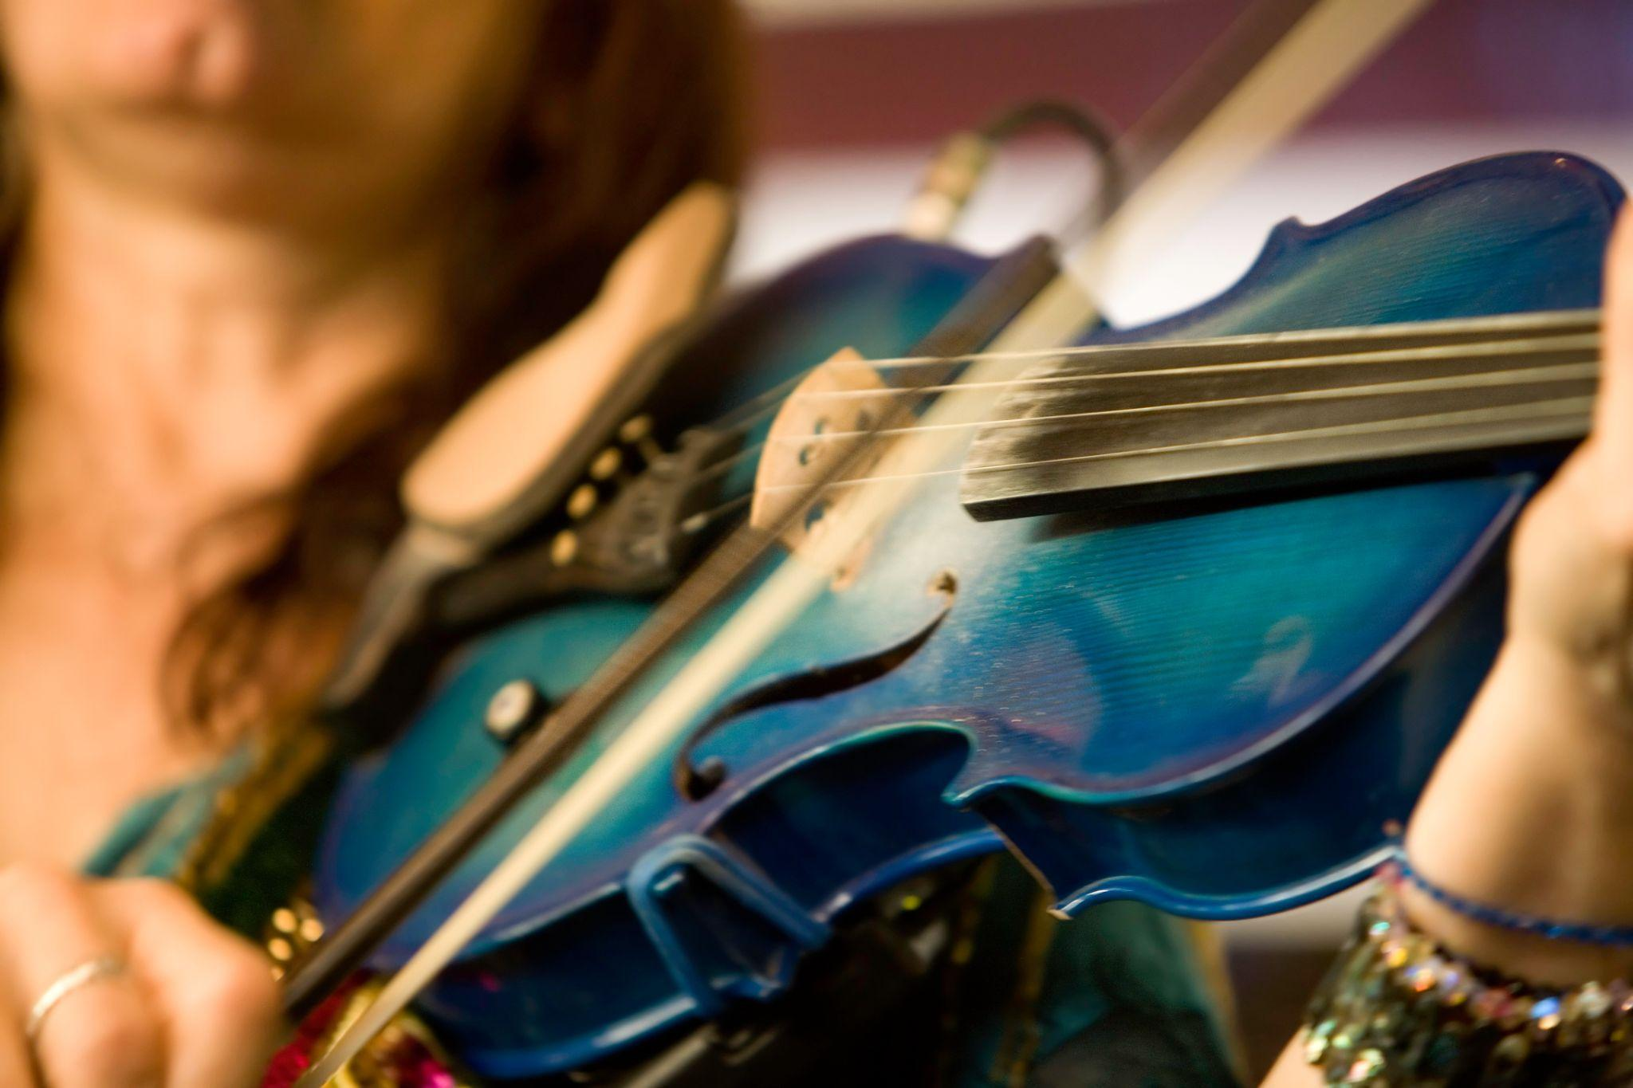
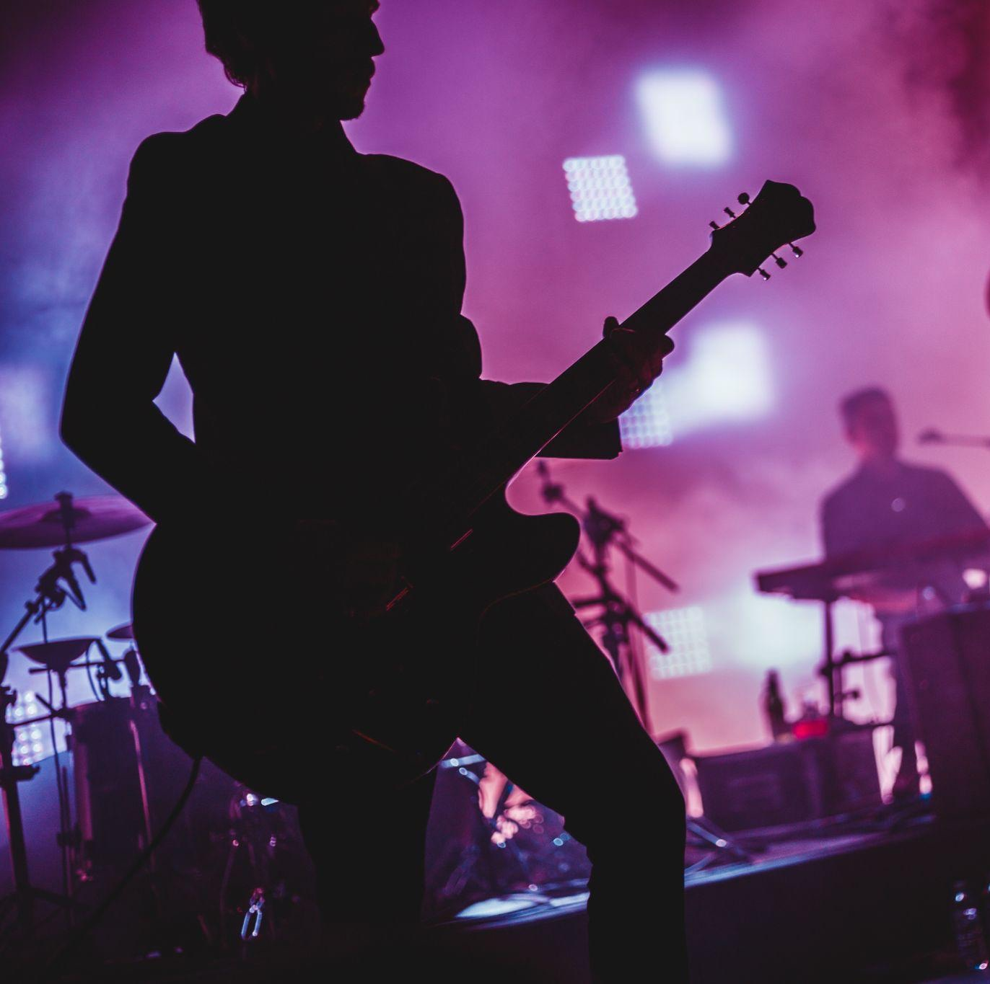
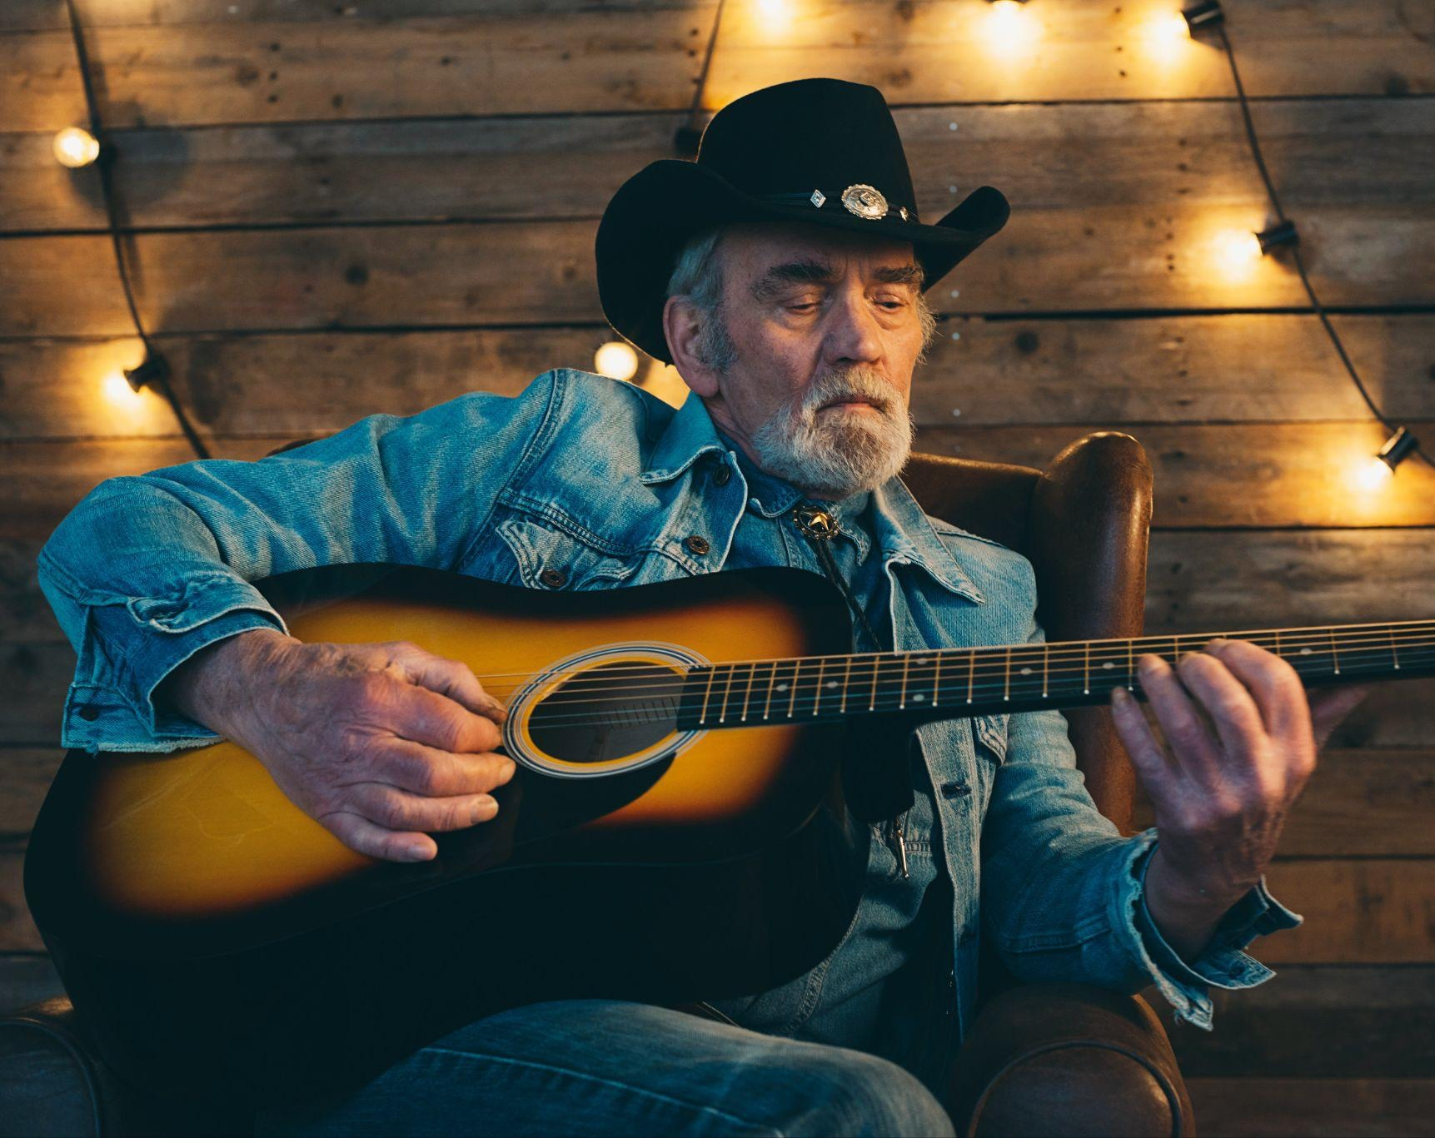
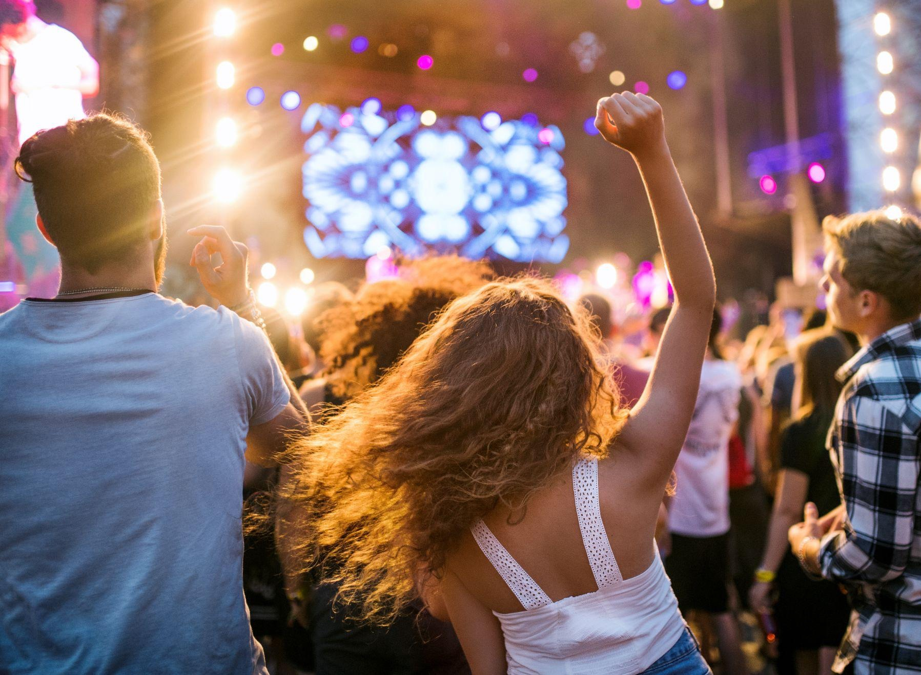
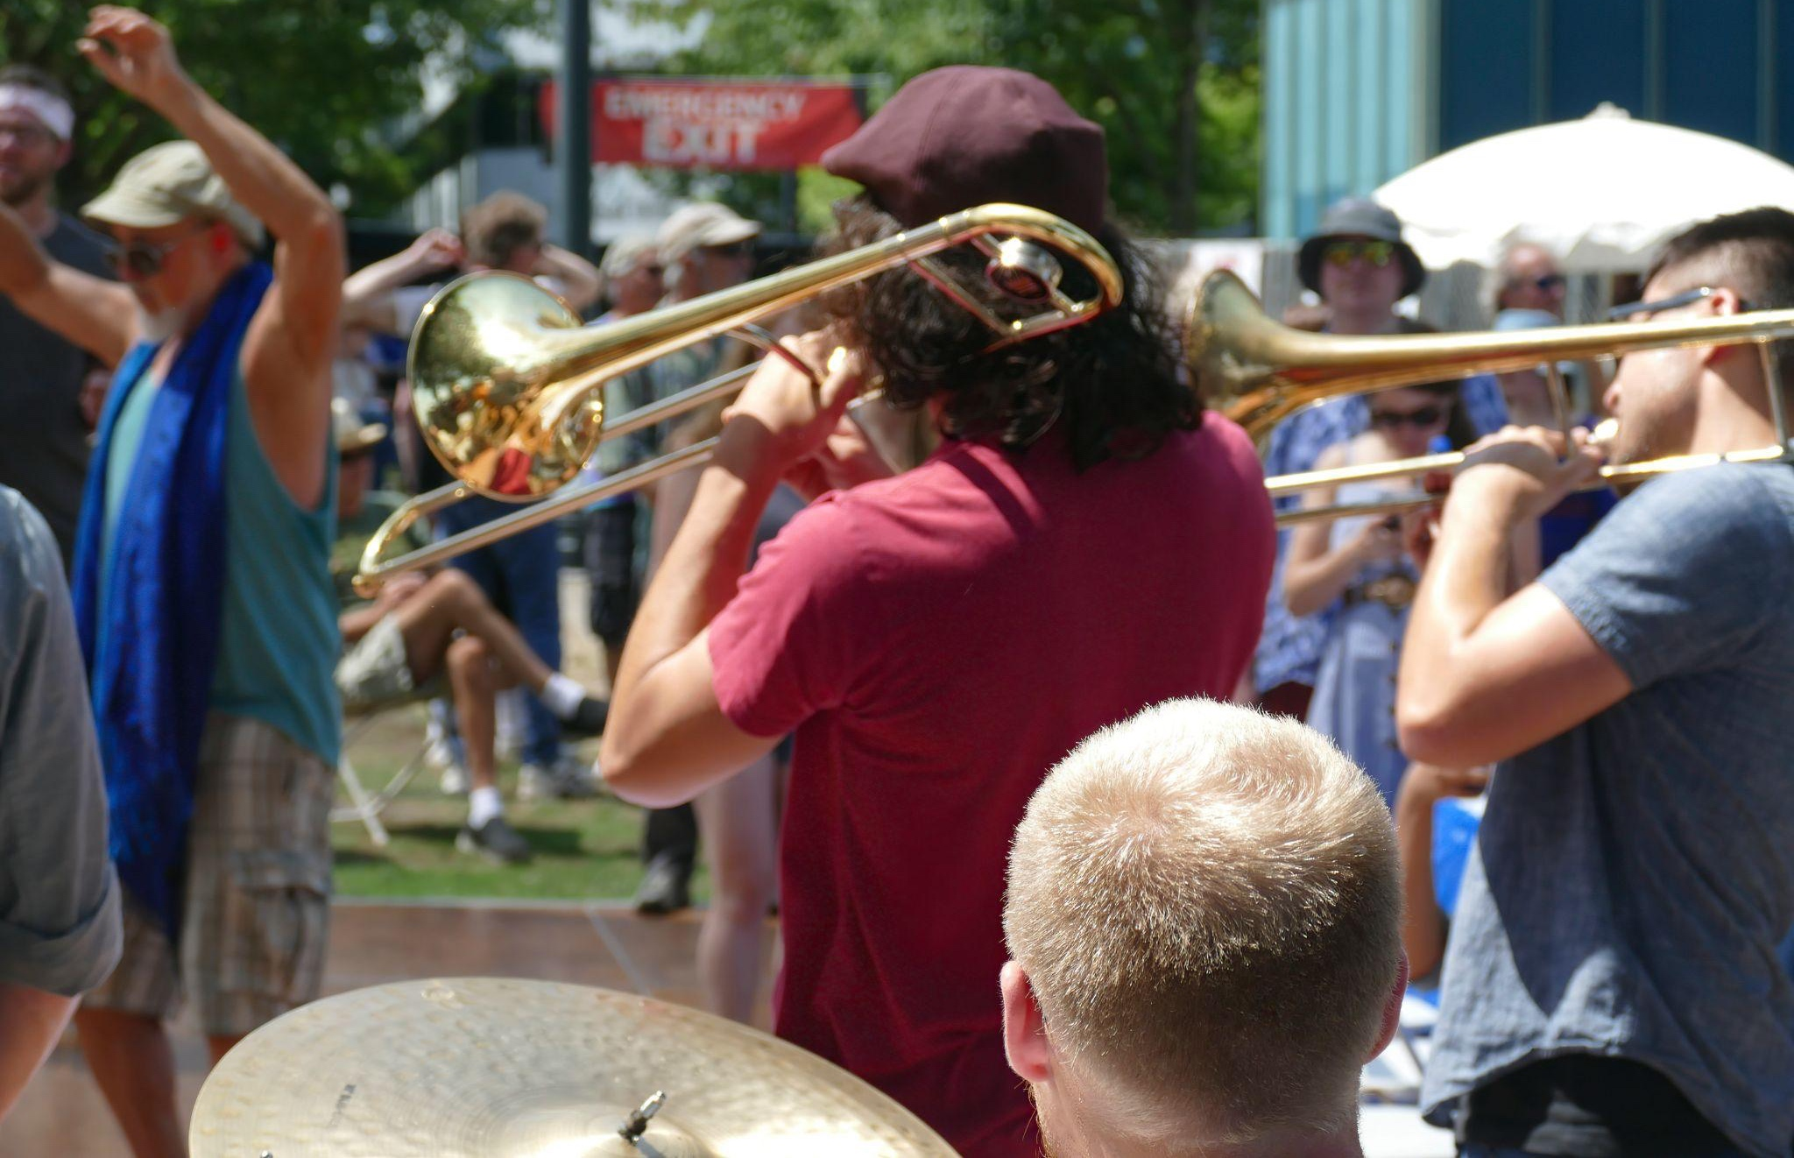
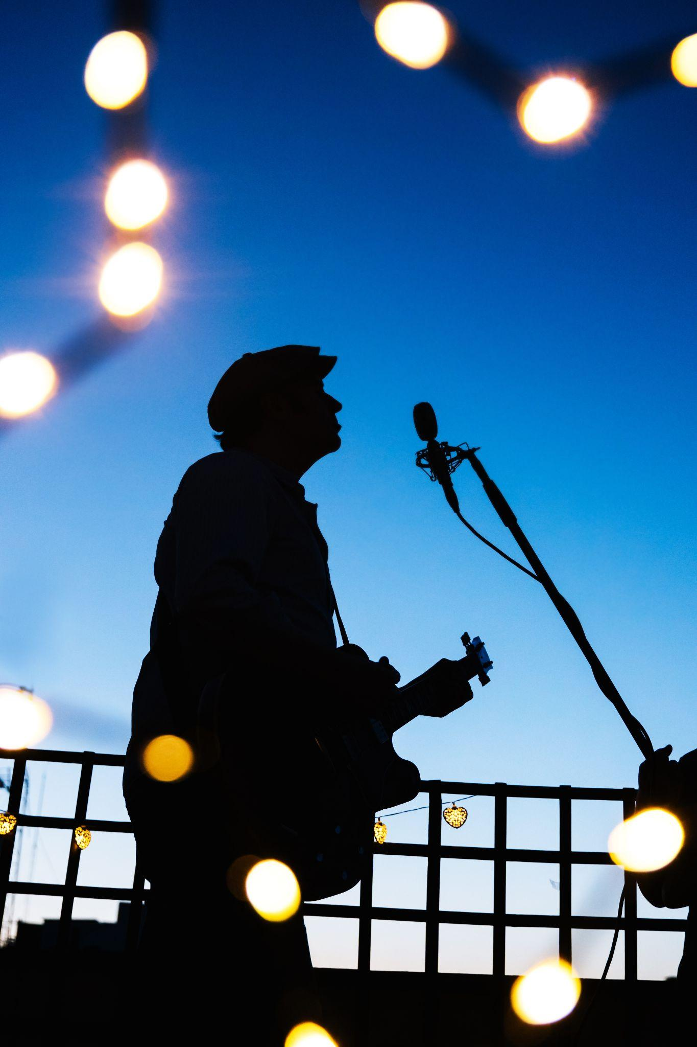
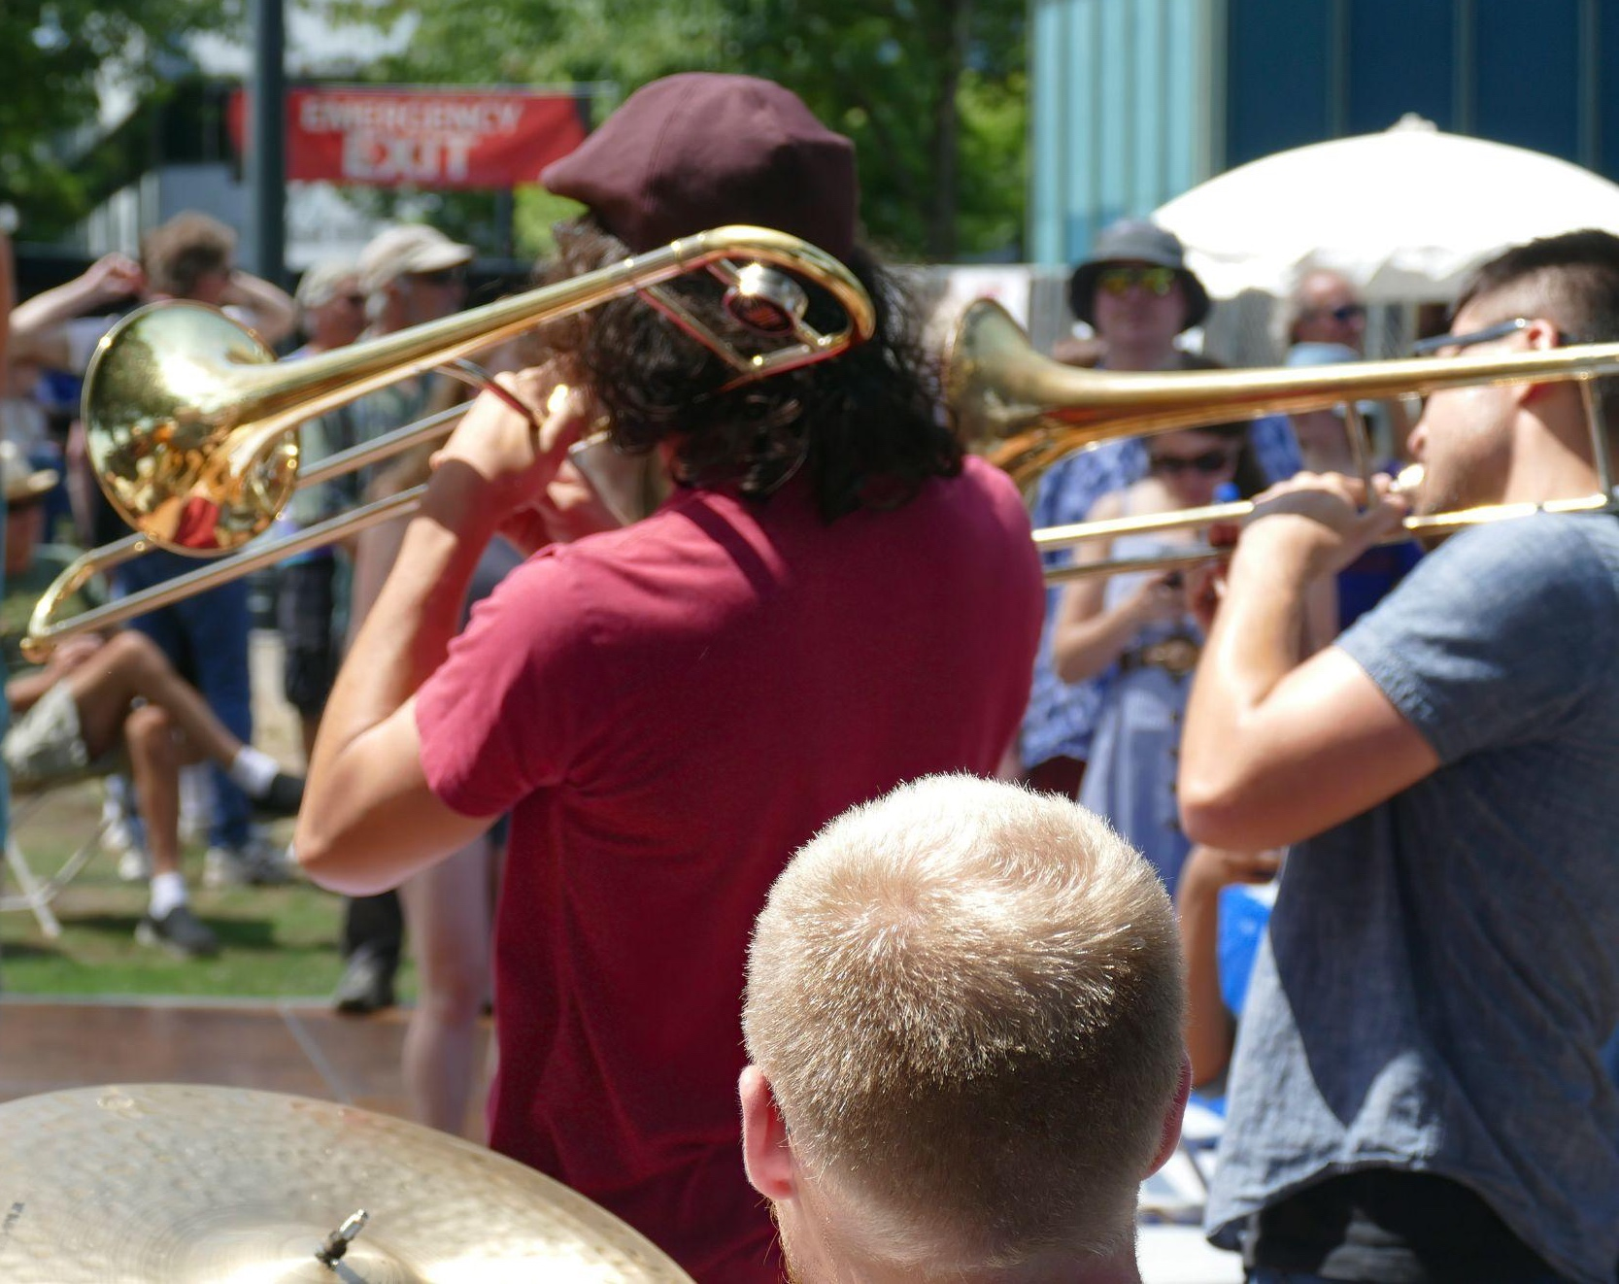
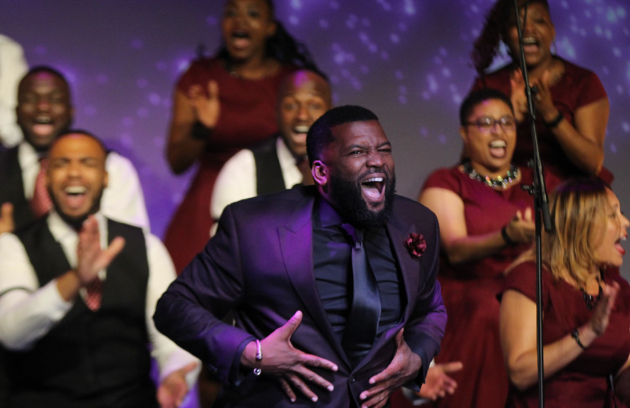
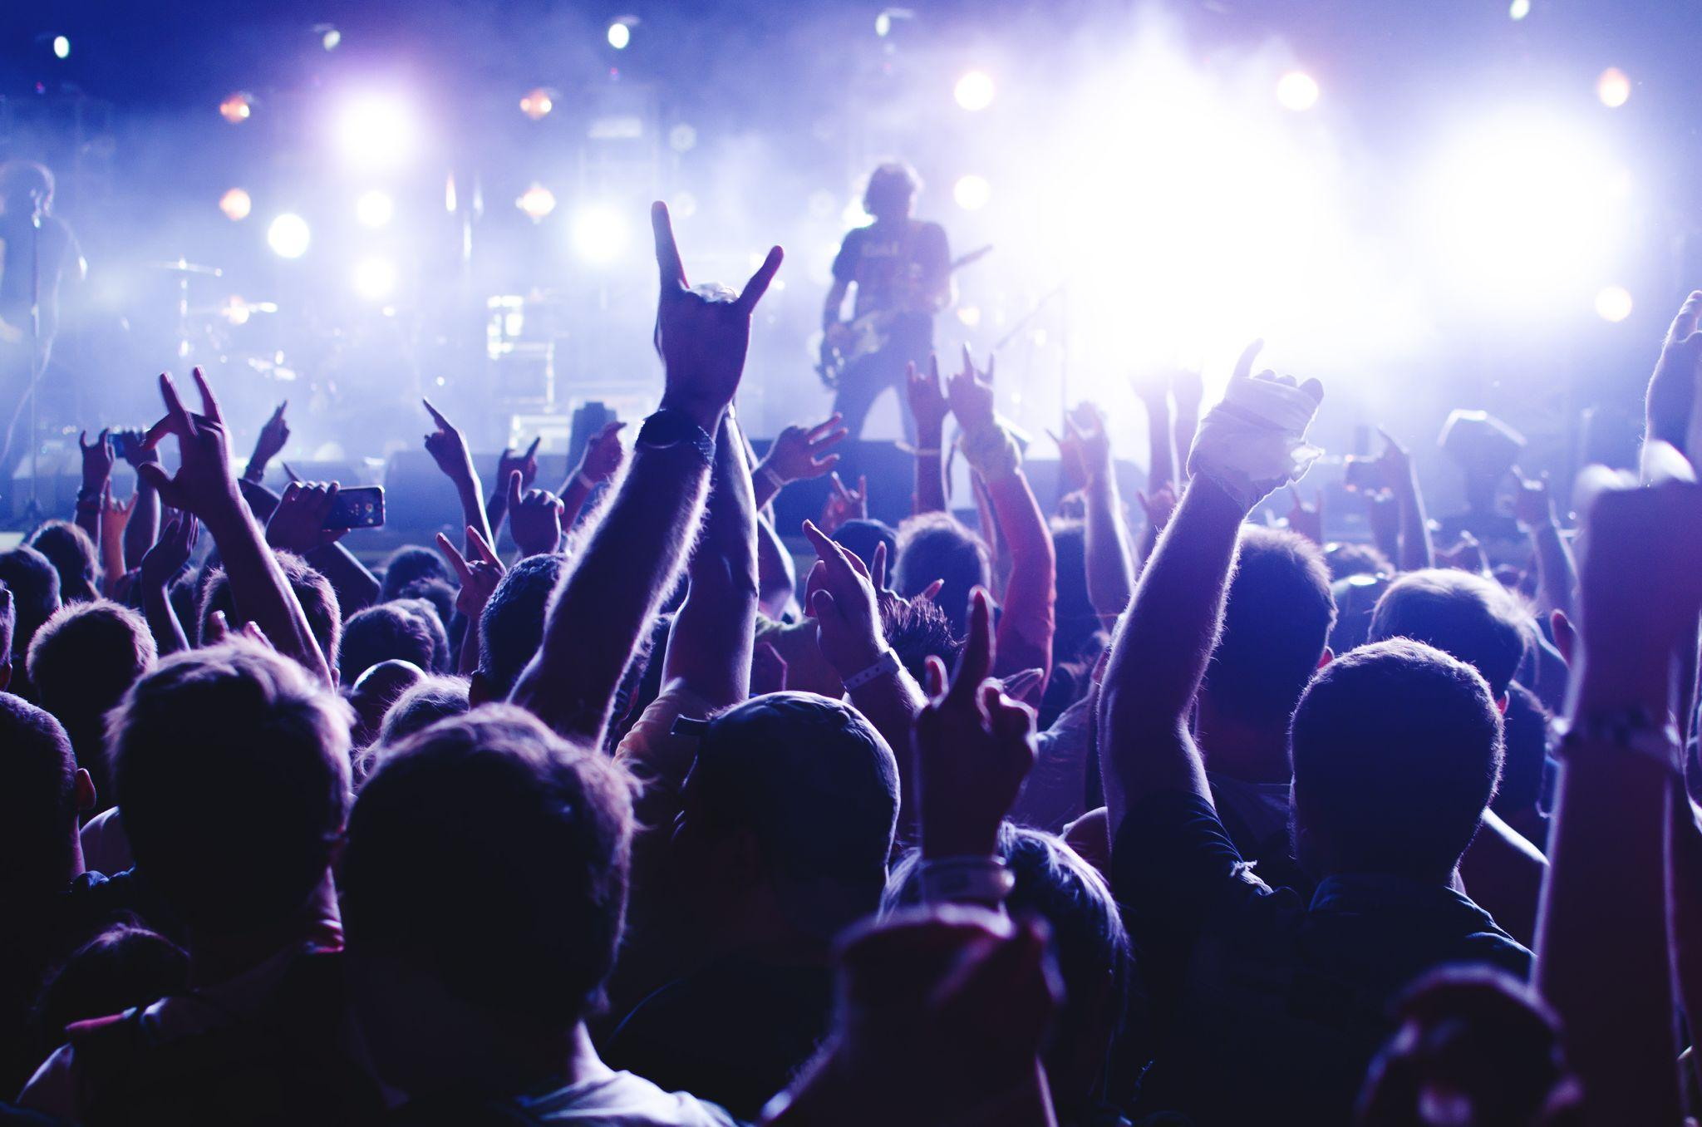
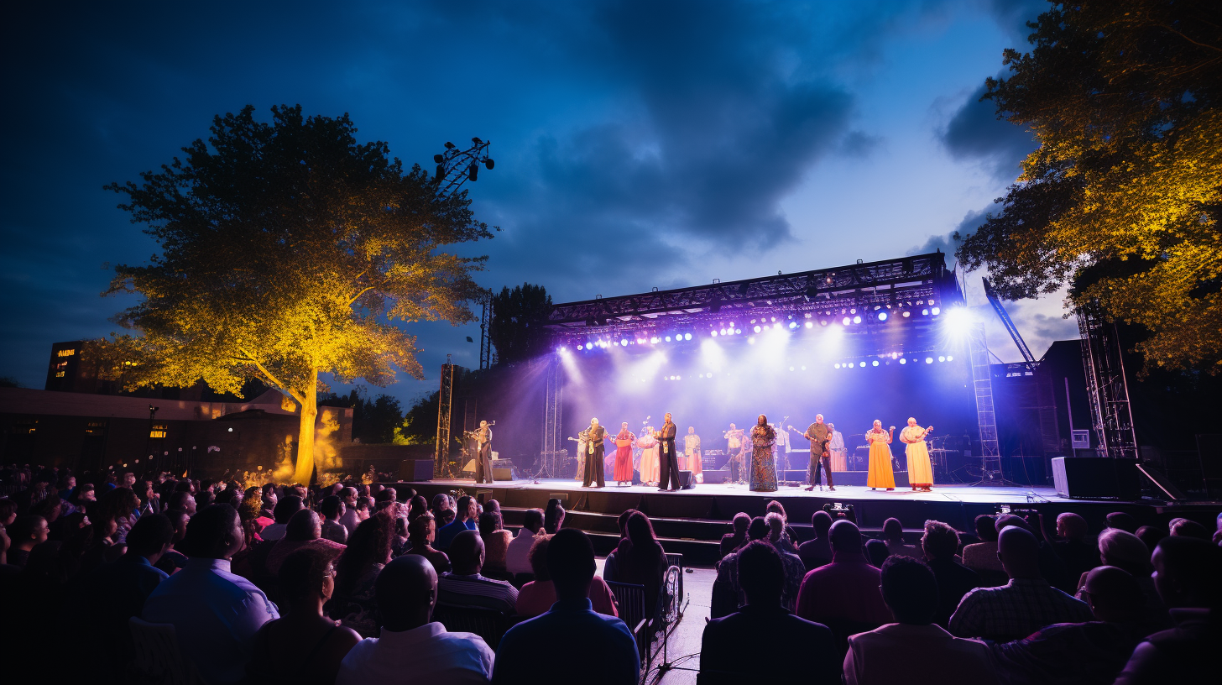
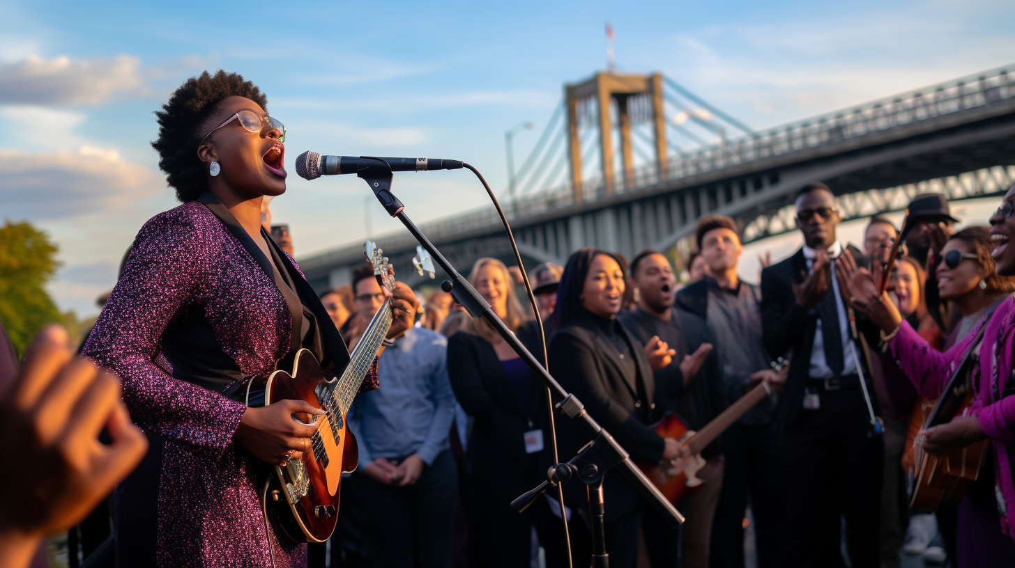
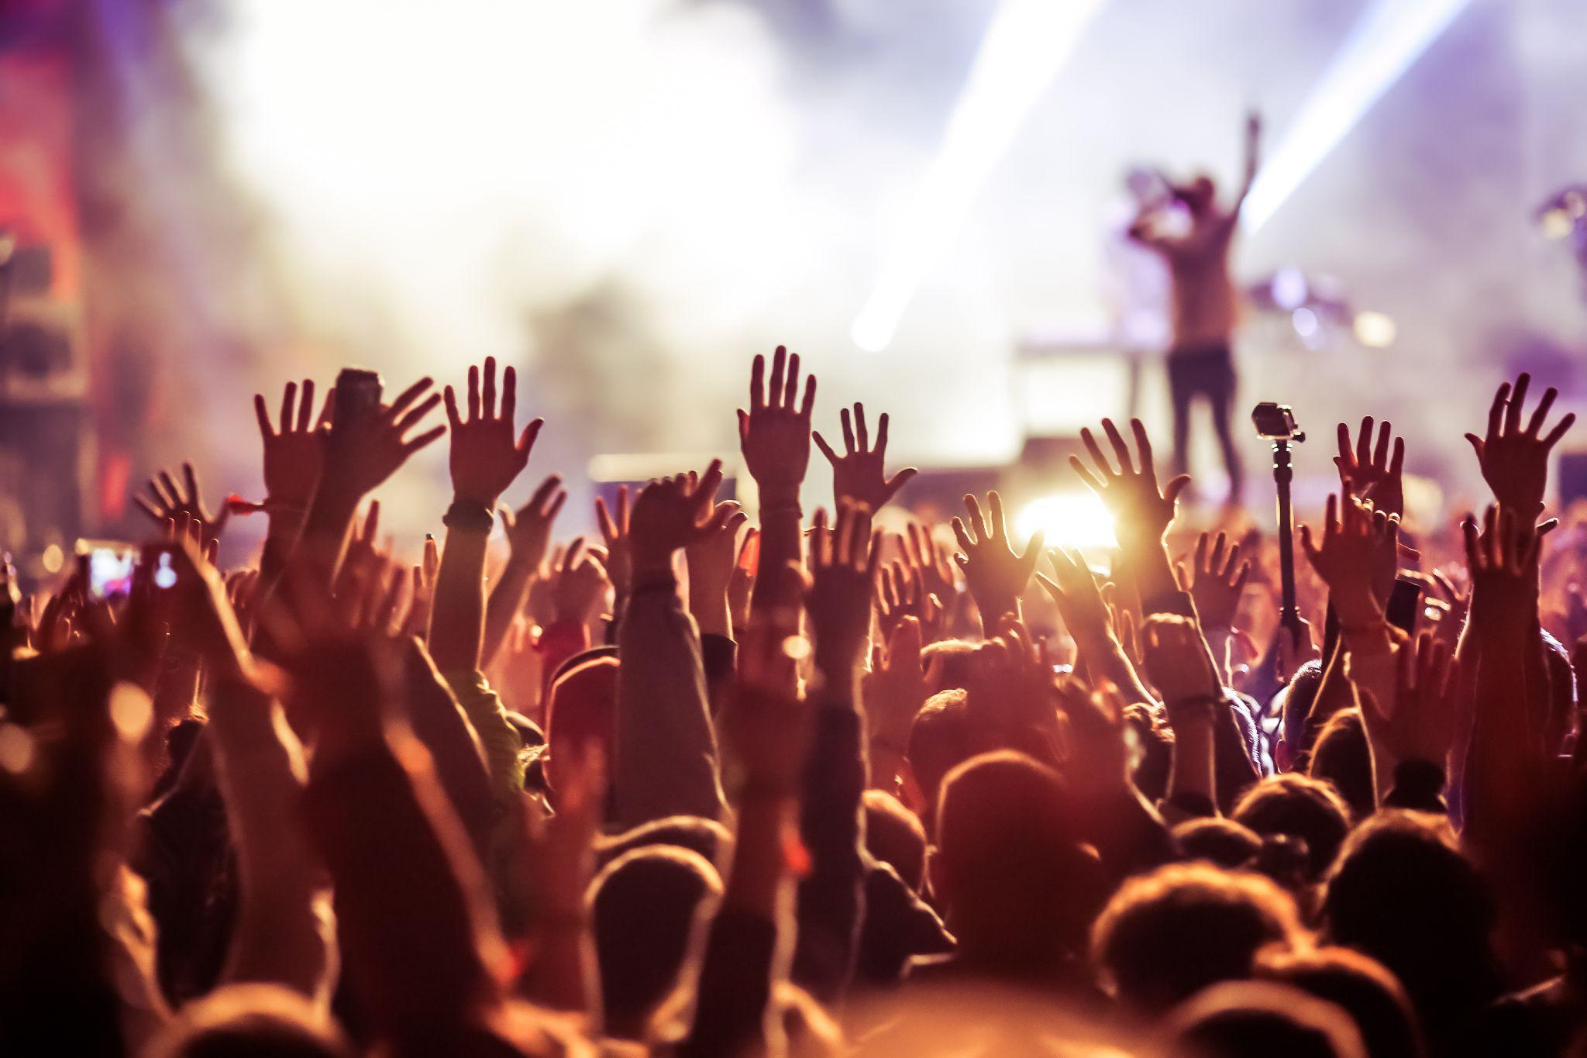
America’s River Roots
MUSIC
Nationally Recognized and Emerging Artists
8 Free stages on the Ohio and Kentucky Riverfront
1 main paid stage
7 Free stages
River Roots Gospel Revival
Cincinnati Black Music Walk of Fame
Image: ©2023 Buoyant Partners, Inc.
Image:
Notes:
on four stages for four days showcasing the depth of America’s roots musical traditions in bluegrass, blues, jazz, gospel, folk, roots rock, and zydeco. A collection of tributes in honor of America's 250th
featuring top gospel choirs from river cities

Slide 5
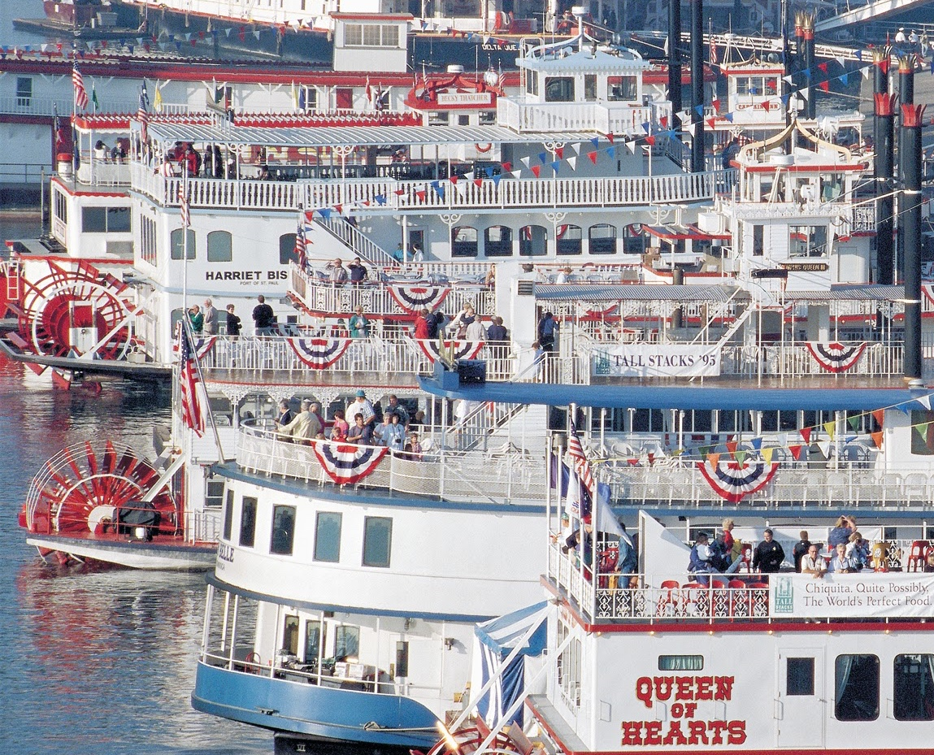
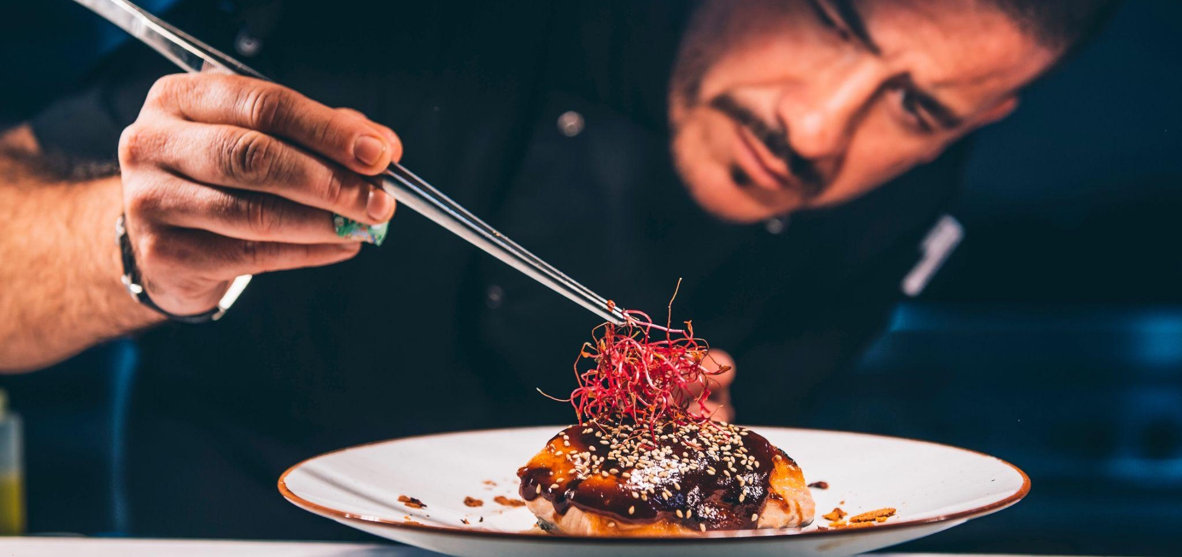
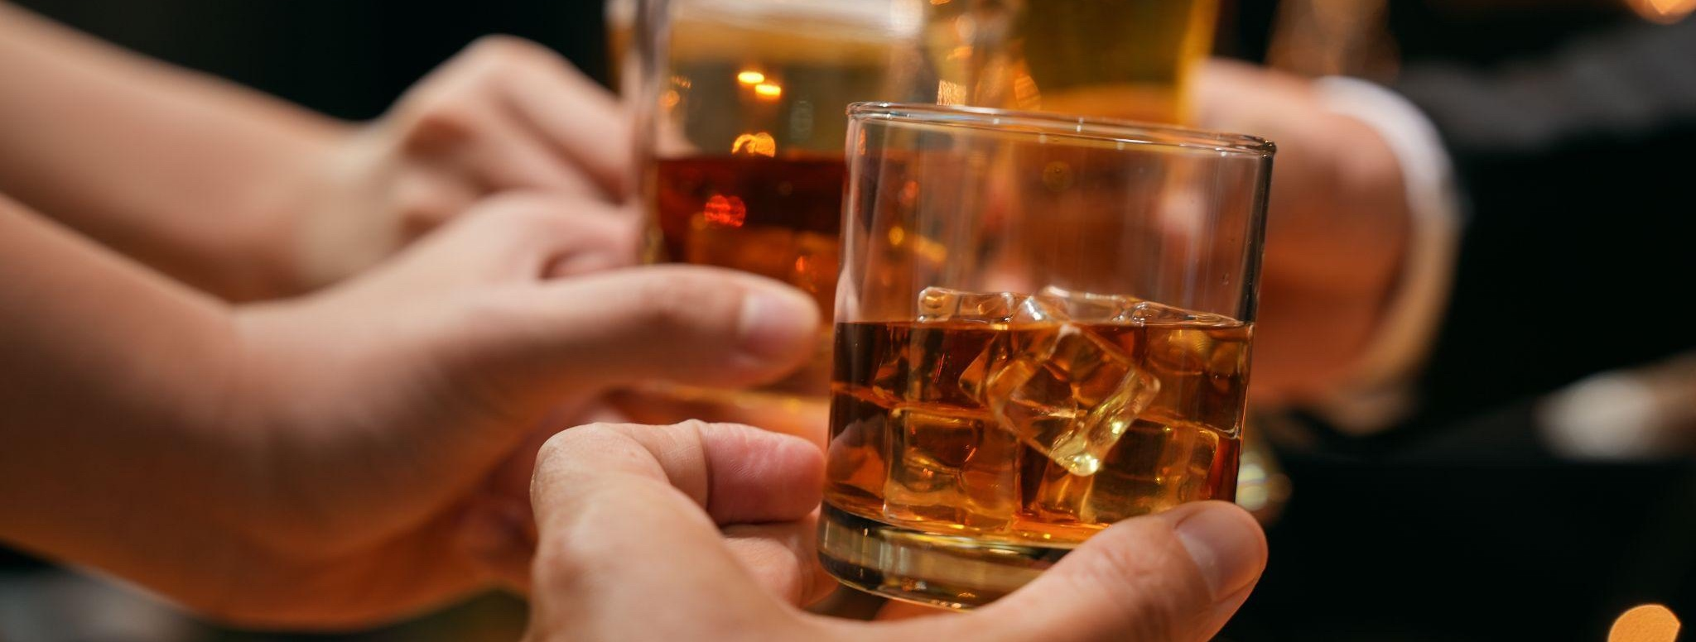
America’s River Roots
CUISINE
Multicultural Food and Products
Regional Food Truck and Restaurant Row
Celebrity Chef Presentations at The
Metropolitan Club & Anderson Pavilion
Bourbon Tasting Sessions
Craft Beer Tasting Sessions
Purple People Bridge “Good and Local” Bazaar
Themed Riverboat Offerings
Image: Kroger | Chef Paul Sturkey
Notes:
Kelly

Slide 6
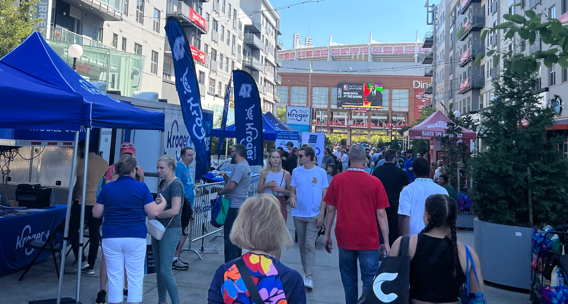
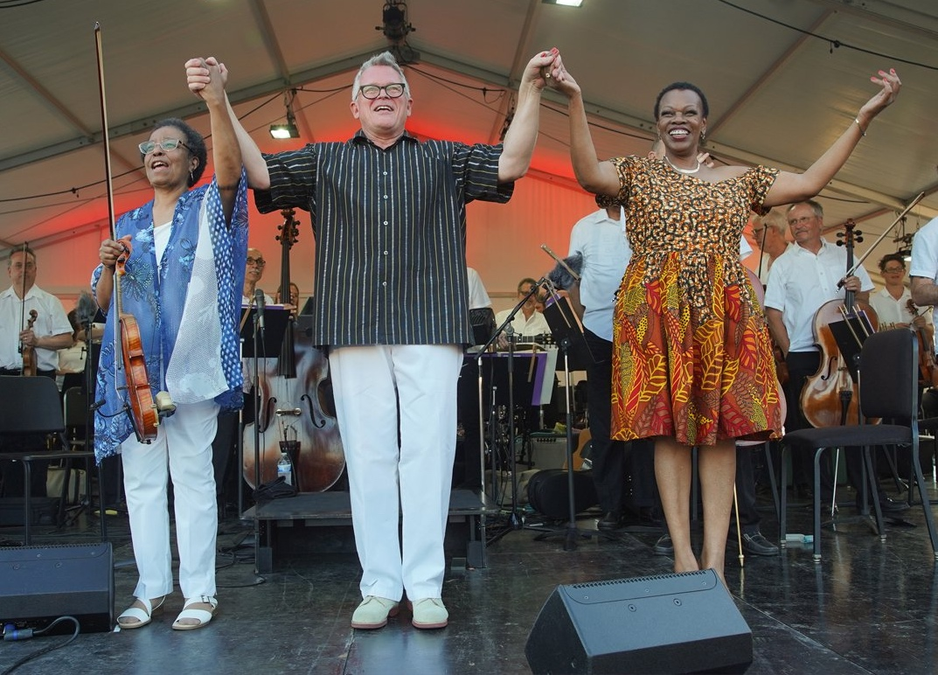
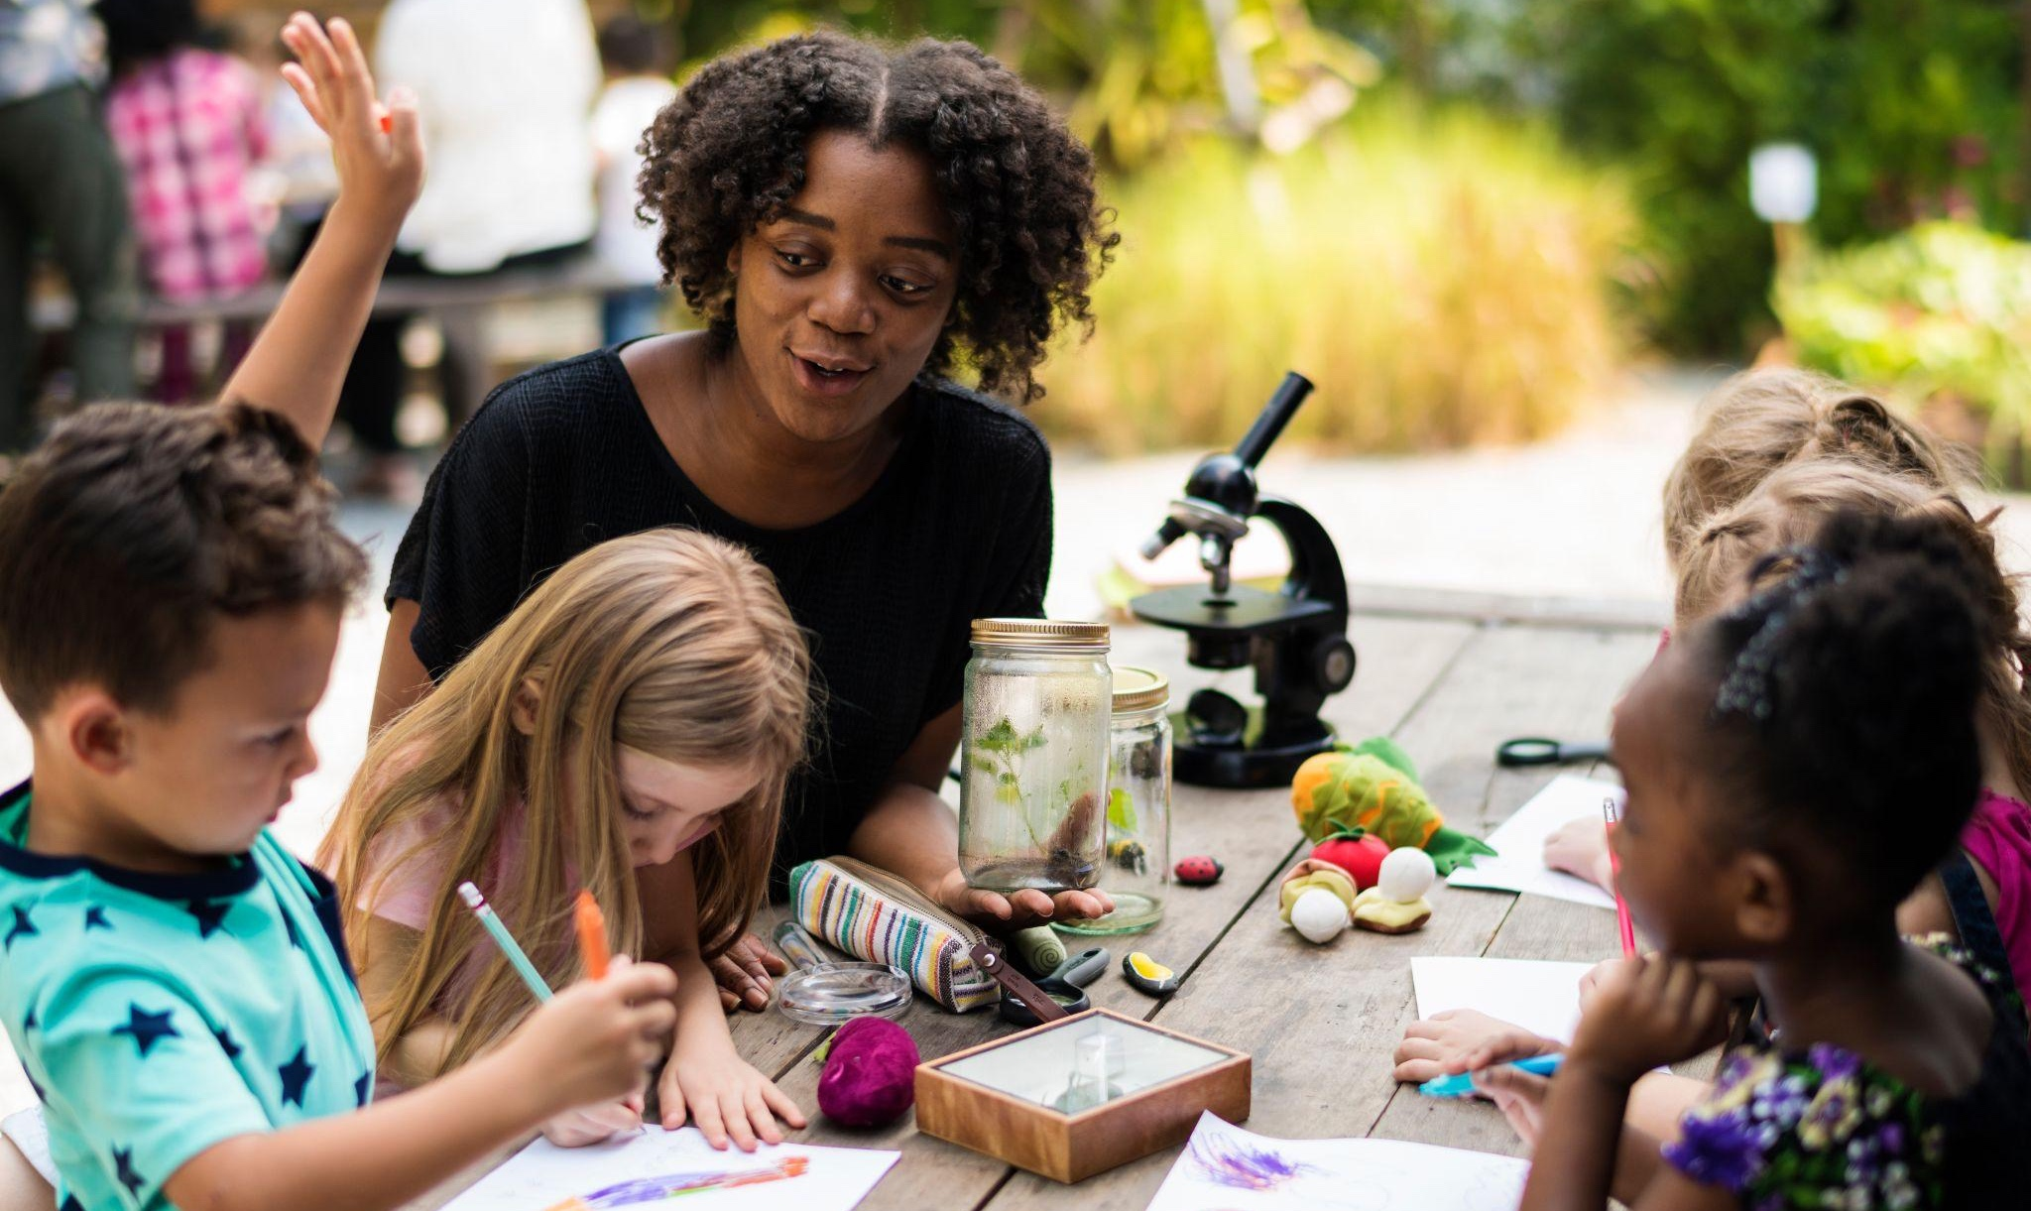
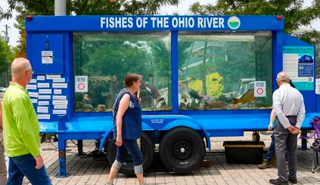
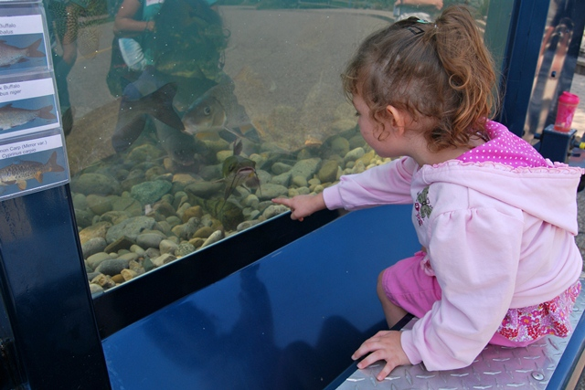
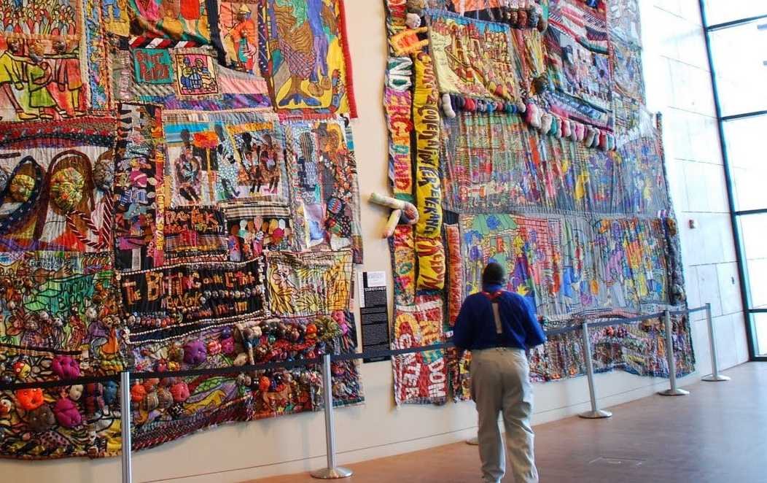
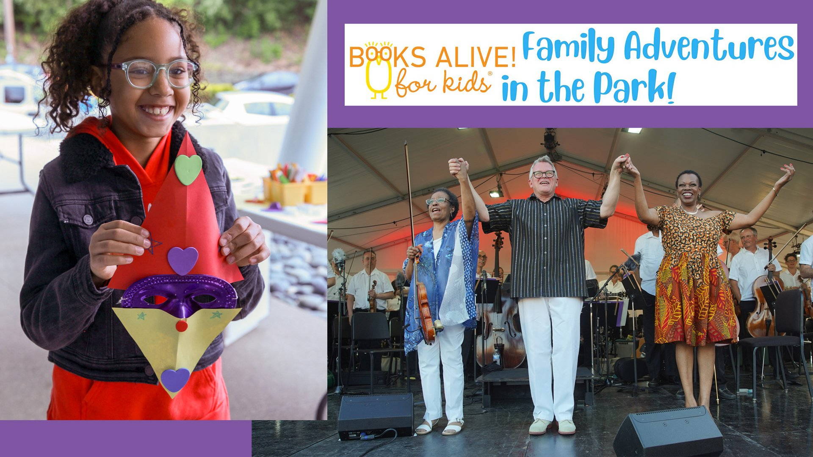
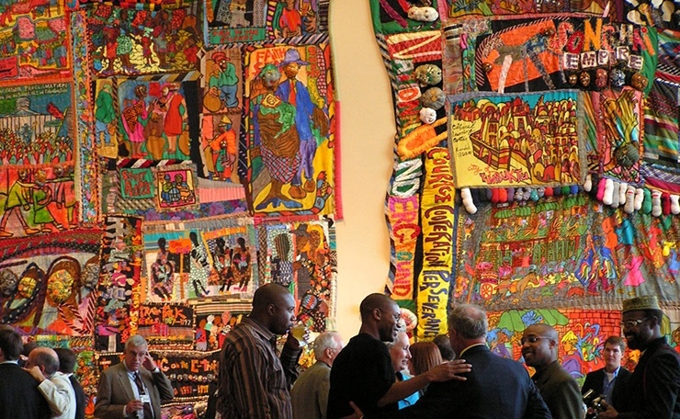
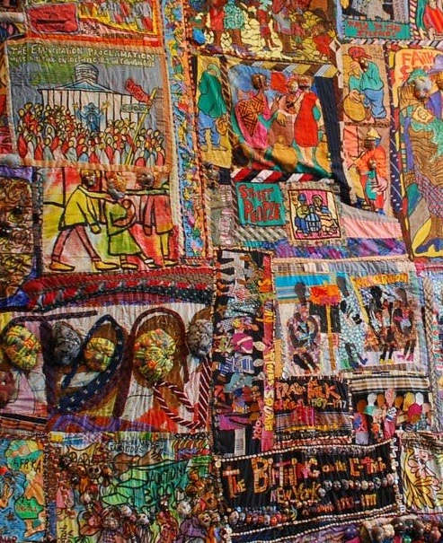
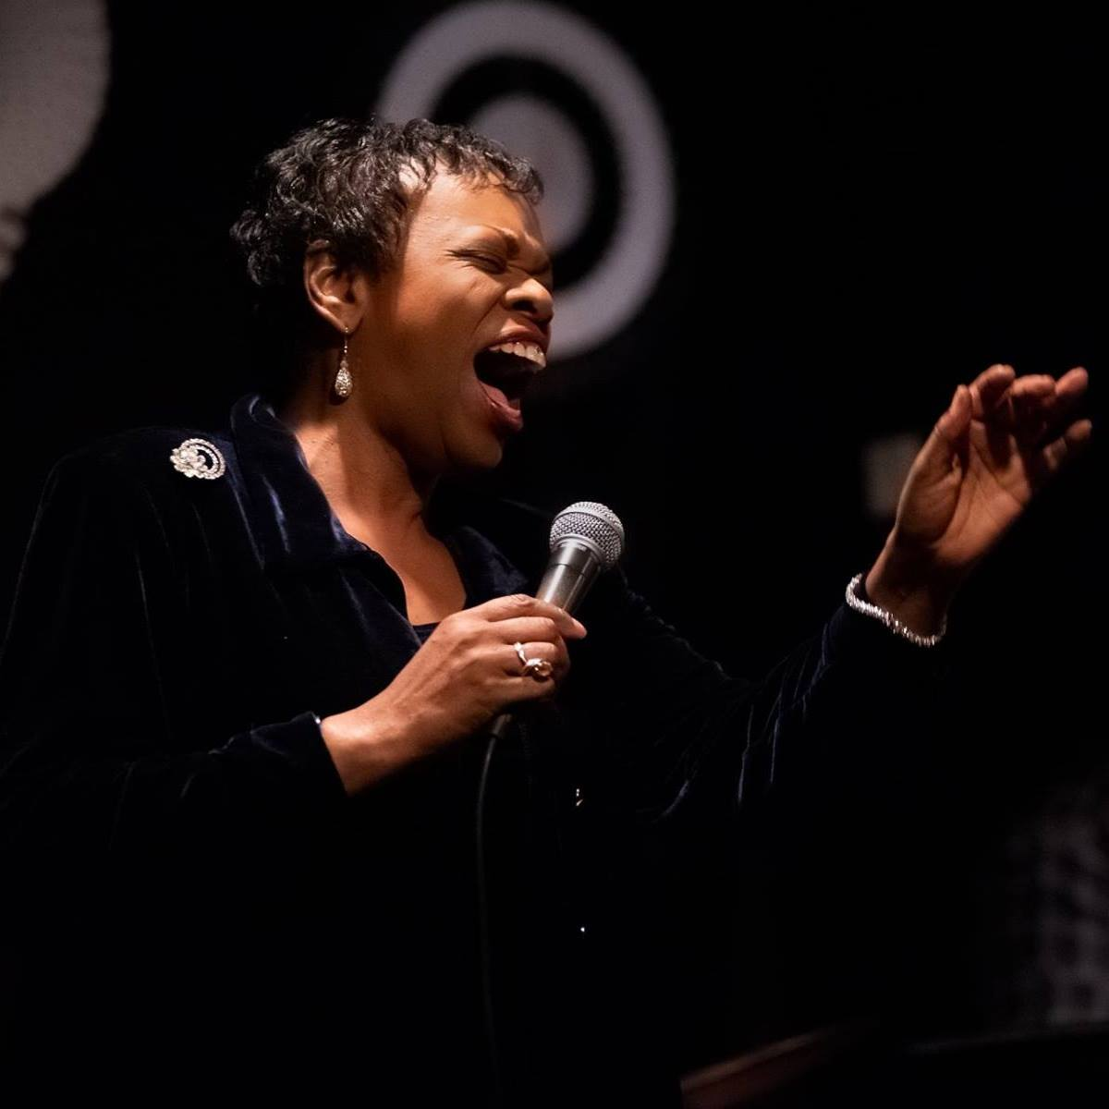
America’s River Roots
CULTURE
Image: Learning Through Art, Inc.
Featuring Tall Stacks Riverboat Cruises
River Cities Expo
Sounds of the River School Program
River Industry Exhibits
Freedom Center Speaker Series
Regional Cultural Tours
Keeneland/Kentucky Bourbon Trail
Freedom Journey
Riverwalk Heritage Tour
Brewmaster Tour
UNESCO Earthworks
Image: Cincinnati Enquirer
Image: Cincinnati Enquirer
Image: Narrative Quilt by Aminah Robinson at The Underground Railroad Freedom Center
Image: Narrative Quilt by Aminah Robinson at The Underground Railroad Freedom Center
Image: Learning Through Art, Inc. | Books Alive! for kids
6
Image: Black Music Walk of Fame | Kathy Wade Jazz Facebook, 2018
Notes:
Kelly

Slide 7
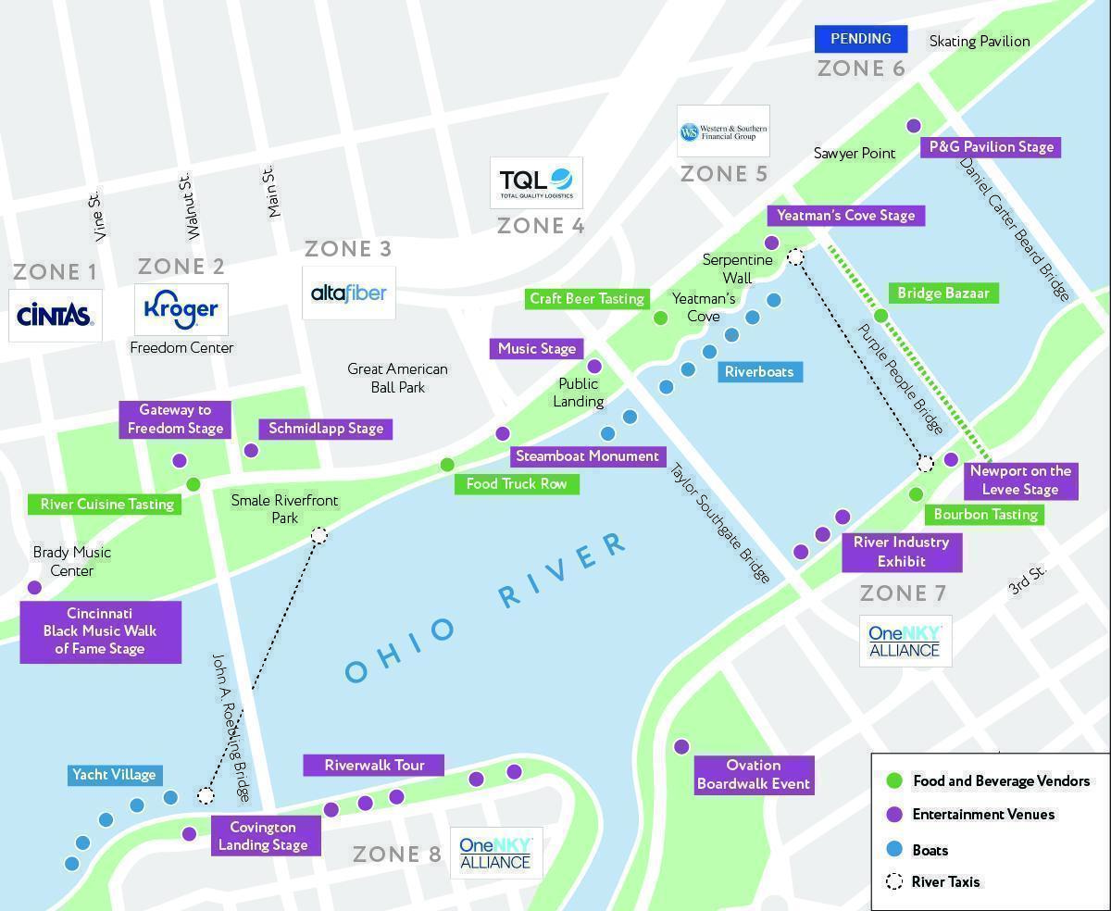
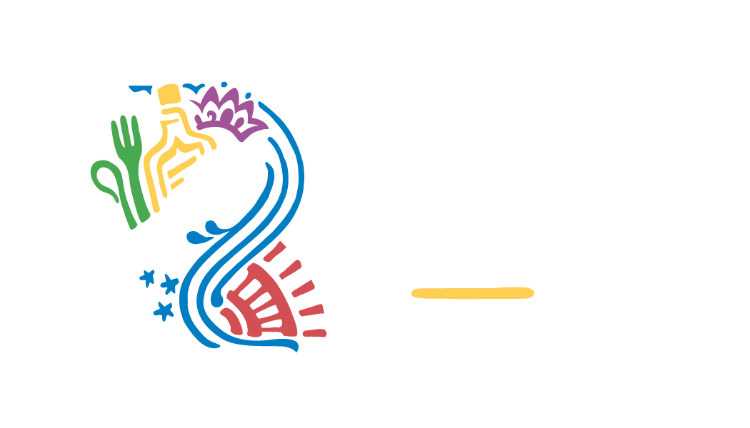
OUR FUNDING: Sponsor Commitments
OUR FUNDING: Sponsor Commitments
River Industry
Exhibit
Riverwalk Tours
River Cusing Tasting
Sponsor Activation Venues
Zone 1: Brady Festival area
Zone 2: Freedom Center
Zone 3: Schmidlapp Garden
Zone 4: Public Landing
Zone 5: Yeatman’s Cove
Zone 6: Sawyer Point
Zone 7: Newport On The Levee
Zone 8: Covington Landing
6
7
©2024 America's River Roots, Inc. All images used for education purposes.
Notes:
KK-add logos Tim takes over on funding

Slide 8
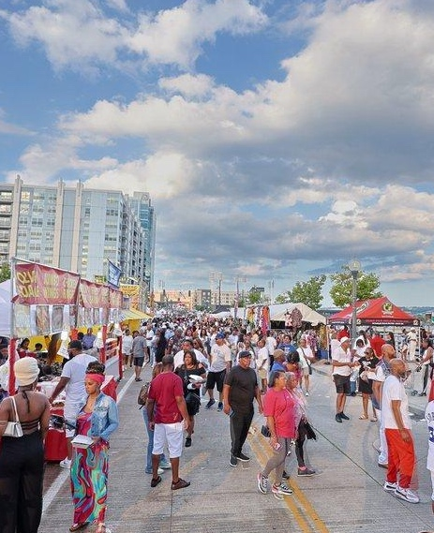
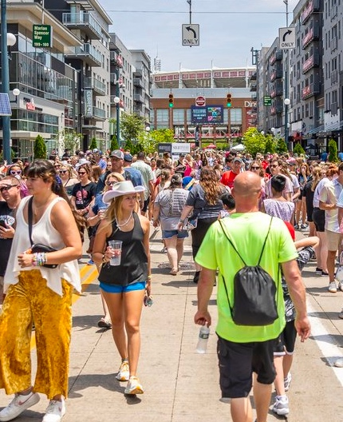
Our Kentucky Partners
BB Riverboats
Belle of Louisville Riverboat
Campbell County
Central Bank
Cincinnati/Northern Kentucky International Airport
City of Covington
City of Newport
Corporex
CTI Clinical Trial Services
David C. Herriman Fund
eGateway Capital
Fidelity Investments
Fischer Homes
Haile Foundation
Hemmer
Horizon Community Funds of NKY
Kenton County
KLH Engineers
Mary M. Miller Riverboat
Meet NKY
NKY Chamber of Commerce
Northern Kentucky University
OneNKY Alliance
Perfetti Van Melle
R.C. Durr Foundation
Southbank Partners
St. Elizabeth Healthcare
Thomas More University
Verst Logistics
Image: Cara Owsley / The Enquirer
Image: Cincinnati Business Courier
Image: Shae Combs / GameDay Communications
Image: Cincinnati Business Courier
10

Slide 9
Our Request to the Kentucky Legislature
We would respectfully request that the Kentucky 250th Planning Commission designate America’s River Roots, Kentucky’s kick off event for the 250th anniversary and that the Kentucky Legislature would endorse this designation.
We would additionally request special consideration from the funding allocation by the Kentucky Legislature during the 2024 session for Kentucky’s 250th events in the amount of $500,000 and that the Kentucky Legislature would endorse this endowment.
And of course make plans to kick off Kentucky’s celebration in Northern Kentucky next October.
Image: Cara Owsley / The Enquirer
Image: Cincinnati Business Courier
Image: Shae Combs / GameDay Communications
Image: Cincinnati Business Courier
10

