Slide 1
Kentucky Ohio River Regional Recreation Authority (KORRRA)
Introduction
Nov. 14, 2024
Interim Joint Committee
on Tourism, Small Business,
and Information Technology

Slide 2
Creation of KORRRA
Modeled after the Kentucky Mountain Regional Recreation Authority (KMRRA)
KORRRA was enacted in the 2024 session
All 25 eligible counties have passed a resolution to join KORRRA and KORRRA first met on Nov. 13, 2024

Slide 3
Purpose of KORRRA
148.034 (2): “The purpose of the authority is to establish, maintain, and promote a recreational trail system throughout the RA to increase economic development, tourism, and outdoor recreation for residents and visitors. The recreational trail system shall be located with significant portions of the system situated on private property made available for use through lease, license, easement, or other appropriate legal form by willing landowners.”

Slide 4
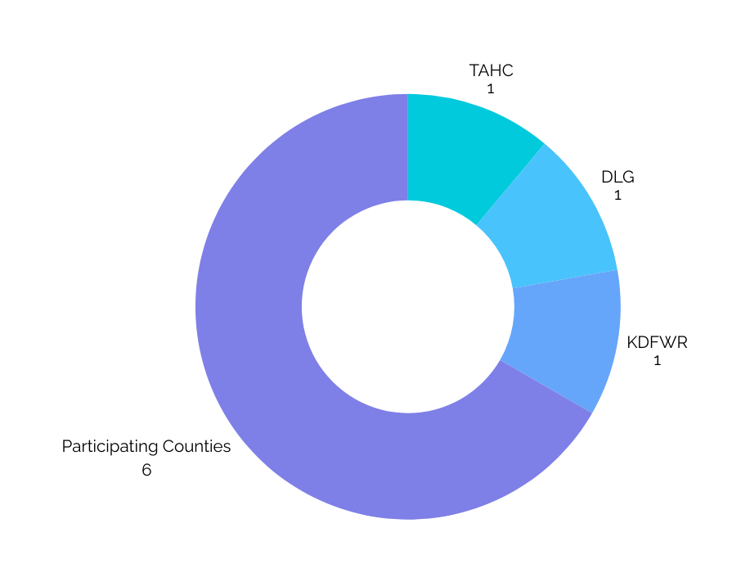
Structure of KORRRA
Nine voting members:
Six participating counties on rotating three year terms
One appointee each from the Tourism, Arts and Heritage Cabinet; the Department for Local Government; and the Department of Fish & Wildlife Resources
Three nonvoting members:
One member of the House and one member of the Senate
If KORRRA has an Executive Director, they may only cast tie-breaking votes
Voting members of KORRRA

Slide 5
Structure of KORRRA
148.034(1) “....The authority shall be a public body corporate and politic and an instrumentality of the Commonwealth, established with all the general corporate powers incidental thereto. The authority shall be attached to the Kentucky Department for Local Government for administrative purposes only. The authority shall be authorized for an initial period of five (5) years from July 15, 2024, and may be renewed by the General Assembly.....”
The Board shall meet at least quarterly with meetings rotating among participating counties.
Until the Board has secured funds to hire an Executive Director, the Board may seek administrative and management assistance.

Slide 6
The Ohio River’s Potential
The Ohio River’s Potential
Boosting recreation economies
Boosting recreation economies
Boosting recreation economies

Slide 7
Recreation Economies
Statewide, wildlife-related recreation contributes $5.9 billion to our economy (KDFWR)
In 2022, the value of the outdoor recreation economy nationally accounted for $563.7 billion of GDP and $1.1 trillion in economic output (US Bureau of Economic Analysis)
Since 2010, investments in the Great Lakes region since 2010—another major waterway with increasing boater registrations—are estimated to generate $2.3b in tourism (University of Michigan)

Slide 8
Efforts Elsewhere
On Nov. 12, 2024, the Ohio Senate Agriculture & Natural Resources Committee held a hearing on S.B. 286 creating an Ohio River Commission of Ohio (ORCO)
Earlier this year, Ohio invested $152m into 17 Ohio River waterfronts through “Ohio’s Wonderful Waterfronts Initiatives”
In October, Pennsylvania announced $53m for outdoor recreation projects and launched an Office of Outdoor Recreation in August
Nationally, the bipartisan Ohio River Congressional Caucus is considering steps to restore the Ohio River Basin on the scale of the Great Lakes Restoration Initiative

Slide 9
The Ohio River Way
The Ohio River Way is a 308-mile water trail through much of Ohio, Indiana, and Kentucky, exploring the Ohio River’s beauty, history, and culture.
As a 501(c)3 nonprofit organization, we connect local governments and organizations throughout our region to share best practices and collaborate on regional projects.

Slide 10
Mission of the Ohio River Way
Mission of the Ohio River Way
Mission of the Ohio River Way
To help people find adventure, to inspire care for the land and water, and to boost the economies of Ohio River communities.
To help people find adventure, to inspire care for the land and water, and to boost the economies of Ohio River communities.

