Slide 1
15-20 minutes: presentation
Q&A to follow
Our committee members- rep all of KY- each of the hubs.

Slide 2
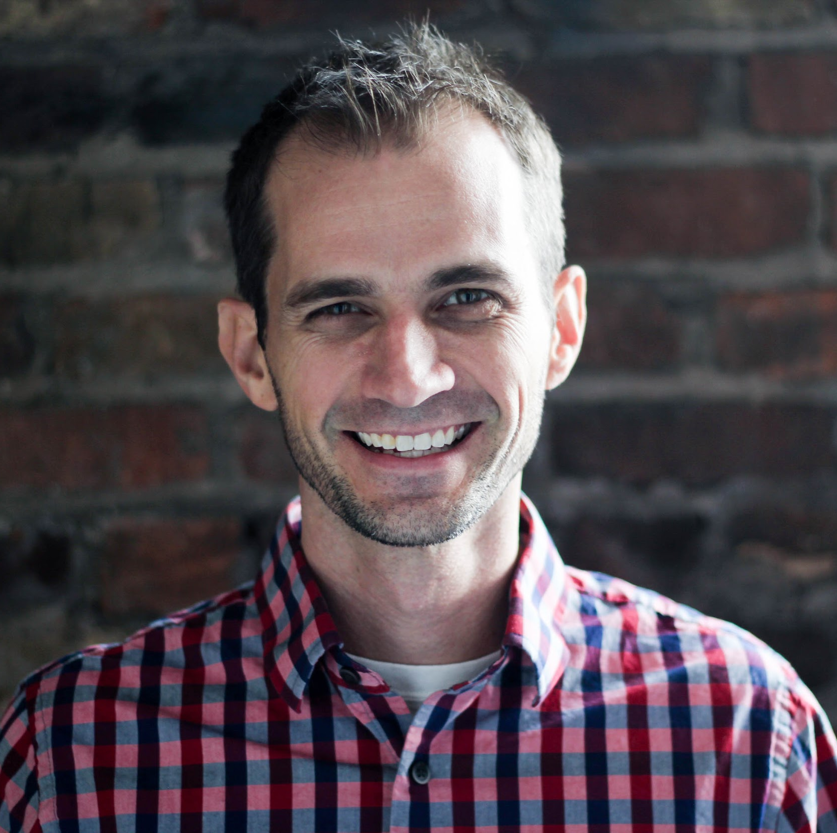
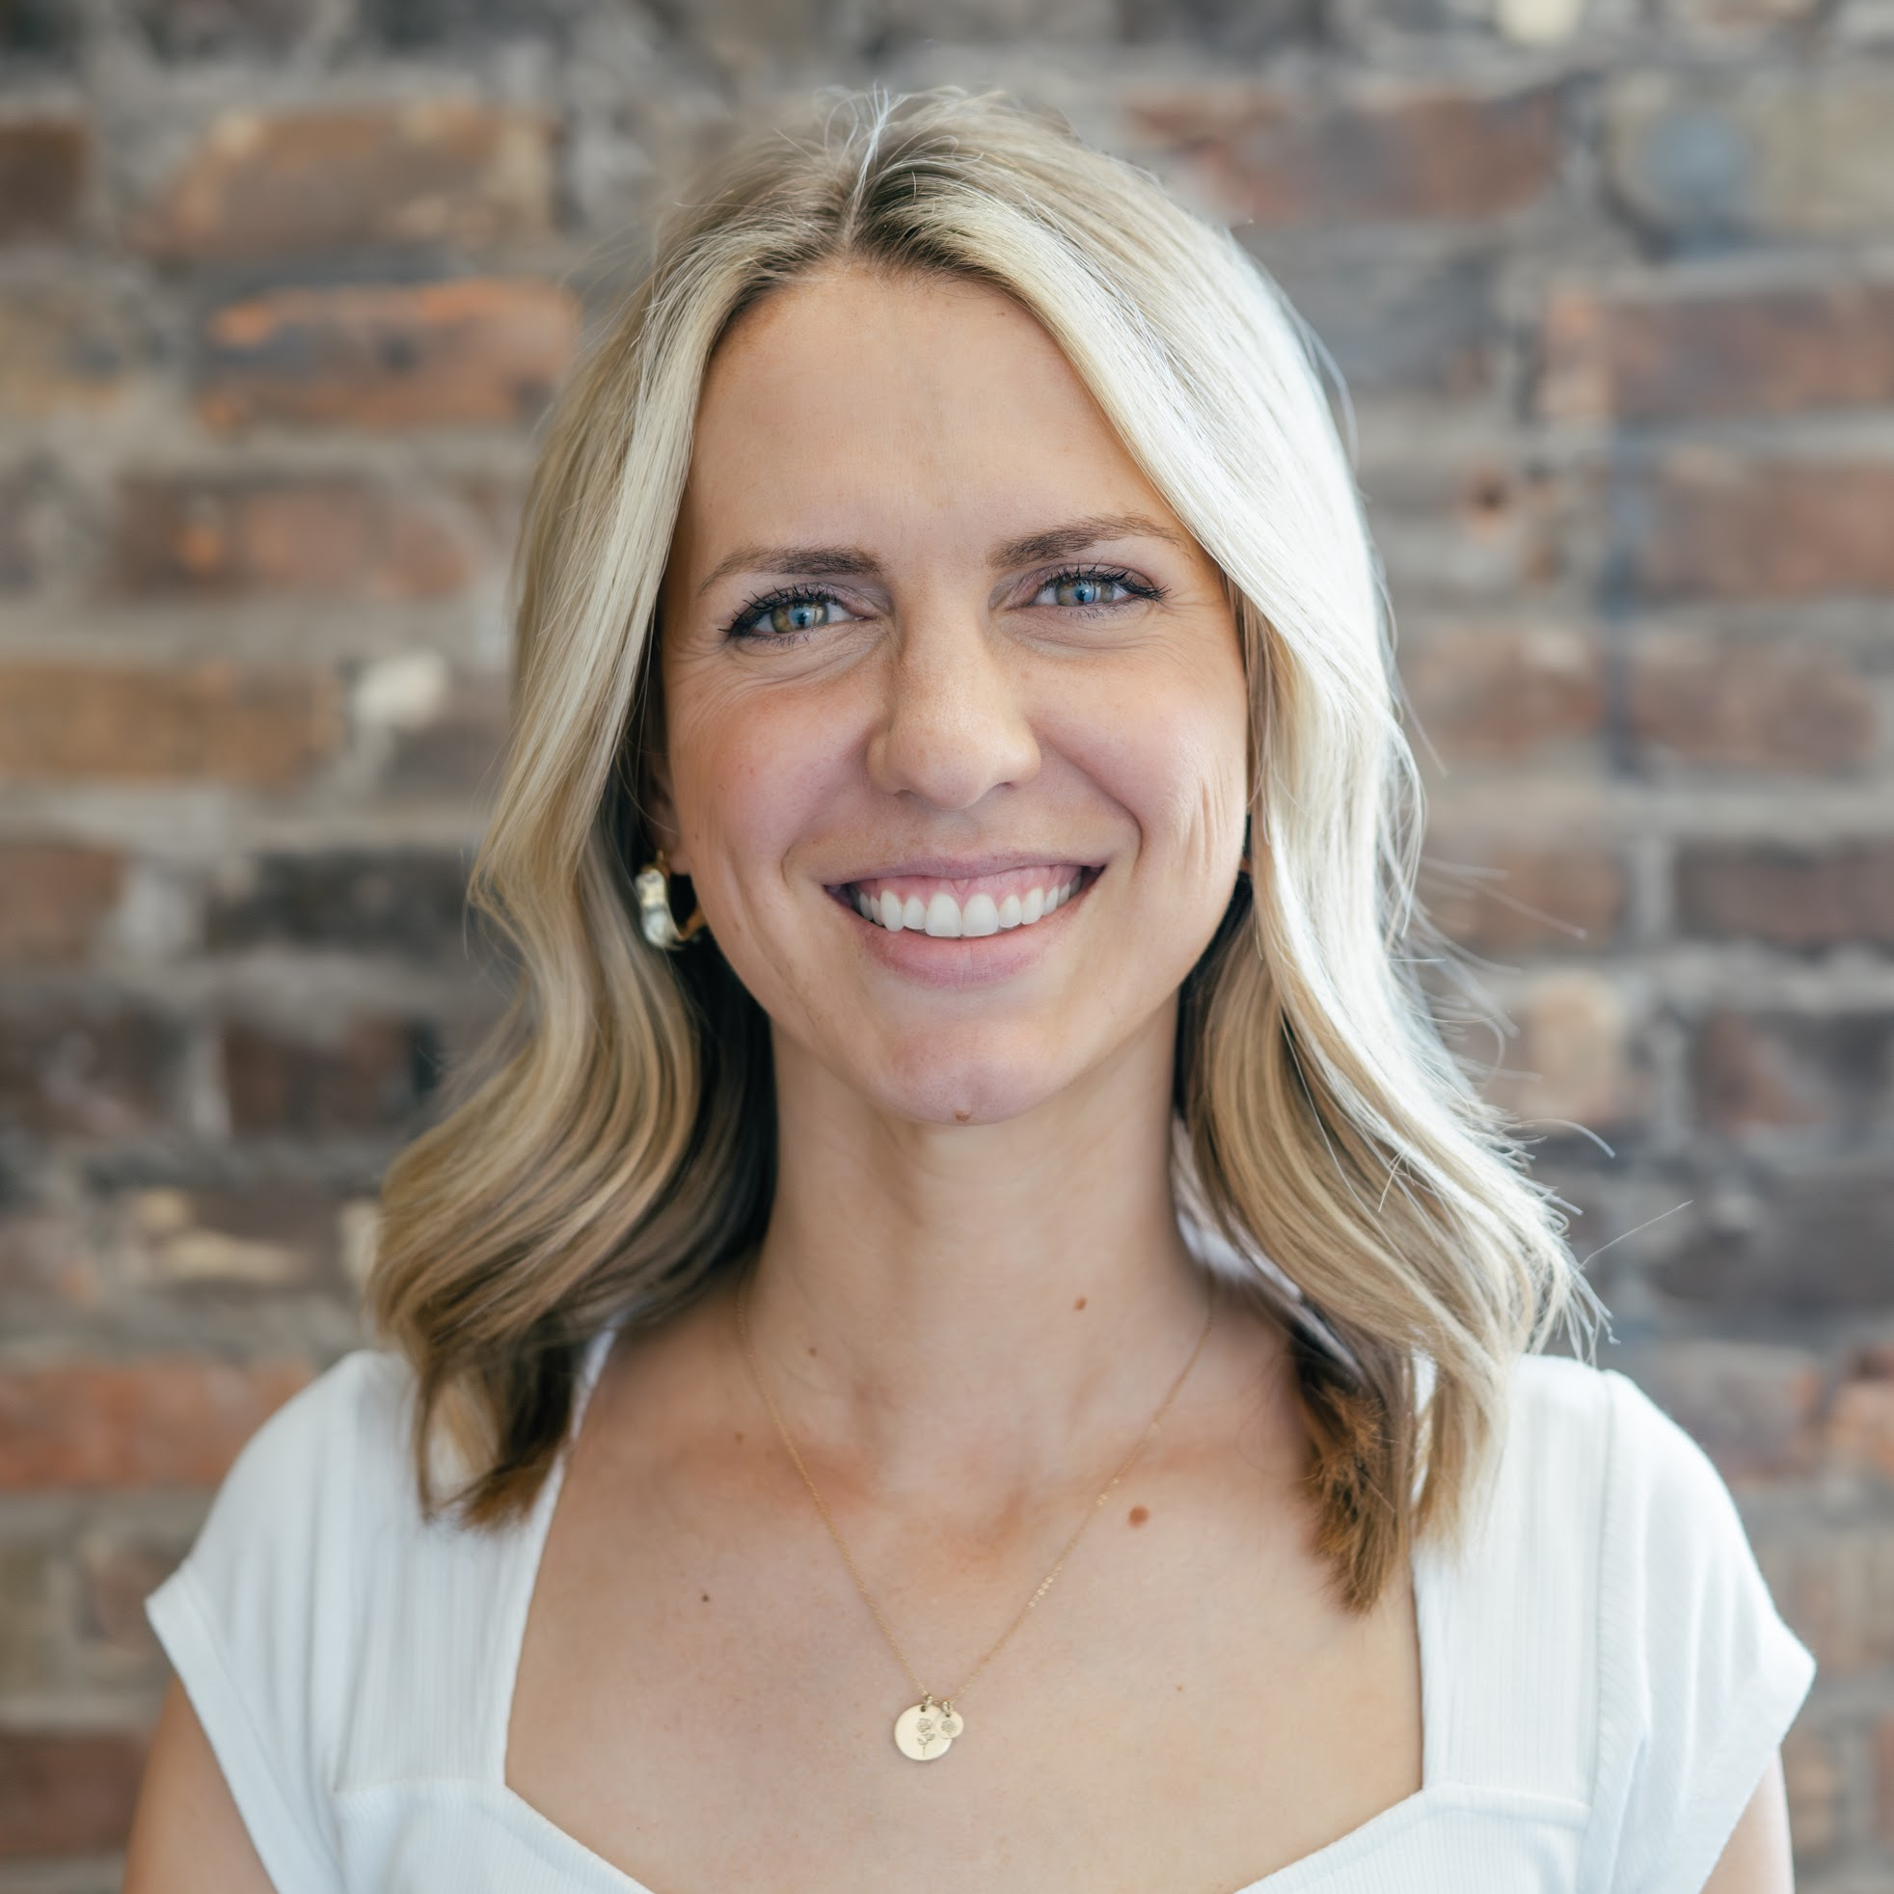
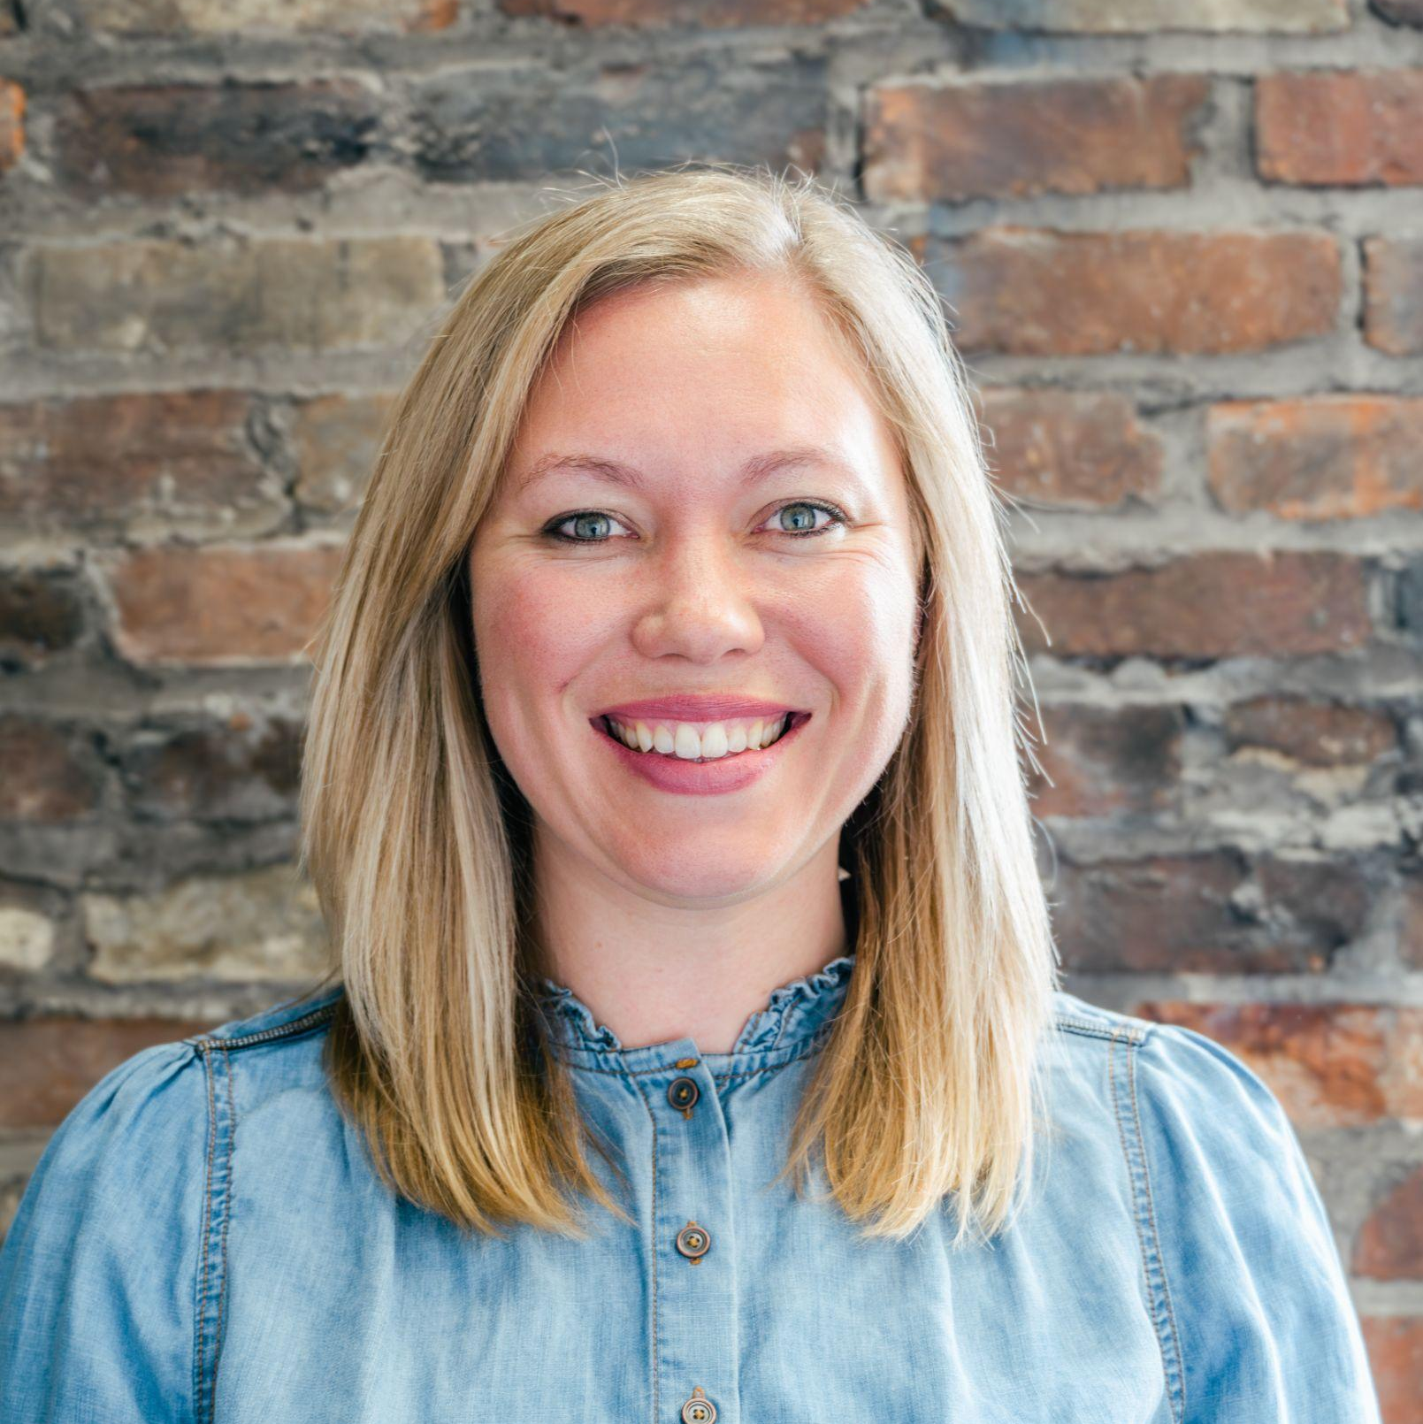
WHO WE ARE
BRIAN RANEY
EMILY WEHRLE
MACKENZIE HANES
From Northern KY
Founder
May or may not have been on Survivor
Loves to Surf & Snowboard
Became a Dad and a Grandpa on the same day
brian@awesomeinc.org
From Central FL
Director of Operations
College volleyball player
Loves the water and being outside
emily@awesomeinc.org
From Mayfield, KY
Partnership Manager
Ph.D. Student at U of L
Executive Bourbon Steward
mackenzie@awesomeinc.org
Notes:
:40

Slide 3
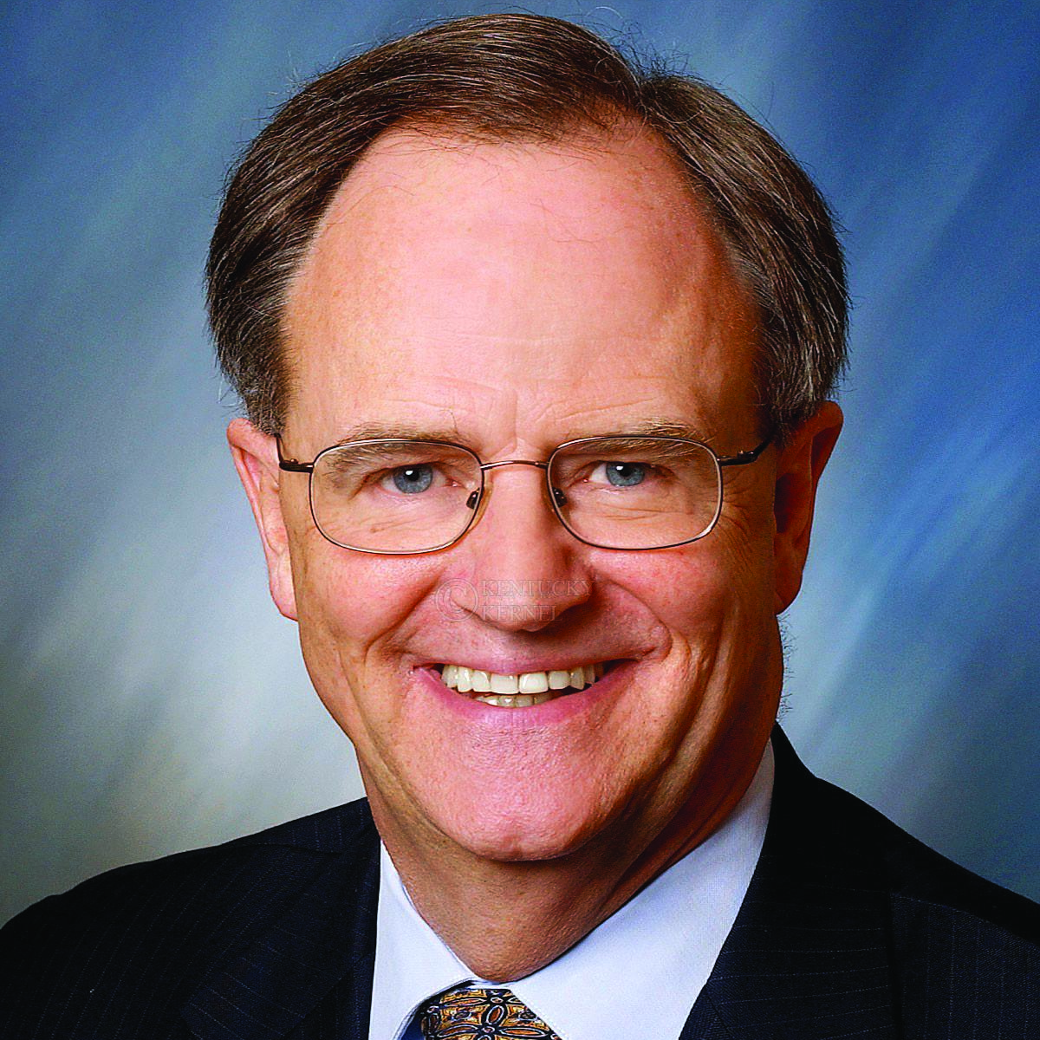
YOU HAVE PERMISSION TO TRY & TO FAIL
DR. LEE TODD
Kentucky Entrepreneur Hall of Fame
2010 Inductee
Realistic Worst Case Scenario
Arby’s decision
Choosing Challenge over Comfort
Notes:
I received a call from their vice president asking me to help them sell their projection picture tube production equipment to RCA, GE or Raytheon. I told him I’d have to think about it. I walked across the street to Arby’s near UK’s campus and had one of those lunches where you talk to yourself. It was as if the Lord came to me and said, “This is your chance, but you’re going to have to stick your neck out and take a big risk.” I called the VP back and told him I’d purchase the equipment, move it to KY and start a company. I would make their special picture tube to help them stay in business and to protect my dream. In three weeks, I was moving 60 tons of equipment to Kentucky in seven United Van Lines trucks and started my first company. Interest rates were 22 %! Patsy and I were expecting our 2nd child, and I’d never made a picture tube in my life! Soon thereafter, I left the UK faculty thus giving up my secure tenured position. I took several risks in the direction of my passion and these risks made it possible for me to develop two companies here in Kentucky, Projectron and DataBeam, and to create several jobs for bright, young people like you.

Slide 4
“It’s ok to have fears, just don’t let your fears have you.”
2003
2007
2009
Notes:
Tell story of Tony Schmidt here (GreekTrack)

Slide 5
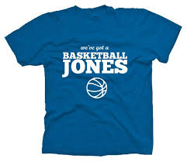
MITIGATING RISK
Firing bullets, not cannon balls (MVP), tshirt story - Basketball Jones
Notes:
5:00
2011 - Terrence Jones returned for his sophomore season
The state started out by taking a small risk on us - small amount of money in 2013. As we proved success, In 2018, that amount grew. In 2024 that amount grew even more. We intend to continue to prove to be good stewards of the funding we receive and come back for more in the future.

Slide 6
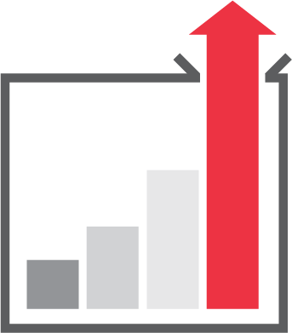
We operate from our Core Values (CVs)
CV #1: Be Good
CV #2: Be Excellent
OUR WHY
To help people pursue their definition of AWESOME…
And to make Kentucky a more awesome place to live, work, and play by helping entrepreneurs build successful startups.
CV #3: Be a Friend
CV #4 Be You
We encourage you to determine your Why and core values. If you don’t have any yet, borrow ours in the meantime.

Slide 7
OUR PROGRAMMING
CREATION
EDUCATION
SUPPORTING PROGRAMS
TECHNOLOGY
ENTREPRENEURSHIP
Notes:
7:05
Brian pass off to Emily here

Slide 8
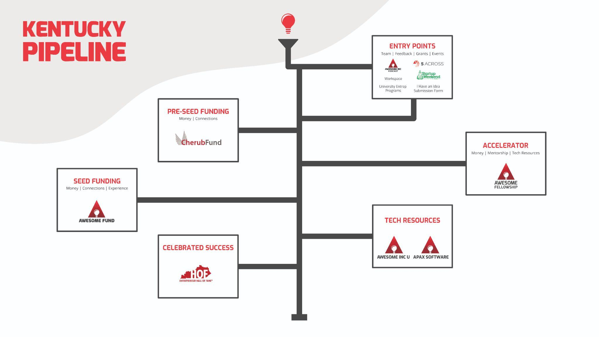
STARTUP PIPELINE
Notes:
10:10 This pipeline is a zoomed out view that shows how a company goes through our programming.
Our whole goal for Awesome Inc is to have a company see through this whole pipeline.
Tell story of Cloverleaf.

Slide 9
SUCCESS METRICS
$155,706,867
Investment Raised by
accelerator companies
788 Jobs Created by
accelerator companies
370 - 5 Across Pitches
55 Kentucky Entrepreneur
Hall of Fame Inductees
280 Tech Jobs Placed
700 Startups Served
Notes:
280- to include grads 2nd, 3rd, etc jobs

Slide 10
KENTUCKY CED GRANT
Notes:
Mac
We want to introduce the CED Grant
We’ve been supporting startups for 15 years, 6 years ago we were asked to provide additional focused support to central Ky, and this year we have been tasked to expand our support to cover this highlighted area. As Brian shared, we are here for the whole state, but through partnership with the Cabinet for Economic Development, we’ve been able to deepen our impact.

Slide 11
MORE ON OUR STATE WIDE PARTNERS
CED Partnership
New Partners
Strengthened Impact
Rural Entrepreneurship
SBDC
Increasing Reach for KY Entrepreneurs
Space and Place for Belonging
University Partners
Notes:
Mac
Tell Forecastr’s Story
Pouring into younger entrepreneurs
Partnering with SBDC to put more boots on the ground
Focus on rural entrepreneurship
Increase reach for Kentucky Entrepreneurs

Slide 12
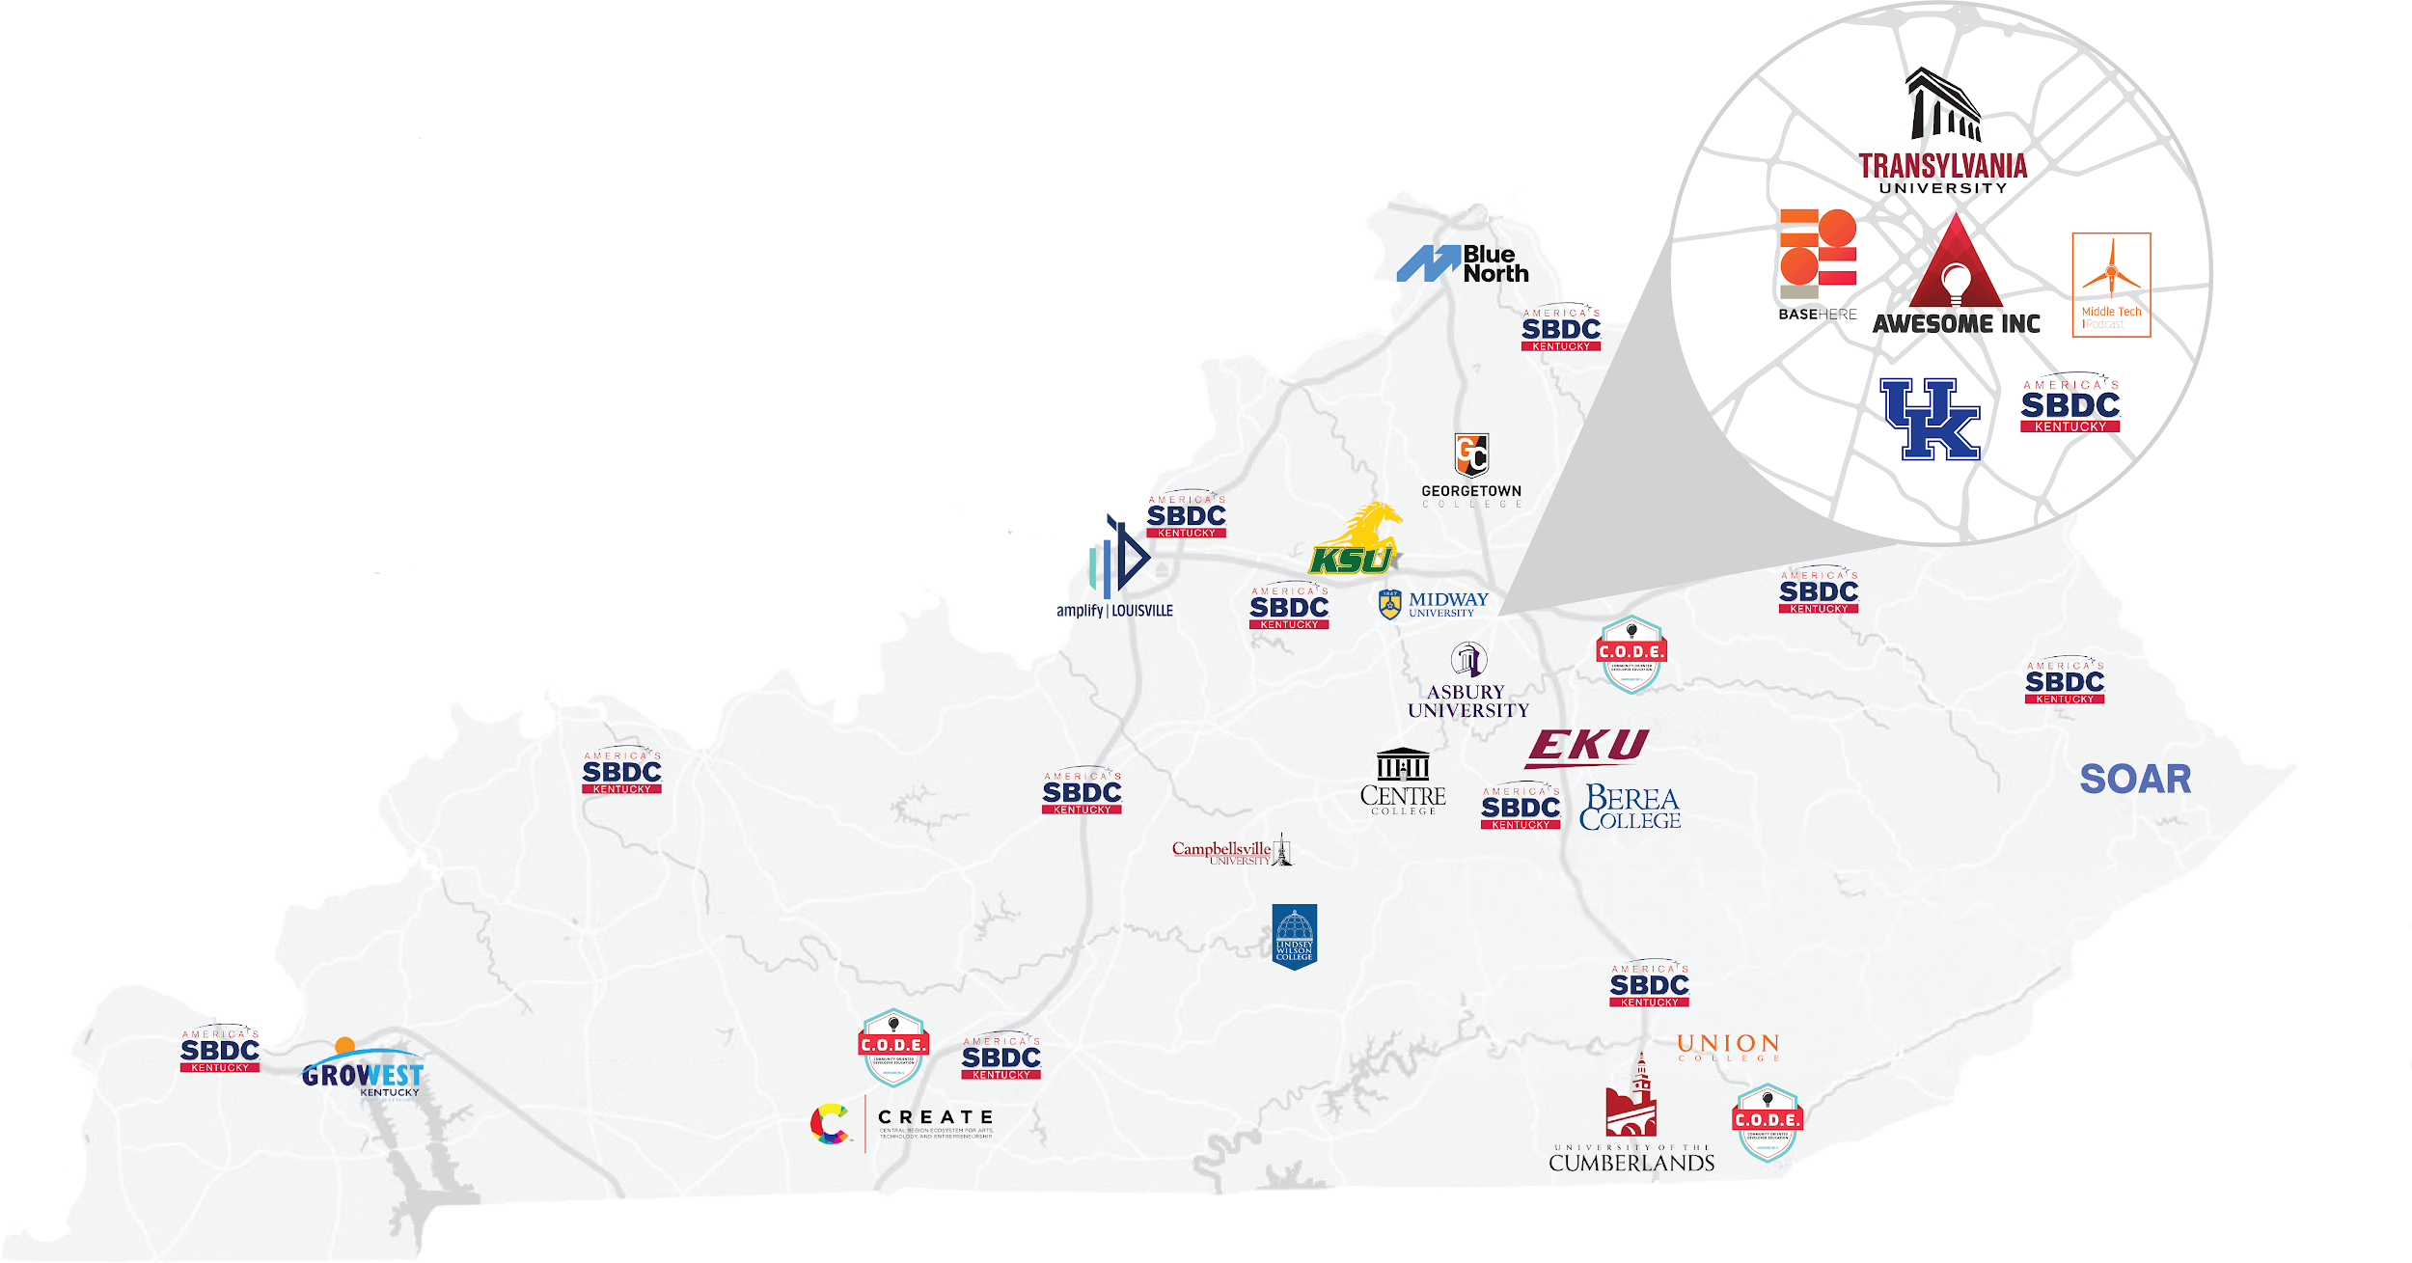
Notes:
We believe that age doesn’t define your ability to have a great idea, but it does limit your connections- we want to change that by pouring into the students at universities in our service area to come along beside orgs that already exist, or provide the capacity for orgs to launch at these schools.

Slide 13
NEXT STEPS
Come visit Awesome Inc for a VIP Tour
Refer promising startups
Refer promising partners (University contacts, Entrepreneurs)
Attend Fellowship Demo Day, Oct 30th
Attend the Kentucky Entrepreneur Hall of Fame, Nov 12th
Help us expand our work by connecting us to other committees
Notes:
Brian here

Slide 14
WHO WE ARE
BRIAN RANEY
EMILY WEHRLE
MACKENZIE HANES
brian@awesomeinc.org
emily@awesomeinc.org
mackenzie@awesomeinc.org
Notes:
:40

