Slide 1



2024 MOTORSPORTS ECONOMY UPDATE
Update
2024
MOVING APPALACHIA FORWARD THROUGH MOTORSPORTS
BY: ERIK HUBBBARD

Slide 2

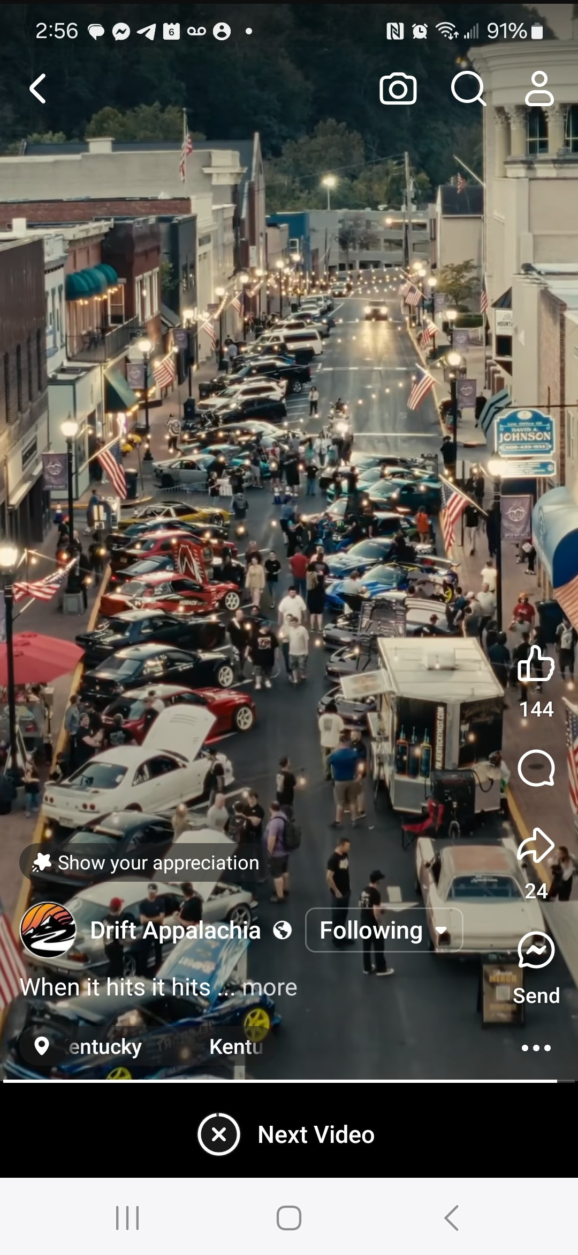
ABOUT OUR
NON-PROFIT
Community First. Racing Second.
We bring economic growth
to Appalachian coal towns & communities in need
through all forms of motorsports.

Slide 3

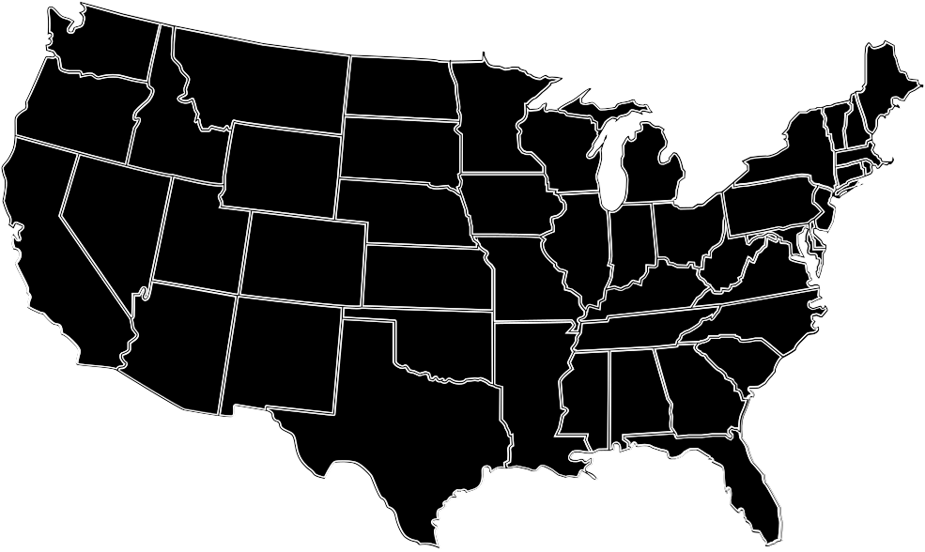



OUR AREA
Within a 1-day drive of more than 50% of America’s population, Backroads of Appalachia’s routes twist through historic coal towns, secluded highways, and breath-taking views.
Routes
Points of Interest
Summary
56 Routes and counting!
1,300+ Points of Interest
We are at the tip of the spear, bringing change to Eastern Kentucky through wayfinding, events, and guiding enthusiasts throughout Appalachia

Slide 4
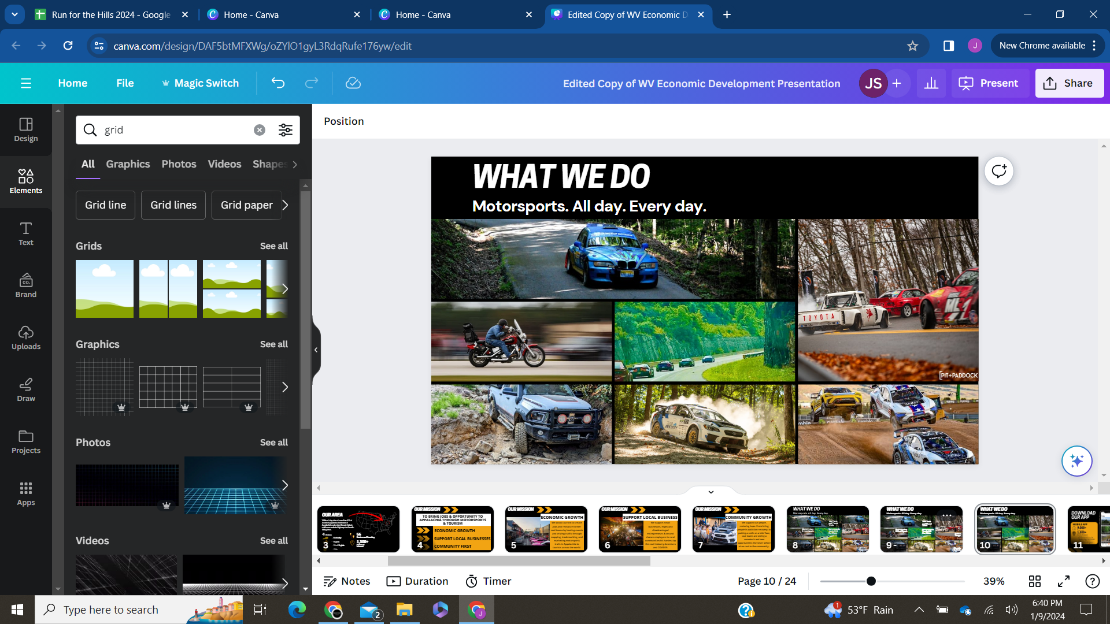
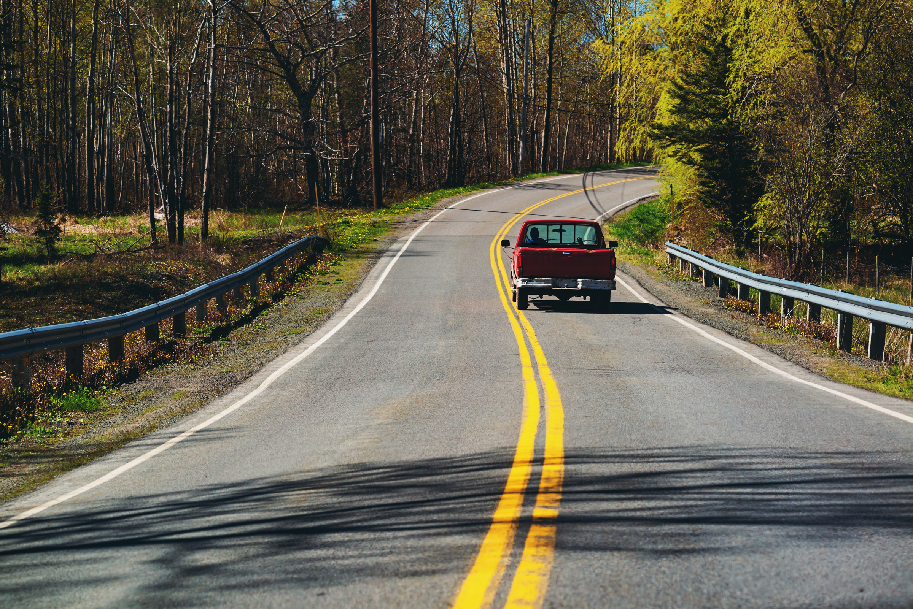
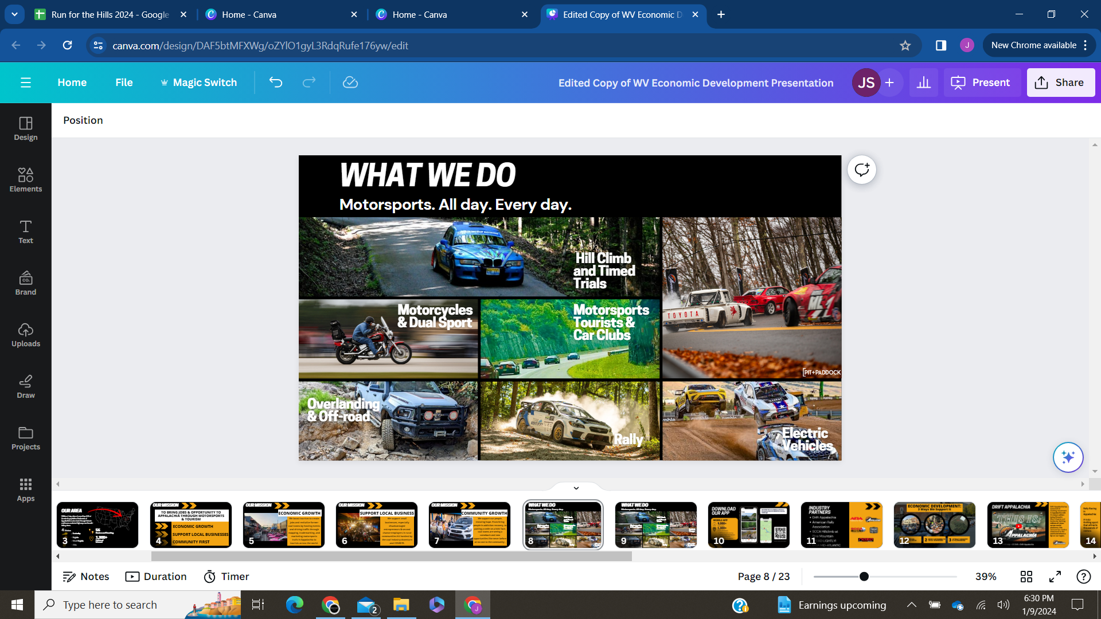
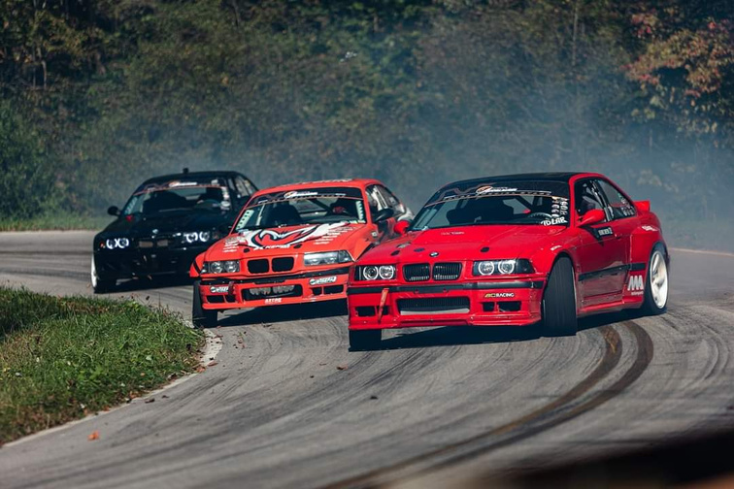
Hill Climb and Timed Trials
Driving routes for everyday tourists to boost our communities
Motorcycles
Motorsports Tourists & Car Clubs
Drift & Touge
Overlanding & Off-road
Electric Vehicles
Rally

Slide 5

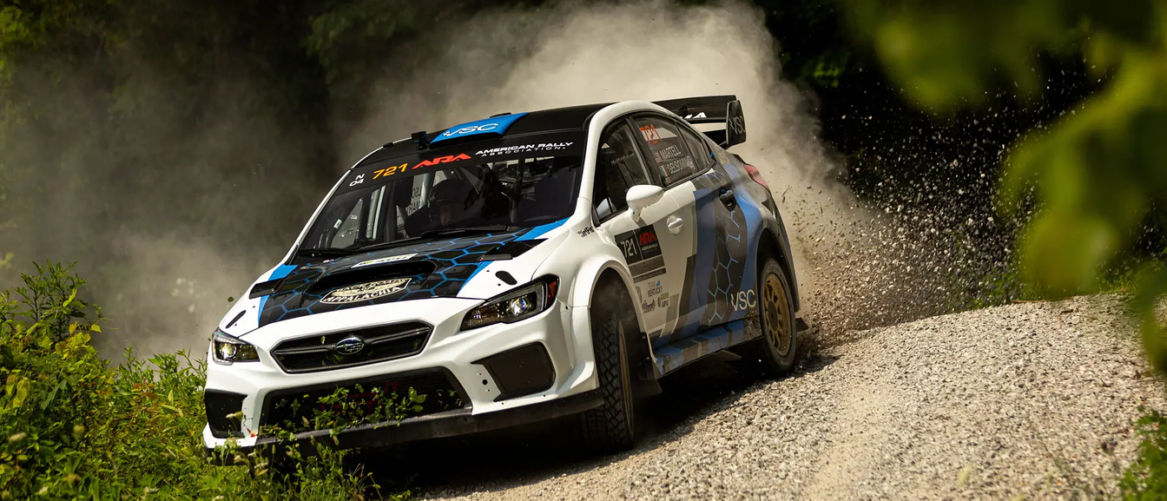

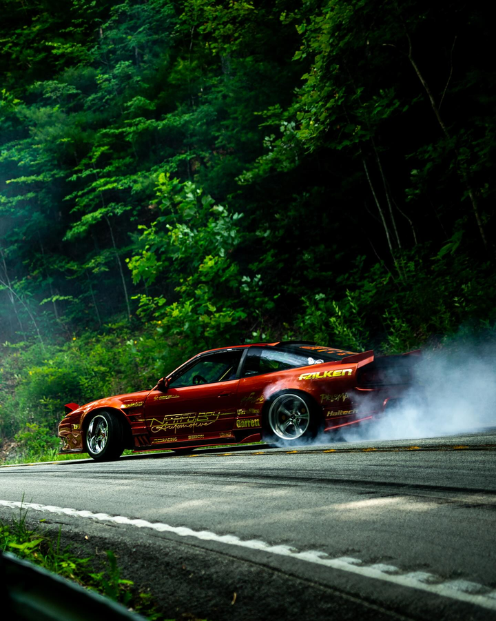
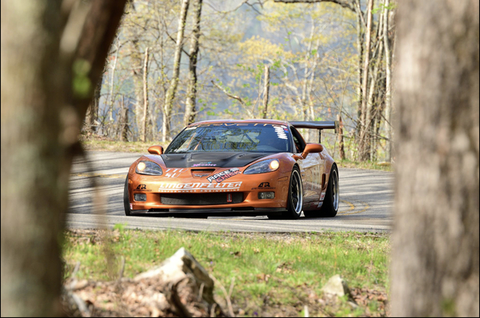
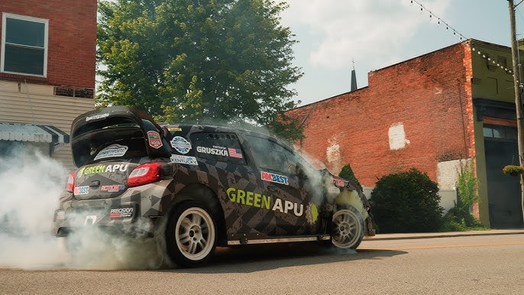

2024 EVENT HIGHLIGHTS
2024 Boone Forest Rally
Drift Appalachia
Special Stage 4 & 5
From competition to exhibition to film documentaries, 2024 has been a year to remember with history being made at every twist and turn.
Thanks to HB-29 and our legislators for believing in us, BOA and EKY is now a domineering entity in the world of motorsports.
Pine Mountain
Hillclimb 2024
Appalachian
Application

Slide 6




The.
Real.
American.
Drift.
Experience.

Slide 7
Rally racing,
but for the
community.

Slide 8
The Pikes
Peak of
Appalachia.

Slide 9

Appalachian
Application.
This is what
winning looks
like.

Slide 10
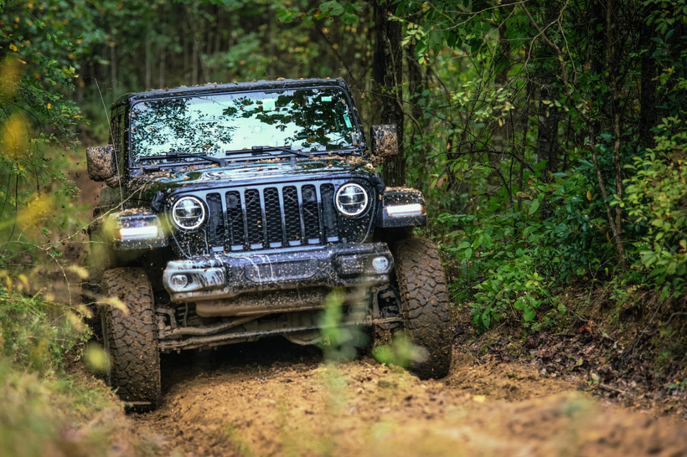
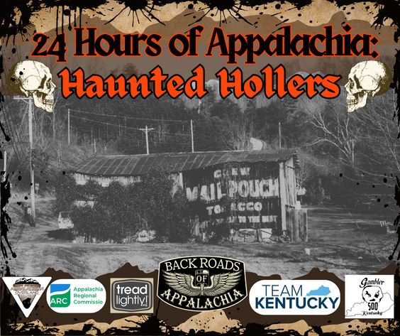
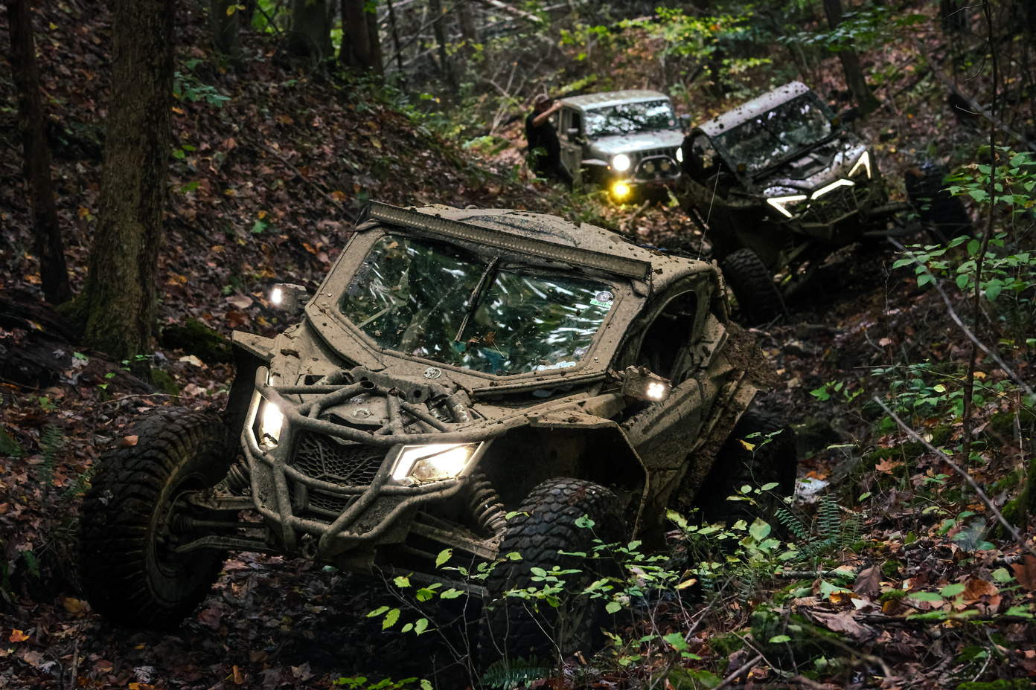




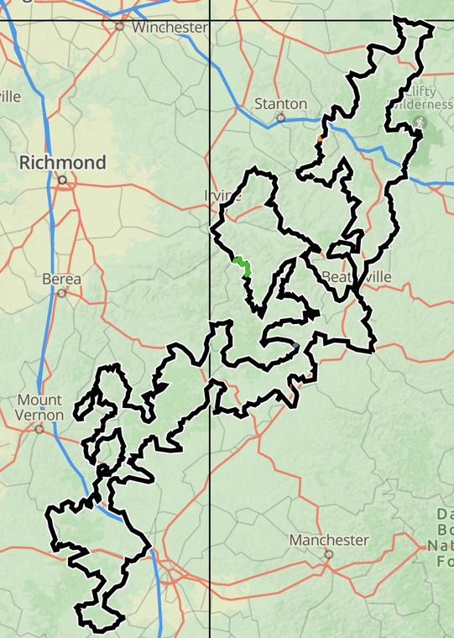
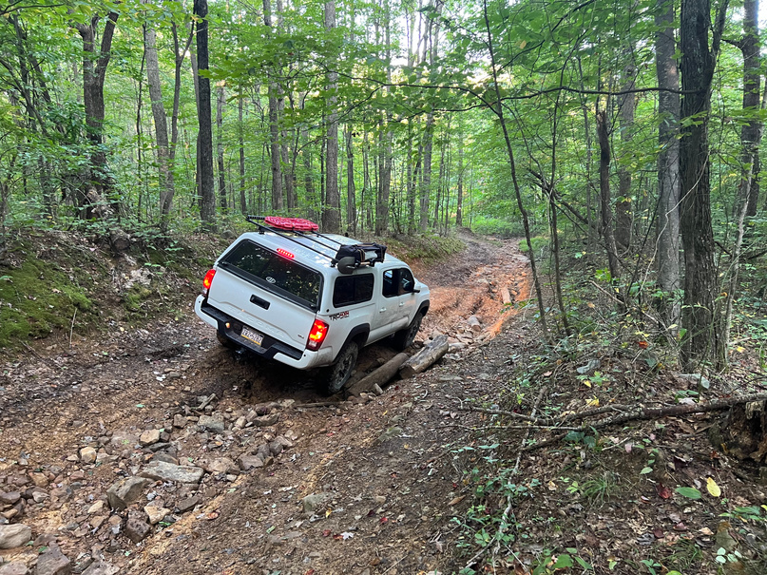
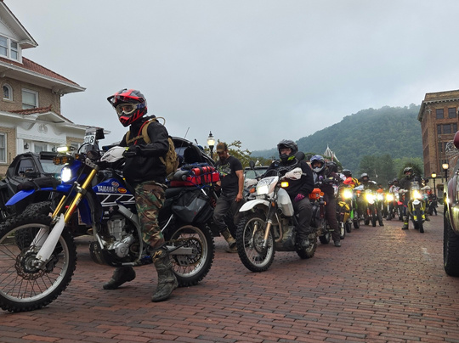
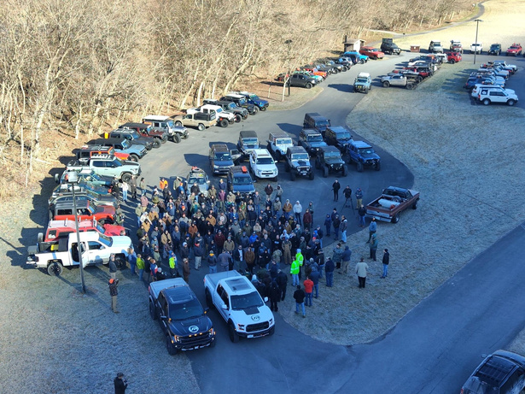
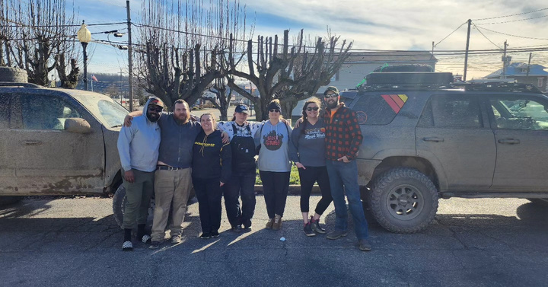
24 HOURS OF APPALACHIA
EST
2024
TO THE MOUNTAINS
The ultimate
test of driving,
navigation, and team work.

Slide 11
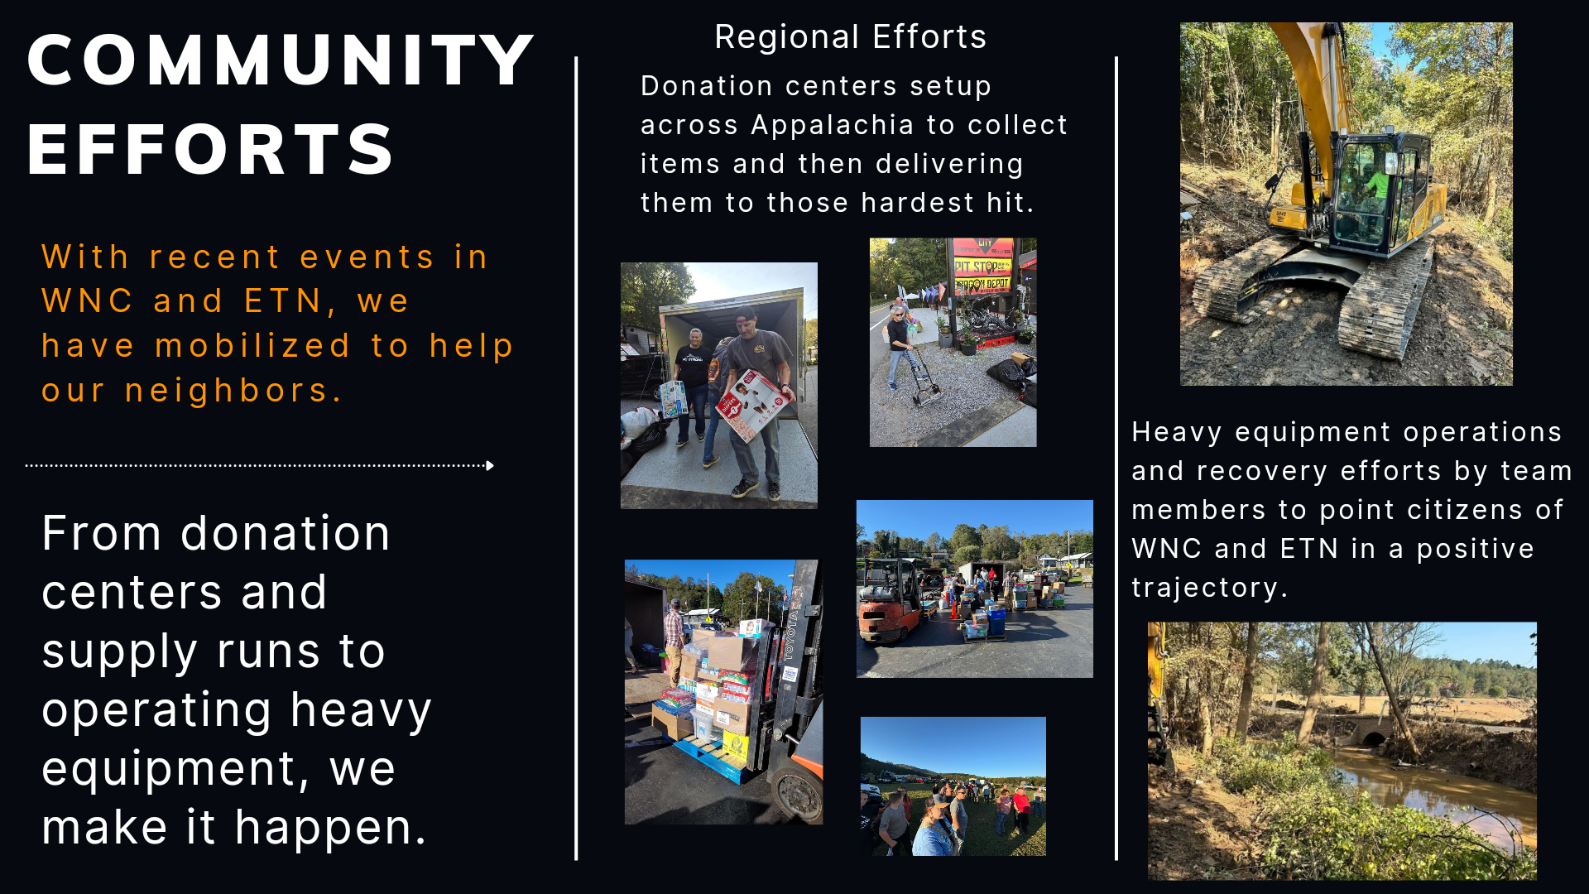

Slide 12
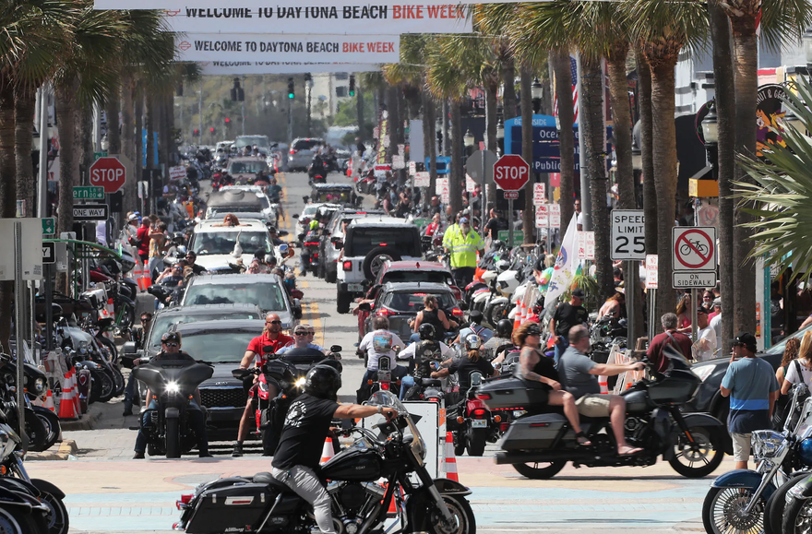
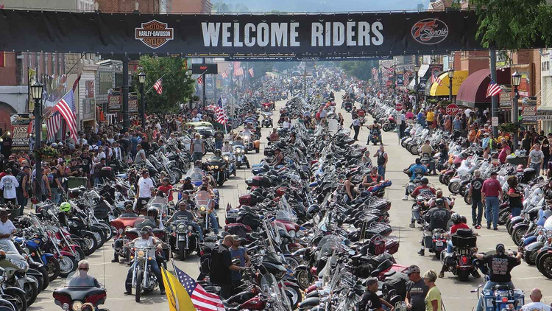
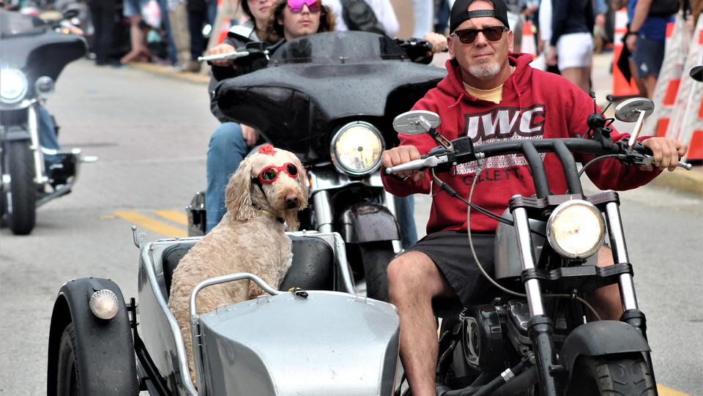
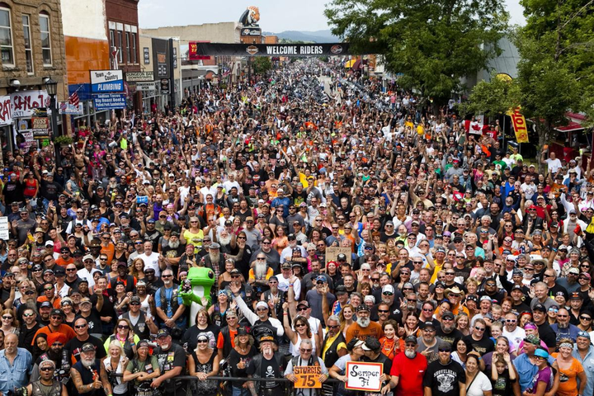

Daytona Beach, FL
Bike Week
Sturgis, SD
Bike Week
NATIONAL
EFFORTS
We are traveling the country to share with the world where the best riding and driving is located. Here in Appalachia.
Awareness
Shining a spotlight on our region and it’s amazing roads, people, and culture.
Over 500,000 people attended
Over 450,000 people attended

Slide 13


IMPACT
CHANGING LIVES AND BRINGING ECONOMIC OPPORTUNITY TO EASTERN KENTUCKY IN A NEW AND EXCITING WAY.
EVENTS
PEOPLE
ECONOMIC
IMPACT
Throughout the region, we host and partner with others to create and realize motorsports events
People bring dollars and sometimes
new businesses to the region
In 2023, we were able to account for over $38M in impact directly to the Kentucky economy
Events bring new dollars
and new faces to the region.
Over 37,000 verified visitors came to Eastern KY in 2024 thanks to motorsports helping to make KY a 3 day destination.
We are on track to meet or surpass last years $38M impact.

Slide 14



IMPACT BY THE NUMBERS
-37,000+ VISITORS
-$325/DAY EXPENDITURE
-AVERAGE OF 3+ ROOM NIGHTS
*OVER 80 ROOM NIGHTS*
-ESTIMATED 2024 IMPACT: $50M+

Slide 15

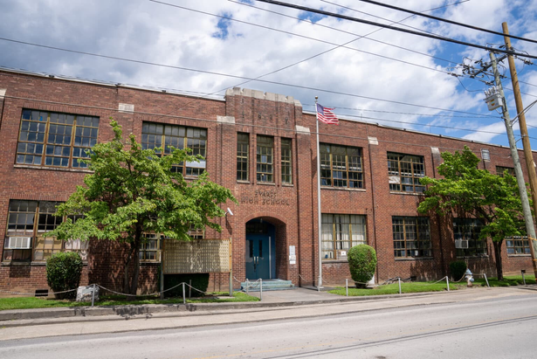






WHERE WE
ARE HEADED
Regional Efforts
Thanks to our relationships throughout Appalachia, we are becoming a regional entity for good.
Community development thanks to motorsports and partnerships.
Evarts High School, Evarts, KY
Awareness
Bringing awareness to our region and it’s recreational and business opportunities through strategic partnerships.
ARC ARISE Grant with a potential of $5.5M for Kentucky
JTF Awards BOA with
$250K grant

Slide 16

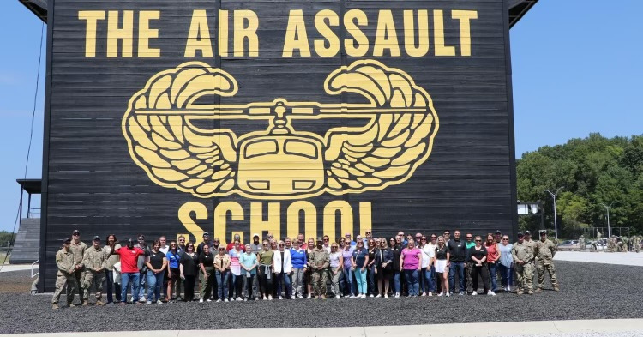
LEADERSHIP.
REDEFINED AND RENEWED.
From military and trades leadership, to Executive Director in Leadership Kentucky 2024.
Thanks to HB-1 and the 2024 Leadership Kentucky program.
Shift.
By attending KY Leadership 2024, Executive Director, Erik Hubbard is learning what it takes to turn military and trade leadership into Kentucky Leadership.

Slide 17

THANK YOU
WE ARE RACING TOWARD A BRIGHTER FUTURE FOR ALL OF APPALACHIA.

