Slide 1
KHS UPDATES - JUNE 20, 2024

Slide 4
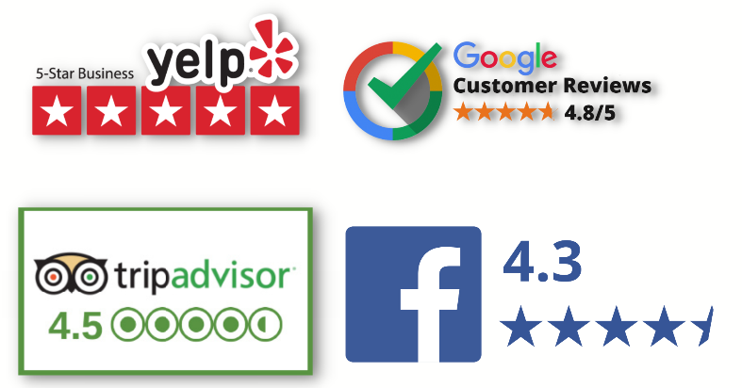
Social Media reach & online ratings
3,050,955
2023 total reach across Facebook,
X (Twitter), and Instagram

Slide 5
Khs campus visitation
2023 saw an increase of 36% in visitation over 2022.
We welcomed visitors from 14 countries, 49 states (all except Montana), and 103 Kentucky counties.
Visitation was up in 1Q 41% over 1Q of the previous year. 1Q 2024 visitation was up 70% from the five-year average (2019-2023).

Slide 6
2023 economic impact
American Alliance of Museums Economic Impact Formula
KHS employed 50 people in Frankfort – payroll & benefits -$4,094,900
KHS spent $2,667,749 (annual budget) on goods and services in Frankfort
Served 30,000+ visitors, including 69% from out of town
Served 11,487 schoolchildren through school visits to museums
Admission fee: $0 - $8
Visit Frankfort/Kentucky Tourism Economic Impact Calculator
Conservative Approach
Day Trippers ($75 x 11,398) (not including Franklin Co) = $854,850
Overnight ($100 x 7,535) = $753,500
Non-Conservative Approach
Day Trippers ($100 x 11,398) = $1,139,800
Overnight ($150 x 7,535) = $1,130,250

Slide 9
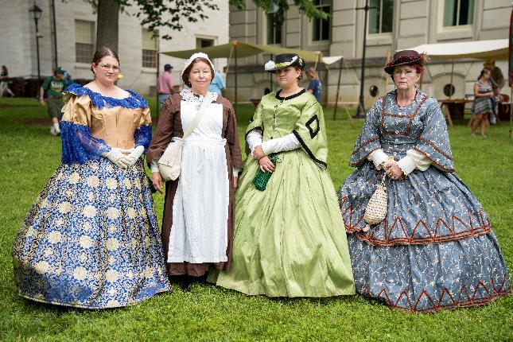
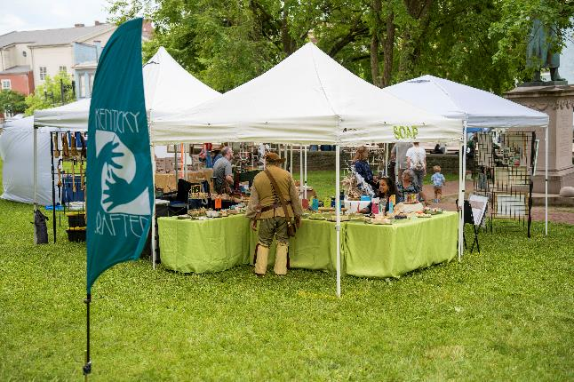
Kentucky history day
Saturday, June 1
Over 2,500 visitors
Over two dozen organizations present with activities, many from the Tourism, Arts and Heritage Cabinet

Slide 10
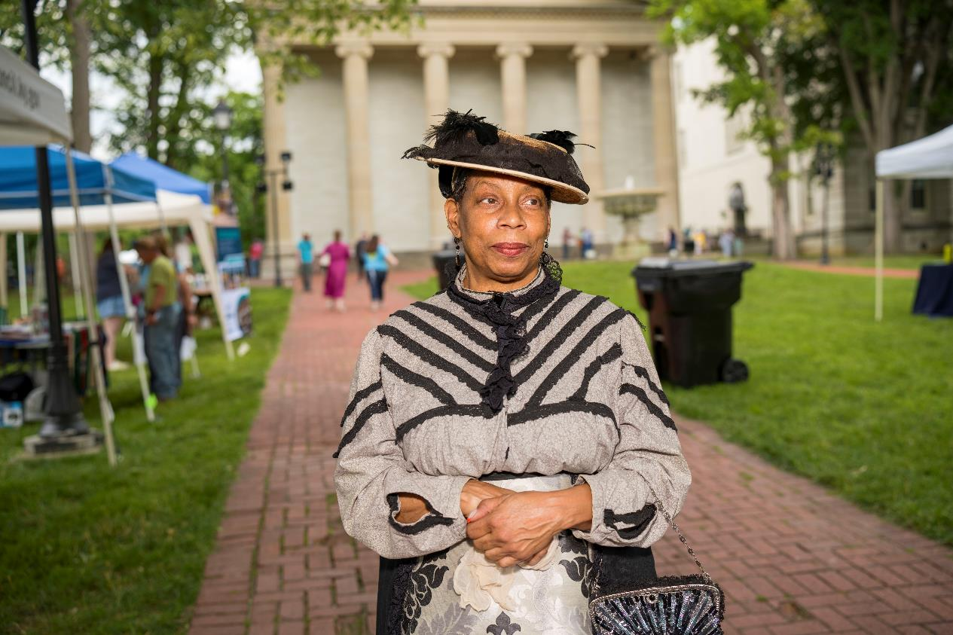
KENTUCKY HISTORY DAY

Slide 11
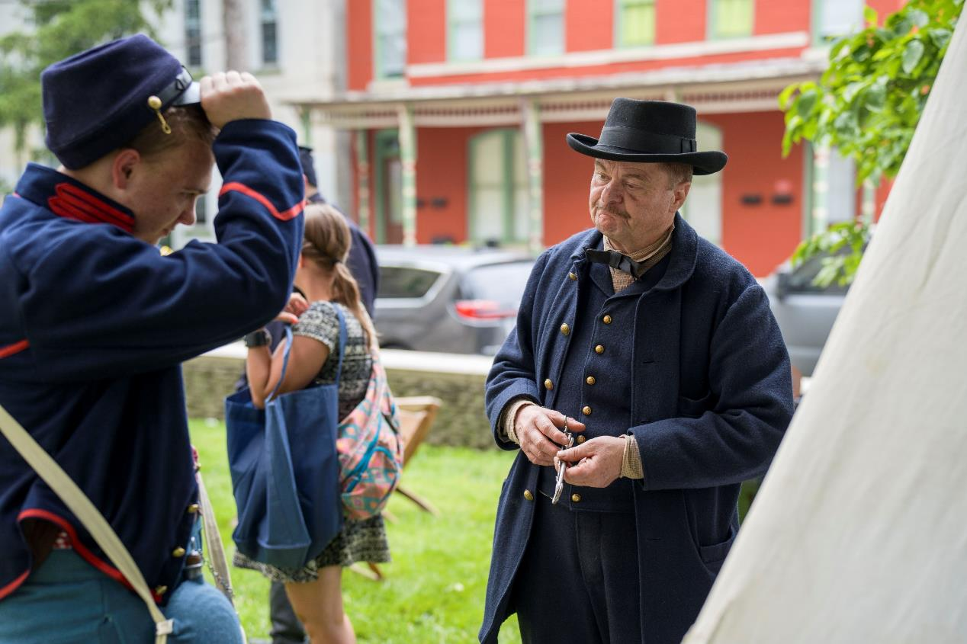
KENTUCKY HISTORY DAY

Slide 12
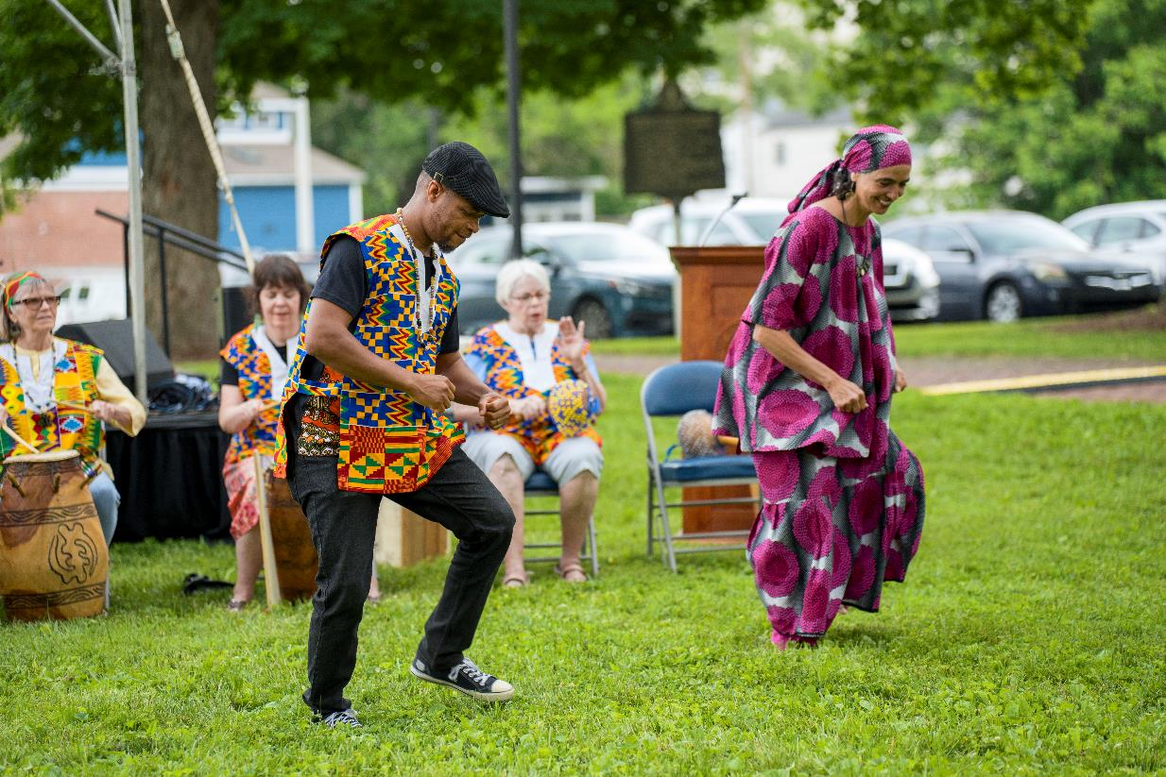
KENTUCKY HISTORY DAY

Slide 13
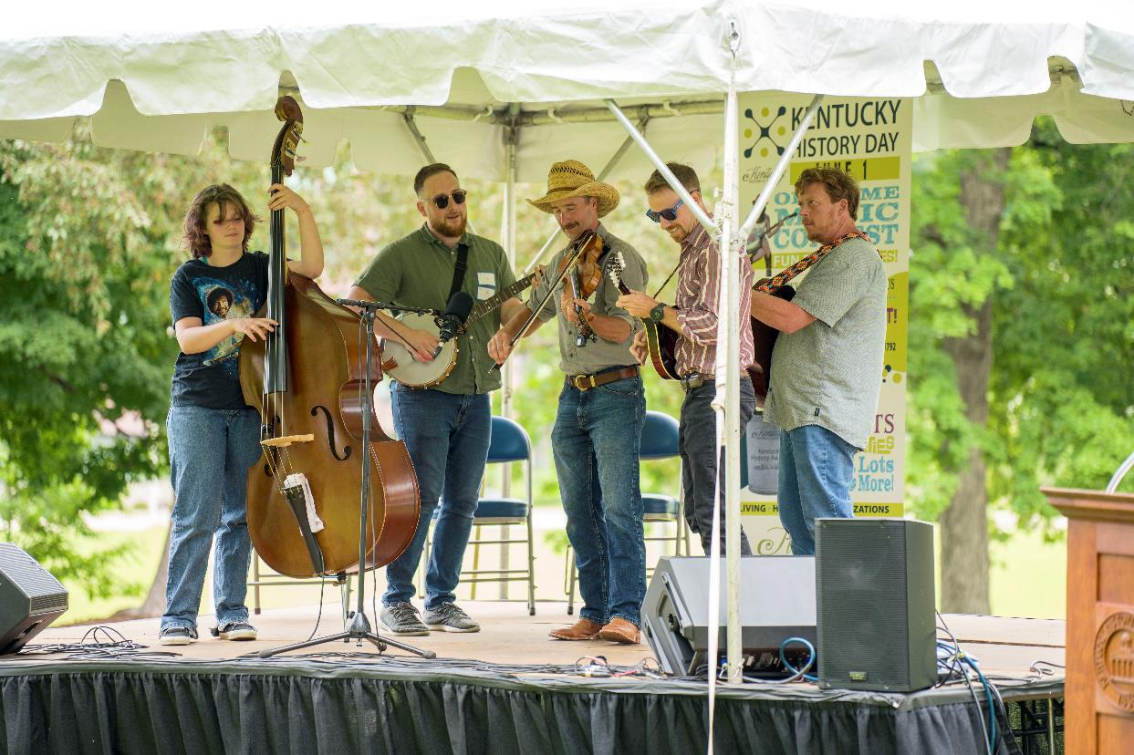
KENTUCKY HISTORY DAY

Slide 14
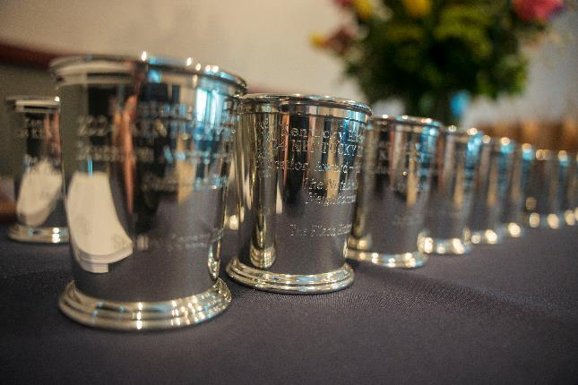
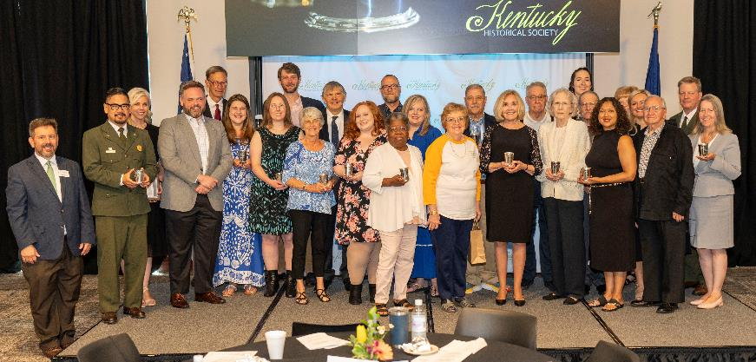
Kentucky history awards
Kickoff to Kentucky History Day
Over 140 attendees
18 individuals and organizations awarded

Slide 15
Kentucky Local History Trust fund
The Kentucky Historical Society oversees the Local History Trust Fund based on its state mandate as the keeper of Kentucky’s legacy.
Donations from Kentucky state income tax returns fund the Local History Trust Fund.
Planning grants range from $290 to $1,000, and implementation grants range from $290 to $2,500.
Grants support local history education programs, collections care, publications, documentaries, social media platforms, websites, and more.
History-minded organizations in Kentucky with 501c3 status, local government agencies, and public libraries can apply for a Local History Trust Fund grant. For-profit entities are not eligible for funding.
Grants are made based on an organization’s plan to advance in one or more areas represented in field-based standards, such as the AASLH Standards and Excellence Program for History Organizations.

Slide 17
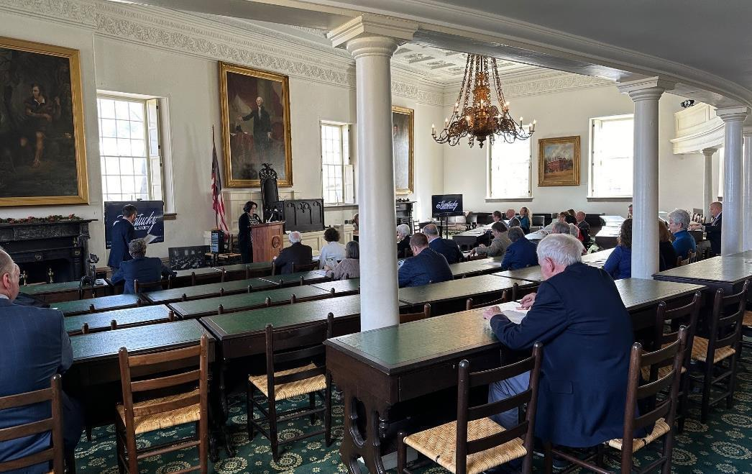
Old State Capitol & Civics programming

Slide 18
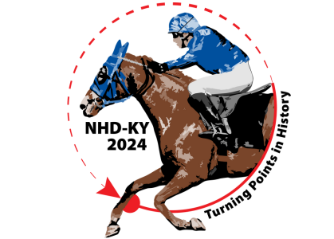
National history day in kentucky
Held April 27th at the University of Kentucky College of Education
225 students from 29 schools participated
34 projects advanced to the NHD National Contest held at the University of Maryland from June 8-13

Slide 19
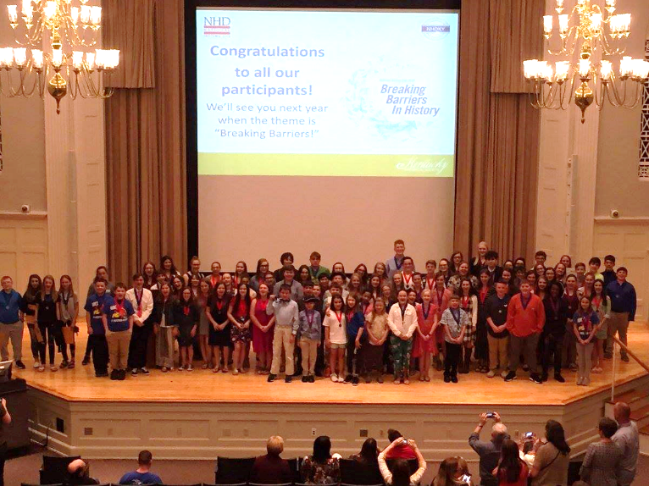
National history day in kentucky
64 students, representing 34 projects, competed at the National History Day National Contest in College Park, Maryland, from June 8 to 13.

Slide 20
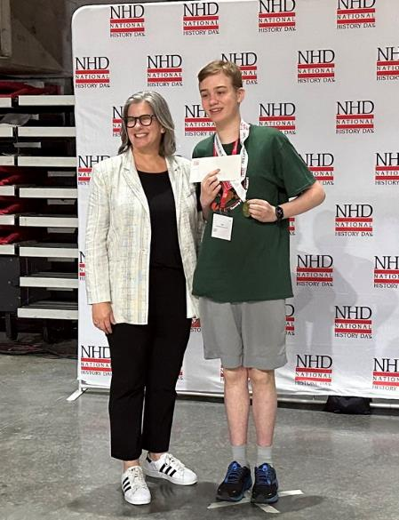
National history day winner
Jack Gill, a student at Paul Laurence Dunbar High School, Lexington took home 1st place in the Senior Individual Documentary for A Theory, A Paper, A Turning Point: Claude Shannon’s 1948 “Mathematical Theory of Communication.”
Gill joined more than half a million students globally who completed historical research projects in one of five categories: documentary, exhibit, paper, performance, or website.

Slide 21
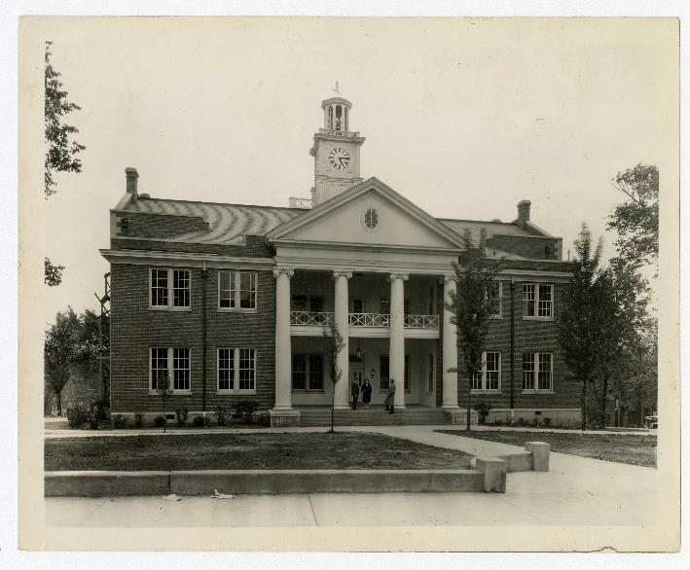
Harrodsburg 250th
Stockade at Fort Harrod, Willard Rouse Jillson, Graphic8_Box4_F8_11
Mercer County Courthouse, Willard Rouse Jillson, Graphic8_Box4_F8_02

Slide 22
Harrodsburg history Roadshow

Slide 24
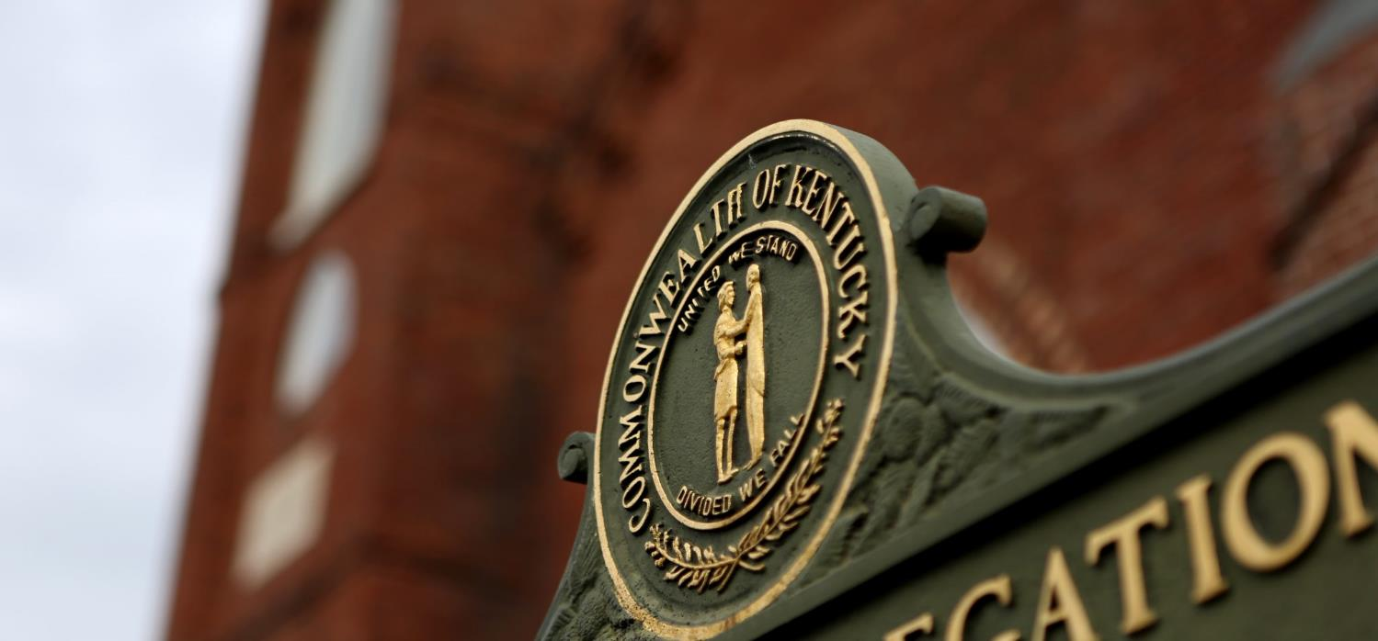
HISTORICAL MARKER PROGRAM
Notes:
Thank you Chairperson Schroder / King / Pratt for this opportunity to talk about one of, if not the most visible program of the Kentucky Historical Society.
It is a tough act to follow Commissioner Storm.

Slide 25
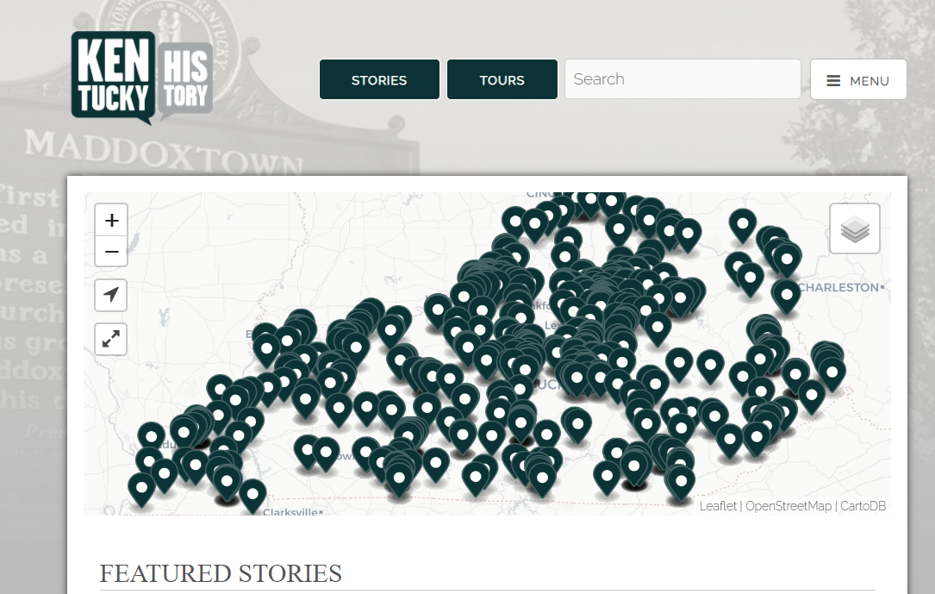
https://explorekyhistory.ky.gov/
Notes:
While physical markers are the keystone of the program, KHS also maintains the ExploreKyHistory smartphone app and website. Here, we are able to expand the histories told on the markers. The app supports multimedia resources, including images from print and object collections, oral histories, videos, and audio recordings. As of May 2021, there are 875 entries, with more than 100,000 annual visitors to the site.
We also maintain an online database of all markers at history.ky.gov. It is relatively basic in its function.
Basic data analytics shows ExploreKYHistory is very well indexed on Google, meaning that Google views this site, its information, and KHS as reputable. We have excellent search engine optimization. You can see this when you google any of the subject matter of the markers ExploreKYHistory usually appears in the top search returns.

Slide 26
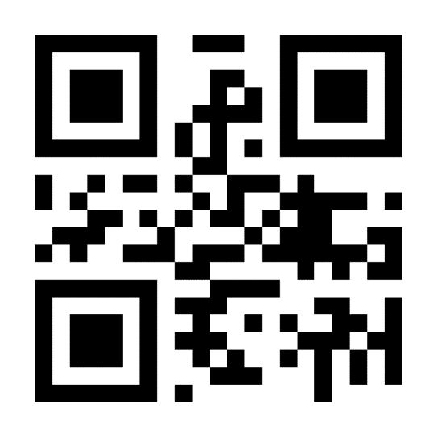
Thank you!
FOR MORE INFORMATION, PLEASE VISIT HISTORY.KY.GOV
OR SCAN QR CODE.

