Slide 1
Kentucky’s Recreational Use Statute & Rock Climbing: Proposed Changes
KRS § 150.645 ; § 411.190 C
Billy Simek
Jereme Ransick
Curtis Rogers

Slide 2
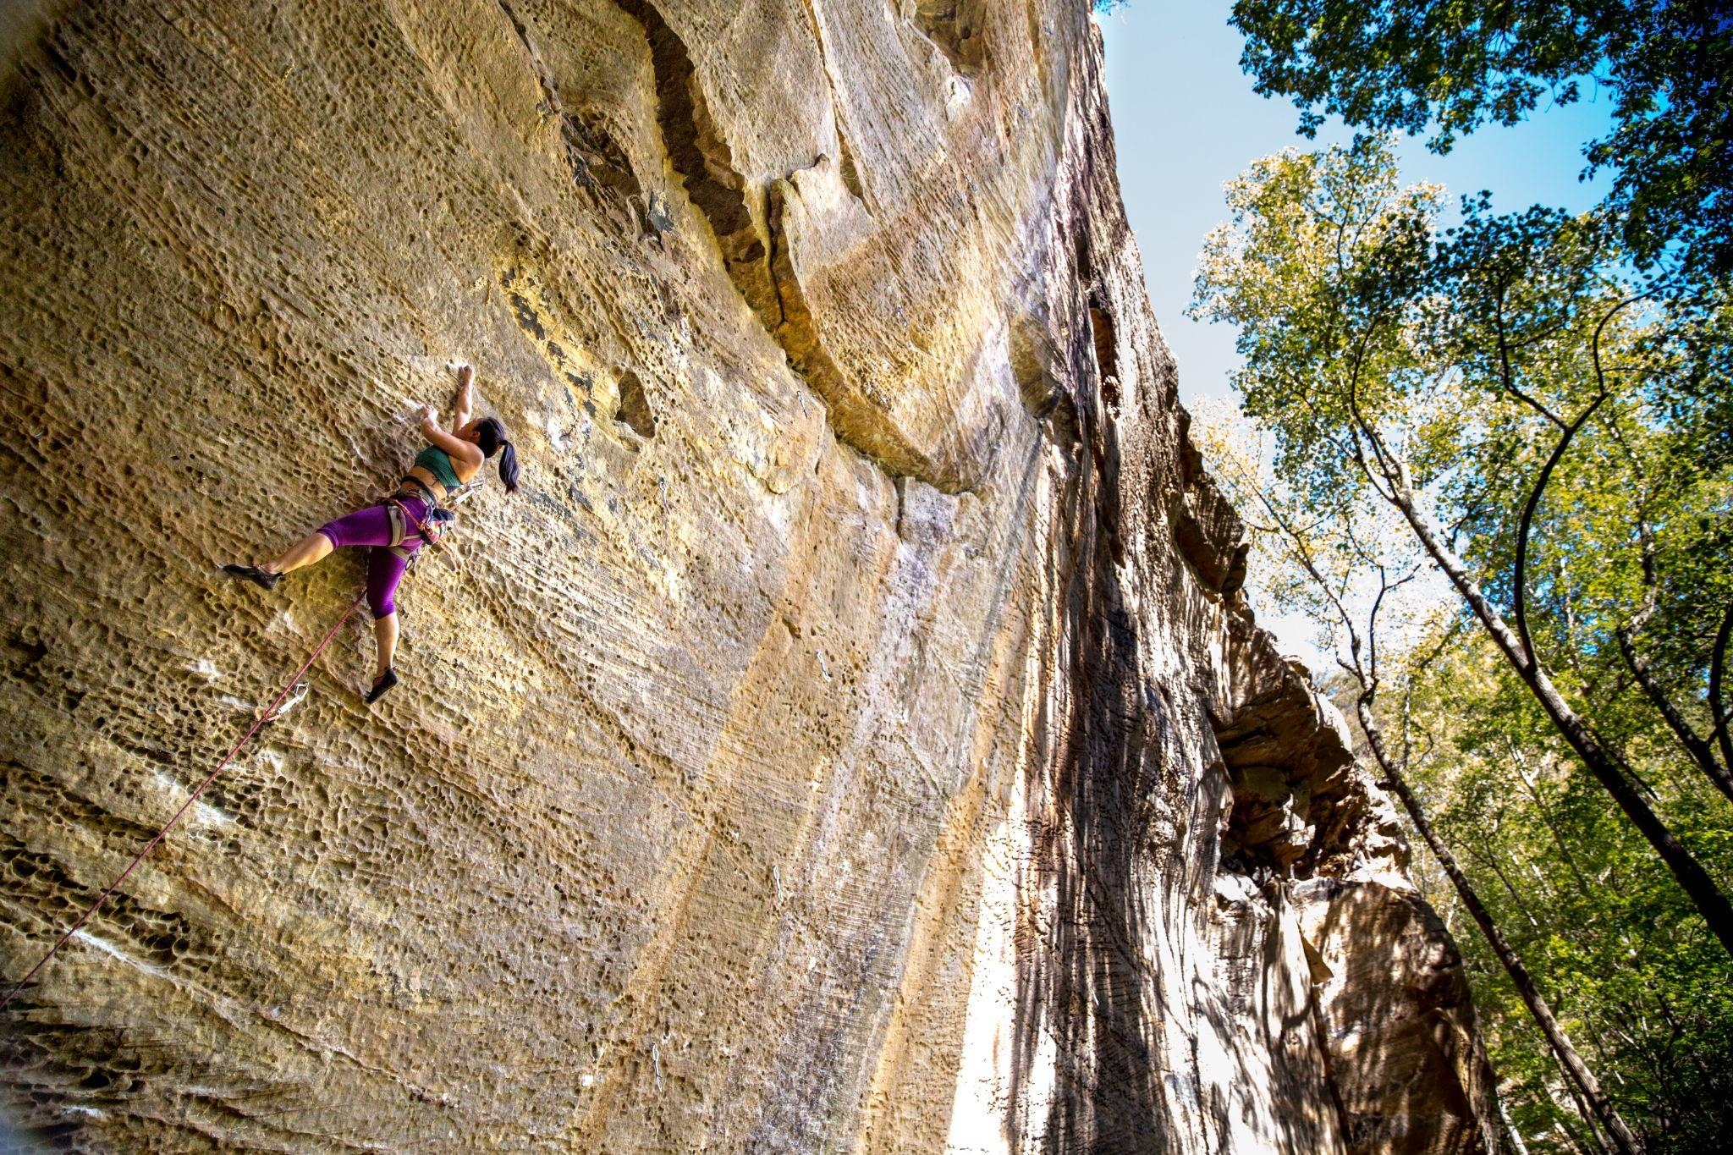
The Red River Gorge
The Red River Gorge is a world-famous destination for climbing.
About 102,000 climber visits in 2020.
A large portion of the Midwest, East, and South view the Red River Gorge as their “home crag.”
International visits are common.
Remote work means that we are seeing more people move to the area specifically for climbing.
“God must be a climber. I mean, just look at the Red River Gorge.” - Outside 2019
Notes:
Most sandstone arches of anywhere east of the Mississippi

Slide 3
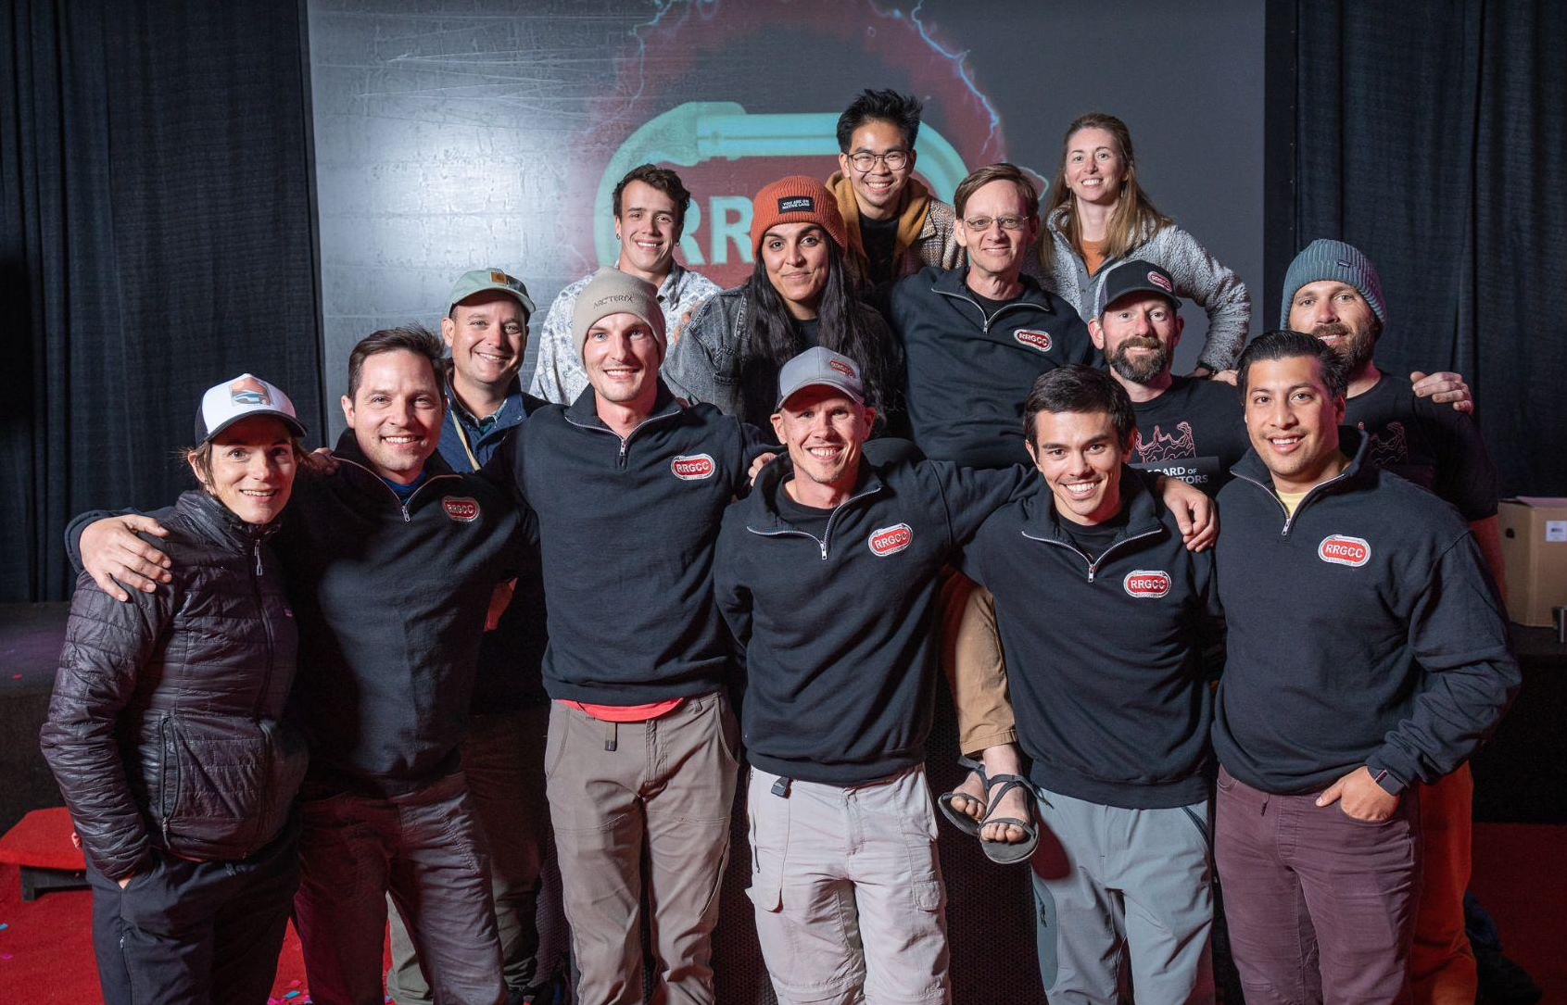
WELCOME
What Is The Red River Gorge Climbers’ Coalition?
We are dedicated to securing and protecting open, public access to rock climbing in the Red River Gorge area of Kentucky and promoting conservation of the environment on the lands where we climb.
Founded in 1996 as a response to the closure of public climbing areas and a moratorium on new routes in the DBNF.
2004 we purchased the Pendergrass Murray Recreational Preserve (750 acres).
2012 we purchased Miller Fork Recreational Preserve (309 acres).
2017 we purchased Bald Rock Recreational Preserve (102 acres).

Slide 4
Types of Climbing Access
Federal Land
State Land
LCO Owned Land
Privately Held Land Open to the Public
Privately Held Land Closed to the Public

Slide 5
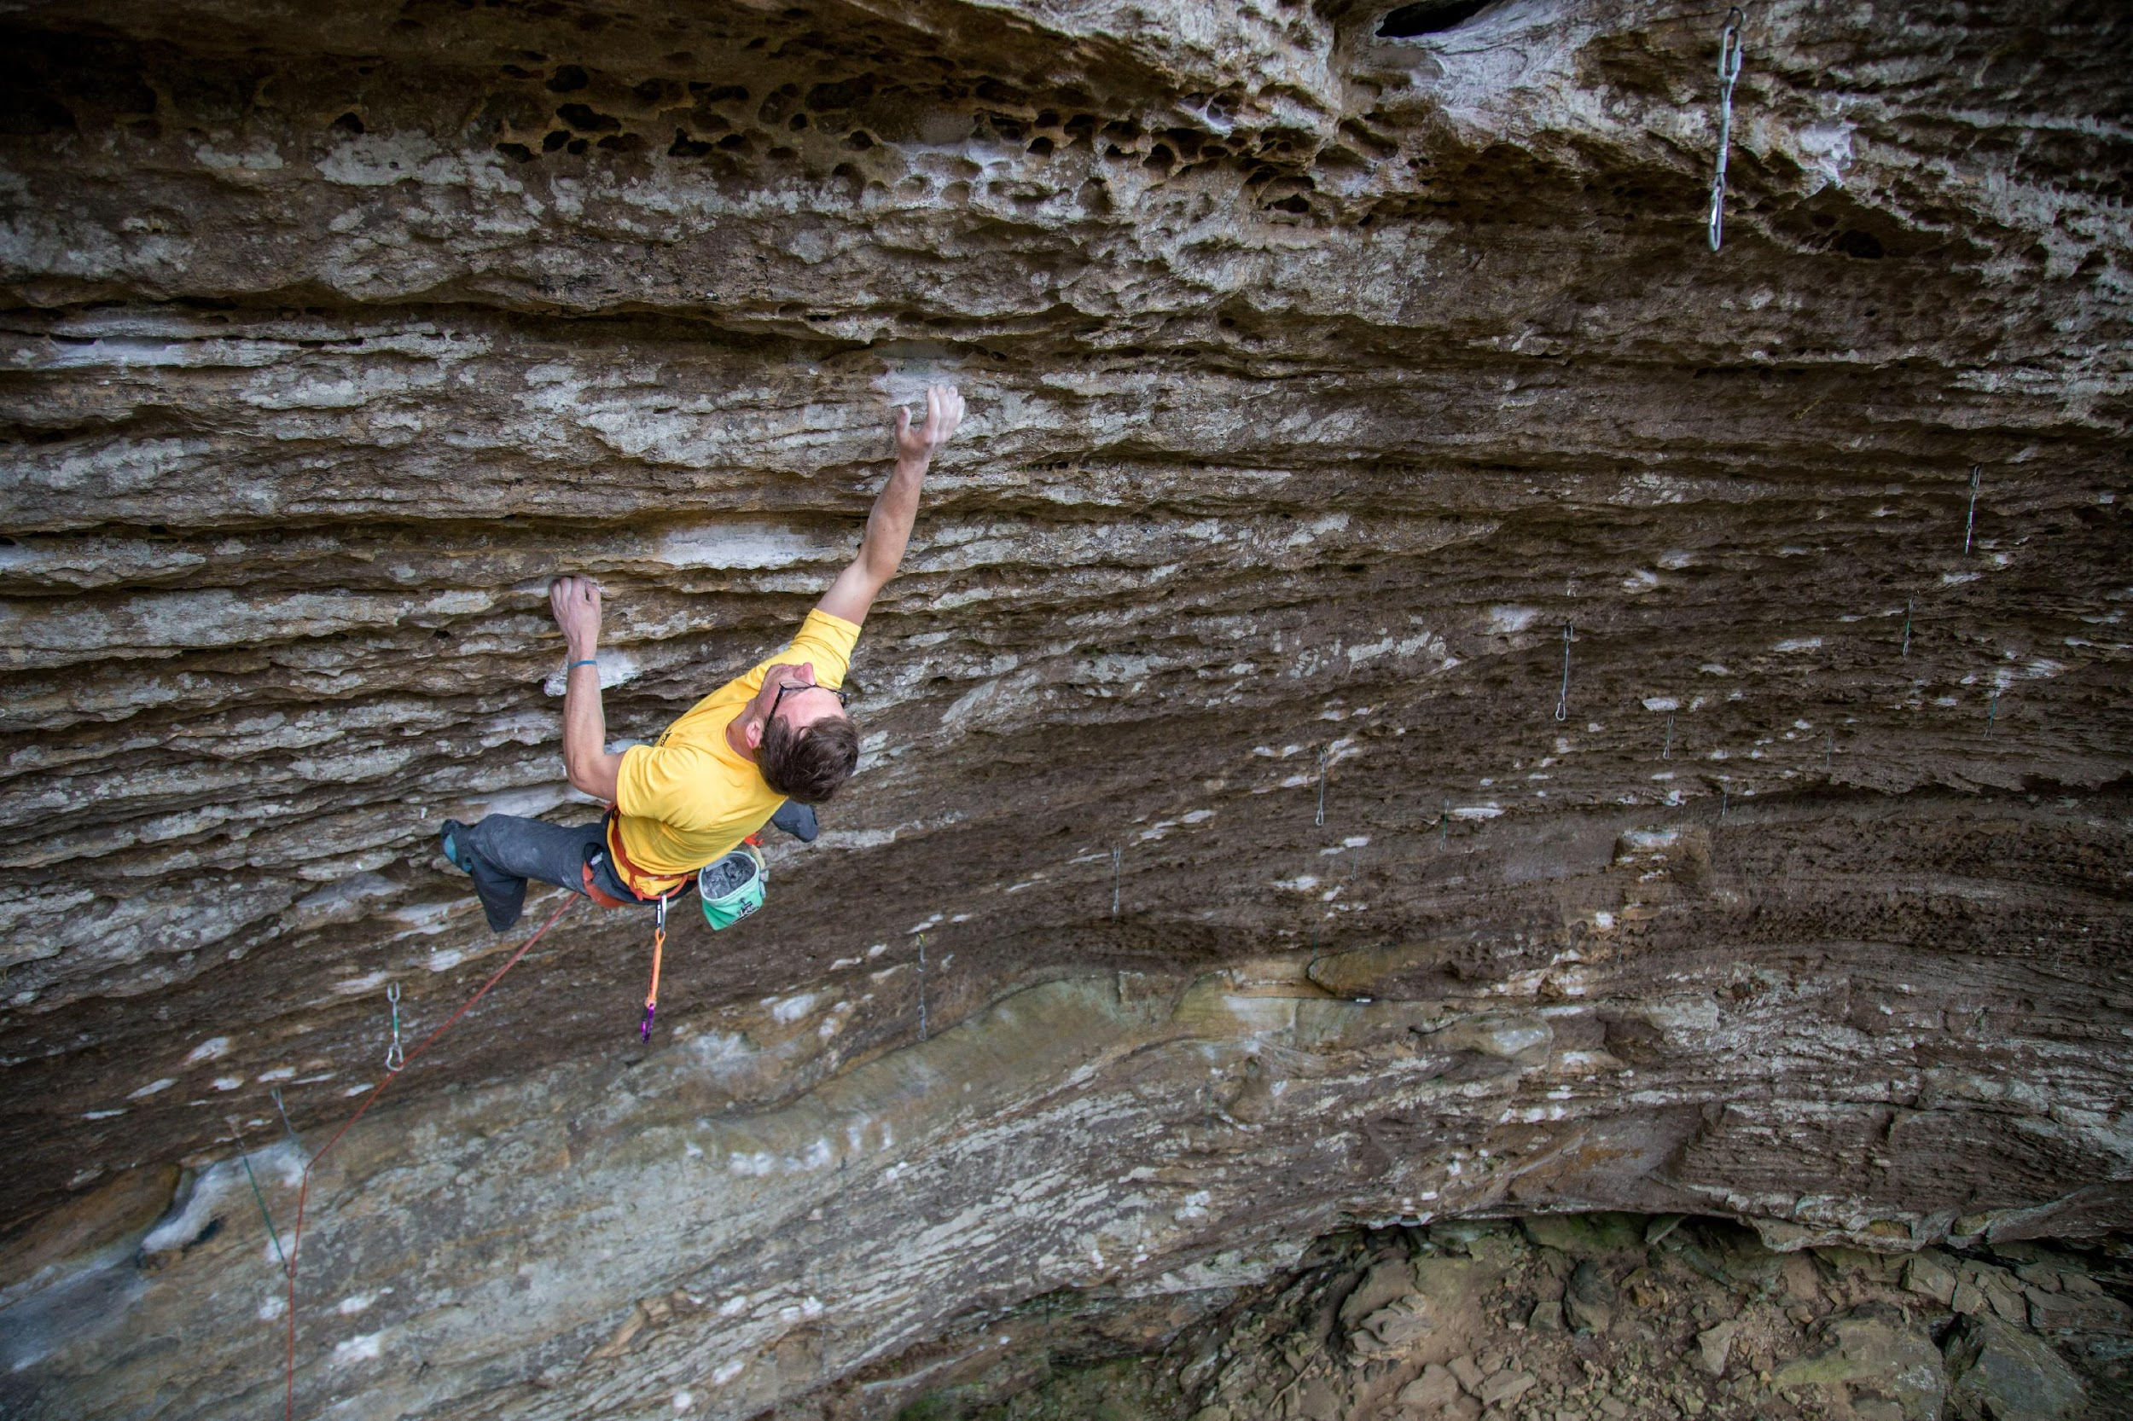
Recreational Use Statutes
1965 the Council of State Gov. created a model RUS in response to increased obesity rates and growing suburban areas.
All fifty states have a Recreational Use Statute.
All variations provide some form of protection to landowners when they allow people to recreate on their land.
Most RUS state that the landowner owes no duty of care to keep the premises safe or to provide a warning of danger.
These statutes don’t apply when the landowner charges a fee for entry or in cases of malicious intent.
Each state has its own list of recreational activities specifically mentioned. Some have different definitions of land.
Notes:
Challenges to RUS that were upheld - Hayloft in Iowa. Tree stand in Kentucky. Woman MTB in Washington and ran into dust from a mower. South Dakota couple rollerblading on a city park trail. Baltimore lost the Promenade case because it was shown they knew about the crack in the pavement and were told to address it and because she was commuting to work.

Slide 6
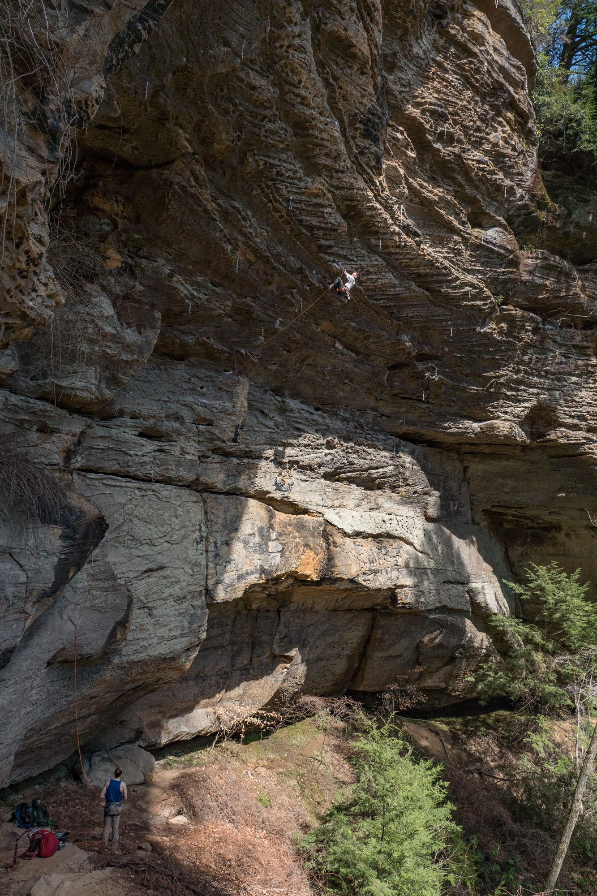
Our Proposal
We would like to propose that Kentucky’s Recreational Use Statute be amended to include rock climbing, bouldering, and rappelling as explicitly protected activities. Additionally, we propose that the definition of “land” be expanded to include boulders, rocks, and cliffs. This language would mirror several other states that have amended their Recreational Use Statutes to protect climbing.

Slide 7
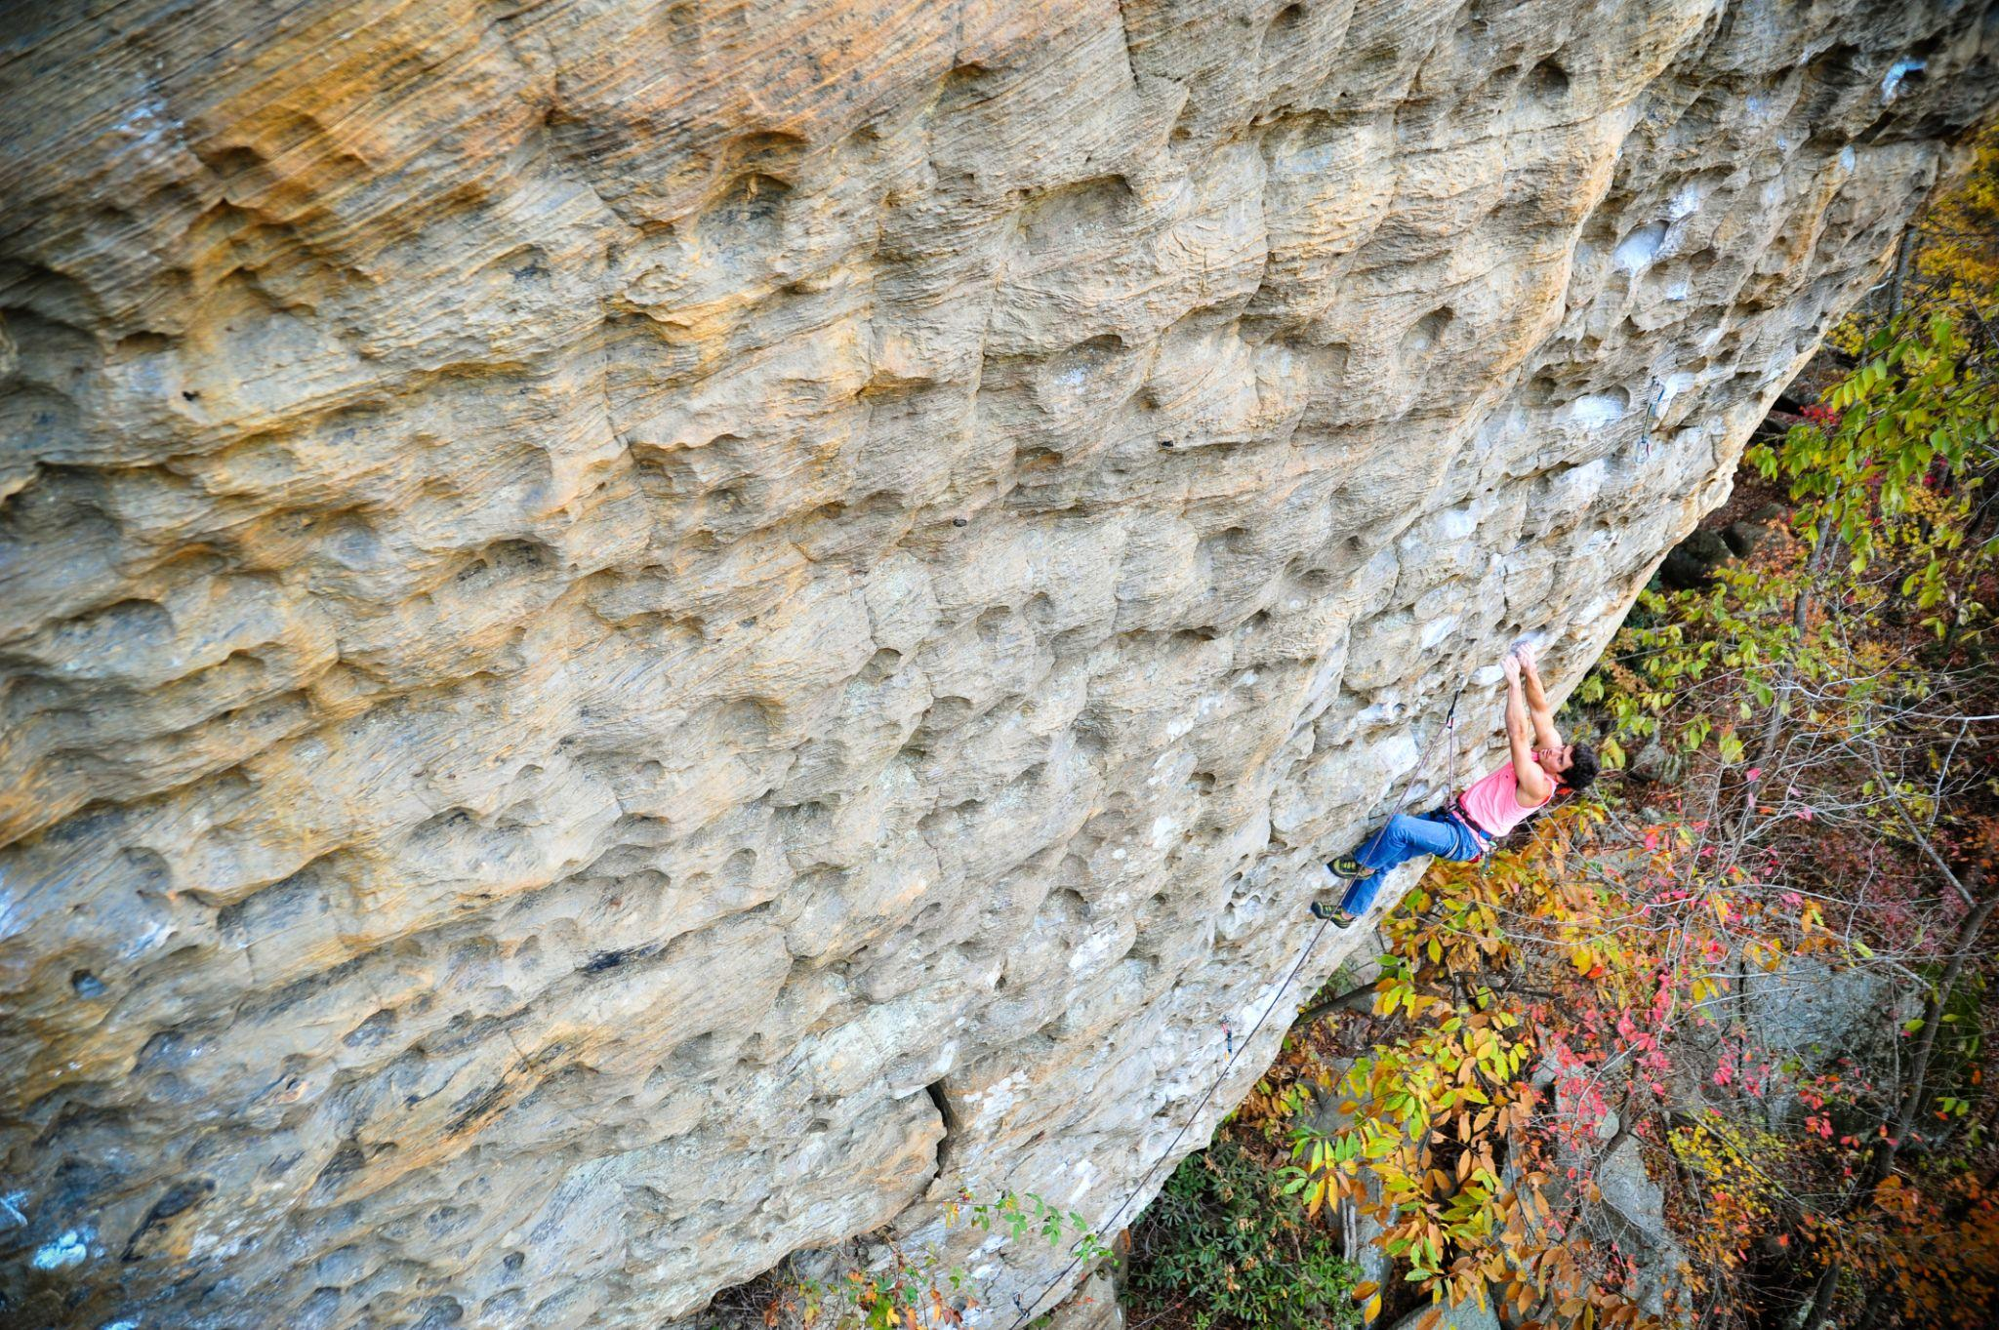
Where is climbing specifically mentioned in a Recreational Use Statute?
Virginia
Tennessee
Alabama
Texas
Colorado
Washington
Wisconsin
Vermont
New Hampshire
Maine
West Virginia (late 2023)
Notes:
https://nationalaglawcenter.org/state-compilations/recreational-use/
Hunting is almost always first on the list
Florida - water sports
Colorado - long list includes kite flying
Texas - Long list includes disc golf
Montana - Specifically mentions “big game hunting”
Maine - mentions “recreational harvesting” in fields, woods, and ocean
New Hampshire - collecting fire wood
Louisiana - Mentions snowmobiling

Slide 8
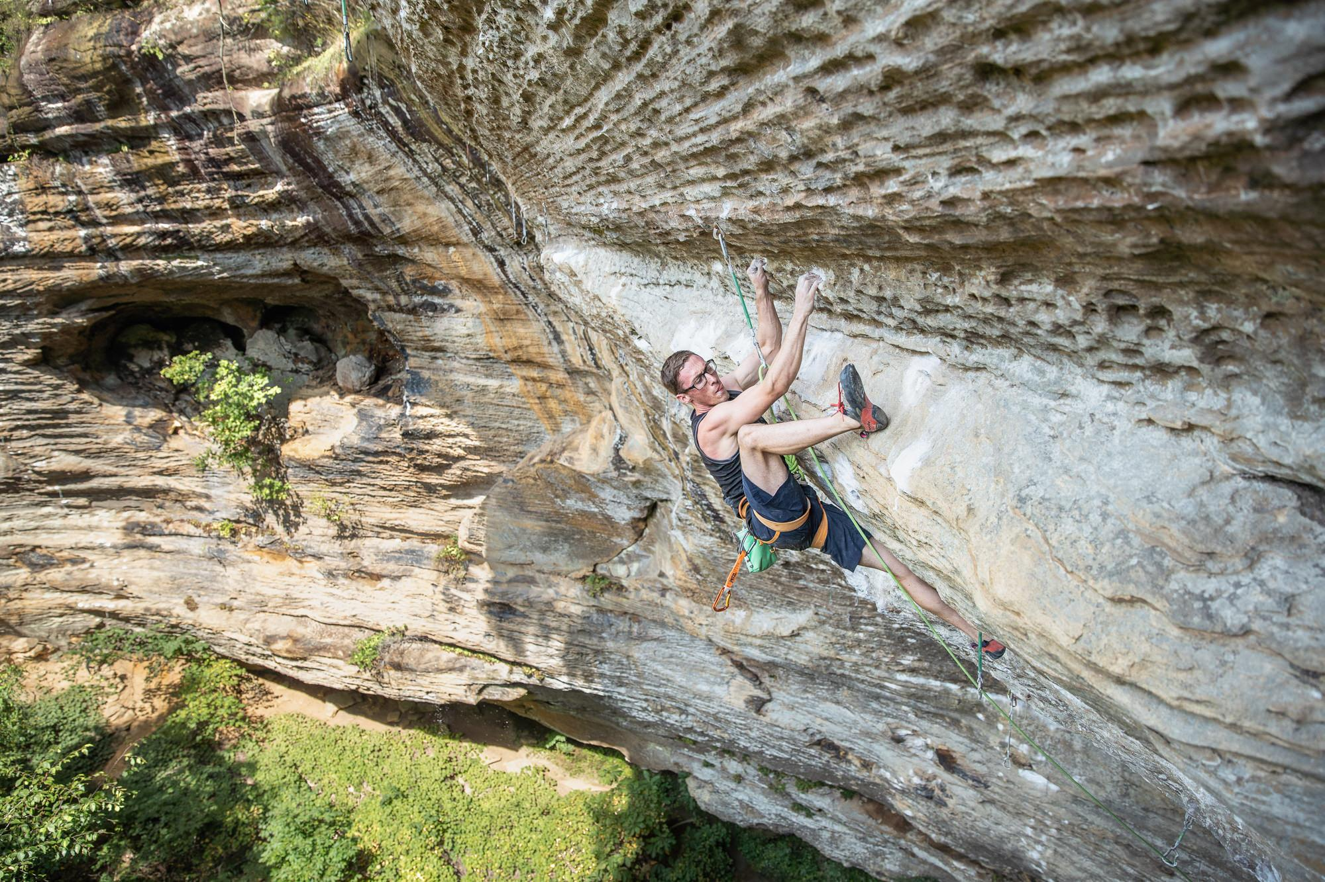
Proposed Changes
Amend the definition of “land” to include rocks, boulders, and cliffs.
Explicitly mention rock climbing, bouldering, and rappelling as protected activities.
Specifically provide the same protections to landowners who allow people to climb on their land as landowners who allow people to hunt on their land.

Slide 9
Why Amend Kentucky’s Recreational Use Statute?
Kentucky has an extremely high concentration of climbing resources.
The Red River Gorge is one of the premier climbing destinations in the world. Visitors come from across the globe to climb on our sandstone.
Climbing has a significant economic impact in rural areas.
Land prices are skyrocketing, and resorts/cabin developments are more prevalent in the area. The RRGCC is working with developers to secure access for climbing.
Climbing is in a period of tremendous growth.
Promoting outdoor activities promotes the health and well being of our citizens.
Notes:
If it grows at the same rate from 2016 to 2020, and there is reason to believe that the rate will increase it would be over 20 million by 2025
https://www.fs.usda.gov/features/wellness-benefits-great-outdoors

Slide 10
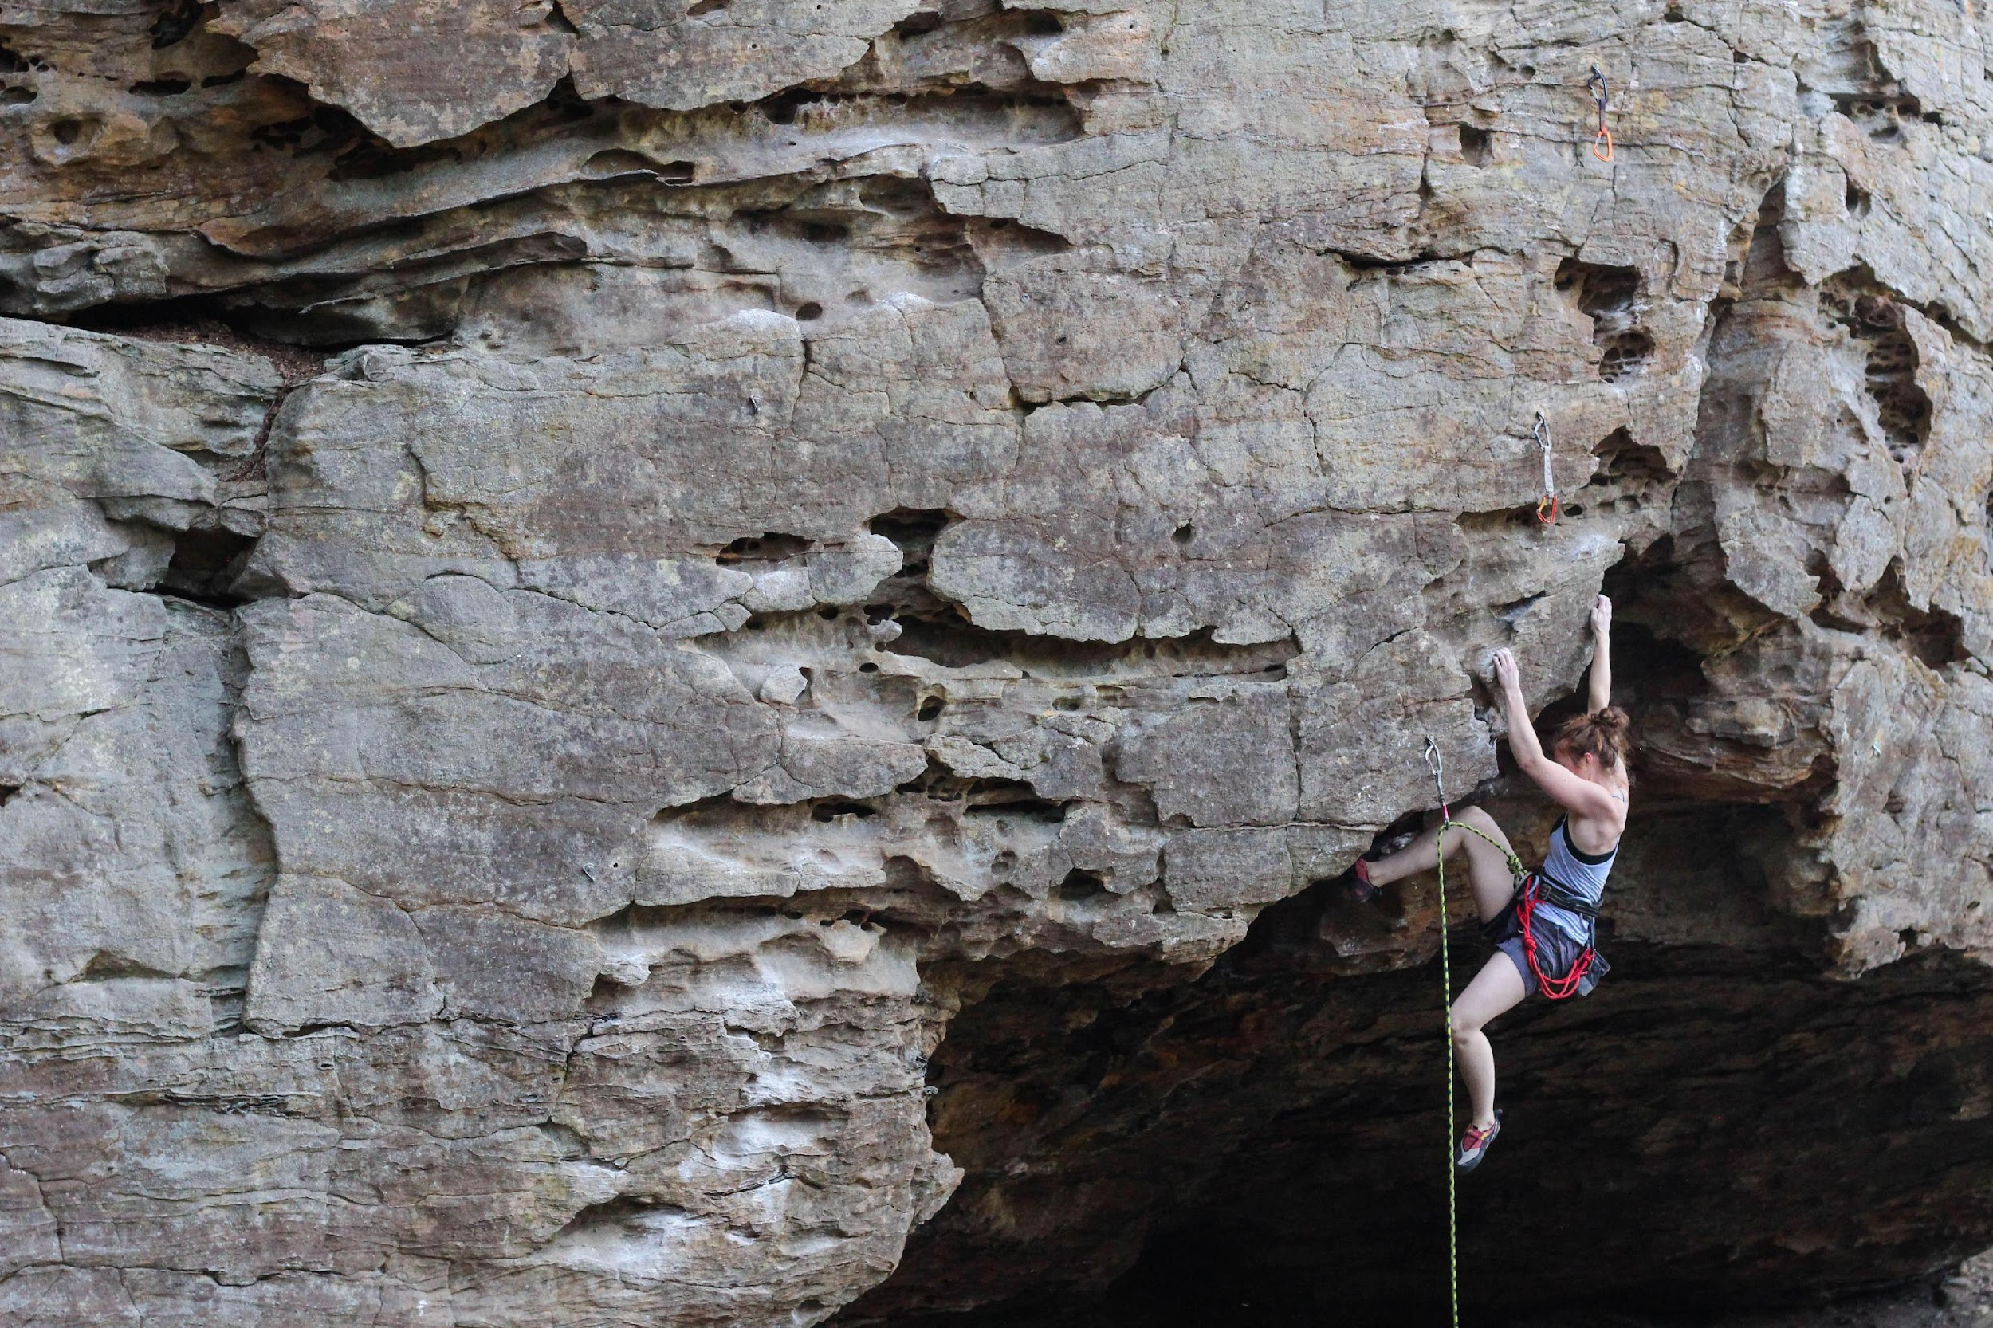
Questions?

