Slide 1

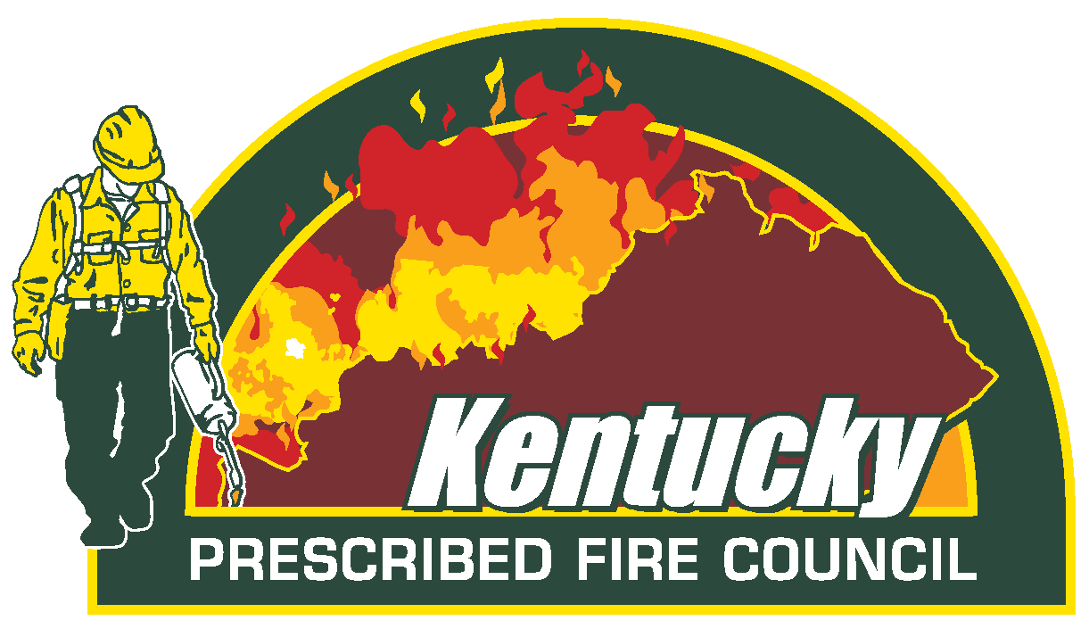
Prescribed Fire
Lighting the Way
The Future of Prescribed Fire in Kentucky
Notes:
Prescribed fire is not wildfire. It’s applied under specific weather conditions, with trained personnel on site, and clear goals in mind.
Make sure to note Brandon’s presentation with high-points and have a smooth transition

Slide 2
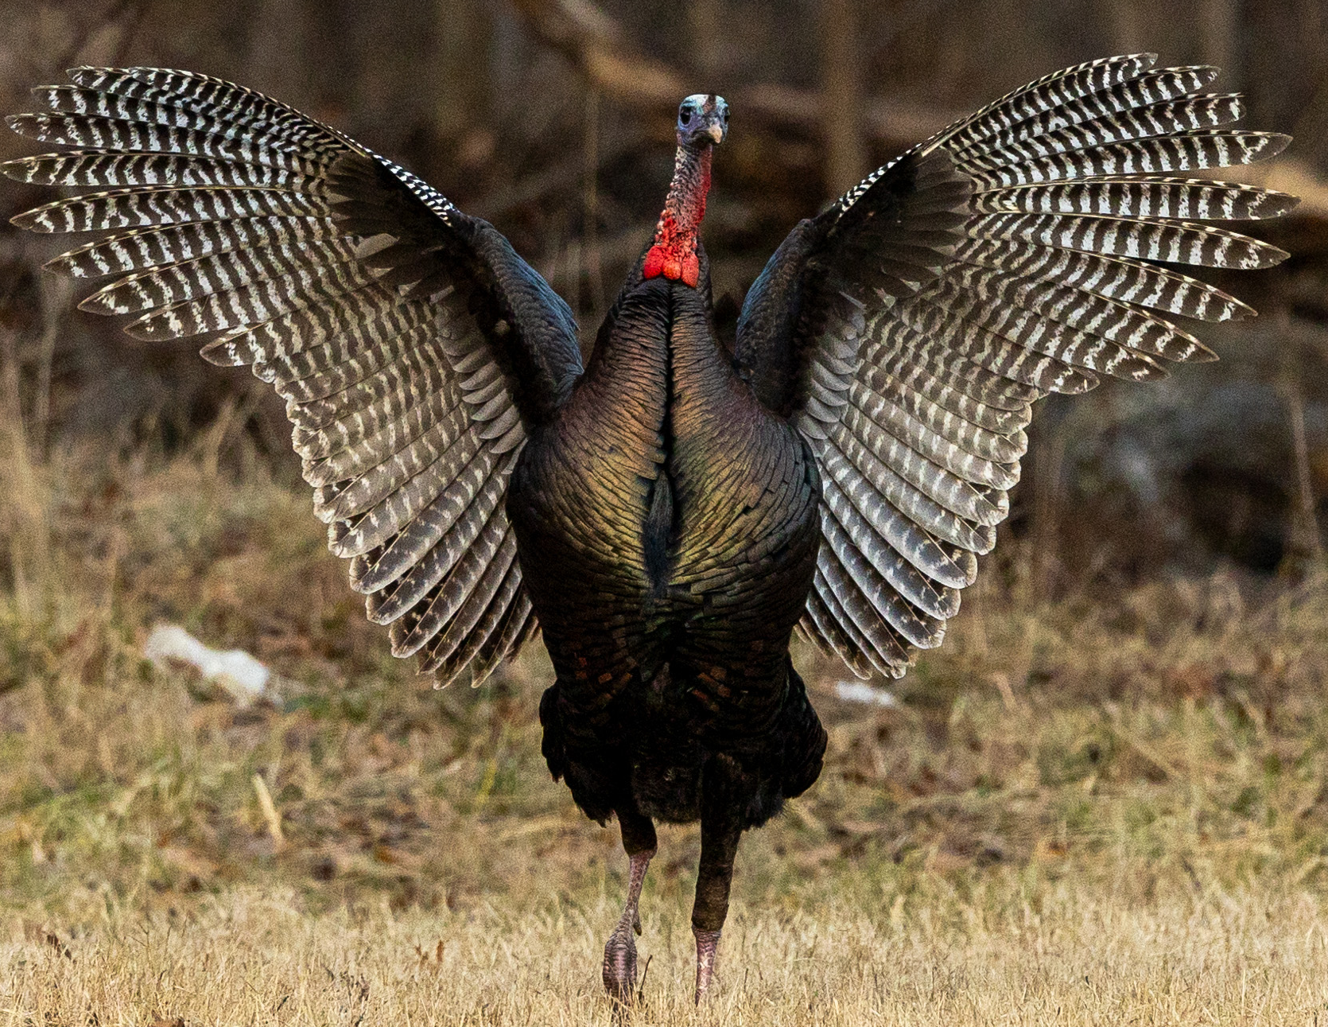
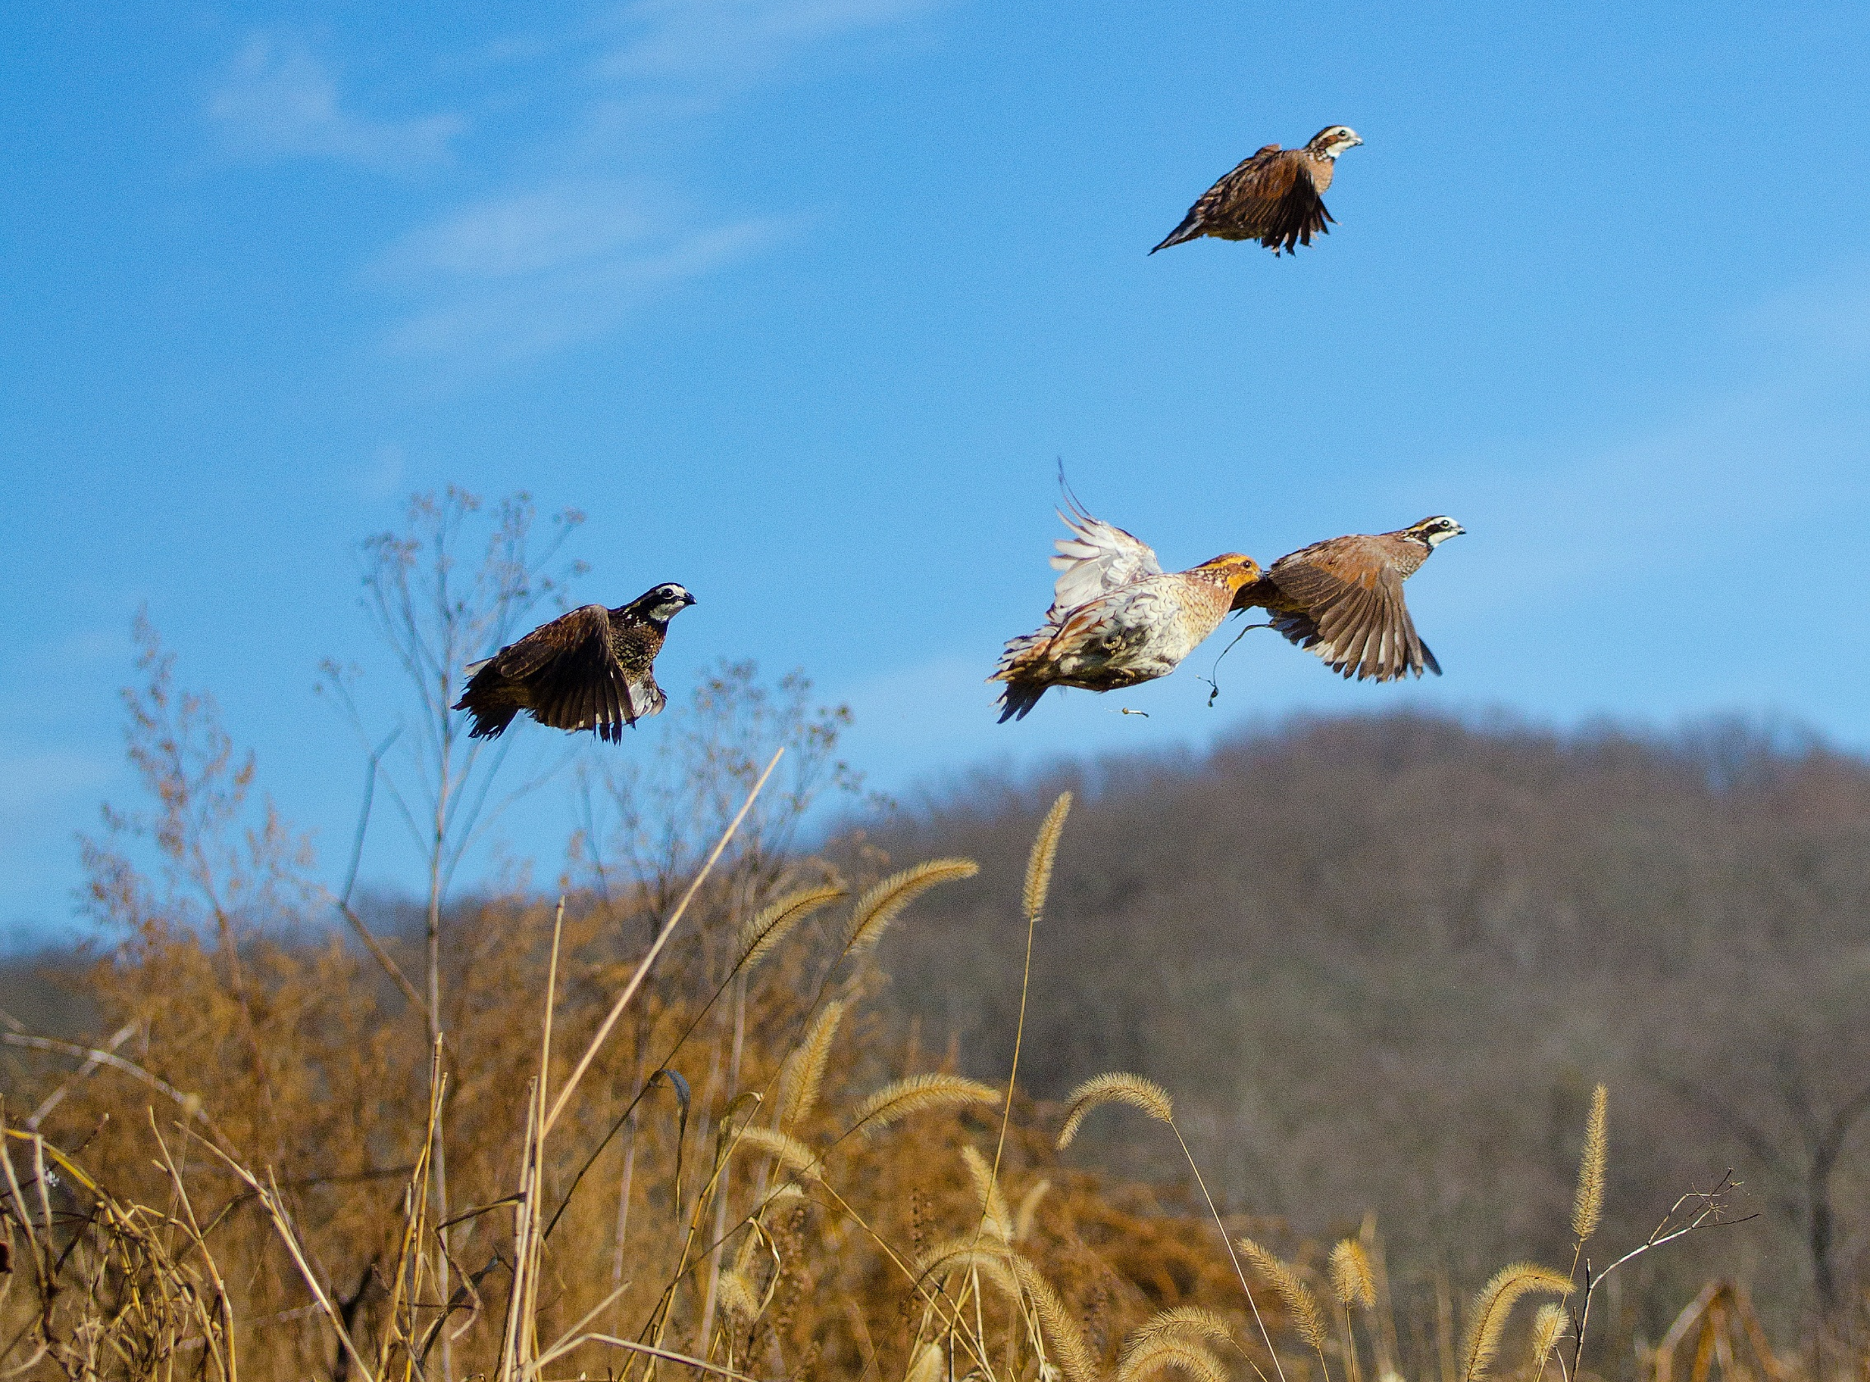
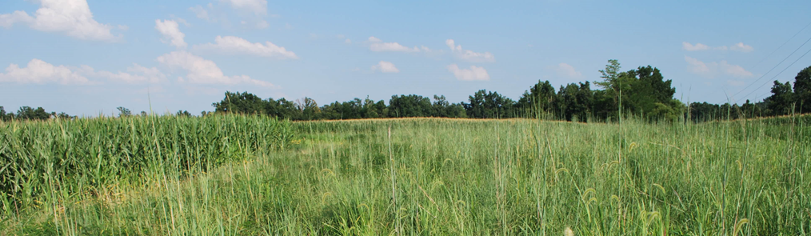
Prescribed Fire
Wildlife habitat → Many declining species rely on the very habitat that only fire can create and sustain
Prescribed fire:
  Reduces trees in open lands
  Creates high quality forage
  Creates nesting areas for many birds
  Allows young birds to avoid predators
Notes:
Prescribed fire is also critical for wildlife habitat. Across Kentucky—and much of the southeastern U.S.—many species are in decline. A major driver of this decline is the loss of open land and early successional habitat, which fire helps maintain. It reduces woody encroachment, creates high-quality forage, and provides essential cover for birds and small mammals, including turkeys and quail.

Slide 3
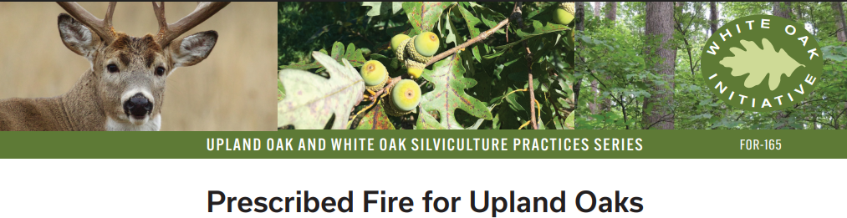

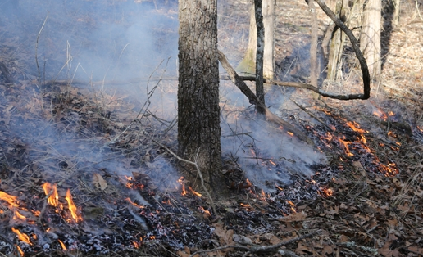
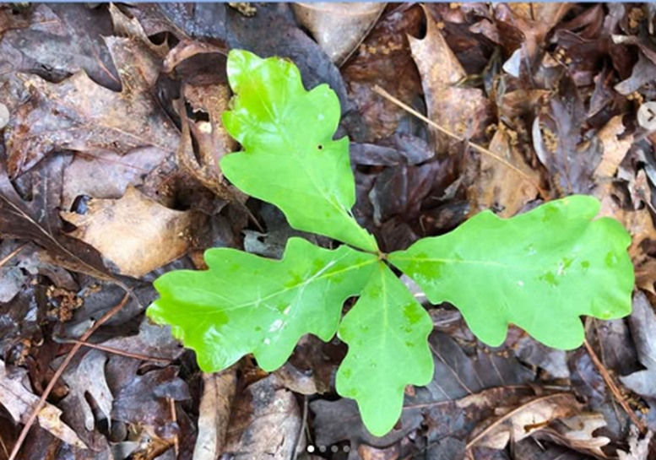
Prescribed Fire
Forest management → Young trees are being outcompeted by faster growing trees. Without help, they won’t reach the canopy
Prescribed fire:
Encourages native plants
Supports wildlife diversity
Reduces ticks
Restores rare systems
Notes:
Prescribed fire reduces competition, allowing slow-growi ng, fire-adapted oaks and hickories to survive and reach the canopy.
Supports wildlife diversity by creating a mosaic of young, open forest conditions used by nesting birds and early successional species.
Zoonotic disease → ticks and tick-borne diseases have increased rapidly in the state since 2000; some 10-fold
reduces tick habitat → Less leaf litter and cover = fewer ticks
breaks transmission cycle → Fewer ticks = fewer human/host encounters
shifts host makeup → Fire-adapted areas support fewer reservoir species
boosts biodiversity → Diverse ecosystems reduce disease spread ("dilution effect")

Slide 4
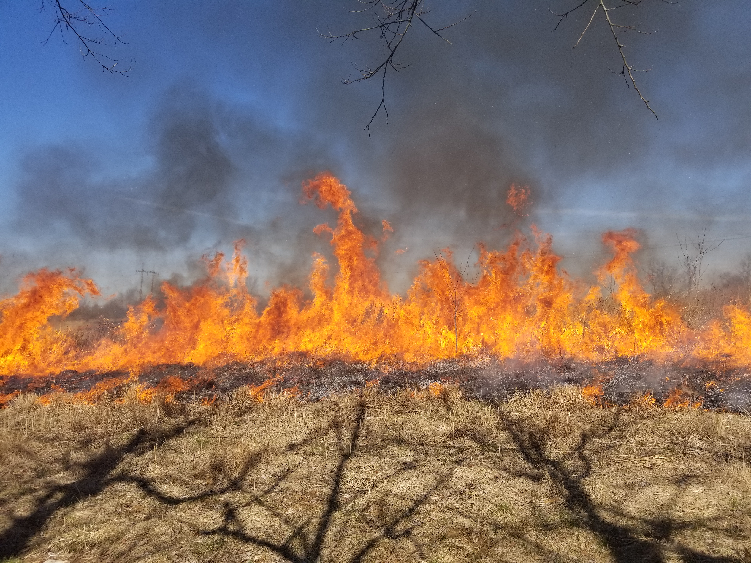
Kentucky Prescribed Fire Council
Partner organizations include:
Landowners
Academia
Local Government
State Agencies
Federal Agencies
Non-Governmental Organizations
Businesses
Contractors
The KPFC’s mission is to promote understanding and enhance
collaboration for the use of ecologically based prescribed fire
in the Commonwealth of Kentucky
Notes:
So, who’s using prescribed fire in Kentucky?
The Kentucky Prescribed Fire Council is a partnership of government agencies, nonprofits, businesses, and landowners committed to using safe, effective, and ecologically based fire. The Council was formed in 2008 in response to a shared recognition that fire is essential for the health of Kentucky’s landscapes.

Slide 5
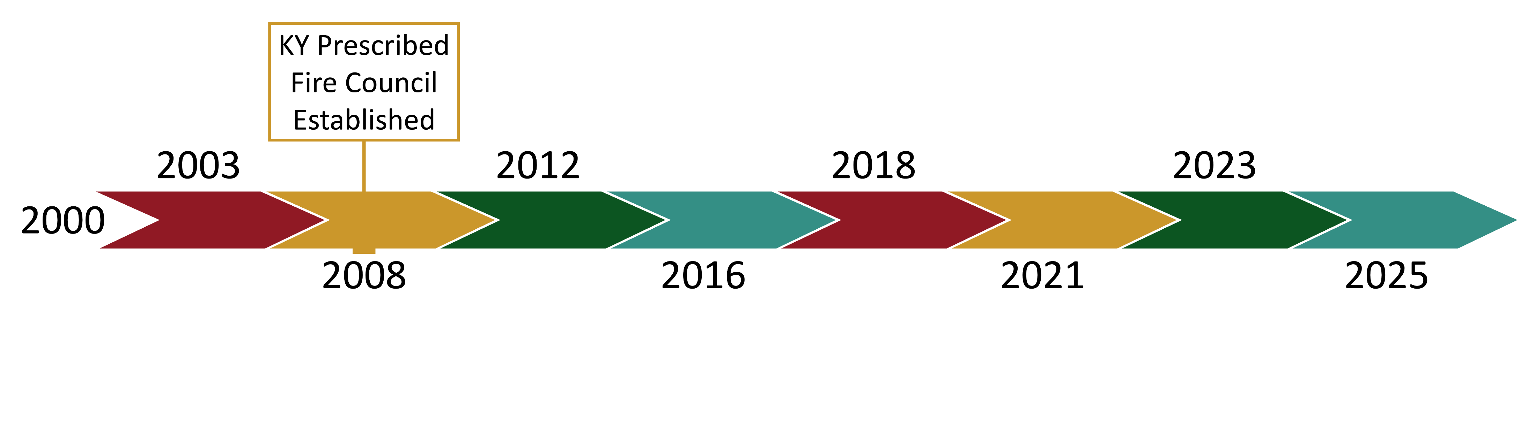
Kentucky Prescribed Fire Council

Slide 6
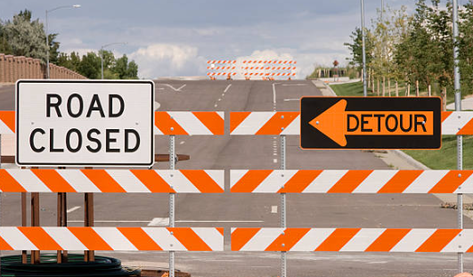
Kentucky Prescribed Fire Council
Roadblocks
Limited workforce capacity
Shortage of Certified Burn Bosses
Low landowner awareness
Liability concerns are a major barrier
Notes:
Back in those early days, the Council identified four major roadblocks to getting more prescribed fire on the ground:

Slide 7
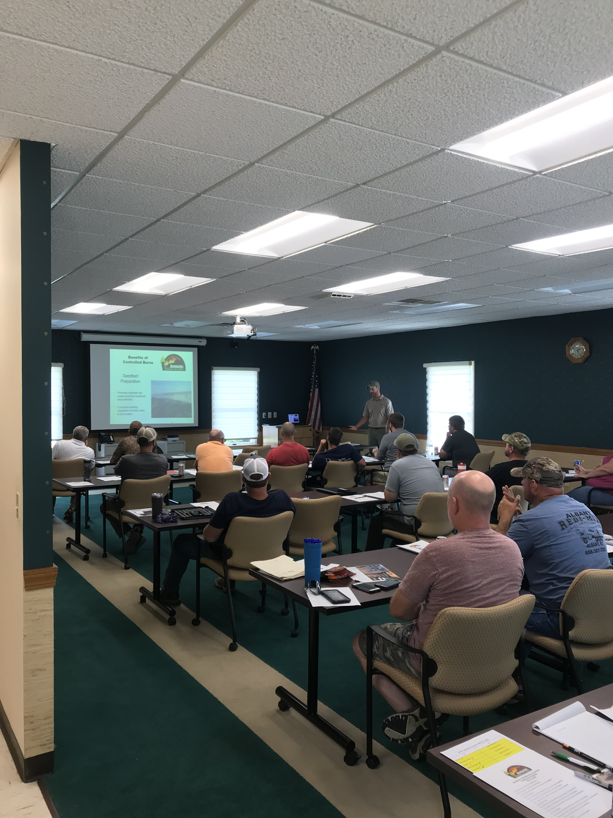
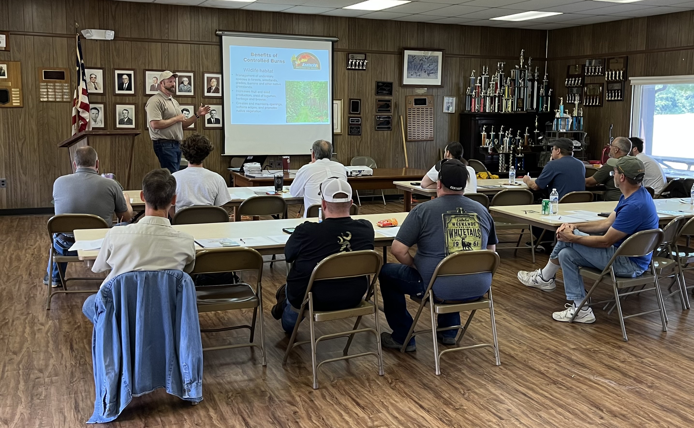
Kentucky Prescribed Fire Council
Roadblocks → Solutions
Limited Workforce Capacity
  Training programs and partnerships have increased the number of qualified personnel ready to conduct prescribed fire
_{Crewmember}
_{Course}
Notes:
To build a workforce, we developed a Crew Member Training Course. This eight-hour course prepares individuals with little to no fire experience to safely assist on burns under the leadership of a certified burn boss.

Slide 8
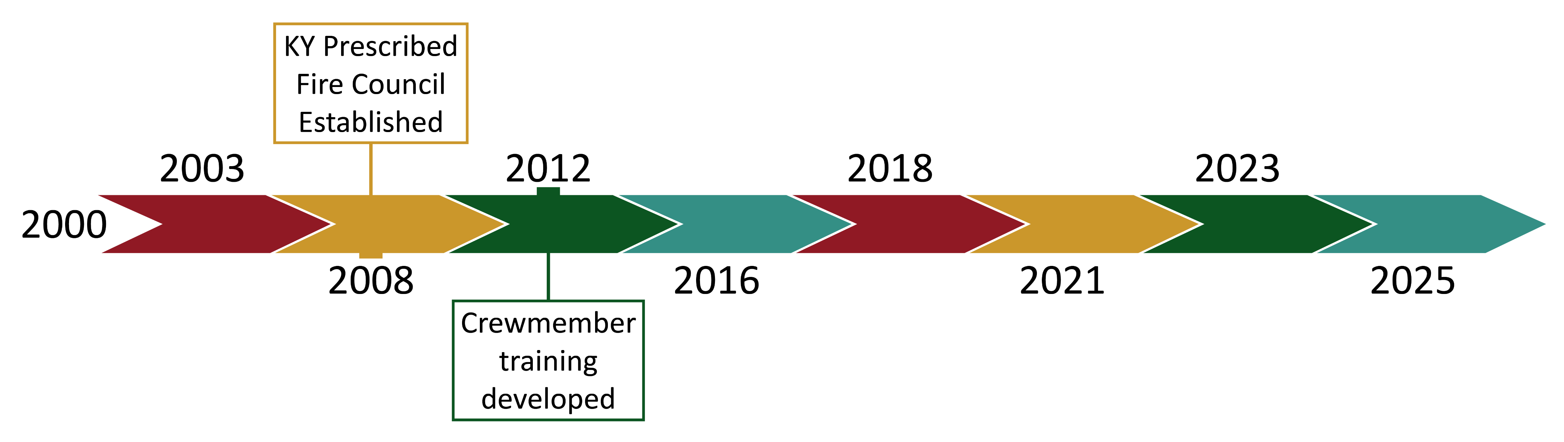
Kentucky Prescribed Fire Council

Slide 9
Kentucky Prescribed Fire Council
Notes:
Since 2012, we've trained more than 500 individuals.

Slide 10
Kentucky Prescribed Fire Council
Limited Workforce Capacity

Slide 11

Kentucky Prescribed Fire Council
Limited Workforce Capacity

Slide 12
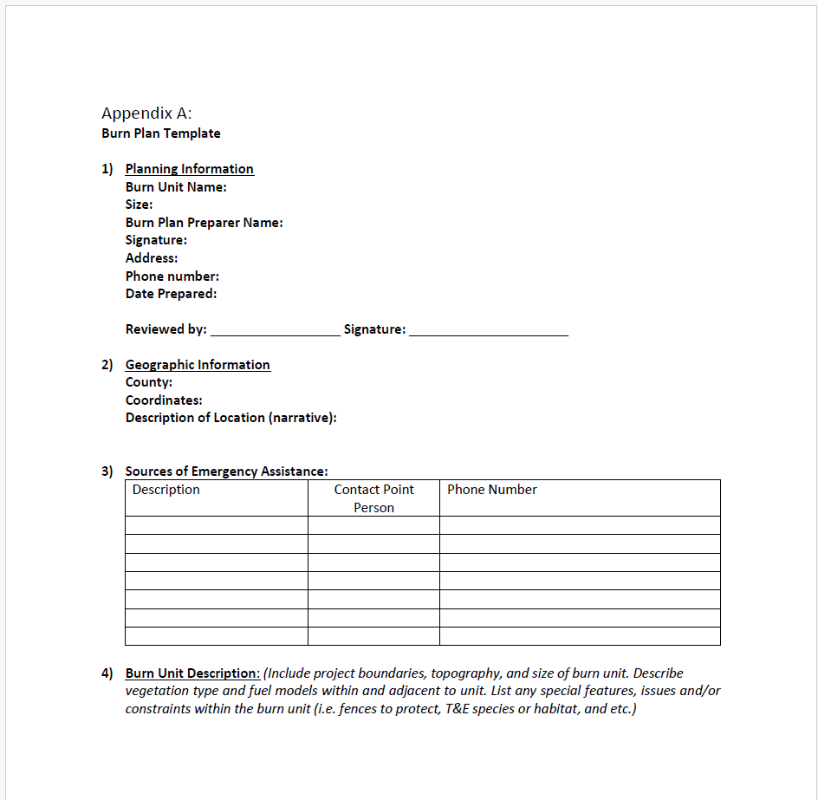
Kentucky Prescribed Fire Council
Roadblocks → Solutions
2. Shortage of Certified Burn Bosses
New efforts are underway to expand certification opportunities and grow the number of experienced burn leaders
_{Kentucky Certified}
_{Burn Boss}
Professional level training→ over 160 total hours of class and field work for certification
Notes:
To grow leadership capacity, we launched the Certified Burn Boss Program. Becoming a burn boss is no small feat—it requires over 160 hours of training and includes planning and executing real burns- in contrast- a person needs at least 60 hours to obtain a driver’s license in the state. Certified Burn Bosses spend countless hours developing a burn plan for each and every burn- outlining critical aspects of weather, fuels, smoke impacts, and personnel to pull off a safe and ecological fire.

Slide 13
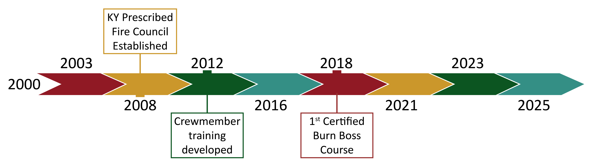
Kentucky Prescribed Fire Council

Slide 14
Kentucky Prescribed Fire Council
187
Notes:
Since launching, we’ve certified 187 burn bosses across a wide range of agencies, contractors, and private landowners.

Slide 15
Kentucky Prescribed Fire Council
187
2. Shortage of Certified Burn Bosses

Slide 16
Kentucky Prescribed Fire Council
187
2. Shortage of Certified Burn Bosses

Slide 17
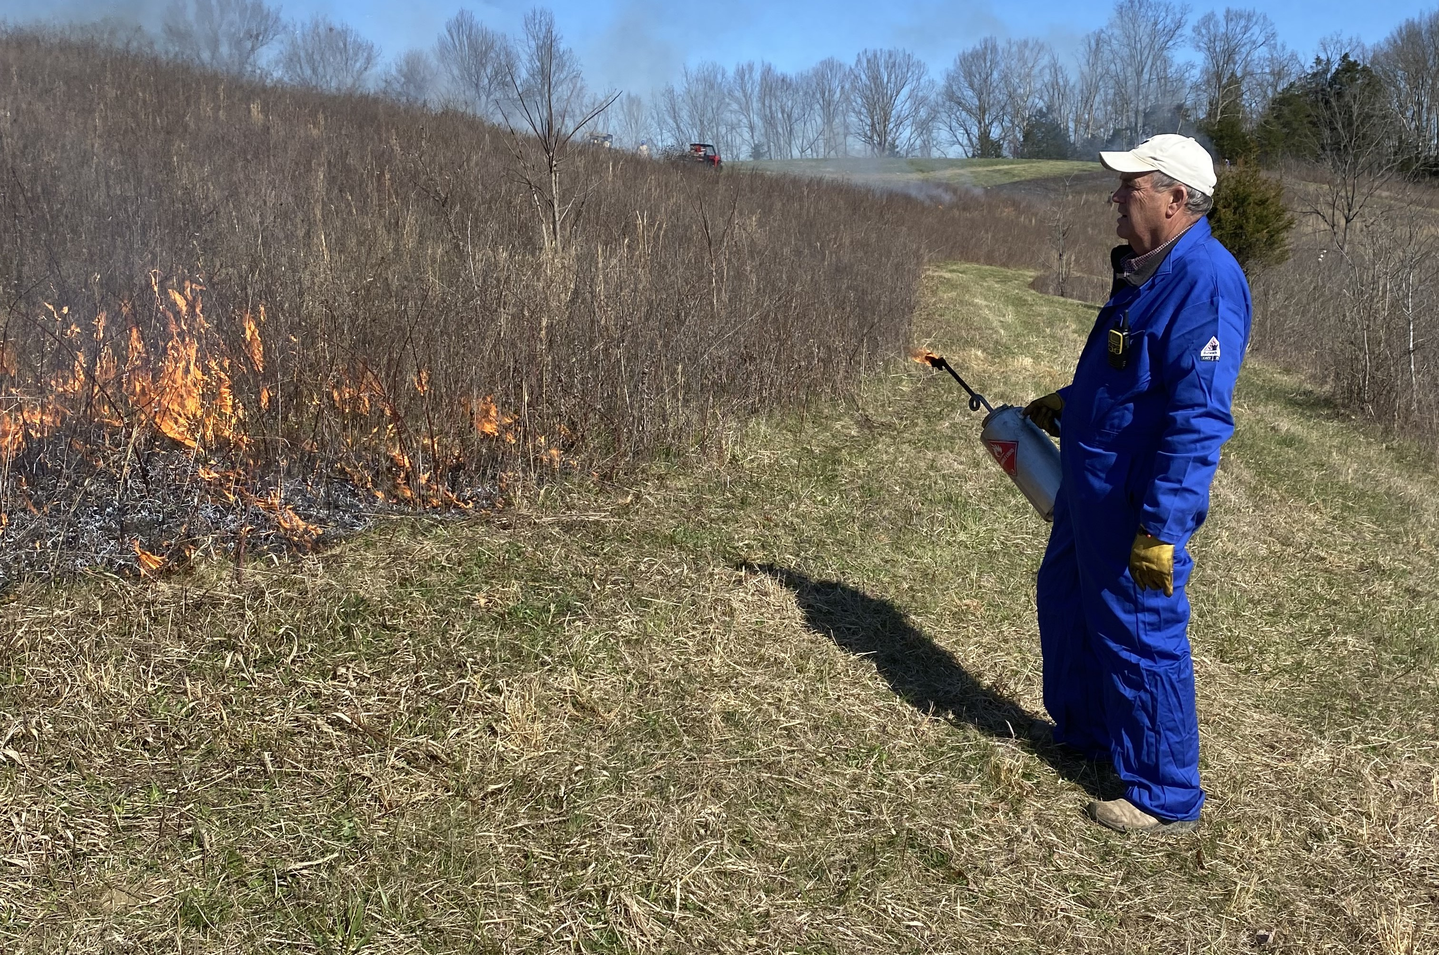
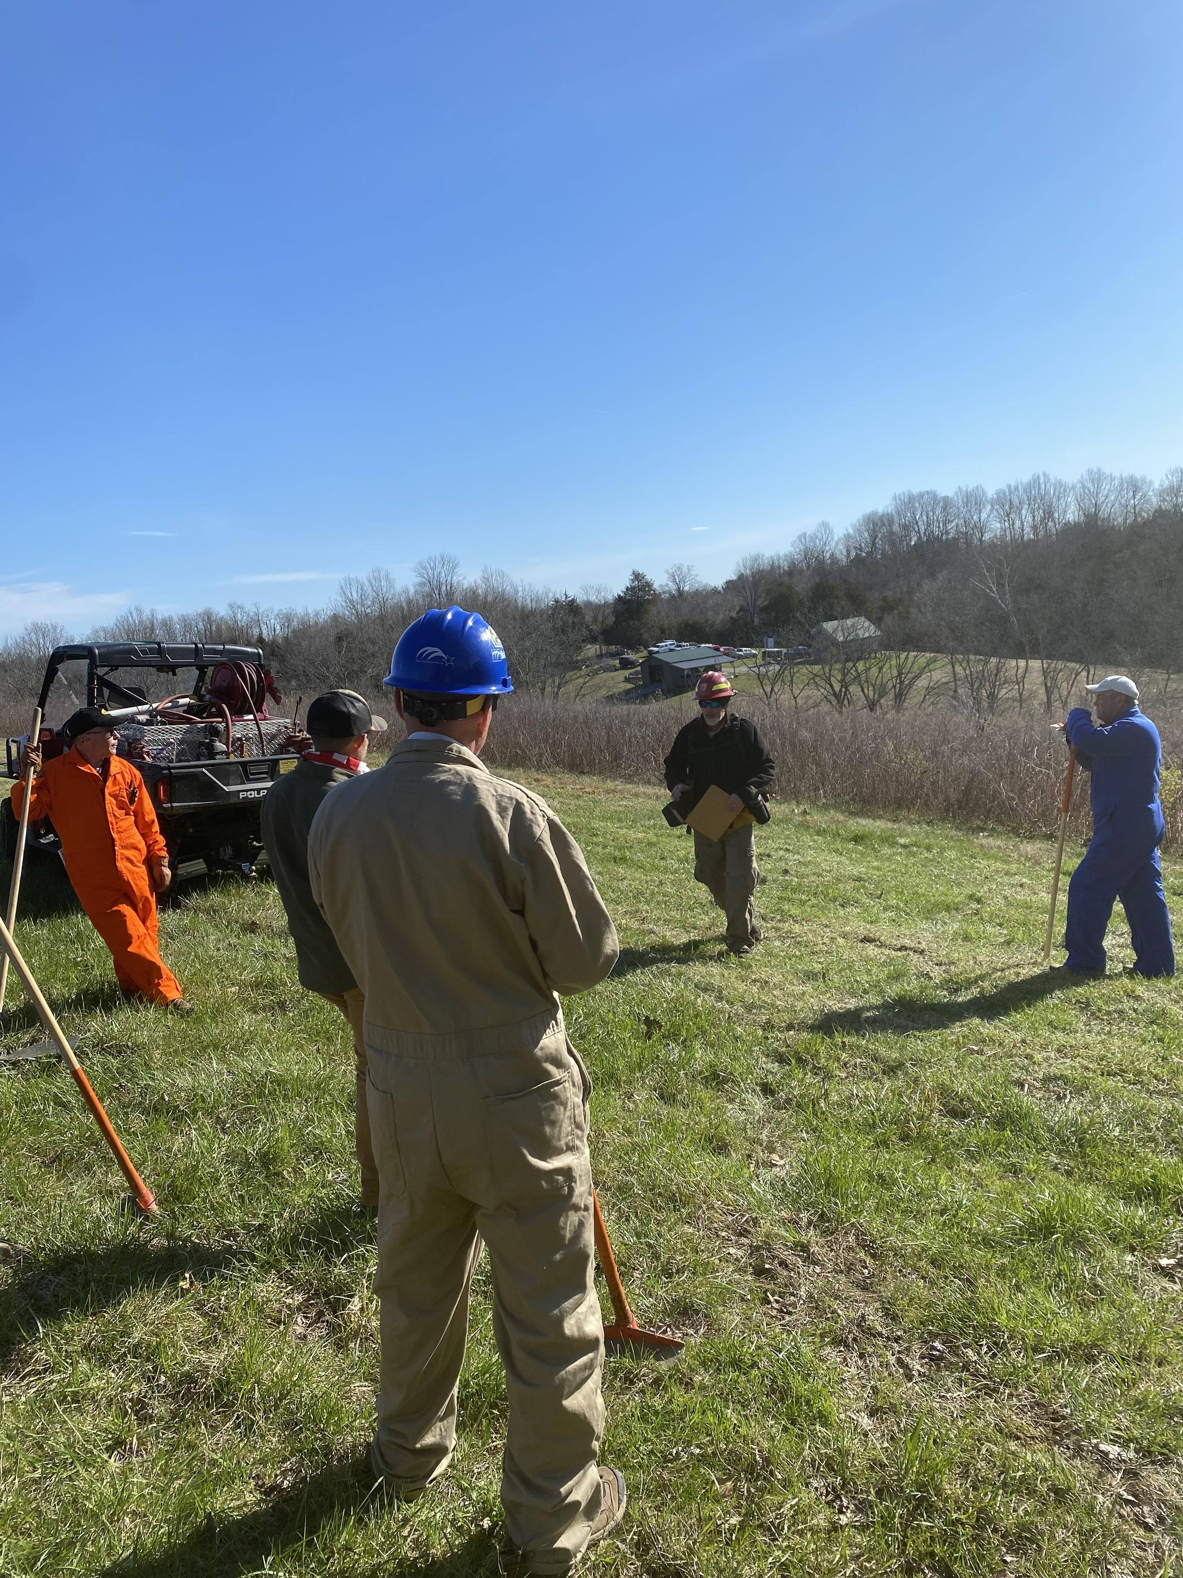
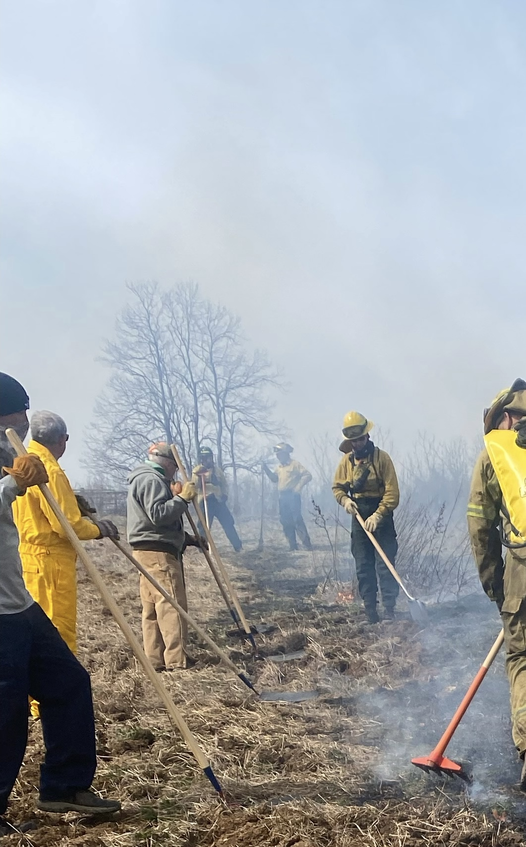
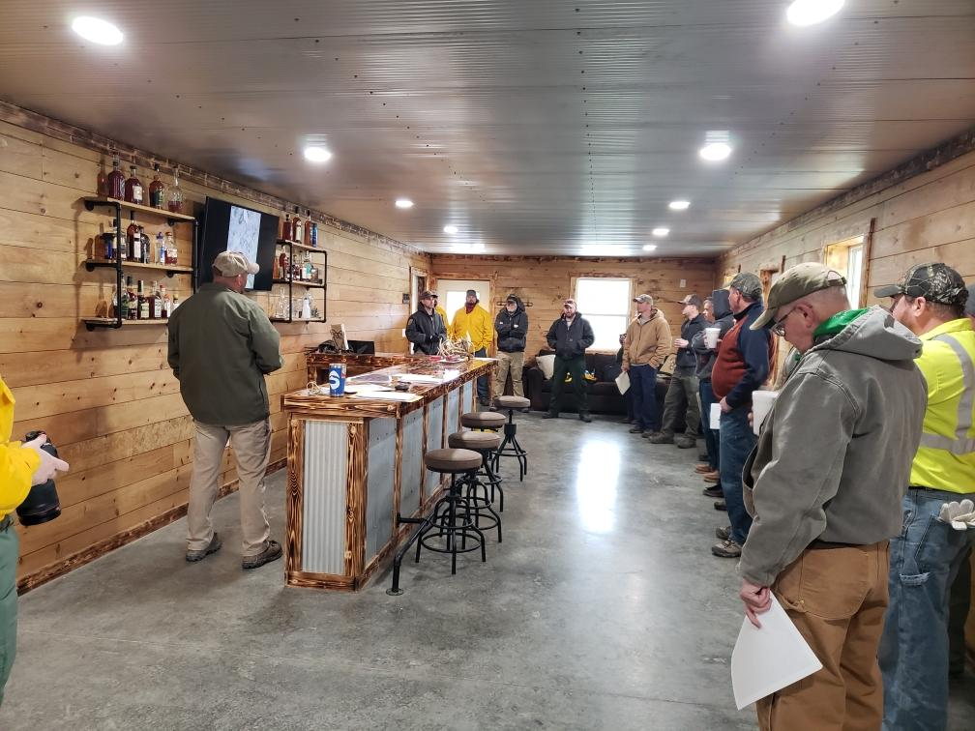
Kentucky Prescribed Fire Council
Roadblocks → Solutions
3. Low Landowner Awareness
  Outreach by agencies and the Kentucky Prescribed Fire Council has significantly improved public understanding and interest in prescribed fire
Learn & Burns
Notes:
To boost awareness, we developed "Learn and Burn“. These are hands-on experiences where landowners who’ve taken the crew course work alongside professionals to conduct a live burn.

Slide 18
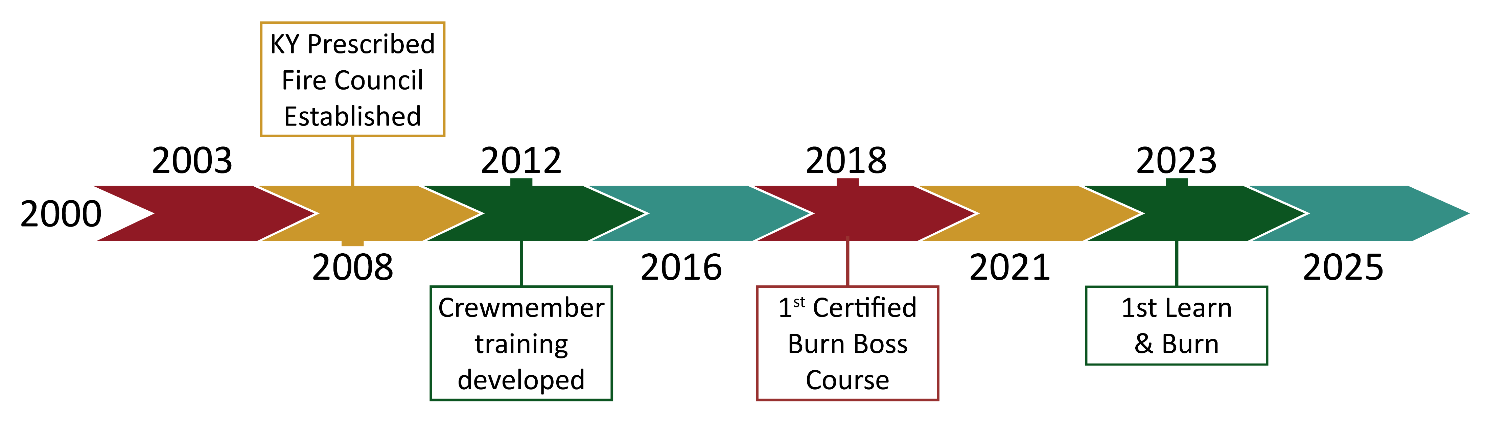
Kentucky Prescribed Fire Council

Slide 19
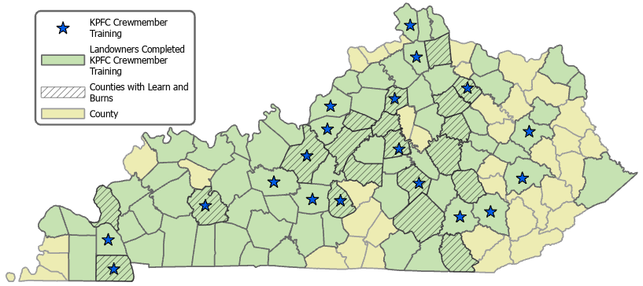
Kentucky Prescribed Fire Council
2023-2025:
21 Learn & Burns
19 Counties
220 Participants
KPFC Learn & Burns

Slide 20
Kentucky Prescribed Fire Council
2023-2025:
21 Learn & Burns
19 Counties
220 Participants
3. Low Landowner Awareness
KPFC Learn & Burns

Slide 21
Kentucky Prescribed Fire Council
2023-2025:
21 Learn & Burns
19 Counties
220 Participants
3. Low Landowner Awareness
KPFC Learn & Burns

Slide 22
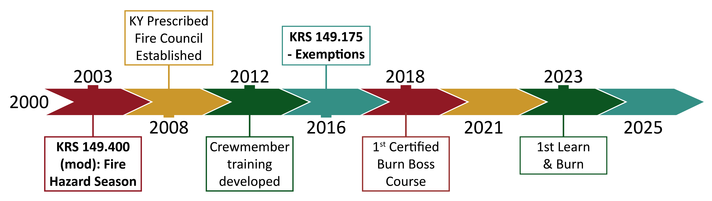
Kentucky Prescribed Fire Council
Notes:
An important synchrony with KRS and KPFC has arisen over the last many years- KRS are developed and the KPFC responds by supporting the interest in those new opportunities.

Slide 23
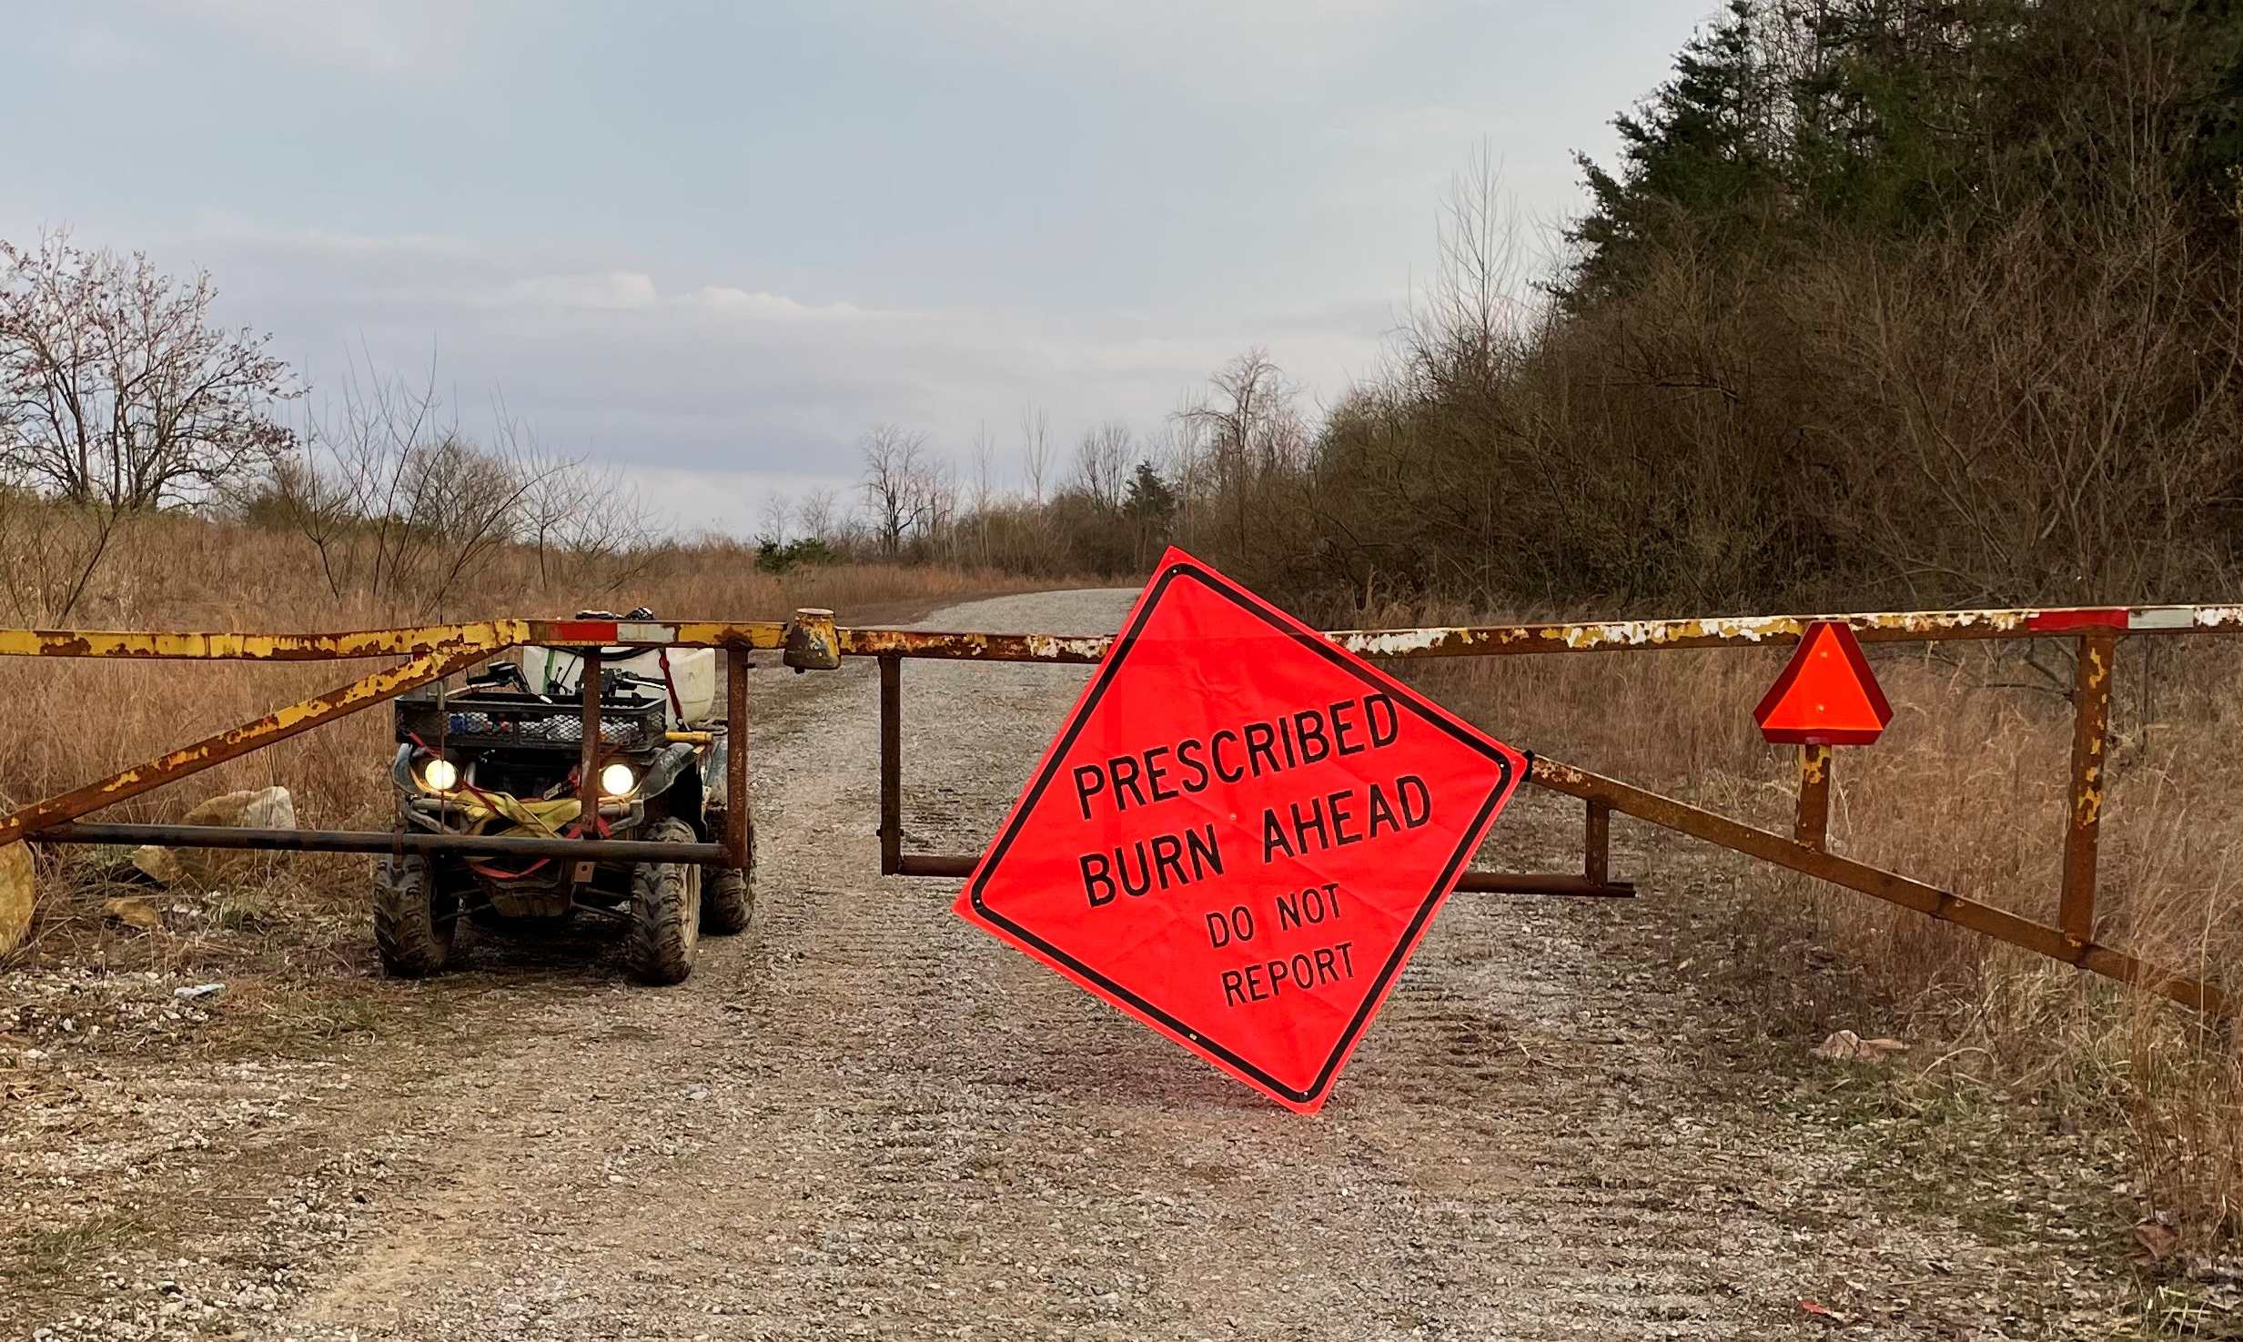
Kentucky Prescribed Fire Council
Roadblocks
Limited workforce capacity
Shortage of Certified Burn Bosses
Low landowner awareness
Liability concerns are a major barrier
Notes:
The KY Prescribed Fire Council has moved down the road on the first 3 roadblocks, however our final roadblock continues to be elusive. Given the history of the Council and the passing and modification of KRS -- we believe a legislative solution could fully unlock the possibilities of safe and ecologically based fire in the Commonwealth.
Currently, Kentucky does not have clear regulatory language for prescribed fire. This legal uncertainty discourages both landowners and contractors from burning, due to fear of lawsuits or financial risk. Without legal clarity, we cannot expect widespread adoption.

Slide 24
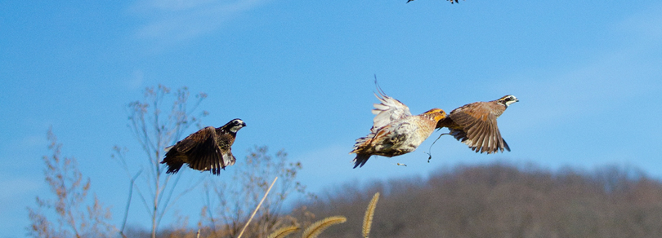
Lighting the Way
How would updating Kentucky’s burning laws help?
Clearer laws = increased participation by prescribed fire contractors
Increased prescribed fire = reduced risk of wildfire
Stronger legal protections reduce liability concerns
Improved consistency across state agencies and private lands
Notes:
Other states have already acted. Florida and Georgia both have liability protections in place—and as a result, they’ve developed robust prescribed fire economies with hundreds of certified contractors performing burns year-round → this could happen in KY (Gatlinburg) → those states invested in their burn practitioners, and it had results → it is imperative that we do the same in KY

Slide 25
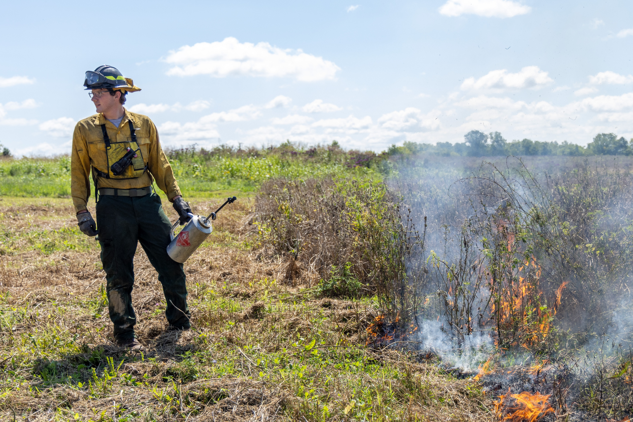
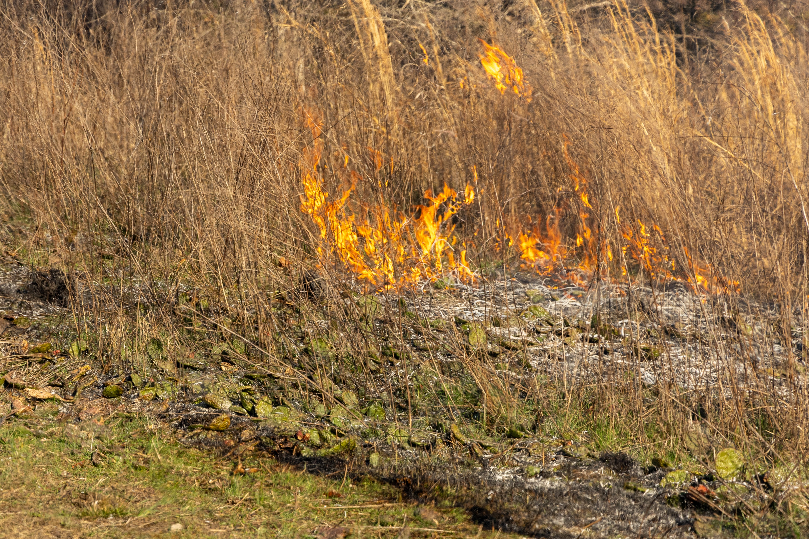
Lighting the Way
Economic Opportunity: Unlocking the Full Potential of Prescribed Fire
Rural job creation
Contractor industry growth
Tens of millions in funding available
Local multiplier effect
Kentucky is leaving money on the table
Notes:
Rural Job Creation
Expanding prescribed fire creates demand for private contractors, equipment suppliers, and burn crews — all rooted in rural communities.
Contractor Industry Growth
States like Florida and Georgia have robust prescribed fire economies with hundreds of certified contractors performing burns year-round.
Millions in Funding Available
Landowners can receive payments through NRCS programs like EQIP to implement prescribed fire — but only if liability concerns are addressed.
Local Multiplier Effect
Every dollar spent on prescribed fire circulates locally — supporting small businesses, agricultural services, and rural infrastructure.
Kentucky Is Leaving Money on the Table
Without liability protections, landowners hesitate to burn and contractors are unwilling to operate — stalling economic activity and conservation progress. Kentucky is leaving money on the table and missing out on both conservation progress and economic development.

Slide 26
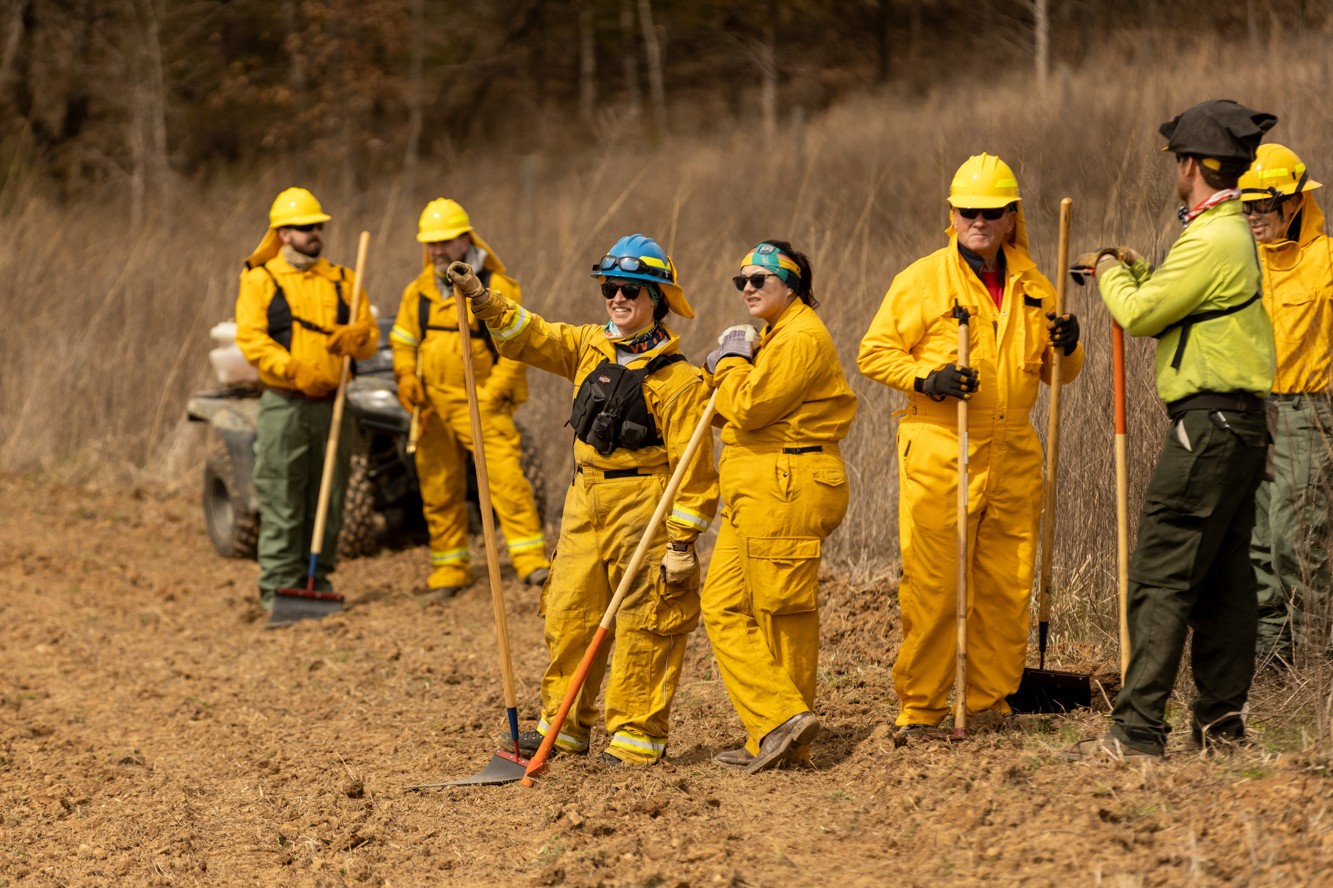
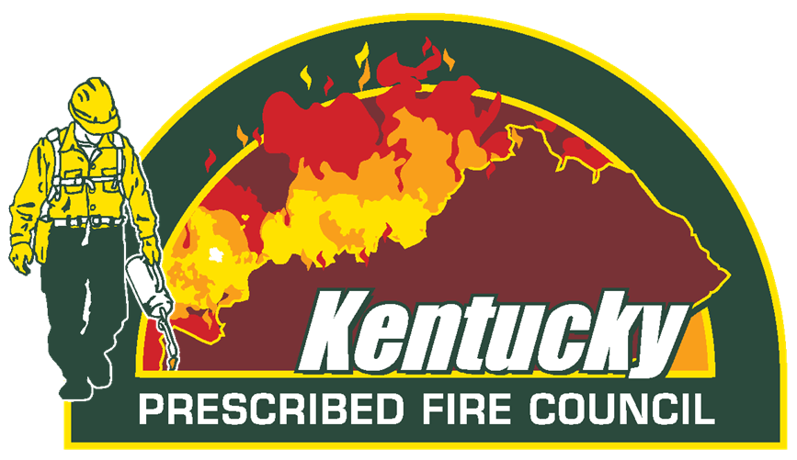
Lighting the Way
Where do we go from here?
Controlled burning is not wildfire, it is a safe, science-based tool
Prescribed fire in Kentucky has come a long way
The stage is set
Notes:
In closing, controlled burning is not wildfire. It’s safe. It’s science-based. It’s planned. And it works.
The Kentucky Prescribed Fire Council has worked for nearly 20 years to address the barriers to this critical practice. We’ve trained the workforce, certified the leadership, and engaged private landowners. Now we ask for your help in addressing the final piece: clear legal protections for those who use prescribed fire responsibly.
This step will unlock the full potential of prescribed fire in Kentucky—supporting wildlife, protecting communities, and growing our rural economy.

