Slide 1

Kentucky Division of Forestry
Kentucky Prescribed Burn Process and
How Prescribed Burning Benefits the State

Slide 2
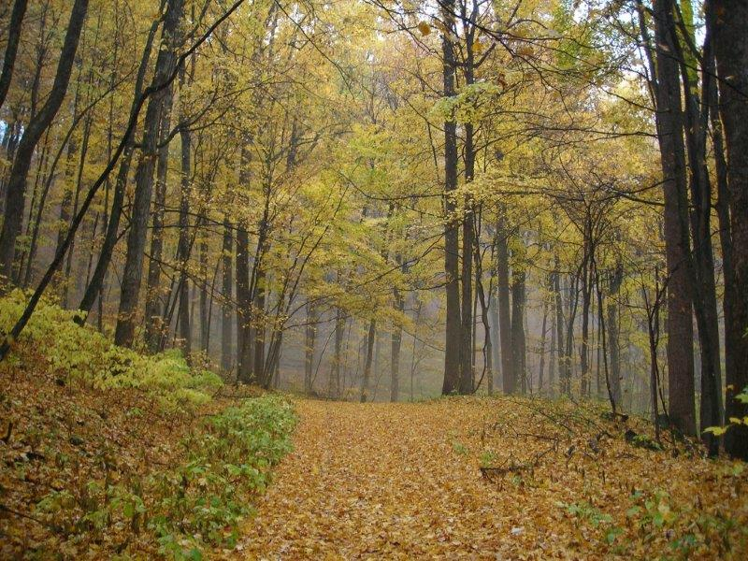
Our Mission
To protect, conserve and enhance the forest resources of the Commonwealth through a public informed of the environmental, social and economic importance of these resources.
Prescribed fire accomplishes this mission:
Protect and Conserve
  Hazardous fuel reduction
Enhance
  Promote oak regeneration

Slide 3

What is Prescribed Fire?
Prescribed fire, Rx fire, control burn
Fire set intentionally with careful planning for specific goals with control measures in place before, during, and after ignition by trained personnel
The term prescribed is used because it’s a treatment land managers use to address wildlife, forestry, and human health issues – naturally

Slide 4
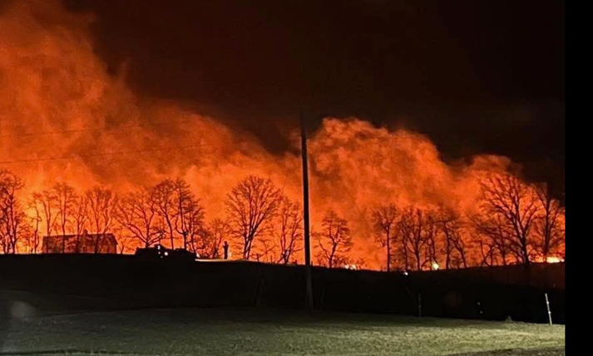
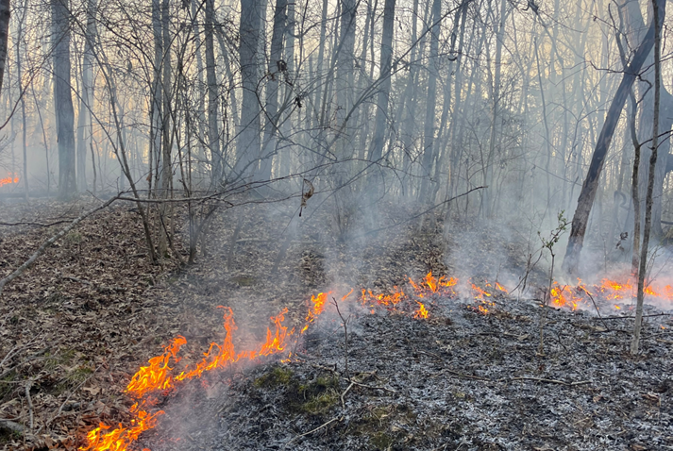
Difference Between Wildfire and Prescribed Fire
Wildfire
Unplanned
Intense
Damaging to landscape
Prescribed Fire
Planned
Intensity is managed
Beneficial to landscape

Slide 5
KRS 149 – Statutes Governing Wildfire
KRS 149.520
Established statewide system
  Forest fire prevention
  Forest fire detection
  Forest fire suppression
Prescribed fire is a form of wildfire prevention

Slide 6
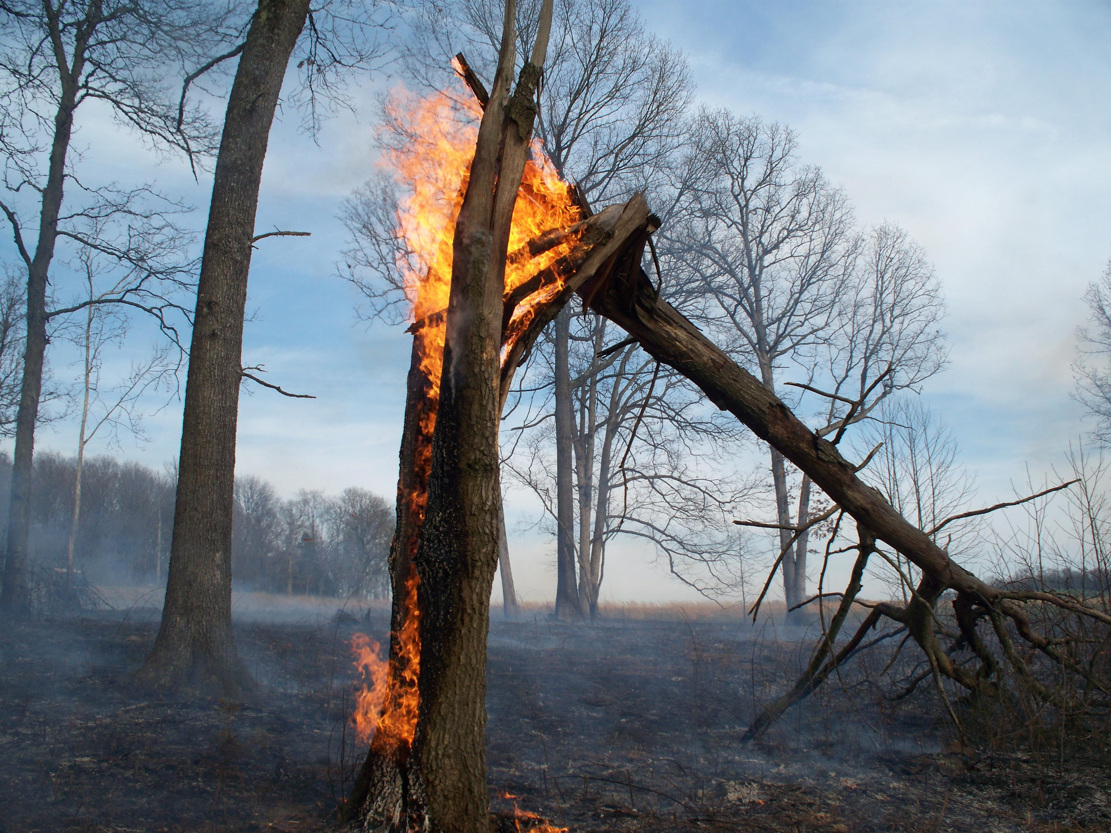
Hazardous Fuel Reduction
Reduces the risk of catastrophic wildfire:
Fuel load contributes to fire intensity
  Lighter fuel load = less intense wildfire
Consistent prescribed fire regime would impact wildfire
  Any acreage with prescribed fire application would resist wildfire growth
  Increase wildland firefighter safety (anchoring to previous Rx fires)

Slide 7
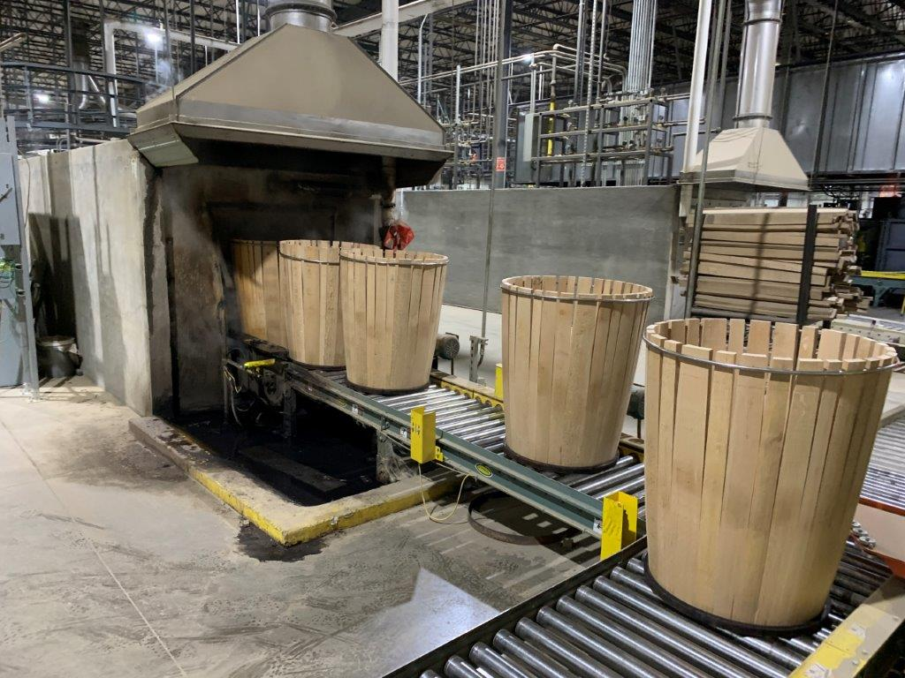
Hazardous Fuel Reduction (Cont.)
High intensity wildfire negatively impacts standing timber
  Low intensity hazardous fuel reduction protects Kentucky’s $19 billion forest industry from severe wildfire
Kentucky wildfire statistics
  10-year annual average
    838 wildfires / 28,545 acres
  1,246 wildfires in 2022
  71,158 acres burned by wildfire in 2016

Slide 8
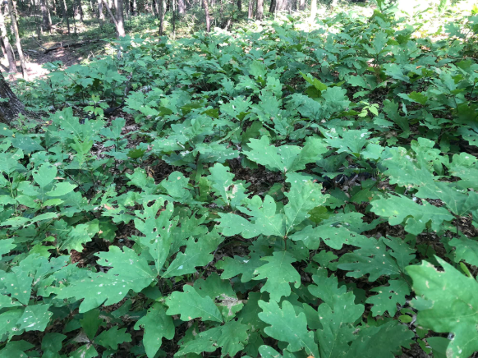
Promote Oak Regeneration
Prescribed fire is a tool to enhance timber stands:
Reduces the competition of native species from non-native / invasive species
Reducing undesirable species and promotes oak growth
  White oak is a critical component of Kentucky’s $9 billion bourbon industry

Slide 9
KRS 149 – Statutes Governing Prescribed Fire
KRS 149.175
Exemptions for persons certified by Kentucky Prescribed Fire Council’s Burn Boss Program
  Allows for prescribed burns during Kentucky’s wildfire hazard season
  Restricts prescribed burns during local burn bans or red flag warnings
Sets notification requirements
  Division of Forestry – 24 hours prior

Slide 10
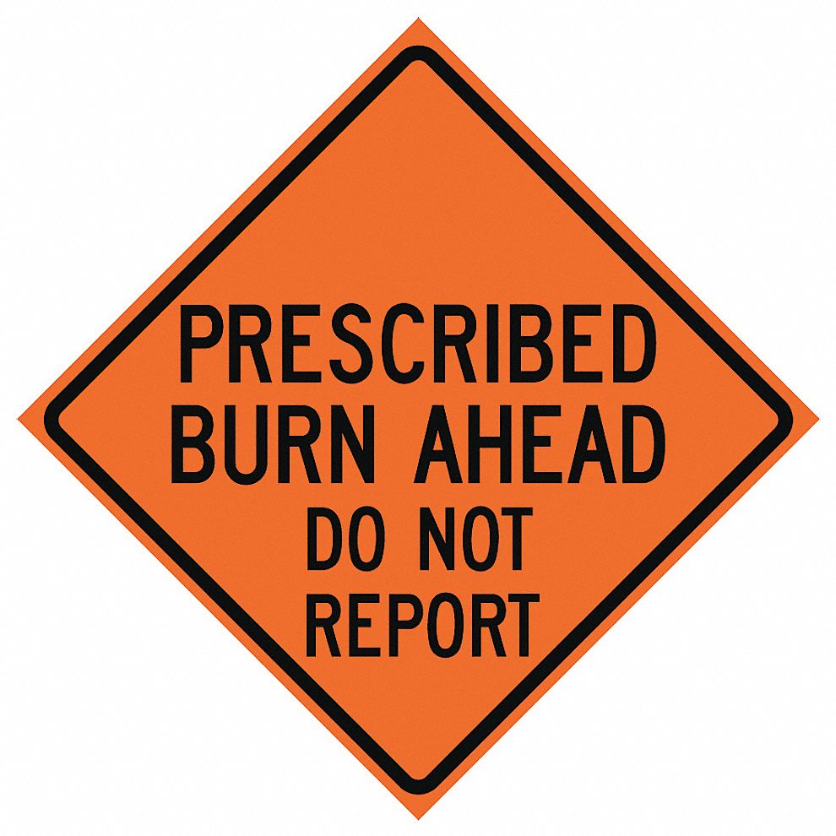
Kentucky Prescribed Burn Process
Kentucky Certified Burn Bosses (KCBB) responsibility
Complete burn plan
Email burn plan to Division of Forestry at least 24 hours prior

Slide 11
Kentucky Prescribed Burn Process (Cont.)
On morning of burn
Contact adjacent landowners
Contact local emergency dispatch
Contact Division of Air Quality
Contact KDF branch office by phone
Update on final plans
Weather discussion for the day
Day following the burn
Contact KDF branch office by phone
Status of the burn
Acres burned

Slide 12
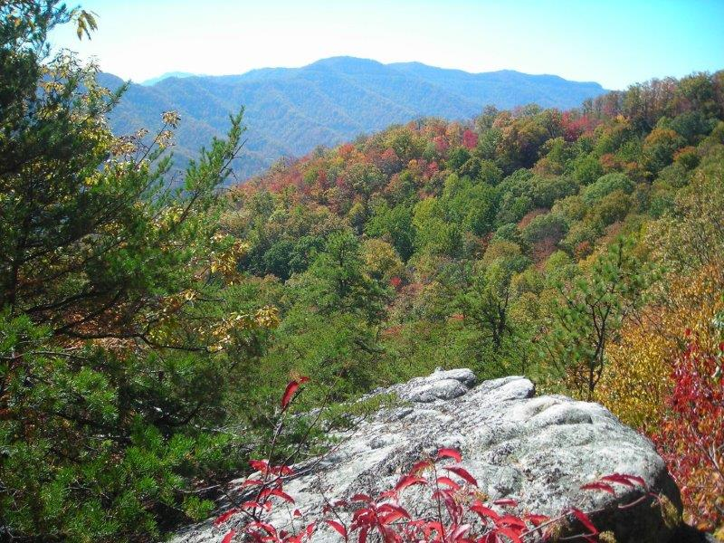
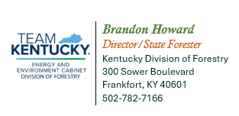
Thank You

