Slide 1
SEPTEMBER 25, 2025
FRANKFORT, KENTUCKY

Slide 12
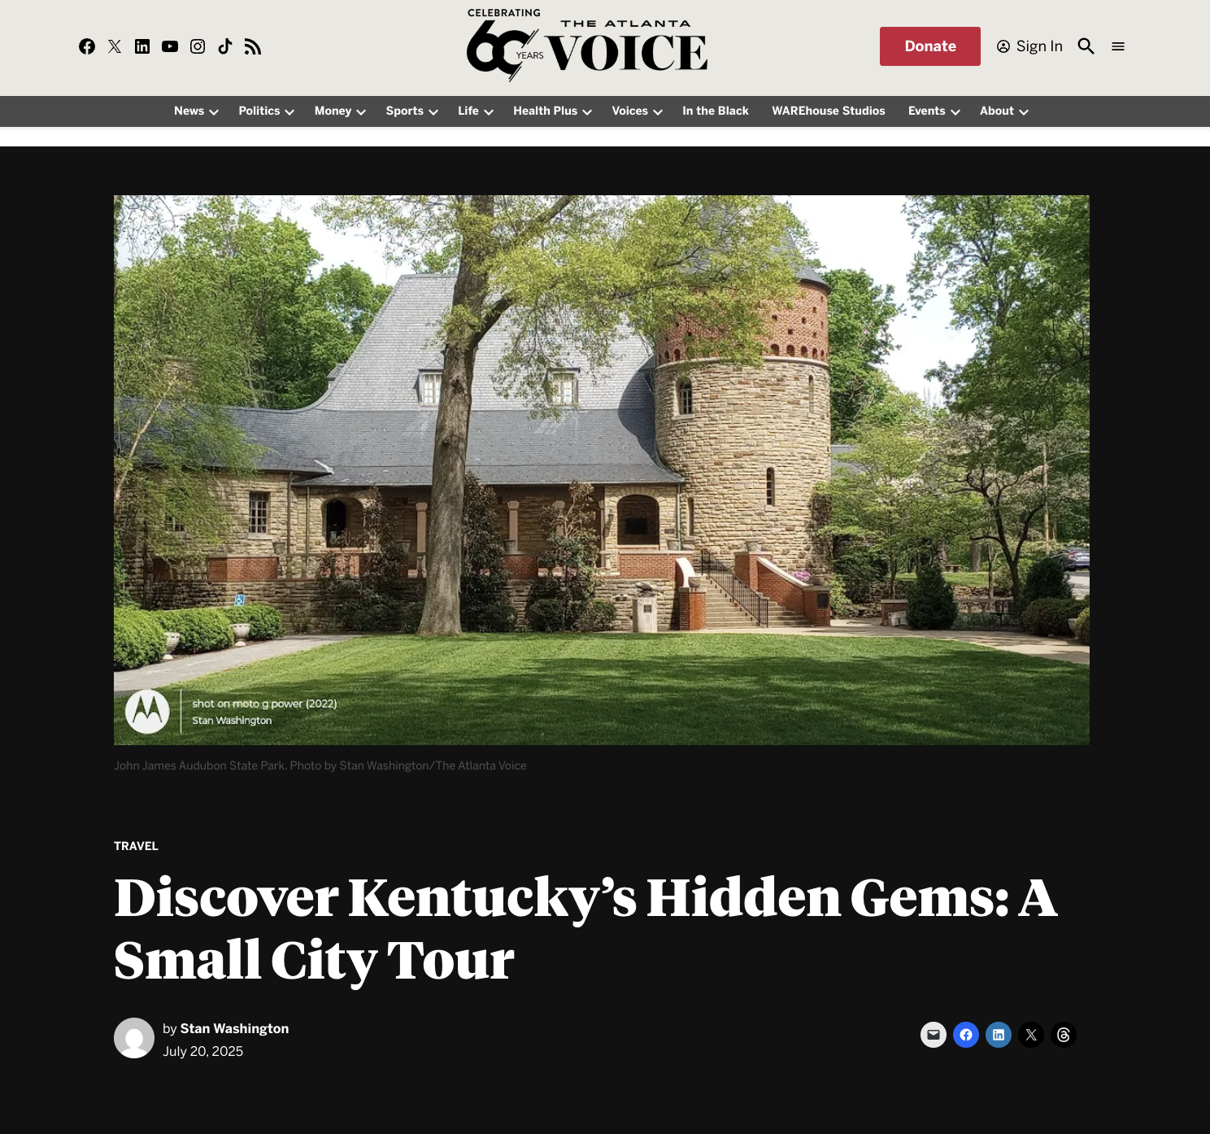

Slide 13
